Slide 1



The brief history of western translation
By Ding Xuan

Slide 2

CONTENTS
The beginning of western translation
Translation in the later stage of Roman Empire to the early Medieval Ages
Six climax
Translation in the 11th c to 12th c
Translation in Renaissance
Translation in the 17th c to the early 20th c
Translation after the second world war

Slide 3

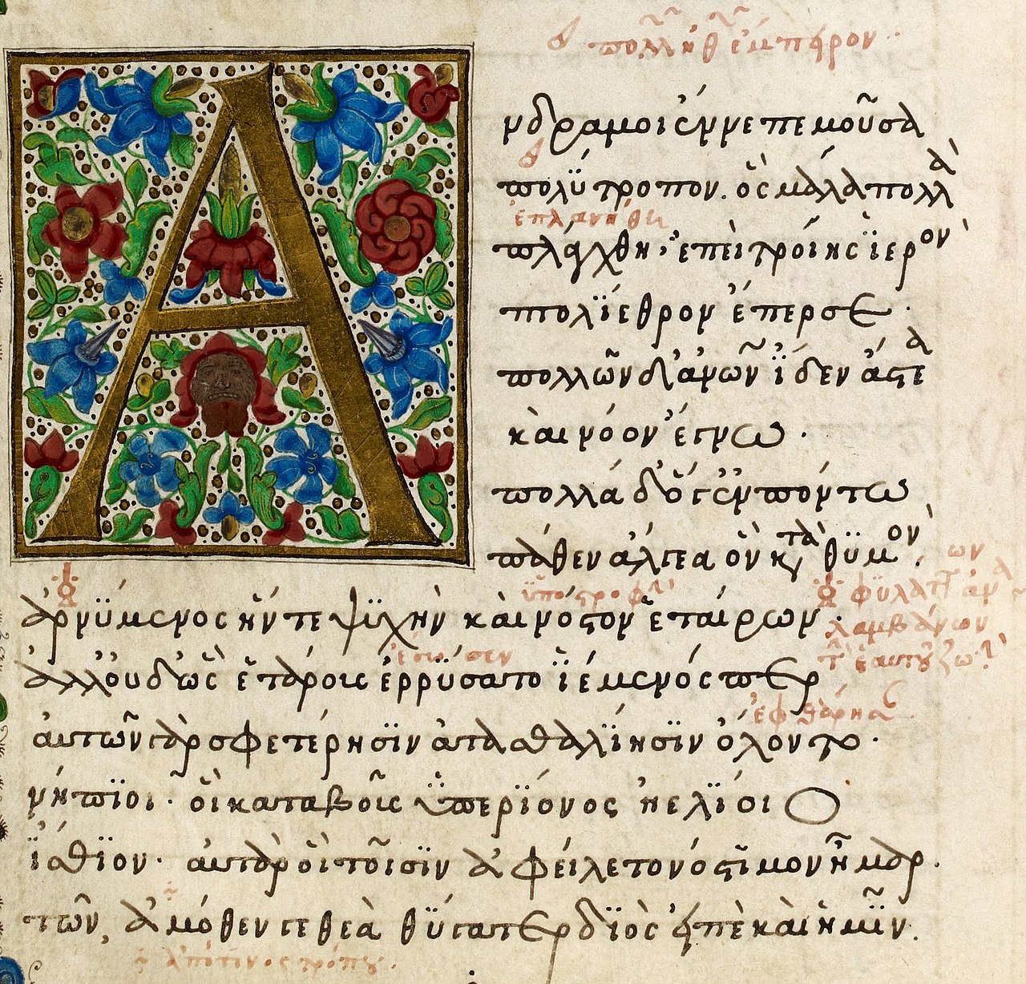
1 The beginning of western translation
In a broad sense, in the 3rd century B.C, it started with Septuagint translated from Hebrew to Greek by 72 Jewish scholars in Alexandria.
In a strict sense, it started with Greek Homeric epic Odyssey translated in Latin by Andronicus in the middle of the 3rd century B.C.
At this stage, the Greek Homeric epics and plays were translated to Latin and introduced to Roman.
The representatives : Ennius, Cicero, Terence, Andronicus…………

Slide 4
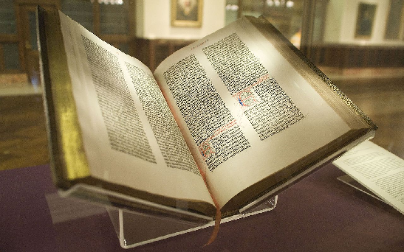
2 Secnd period: the later stage of Roman Empire to the early Medieval Ages
The translation in this period was characterized by religion. The power of Christian was overwhelming so that many versions of Bible came out.
Bible was translated to Latin and many other ethnic languages.

Slide 5


3 Third period: Translation in the 11th c to 12th c
Many translators came to Toledo and translated important medical, scientific , religious and philosophical works into Castilian(the beginning of Spanish language) and Latin from Hebrew, Greek and Arabic.
It was the rare time when Muslim got along with Christians.

Slide 6
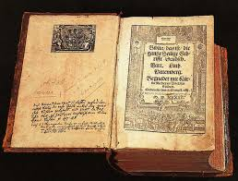
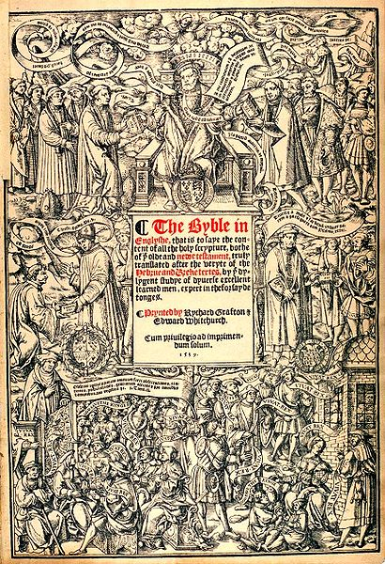
4 Forth period: Translation in Renaissance(14th c to 16th c)
The translation activities permeated into various fields such as thoughts, politics, philosophy, literature and religion and so on. Many great translators and mavelous translations were appeared.
Germany: Martin Luther produced a German translation version of Bible.
France: Blutarch translated Comperative Biograph of Greek and Roman Celebrities, also called The Biography of Celebrities.
North: The Biography of Celebrities (1579)
Chapman: Iliad and Odyssey(1598-1616)
Florio: Montaigne’s Essays(1603)
King James Bible Translation(1611) “the greatest English translation”
Britain

Slide 7
5 Fifth period: Translation in the 17th c to the early 20th c
Many master’s works were translated to various countries’ languages, such as Shakespeare, Balzac, Goethe and Cervantes and so on. The translators focused on modern and contemporary works rather than classic works.
Besides, the theories of translation developed a lot.
England: Matthew Arnold and Newman debated on translation of Homeric epics.
Germany:Goethe and Schleiermacher(施莱尔马赫）put linguistics and literature theory into translation.
Russia: Pushkin, Belinski and Zhukovski put forward translation theory of literature and art.

Slide 8
6 Sixth period: Translation after the second world war
The realm, scale and function of translation are enlarged.
The form of translation have been changed.
The theories of translation has achieved unprecedented development.
Realm:literature and religion works
bussiness, technology and national cooperation
Scale: the number of translators have rised- from literature masters to the specialized people.
Function: plays an important role in global communication and cooperation in many fields.
translation education and colleges
translation organizations
machine translation
Internationl Federation of Translation
International Association of Conference Interpreters
Form

Slide 9
Thanks for listening!
Bibliography:
[1] 谭载喜. 《西方翻译简史》[M]. 北京：商务印书馆, 1991
[2] 彭长江. 《英汉-汉英翻译教程》 [M]. 长沙：湖南师范大学出版社，2017.8
[3] https://www.daytranslations.com/blog/history-of-translation/amp/ 2021.10.17

