Slide 1
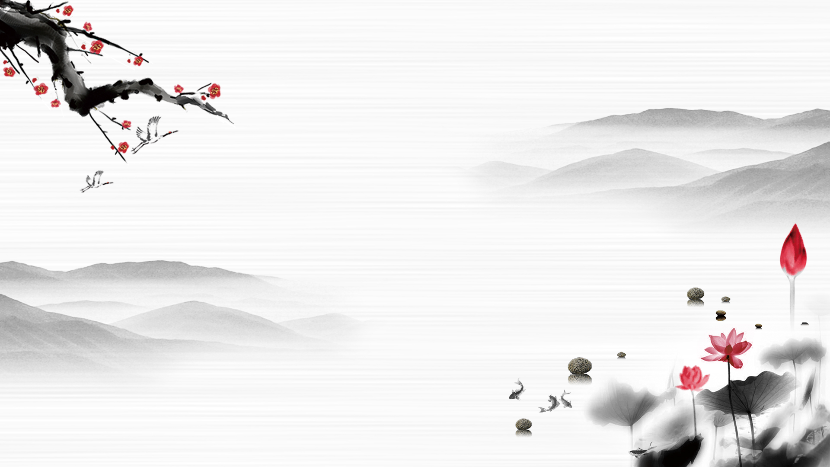
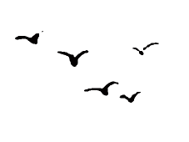
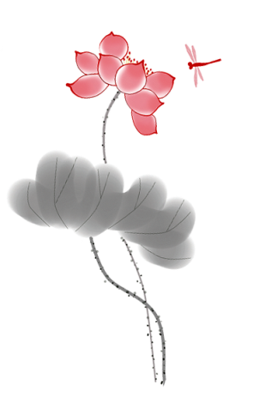
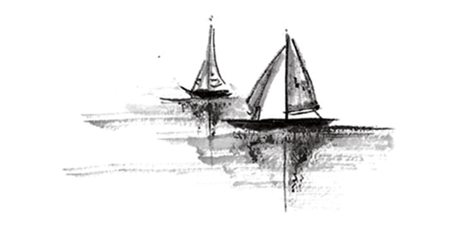

PAINTING
Zhu Xu
Mo Ling

Slide 2
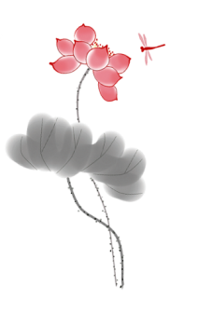
DIRECTORY
01
Introduction
02
Classification
03
Translation methods
04
Conclusion

Slide 3
Introduction

Slide 4
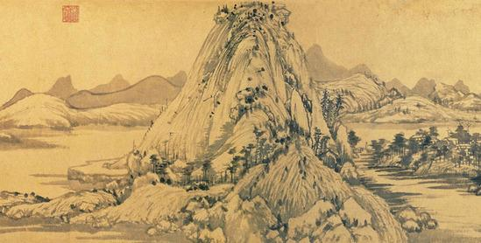
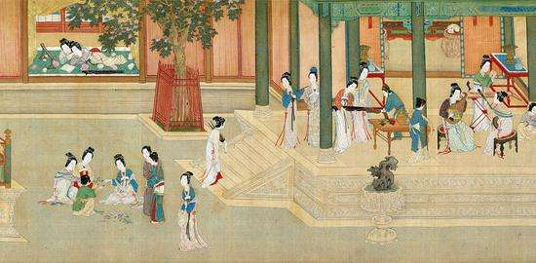
Introduction
Chinese painting, commonly known as “dan qing” or “guo hua” in Chinese (meaning the national painting), is mainly drawn on the silk or paper and then framed in a scroll. It involves the use of a brush, ink and paint.

Slide 5
Classification of Chinese Paintings
The perspective of techniques
The perspective of contents

Slide 6
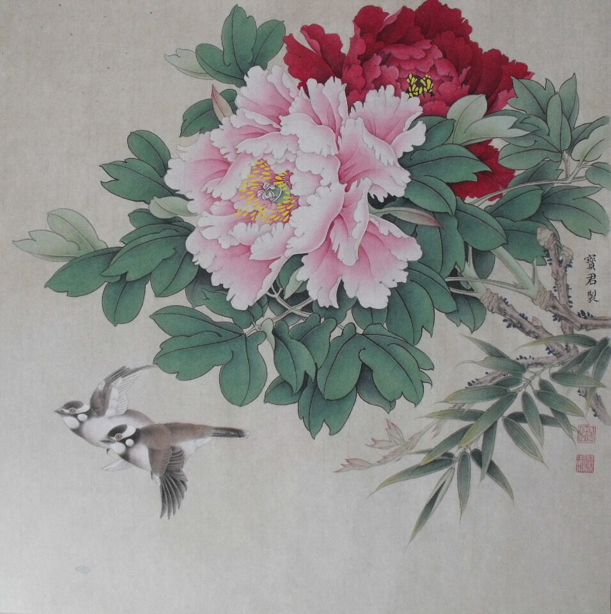
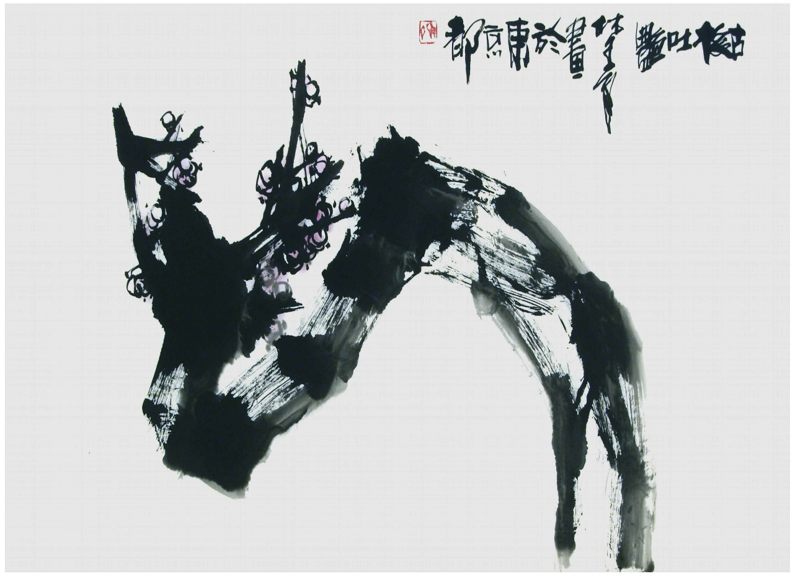
Classification of Chinese Paintings
Freehand Brushwork Painting (xieyi)
Claborate-style Painting (gongbi)
.

Slide 7
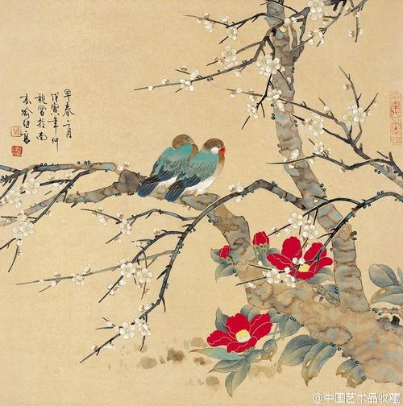
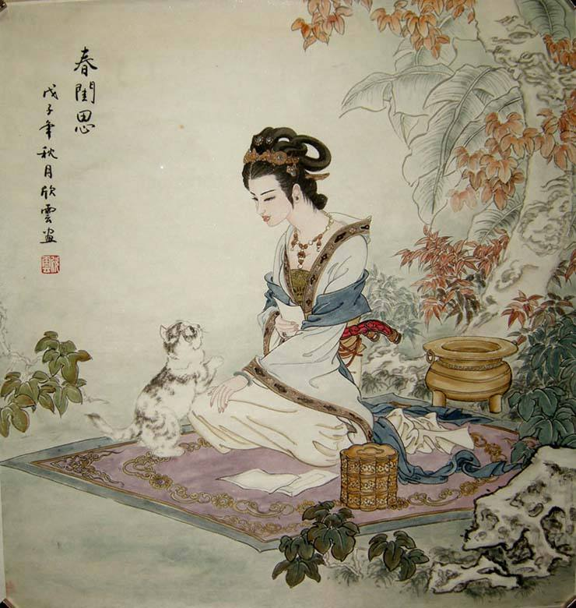
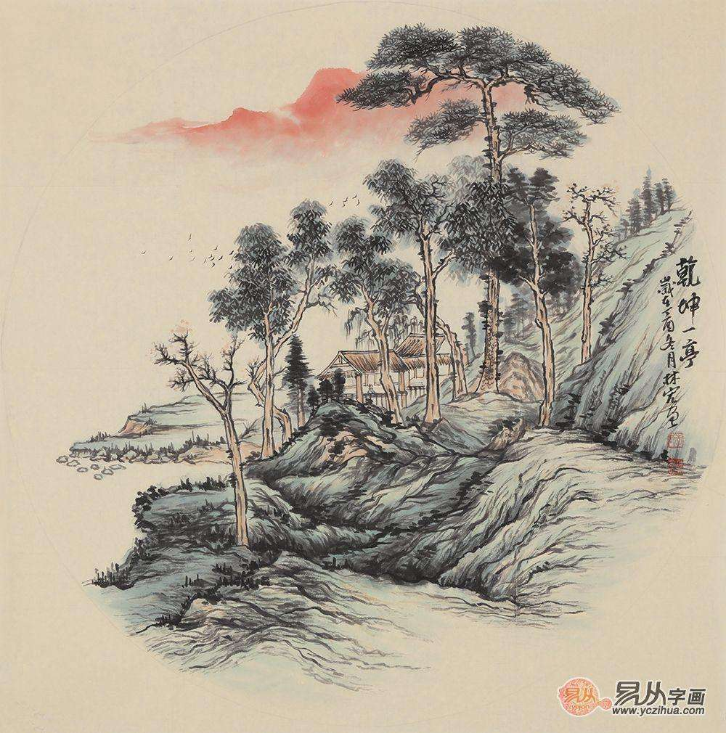
Classification of Chinese Paintings
Landscape Painting
Flowers and Birds Painting
Figure Painting

Slide 8
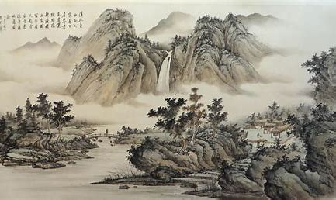
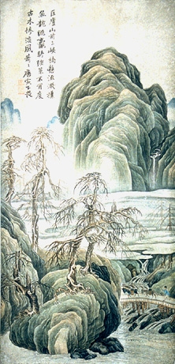
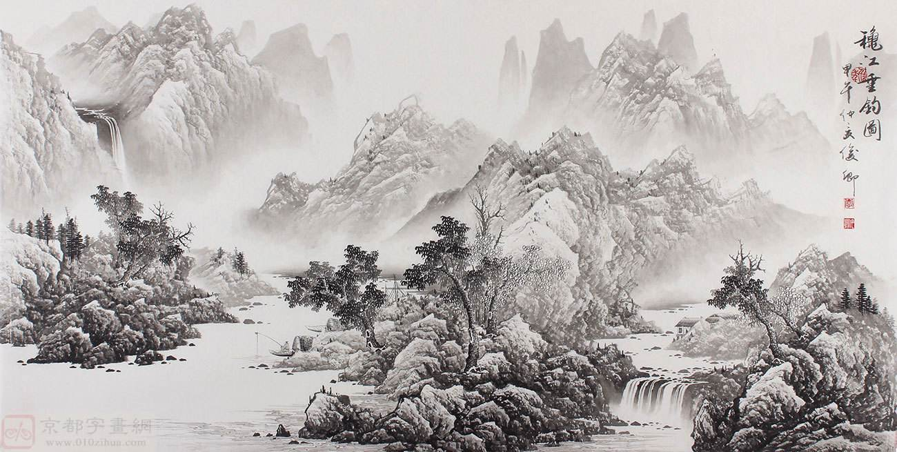
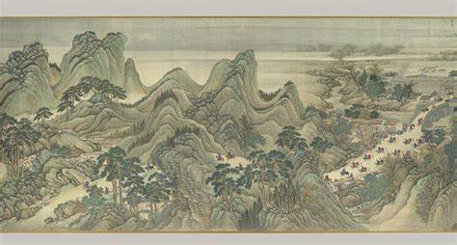
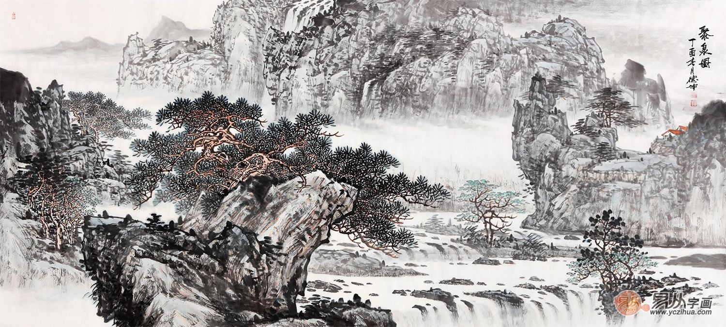
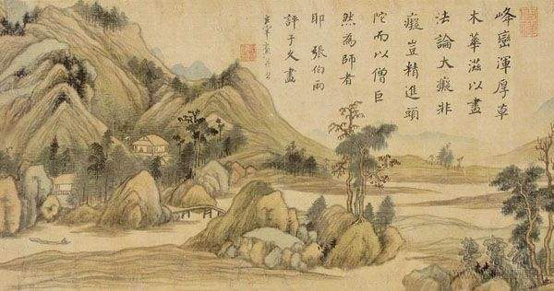
Landscape painting

Slide 9
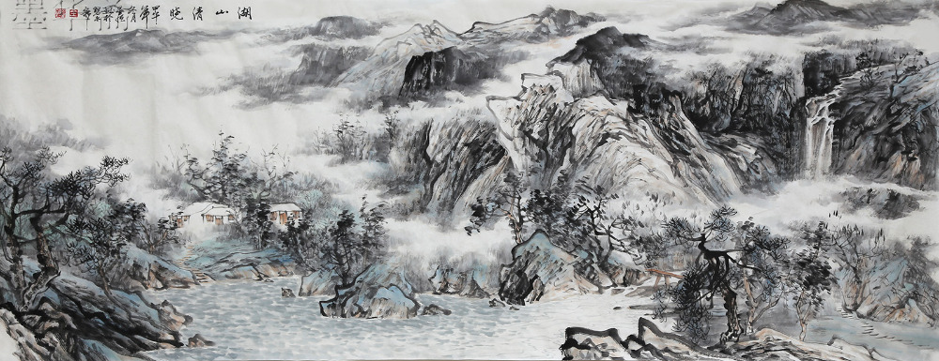
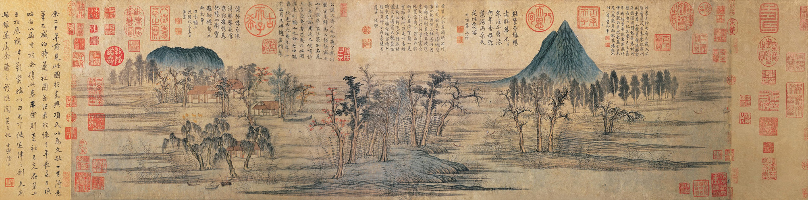
Features: ink, light, purple-red, dark green, boneless, chin-pi

Slide 10
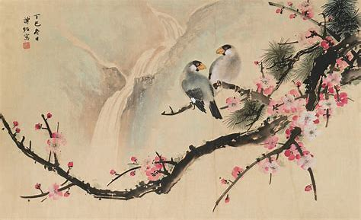
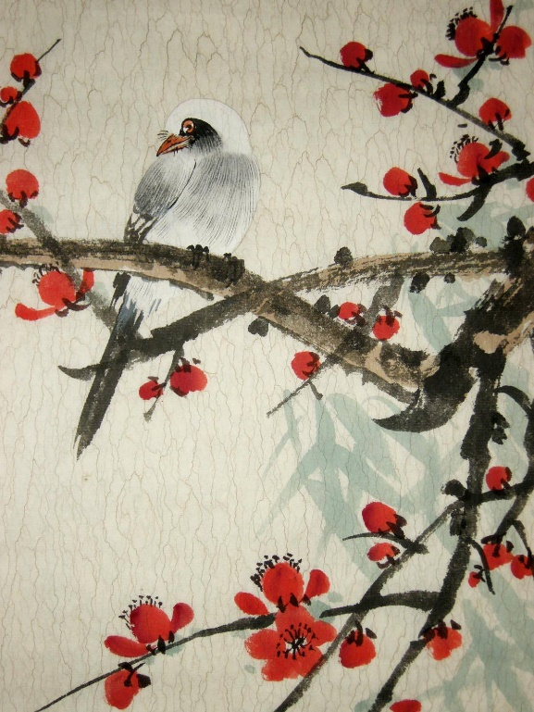
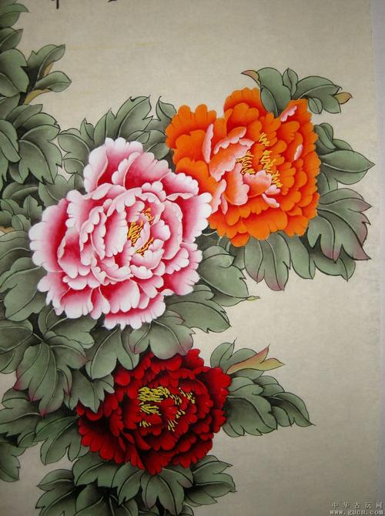
Flower and birds painting

Slide 11
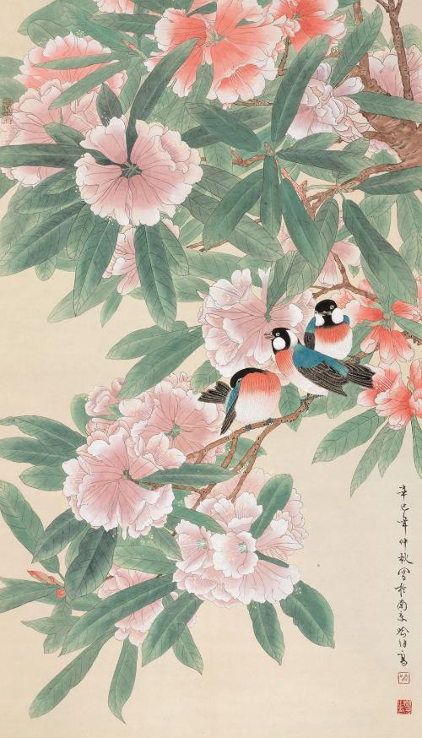
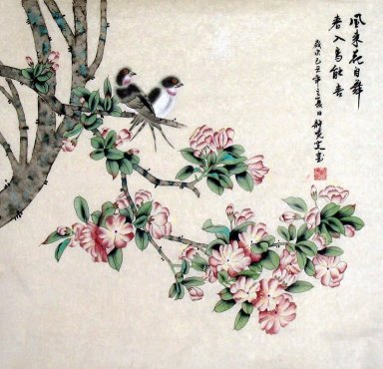
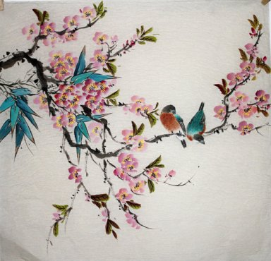
Features: detailed, symbolic, colorful

Slide 12
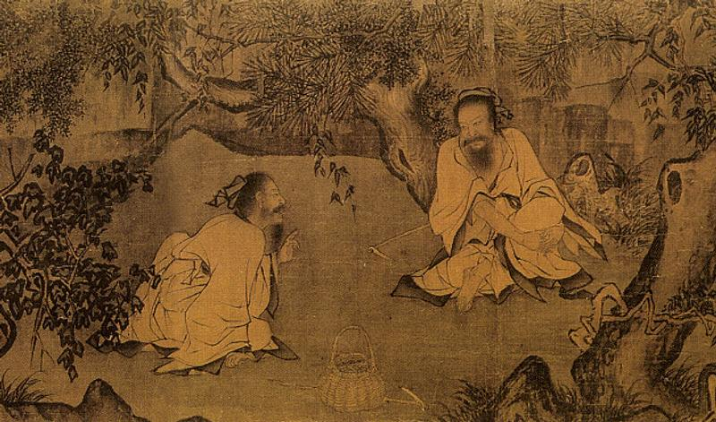
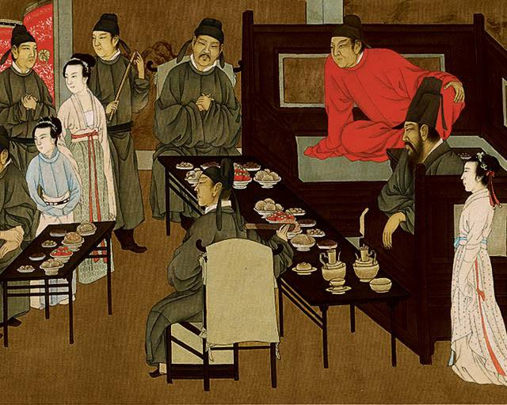
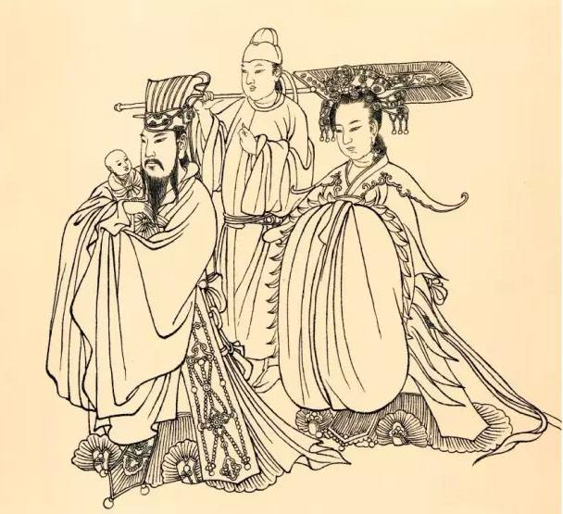
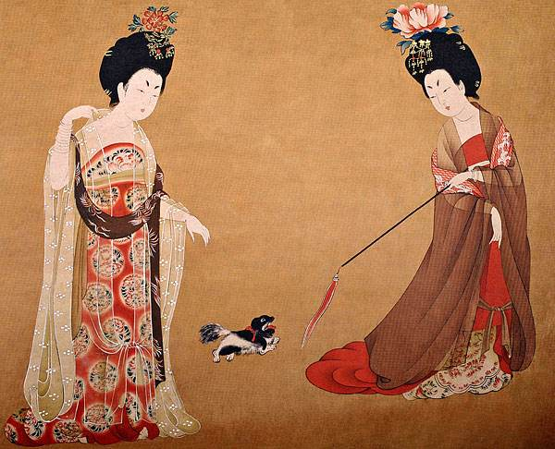
Figure painting

Slide 13
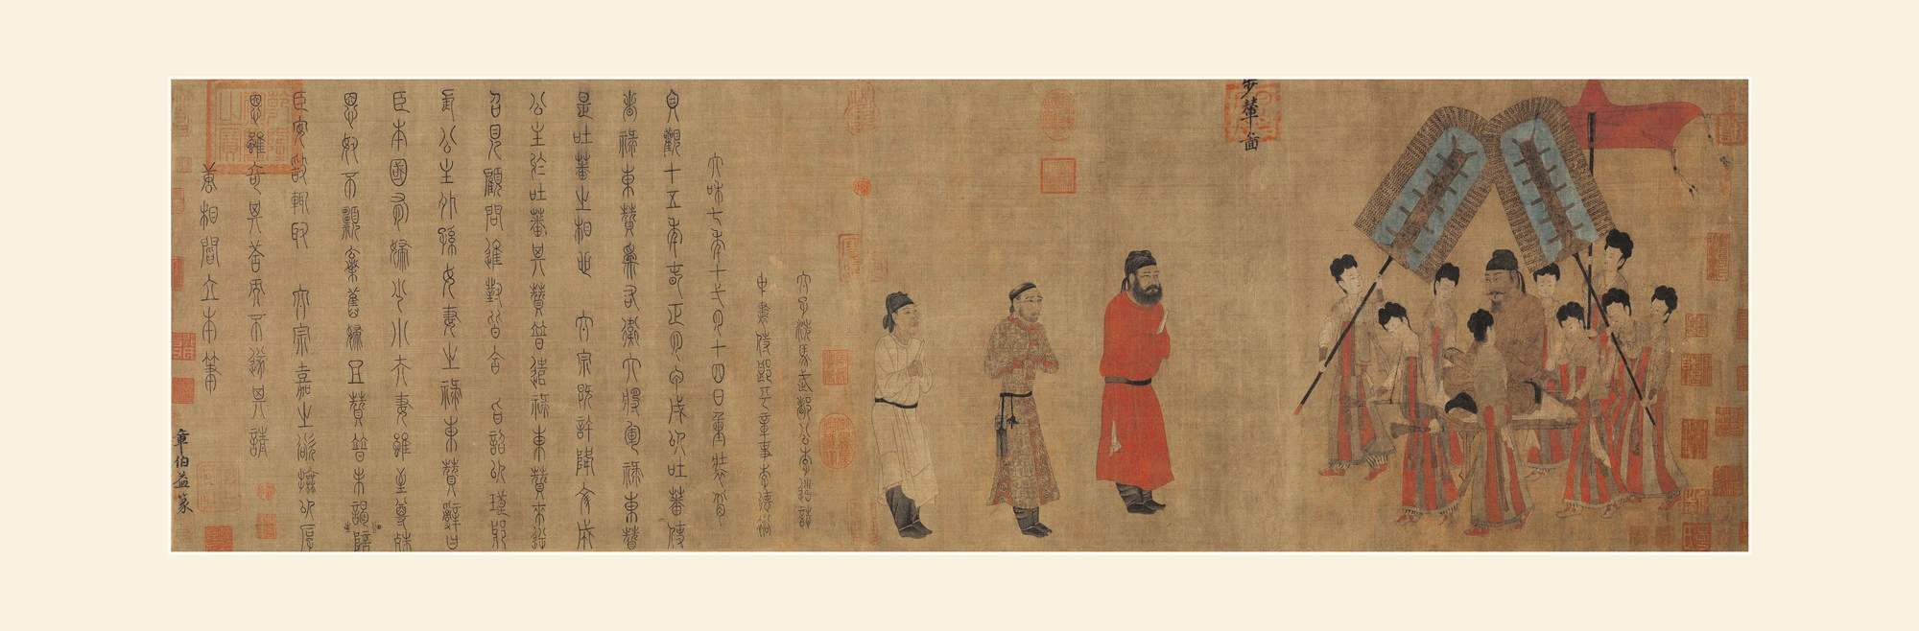
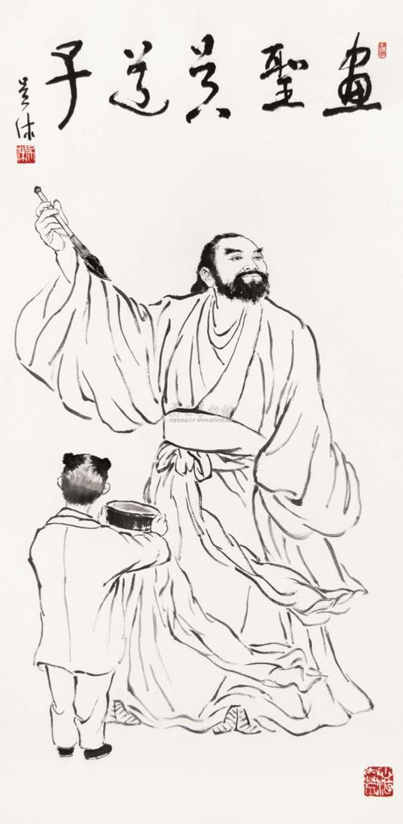
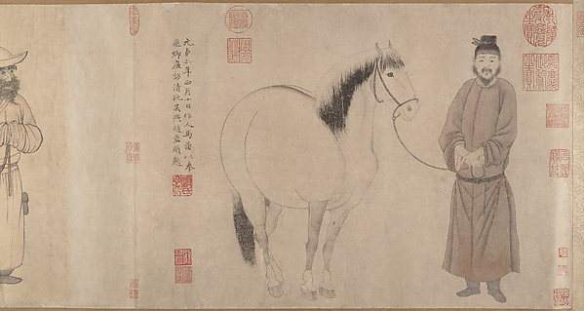
Features: vivid expressions, properly detailed

Slide 14
Translation methods

Slide 15
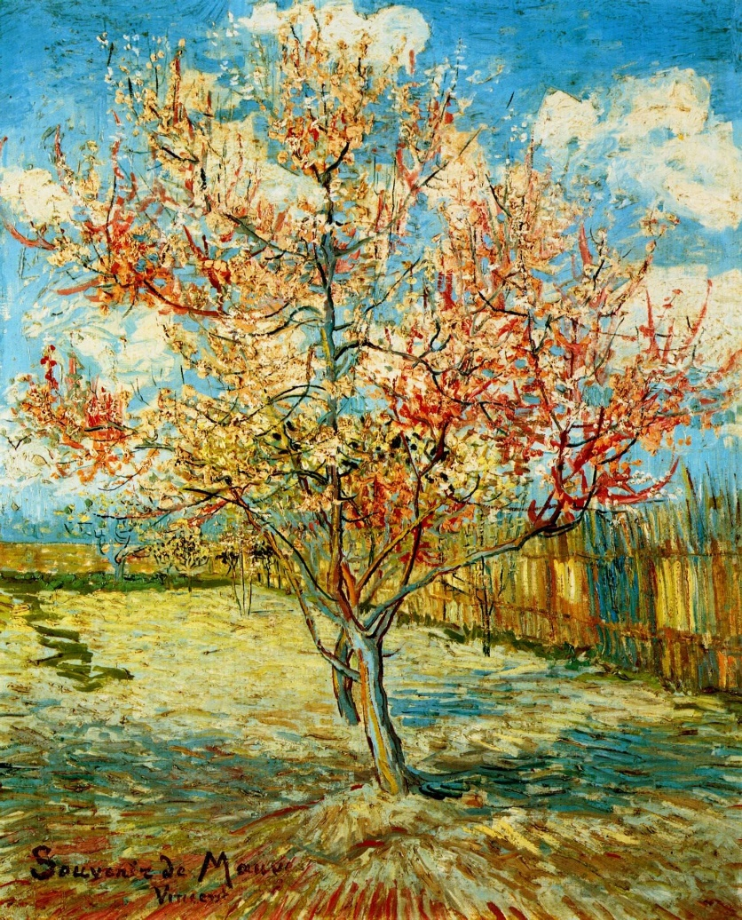
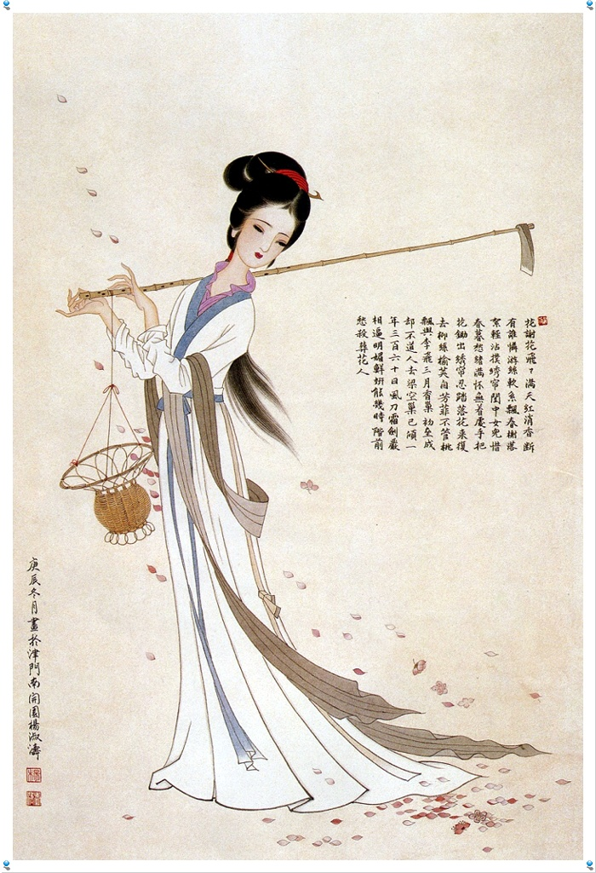
Translation methods
1.1 To highlight the artistic conception
《黛玉葬花》
译文：Daiyu buried fallen flowers
《盛开的桃花》
译文：The peach blossom in full bloom

Slide 16
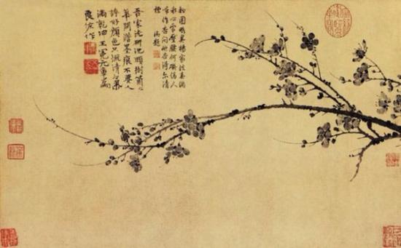
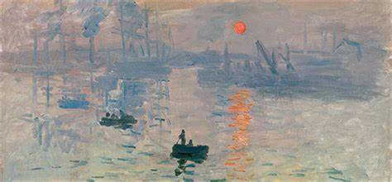
Translation methods
1.2 To highlight the characteristics of the school
《墨梅》
译文：Ink plum
《日出 印象》
译文：Sunrise Impression

Slide 17
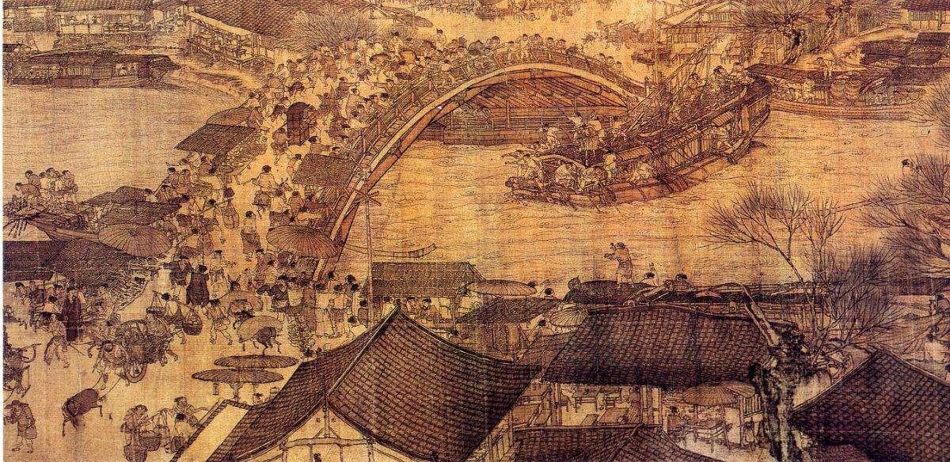
Translation methods
2. To highlight the contents of Chinese painting
《清明上河图》
译文：Peace and Prosperity Along the River

Slide 18
《韩熙载夜宴图》
译名：Han Xizai Evening Banquet

Slide 19
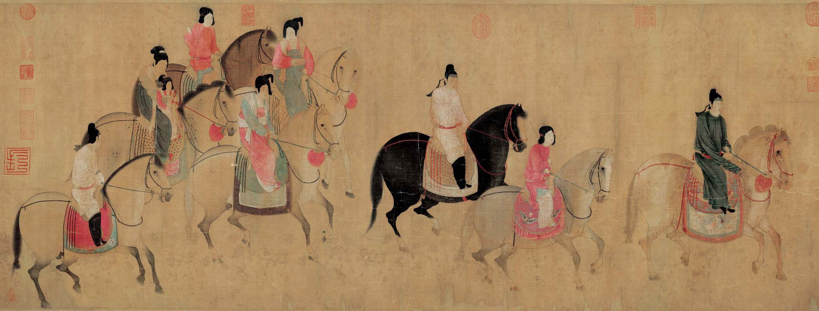
Translation methods
3. To highlight the cultural background
《虢国夫人游春图》
译文：The Spring Party of Lady Guo-guo

Slide 20
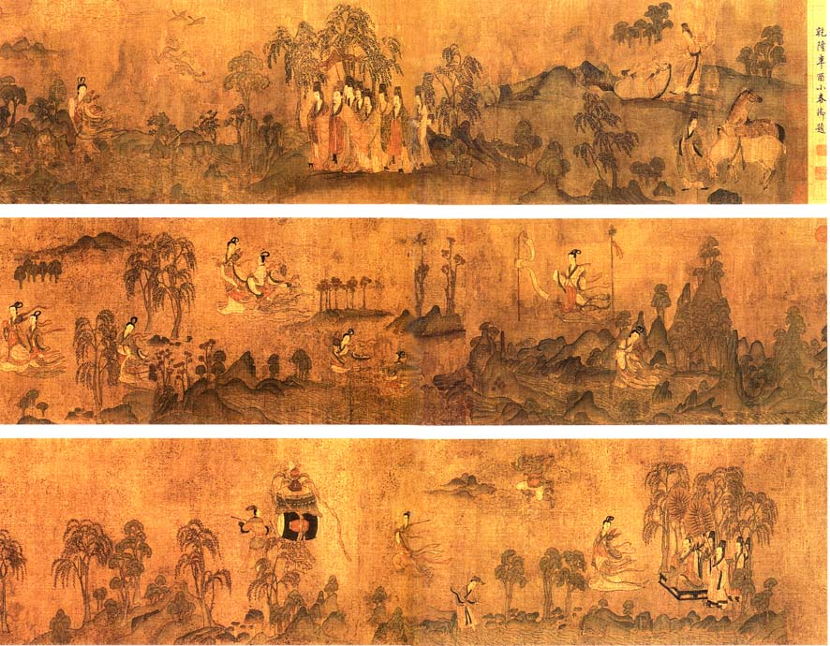
《洛神赋图》
译文：The painting of Ode to the Goddess in Luo

Slide 21
Conclusion

Slide 22
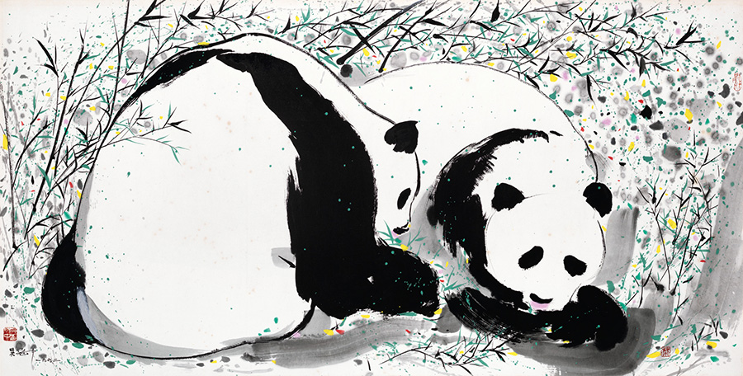
Pandas by Wu Guanzhong sold for 5,043,792 yuan ($785,408) at the Poly Hong Kong 2015 autumn auction

Slide 23
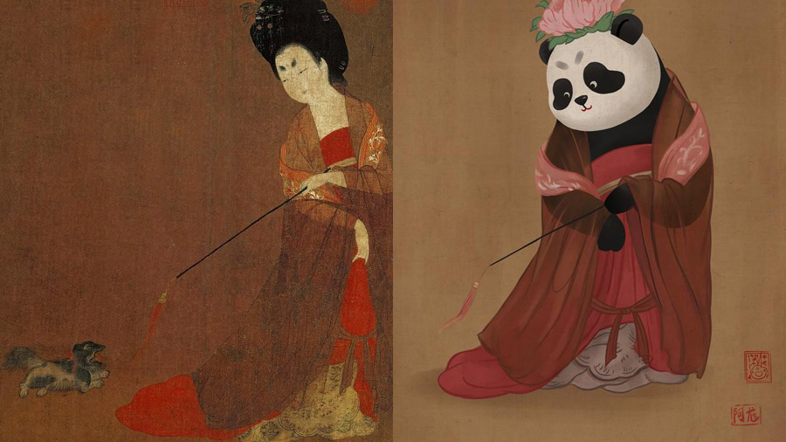
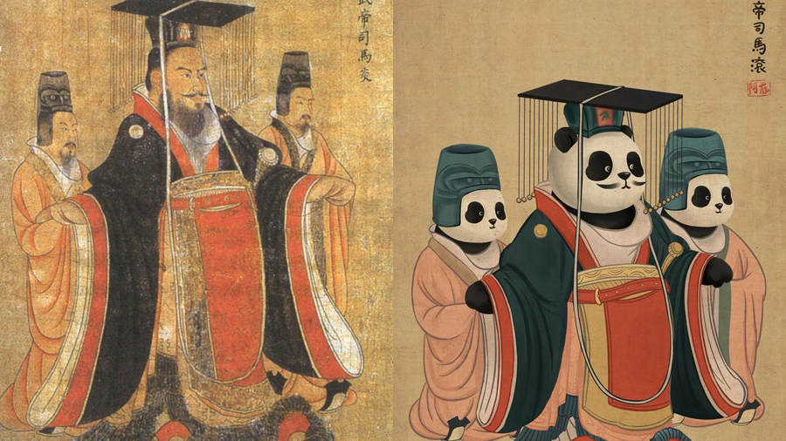
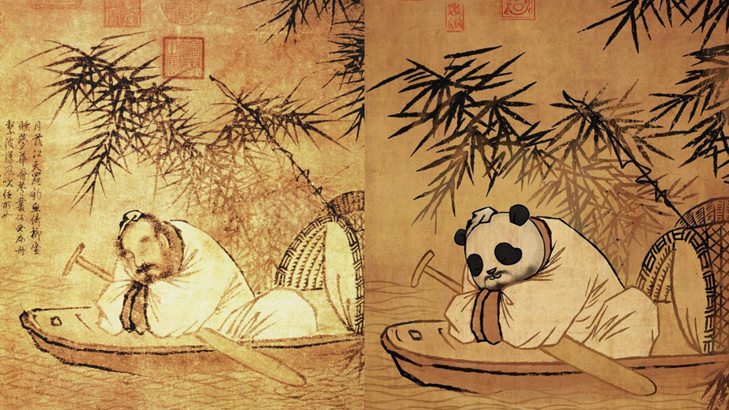

Slide 24
Thanks for your attention ☺

