Slide 1
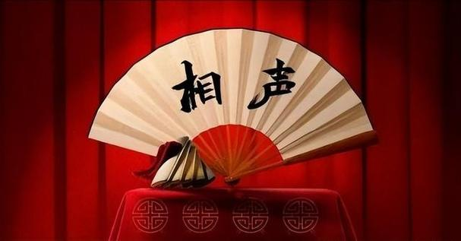
Crosstalk
presenter:陈倩
2024.03.29

Slide 2
contents
1.The summary of text
2.Commonly used props
3.Present situation and development trend
4. Problems and measures

Slide 3
The summary of text
1

Slide 4
1.The development of crosstalk
Qing dynasty
In the early years of republic of china
Since the founding of the people’s Republic of China
2.Four basic skills
Speaking, Imitating, Teasing, Sing
3.Characteristics of crosstalk (contrast it with comedy)
The art of “Speaking”
The art of “laughter”
4.Famous artists
Zhu Shaowen,Hou Baolin,Man Sanli...

Slide 5
Commonly used props of crosstalk
2

Slide 6
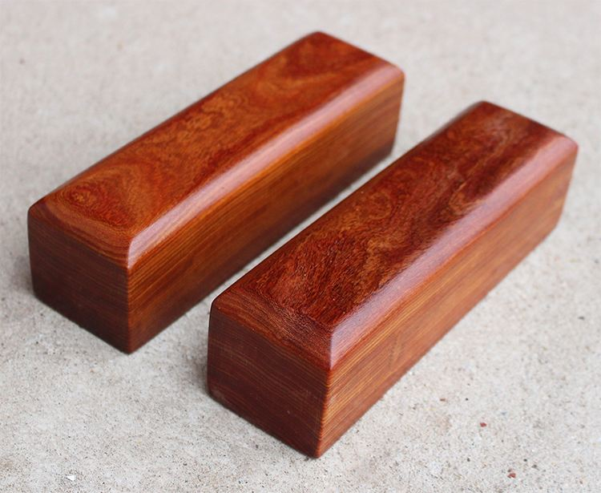
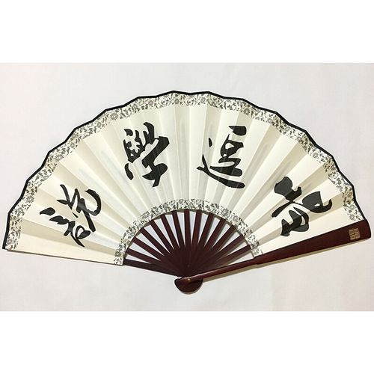


1.Attention-catching block （醒木） 2.Folding fan
Creating a certain performance atmosphere and reminding the audience that the artists are going to talk about the important points
The first is to depict the scene of hitting the performer, and the second is to simulate props such as knives, guns, pens, etc

Slide 7
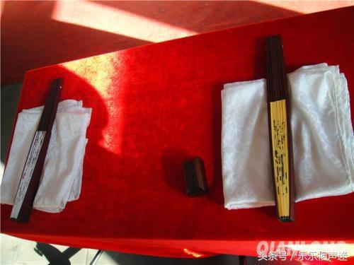
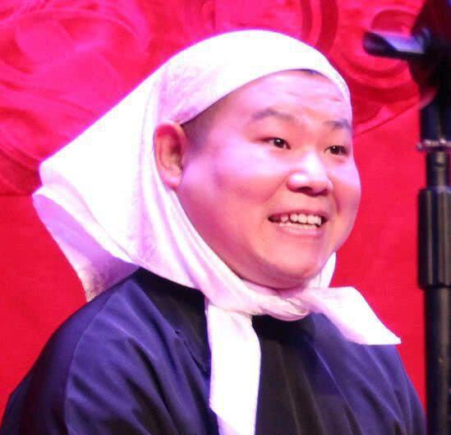
3.Handkerchief
A simple way of makeup, wrapping a handkerchief around the head to play female roles

Slide 8
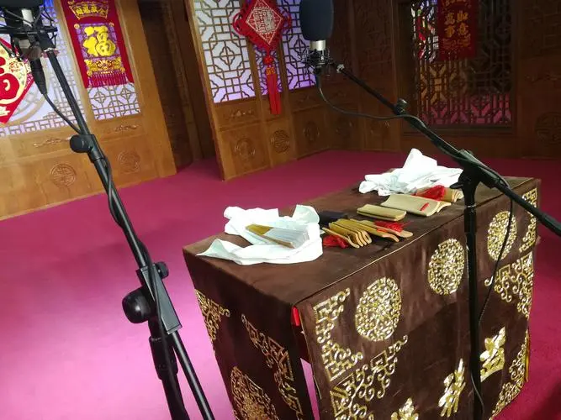
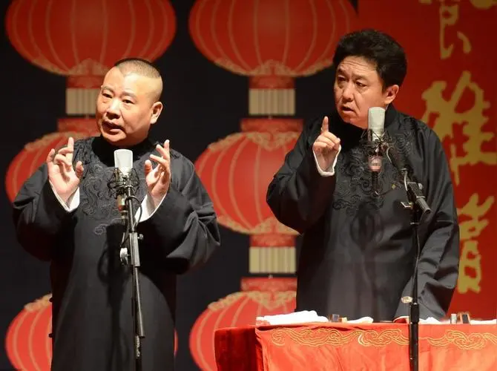
4.Desk
1. It is used to place props
2. To shift the audience's attention to the performer（逗哏）

Slide 9
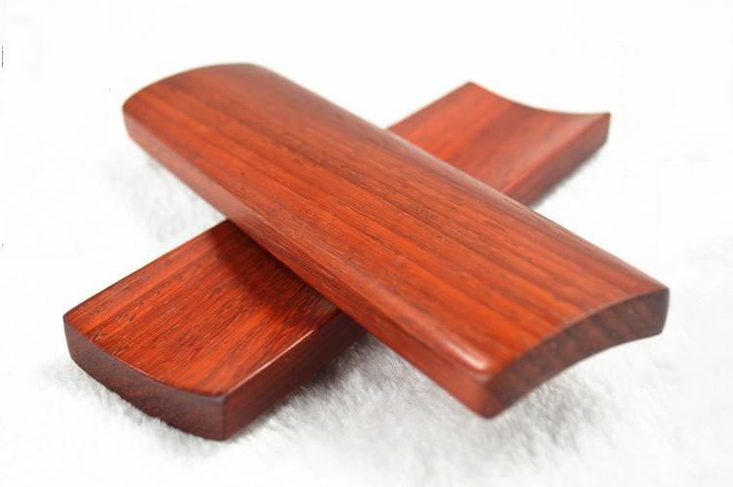
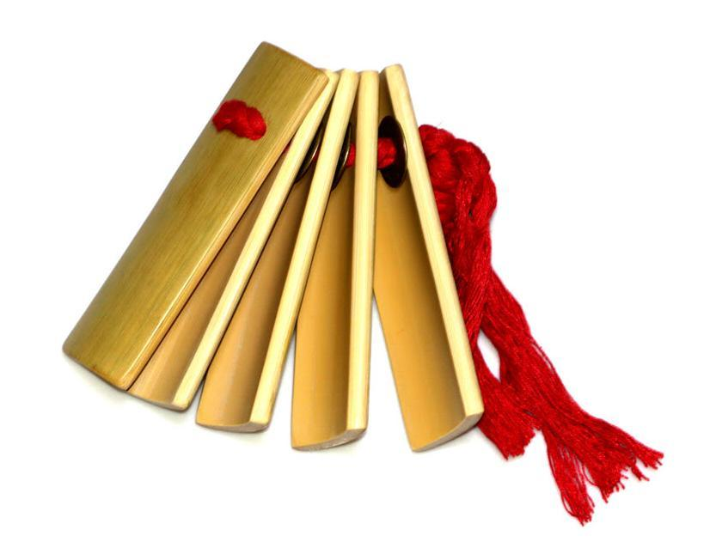
5.御(玉)子板（A folk music instrument made of bamboo similar to allegro)
御子板:The accompaniment tool used by cross-talk performers to sing the lyrics of Taiping Song
快板

Slide 10
Present situation and development trend
3

Slide 11
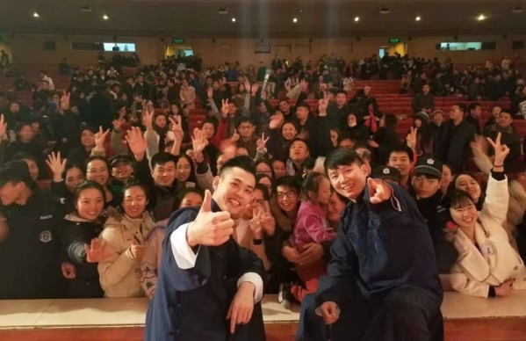
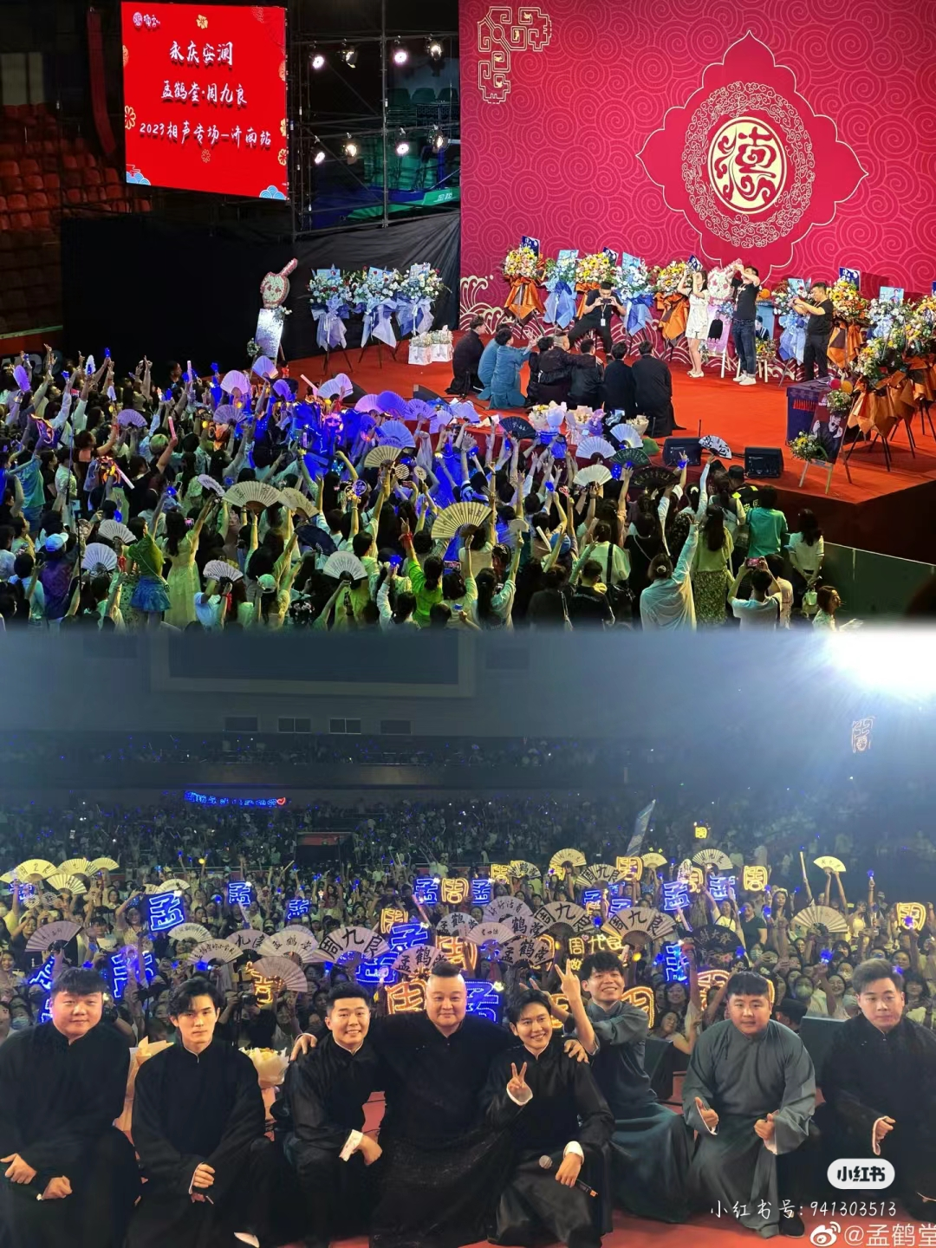
1. The audience is younger the fan culture

Slide 12
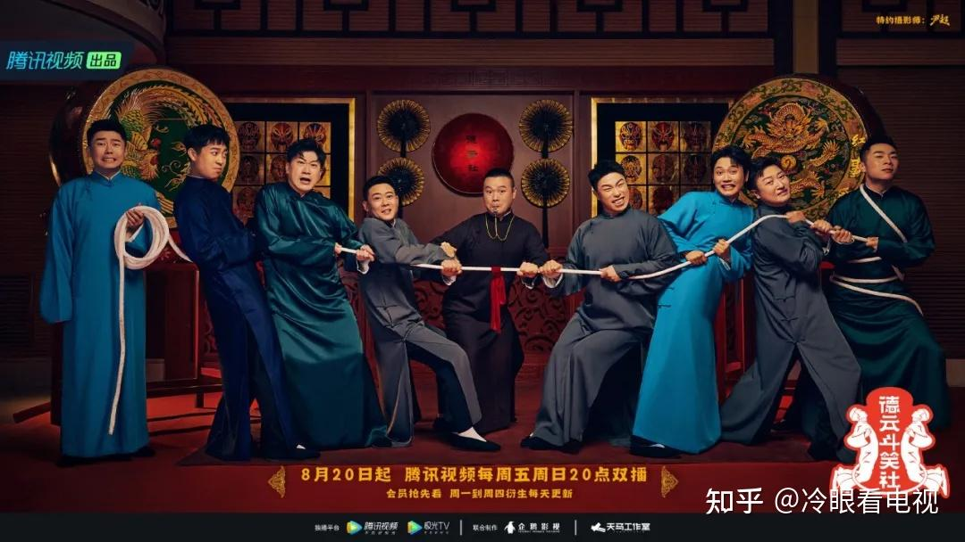
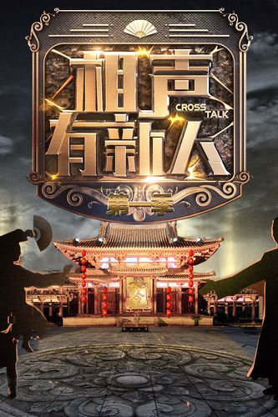
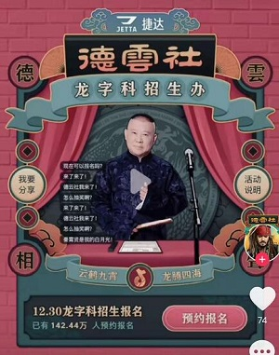
2. Use the mass media to spread

Slide 13
Problems and measures
4

Slide 14

Problems
1. Insufficient driving force for innovative development
2. Overcatering to the consumer market
3. Uneven regional development
4. Lack of young inheritors

Slide 15
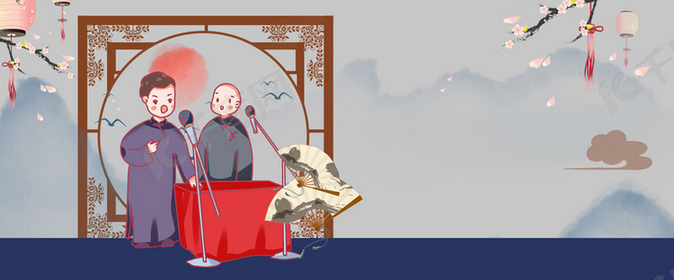
Measures
1. Mass media participation is crucial
2. Educational resource utilization
3. Talent training plan and creative incentive mechanism
4. Relying on professional knowledge to spread overseas, promoting cultural exchange and innovation

Slide 16
Thanks

