Slide 1



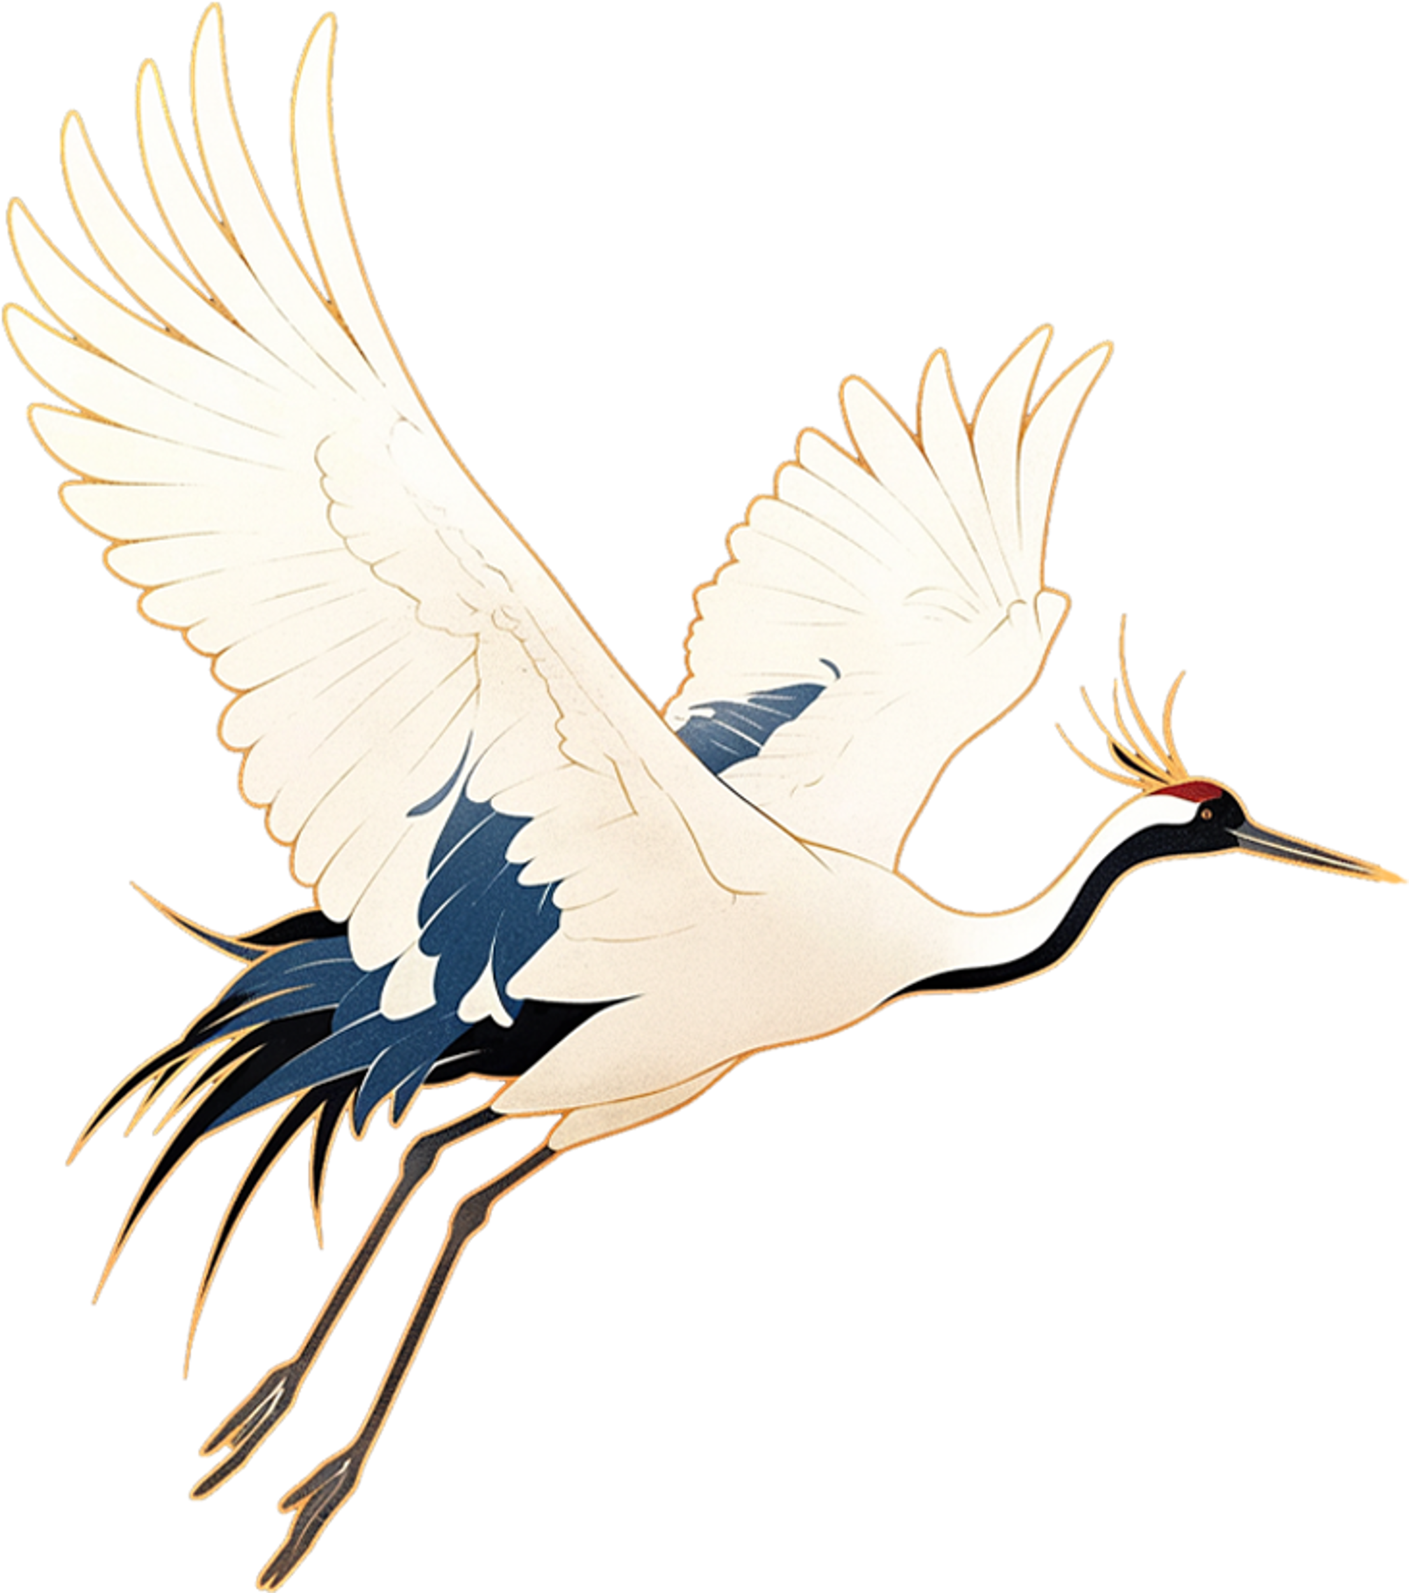


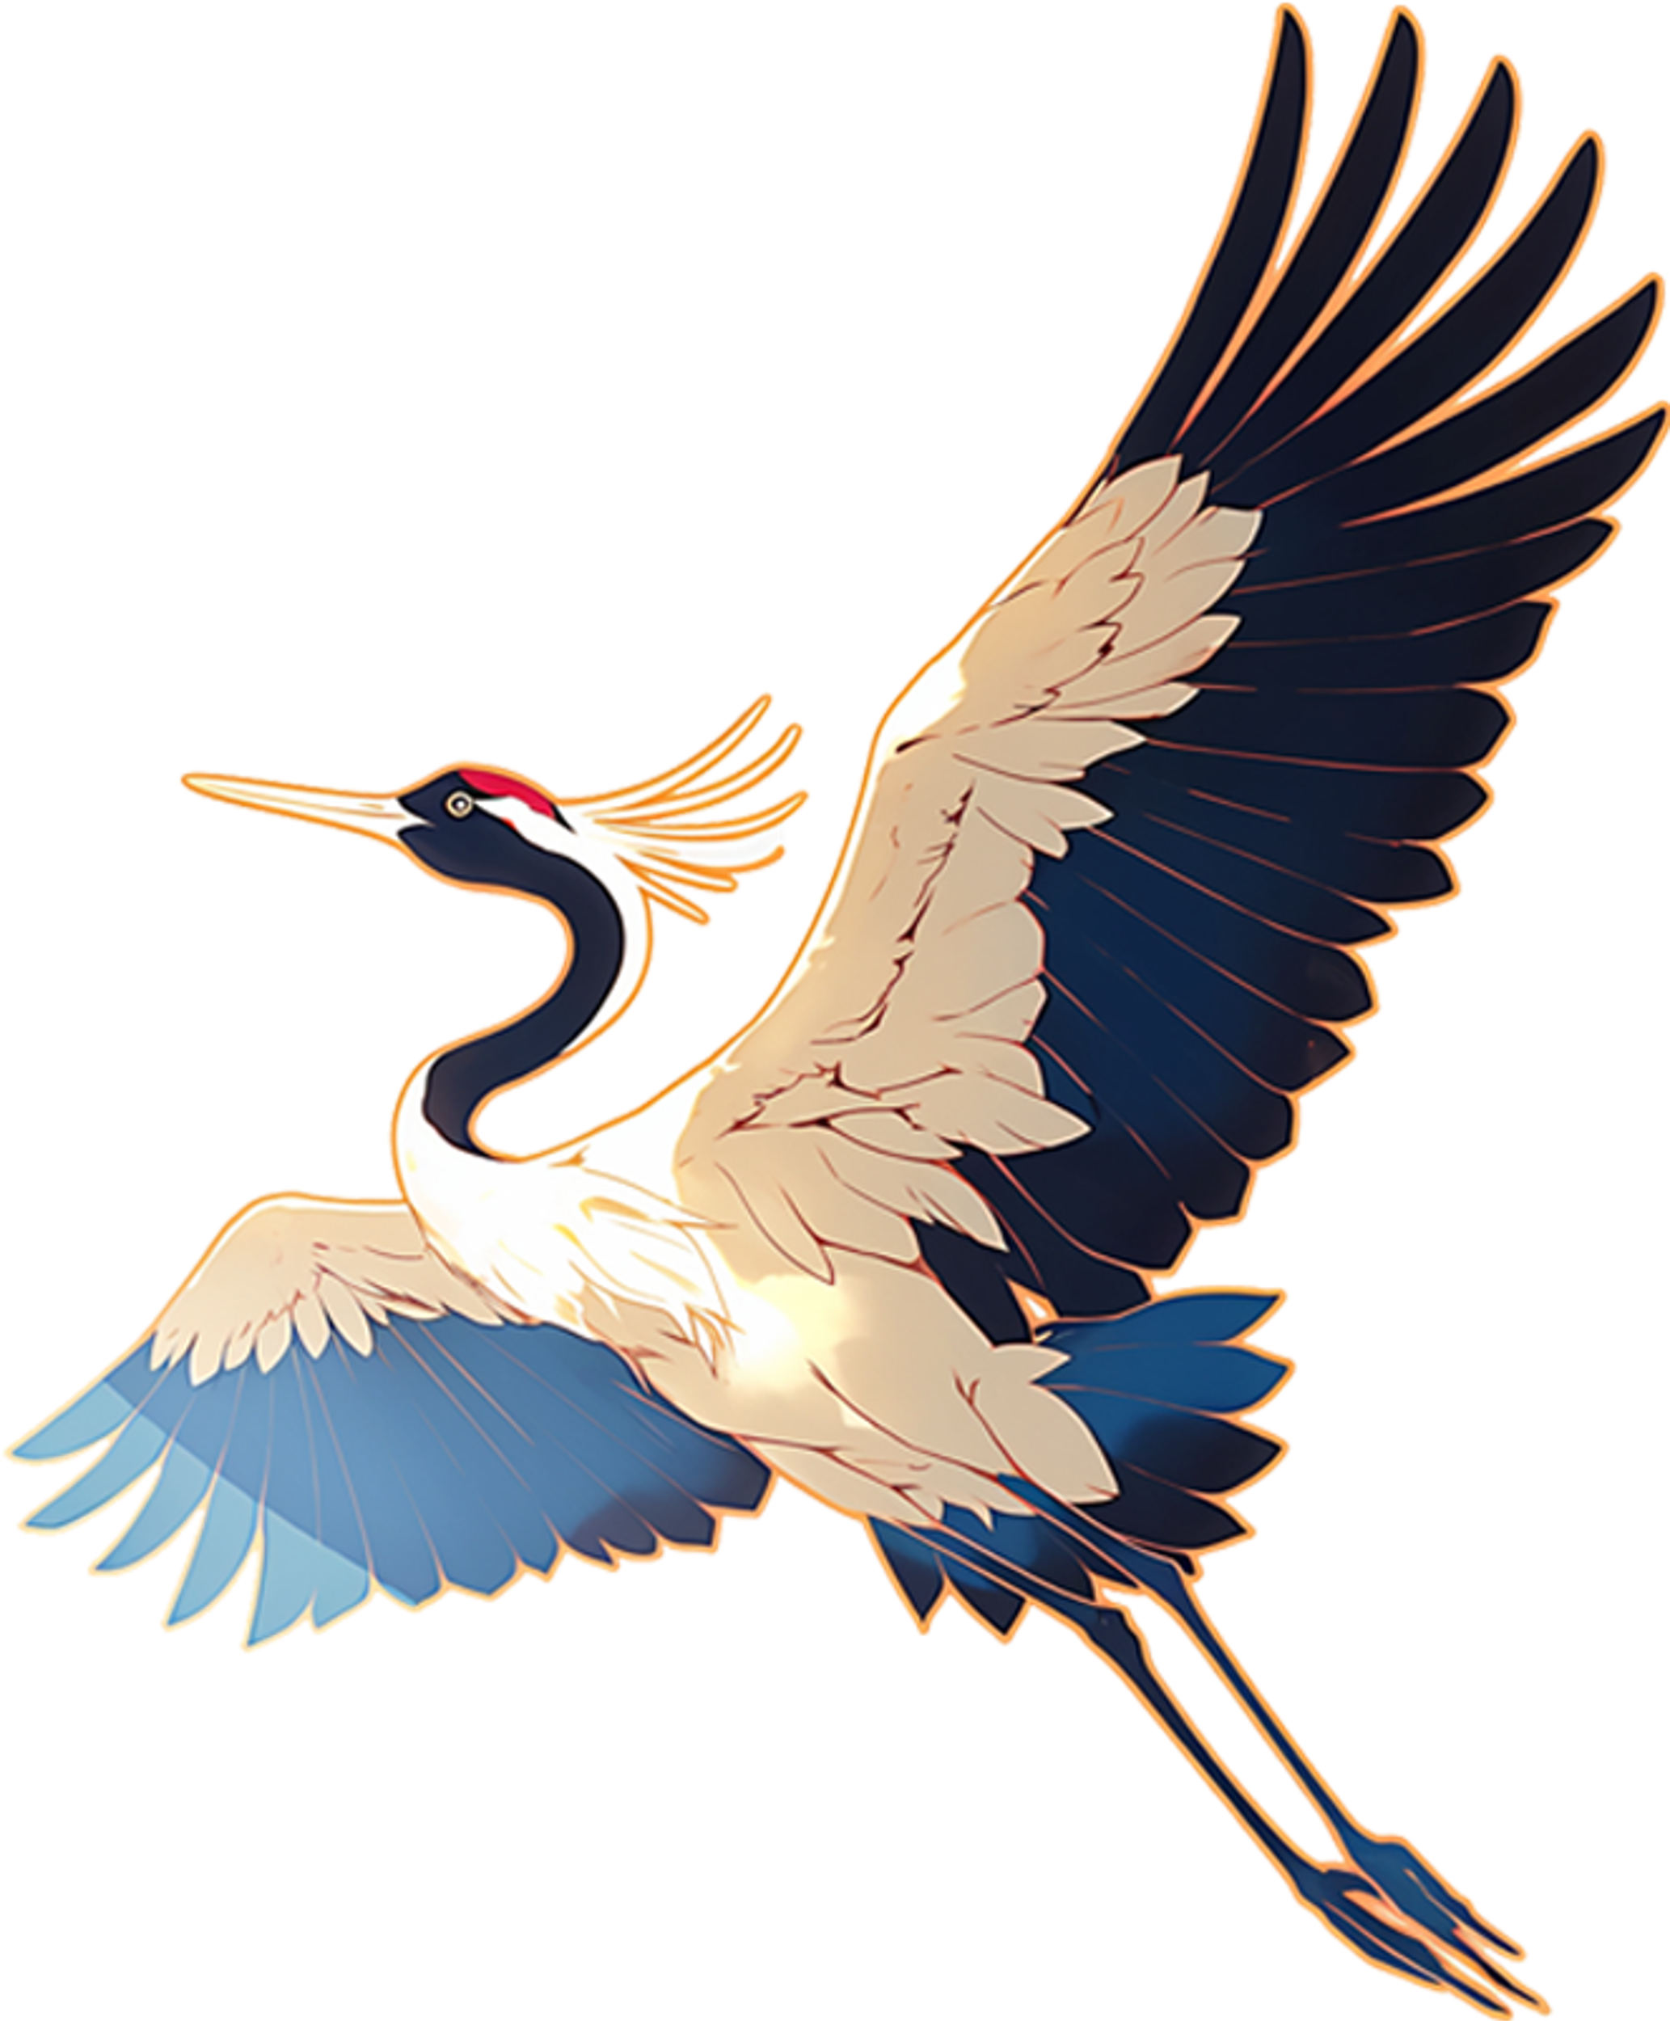
02
The Spiritual Value of Flowers

Slide 2
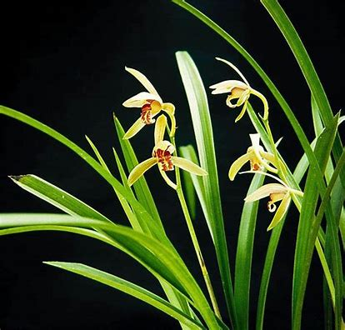
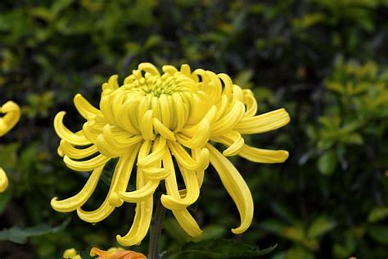
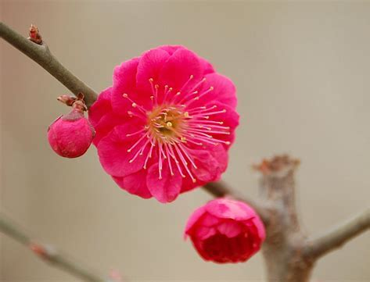
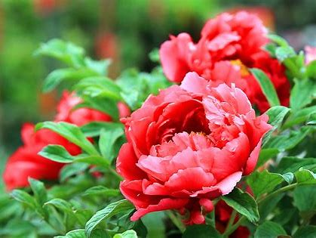
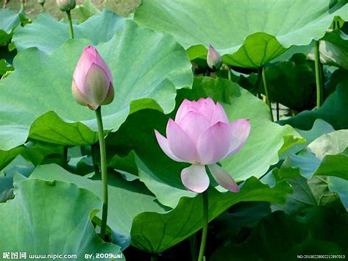
Symbolic Meaning
plum blossoms：perseverance
chrysanthemums： contentment with simple fame and wealth
Oorchids：elegance
peonies：wealth and prosperity
lotuses：purity and solemnity
Notes:
In Chinese culture, flowers are often given specific symbolic meanings.
‘orchid(kid)
So/’lemnity

Slide 3
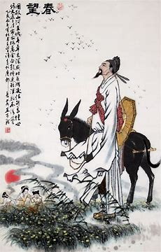
Literary and Artistic Expression
Floral Imagery in Literature
In classical Chinese literature, flowers are a common motif. In Tang and Song poetry, flowers are often used to express the poets' emotions and philosophies.
For example, Du Fu’s “Grieved over the years,
flowers are moved to tears; Seeing us apart, birds cry with broken heart,“（感时花溅泪，恨别鸟惊心） uses flowers to express his feelings about the situation and the sorrow of parting.

Slide 4
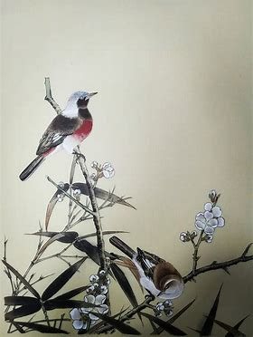
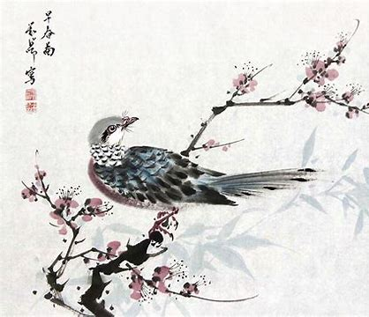
Floral Themes in Painting Art
Flower-and-Bird Painting is a genre of Chinese traditional painting that focuses on depicting various plants, flowers, birds, and insects. It is one of the three major genres of Chinese painting, alongside landscape and figure painting. This art form has a history of thousands of years, with its roots in the decorative arts of the Neolithic period and maturing into a distinct genre during the Tang Dynasty.

Slide 5
Emotional Value
01.
02.
03.
Emotional Symbolism of Flowers
Emotional Experience with Flowers
Festivals and Flowers
In Chinese culture, flowers are often given specific emotional symbolism. These symbols are not only reflected in literature and art but also influence emotional expression in daily life.
Flowers can bring people beautiful emotional experiences. For example, walking in a garden and admiring various flowers can make people feel relaxed and happy. The emotional experience of flowers enriches people's spiritual life and improves the quality of life.
In traditional Chinese festivals, flowers are often used to express emotions and yearnings. The emotional culture of flowers reflects people's pursuit and longing for a better life. In ancient times, during the Flower Festival, people would express their love for spring and life by admiring and praising flowers.

Slide 6
03
Differences Between Chinese and Western Cultures of Flowers

Slide 7
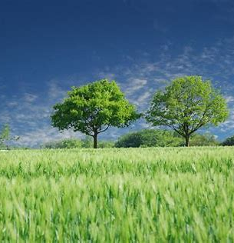
Characteristics of Chinese Culture of Flowers
The Philosophy of Unity of Man and Nature
Chinese culture of flowers is deeply influenced by the philosophical thought of "the unity of man and nature." People believe in the harmonious coexistence of humans and nature, where flowers are not only a part of the natural world but also a bridge for communication between humans and nature.
Expressing Emotion Through Flowers
In Chinese culture of flowers, people often express emotions and thoughts through flowers. This way of expressing emotion through flowers makes Chinese culture of flowers more colorful and poetic.

Slide 8
Characteristics of Western Culture of flowers
The Scientific Spirit of Objective Treatment
The Connection Between Flowers and Religion
Western culture of flowers pays more attention to the scientific value and practicality of flowers. For example, research on the classification, growth habits, and breeding techniques of flowers. This scientific spirit of objective treatment makes Western culture of flowers more rational and systematic.
In Western culture, flowers have a close connection with religion. For example, lilies in Christianity symbolize purity and sanctity, and roses in Islam symbolize paradise and eternity. These religious symbols of flowers reflect the religious colors and spiritual sustenance of Western culture of flowers.

Slide 9
Questions
1. Name at least three types of flowers and their edible value.
2. Name at least three types of flowers and their symbolic meanings.
3. Provide at least three sentences from ancient Chinese poems that contain the character “花”.

Slide 10
Thank you!

