Slide 1
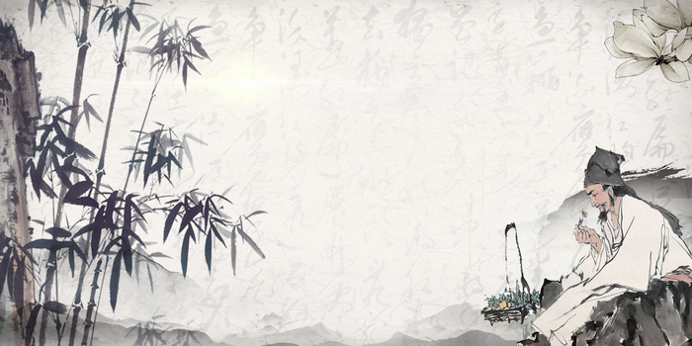
Zhang Zhongjing

Slide 2
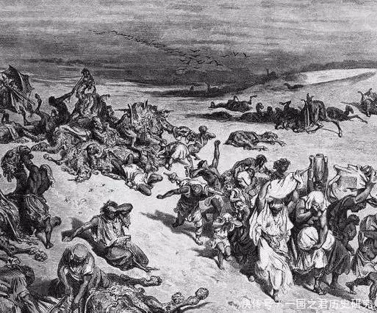
Historical background
In the late Eastern Han Dynasty, the consorts’ relatives and eunuchs alternately held sway over the court, resulting in extreme political corruption. The problem of land annexation was severe, forcing a large number of farmers to lose their land and become refugees. Wars triggered large-scale population migration, coupled with poor sanitary conditions, which led to frequent outbreaks of epidemics,mainly typhoid-like infectious diseases

Slide 3
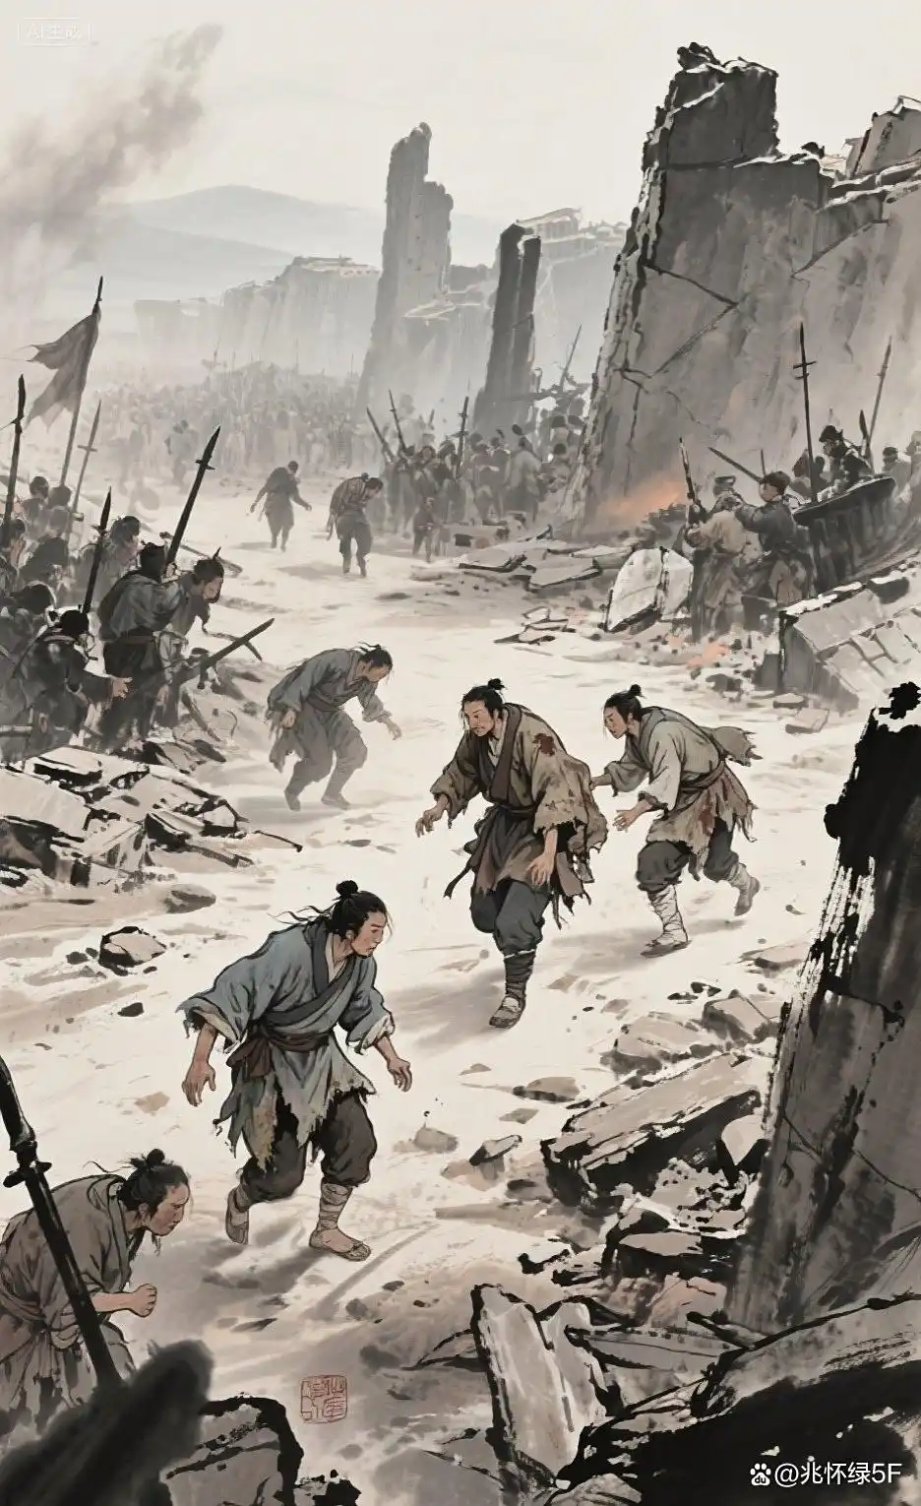
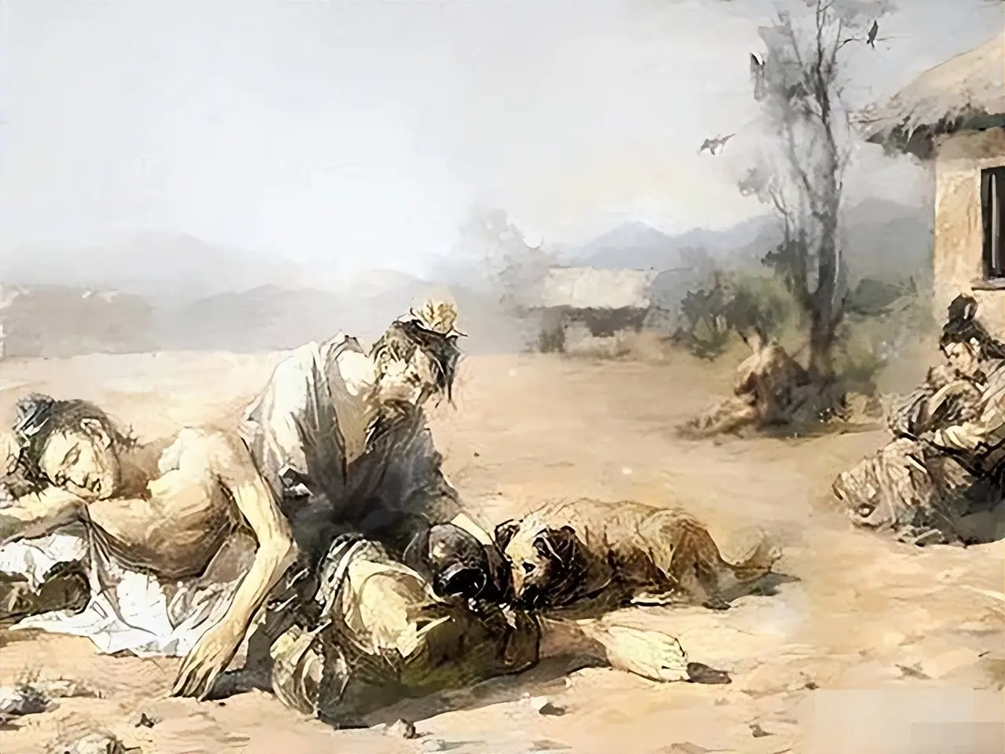
In the preface to Treatise on Febrile and Miscellaneous Diseases, Zhang Zhongjing depicted the tragic scene of the time: “My clan was once large, with over 200 members. Yet since the Jian’an era began, less than a decade has passed, and two-thirds of them have perished. Of these deaths, seven out of ten were caused by typhoid.”

Slide 4
Medical standards at that time were relatively backward. On the one hand, witch doctors were prevalent among the folk; many people relied on superstition when ill, thus delaying treatment. On the other hand, although traditional medical classics such as Huangdi Neijing (Yellow Emperor’s Internal Classic) and Nanjing (Classic of Difficult Issues) laid down theoretical foundations, they lacked systematic clinical diagnosis and treatment protocols. As a result, physicians were often helpless when treating epidemic diseases.

Slide 5
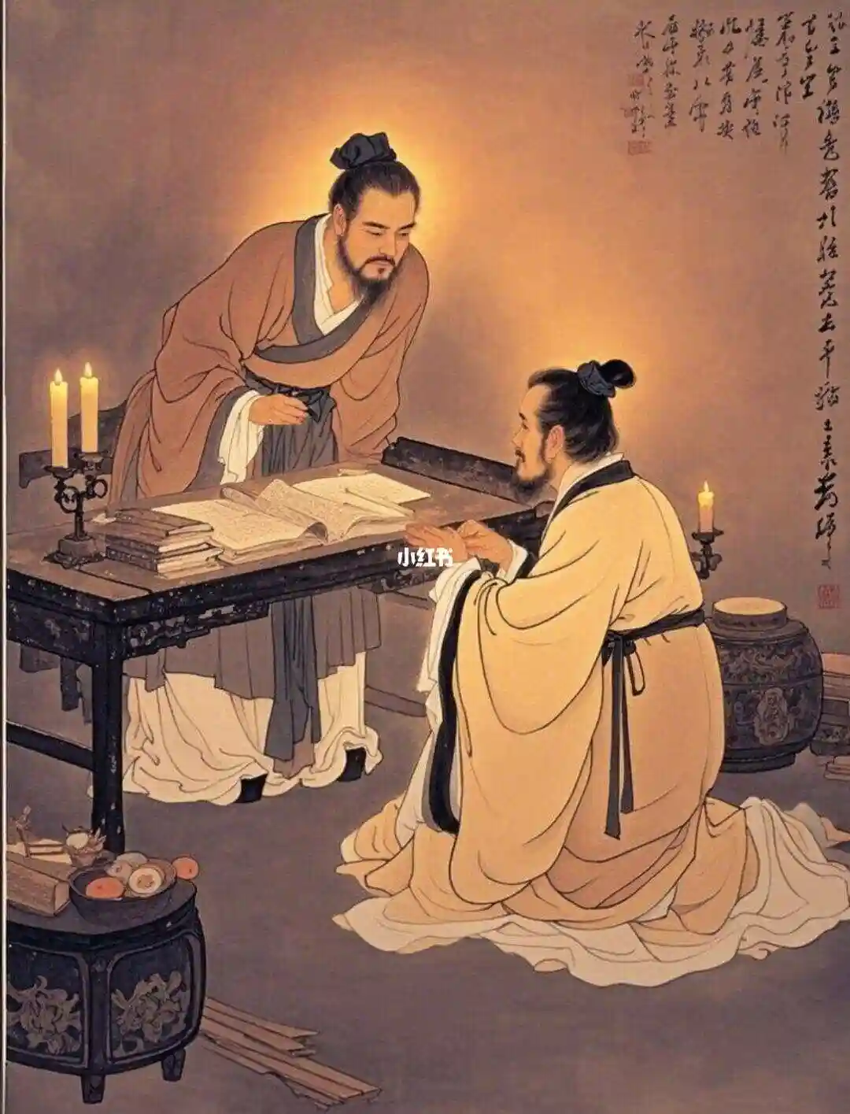
Life experiences
Zhang Zhongjing was intelligent and diligent from an early age, with a passion for reading a wide range of books, especially medical works.At around ten years old, he apprenticed himself to Zhang Bozu, a renowned local doctor in the same prefecture. He threw himself wholeheartedly into his medical studies, sparing no effort whether accompanying his master on home visits, copying prescriptions, gathering medicinal herbs in the mountains, or processing them back home.

Slide 6
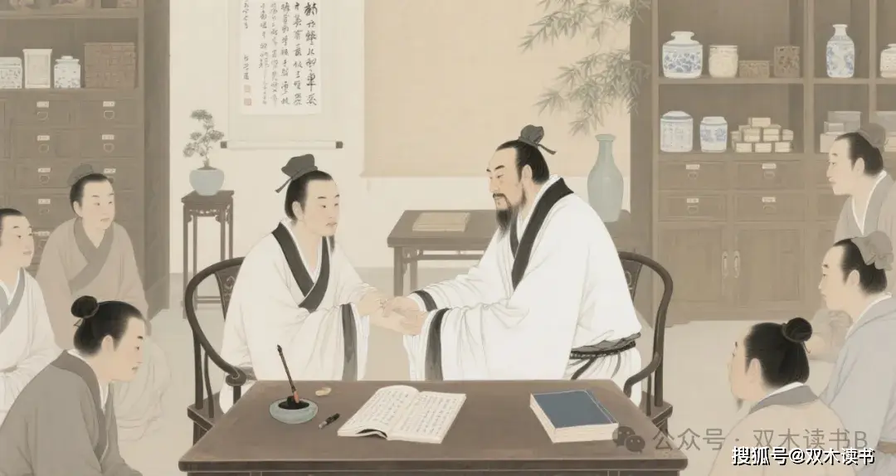
Under the Xiaolian，Zhang Zhongjing inherited his family’s tradition and was recommended by local authorities to serve as an official during the reign of Emperor Ling. Yet he never forgot his original aspiration to practice medicine, on the first and fifteenth day of each lunar month, he would open the government office wide and let sick villagers enter, then sit solemnly in the hall to diagnose and treat them one by one. This act caused a great sensation, and the people held him in even higher esteem. Later, doctors who practice medicine in pharmacies came to be universally known as “sitting hall physicians” in memory of Zhang Zhongjing.

Slide 7
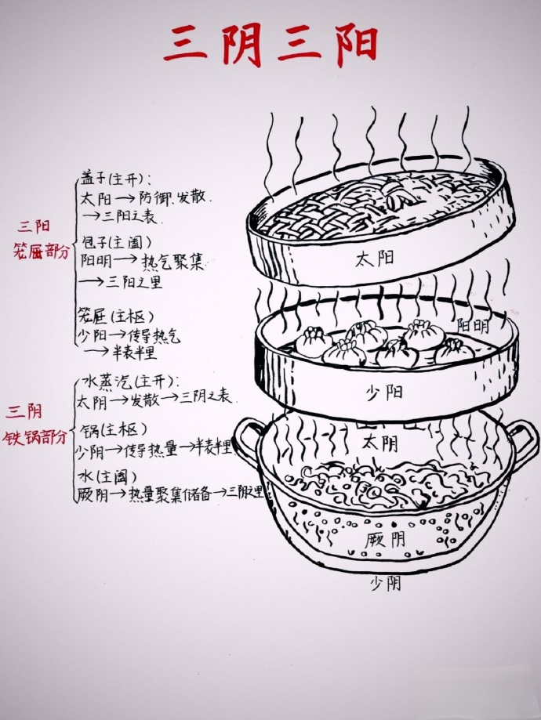
Achievements
In Treatise on Febrile and Miscellaneous Diseases, he proposed the framework of"Six-Meridian Syndrome Differentiation"to analyze the disease location, nature and progression rules of exogenous febrile diseases (typhoid).It has since become the fundamental principle of TCM clinical diagnosis and treatment, which is still in use today.

Slide 8
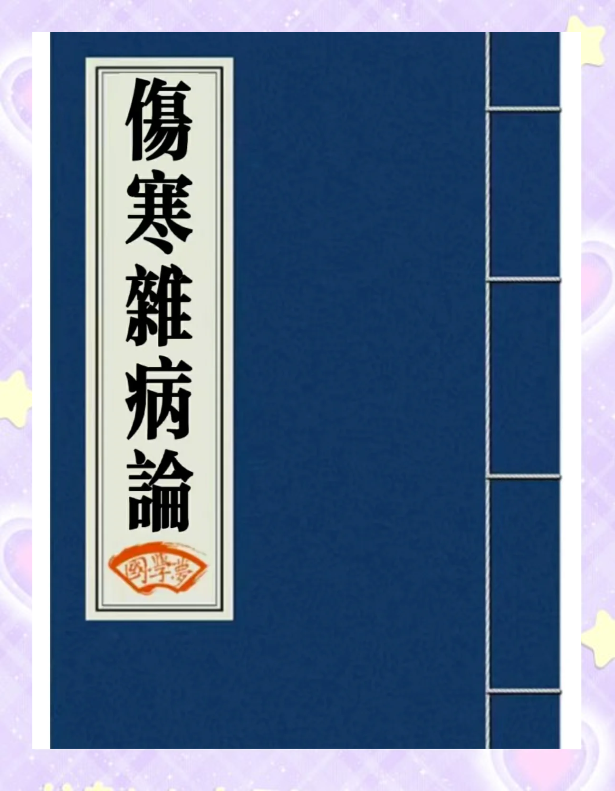
He compiled the Immortal Medical Classic Treatise on Febrile and Miscellaneous Diseases.This book is the first medical masterpiece in China that integrates TCM theories, diagnostic methods, treatment principles and herbal formulas in a systematic way.During its circulation, the original text was compiled by later generations into two independent works:Treatise on Febrile Diseases ,and the Synopsis of the Golden Chamber .

Slide 9
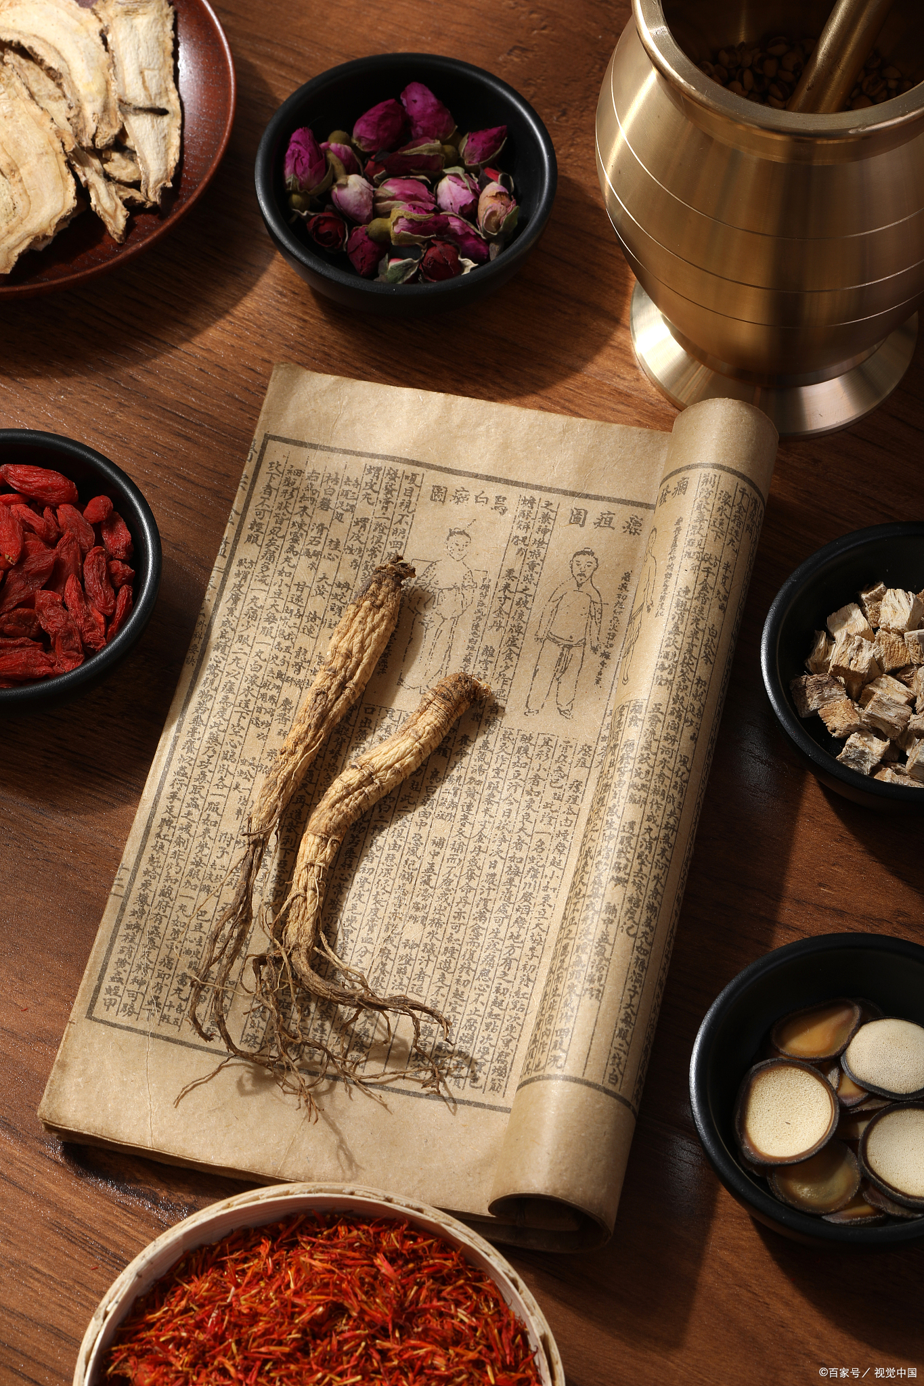
Influence
The principle of "treatment based on syndrome differentiation" put forward by him has become the fundamental guideline for TCM clinical practice, completely changing the previous limitation that some physicians only prescribed medicines for specific symptoms without systematic analysis of pathological mechanisms.

Slide 10
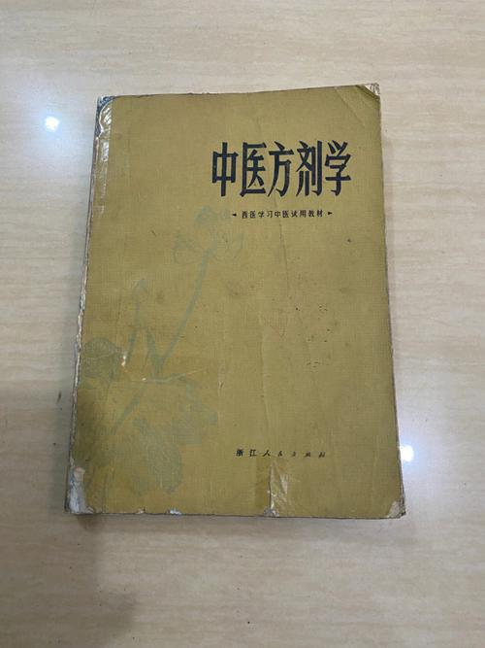
The classic formulas (jingfang) created by Zhang Zhongjing, characterized by rigorous compatibility and proven efficacy, have become the origin of the development of formulaology in later generations.

Slide 11
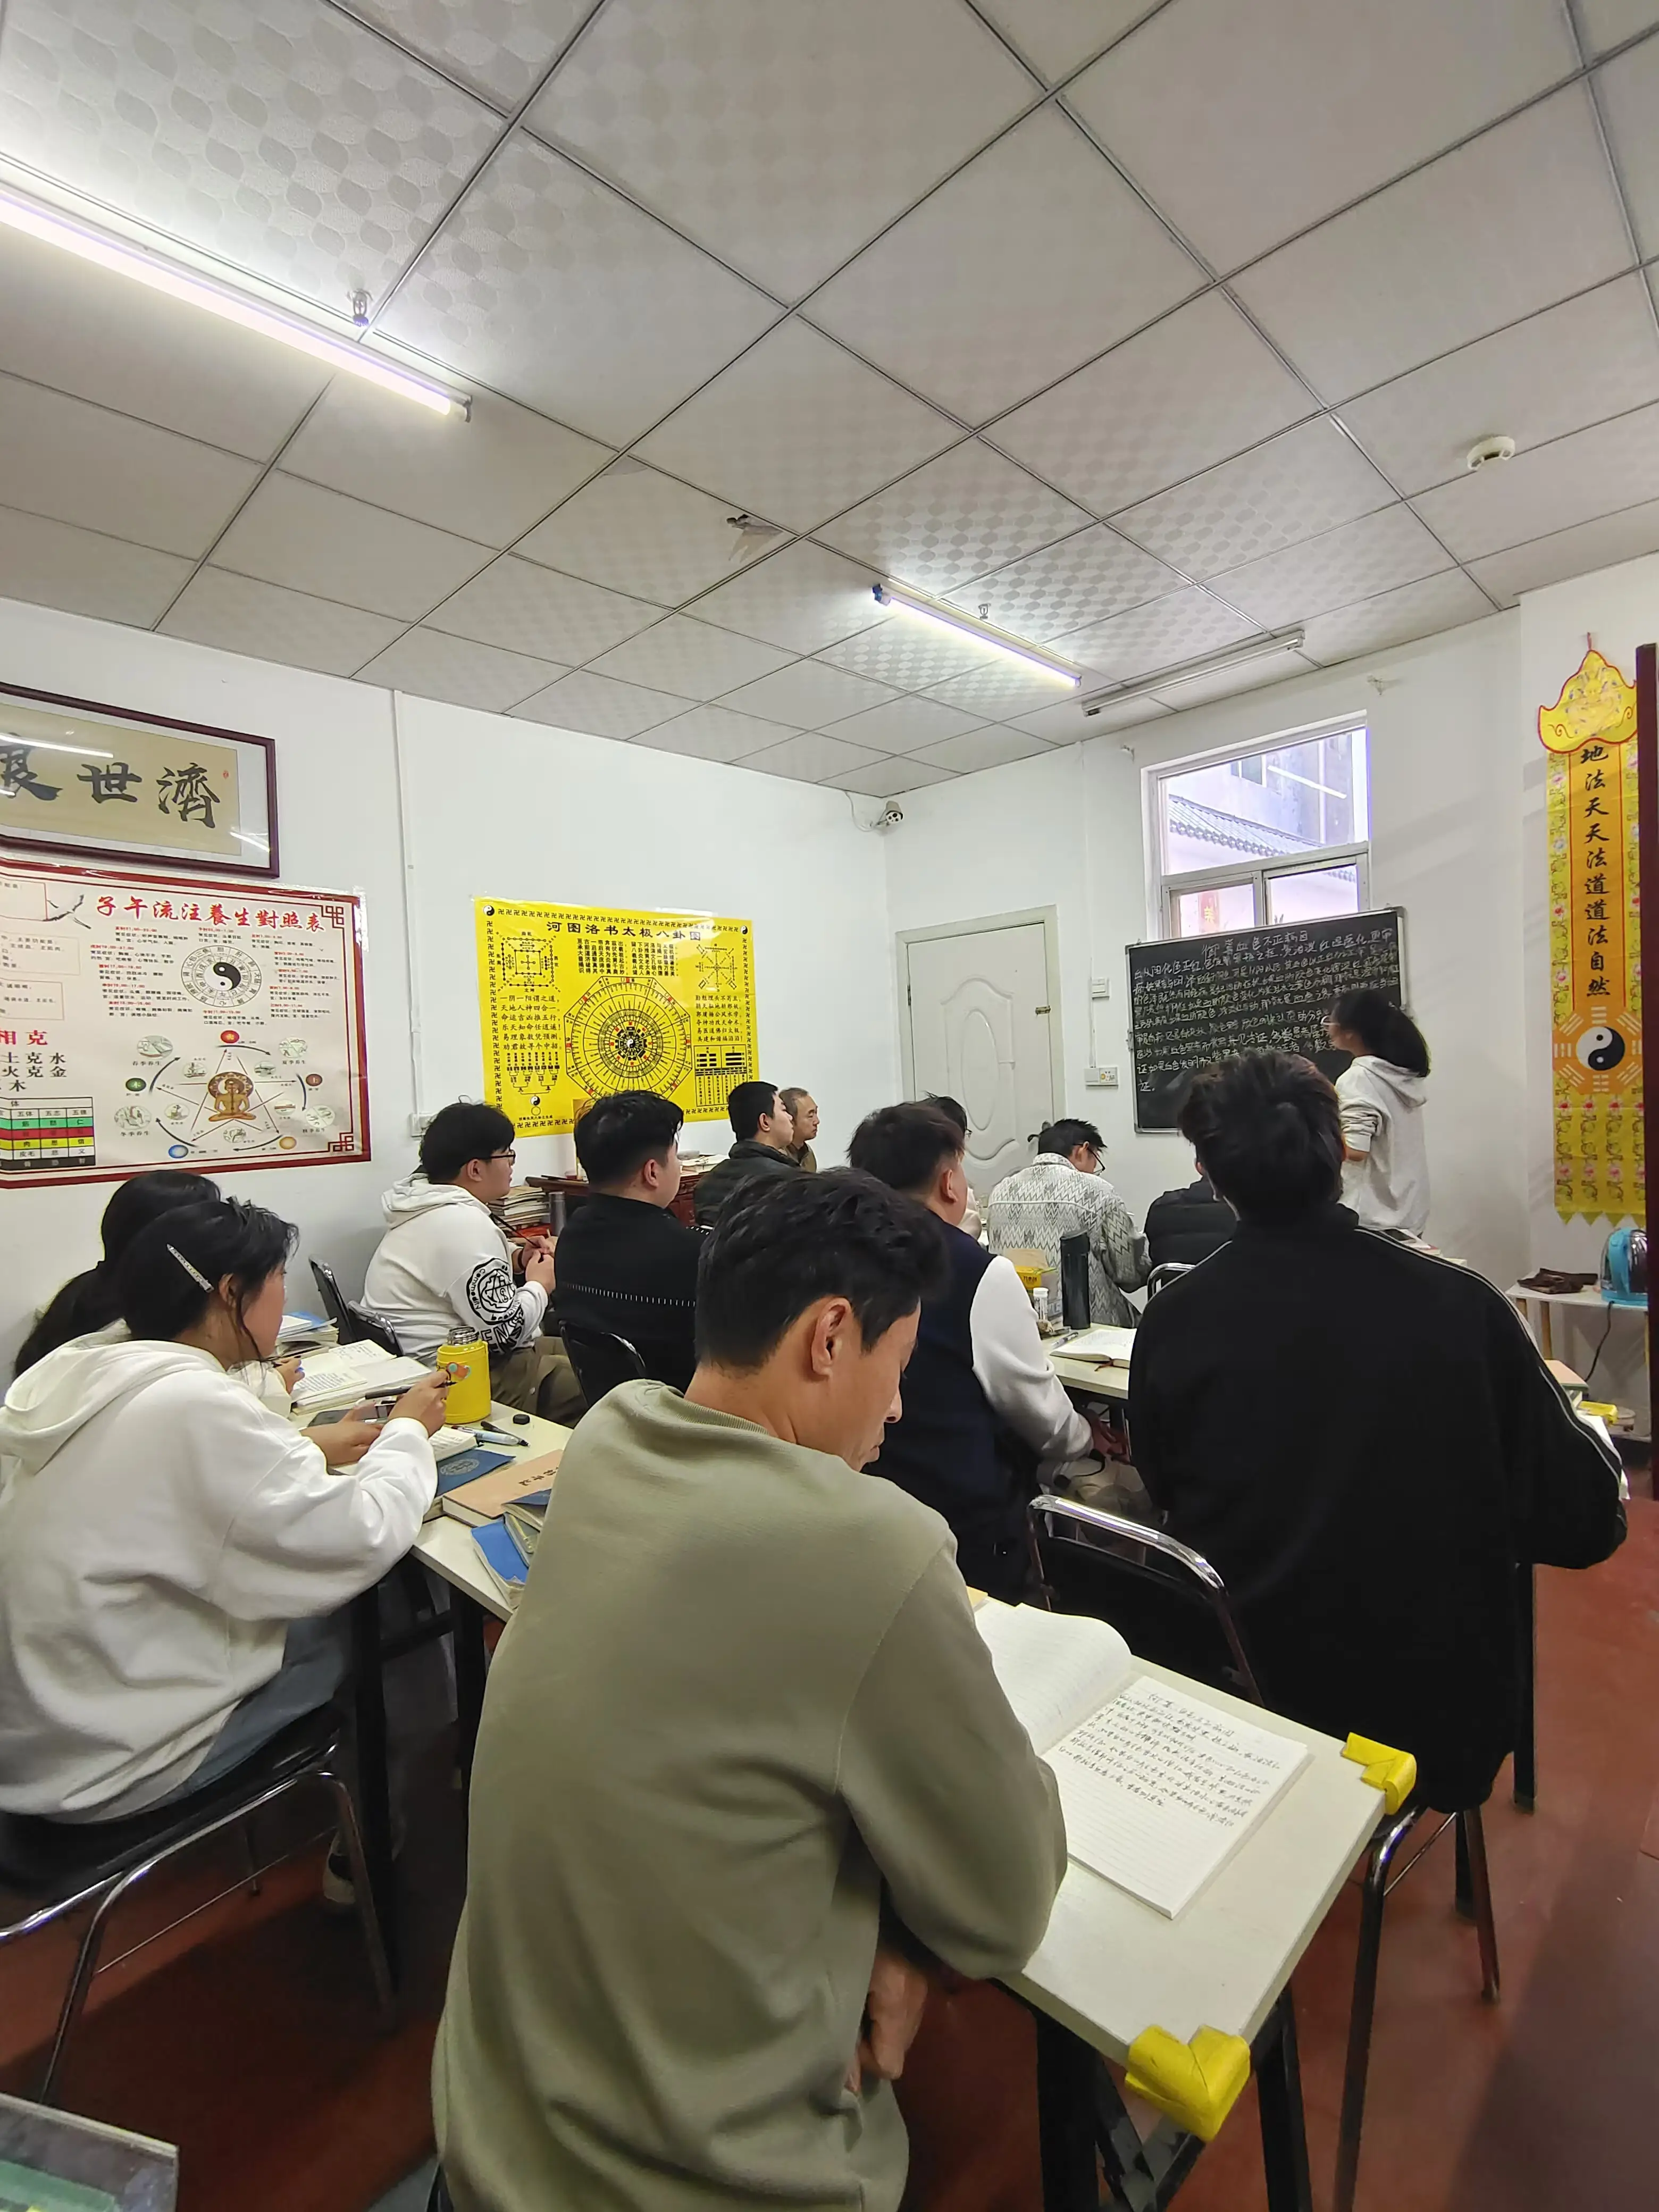
Since Treatise on Febrile Diseases and Synopsis of the Golden Chamber were compiled by Wang Shuhe in the Jin Dynasty, they have been regarded as the compulsory classics of TCM.

Slide 12
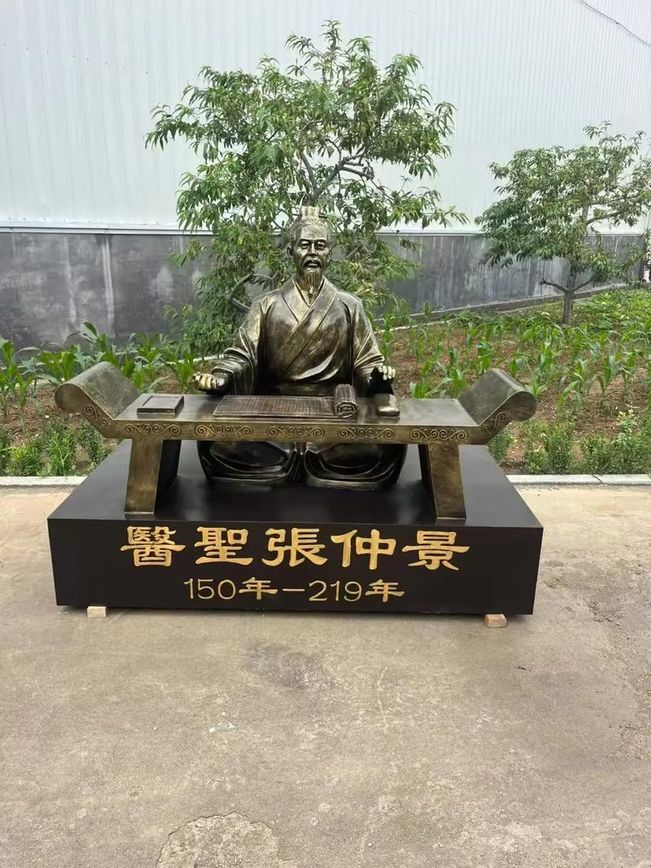
Zhang Zhongjing’s deeds of "sitting in the government hall to practice medicine" and distributing free medicines to help the poor, have become the medical ethics guidelines for physicians in later generations

Slide 13
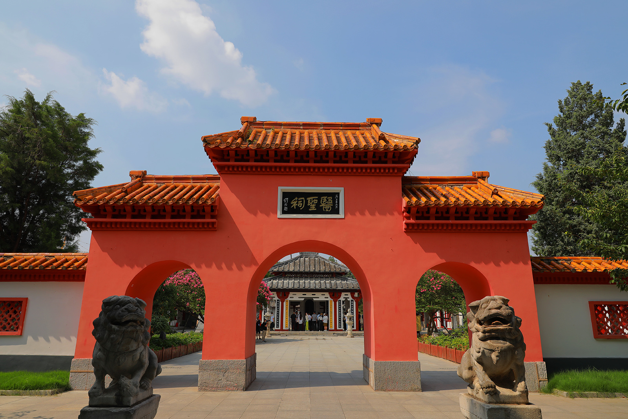
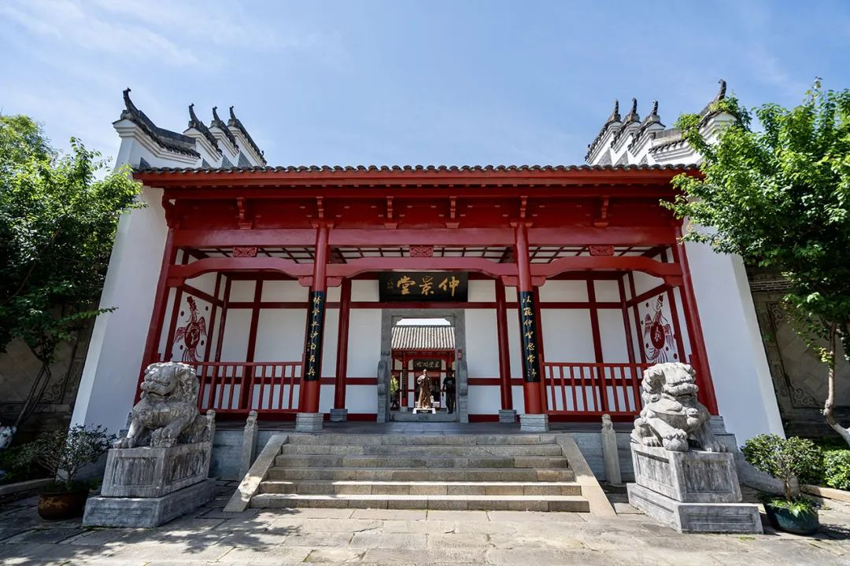

Commemoration
Medical Sage Temple
Zhongjingtang,Changsha

Slide 14
Thank you!

