Slide 1
Chinese Panda Diplomacy
Guan Na 关娜 English translation
Cai Si 蔡思 Japanese translation
2022.12.30

Slide 2
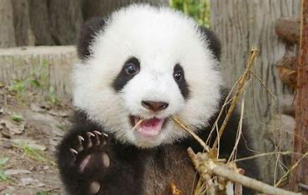
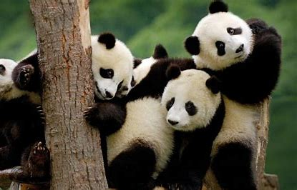
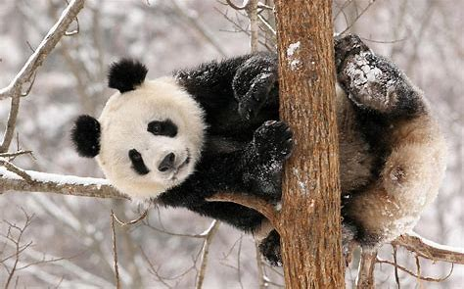
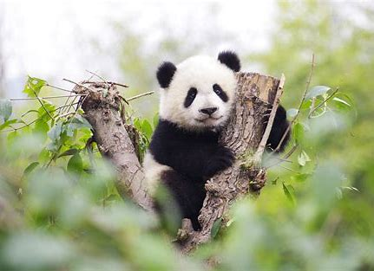
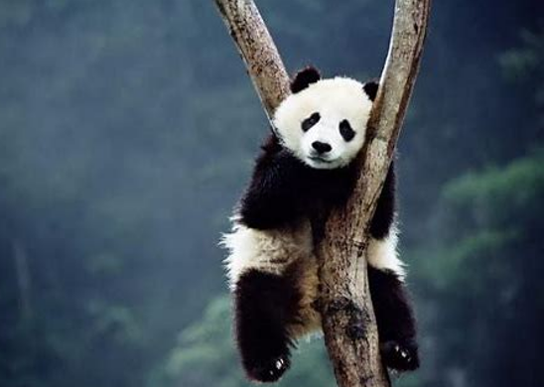
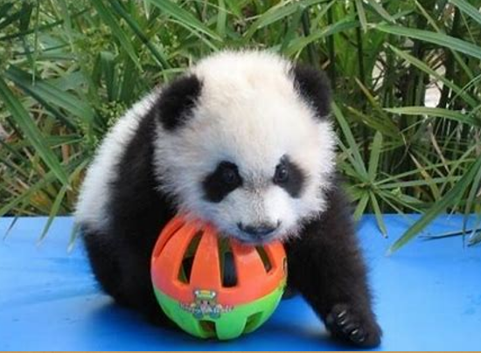

Slide 3
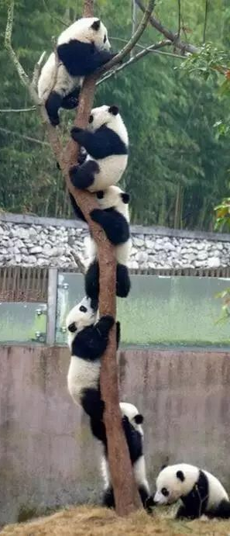
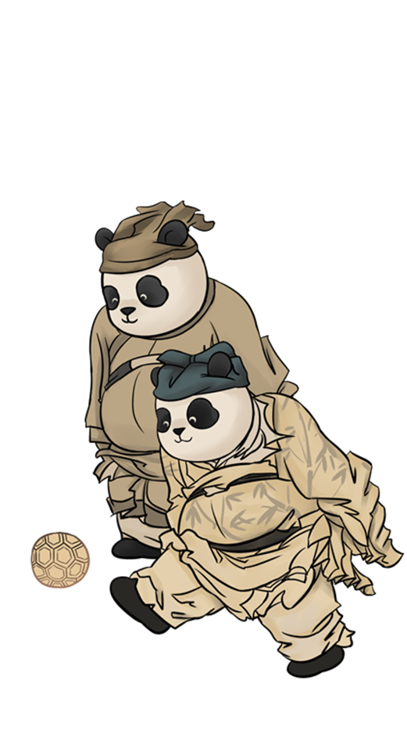
1.What comes to your mind when you think of pandas?
Black & white
bamboo
Sichuanese Mandarin
cute
China
national treasure
Panda Diplomacy
cuddly
endangered species
Panda head meme
Kung Fu Panda

Slide 4

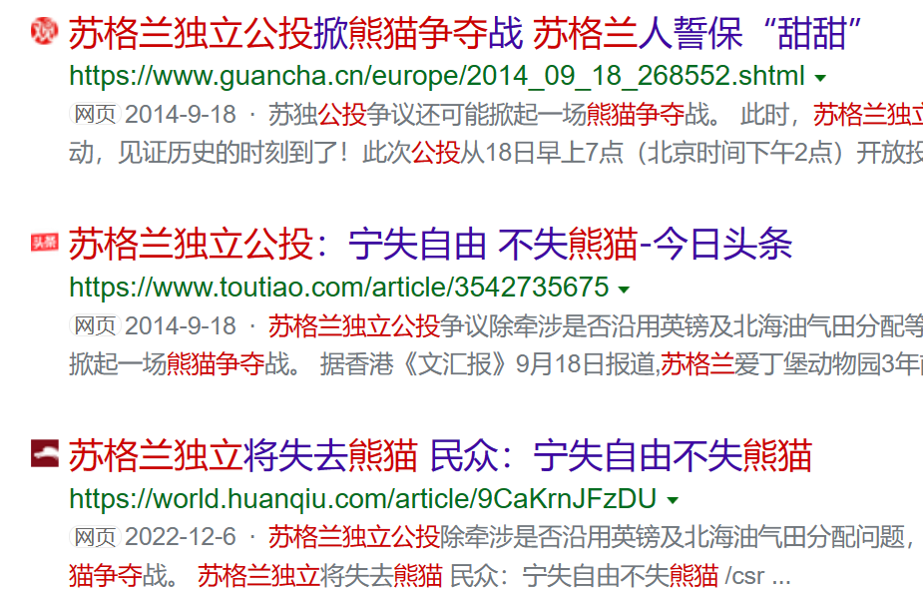
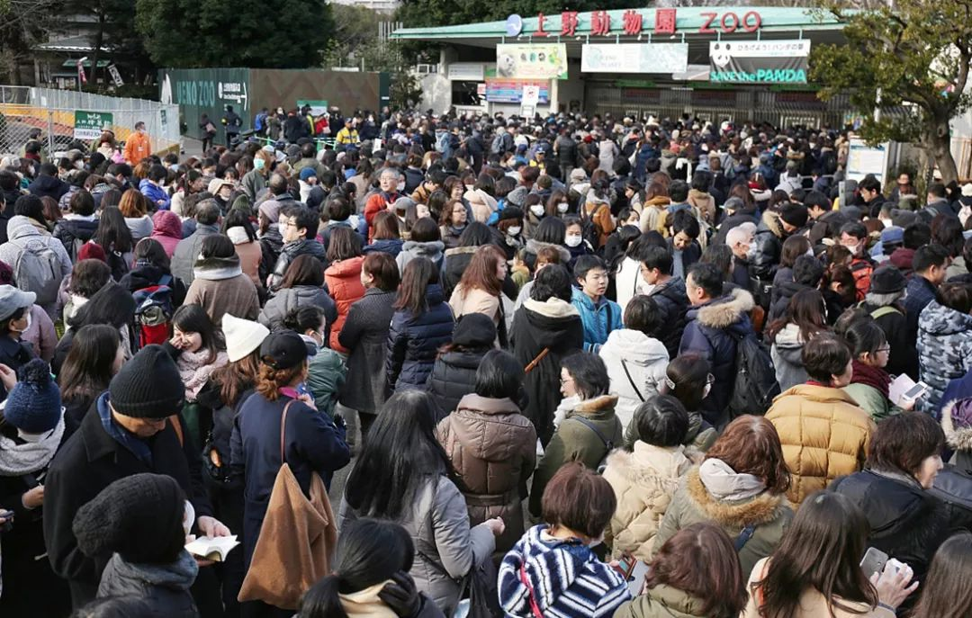
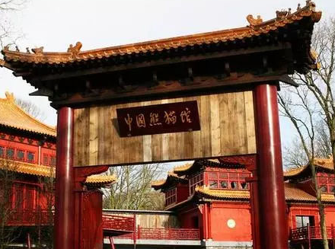
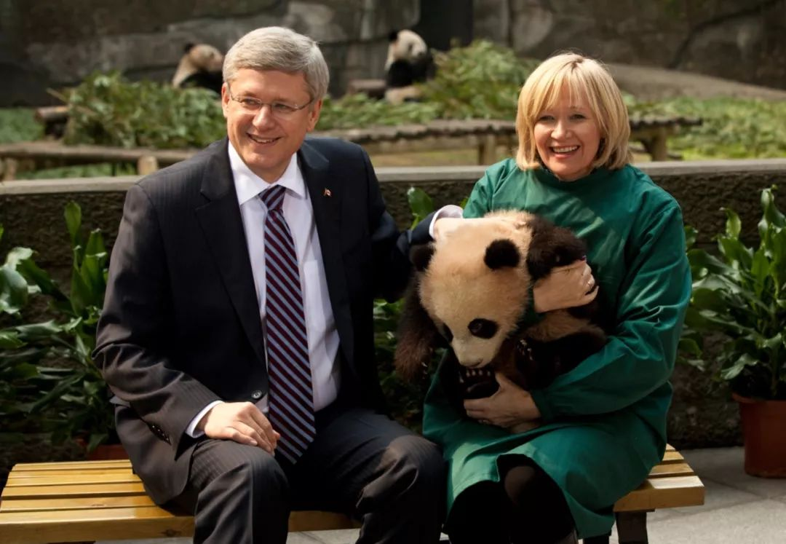
2.Why are people so fascinated with pandas?

Slide 5

3.The most unequal treaties in the world today: Panda lease treaty
If you want to rent a loan, you have to sign an unequal treaty.
1.Every panda needs to pay US $1 million a year.
2.Before renting a panda, you should first formulate a research plan that can benefit wild pandas, and also help to get funding for China's panda protection project.
3.Prove the ability to raise pandas by self certification.
4.Every panda gave birth to a baby cub, and the borrower need to pay China $600 thousand, and must return to China after the age of 3.
5.If panda die because of human error, it will have to pay a compensation of $500 thousand.

Slide 6
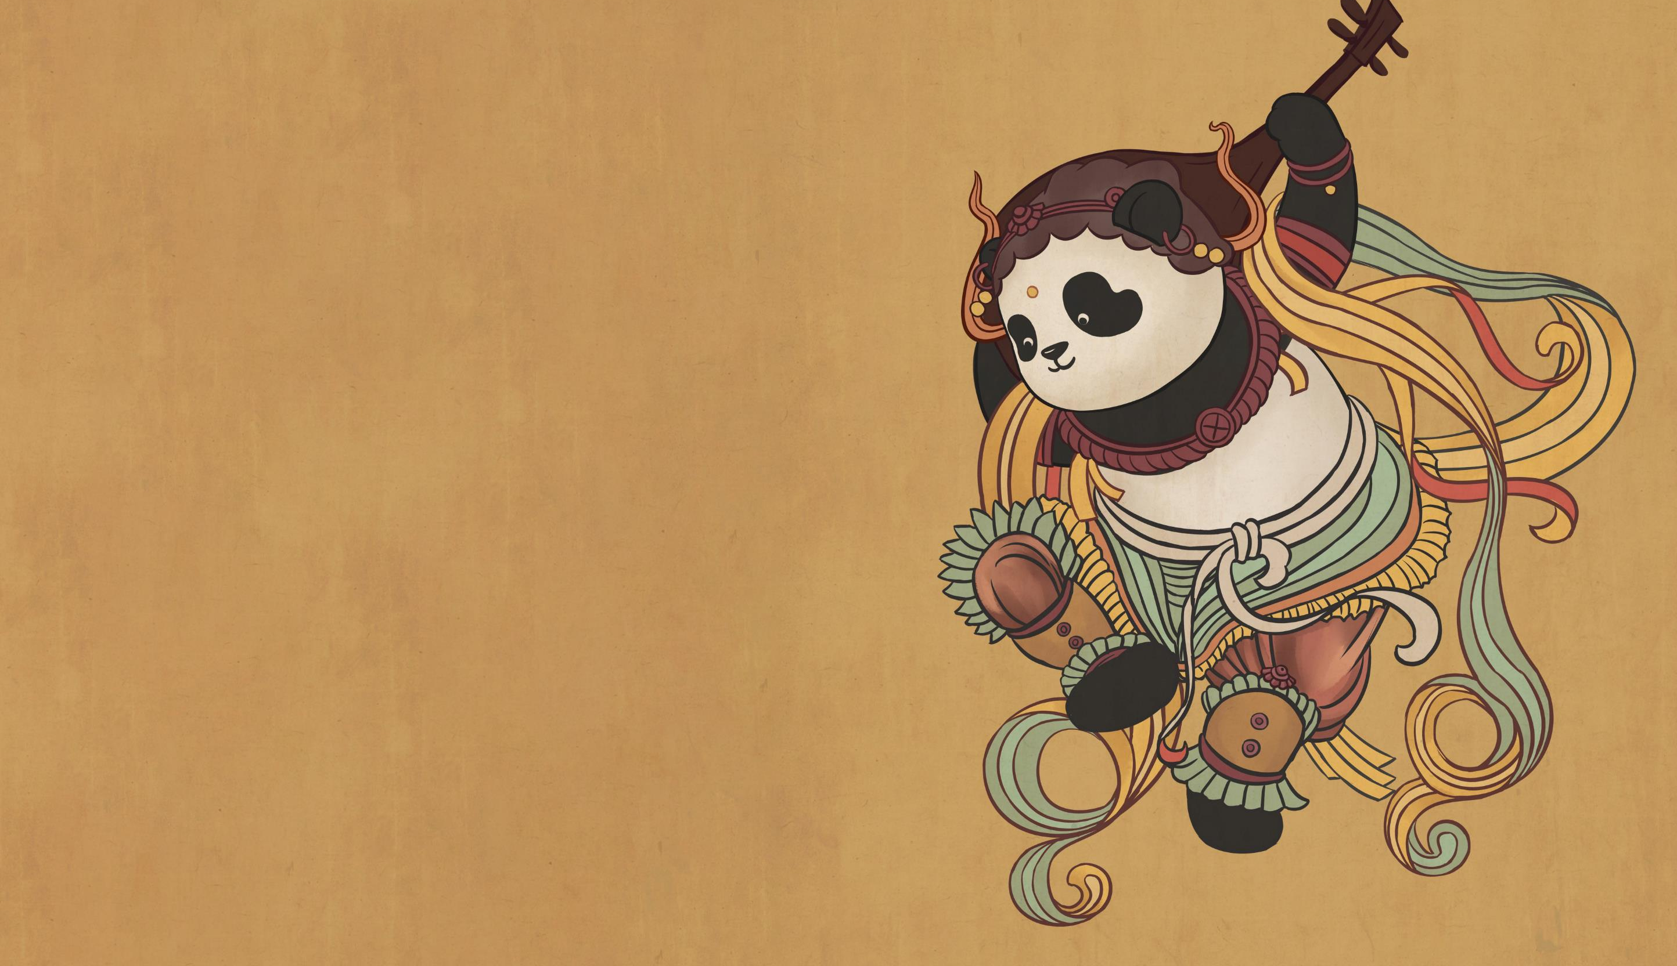
Thank you

