Slide 1




Question 1: Which festival is depicted in this film?
Question 1
REMEMBER ME
Coco 《寻梦环游记》
Zhong YUAN FESTIVAL
DAY OF THE DEAD

Slide 2






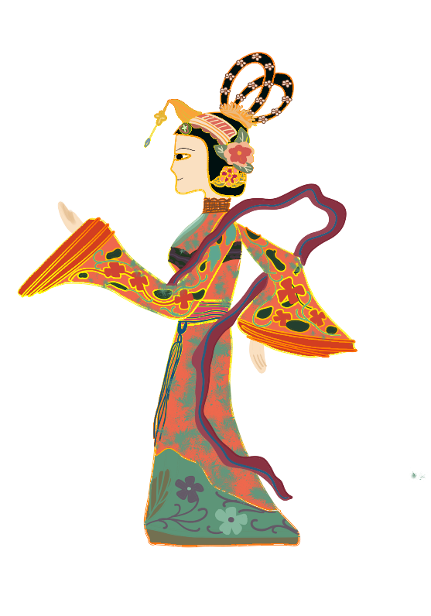

Zhong
Yuanz
Festival
Ou Huang

Slide 3

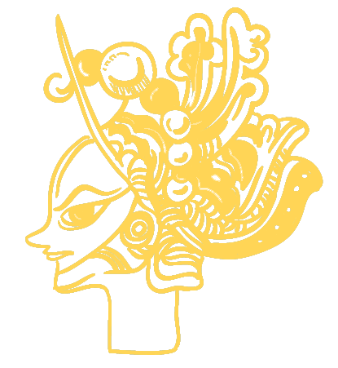
1. Dates of Observance
Zhongyuan Festival
Day of the Dead
Zhong YUAN FESTIVAL
Hungry Ghost Festival
Day of the little angels
Nov. 1st
on the 15th day of the seventh lunar month
Day of the adult angels
Nov. 2nd
Harvest
Abundance
Gratitude

Slide 4
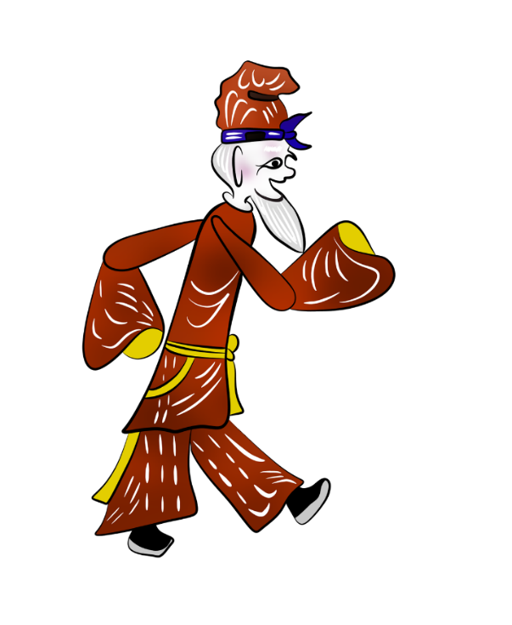
2.1 Ceremonies and Traditions
Prepare Offerings
Kneel in Reverence
Zhong YUAN FESTIVAL
ancestor worship
Solemn
Remembrance
Burn Spirit Money
Paying Homage

Slide 5
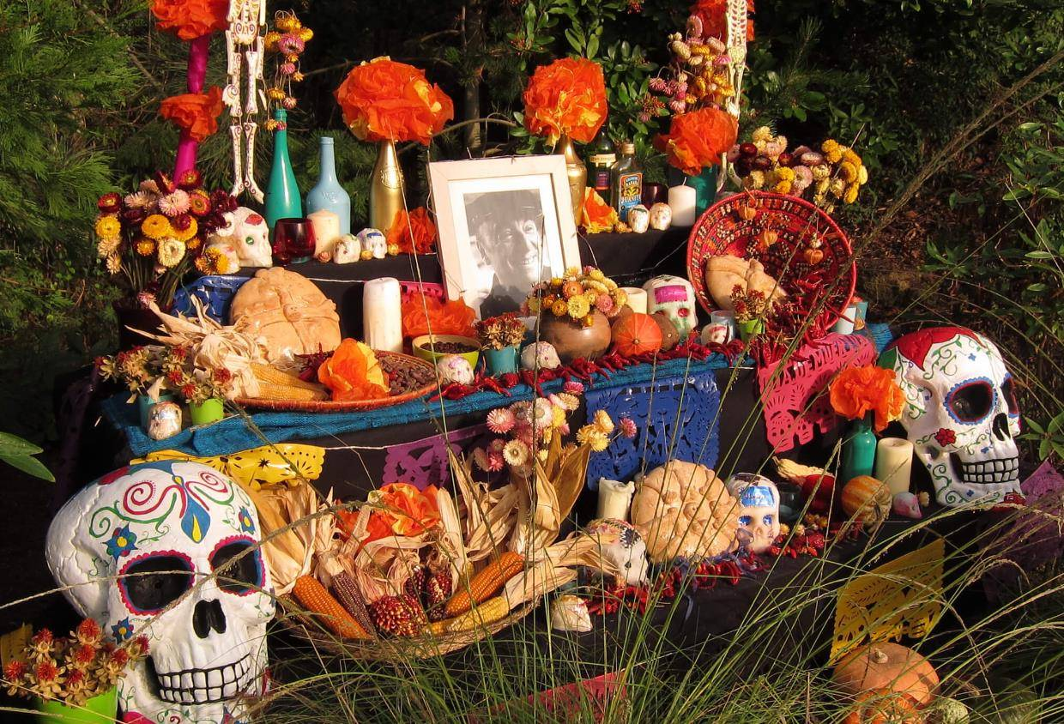
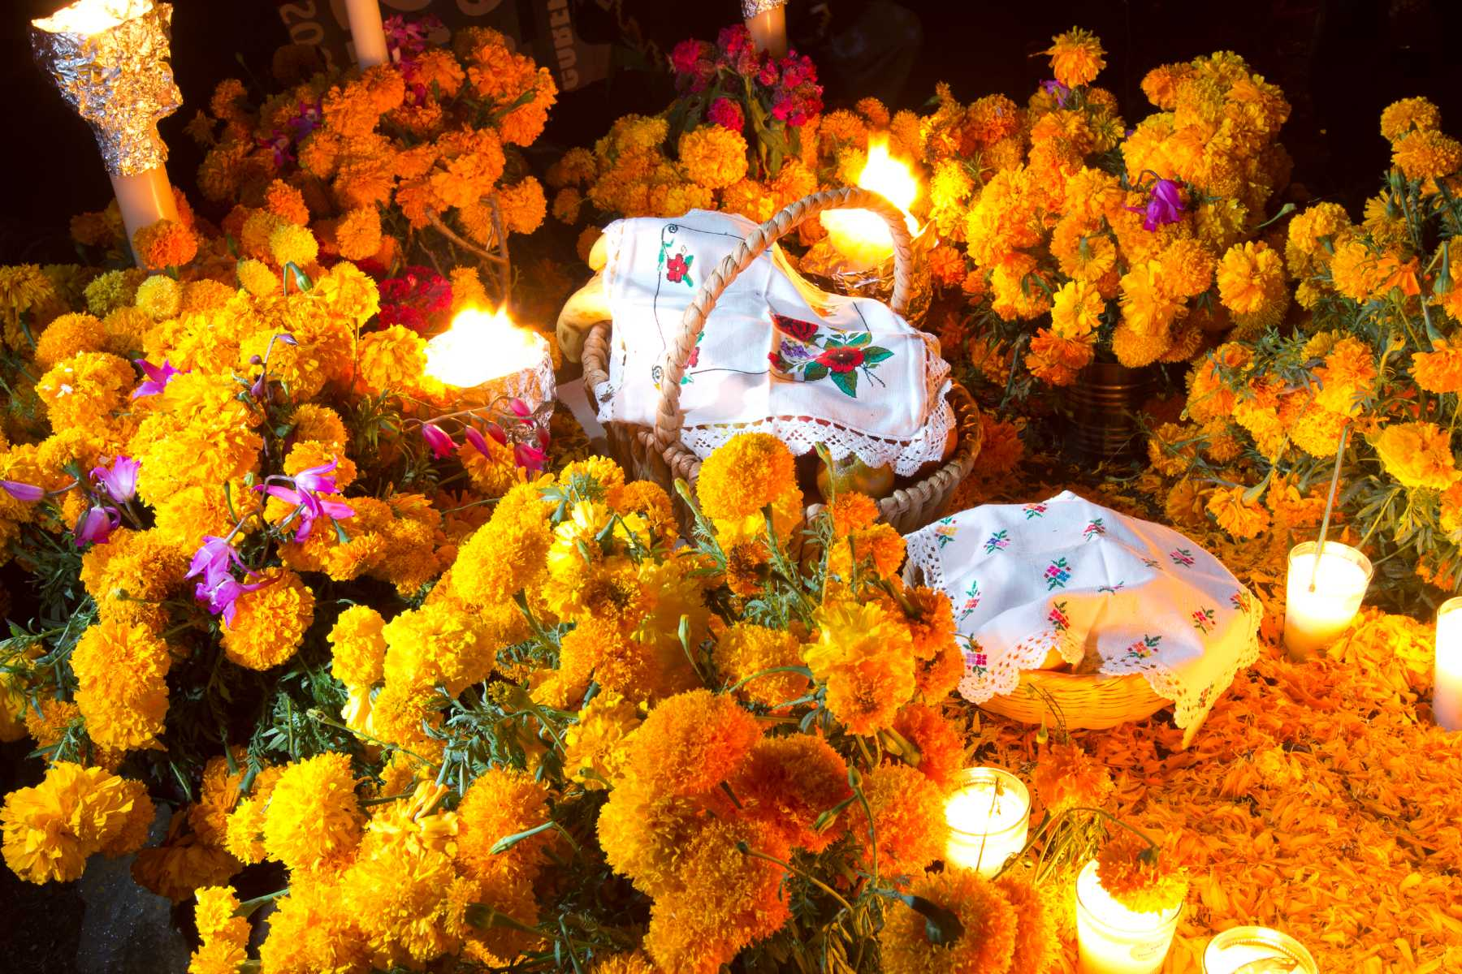

2.2 Ceremonies and Traditions
Elaborate Altars
Marigolds
Music Dance
Sharing Anecdotes

Slide 6
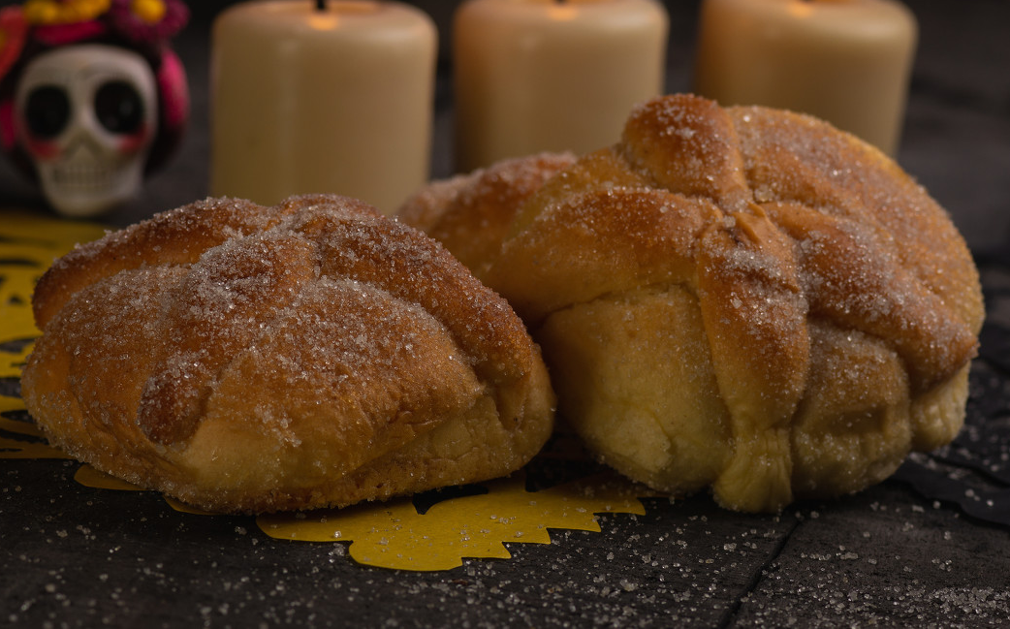
3.1 Culinary Offerings
Bone-Shaped Designs
Connection Between the Living and the Departed
Cyclical Nature of Life and Death

Slide 7
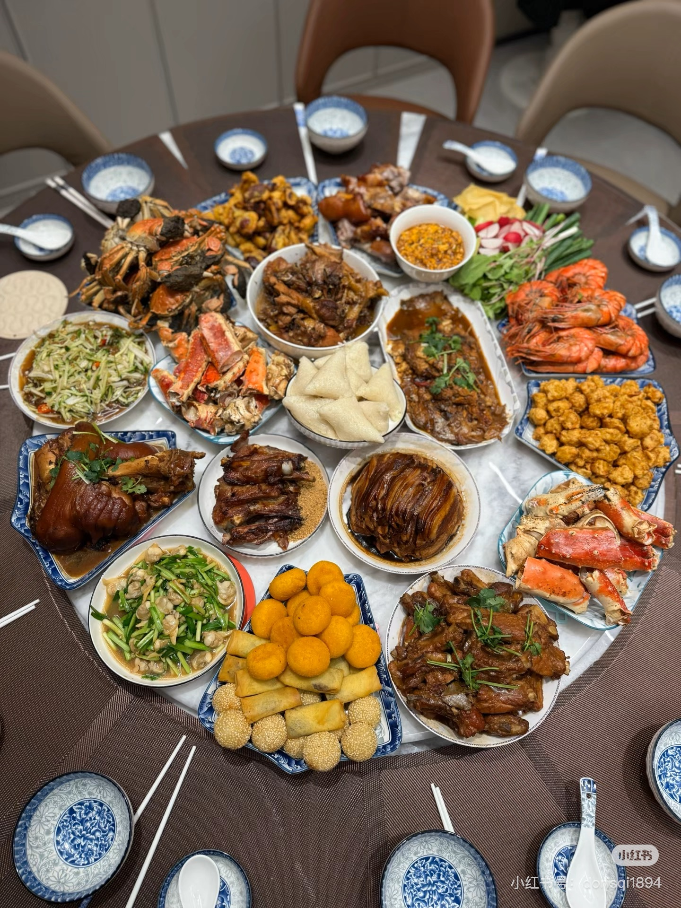
3.2 Culinary Offerings
Zhong YUAN FESTIVAL
The Harvest Season
Eating Fresh Foods
Share Fruits of Labor
Maintain Familial Bonds
Chi Xin

Slide 8
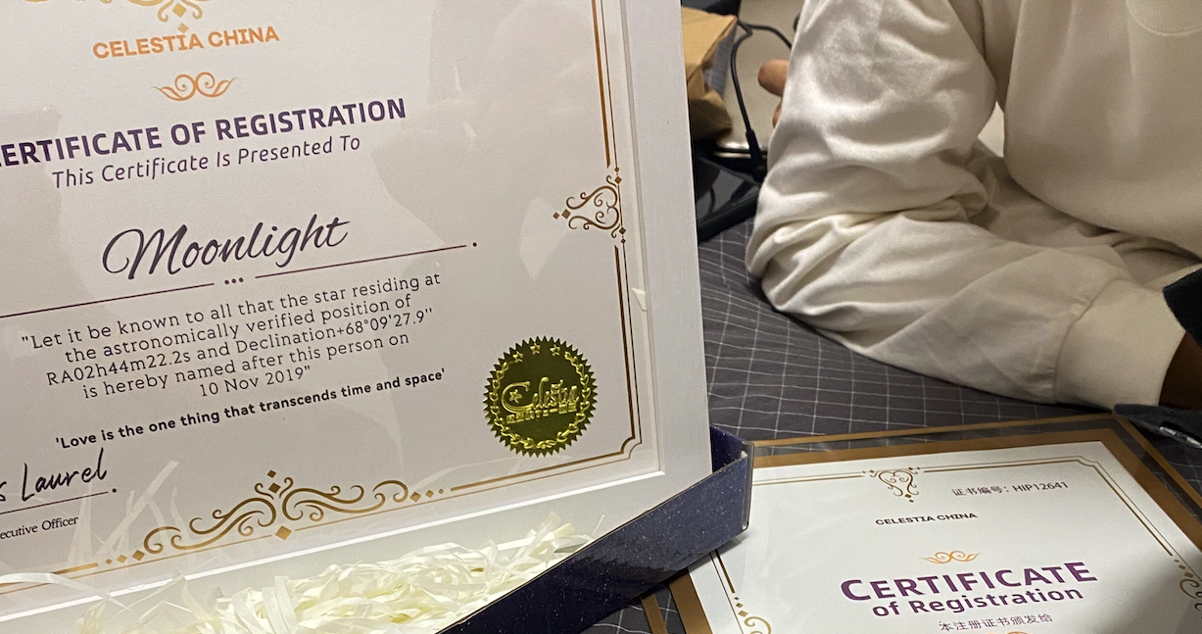
4. Personal Reflection
Love is the one thing that transcends time and space.

