Slide 1

中国文化基础 Foundation of Chinese Cultures for Bachelor Students of Translation Studies
湖南师范大学 2021年3月3日-2021年6月16日 中国文化基础 周三第七和第八节课14:30-16:10，
上课地点：在线
助教：刘廷阳 Liu Tingyang, wiki 助教：陈柯汝 Chen Keru
吴漠汀特聘教授 Distinguished Professor Dr. Martin Woesler
湖南师范大学外国学院 Foreign Studies College, Hunan Normal University

Slide 2
Session 9 第九周
Session Overview 本节概览 and Quizzes
Classroom presentation no.22 on topic Presentation Ancient literature: Four Folk Stories of Ancient China by Guo Yabo 郭亚 https://ks.wjx.top/vj/tjSBAcA.aspx
Classroom presentation no.23 on topic Chinese fairy tales by 李艺浩 Presentation on topic Chinese fairy tales by 李艺浩 Li Yihao https://ks.wjx.top/vj/wUOEtUD.aspx
Classroom presentation no.24 on Presentation Chinese language: Chinese Dialects by Wang Chuyi 王楚仪 https://ks.wjx.top/vm/P2rF4SZ.aspx

Slide 3
Session 9 第九周
Session Overview 本节概览 and Quizzes
10 Aesthetic ideals and social customs: Chinese Marriage Customs Presentation on Marriage Customs by Dù Xīnyǔ 杜心语 (Quiz has been taken)

Slide 4
Session 9 第九周
Please prepare for next time
Panda
Face-Changing in Sichuan Opera
Hulijing

Slide 5
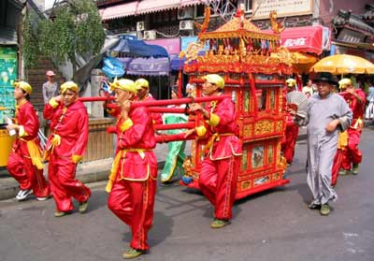
(晚一點：) Marriage (Dù Xīnyǔ 杜心语)

Slide 6
Always here for you! 随时为你们服务
Professor Dr. Martin Woesler 吴漠汀 湖南师范大学特聘教授，博士导师
Office / 办公室: 外国语学院406
国际汉学中心308
Phone / 电话: (150) 1138 8818 (德国+49 178 2073538) Email / 电子邮件: wmt@hunnu.edu.cn

Slide 7
Thank You

