Slide 1
Chinese Dialects
presented by Xie Zhouzhou,
Zhang Keke from English translation
2022.12.23

Slide 2
Brief introduction of Chinese dialects
目录
Main categories of Chinese dialectes
Several representive Chinese dialects

Slide 3
Brief introduction of Chinese dialects
"Dialect" refers to different meanings in different groups, according to the Chinese , "dialect " is both a political concept and a linguistic one, and it is also known as "Vernacular ."China enjoys a vast field and a long history. In the process of historical development, different divisions and unification inevitably occurred in the society, which led to the gradual emergence of diverse and complex dialects system in Chinese. There are many factors contributing to the evolution of dialect, including social, historical and geographical factors, as well as the language itself.

Slide 4
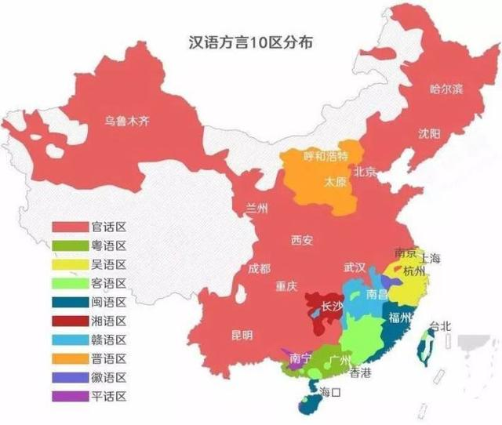
Main categories of Chinese dialectes
According to the dialects, Chinese is divided into two categories: the official dialects and the nine local dialects. Official dialects, namely modern Chinese, are not independent dialects, because they are very similar in pronunciation, vocabulary and grammar to the common language. Other regional dialects differ greatly in pronunciation, vocabulary and grammar, thus forming their own dialect systems. The official dialects include northeast Mandarin, Peking mandarin, Ji Lu mandarin, Jiao-Liao mandarin, Central Plains mandarin, Lan-Yin mandarin, Southwest Mandarin and Jianghuai mandarin. The nine local dialects include Wu dialect, Cantonese, Fujian dialect, Hunan dialect, Hakka, Gan dialect, Hui dialect, Jin dialect and Pinghua.

Slide 5
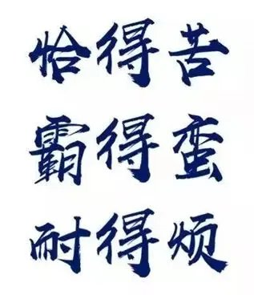
Hunan dialects
Xiangyu, also known as xiang dialect or Hunan dialect, belongs to the sino-tibetan language, and is the main language used by the Hunan people who live in xiangjiang river basin and its branches. Xiangyu is divided into two categories: new Xiangyu and The old Xiangyu. The new Xiangyu is represented by Changsha dialect while the old one is represented by Shuangfeng dialect. The core area of ancient Chu language is located in the middle reaches of the Yangtze River, and Chu language is the ancestor language of Xiang language. Modern Xiangyu speakers are mainly distributed in a considerable part of Hunan province in Mainland China, including Changsha, Zhuzhou, Xiangtan, Yueyang, Yiyang, Loudi, Hengyang, Shaoyang, Yongzhou and so on. In 2010, the number of Xiangyu-speaker was estimated to be about 45 million. The regional dialects of Hunan province include Hunan, Southwest Official, Gan, Hakka, and Xiangxiang, southern Hunan dialect.Xiangyu is the main dialect of Hunan Province. Hunan province is a region that has diverse dialects.

Slide 6
Cantonese
Yueyu, or Cantonese, Guangdong dialect and Tang dialect, is commonly known as "baihua". It is a Chinese dialect in the Chinese-Tibetan Chinese language family. Cantonese is the mother tongue of the Guangfu nationality, an important carrier of the Guangfu culture of the Han nationality, and one of the basic symbolic cultural identities of the Guangfu nationality. Cantonese has a complete language system consisting of nine tones and six volumes of tones, retaining many characteristics of Middle Ancient Chinese. Besides Putonghua, it is the only Chinese language that has been studied independently by foreign universities.
As for the origin of Cantonese, there are different opinions. Some says that it originated from the Northern Mid-plain dialect and others the Chu language from the State of Chu. Cantonese is one of the southern dialects that retains more middle Ancient Chinese elements than other dialects, among which the most prominent feature is that it relatively retains the universal middle Ancient Chinese "Ru Sheng", and its initials, finals and tones have a good correspondence with the ancient Chinese standard rhymes in"Qu Yun" and "Guang Yun".

Slide 7
References
Peng Jianguo 彭建国(2006). 《湘语音韵历史层次研究》. [ A Study on the Historical perspective of Xiang Phonology]. ”湖南大学出版社”[Hunan University Press]. 25-26.
Li Rong 李荣(1989). 汉语方言的分区. [The division of Chinese dialects] (04)：241-259.
Julie M. Groves (2008). Language or Dialect—or Topolect? A Comparison of the Attitudes of Hong Kongers and Mainland Chinese towards the Status of Cantonese . SINO-PLATONIC PAPERS. 1-60.

Slide 8
Thanks for your attention

