Slide 1
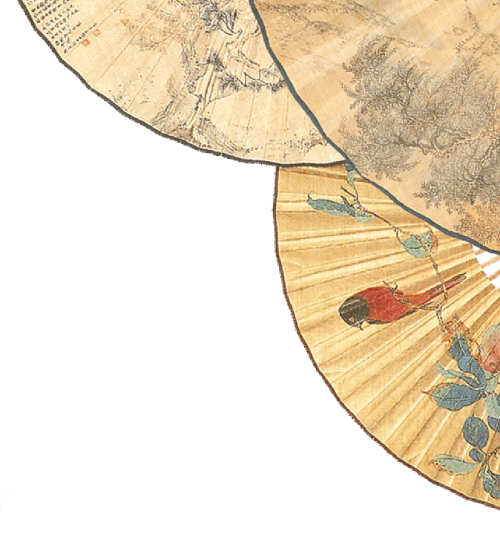

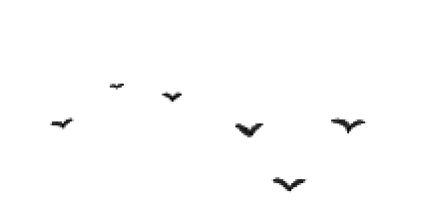
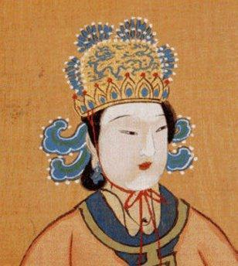

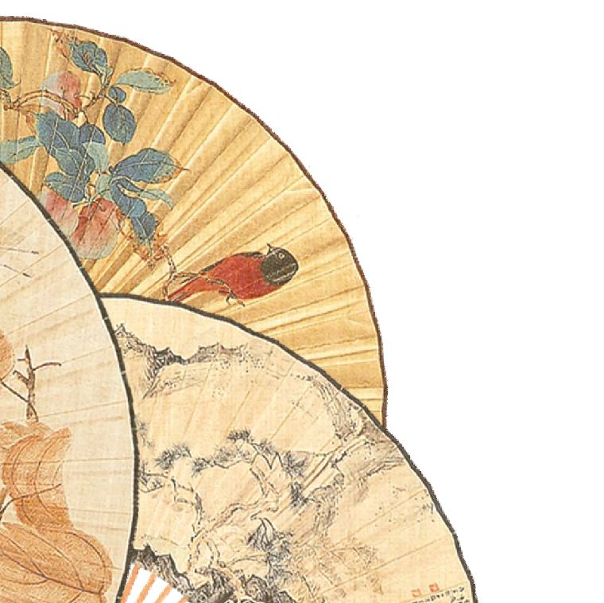

Wu Zetian -
China's Only Female Emperor
Song Xin 2025.5.6
Notes:
wps稻壳儿佳誉设计原创链接：http://chn.docer.com/works?userid=219874625_1

Slide 2

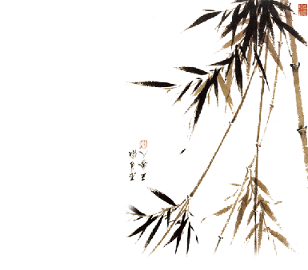
01 Brief introduction
14 - Enter palace
26 - Become concubine（妃）
32 - Reign empress
60 - Found dynasty
66 - Rule sovereign
81 - Relinquish throne
82 - Pass away
The only legitimate female emperor of China (624.2.17-705.12.16), Wu zetian reigned for 15 years(690-705).
Notes:
wps稻壳儿佳誉设计原创链接：http://chn.docer.com/works?userid=219874625_5_8

Slide 3
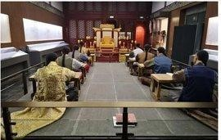
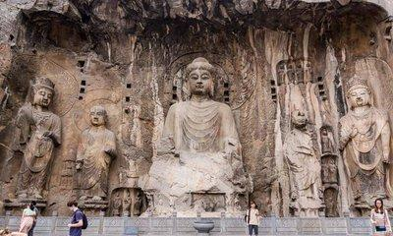
02 Major achievements
and controversies
•Palace examination（殿试）
The Longmen Grottoes （龙门石窟）

Slide 4
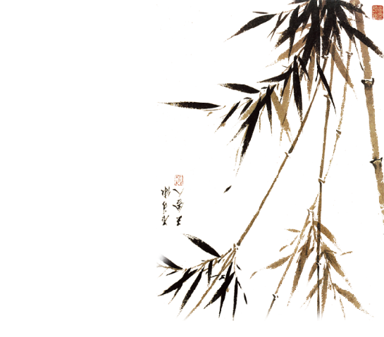
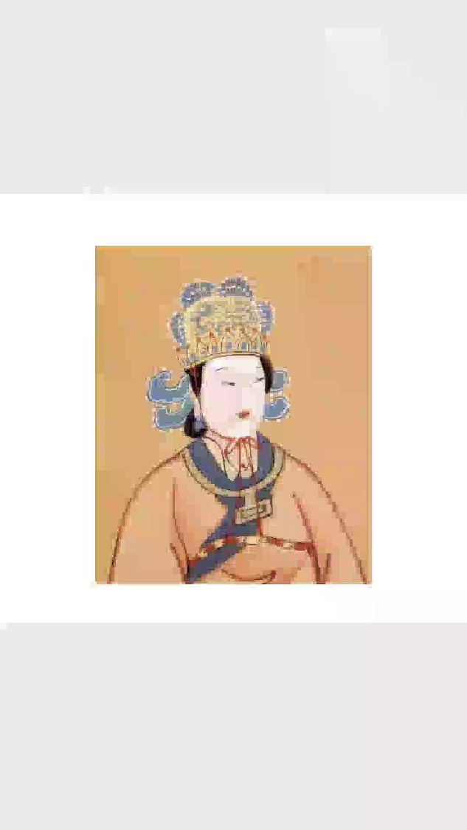
03 Cultural Decoding:
Three Chinese Wisdoms
Notes:
wps稻壳儿佳誉设计原创链接：http://chn.docer.com/works?userid=219874625_1

Slide 5

03 Cultural Decoding:
Three Chinese Wisdoms
1. The magic of Chinese characters
which Chinese character she created
is still in use
Notes:
wps稻壳儿佳誉设计原创链接：http://chn.docer.com/works?userid=219874625_1

Slide 6
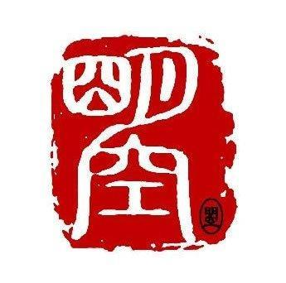
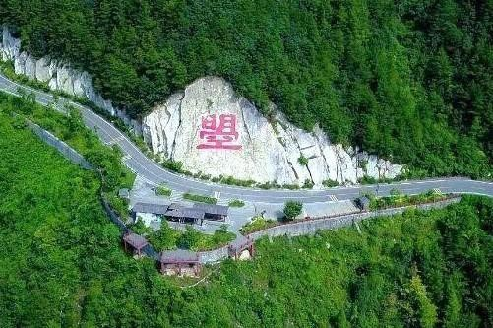
03 Cultural Decoding:
Three Chinese Wisdoms
1. The magic of Chinese characters"曌"zhào
日(sun) +月 (moon) +空 (sky)
= 日月当空，普照大地
(I shine over everything!)
Wu Zhao (武曌)
Notes:
wps稻壳儿佳誉设计原创链接：http://chn.docer.com/works?userid=219874625_1

Slide 7
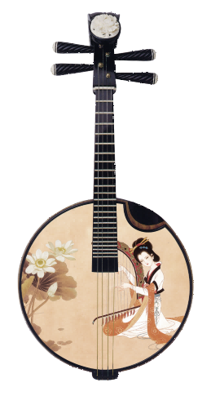
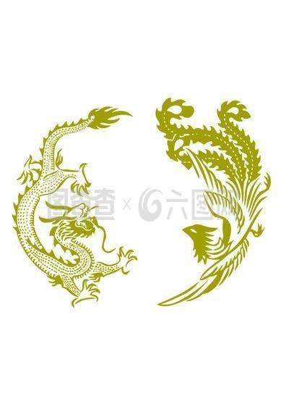
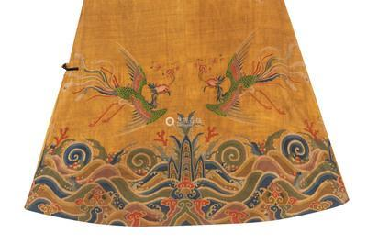
03 Cultural Decoding:
Three Chinese Wisdoms
2. The wisdom of Yin（阴） and Yang（阳） balance
Notes:
wps稻壳儿佳誉设计原创链接：http://chn.docer.com/works?userid=219874625_1

Slide 8
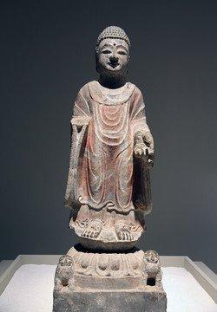
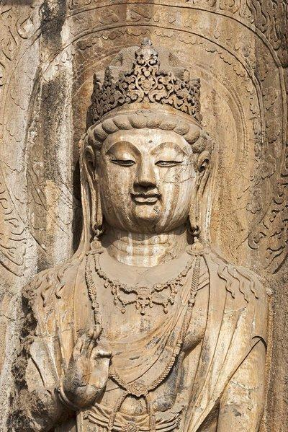
03 Cultural Decoding:
Three Chinese Wisdoms
3. The interweaving of tradition and change
➩
Notes:
wps稻壳儿佳誉设计原创链接：http://chn.docer.com/works?userid=219874625_1

Slide 9

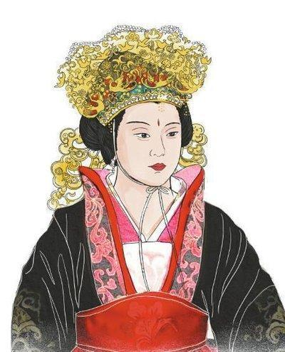
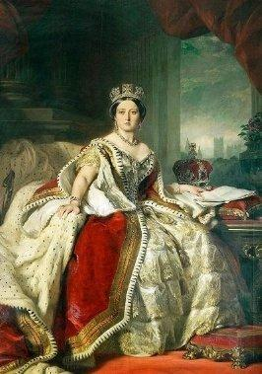
04 A comparison with Queen Victoria
Similarities
•Long reigns
•Political influence
•Patronage of culture
•Succession challenges
•Female rulers in male-dominated eras
Notes:
wps稻壳儿佳誉设计原创链接：http://chn.docer.com/works?userid=219874625

Slide 10
04 A comparison with Queen Victoria
Differences
•Rise to power:Self-made, ruthless vs Inherited throne
•Governance: Absolute rule, dynasty founder vs Constitutional monarch
•Legacy: Controversial, Zhou Dynasty vs Symbol of British Empire
Emperor Wu zetian vs
Queen Victoria
Notes:
wps稻壳儿佳誉设计原创链接：http://chn.docer.com/works?userid=219874625

Slide 11
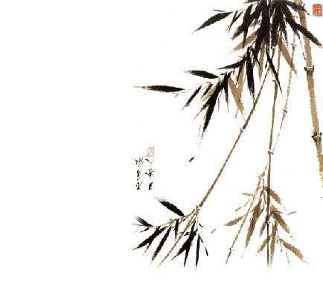
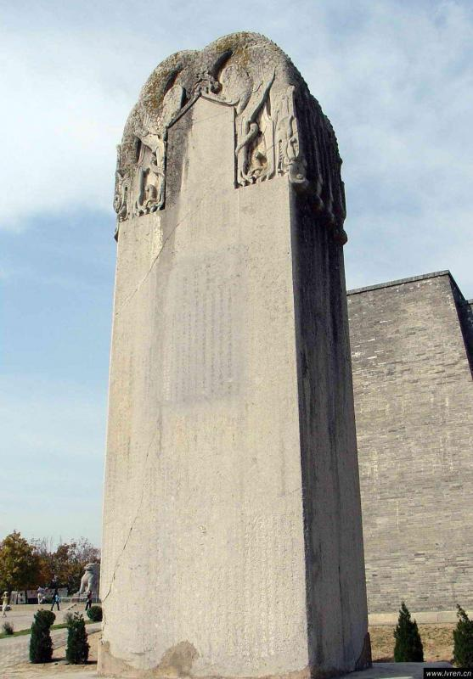
05 Historical Significance
•The Wordless Stele （无字碑）

Slide 12
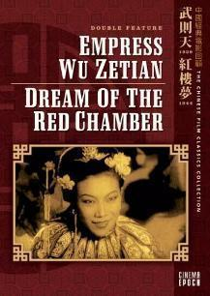
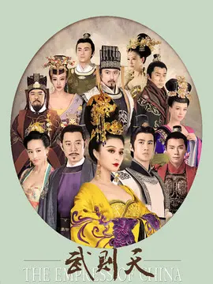
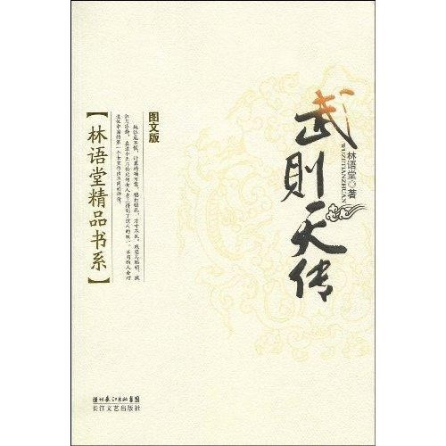
05 Historical Significance

Slide 13
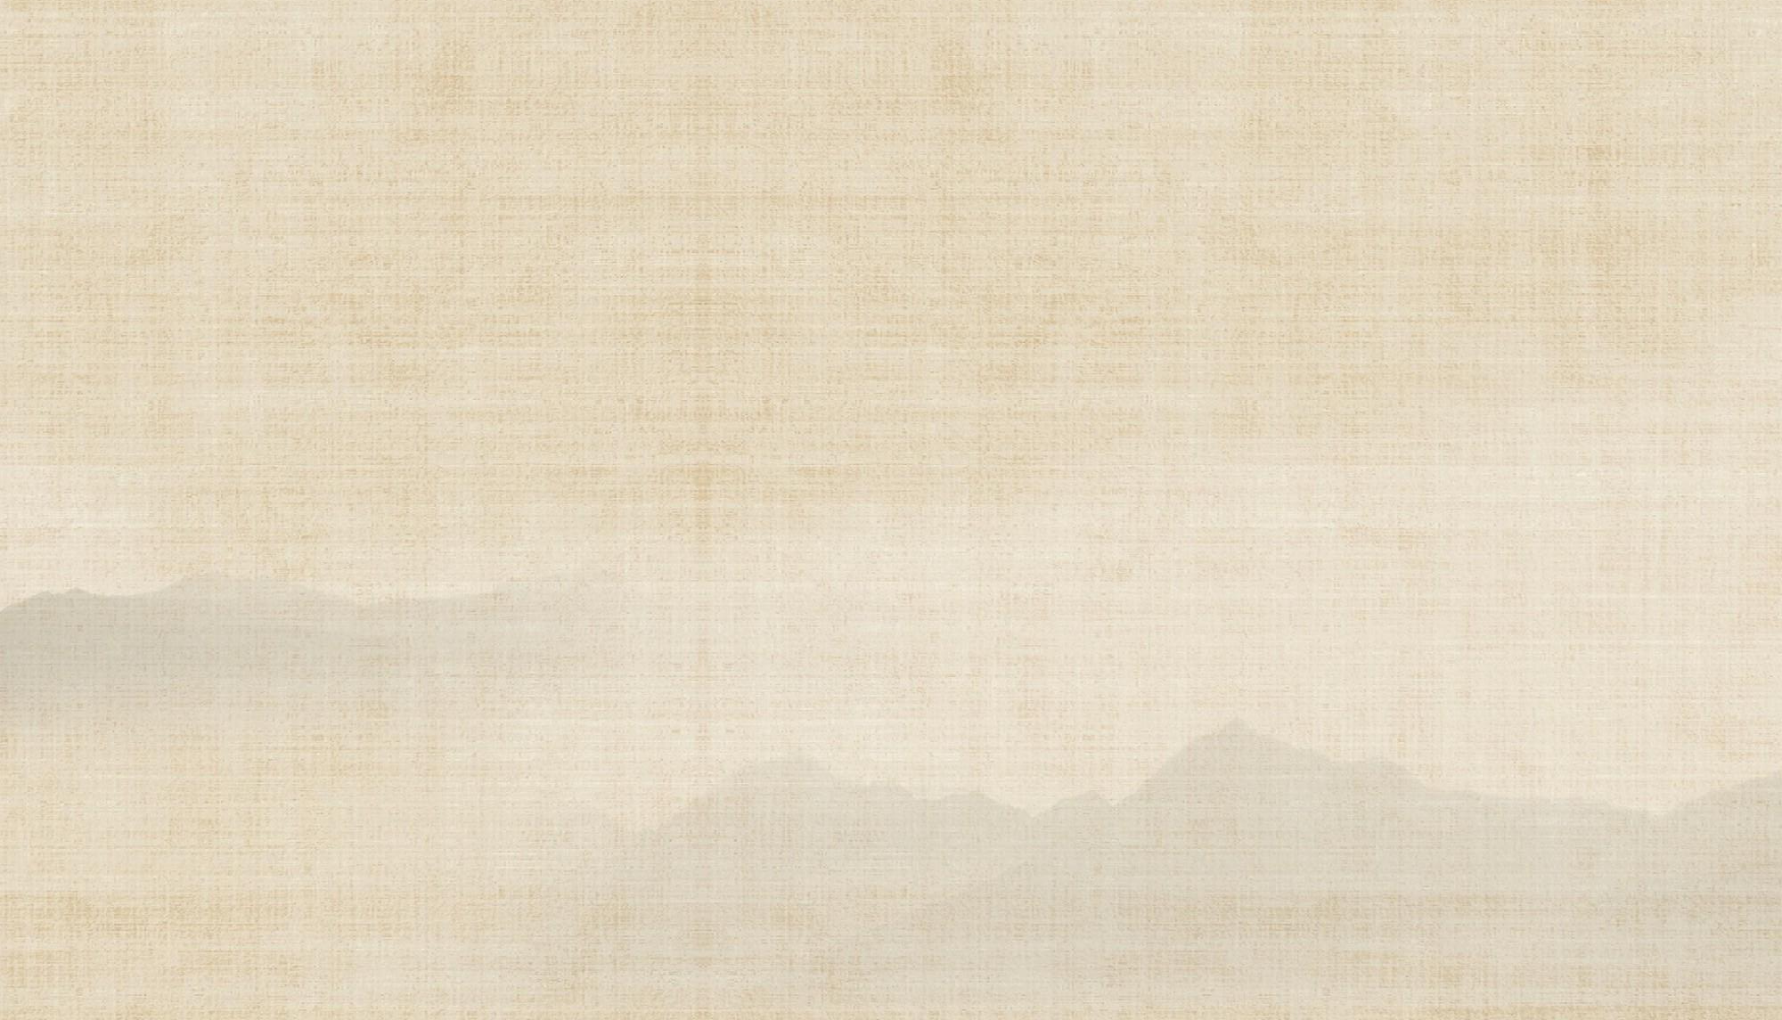
Thank you!
Notes:
wps稻壳儿佳誉设计原创链接：http://chn.docer.com/works?userid=219874625_1

