Slide 1

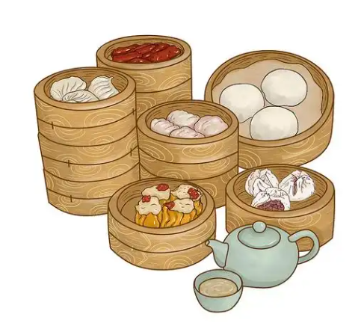
广东早茶
Guangdong Morning Tea Culture
speaker：Zheng Jinlian 郑锦莲

Slide 2
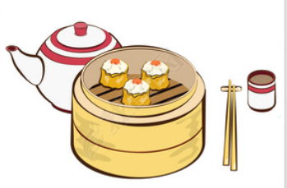
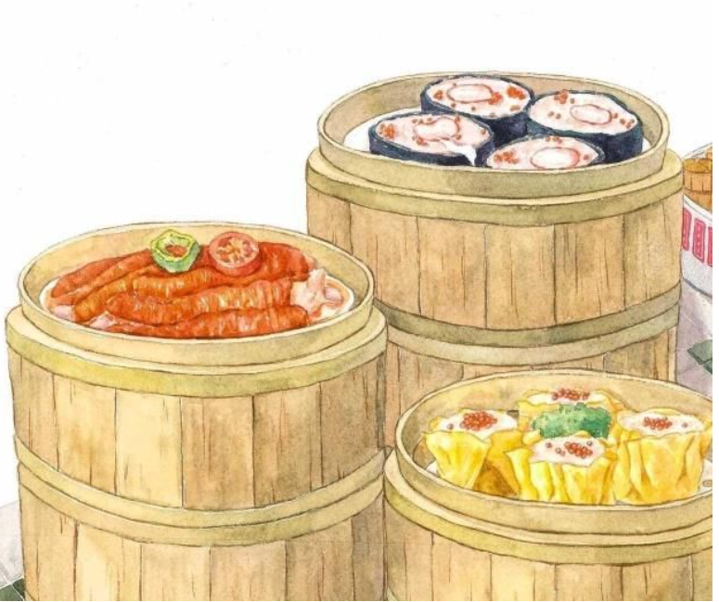
Yum Cha 饮茶
Tan Cha 叹茶
drinking the morning tea
enjoying the morning tea

Slide 3

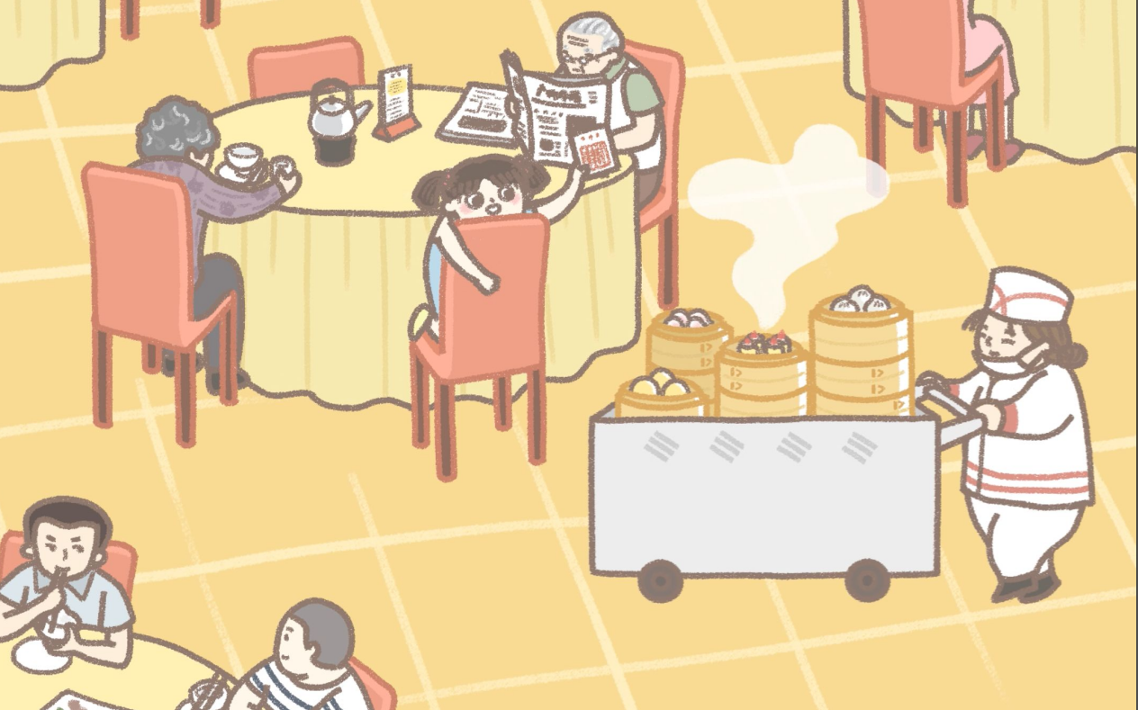
dim sum order sheet
点心单
Har Gow 虾饺
Siu Mai 烧麦
Char Siu Bao 叉烧包
dim sum trolleys
点心车

Slide 4

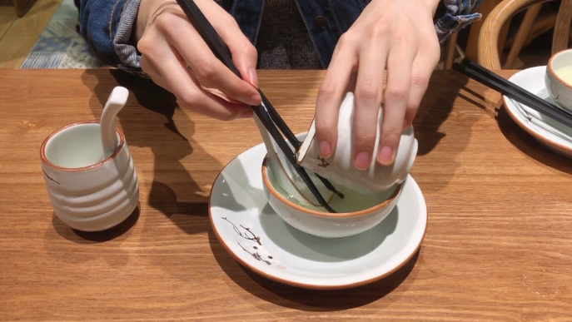
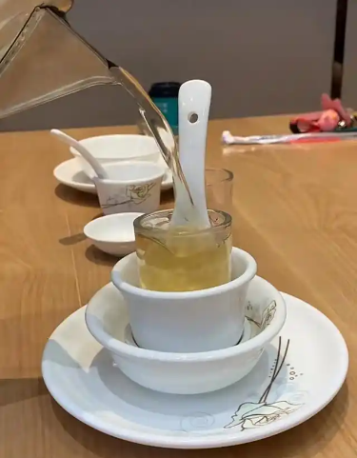
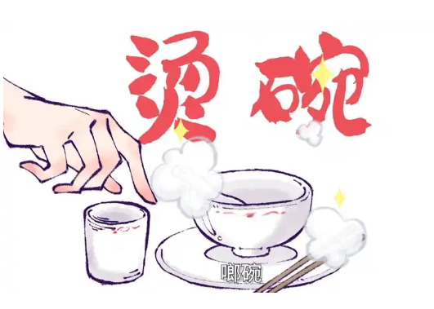
rinsing bowls and chopsticks
啷碗筷

Slide 5

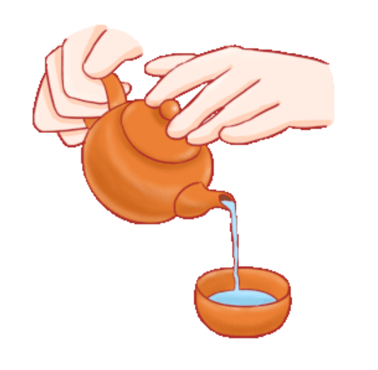
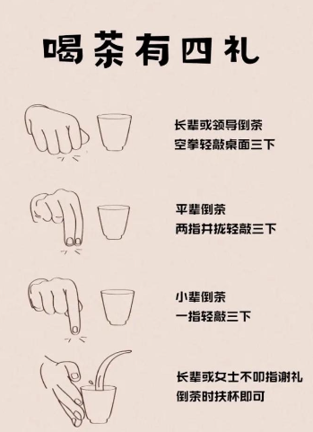
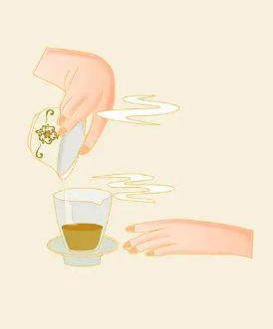
Kou Cha Li（tea tapping ritual）
叩茶礼
谢谢~

Slide 6
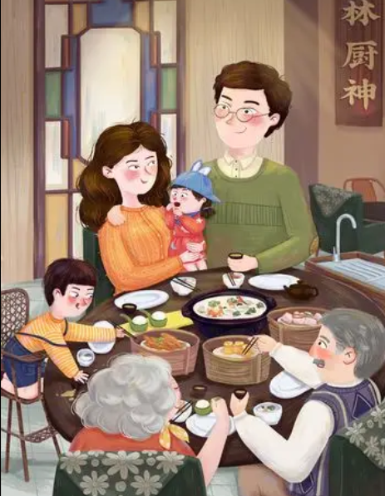
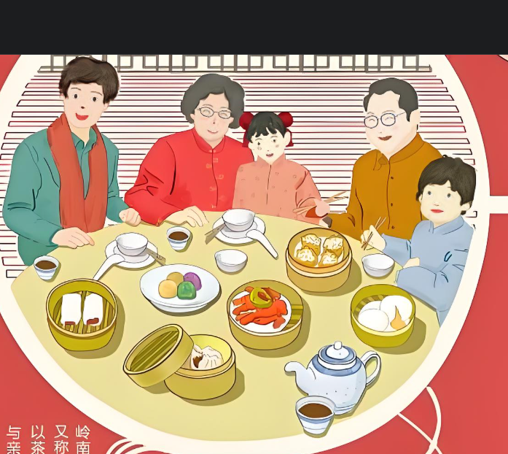
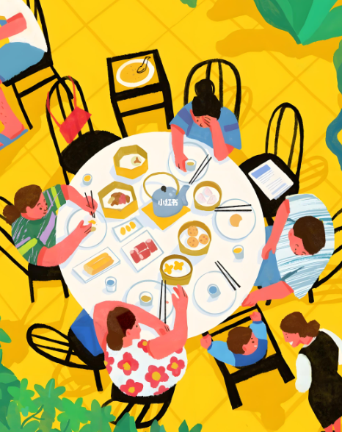

Slide 7



Thanks！

Slide 8
术语表
叩茶礼 | Tea tapping ritual/Tea Tapping Custom
用食指和中指轻拍桌子 | tap the table with your index and middle fingers
烫碗筷（用茶水冲洗杯子、碗筷） | rinsing utensils with hot tea/cleaning bowls and chopsticks with hot tea
广东早茶 | Cantonese morning tea/Guangdong morning tea
饮茶 | Yum Cha, which means drinking tea
叹茶 | Tan Cha, which means enioys tea
点心单 | dim sum order sheet
在点心单上做标记/盖章 | mark them on the sheet or stamp the card
茶水盆子 | rinsing bowl/utensil washing basin
倒茶，斟茶 | pouring tea
点心车 | dim sum trolleys
虾饺 | Har Gow (shrimp dumplings)
猪肉饺 | Siu Mai (pork dumplings)
叉烧包 | Char Siu Bao(barbecue pork buns)

