Slide 1

Translation Development
in New China
新中国翻译的发展
By Zheng Huajun & Li Luyi

Slide 2
CONTENTS
01
Overview of development status
02
Exploration of development reasons
03
Review and reflection on development

Slide 3
Overview of development status
01
1、1949-1957 (explorations period of New China)
2、1957-1966 (ten years before the Cultural Revolution)
3、1966-1978 (cultural Revolution)
4、1978- (after the reform and opening up)

Slide 4
1949-1957
(explorations period of New China)
Before the reform and opening up, most translation research papers were published during this period.
1
1957-1966
(ten years before the Cultural Revolution)
During this period, the attention and support of the relevant departments to translation work declined but continued until the end of the Cultural Revolution.
2
1966-1978
(Cultural Revolution)
As a result of the country's foreign exchange needs, translation activities have not stopped, but the form and scale are controlled.
3
1978-
（after the reform and opening up）
With the rapid improvement of China's international status, translation practice and translation studies have been developing rapidly.
4

Slide 5
Exploration of development reasons
02
Social progress and ideological liberation promote
the development of translation
The growth of translation research team
and discipline construction

Slide 6

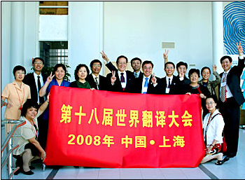
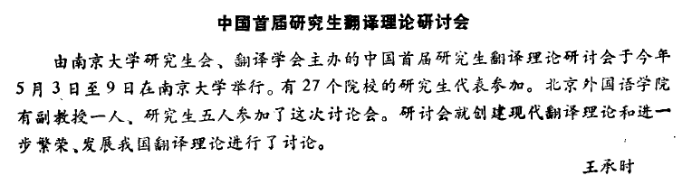

The first graduate seminaron
of translation theory
1987
The International Federation of Translators BBS Asia
1995
1995
The 18th world conference
on translation
2008

Slide 7
1) Development of research team
2）Construction of translation studies
(1) Three aspects
(2) Relevant journals
(3) Translation and Publishing Company
(4) Cultivation of talents

Slide 8
Review and reflection on development
03
SCharacteristics of translation studies in New China
Reflections on the development of Translation
in New China

Slide 9
Thank You For Your Watching
Notes:
更多精品素材：http://shop248912786.taobao.com/index.htm （下拉可隐藏）

