Slide 2
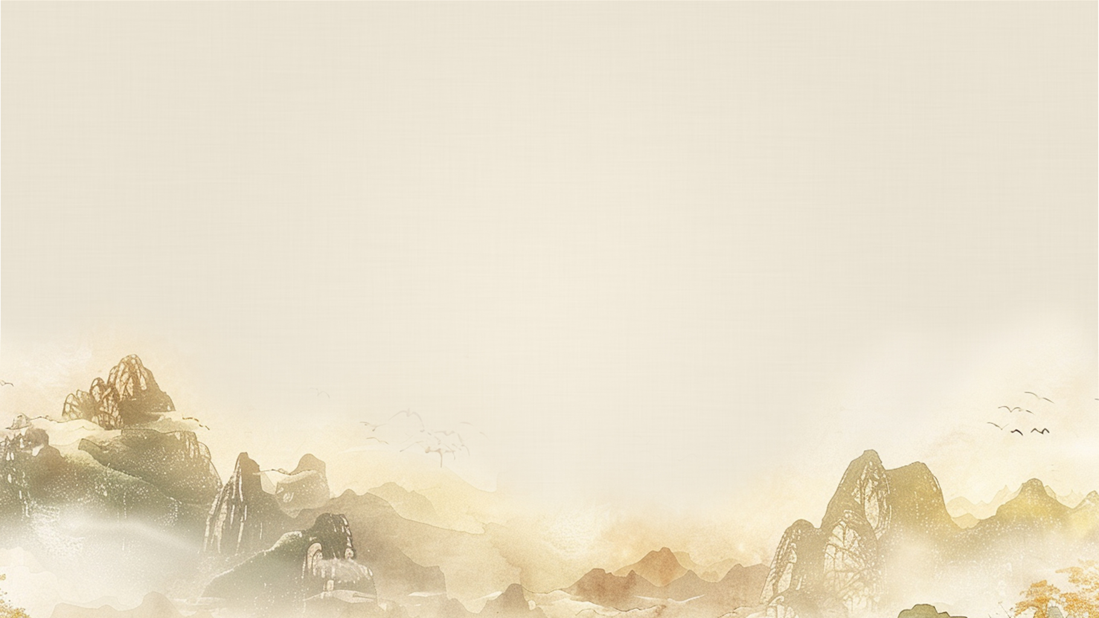


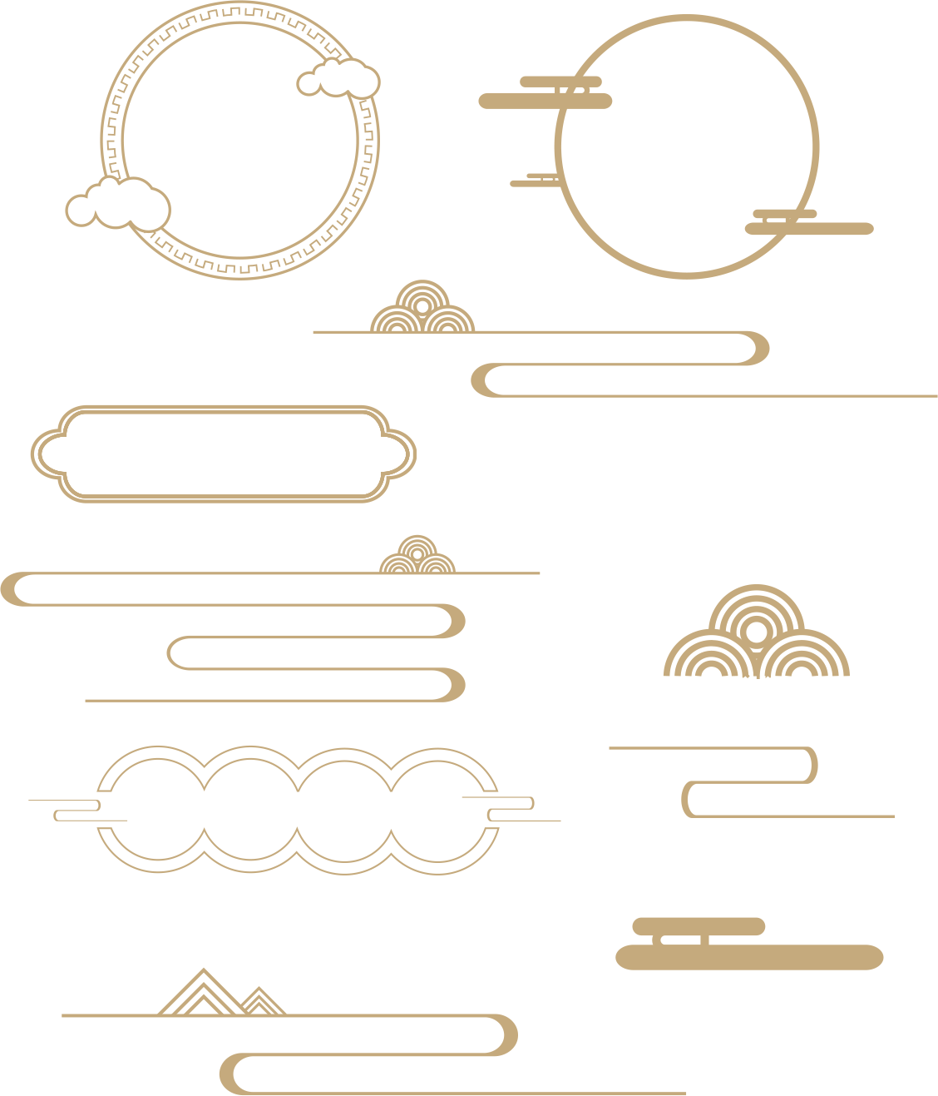
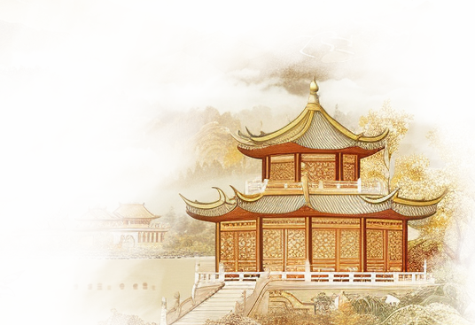

02
Garden structures

Slide 3
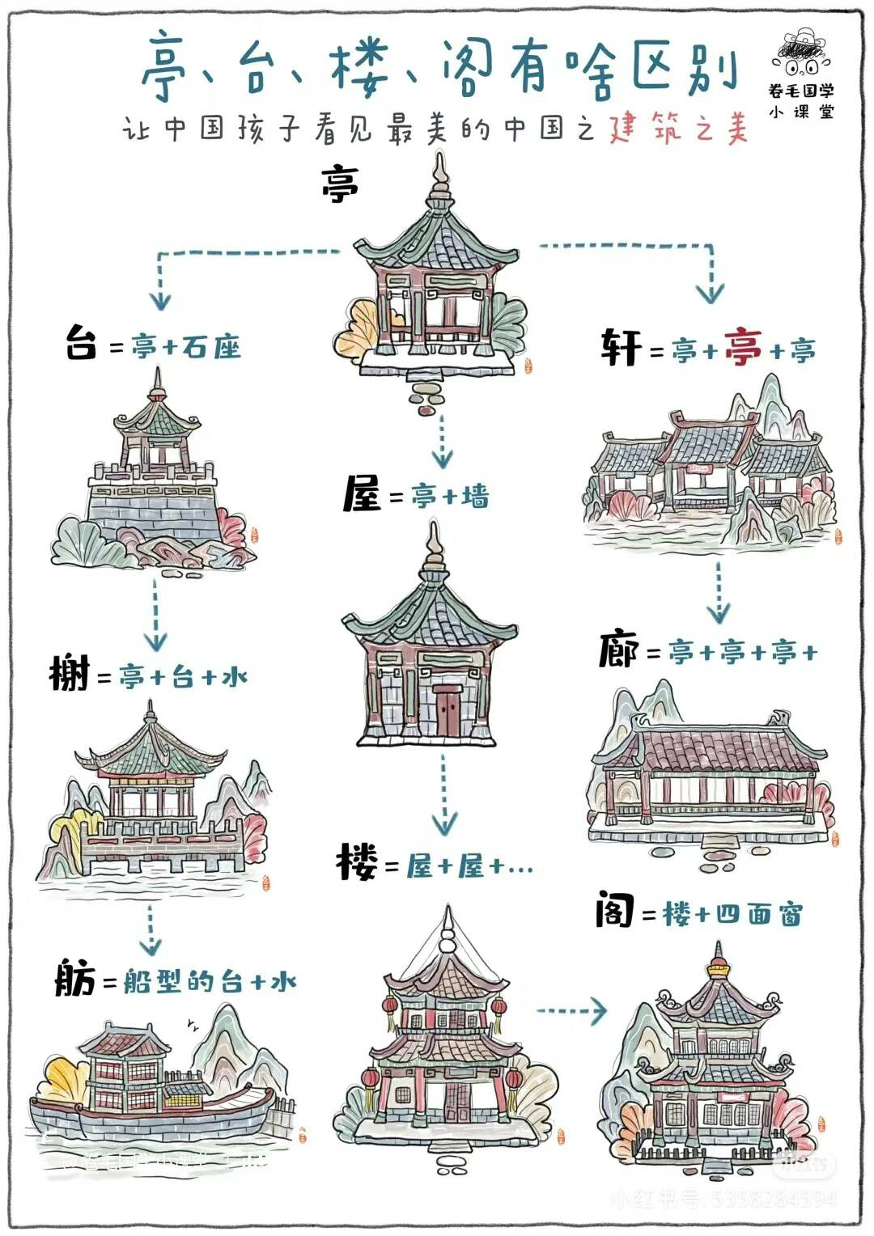
Architectures
Chinese gardens are celebrated for their elegant and harmonious architecture, which includes pavilions, terraces, towers, and pavilions.
Pavilions (亭): Pavilions are open-sided structures . They serve as places for rest and contemplation, offering beautiful views of the surrounding landscape. Pavilions are typically small and can be round, square, or polygonal in shape, often with a pitched roof.
Terraces (台): Terraces are flat, elevated platforms that can be used for various purposes, such as viewing platforms or for placing other structures like pavilions or towers. They are often built on slopes to take advantage of the natural topography and provide a vantage point for enjoying the garden's scenery.
Towers (楼): Towers are multi-storey buildings, often used for panoramic views of the garden or the surrounding landscape. They can be square, round, or octagonal and are usually more elaborately decorated than pavilions.
Tower Pavilions (阁): Tower Pavilions in the context of Chinese gardens are similar to towers but are typically smaller and more ornate. They are often used as a place for scholarly pursuits, such as reading, writing, or painting, and may house collections of calligraphy or paintings.

Slide 4
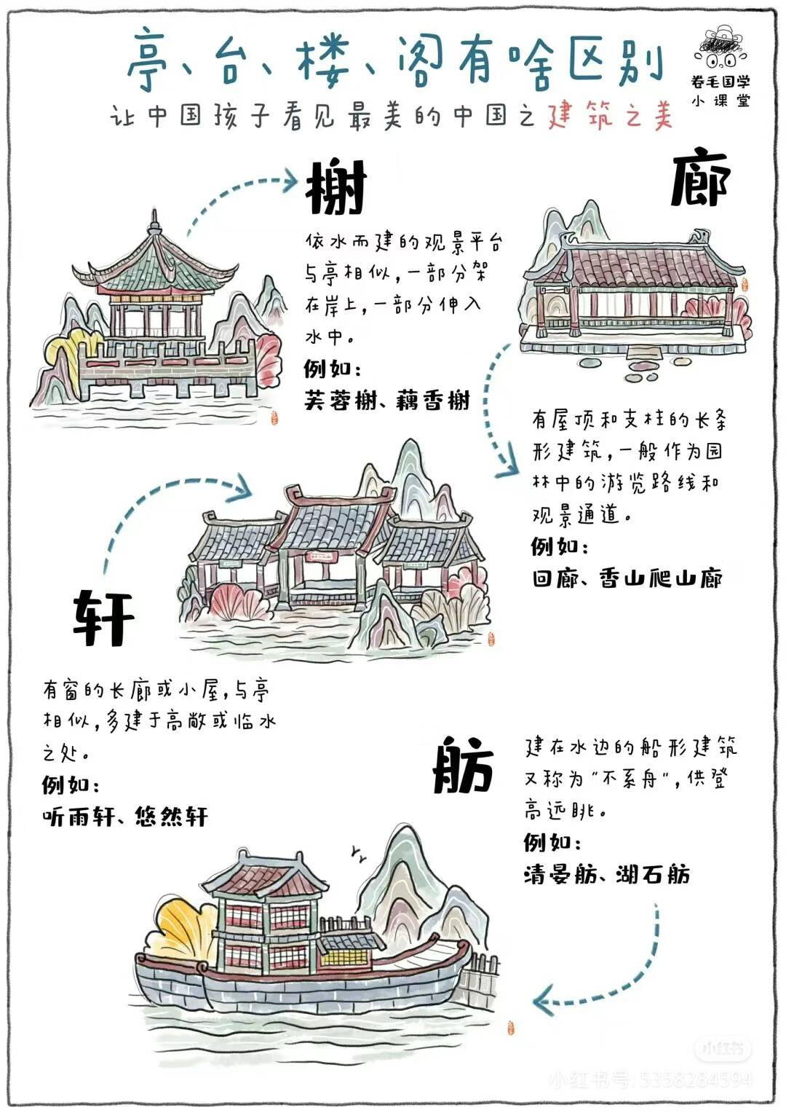
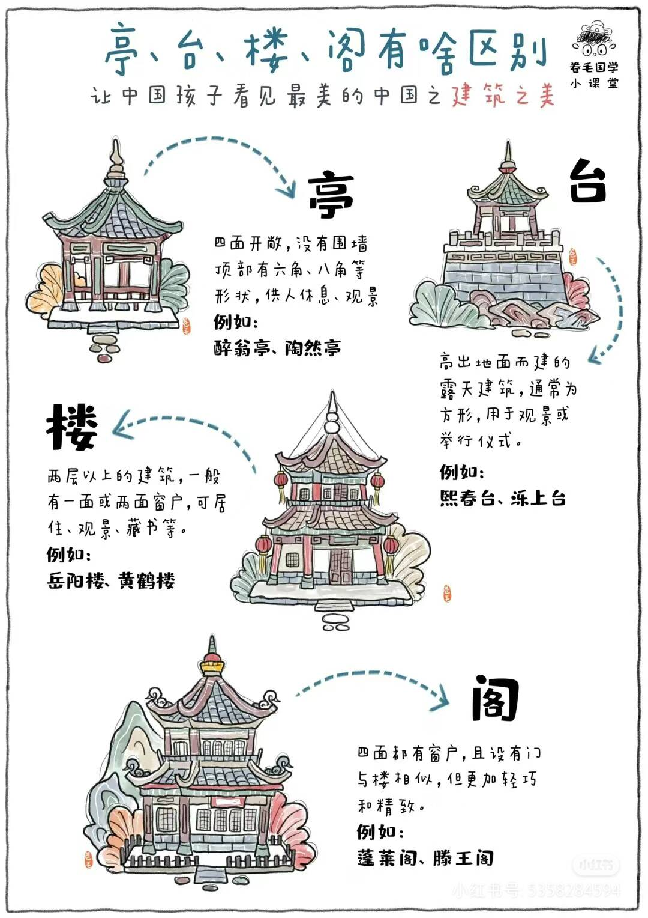

Slide 5
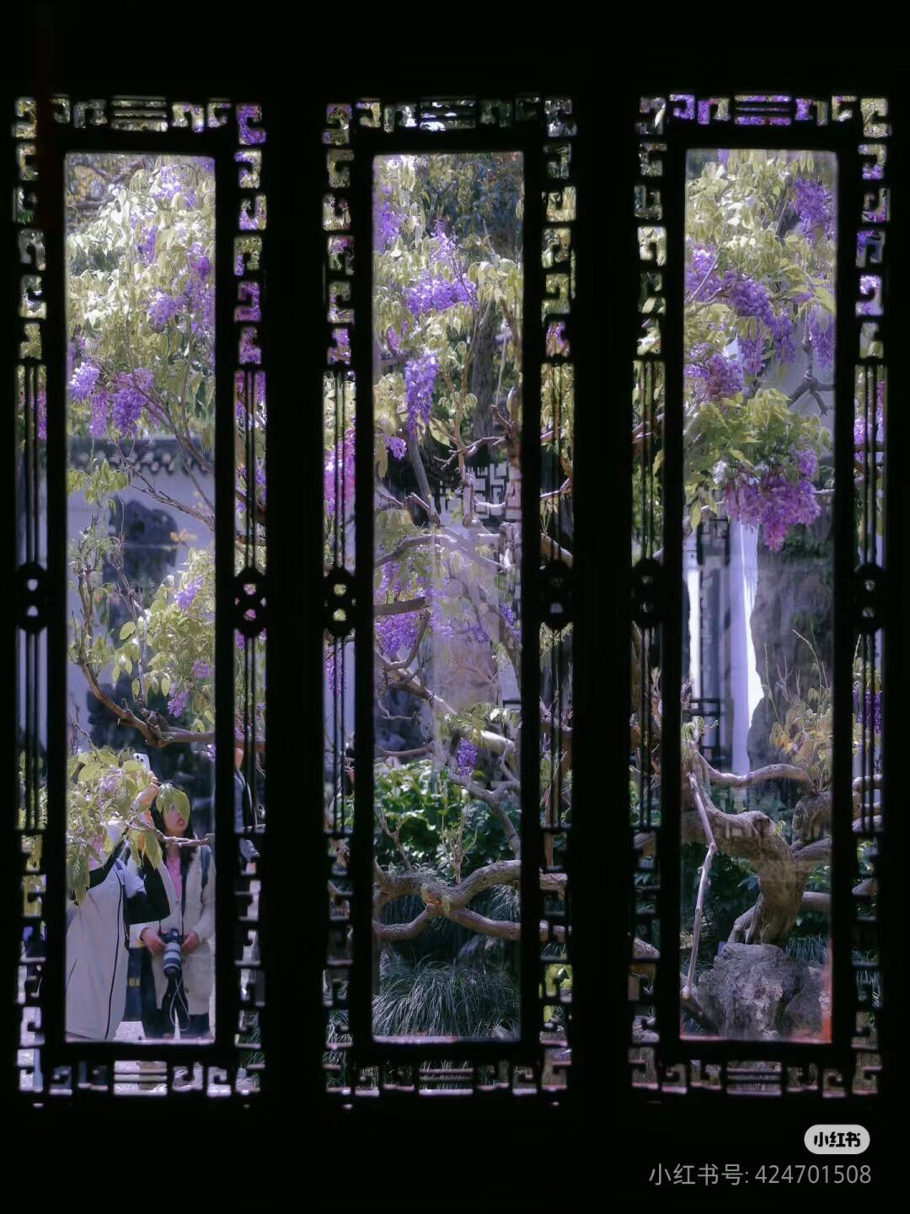
Windows
In Chinese gardens, the window is a distinctive architectural element that serves both decorative and practical purposes. These windows come in a variety of designs and patterns, often featuring plants, animals, calligraphy, and geometric shapes, symbolizing good fortune and auspiciousness.
The main functions of windows include decorating walls, providing ventilation and light, framing views, and facilitating movement. The design and layout of windows imbue every corner of the garden with poetic and picturesque charm, allowing one to experience the infinite beauty of nature within a confined space.

Slide 6
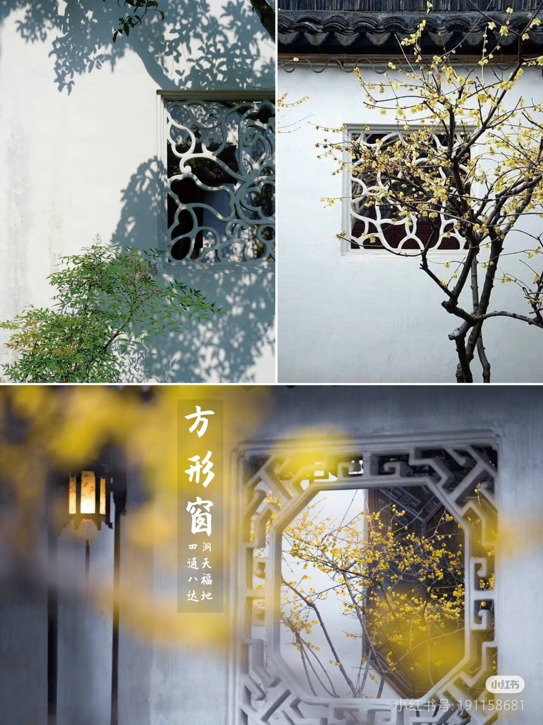
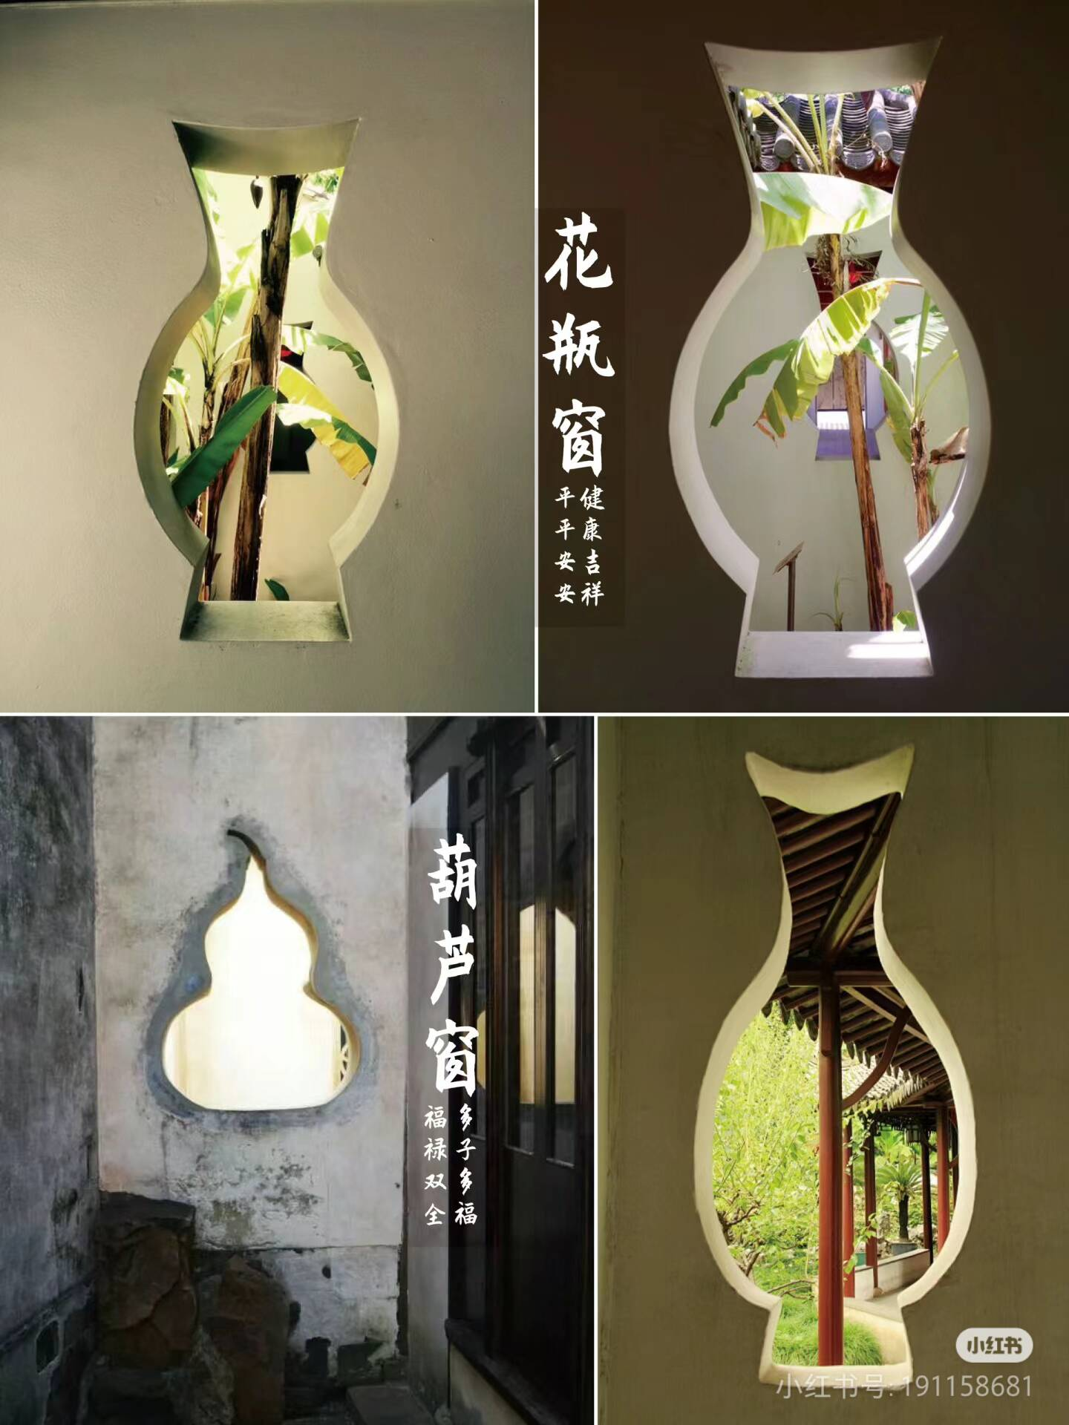
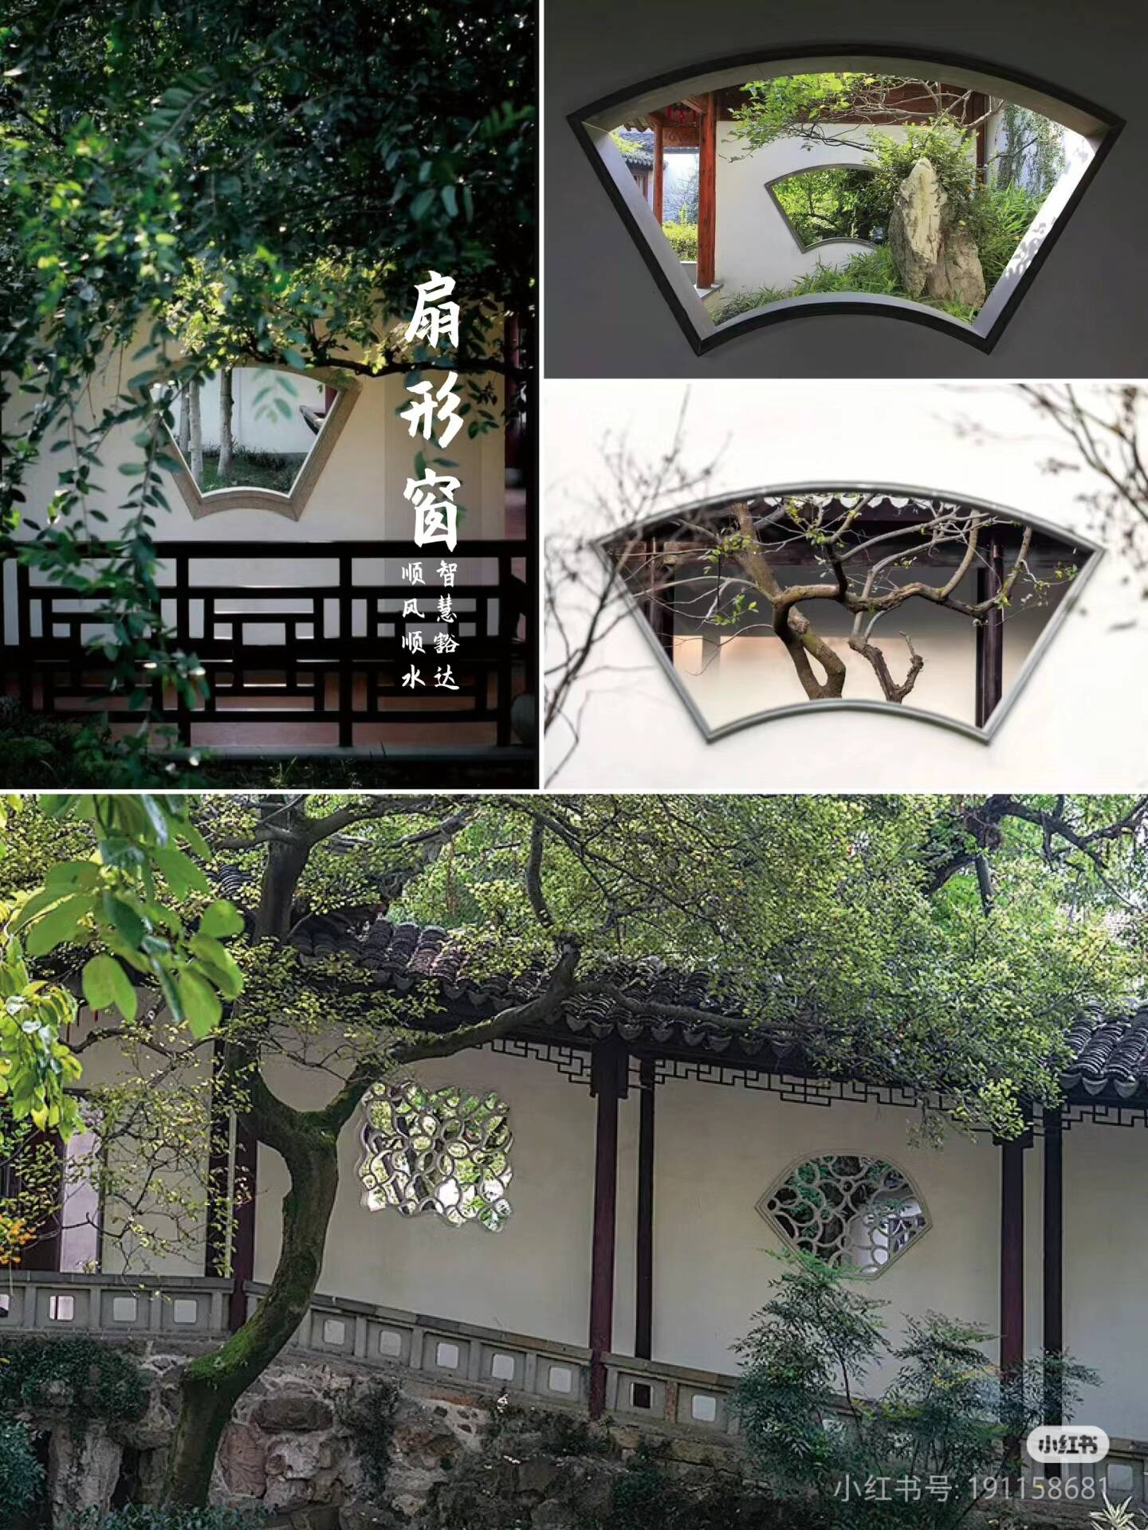
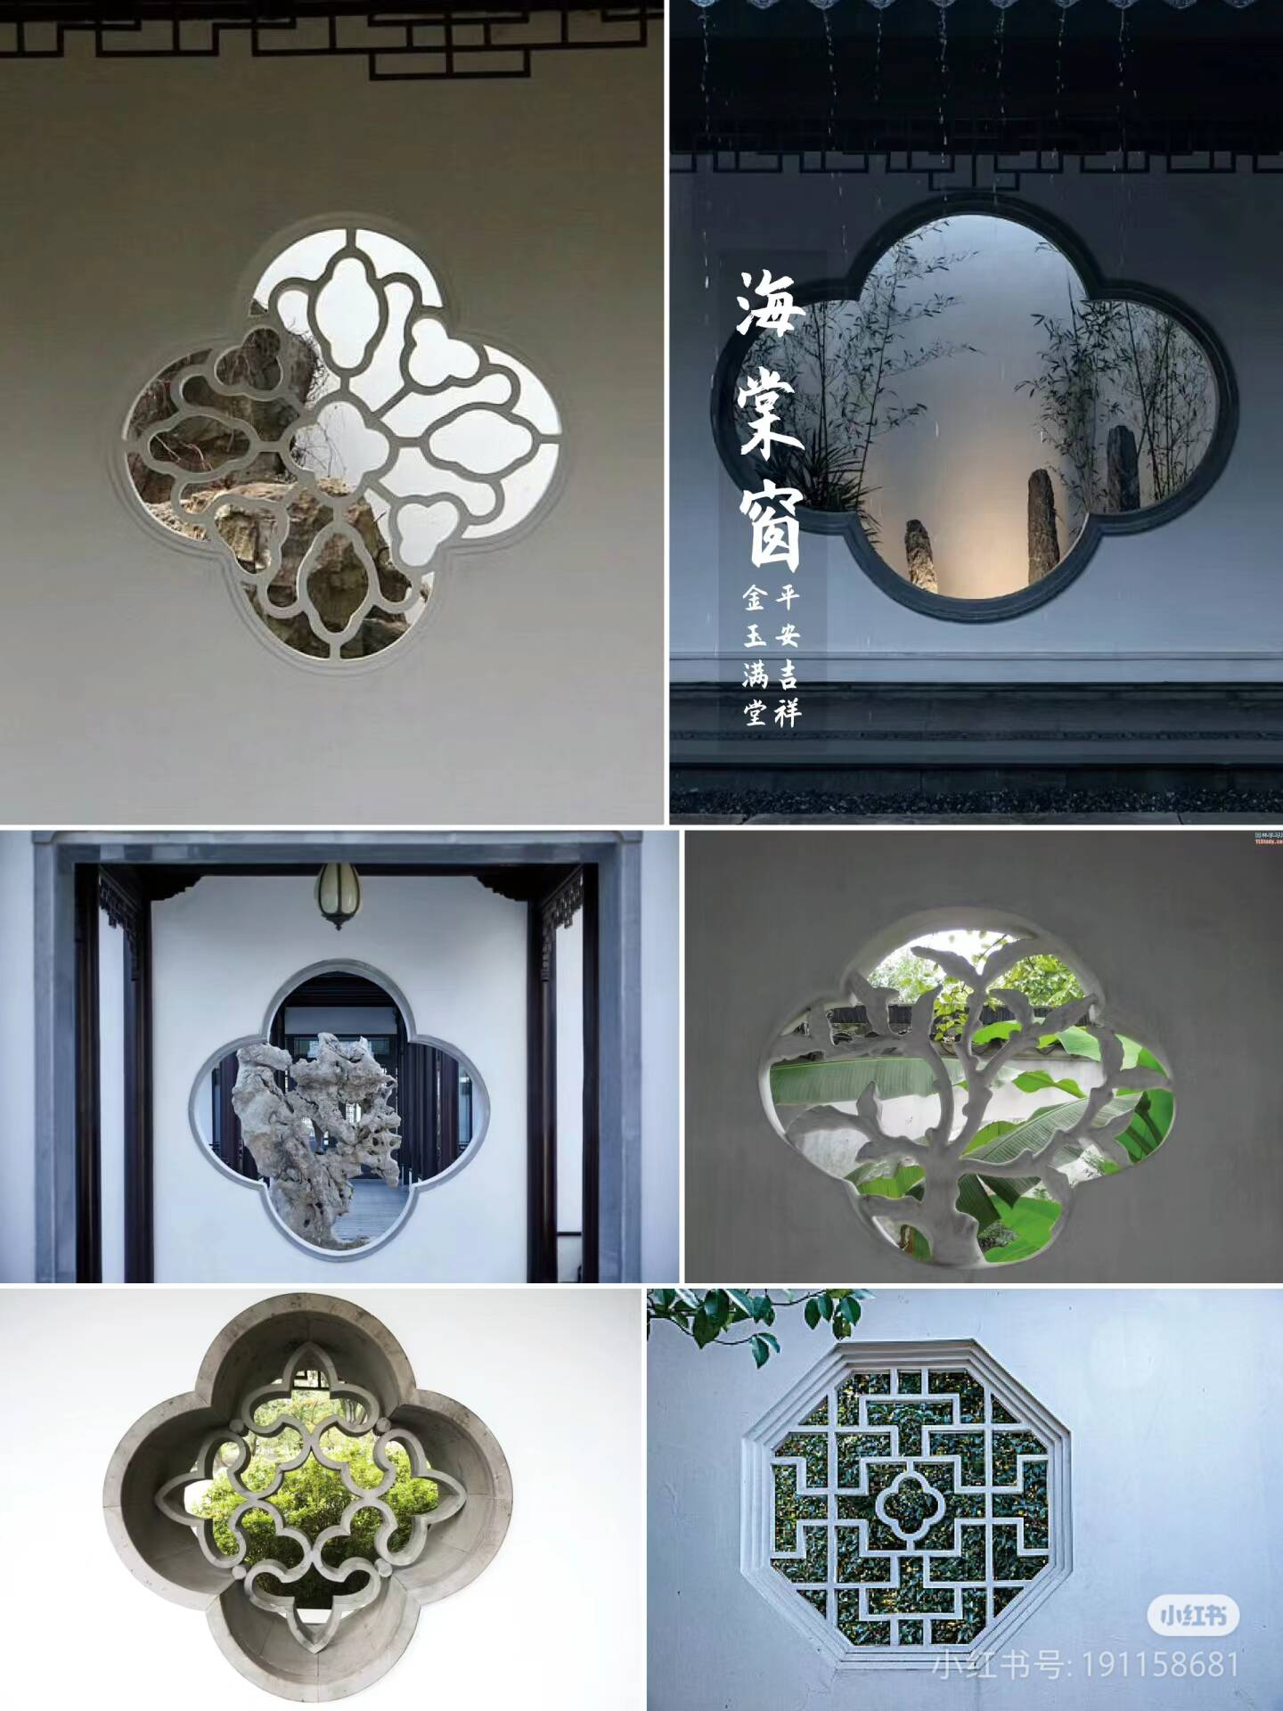
Vase-shaped windows
crabapple
windows
Square windows
calabash windows
Fan-shaped windows

Slide 7
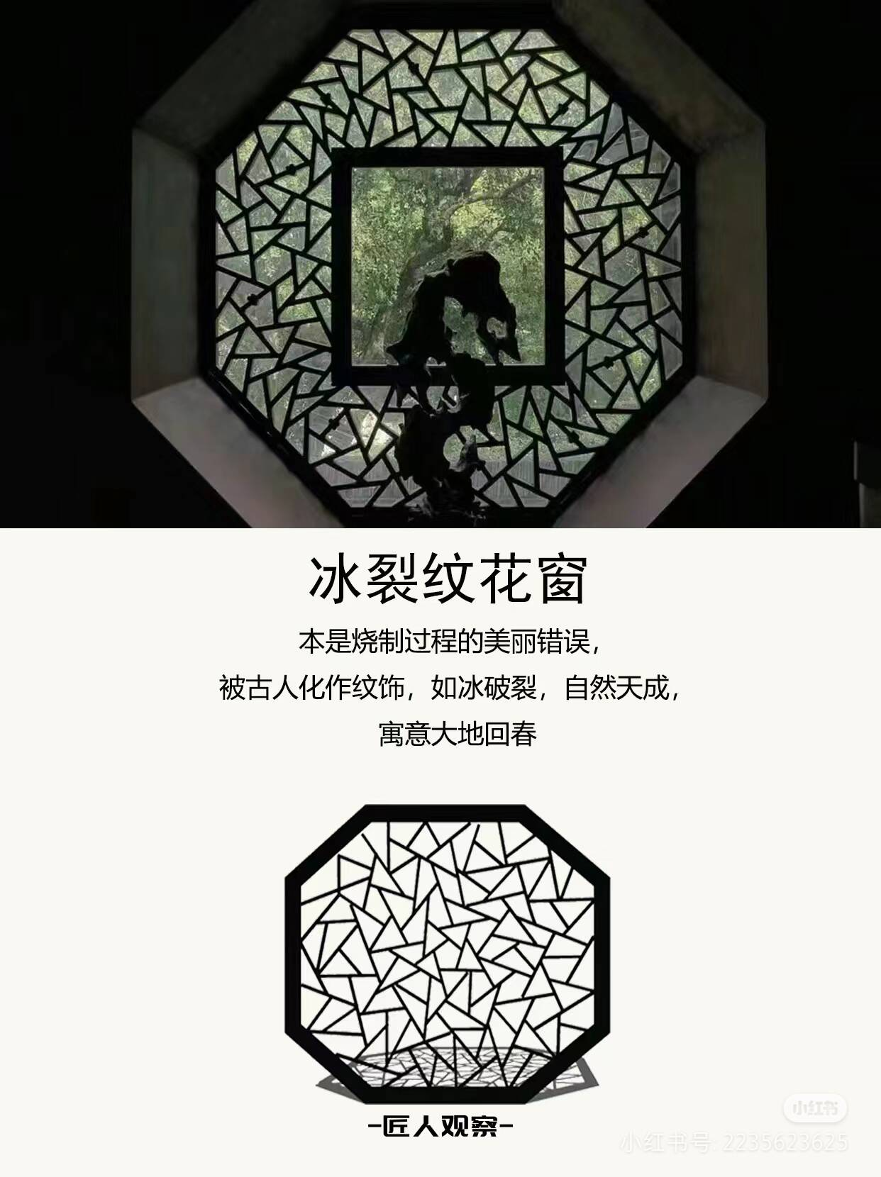
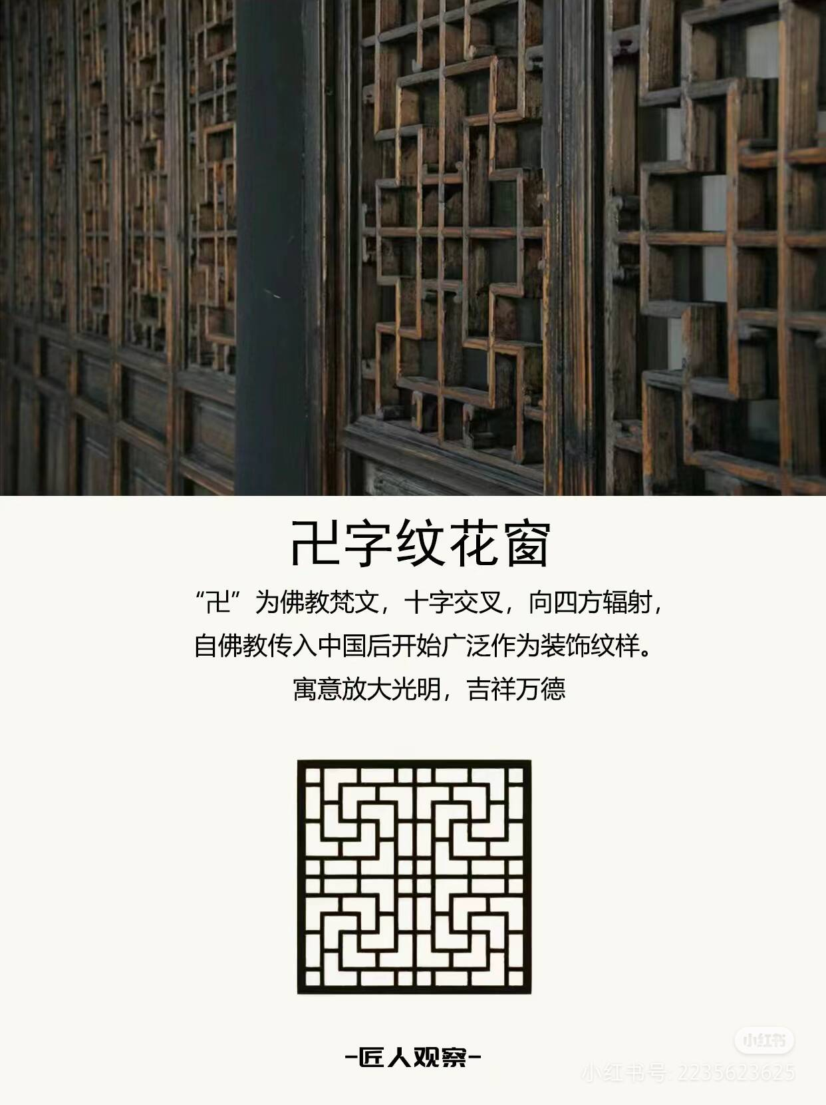
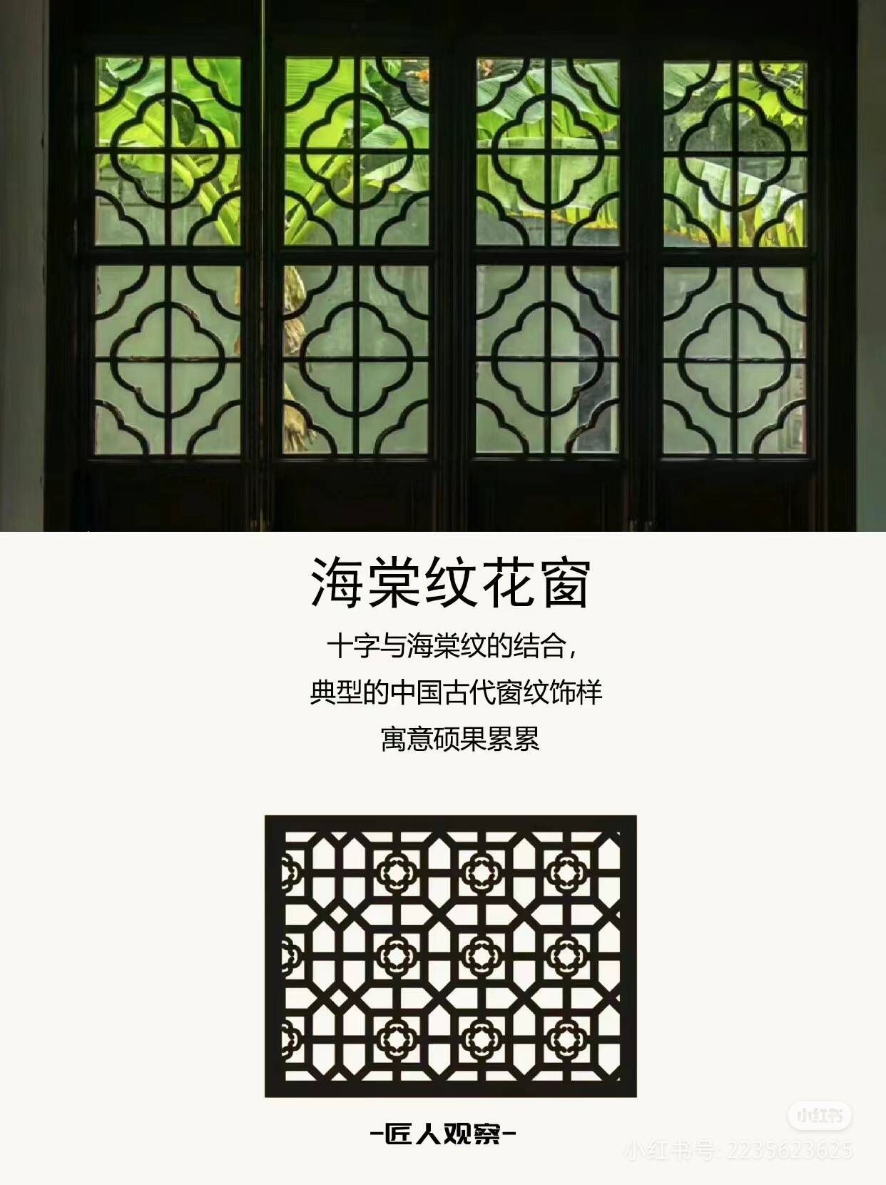
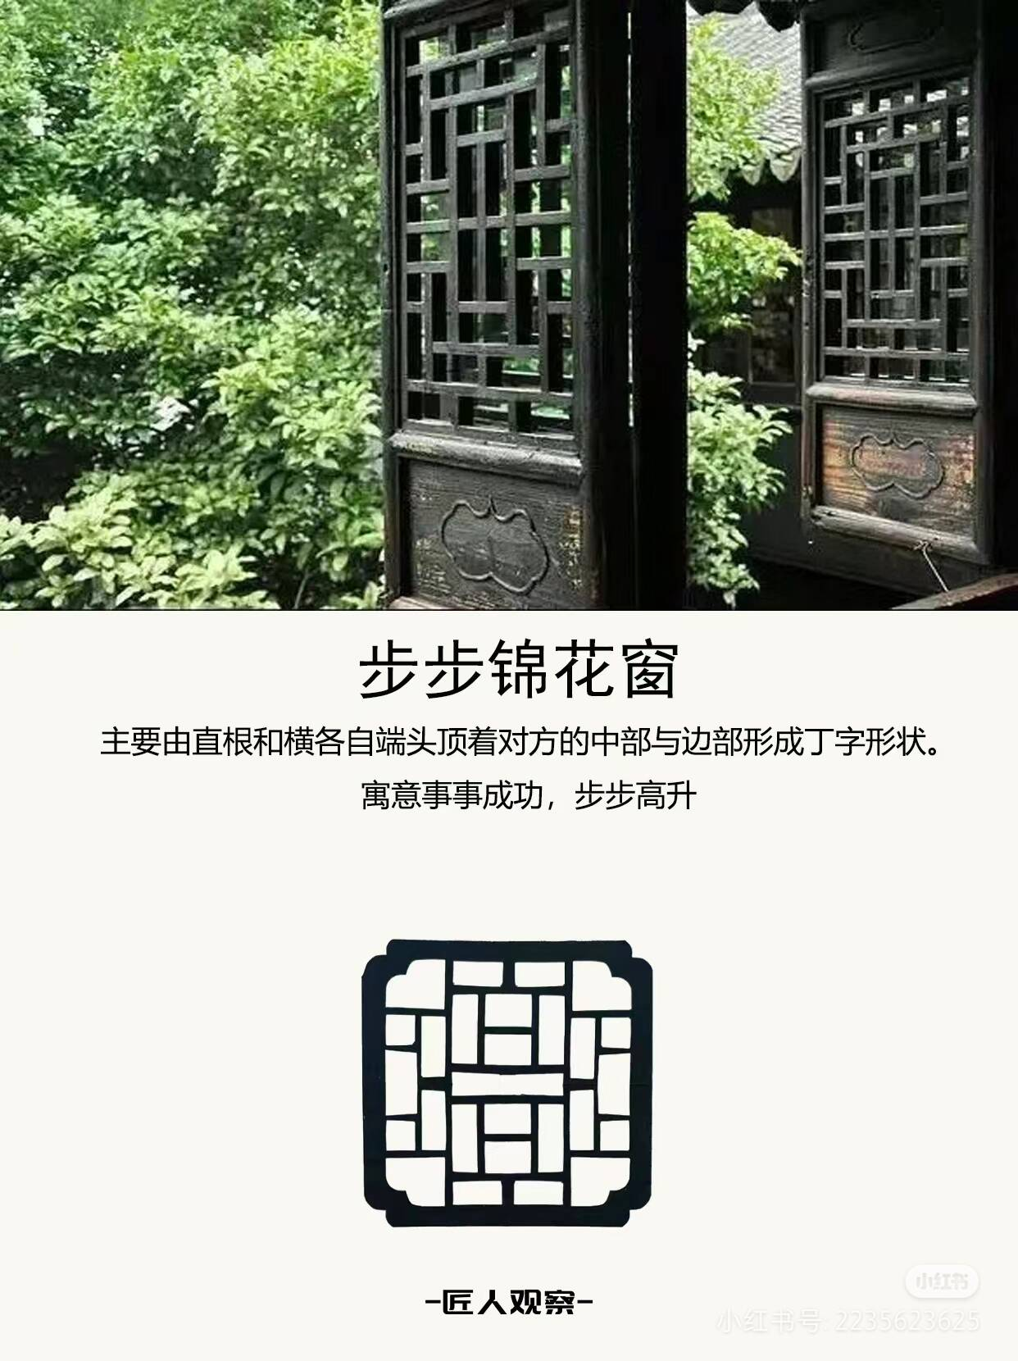
crabapple pattern window
"Bu Bu Jin" pattern window
"ice crack" pattern window
"卍" pattern window

Slide 8
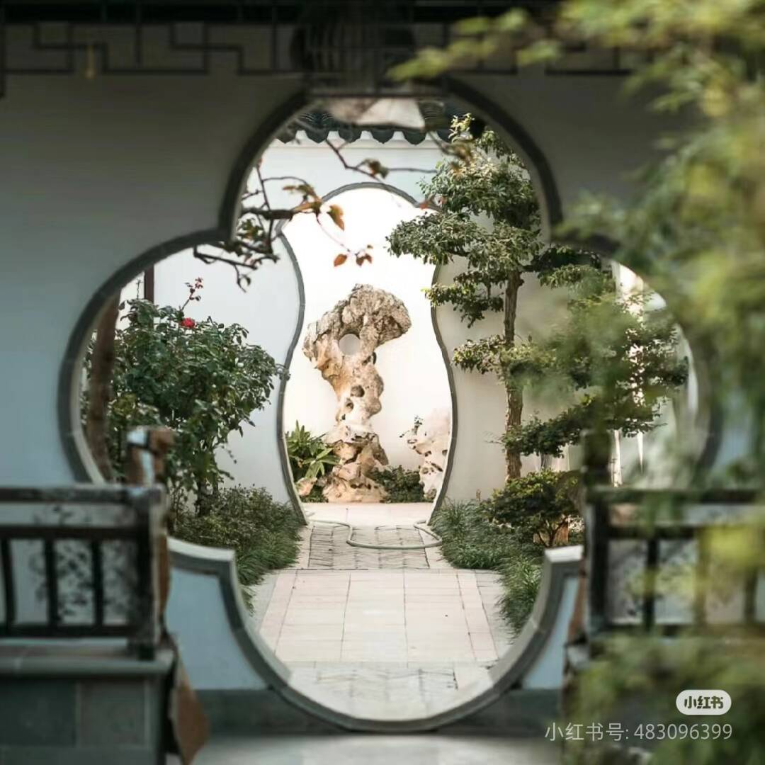
Gates
The gate in Chinese gardens is a unique architectural element. It serves not only as an important passageway within the garden but also as a significant component of garden art. Typically, moon gates lack actual doors and consist only of a frame, which is ingeniously designed to guide the visitor's path, connect spaces, and also serve as a decorative element within the garden. The design and layout of moon gates imbue every part of the garden with a sense of poetry and painting.
Gates come in various forms, which can be categorized into three types based on the characteristics of their frame lines: curved, straight, and mixed. Curved moon gates have a frame line that is curved, such as the crescent moon gate, oval gate, and circular gate, which are commonly used in classical Chinese courtyards. Straight moon gates have frame lines that are straight or angular, with the gate forming a polygon, such as the square gate, rectangular gate, and hexagonal gate. Mixed moon gates combine both straight and curved lines, with common examples including the bottle gate, gourd gate, begonia gate, and sword ring gate.

Slide 9
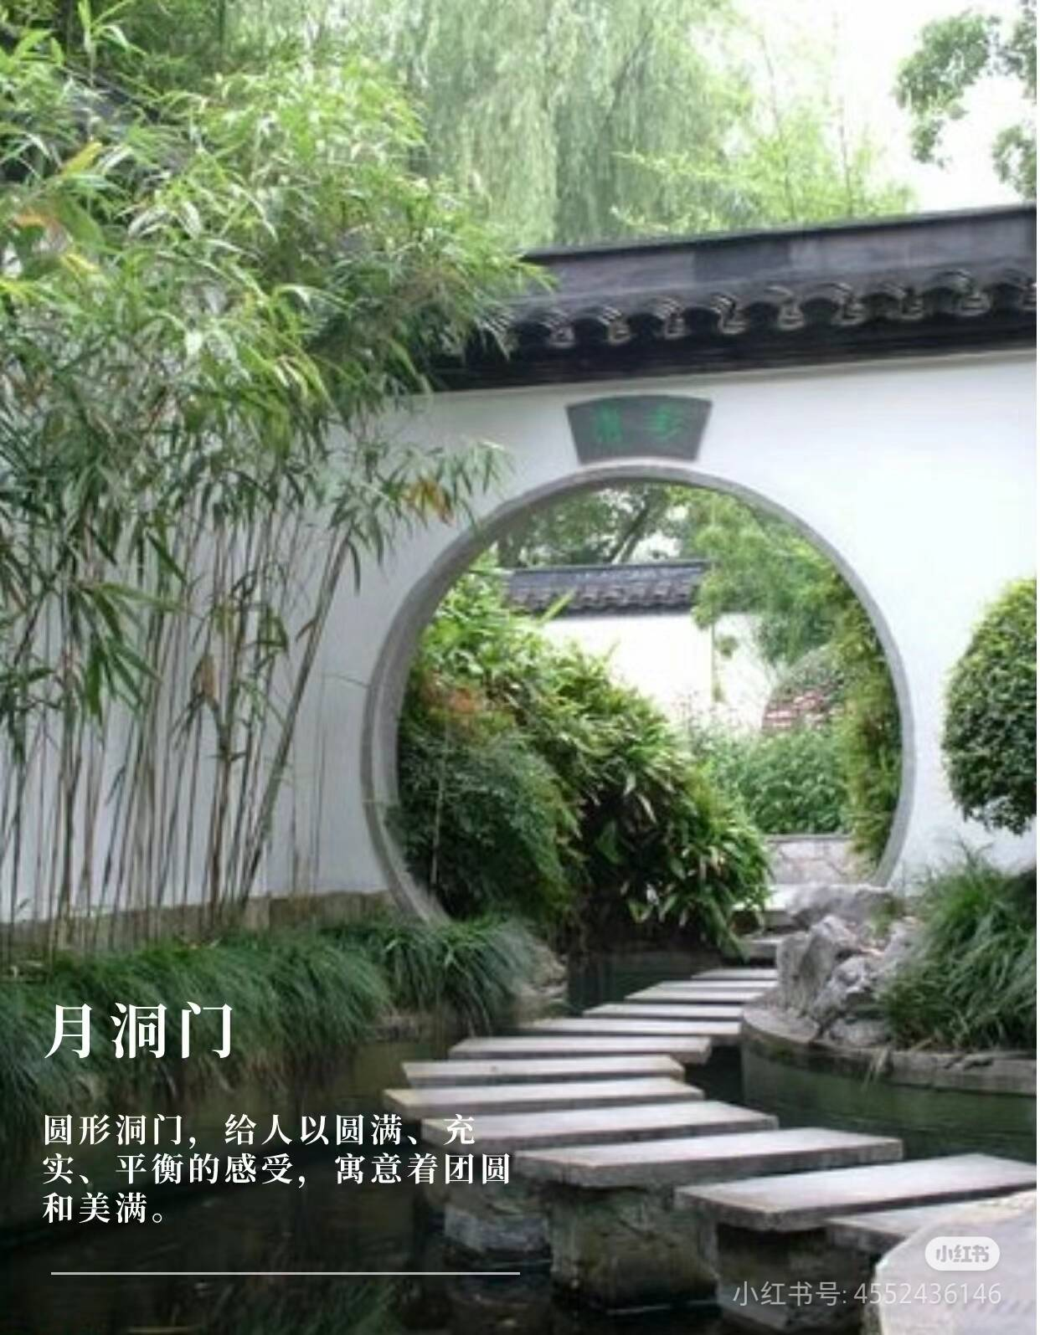
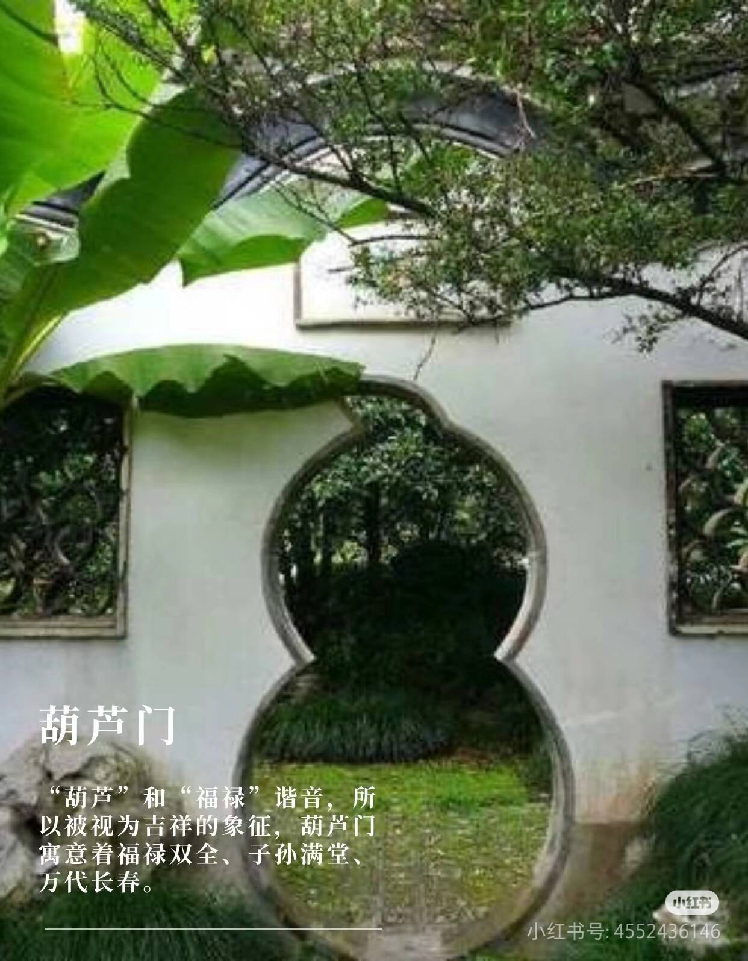
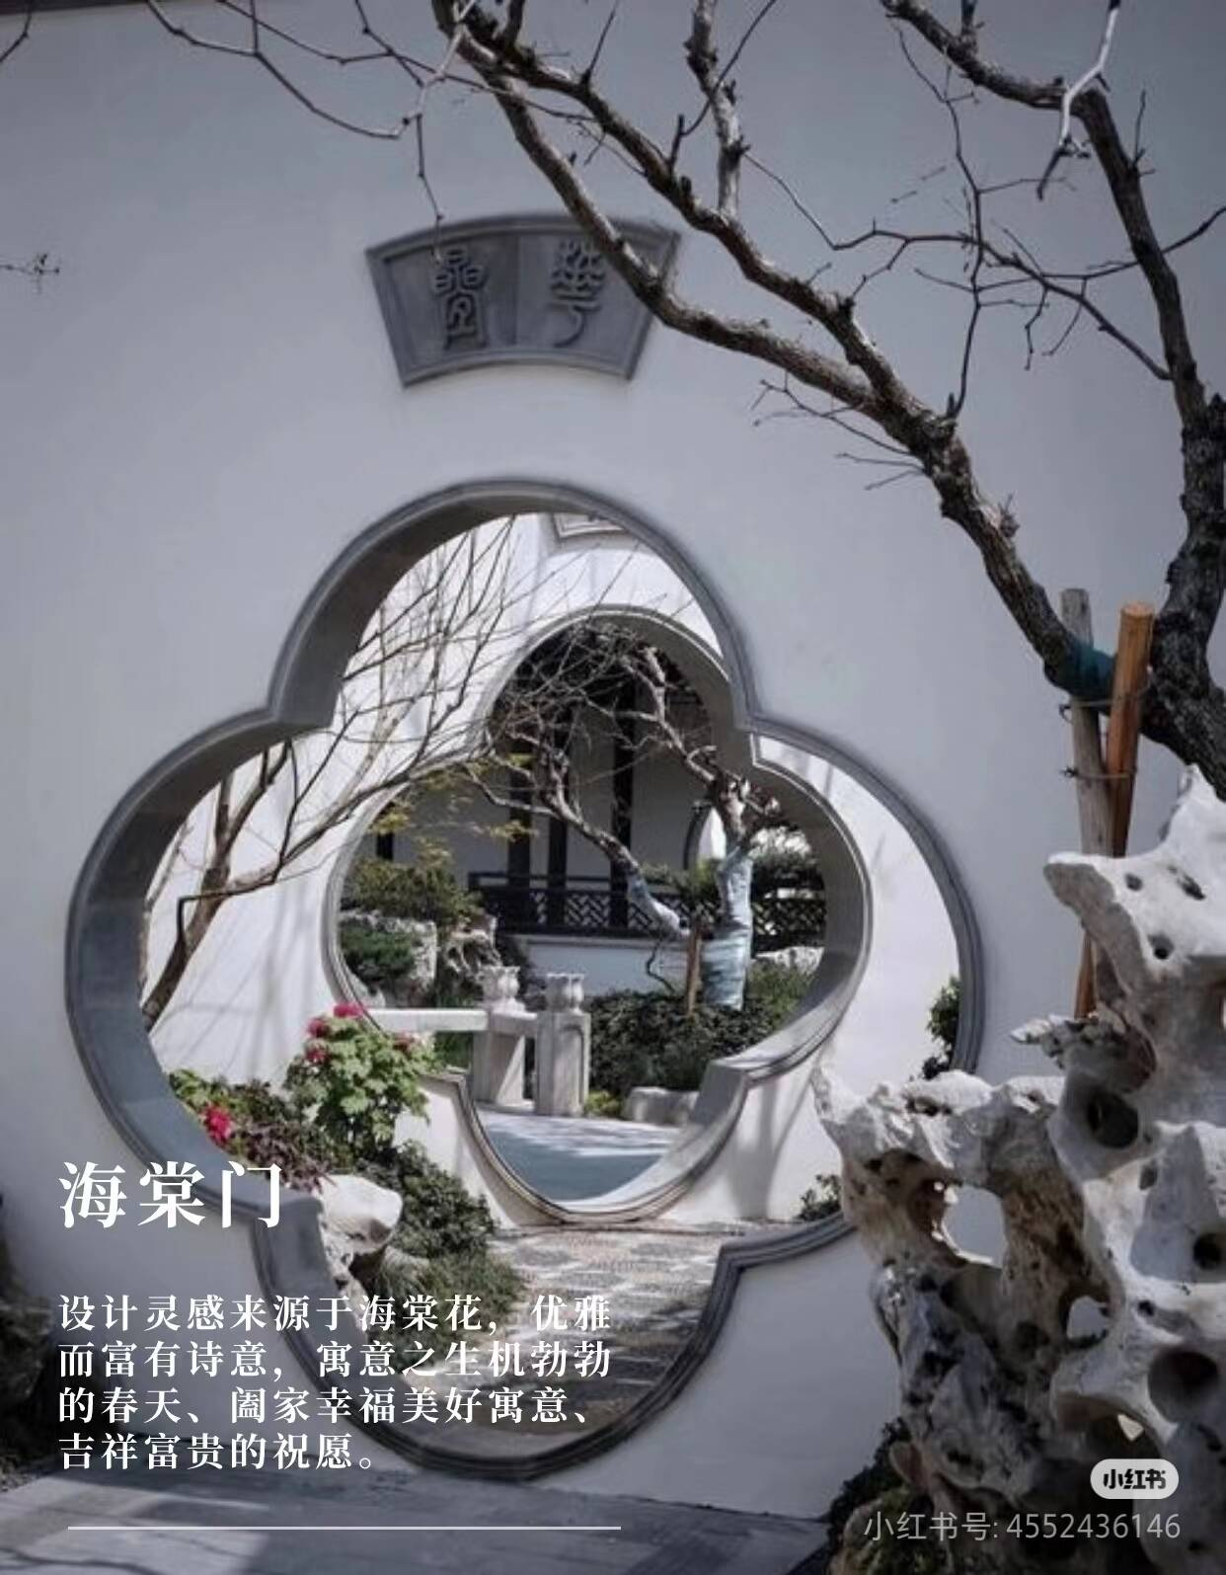
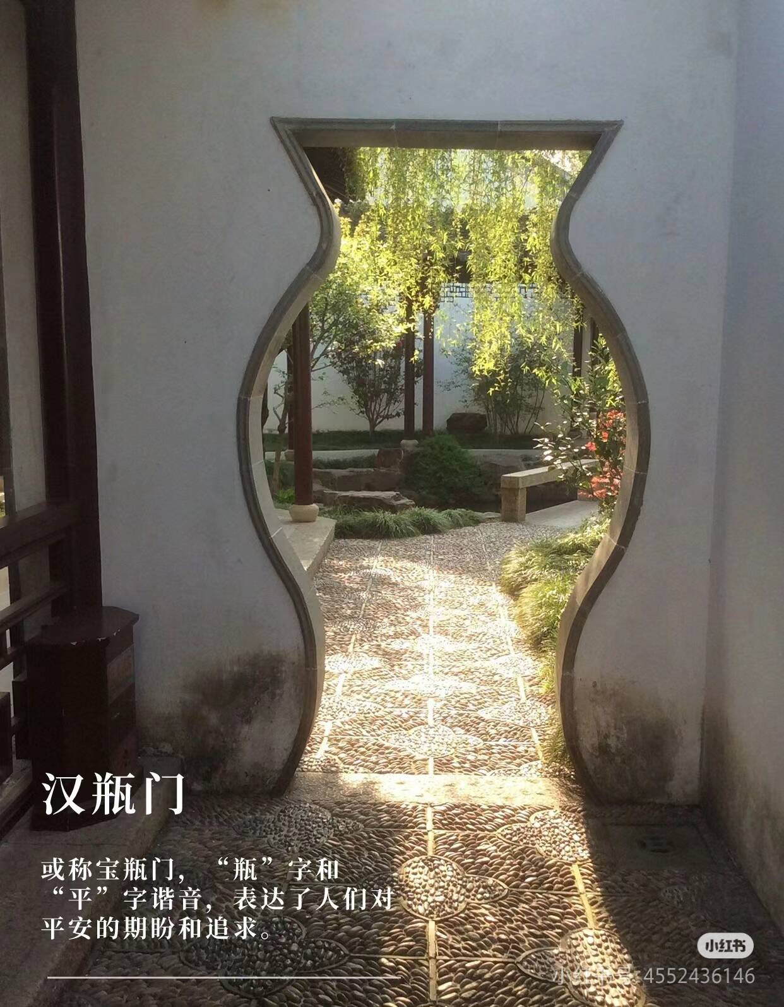
Buddha Vase gate
crabapple gate
Moon gate
Gourd gate

Slide 10
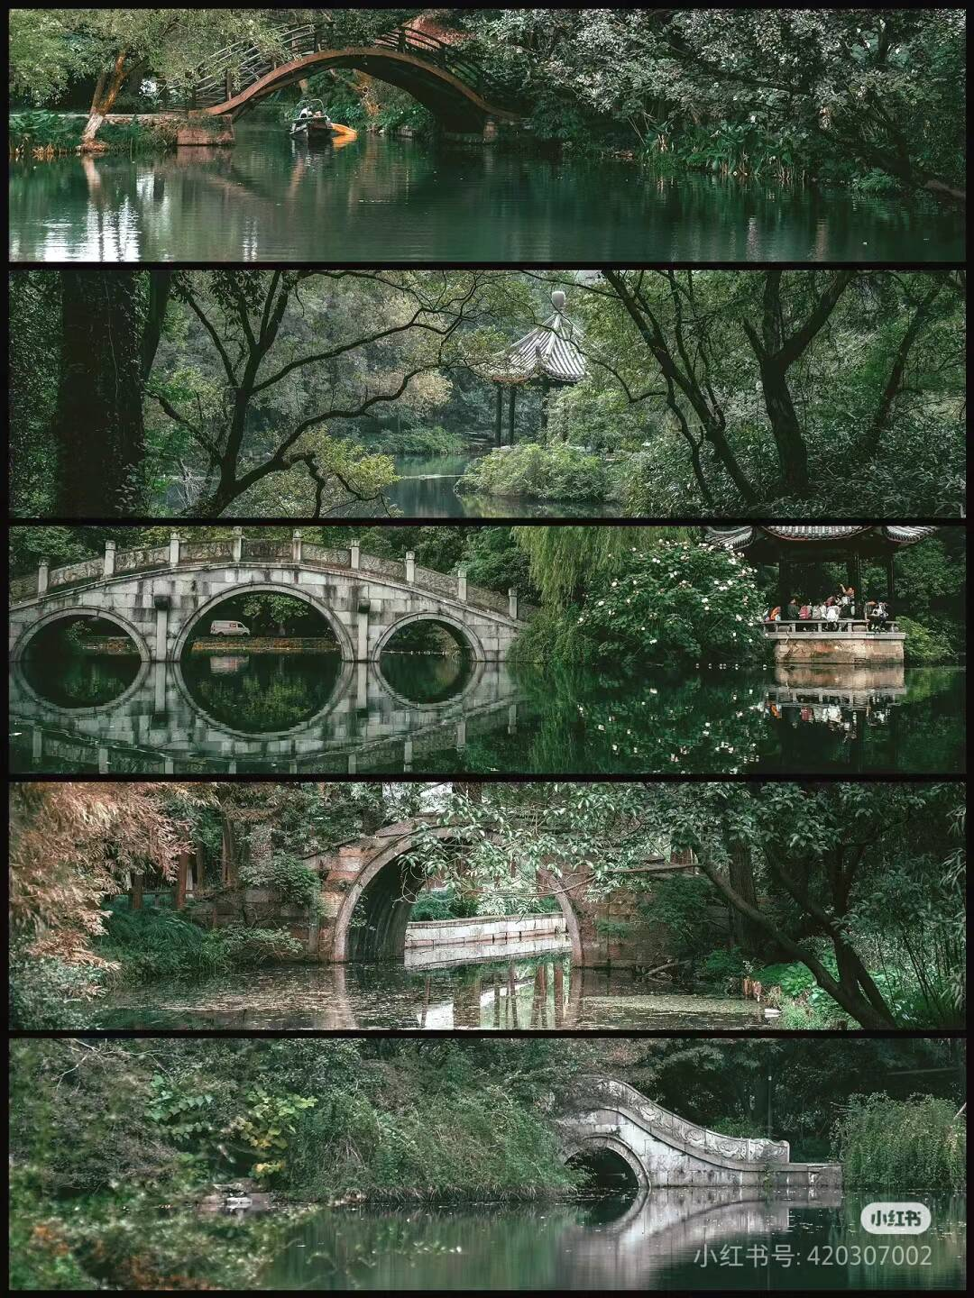
Bridges
Chinese gardens are known for their integration of natural elements with architectural features, and bridges are a quintessential part of this design. Here's a brief introduction to bridges in Chinese gardens:
Harmony with Nature: Bridges in Chinese gardens are designed to blend seamlessly with the surrounding landscape. They often follow the natural contours of the water, enhancing the garden's harmony with nature.
Aesthetic Purpose: Bridges serve as focal points and visual connectors, linking different areas of the garden and providing picturesque views. They are often used to frame views and create a sense of depth.
Variety of Styles: Chinese garden bridges come in various styles, including arch bridges, flat bridges, and floating bridges. Each style contributes to the garden's overall aesthetic and reflects the garden's design philosophy.

Slide 11
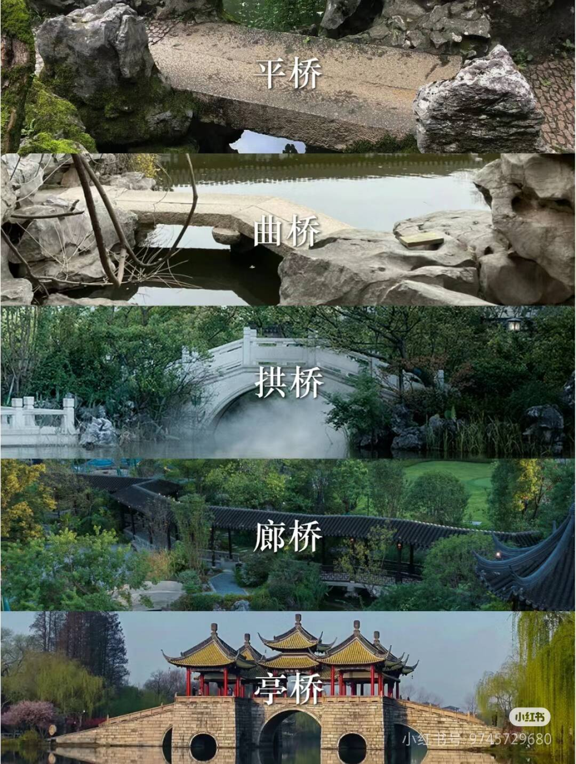
Flat Bridge (Ping Qiao): This is the simplest type of bridge with a level surface, parallel to the water surface or ground. It is typically supported by stone or wooden piers. Flat bridges are commonly used over small streams or water surfaces and exude a natural and approachable charm. Sometimes, they are designed with zigzags to add a sense of depth and layering to the water surface, such as the Nine-Turn Bridge in Jiangnan gardens.
Winding Bridge (Qu Qiao): The surface of a winding bridge has multiple turns, often three, four, or more. This design is not for the convenience of transportation but to expand the sense of space, and guide the visitors' line of sight, achieving the effect of "scenery changes with every step."
Arch Bridge (Gong Qiao): Arch bridges are known for their elegant curves and can be single-arch, double-arch, or multi-arch designs. They add a three-dimensional aspect to the water surface and facilitate the passage of boats beneath. In gardens, single-arch bridges are common because they are more delicate and in line with the garden's overall aesthetic and artistic requirements.

Slide 12
03
Garden design

Slide 13
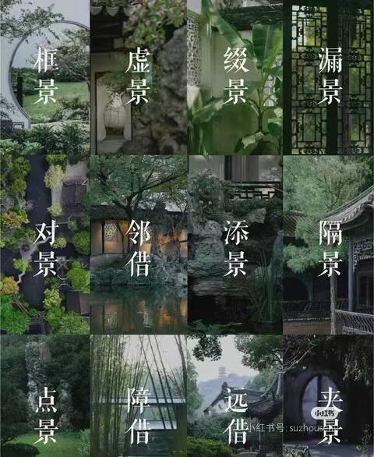
Scenic composition
The scenic composition techniques in Chinese gardens are an essential part of garden design. They create harmonious, natural, and poetic garden spaces through ingenious layout and design. Here are some common landscape creation techniques:
Borrowed Scenery(借景）: Utilizes natural landscapes or buildings outside the garden. By opening windows or setting doors, external views are "borrowed" into the garden, expanding the visual space.
Screened Scenery（障景）: Uses screens, rockery, trees, etc., to block parts of the view, guiding visitors' touring routes and adding a sense of mystery and desire to explore.
Framed Scenery（框景）: Uses doors, windows, and openings as "frames" to frame garden views into beautiful pictures, enhancing the viewing effect.
Corresponding Scenery（对景）: Sets up two or more landscapes or points of interest within the garden that correspond to each other, creating a visual dialogue and adding a sense of depth to the space.

Slide 14
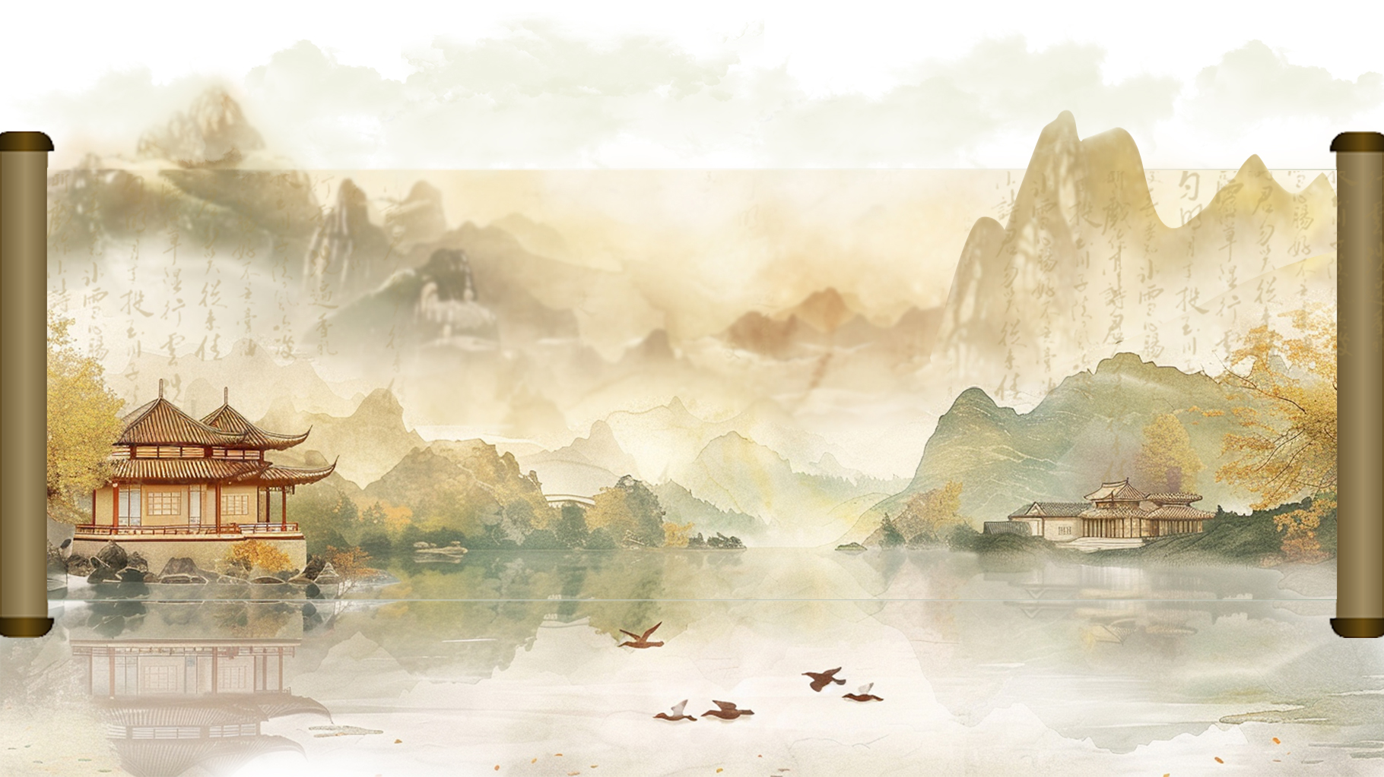
Thank you!
汇报人：Lilian
汇报时间：2024.9

