Slide 1

Marriage and Burial Customs
of Tujia People
Presented by Jiao Mengting

Slide 2

Content
1
Introduction
2
Tujia Marriage Customs
3
Tujia Burial Customs
4
Q & A

Slide 3

PART 01
Introduction

Slide 4
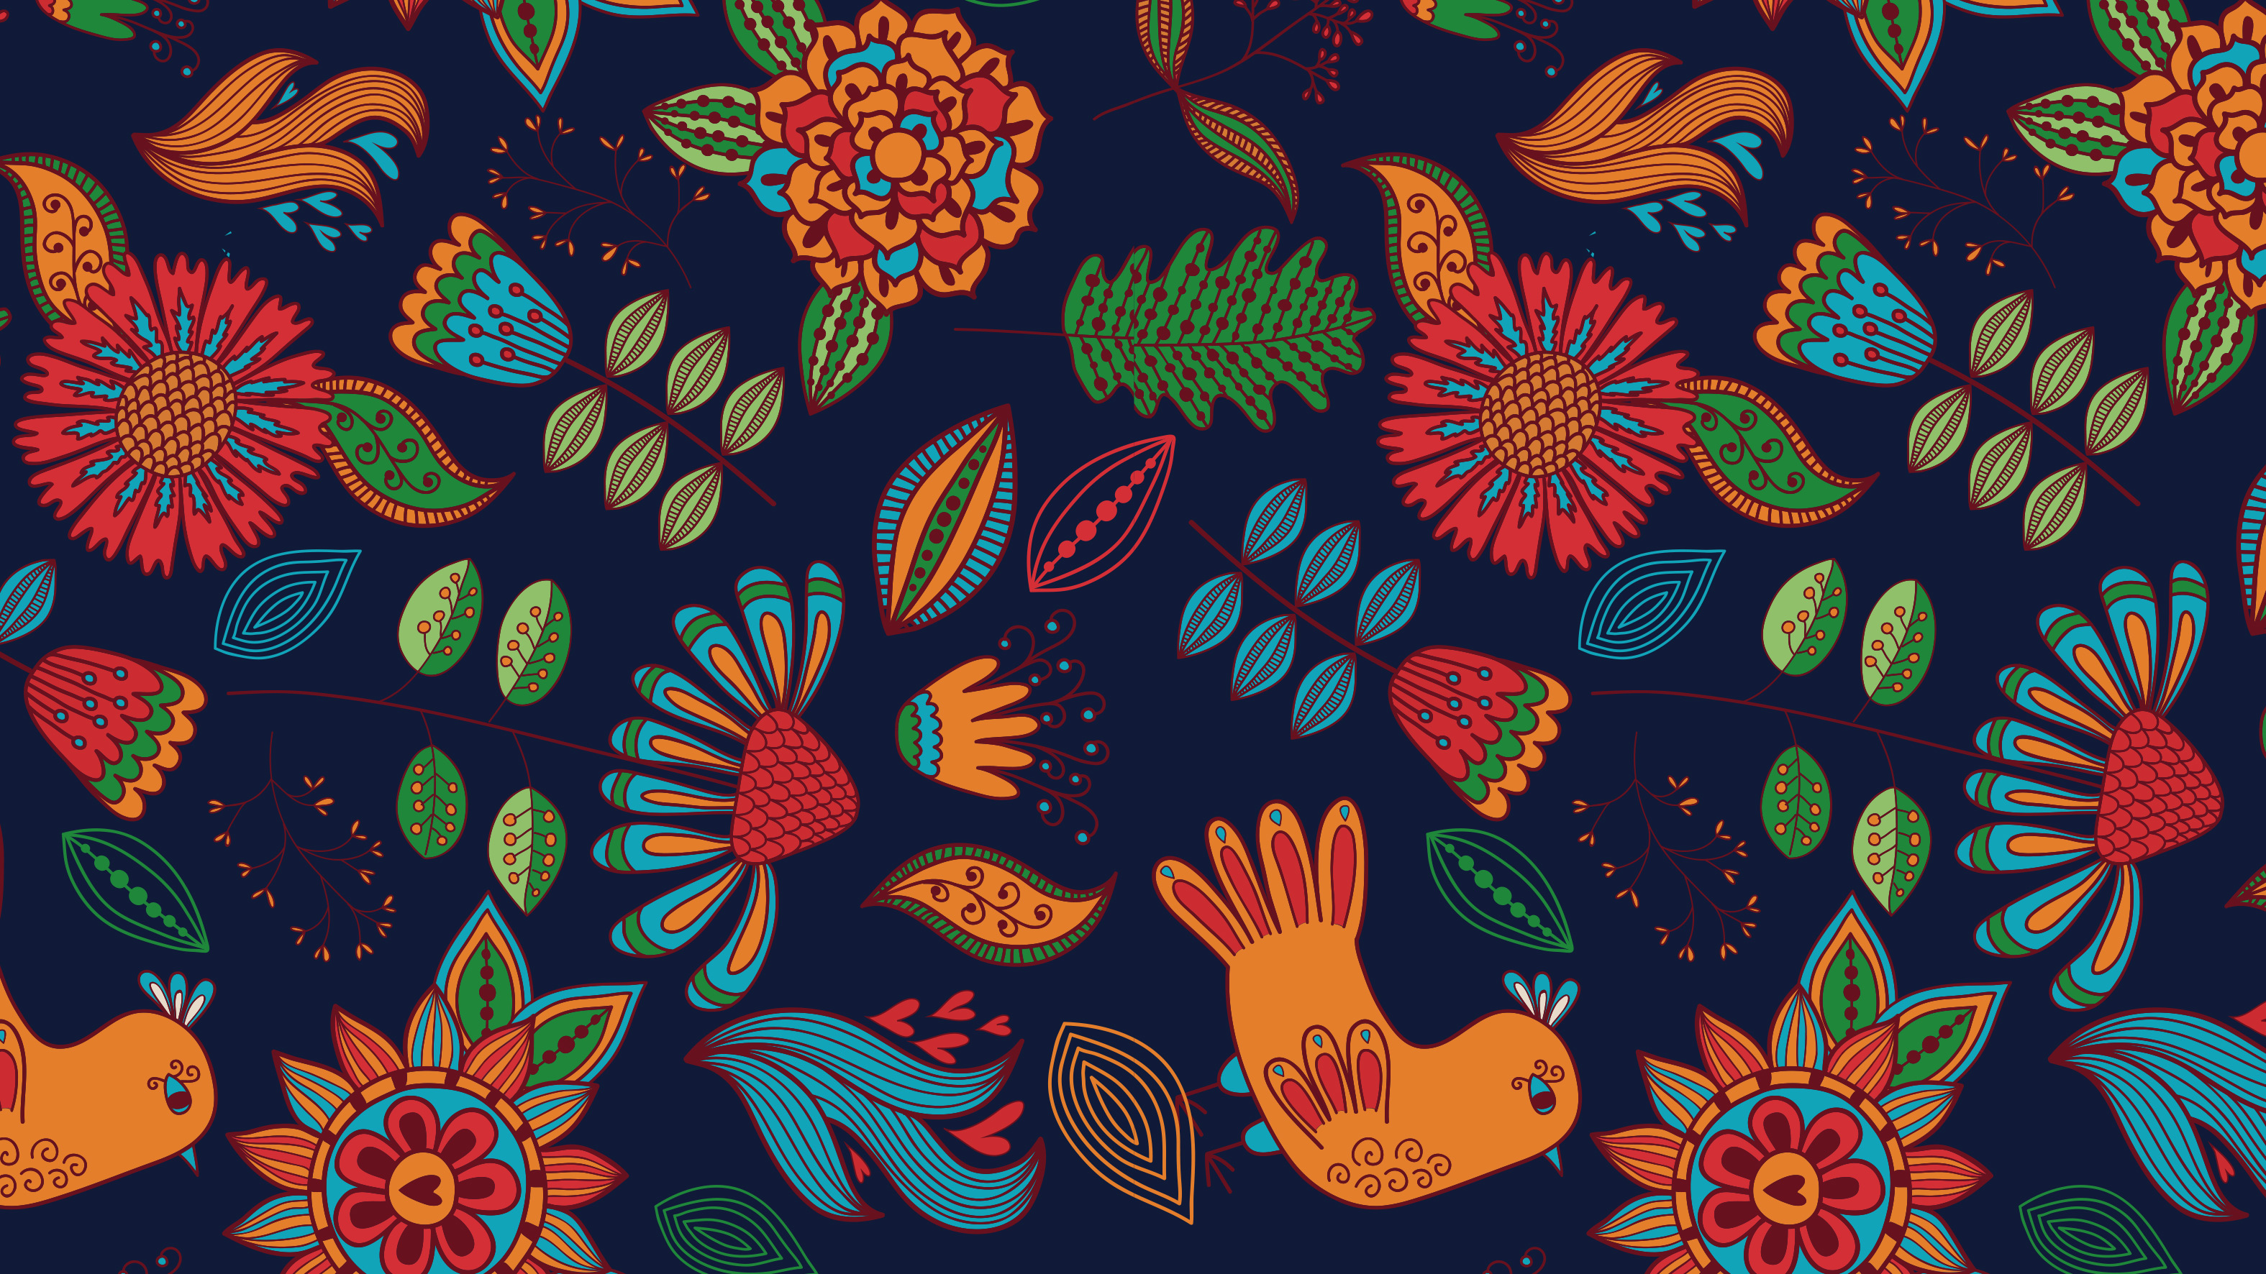
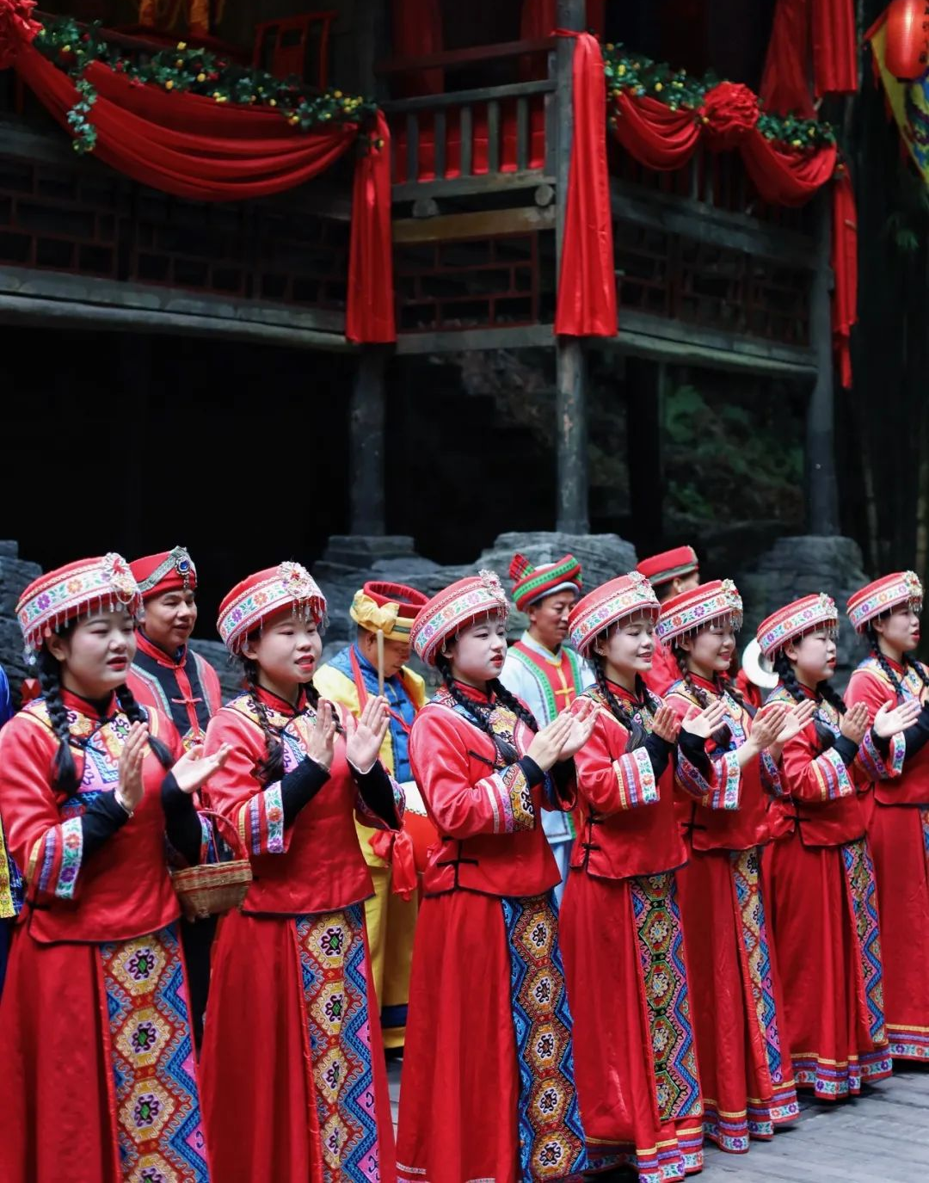
Introduction to the Tujia Ethnic Group
Introduction to the Tujia Ethnic Group
The Tujia, an established ethnic group in China, possess a rich cultural heritage despite lacking a written language. Their unique identity is particularly evident in their marriage and burial customs, which have evolved over time while retaining distinctive characteristics. These customs offer a fascinating glimpse into the social fabric and traditions of the Tujia people, reflecting their values, beliefs, and historical development.

Slide 5
PART 02
Tujia Marriage
Customs

Slide 6
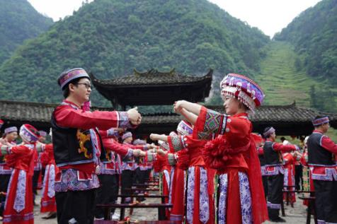
Tujia Marriage Customs
Pre-Reform Era
Marriages were relatively free, with couples uniting after mutual consent and a Tujia teacher's testimony.
Post-Reform Era
Arranged marriages became common, enforced by parents and matchmakers.
Modern Times
With the new marriage law, Tujia people now enjoy marital autonomy

Slide 7
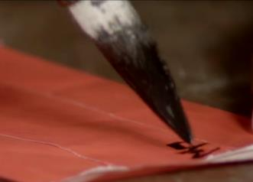
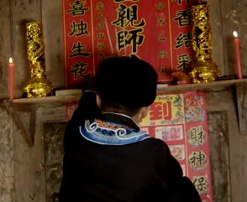
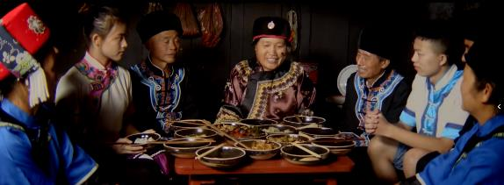
Tujia Wedding Rituals
Marriage Proposal (求婚)
Asking for Red Geng (讨红庚)
Proofing (打样)
Betrothal (定亲)
The initial step in the marriage process, similar to engagement in Western cultures.
Arranged marriages became common, enforced by parents and matchmakers.
A unique Tujia custom, possibly related to gift-giving or symbolic gestures.
Also known as “inserting thatched incense”, marking the official engagement.

Slide 8
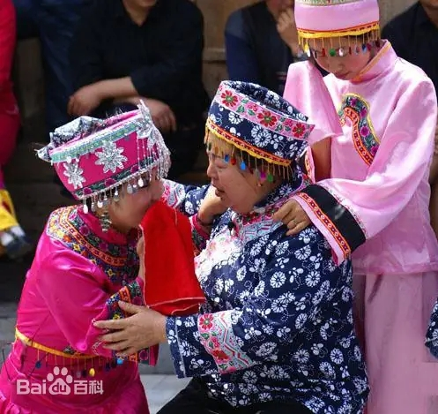
Tujia Marriage Customs
The Crying Marriage Custom
The "crying marriage" is a unique and ancient Tujia wedding tradition, dating back two to three thousand years. Originally believed to be a remnant of "bride snatching" customs, it has evolved into a ritual for ethics and marriage education. This custom involves not just the bride, but also relatives, creating a collective, familial experience.
The crying marriage consists of over 20 procedures, each with specific content and strict protocols. This ceremonial aspect underscores its cultural significance and the importance of tradition in Tujia society.

Slide 9
PART 03
Tujia Burial
Customs

Slide 10
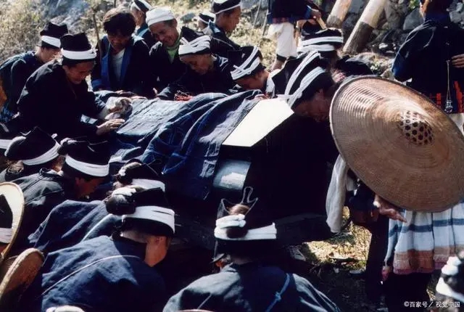
Tujia Burial Customs
Cremation
Historically, the Tujia people were among the first to practice cremation as a burial method.
Rock Coffin Burial
Another traditional burial practice involving the use of rock formations as natural coffins.
Modern Practices
Contemporary Tujia funeral customs have evolved to incorporate unique national characteristics.

Slide 11
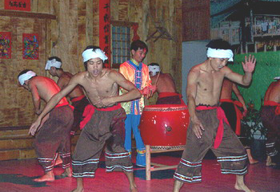
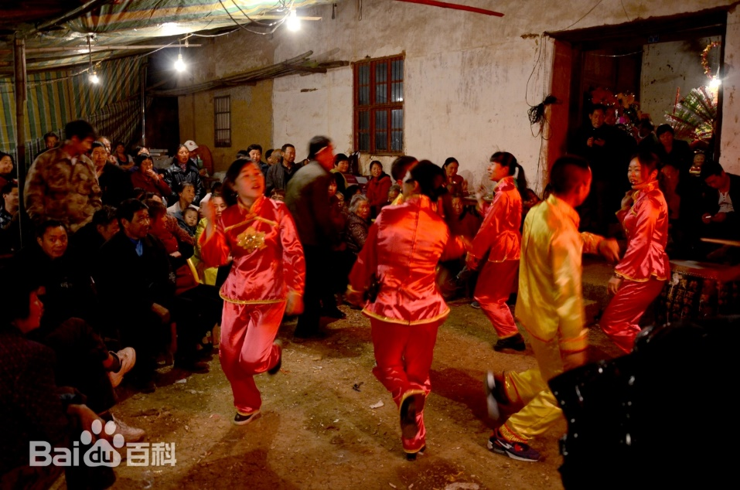
The Funeral Dance Tradition
The Tujia funeral dance, recorded since the Sui and Tang dynasties, is a wild and energetic tribute to the deceased. This important custom serves to honor the dead and comfort the living. The dance is characterized by its unique musical composition and movements.
"Jumping mourning" is a crucial part of the funeral, where neighbors gather to perform the dance. Led by a Taoist priest, with the eldest son holding the deceased's spiritual tablet, mourners dance vigorously in the courtyard, forming various formations.

Slide 12
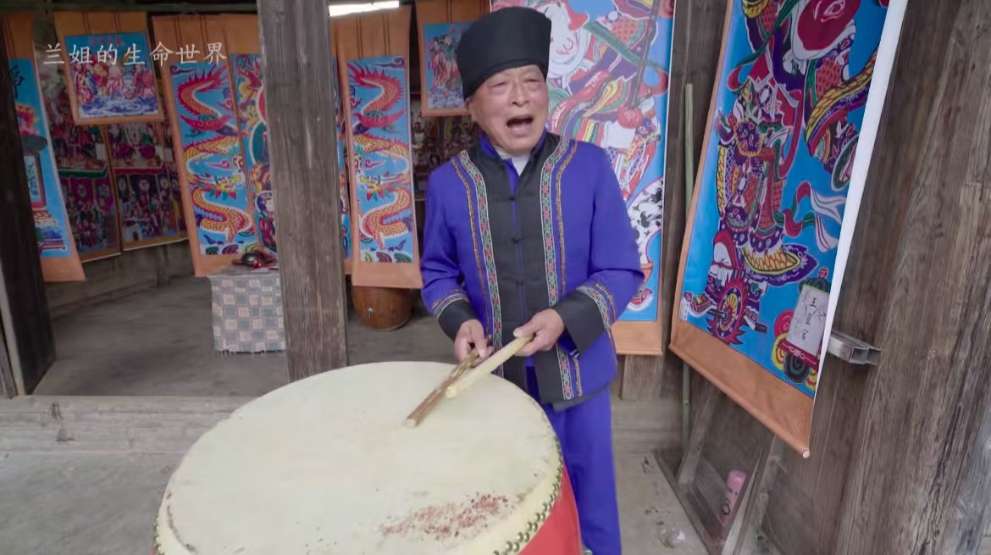
Mourning Hall Singing
Setting the Scene
Mourners gather around the coffin in the main hall, with a cowry drum placed in a wooden foot basin.
1
The Performance
Singers beat drums and recite auspicious words, narrating the deceased's life experiences and achievements.
2
Duration
The singing may continue for several days and nights until the funeral and burial are complete.
3

Slide 13
PART 04
Q & A

Slide 14
Questions
Do the Tujia have their own ethnic script?
Was marriage free in the historical Tujia family?
What are the marriage rites of the Tujia?
What are the main artistic features of mourning?

Slide 15

Thank you for your listening

