Slide 1
Ancient-style Architecture

Slide 2
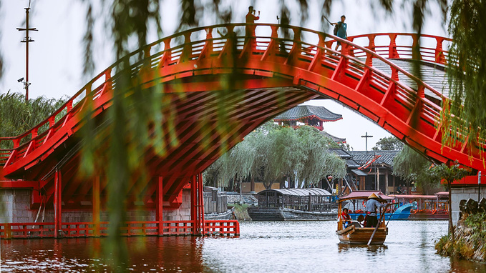
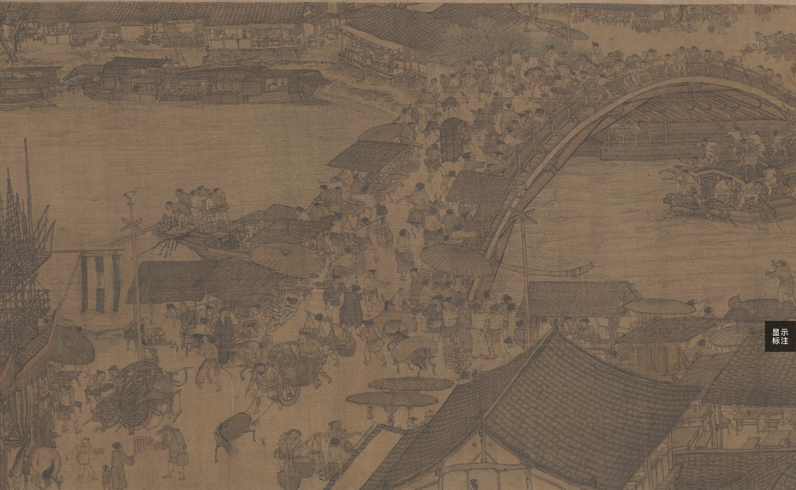
Rainbow Bridge
What makes the Rainbow Bridge special?
从东水门外七里曰虹桥，其桥无柱，皆以巨木虚架，饰以丹艧huò，宛如飞虹。——《东京梦华录•卷一•河道》

Slide 3
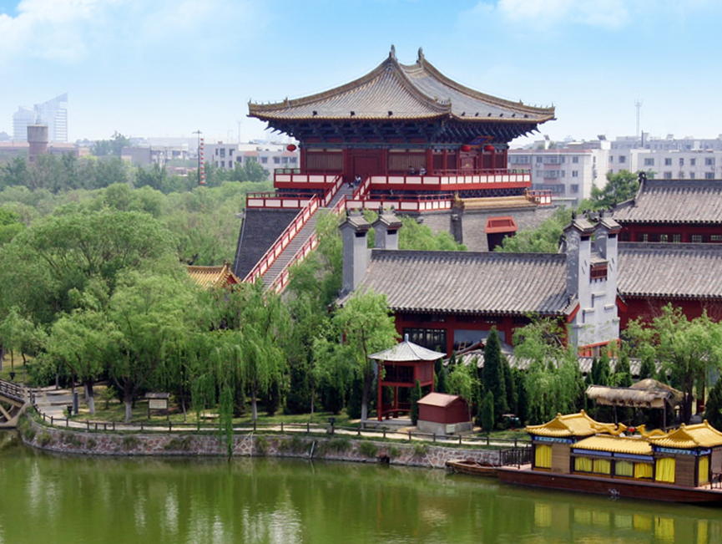
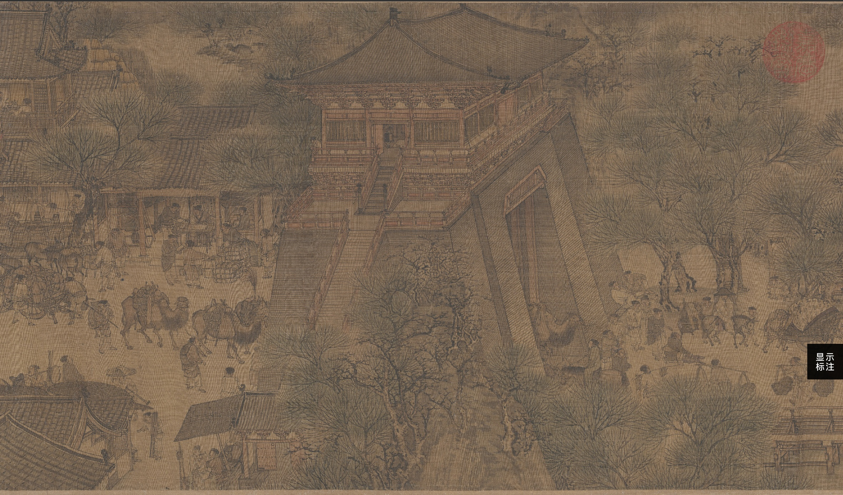
Upper Gate to Virtue
What is the meaning behind the name?
汴河上水门南曰大通，北曰天泽。汴河下水门南曰上善，北曰通津。——《汴京遗迹志》

Slide 4
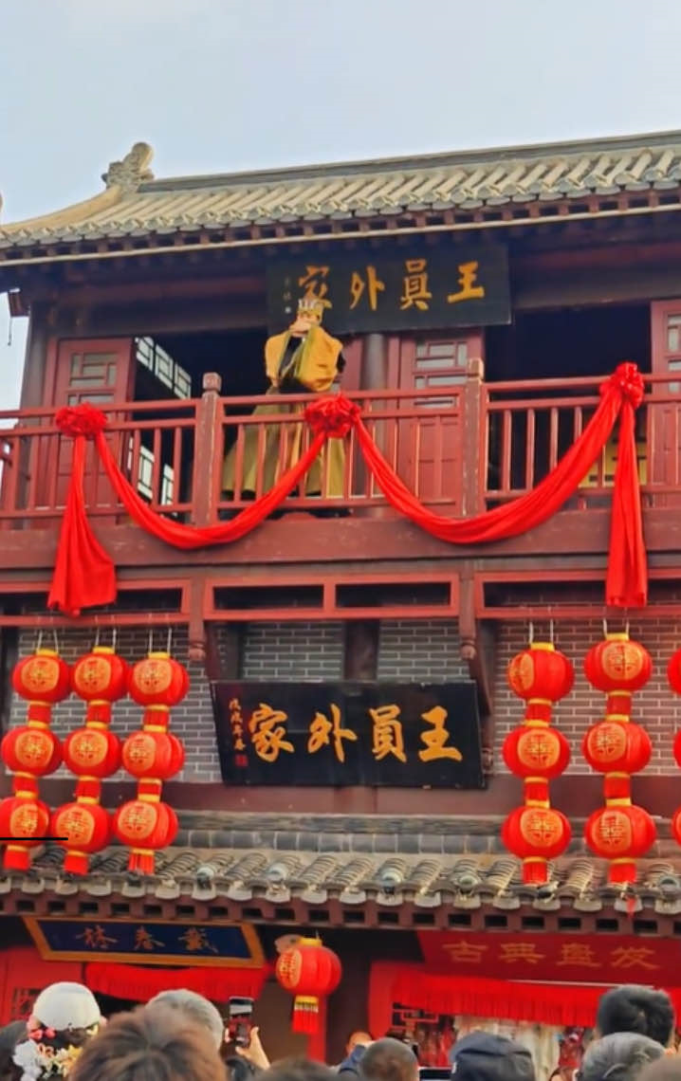
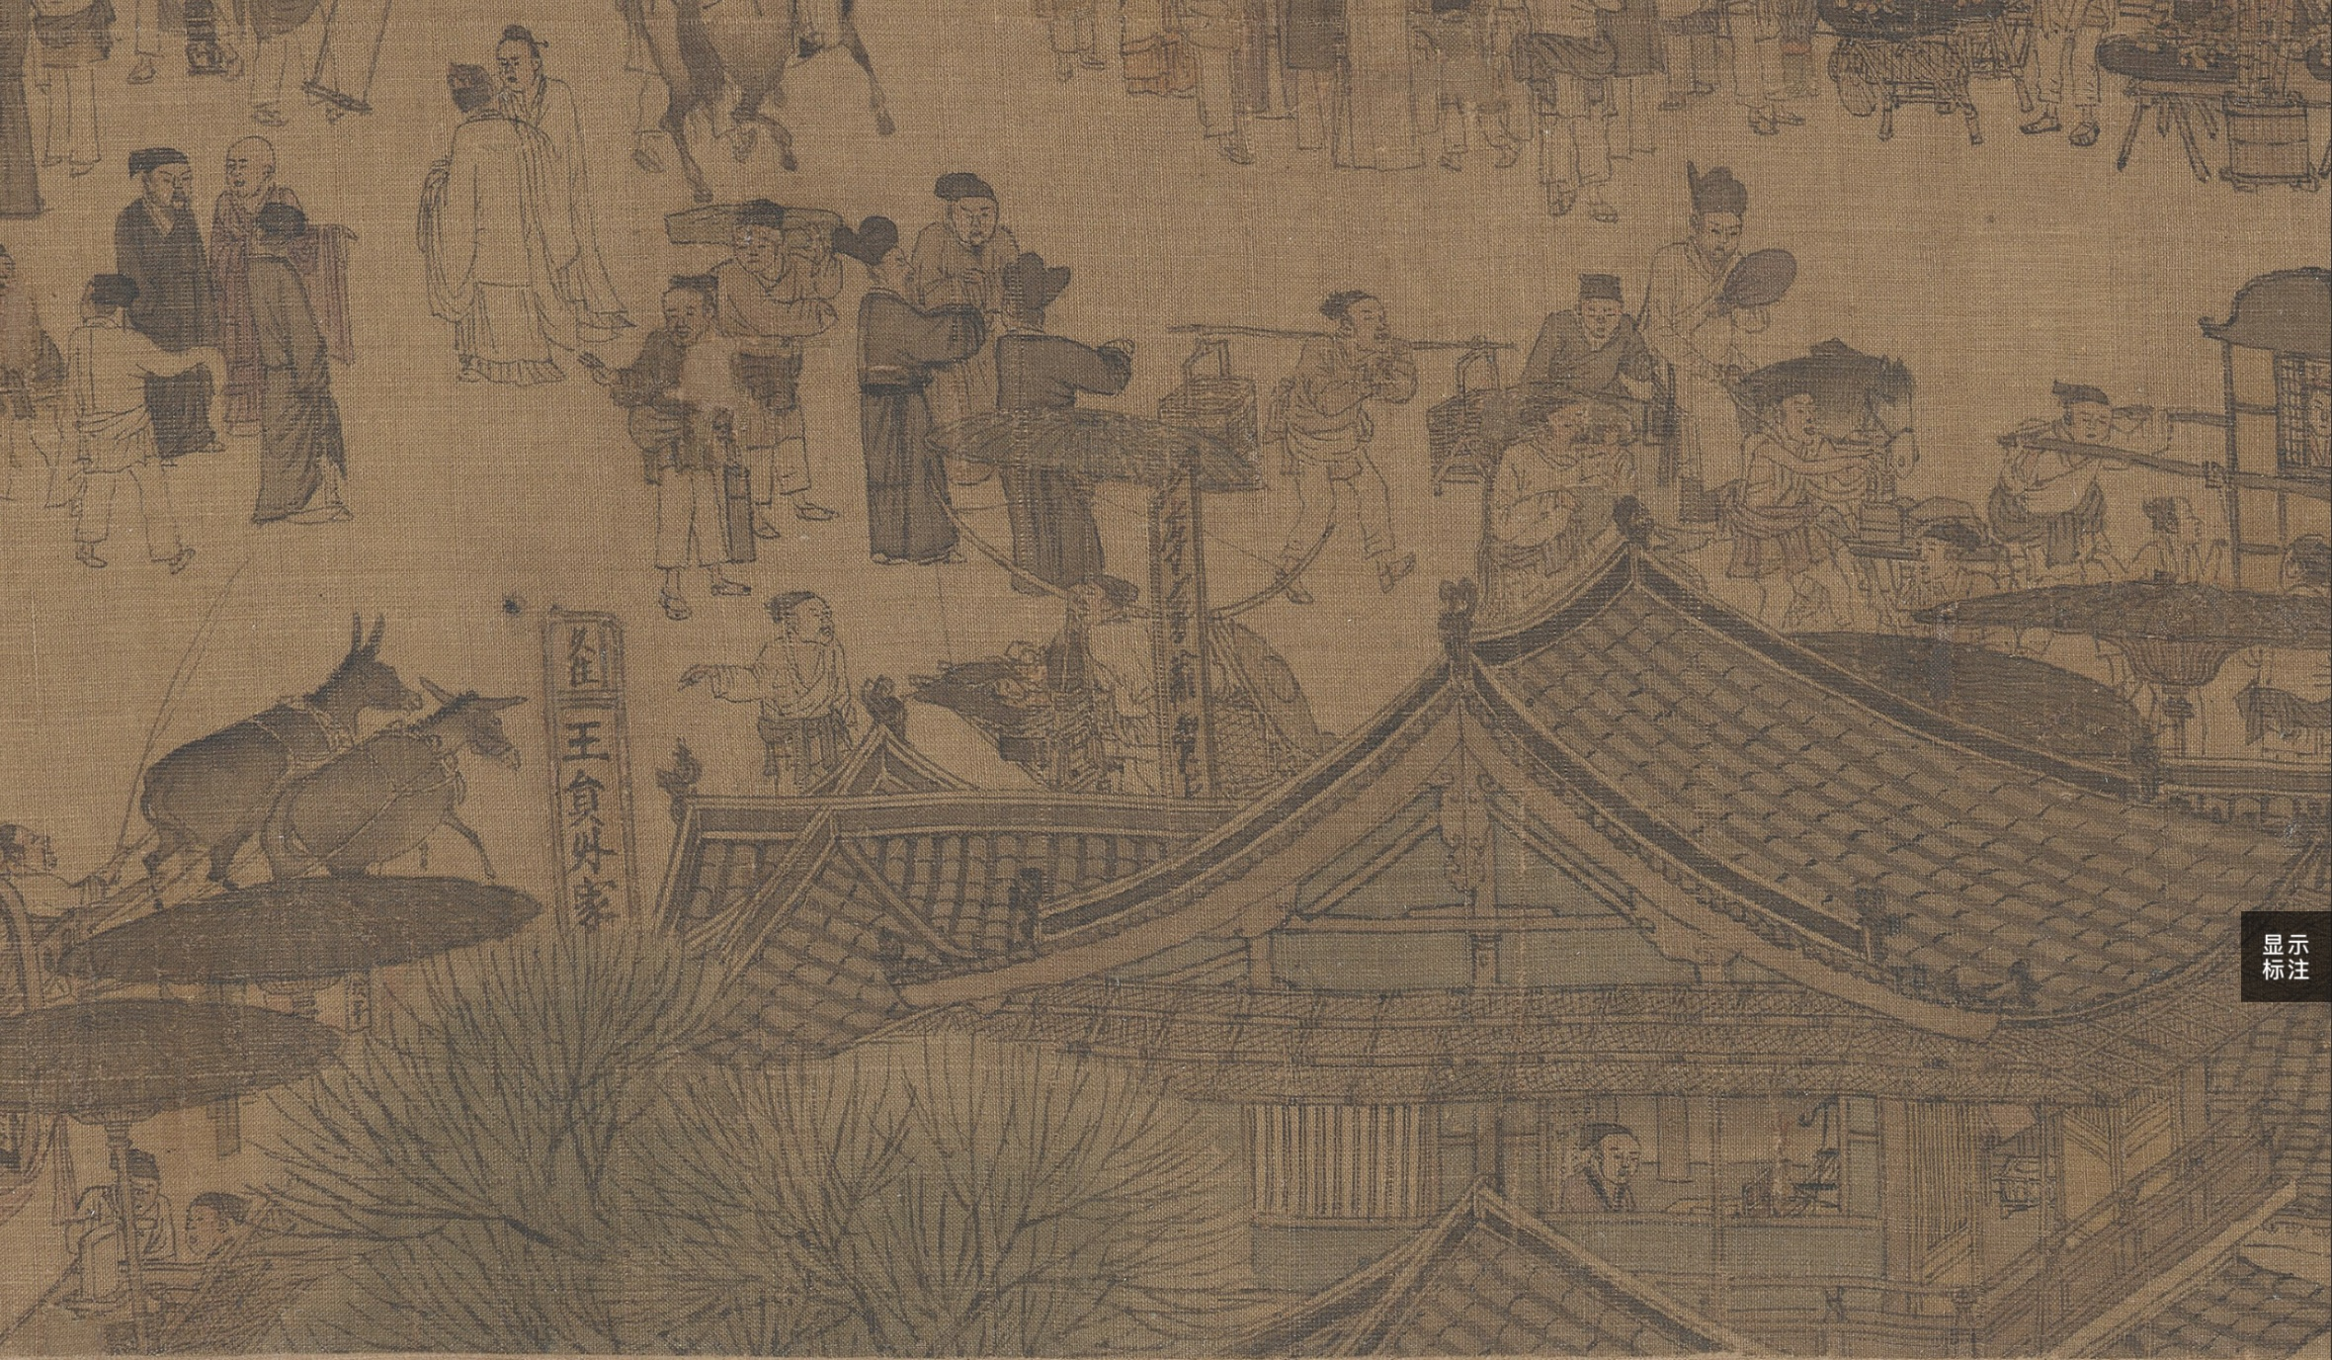
Mr. Wang’s Hotel
Performance: Mr. Wang’s Daughter’s Hand in Marriage

Slide 5
Breathtaking Performances

Slide 6
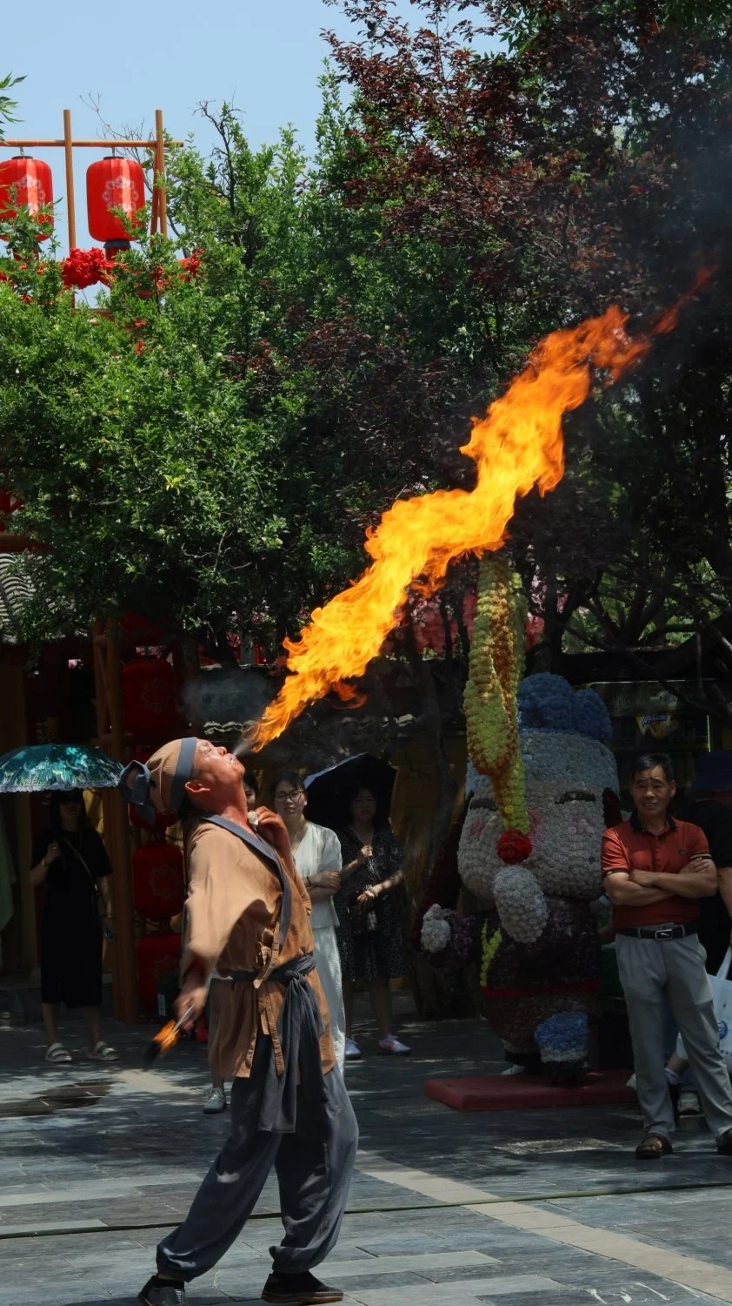
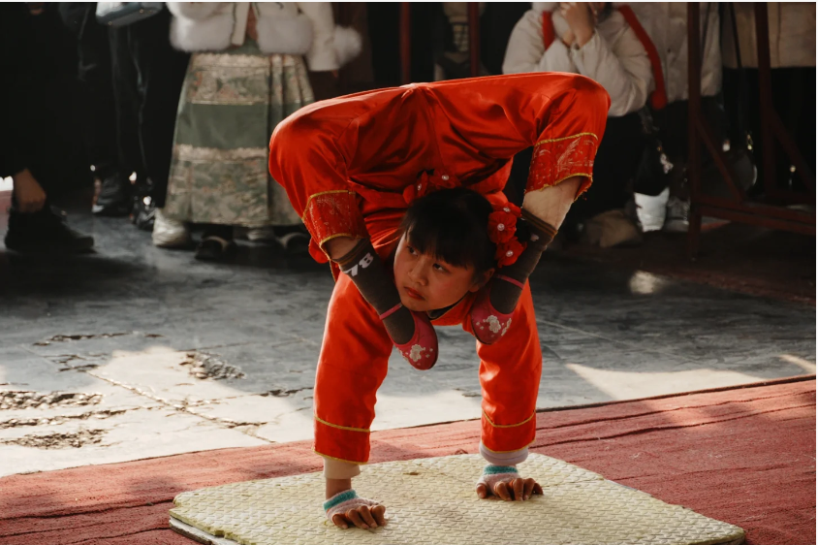
Acrobatics and Stunts

