Slide 1

Beijing Opera
丁代凤 Ding Daifeng
甘奉玉 Gan Fengyu

Slide 2

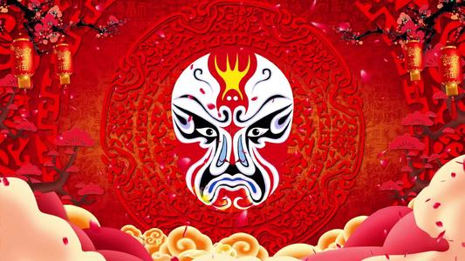
Beijing Opera
01. History of Beijing Opera
02. Features of Beijing Opera
03. Four main roles in Beijing Opera
04. Translation methods

Slide 3

PART ONE
History of Beijing Opera

Slide 4
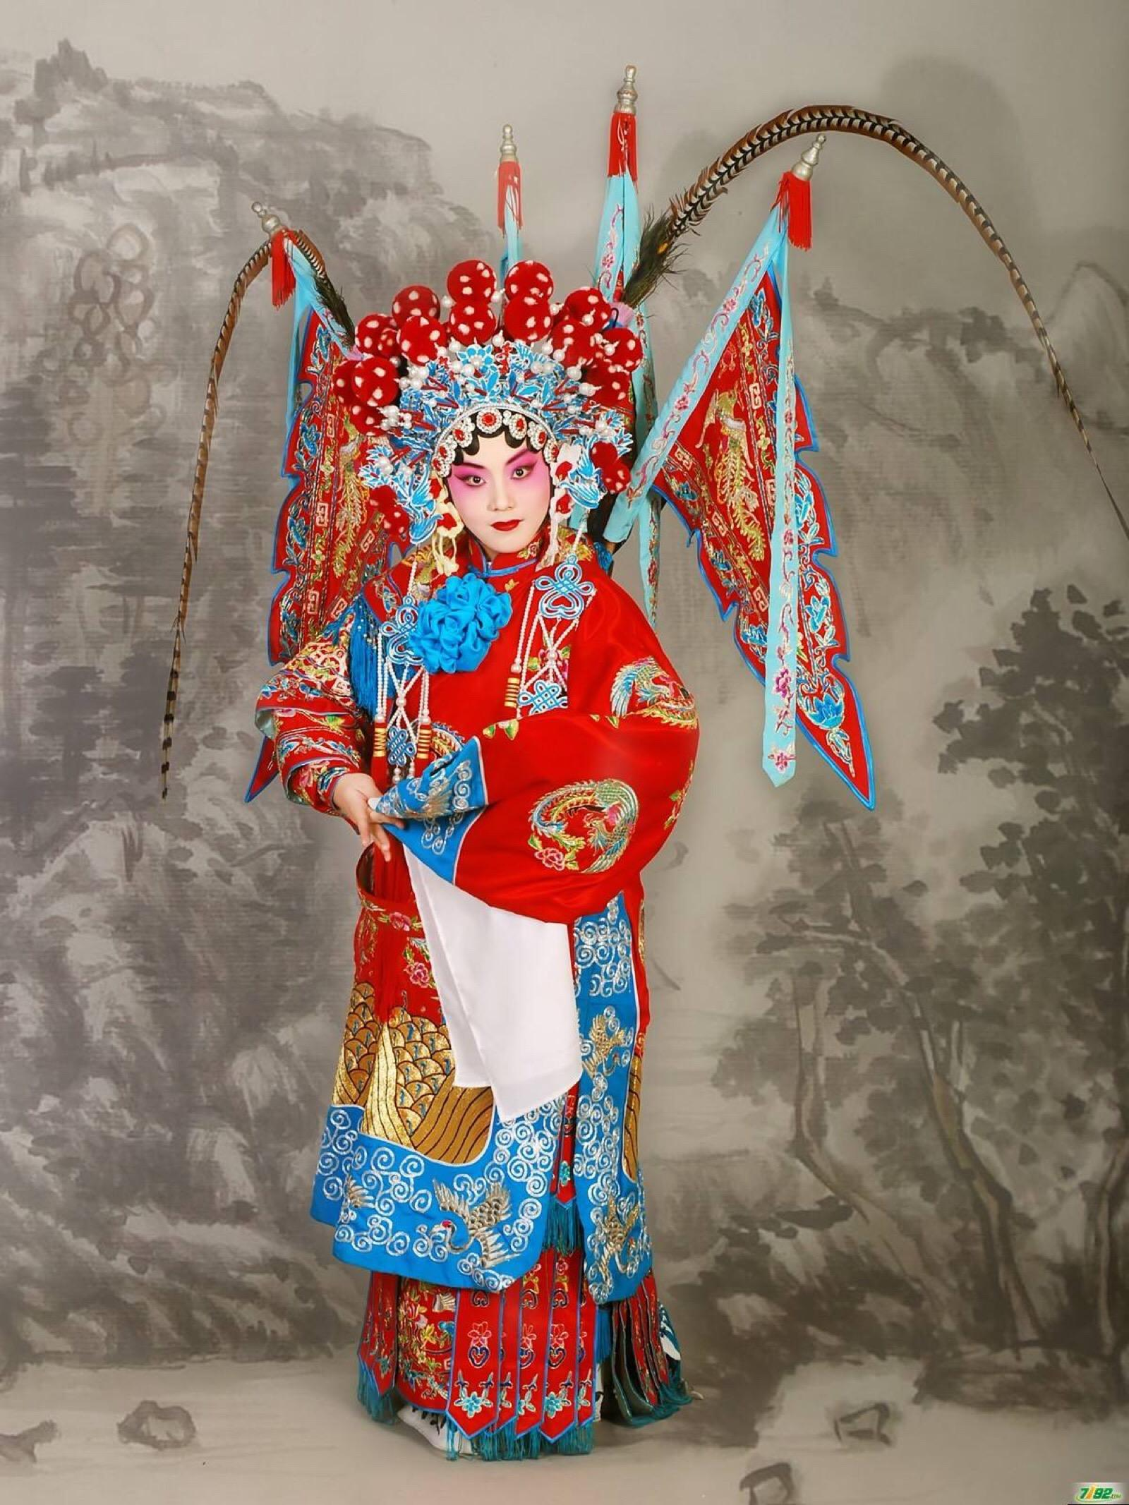
History of Beijing Opera
Beijing opera is the quintessence of Chinese culture with a history of more than 200 years.
During the reign of the Qianlong emperor in the Qing dynasty, Qianlong had an interest in the local opera. In 1790, to celebrate his 80th birthday, he summoned opera troupes from different places to perform for him in Beijing.

Slide 5
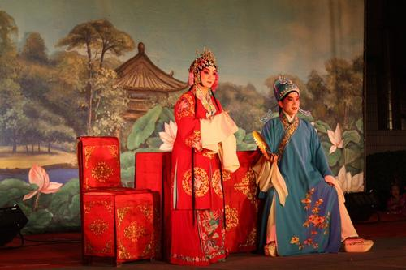
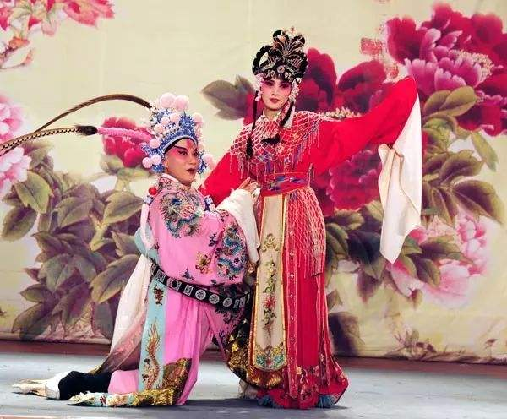
History of Beijing Opera
徽剧
Four famous troupes from Anhui province remained in Beijing after the celebration. In 1828, a Hubei troupe came to Beijing and often performed together with the Anhui troupes.
The two types of singing mixed together and a new type came into being known as Beijing Opera.
汉剧

Slide 6
PART TWO
Features of Beijing Opera

Slide 7
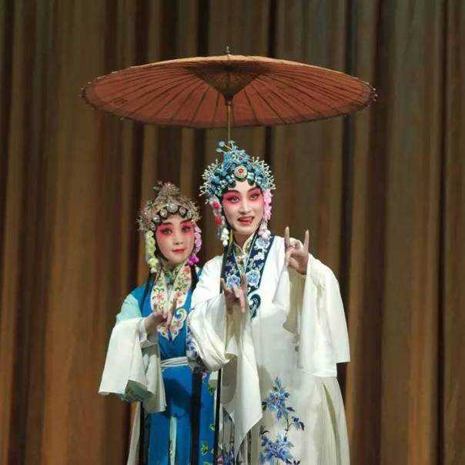
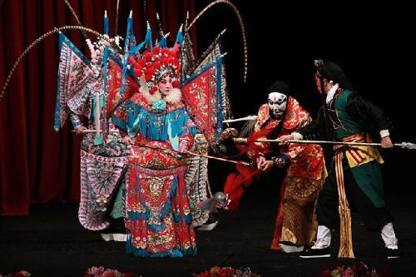
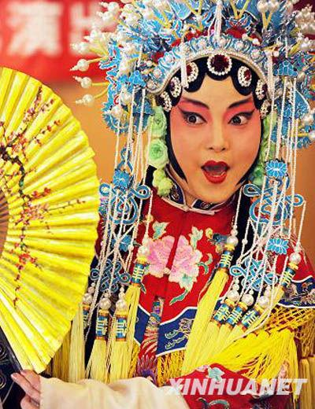
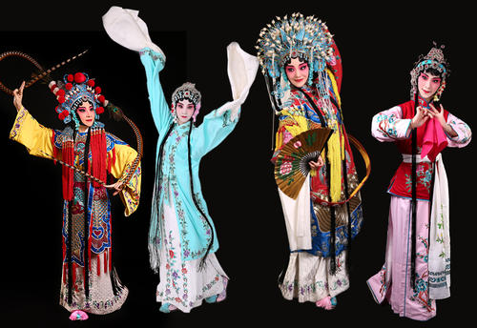
1. Comprehensive performing forms
sing唱
do做
read念
fight打

Slide 8
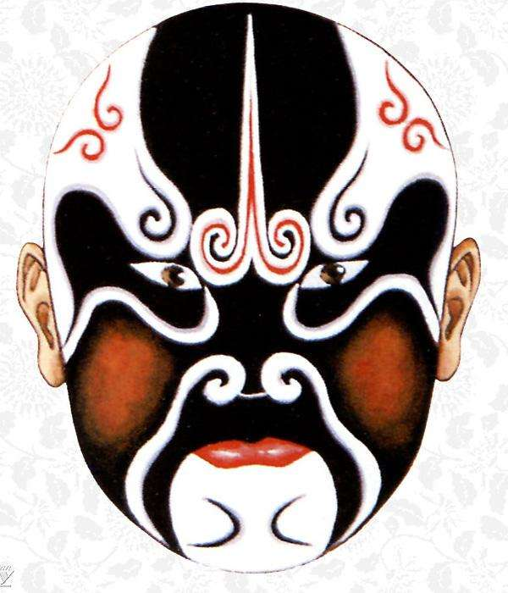
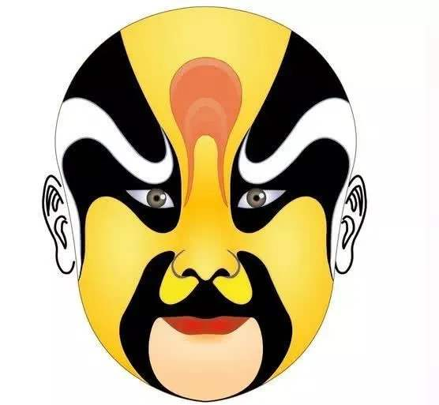
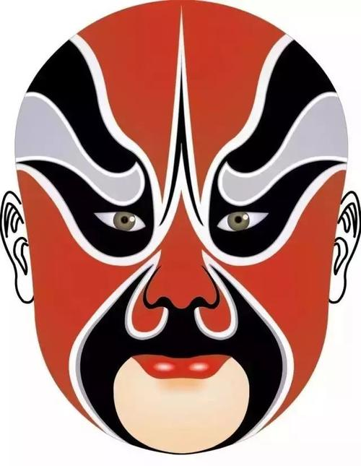
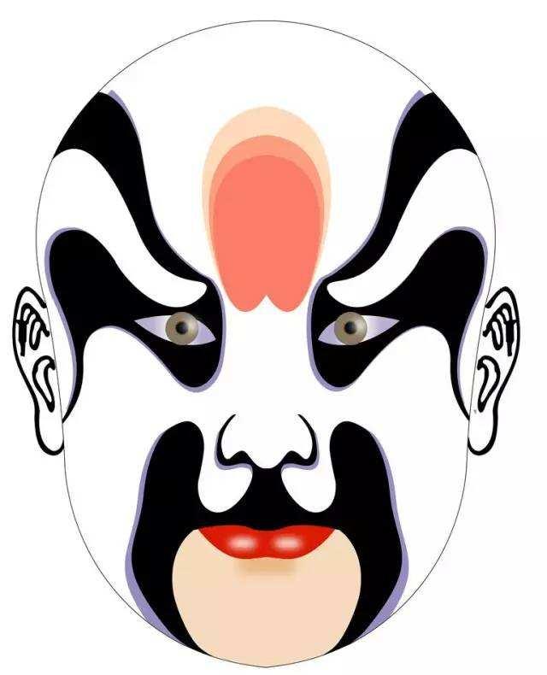
2. Colorful facial painting
Red: braveness
Guan Yu(关羽)
White: cunning
Cao Cao(曹操)
Black: integrity
Bao Zheng(包拯)
Yellow: brutality
Yuwen Chengdu(宇文成都)

Slide 9
PART THREE
Four main roles in Beijing Opera

Slide 10
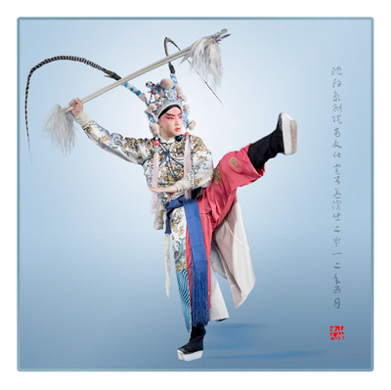
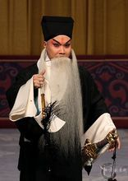
Sheng（生）
Sheng: male roles
laosheng: middle-aged or old men xiaosheng:young men
wusheng:men with martial skills

Slide 11
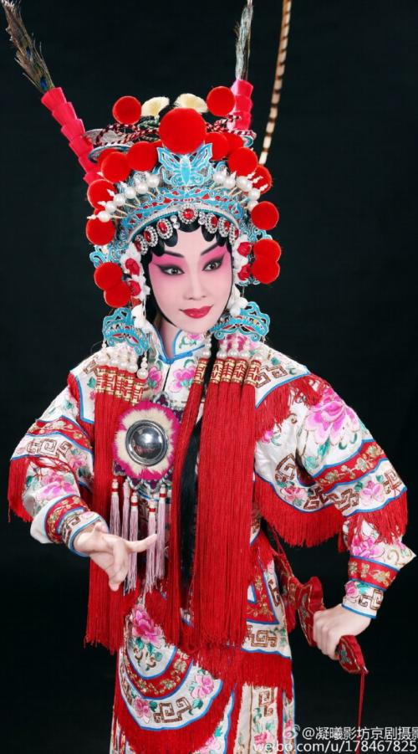
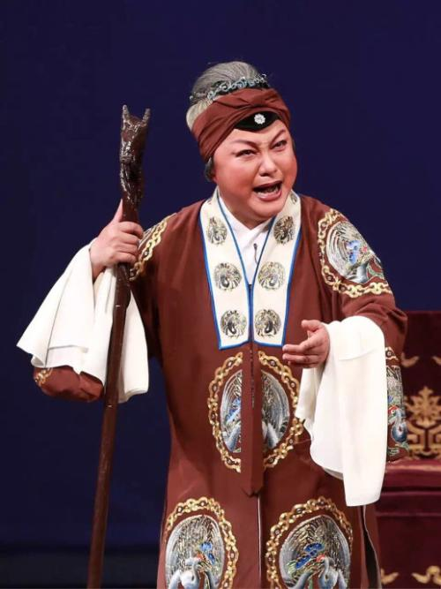
Dan（旦）
Dan: female roles
qingyi: woman with a strict moral code laodan: elderly woman
点击此处添加标题
标题数字等都可以通过点击和重新输入进行更改，顶部“开始”面板中可以对字体、字号、颜色、行距等进行修改。建议正文12号字，1.3倍字间距。双击图片，在顶部导航中找到填充，下拉菜单选择填充方式，选择“图片或纹理”，在来自图片中选择想要插入的图片，点击插入并确定。

Slide 12
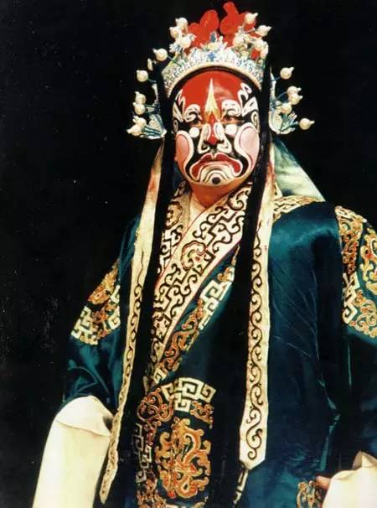
Jing（净）
Jing: roles with painted faces
It includes wenjing (civilian type) and wujing (warrior type).
They are usually warriors, heroes and statesmen.
点击此处添加标题
标题数字等都可以通过点击和重新输入进行更改，顶部“开始”面板中可以对字体、字号、颜色、行距等进行修改。建议正文12号字，1.3倍字间距。双击图片，在顶部导航中找到填充，下拉菜单选择填充方式，选择“图片或纹理”，在来自图片中选择想要插入的图片，点击插入并确定。

Slide 13
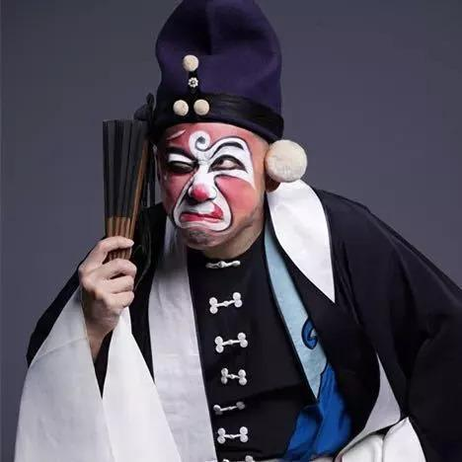
Chou（丑）
Chou: comic characters
wenchou: civilian clown
wuchou: clown with martial skills
点击此处添加标题
标题数字等都可以通过点击和重新输入进行更改，顶部“开始”面板中可以对字体、字号、颜色、行距等进行修改。建议正文12号字，1.3倍字间距。双击图片，在顶部导航中找到填充，下拉菜单选择填充方式，选择“图片或纹理”，在来自图片中选择想要插入的图片，点击插入并确定。

Slide 14
PART FOUR
Translation methods

Slide 15
Translation methods
1. Free translation（意译）
吉日良辰当欢笑，为什么鲛珠化泪抛？
On auspicious day people should laugh, but why does she cast the tears behind?

Slide 16
Translation methods
2. Conversion（词性转换）
也有饥寒悲怀抱，也有失意痛苦号啕；轿内的人儿弹别调，必有隐情在心潮。
There is also cold and sadness. There is also frustration and crying. The girl in the sedan is crying painfully. So there must be a sad story in her heart.

Slide 17
Translation methods
3. Amplification（增词法）
好一个贞洁王宝钏。
Wang Baochuan, you are really too pure.

Slide 18
THANK YOU!

