Slide 1

Ancient literature
神话
Chinese Mythology
—— Li Wanying ——

Slide 2
Content
1
2
Creation of Myths
Classification of Myths
3
4
Preservations of Myths
Significance of Myths
docerID:327037375

Slide 3
1
Creation of Myths

Slide 4

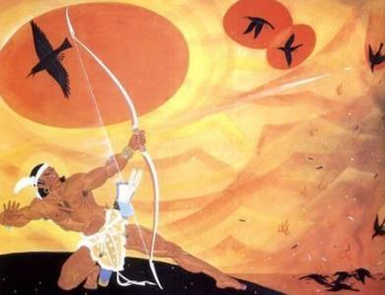

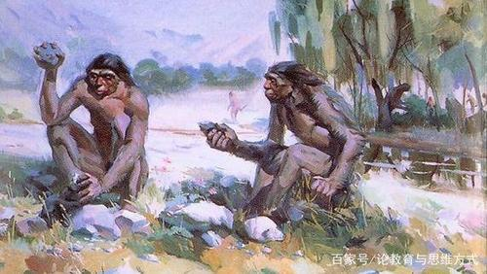
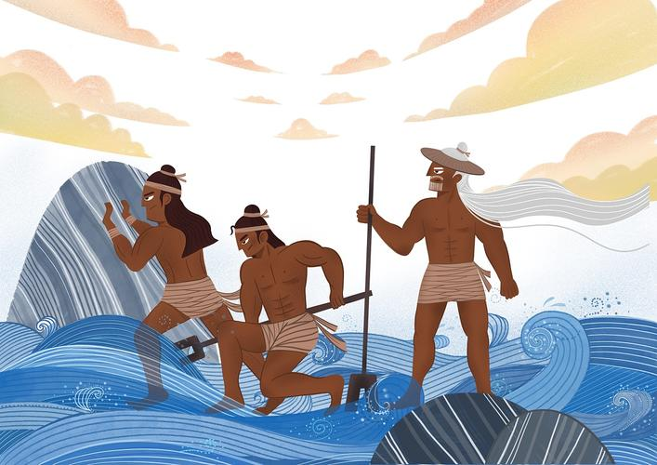

Low productivity
Thinking ability↑
Myths
...
？
Mythology is the product of primitive society when human productivity was low, and it is the product of conquering natural forces through fantasy.

Slide 5
2
Classification of Myths

Slide 6
Panku Created the world
the origin of the world
Exploration
NvWa created Human Beings
the origin of the human beings
Myths in
ancient China
Houyi Shot the Suns
drought
Conquest
Gun Yu Tamed the Flood
flood

Slide 7
Conquest -- Houyi Shot the Suns and Gun Yu Tamed the Flood
Drought
Flood
Houyi Shot the Suns
Gun Yu Tamed the Flood
There were ten suns in the sky in the ancient time. They should be in place in turns, but sometimes they appeared together which brought great disaster to earth. So people created a character named Yi, who shot down other nine suns for them to eliminate the drought.
Gun stealed the God's magical soil to block floods in the human world, but was killed as being discovered. And Yu, the son of Gun, determined to follow in his father's footsteps and finally succeeded in taming the floods by dredging.

Slide 8
3
Preservations of Myths

Slide 9
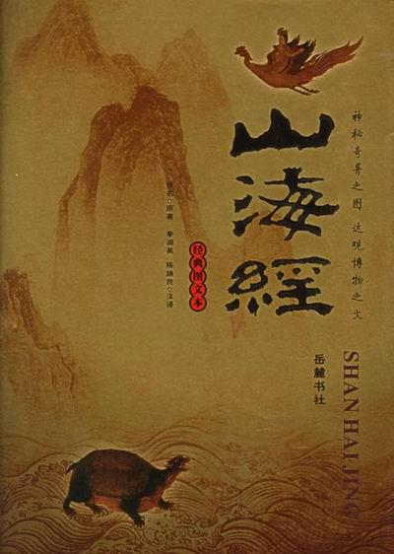
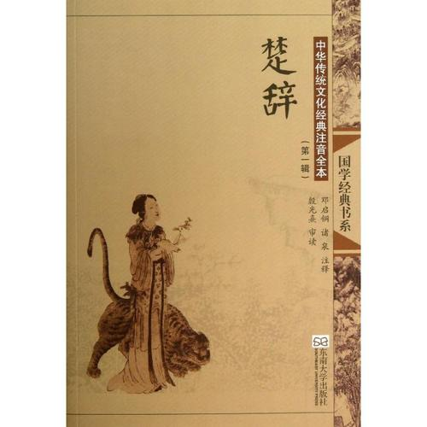
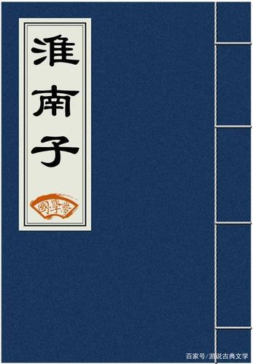
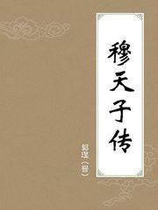
Four ancient classics with myths
Mutianzi
Biography
Shanhai Jing
Chu Ci
Huainanzi
It collects the most abundant mythological materials.
Four famous myths in ancient China

Slide 10
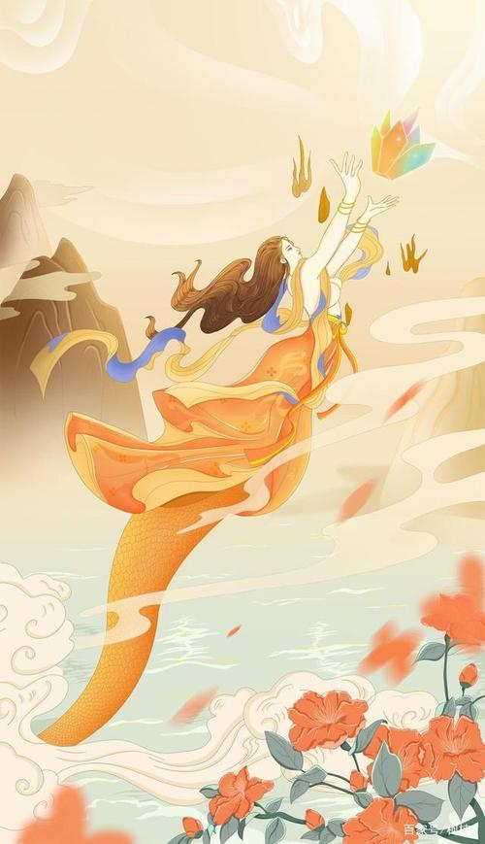
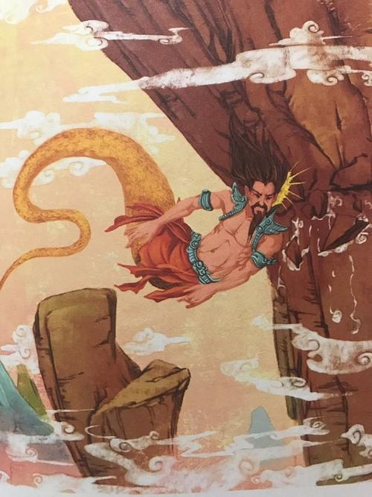
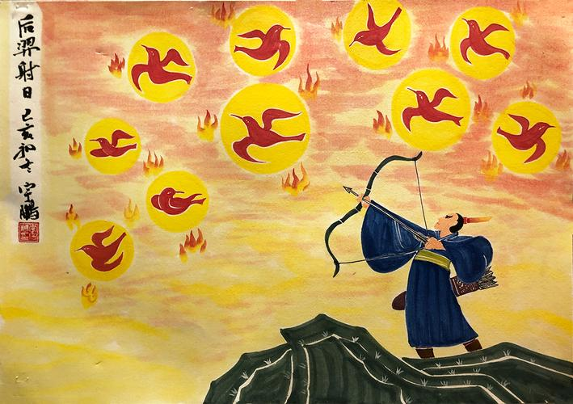
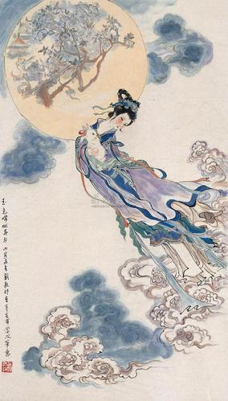
Huainanzi -- Four famous myths in ancient China
NvWa
Mended the Sky
GongGong
Against Buzhou Mountain
HouYI
Shot the Suns
Chang'e
Flied to the moon

Slide 11
4
Significance of Myths

Slide 12
Significance of Myths
·The methology is the source of our ancient literature and art.
·Its achievements in terms of amazing fantasy, vivid story and the skill of hyperbole profoundly influenced the later writers such as Qu Yuan, Tao Yuanming, Li Bai, etc. and the later fiction and traditional opera.
·The enthusiasm and preserverance, the heroism without fear of violence or sacrifice produced positive effect in the development of ancient literature and in the formation of our national temperament.

Slide 13
神话
Thank you
—— Li Wanying ——

