Slide 1
Traditional Crafts:
Folk Art—Chinese Paper-cutting

Slide 2
Contents:
1. Introduction
2. History
3.Appreciation and Translation

Slide 3
Color: Red is the main color, demonstrating warmth, passion, brightness, and happiness. Besides red, mono-colored paper-cutting is also available in black or other colors, which are used according to different circumstances.
Reason: It originated in ancient ancestor worship activities in which people pray for their ancestors and gods.
Function: It serves as the decorations for the doors, walls, mirrors, lanterns and so on

Slide 4
Theme: Folk paper-cutting has a wide range of subjects, including auspicious patterns, historical allusions, mythological dramas, landscapes, flowers, birds, fish and insects, twelve zodiac animals, pavilions, totem worship, and religious beliefs.
Time: Traditionally, on the 23rd day of the twelfth lunar month, women "drop their hoes and pick up scissors to cut papers"; on the 28th, flowers are pasted on the windows.

Slide 5
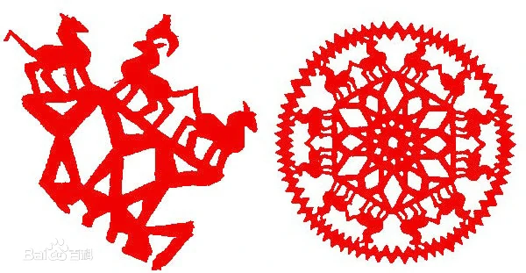
History:
The earliest paper-cutting was found in Turfan which is in the northwest part of China. It was in 6th century . At that time, the paper was just invented.

Slide 6
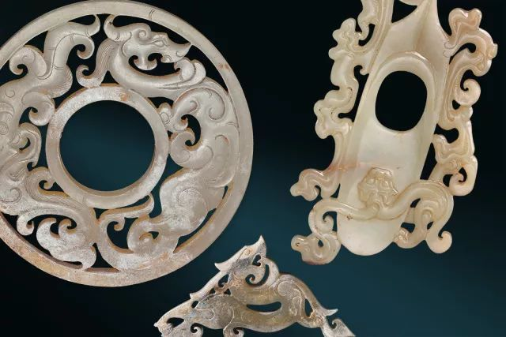
But the skill of cutting and carving appeared way before the invention of paper, and a number of materials, from the bark, leaves and animal skin, to later silk, were cut into certain shapes to decorate things, which laid a solid foundation for the art of paper-cutting.

Slide 7
In the Tang dynasty the custom of paper-cutting began to be popular, and the handicraft man cut paper to different shapes, each given a special name. Namely, the shape of square was named “Fangsheng”, the flower-shaped “Huasheng”, the people-shaped “Rensheng”. Two pieces of “Huasheng”, which were the remains in the Tang Dynasty, are preserved now in in Japan.
By the Song Dynasty, with the prosperous economy and culture, in addition to daily decoration, paper-cutting was used in other crafts such as porcelain（瓷器） and blue calico（印花布）.

Slide 8
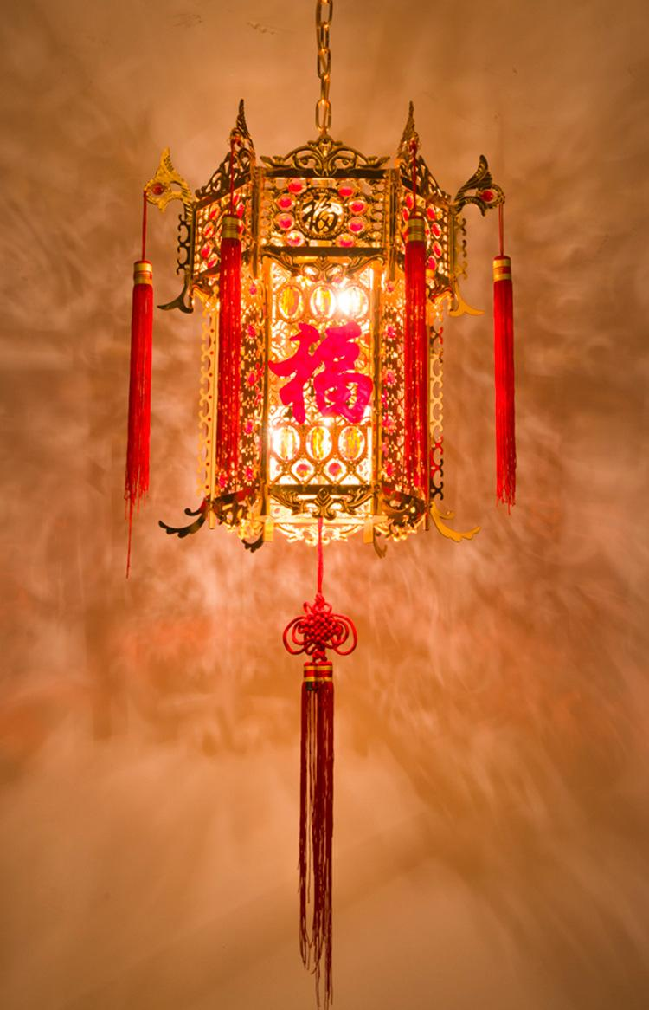
The art of paper-cutting became mature in Yuan, Ming, and Qing dynasties. There emerged well designed paper-cutting works in the Yuan dynasty, and collectors began to collect paper-cutting as artworks. By the Ming Dynasty, the application of paper-cutting became even wider, with clip gauze lantern as a representative. It is a lantern with paper-cutting clipped in, candlelight reflecting the pattern.

Slide 9
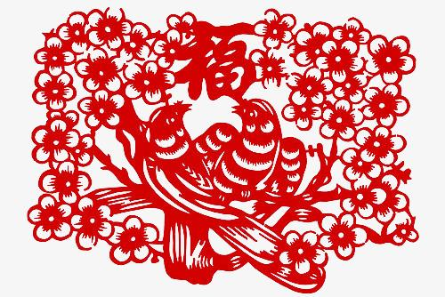
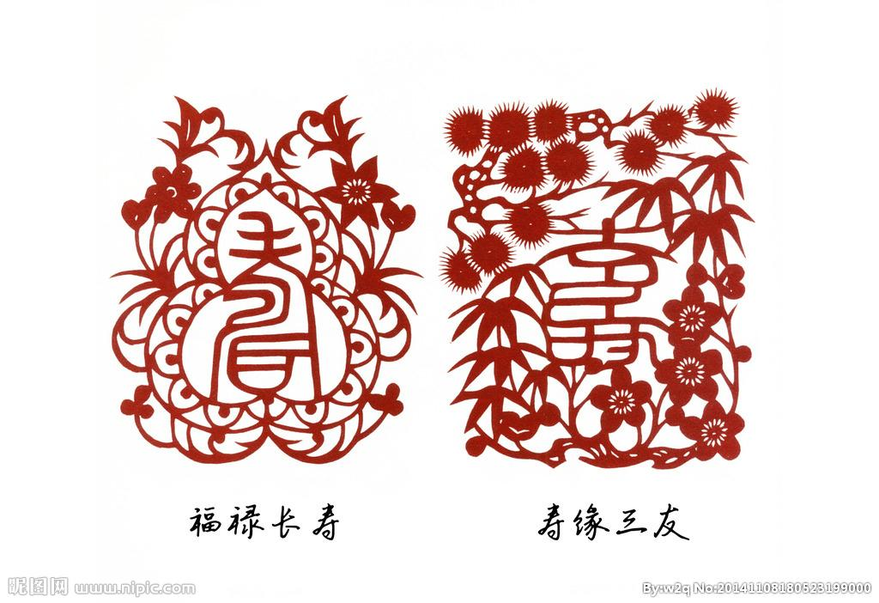
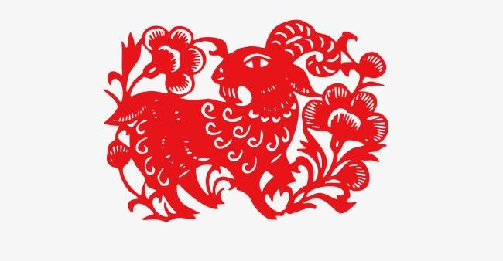
Mono-colored paper-cutting refers to paper-cuttings cut or curved with a single-colored paper, mostly in red.

Slide 10
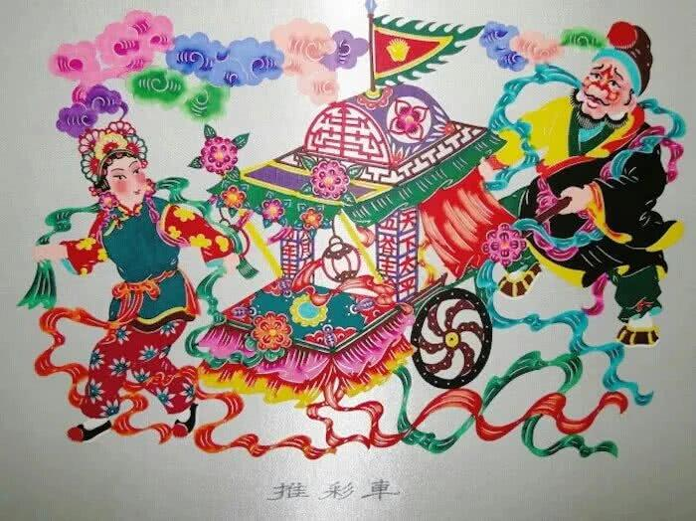
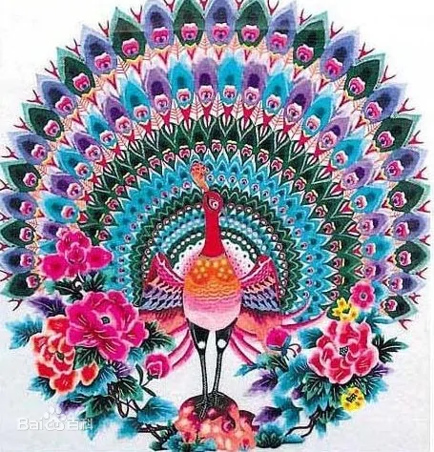
Dyed paper-cutting
The handicraftsman would mostly choose Xuan paper as the material, a kind of thin white paper that absorbs water easily. Twenty or thirty pieces of such paper are put into a pile and the pattern is carved out with a knife. Then the mass of paper is dyed.

Slide 11
Translation:
Paper-cutting
Cut (skill)
Paper(material)
Literal translation
Snip/clip

