Slide 1
Beijing Normal University
北京师范大学
翻译文学 Translated literature
Prof. Dr. Martin Woesler
北京师范大学客座教授

Slide 2
Session 1
Session Overview
Self-introduction
Contents, required textbooks
Review existing concepts, preview this semester‘s contents:
What you will be able to do at the end of this semester
Jointly agree on commitment, use of classroom time, weight of grades
Presentation today:
Translation: History, Theories, transformation etc. 翻译：历史，理论，转变等。
further resources: Wiki web site
Assignment for 3rd session: Choose 1 author, reading

Slide 3
Self-Introduction 自我介绍
Bochum, Peking, Harvard, Mainz/Germersheim, Witten, Harvard, Orem/USA, Rome, Peking Normal & Witten
Essays (Western influence, social impact, cf.: blogs)
Early literary translations
Development of literature (Canonization, Categorization)
Early Western reception of Dream of the Red Chamber

Slide 4
TRANSLATED LITERATURE: Weekly content
课程：（中／英） | 授课教师：Martin Woesler
周数 | 授课内容
Week 1 | Translation: History, Theories, transformation etc.
 | 翻译：历史，理论，转变等
Week 2 | Translation: Asian Translation Tradition
 | 翻译：亚洲翻译传统
Week 3 | Literature: The role and function of Literature in China and the West
 | 文学：中西方世界里文学的角色和功能
Week 4 | Literature: History, concept of world literature
 | 文学：历史，世界文学概念

Slide 5
周数 | 授课内容
Week 5 | Earliest translations from the West to Chinese
 | 从西方到中国的早期翻译
Week 6 | Earliest translations: The role of the Bible
 | 早期翻译：《圣经》的角色
Week 7 | Earliest translations: Western Fables
 | 早期翻译：西方寓言
Week 8 | Earliest translations: Western Novels
 | 早期翻译：西方小说
Week 9 | Examples of earliest world literature in Chinese translation: The Lady of the Cameillas
 | 早期世界文学的中文翻译之例：《茶花女》

Slide 6
周数 | 授课内容
Week 10 | Examples of world literature in Chinese translation: Goethe’s Faust and different Goethe translations
 | 世界文学的中文翻译之例：歌德的《浮士德》和歌德的不同翻译
Week 11 | Example 1 from “The Classical Guide to World Literature”
 | “世界文学经典导读”之例一
Week 12 | Example 2 from “The Classical Guide to World Literature”
 | “世界文学经典导读”之例二
Week 13 | Example 3 from “The Classical Guide to World Literature”
 | “世界文学经典导读”之例三
Week 14 | Example 4 from “The Classical Guide to World Literature”
 | “世界文学经典导读”之例四
Week 15 | Example 5 from “The Classical Guide to World Literature”
 | “世界文学经典导读”之例五
General Literature: Fadiman, Clifton, and John S. Major. The New Lifetime Reading Plan: The Classical Guide to World Literature, Revised and Expanded. Harper Collins, 1999.

Slide 7
About grades
Expectation for grades
=
Requirements from the curriculum

Slide 8
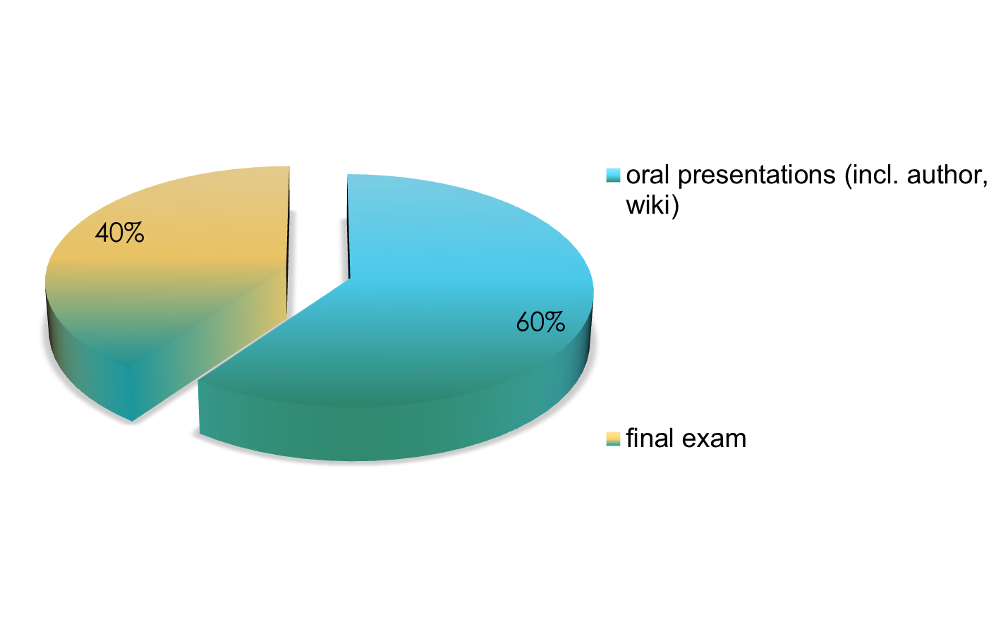
About grades

Slide 9
Unique Selling Points
quality: based on experience in Germany (Bochum, Mainz/Germers-heim, UAL Munich, Witten), Italy (Rome III), the USA (Harvard, UVU)
understand major literary trends with selection of extracts from main texts
active: enact historical authors and their standpoints
jointly agree on: weight of grades
jointly agree on: your oral presentation will be documented in a wiki article and will be published
fellowship: get help of others and help others
simple quizzes as reading response

Slide 10
Session 1
Translation: History, Theories, transformation etc.
翻译：历史，理论，转变等
Since when do we have translation?
What are the main milestones of translation history?
How many pieces of literature do we know in its original and through its translation?
What are the main theories of translation?
What is transformed in a translation process?

Slide 11
History of translation
Source: er.nau.edu.ua/bitstream/NAU/10323/4/Lecture%201.ppt

Slide 12
Translation in antiquity.
    1. Translation in ancient Egypt.
    2. Translation in Assyria and Babylon.
    3. Translation in ancient China and India.
    4. Translation in the Roman Empire.

Slide 13
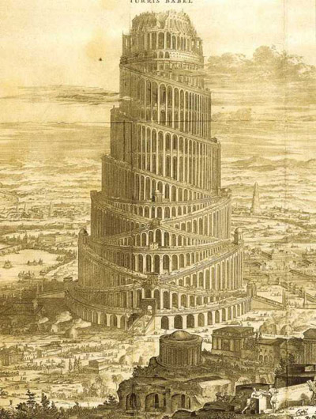
the Tower of Babel
But the Lord came down to see the city and the tower that the men were building.
The Lord said, “If as one people speaking the same language they have begun to do this, then nothing they plan to do will be impossible for them. Come, let us go down and confuse their language so they will not understand each other.”
(Genesis 11: 5-7)

Slide 14
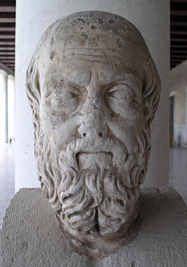
Translation in ancient Egypt
Now of the Egyptians there are seven classes, and of these one class is called that of the priests, and another that of the warriors, while the others are the cowherds, swineherds, shopkeepers, interpreters, and boatmen.
This is the number of the classes of the Egyptians, and their names are given them from the occupations which they follow.
(Herodotus Histories 2.164)

Slide 15
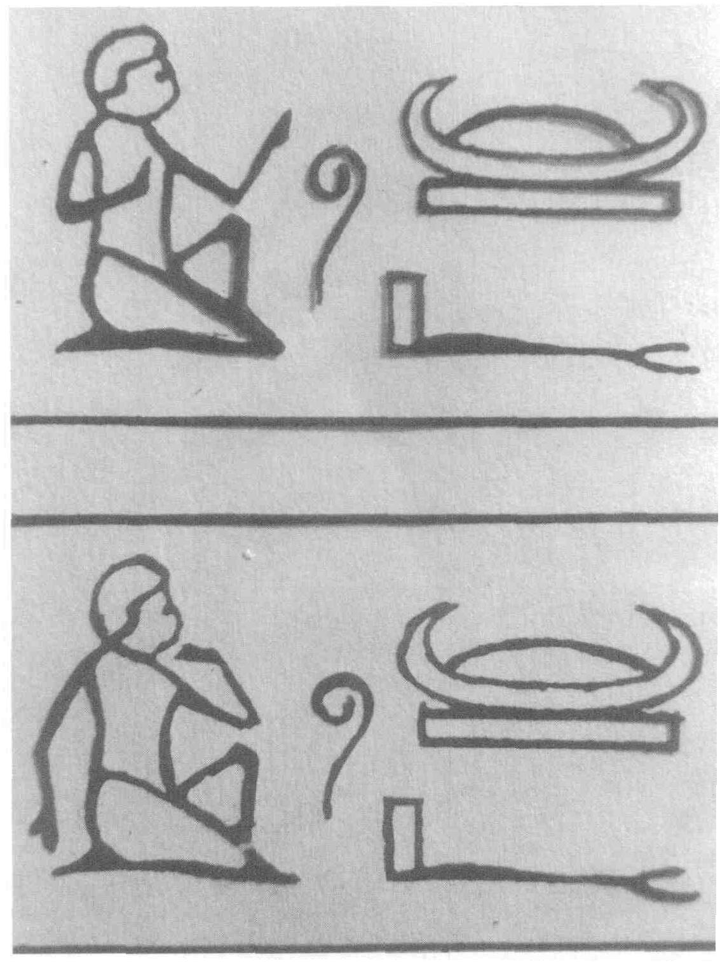
Translation in ancient Egypt
Egyptian hieroglyphic meaning “interpreting”

Slide 16
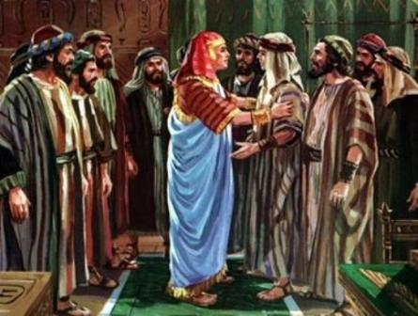
Translation in ancient Egypt
They did not know that Joseph understood them, for there was an interpreter between them. (Genesis 42)

Slide 17
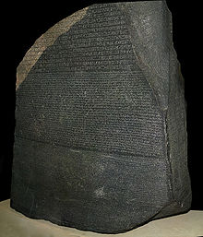
Translation in ancient Egypt
Rosetta Stone, bearing the first known bilingual text.

Slide 18
Translation in ancient Egypt
The inscription on the Rosetta Stone records a decree that was issued at Memphis in 196 BCE on behalf of King Ptolemy V.
The decree appears in three texts: ancient Egyptian hieroglyphs, Egyptian demotic script (used in everyday speech),
and ancient Greek.

Slide 19
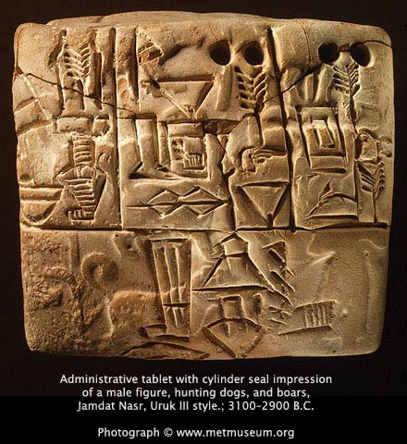
Translation in Assyria and Babylon
The Sumerian language of Mesopotamia (modern Iraq) is the earliest known written language
Sumerians wrote in cuneiform on clay tablets
bilingual cuneiform dictionaries of Sumerian and Akkadian (1800-1600 B.C.)

Slide 20
Translation in Assyria and Babylon
In ancient Assyria and Babylonia there was a regular board of interpreters working at court.
During the war the interpreters accompanied the king together with scribes and other officers.

Slide 21
Translation in ancient China and India.
The earliest translation activities in China date back to the Zhou dynasty (11th c.BC). Translation was carried out by government clerks.
"Translation is to replace one written language with another without changing the meaning for mutual understanding."
Jia Gongyan, an imperial scholar
(late Zhou dynasty)

Slide 22
Translation in ancient China and India
In the fifth century, translation of Buddhist scripture was officially organized on a large scale in China.
Dao An, Director of the State Translation School, advocated strict literal translation of the Buddhist scriptures, because he himself didn't know any Sanskrit.

Slide 23
Translation in ancient China and India
Indian Buddhist monk Kumarajiva (350-410) carried out a great reform of the principles and methods for the translation of Sanskrit sutras.
He applied a free translation approach to transfer the true essence of the Sanskrit Sutras.
He was the first person in the history of translation in China to suggest that translators should sign their names to the translated works.

Slide 24
Translation in ancient China and India
In the year 150, a Greek astrological text, written in Alexandria a hundred years earlier, was translated into Sanskrit.
In the classical period (100 -1000), translation activity in India was connected with the significant development of drama.

Slide 25
Translation in ancient China and India
Sanskrit plays started to allow characters who were not kings or brahmins to speak in Prakrit, an intermediate stage between Classical Sanskrit and the modern Indian languages derived from Sanskrit.
Prakrit speeches in plays were provided with glosses in Sanskrit.

Slide 26
Translation in ancient China and India
From the 7th century onwards, contacts with Arab traders resulted in the exchange of medical expertise between Indians and Arabs. Medical treatises were translated from Sanskrit into other languages both inside India and outside it.

Slide 27
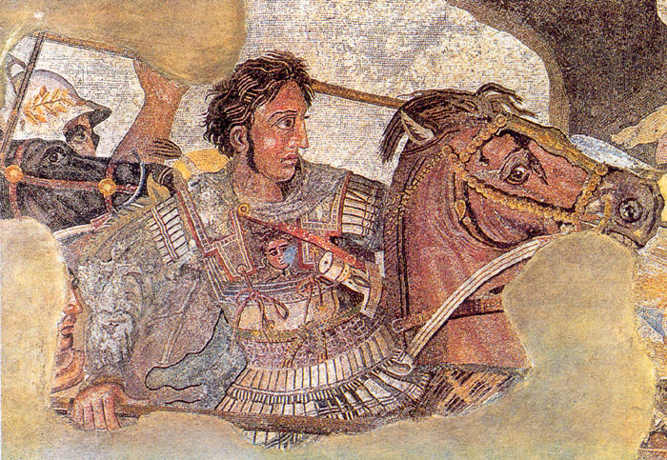
Translation in the Roman Empire
References to the services of military interpreters are found in Greek literature concerning Alexander the Great’s campaigns in Asia, which took him as far as India.

Slide 28
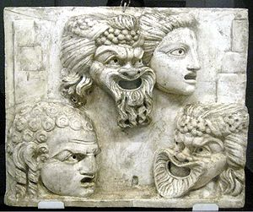
Translation in the Roman Empire
In the 3rd c. BC the popularity of Greek theatre among the Romans encouraged Latin authors to make free translations and adaptations of Greek plays.

Slide 29
Translation in the Roman Empire
Livius Andronicus (c. 285-204 BC) wrote a Latin version of the Odyssey (250 BC) and a number of plays commissioned for the Roman Games of 240 BC.

Slide 30
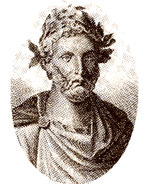
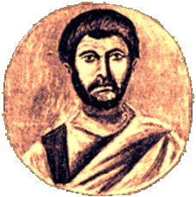
Translation in the Roman Empire
Plautus (d.184 BC) and Terence (?190-?159 BC) - the world's first commercial literary translators.

Slide 31
Translation in the Roman Empire
The Roman authors made free adaptations of the original Greek plays to suit the taste of the Roman audience.

Slide 32
Translation in the Roman Empire
In the century following Terence, the Greeks introduced rhetoric to Rome and translation began to be seen as a branch of rhetoric.

Slide 33
Translation in the Roman Empire
The greatest age of Roman literary translation began with a translation of Homer by Matius (about 100 BC) and lasted until the middle of the 1st c. AD.
This age set the tradition of treating translation as a literary apprenticeship.

Slide 34
Translation in the Roman Empire
Among the greatest names associated with the development of a truly Roman literature are the poets Catullus (87-57 BC) and Horace (65-8 BC) and the statesman, orator and philosopher Cicero (106-43 BC).

Slide 35
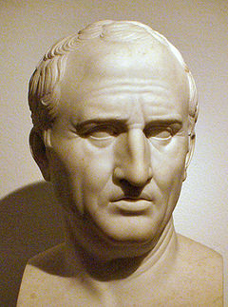
Translation in the Roman Empire
In De optimo genere oratum
(The Best Kind of Orator) Cicero makes two major points:
word-for-word translation is not suitable;
the translators should seek in their own languages expressions that make the translation sound as forceful and convincing as the original text.

Slide 36
Translation in the Roman Empire
Cicero's translations of Greek philosophers prepared the ground for most modern philosophical terminology.

Slide 37
Translation in the Roman Empire
‘De optimo genere oratorum’ (the Best Kind of Orator):
For I have translated into Latin two of the most eloquent and most noble speeches in Athenian literature, those two speeches in which Aeschines and Demosthenes oppose each other. And I have not translated like a mere hack, but in the manner of an orator, translating the same themes and their expression and sentence shapes in words consonant with our conventions.

Slide 38
Translation in the Roman Empire
In so doing I did not think it necessary to translate word for word, but I have kept the force and flavour of the passage. For I saw my duty not as counting out words for the reader, but as weighing them out. And this is the goal of my project: to give my countrymen an understanding of what they are to seek from those models who aim to be Attic in style, and of the formulas of speech they are to have recourse to.

Slide 39
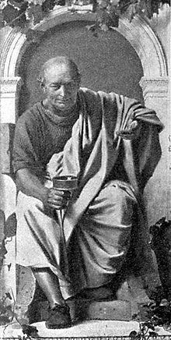
Translation in the Roman Empire
Horace criticizes the ‘faithful’ translator and follows the way of free interpretation of originals.

Slide 40
Translation in the Roman Empire
Horace supported Cicero’s recommendations for translators of orations, where the aim is not so much a literal transcription of the Greek words as a representation of the persuasiveness of source texts, which are transcriptions of delivered speeches.

Slide 41
Translation in the Roman Empire
From Horace, Satires, Epistles and Ars Poetica:
In ground open to all you will win private rights, if you do not linger along the easy and open pathway, if you do not seek to render word for word as a slavish translator.

Slide 42
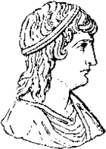
Translation in the Roman Empire
The way of free interpretation
from the source language works in translation was accepted and further developed in the 2nd c. AD by Apuleius
(c. 125 – c. 180), who would still more deliberately rearrange the ancient Greek originals altering them sometimes beyond recognition.

Slide 43
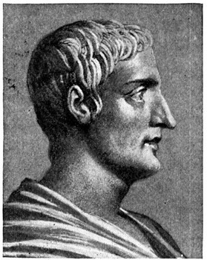
Translation in the Roman Empire
Quintilian
(?30-?96 AD)
Institutio Oratoria
(Education of an Orator)

Slide 44
Translation in the Roman Empire
Quintilian sees translation not only as a tool in the acquisition of a foreign language, but as a means of enriching the target language.
He systematizes much of what earlier writers had to say, making clear, for instance, the distinction between metaphrasis (word-for-word translation) and paraphrasis (phrase-by-phrase translation).

Slide 45
Translation in the Roman Empire
From Institute of Oratory; or Education of an Orator
From these [Greek] authors, and others worthy to be read, a stock of words, a variety of figures, and the art of composition must be acquired; and our minds must be directed to the imitation of all their excellences; for it cannot be doubted that a great portion of art consists in imitation, since, though to invent is first in order of time, and holds the first place in merit, yet it is of advantage to copy what has been invented with success. [ . . . ]

Slide 46
Translation in the Roman Empire
From Institute of Oratory; or Education of an Orator
We must, indeed, be either like or unlike those who excel and nature rarely forms one like, though imitation does so frequently. But the very circumstance that renders the study of all subjects so much more easy to us, than it was to those who had nothing to imitate, will prove a disadvantage to us, unless it be turned to account with caution and judgement.

Slide 47
Translation in the Roman Empire
From Institute of Oratory; or Education of an Orator
Undoubtedly, then, imitation is not sufficient of itself, if for no other reason than that it is the mark of an indolent nature to rest satisfied with what has been invented by others. For what would have been the case, if, in those times which were without any models, mankind had thought that they were not to execute or imagine anything but what they already knew? Assuredly nothing would have been invented. [ . . . ]

Slide 48
Translation in the Roman Empire
From Institute of Oratory; or Education of an Orator
It is dishonourable even to rest satisfied with simply equalling what we imitate. For what would have been the case, again, if no one had accomplished more than he whom he copied? [ . . . ] But if it is not allowable to add to what has preceded us, how can we ever hope to see a complete orator, when among those, whom we have hitherto recognised as the greatest, no one has been found in whom there is not something defective or censurable?

Slide 49
Translation in the Roman Empire
From Institute of Oratory; or Education of an Orator
Even those who do not aim at the highest excellence should rather try to excel, than merely follow, their predecessors; for he who makes it his object to get before another, will possibly, if he does not go by him, get abreast of him. But assuredly no one will come up with him in whose steps he thinks that he must tread, for he who follows another must of necessity always be behind him. [ . . . ]

Slide 50
Translation in the Roman Empire
From Institute of Oratory; or Education of an Orator
Our ancient orators believed that the most efficacious means of acquiring a command of their language was to translate Greek works into Latin. Crassus, quoted in Cicero, De Oratore l. 155, says he made a practice of it; and Cicero, speaking in his own name, recommended it very often. And indeed, he published books by Xenophon and Plato he had translated.
[ . . . ] The reason for this exercise is extremely obvious. For Greek authors abound in richness of expression and bring the greatest finesse into their oratory.

Slide 51
Translation in the Roman Empire
From Institute of Oratory; or Education of an Orator
And therefore those who would translate these authors must use the best of language while relying on their native resources. Because our Roman language is immensely different from Greek, we are bound by a certain need to rethink the many and varied figures with which a work is adorned.
[ . . . ] For I do not want translation to be a mere paraphrase, but a struggle and rivalry over the same meanings.

Slide 52
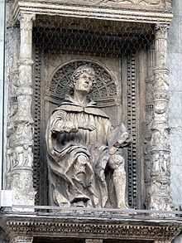
Translation in the Roman Empire
Gaius Plinius Caecilius Secundus (Pliny the Younger)
(61? – 112? AD)

Slide 53
Translation in the Roman Empire
From Epistle VII ix. 1–6, Letter to Fuscus Salinator (85 AD)
You ask my opinion on how you should study during your retirement which you have enjoyed for some time now. As many advise, it is of primary importance to translate from Greek into Latin or from Latin into Greek. By this type of exercise one becomes sensitive
to the properties and richness of vocabulary, to the wealth of figures of speech, to effective exposition; and moreover, by the imitation of the best models is learnt the power of writing on the same subject matter.

Slide 54
Translation in the Roman Empire
From Epistle VII ix. 1–6, Letter to Fuscus Salinator (85 AD)
And at the same time, a translator cannot ignore the responsibilities of a reader. For from this comes understanding and critical sense.
When you have read closely enough to retain matter and argument, there is nothing to prevent you from writing like your author’s rival and then comparing your work with what you have read. Then you should seek out what is better in your version and better in his. You will have great satisfaction if some of your work is better, and considerable embarrassment if all of his shows more skill.

Slide 55
Translation in the Roman Empire
From Epistle VII ix. 1–6, Letter to Fuscus Salinator (85 AD)
At times one can choose extremely familiar passages, and then seek to excel those you have chosen. Being private this struggle is bold but not out of place: although we do see many who have taken on these contests with much credit to themselves, and who have shown enough self-confidence to surpass those they intended merely to follow.

Slide 56
Translation in the Roman Empire
From Epistle VII ix. 1–6, Letter to Fuscus Salinator (85 AD)
You can revise what you have written after letting it lie, keep much of it, skim through much of it, add new material, rewrite a lot of it. This is laborious and tedious; but, because of its very difficulty, it bears fruit in bringing you new fire, and giving you new drive when your enthusiasm has flagged. For you will be weaving new members into the complete body without disturbing the balance of the original.

Slide 57
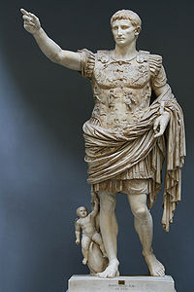
Translation in the Roman Empire
The Emperor Augustus
(63 BC – 14 AD) set up a translation office to assist in administering the Empire.
End of source: er.nau.edu.ua/bitstream/NAU/10323/4/Lecture%201.ppt

Slide 58
THEORIES:
“TRANSLATION STUDIES:
A BRIEF HISTORY“
Source: www.pfri.uniri.hr/~bopri/documents/Histoftranslstudies.ppt

Slide 59
A brief history of the discipline
Cicero, Horace (1st cent BCE), St Jerome (4th cent. CE): The Bible – battleground of conflicting ideologies in western Europe: literal vs. free (word or sense; interpres ut orator)
Period until the late 1960s: TR – an element of language learning (in modern language courses)
  the grammar-translation method)
  classical languages + M. Luther (modern languages) – translation exercises
  a means of learning foreign language (reading skills)
  change of attitude with the rise of the direct method (spoken lang.) - NO translation in the classroom
Since the 1970s: TR developed into an academic discipline

Slide 60
1. The early period
The practice of translation was discussed by Cicero and Horace (first century BCE) and St Jerome (fourth century AD);
  their writings exerted an important influence up until the twentieth century
  St Jerome’s approach to translating the Greek Septuagint Bible into Latin affected later translations of the Scriptures.
  Non verbum de verbo sed sensum de senso!
the translation of the Bible was to be – for well over a thousand years and especially during the Reformation in the sixteenth century – the battleground of conflicting ideologies in western Europe

Slide 61
"What happened at the Tower of Babel?"
The Tower of Babel is described in Genesis chapter 11, verses 1-9. After the Flood, God commanded humanity to "increase in number and fill the earth" (Genesis 9:1).
Humanity decided to do the exact opposite, "Then they said, "Come, let us build ourselves a city, with a tower that reaches to the heavens, so that we may make a name for ourselves and not be scattered over the face of the whole earth" (Genesis 11:4).
Humanity decided to build a great city and all congregate there. They decided to build a gigantic tower as a symbol their power, to make a name for themselves (Genesis 11:4).
This tower is remembered as the Tower of Babel.In response, God confused the languages of humanity so that we could no longer communicate with each other (Genesis 11:7).
The result was that people congregated with other people who spoke the same language - and then went and settled in other parts of the world (Genesis 11:8-9).
God confused the languages at the Tower of Babel to enforce His command for humanity to spread throughout the entire world.
Some Bible teachers also believe that God created the different races of humanity at the Tower of Babel. This is possible, but it is not taught in the Biblical text. On the origin of the races - http://www.gotquestions.org/different-races.html.
It seems more likely that the different races existed prior to the Tower of Babel and that God confused the languages at least partially based on the different races. From the Tower of Babel, humanity divided based on language (and possibly race) and settled in various parts of the world.
Recommended Resource: The Answers Book by Ken Ham.

Slide 62
1. Translation – before the 20th century
Word-for-word or sense-for-sense TR
Martin Luther
Early attempts at systematic TR: Dryden, Dolet, Tytler
Schleirmacher and the evaluation of the foreign
TR theories in 19th and early 20th cent.

Slide 63
Word-for-word or sense-for-sense TR
TR theory until 20th cent.: a sterile debate over the triad literal, free, and faithful TR (Steiner 1998)
Cicero (1st cent BC, De optimo genere oratorum):
  word for word vs sense for sense TR – chief principles of TR of the age
  word for word (interpreter / literal TLR) - The replacement of each individual word of ST (Greek) with its closest grammatical equivalent in Latin (reading Gr & Lat side by side), p. 19
  sense for sense (orator) – procuce a speech that would move the listeners

Slide 64
Ancient tradition, the Middle Ages
Horace (Ars poetica): the goal of producing an aesthetically pleasing and creative text in the TL
St Jerome (influenced by Cicero & Horace) – De optimo genere interpretandi – 395 AD –
  Now I not only admit but freely announce that in translating from Greek – except of course in the case of the Holy Scripture, where even the syntax contains a mystery – I render not word-for-word but sense-for-sense.
  Jerome’s view interpreted later as opposing poles: literal vs free TR (form vs content) – a perennial debate
  word-for-word produces an absurd TR, cloaking the sense of the original
Chinese TR: same type of concern about TR (Sanskrit Buddhist sutras into Chinese)
Rich TR tradition of the Arab world: word-for-word TR unsuccessful (the Abbasid Period – 750-1250)

Slide 65
Matin Luther
Literal vs free TR debate continued
‘correct’ established meaning of the Bible
Any diverging from the accepted interpretation deemed heretical
Dolet (1546) burned (apparently) for adding the phrase rien du tout in a passage about whate existed after death – immortality issue!

Slide 66
Non-literal TR seen as blasphemy, a weapon against the church:
The New Testament into East Middle German (1522)
Old Testament (1534)
Sendbrief vom Dolmetschen (1530) – accused of altering the Holy Scriptures in gis vernacular, dialect TR, p. 22)
Accused for adding the word allein – not found in the original
Rejected word-for-word TR
Focusing on the TL and TLT reader (in the vernacular)

Slide 67
Faithful, spirit and truth: faithful- accurate - translation
Not theory of TR, just explanations in prefaces
No consideration of previous TR work
Lack of consecutiveness (Amos 1920)

Slide 68
Kelly (1979) The True Interpreter
FIDELITY – (fidus interpres)
  initially dismissed as word-for-word TR
  End of 17th cent.: faithfulness to the meaning rather than the words of the author
SPIRIT
  Creative energy, inspiration (to literature)
  StAugustin: The Holy Spirit
TRUTH
  Spirit and truth – intertwined (truth = content)
  =<content> not until 20th cent.
An interconnection between fidelity, spirit and truth in the TR of sacre texts

Slide 69
Early attempts at a systematic theory of TR
Dryden (1680): TR categories:
  Metaphrase: corr. to literal, word-for-word, line for line
  Paraphrase: TR with latitude, words not so strictly followed as the sense; corr. to faithful, sense-for-sense TR
  Imitation: forsaking both words and sense; corr. to free TR and adaptation

Slide 70
Dolet (1540): principles of TR
TLR must perfectly understand the sense and the material of the original author, although he should feel free to clarify obsurities
TLR should have a perfect knowledge of both SL and TL, so as not to lessen the majesty of the language
TLR should avoid word-for-word renderings
TLR should avoid Latinate and unusual forms
TLR should assemble and liaise with words eloquently to avoid clumsiness

Slide 71
Tytler (1797): laws and rules:
The TR should give a complete transcript of the ideas of the original work
The style and manner of writing should be of the same character with that of the original
The TR should have all the ease of the original composition

Slide 72
Schleiermacher and the valorization of the foreign
17th cent.: TR as imitation
18th cent.: TLR’s duty to recreate the spirit of ST for the reader of the time
Early 19th cent (Romanticism):
  Translatability vs untranslatability
Schleiermacher (1813) Ueber die verschiedenen Methoden des Uebersetzens
Founder of Protestant theology and modern hemeneutics:
  a Romantic approach to interpretation
  based not on absolute truth
  but on the individual’s inner feeling and understanding

Slide 73
Schleiermacher, ctd.
Distinguished between:
  Dollmetscher (commercial texts)
  Uebersetzer (scholarly and artistic texts):
    On a higher creative plane
    Breathing new life into the language
Q: How to bring the ST writer and the TT reader together?

Slide 74
Only two paths for the ‘true’ TLR:
Either the TLR leaves the writer alone as much as possible and moves the reader to the writer, or
He leaves the reader alone as much as possible and moves the writer toward the reader
TLR must adopt ans ‘alienating’ method of TR orienting himself by the language and content of the ST
TLR must valorize the foreign and transfer that into TL
  He must communicate the same impression which he/she receibed from SLT
  A special language of TR is necessary for compensating the hackneyed expression that cannot convey the impression of thge foreign

Slide 75
Schleiermacher’s influence:
Enormous influence on modern translation
Consideration of different text types (Reiss)
Alienating vs naturalizing (Venuti)
‘Language of translation’ (Benjamin)
Hermeneutics (Steiner)

Slide 76
Late 19th and early 20th cent.
Focus on the status of the SLT and the form of TLT
Newman (translating Homer): foreignnes of the work (deliberate archaic language)
M. Arnold: advocated a transparent TR of Homer
Elitist attitude: It was thought that TR could never reach the heigths of the ST, it is preferable to read the work in the original language

Slide 77
Result: Devaluation and marginalization of TR (in UK):
Preuniv. and univ. students of languages dissuaded from turning to translation for help
Very little popular literature translated into English
Relatively few subtitled foreign films in cinemas or on TV

Slide 78
3. TR Studies since 1970s:
TR developed into an academic discipline
US: TR workshops, creative writing, Princeton, Iowa; comparative literature (cultural studies)
Contrastive analysis (TR - subject of research): Linguistic approach : languages in contrast (1960’s – 1970’s)
  CA: James 1980, Vinay Darbelnet (1958), Catford 1965, Connor, Chesterman (2001)
  CA useful but fails to account for sociolinguistic & pragmatic factors nor the role of TR as a comm. act

Slide 79
Since 1970s, ctd.
LINGUISTIC / SYSTEMATIC APPROACH: (1950’s – 1960’s)
J.P. Vinay & J. Darbelnet (1958) Stylistique comparee du francais et de l’anglais – contrastive approach
G. Mounin (1963) Les problemes theoriques de la traduction – linguistic issues
E. Nida (1964) Toward a Science of Translating = Ubersetzungswissenschaft (W. Wills, Koller, Kade, Neubert)
Candidate names: science, translatology, translatologie, traductolgia – studies

Slide 80
Translation Studies
André Lefevere – Louvain Colloquium on Literature and Translation, 1976
Translation Studies – discipline concerned with ‘the problems raised by the production and description of translation’
a discipline in its own right: complex
not a minor branch of comparative literary study
not a specific area of linguistics

Slide 81
THE HOLMES – TOURY ‘map’
J. S. Holmes (1972 / 1988 / 2000)
Paper - 1972: Third International Congress of Applied Linguistics (Holmes’ founding statement for the field:
limitations by TR being dispersed across other disciplines
need to reach all scholars working in the field (from whatever background)
cf. ‘map’ of TR studies
Holmes in G. Toury (1995): TR Studies cover:
description of the phenomena of TR (descr. TR theory - DTS)
the establishment of gen. principles to explain and predict such phenomena (TR theory)

Slide 82
DTS:
product-oriented DTS (examines existing translations) – diachronic - synchronic )
function-oriented DTS (function of the translation in the recipient sociocultural situation)
process-oriented DTS (psychology of translation)

Slide 83
No general - only partial theories
medium-restricted theories – MT / human
area-restricted theories – to specific language pairs (contrastive; stylistics)
rank-restricted theories – word or sentence
text-type restricted – history of TR
problem-restricted - equivalence, unit of TR, universals etc.
NB: a mix of theories (‘pure’ aspects of the theory – preferred by Holmes)

Slide 84
Main issues:
literal vs. free vs faithful
unit of translation
contrastive analysis
the equivalence problem
translatability vs untranslatability
SLT vs TLT relation
translation types
translation strategies
communication factors
cognitive factors
machine translation
translation quality assessment
translation ethics / manipulation etc.

Slide 85
DEVELOPMENTS SINCE 1970s - summary
contrastive analysis giving way
strong linguistic-oriented ‘science’ approach to TR (Germany) , decline of the equivalence issue (Snell-Hornby 1995)
theories around text types (Reiss)
text purpose – ‘skopos’ (Reiss, Vermeer)
TR viewed as a communicative act in a sociocultural context (influenced by M.A.K. Halliday: discourse analysis and systemic functional grammar) – Bell 1991, Baker 1992, Hatim and Mason (1990, 1997),

Slide 86
e) Hallidayan influence:
discourse analysis and
systemic functional grammar:
views language as a communicative act in a sociocultural context
prominent over the past decades in Australia and the UK: Bell (1991), Baker (1992) and Hatim and Mason (1990, 1997)
the rise of a descriptive approach (late 1970s and the 1980s) G. Toury 1991, 1995), I. Even-Zohar:
origins in comparative literature and Russian Formalism (Levy, Popovič)

Slide 87
The polysystemist approach (Lefevere, Bassnet, Hermans – the Manipulation School) – dynamic, culturally oriented approach – literary TR
the literary polysystem in which:

Slide 88
g) the literary polysystem in which:
different literatures and genres, including translated and non-translated works, compete for dominance (Tel Aviv: Itamar Even-Zohar and Gideon Toury)
The polysystemists (André Lefevere, Susan Bassnett and Theo Hermans), e.g. The Manipulation of Literature: Studies in Literary Translation (Hermans 1985a), the ‘Manipulation School’
a dynamic, culturally oriented approach (continuation of Holmes’s DTS)
Gender research (Canada), feminist topics, postcolonial translation theory

Slide 89
Cultural studies-oriented analysis: Translator’s invisibility – Venuti
Translation studies have become well established as a discipline

Slide 90
CONCLUSION:
Various theories competing for supremacy
Split between theory and practice – ways to overcome it
Rapid development of the discipline
Challenges of the new technology
No general and comprehensive theory
Richness of linguistic, literary, historical, culturalist etc. approaches
Holistic approach

Slide 91
Developments since the 1970s
Different areas of Holmes’s map come to the fore:
Contrastive analysis has fallen by the wayside
The linguistic-oriented ‘science’ of translation has continued strongly in Germany
concept of equivalence associated the ling. approach has declined
the rise of theories centered around text types (Reiss; see chapter 5) and text purpose (the skopos theory of Reiss and Vermeer

Slide 92
Hallidayan influence of
discourse analysis and
systemic functional grammar
which views language as a communicative act in a sociocultural context
prominent over the past decades in Australia and the UK: Bell (1991), Baker (1992) and Hatim and Mason (1990, 1997)
- the rise of a descriptive approach (late 1970s and the 1980s):
- origins in comparative literature and Russian Formalism (Levy, Popovič)

Slide 93
The Polysystems approach:
the literary polysystem in which:
different literatures and genres, including translated and non-translated works, compete for dominance (Tel Aviv: Itamar Even-Zohar and Gideon Toury)
The polysystemists (André Lefevere, Susan Bassnett and Theo Hermans), e.g. The Manipulation of Literature: Studies in Literary Translation (Hermans 1985a), the ‘Manipulation School’
a dynamic, culturally oriented approach (continuation of Holmes’s DTS)

Slide 94
Nature of translation
TR – a form of interhuman communication
Jakobson:
  intralingual
  interlingual
  intersemiotic

Slide 95
TRANSLATION STUDIES
Holmes: 1972 / 1988 – 2000: The name and nature of TR studies
  = ‘the complex of problems clustered round the phenomenon of translating and translations’
M. Snell-Hornby 1988: TR studies: An Integral Approach –
  ‘the demand that TR Studies should be viewed as an independent discipline … has come from several quarters in recent years’
M. Baker (1997) The Routledge Encyclopaedia. :
  TRS – ‘exciting new discipline’, bringing together scholars from a wide variety of often more traditional disciplines

Slide 96
TRANSLATION STUDIES - impact
Visible ways of prominence:
proliferation of specialized translating (BA / MA)
proliferation of interpreting courses
literary translation
proliferation of conferences, books and journals (Babel, Traduire, Perspectives, Rivista int. di technica della traduzione, Target, Translator)
publishers: Benjamins, Routledge, St. Jerome, Multilingual Matters)
associations’ bulletins: The Linguist, the ITI Bulletin (Inst. For Translating and Interpreters, TRANSST, BET, In Other Words)
END OF SOURCE www.pfri.uniri.hr/~bopri/documents/Histoftranslstudies.ppt

Slide 97
Prepare for session 2
Translation: Asian Translation Tradition 翻译：亚洲翻译传统
Is there a unique, national tradition?

Slide 98
Readings
On Translation studies since the 17th century
Venuti, Lawrence. The translator's invisibility: A history of translation. Routledge, 2008 (Fulltext pdf available from: http://s3.amazonaws.com/academia.edu.documents/40500942/venuti.pdf?AWSAccessKeyId=AKIAJ56TQJRTWSMTNPEA&Expires=1472928774&Signature=YKv4m6HTwnQZBmNOQCCqkux7y3I%3D&response-content-disposition=inline%3B%20filename%3DThe_Translator_s_Invisibility_A_History.pdf)
Venuti, Lawrence. The translation studies reader. Routledge, 2012.
(pdf: http://xa.yimg.com/kq/groups/19493185/382697959/name/venuti-translation%2Bstudies,%2Breader.pdf)

Slide 99
Suggested Presentations
Everybody does 1 15-min. presentation– suggest a topic until session 3
Everybody needs to choose one figure to identify with
Alternatives: Project assistant
  Work as student assistant for project „Dissemination of Chinese literature abroad“ (German needed)
  Work as teaching preparation assistant (each week handout)
  Work as research project assistant (5 year research plan)
  Work as editorial assistant for 3rd edition of Hongloumeng

Slide 100
Always here for you!
随时为你们服务
Professor Dr. Martin Woesler
吴漠汀
北京师范大学客座教授、
德国威藤-海德克大学教授，博士导师
北京市海淀区新街口外大街19号北京师范大学
主楼C区4103室邮编：100875，电话：15011388818
Office / 办公室: 主楼C区4103室
Phone / 电话: (150) 1138 8818
Email / 电子邮件: martin@woesler.de

