Slide 1
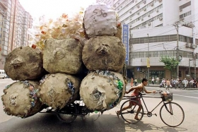
What if China goes Green and Wins?
History. China has created a five year plan since 1953 to bolster its economy forward. In 1956 there were no privately owned industries.

Slide 2
For 30 years China has gained 10% growth.
The plan was begun with help from the Soviets.
1965-some 20 million peasants starved.
1970-basic needs prioritized
1980-fast growth.
1990-Thrift,self reliance,infastructure
1995-5 trillion GNP

Slide 3
2005-urbanization 51.5%
2010-forrest coverage to go up, pollutants to go down
Hong Cong center of international finance
(China asked their folks to turn over their companies to the government early-on which they did. Gov’t trained professionals.)

Slide 4
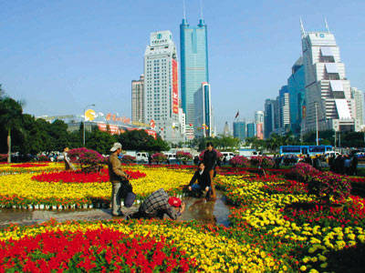

Slide 5
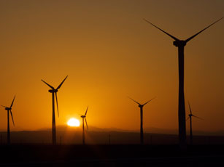

Slide 6
History recapped: industrializing and hard work since 1953 has carried China upward
China is the leader in solar sales and wind power sales. Presently accused of undercutting the market.

Slide 7
Insulating is a priority
Wikipedia.org
Bike riding still important to Chinese. Zhu Dongyang,cri.cn.
“We definitely need China to succeed if the world is to succeed. Whatever China does will have global repercussions because a lot of the worlds manufacturing is going-on there.”Nis Hoeyrup Christensen, China daily .com.cn

