Slide 1
让额头看起来饱满一些
眼睛放大一点，加一点眼神光
皮肤上的痘印、卡粉的地方要去掉，但皮肤的质感要保留
衣服/袜子上的褶皱修掉
头发颜色均匀一下，蓬松一点
发际线修整齐，发缝太宽了，补一下
把背景图里的杂物/多余的人去掉
手臂p瘦一点，拉长脖子
嘴巴不要歪嘴，调整一下微笑唇
笑的时候牙龈露得太多了，稍微修一下
头缩小一点，肩膀拉宽一点，调整一下头肩比
身高和腿适当拉长一点，但不要太夸张
消除斜方肌，淡化颈纹，锁骨立体化
露出来的打底裤/打底衣修掉
调整一下大小脸，使脸部线条流畅
照片不能太亮（过曝）也不要太暗，整体光线要合适
把鼻梁弄高一点，鼻翼收小一点，让鼻子看起来更立体

Slide 2
The Photo Retouching Culture in China
Presented by Li Pan

Slide 3
CONTENTS
The development of photo retouching in China
The application of photo retouching in China
The reasons of photo retouching in China
The influence of photo retouching in China

Slide 4
The development of photo retouching in China
Traditionally, photo retouching is a way of eliminating or covering flaws on the pictures by using brushes and pigments.
In ancient China
mainly exists in portraiture
extravagant payment → exclusive to the upper classes and the imperial
embellish imperfections or magnify beauty

Slide 5
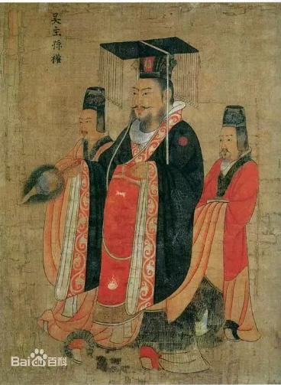
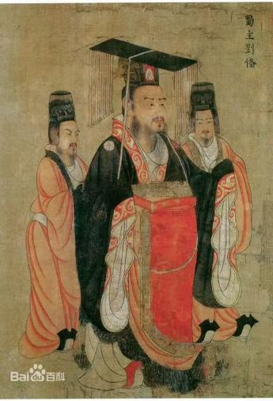
The development of photo retouching in China
唐·阎立本·历代帝王图·吴主孙权
唐·阎立本·历代帝王图·蜀主刘备

Slide 6







The development of photo retouching in China
Comtemporarily, the conception photo retouching has been converted into a technology of editing pictures by adjusting image parameters.
In the digital age: image processing software tools
professional; requiring high technical proficiency
→not spread so widely as expected
Photoshop
easier and more convenient to operate
→popular among Chinese; the substitute for Photoshop
Meitu Xiuxiu
(美图秀秀)
Butter Camera
(黄油相机)
Light Colour Camera
(轻颜相机)
Hypic
(醒图)

Slide 7
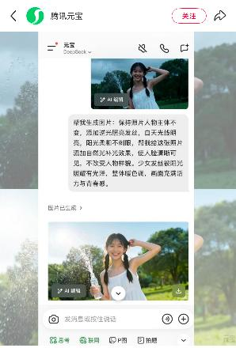
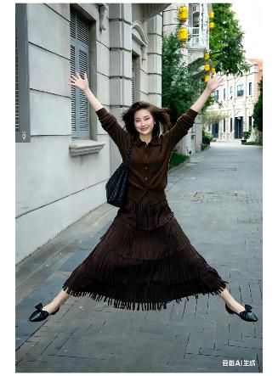
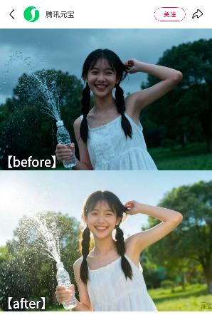
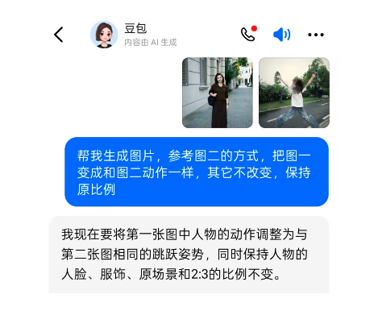
The development of photo retouching in China
Comtemporarily, the conception photo retouching has been converted into a technology of editing pictures by adjusting image parameters.
In the digital age: AI
prompt
prompt

Slide 8




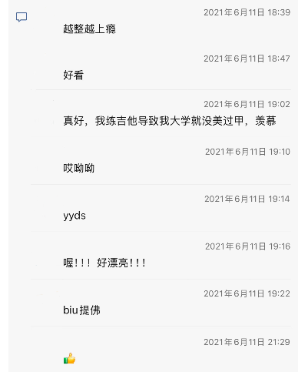
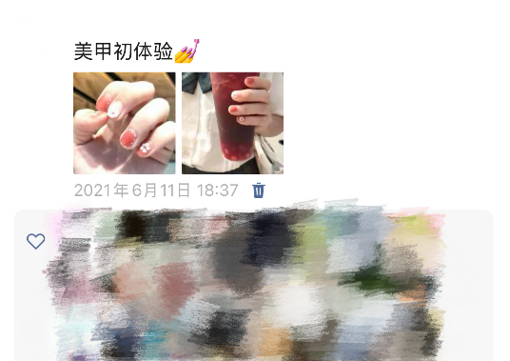
The application of photo retouching in China
On social media platforms
Picture social has become one of the basic ways of socializing in China.

Slide 9
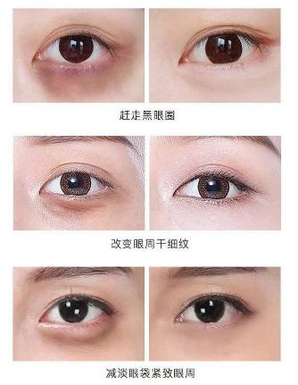
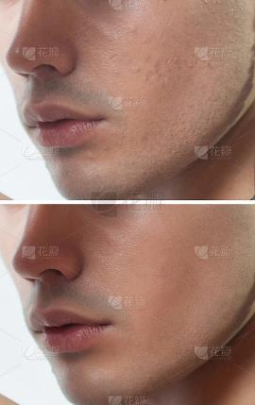
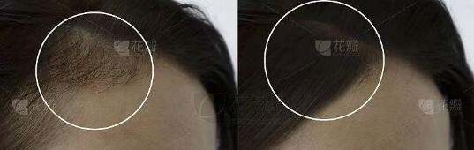
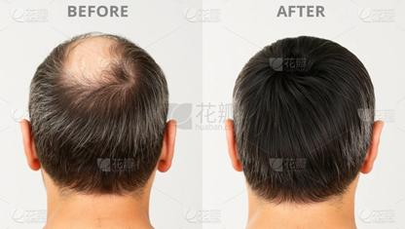
The application of photo retouching in China
In commercial field
skin care
hair care

Slide 10
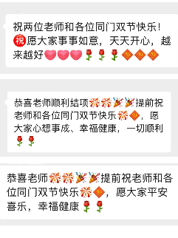
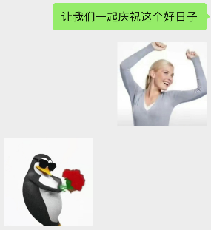
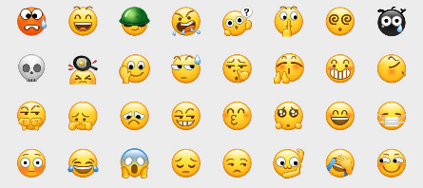
The application of photo retouching in China
Memes
essential chatting assistant
interesting and not offensive

Slide 11
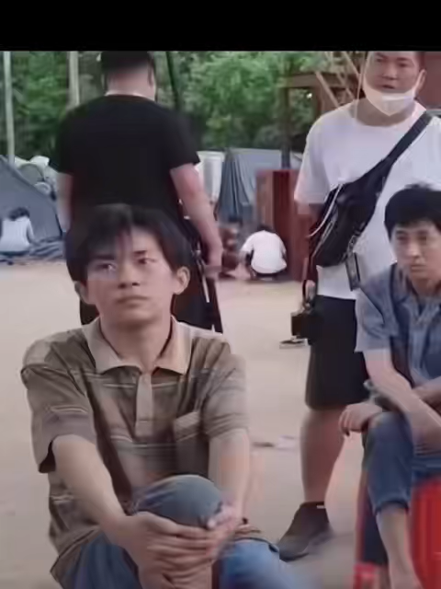
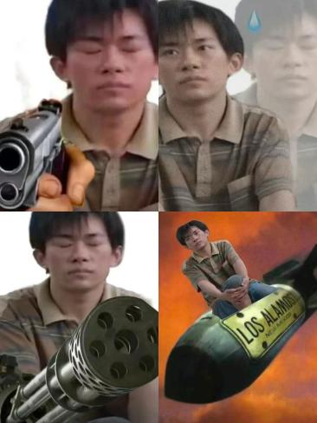
The application of photo retouching in China
Memes

Slide 12
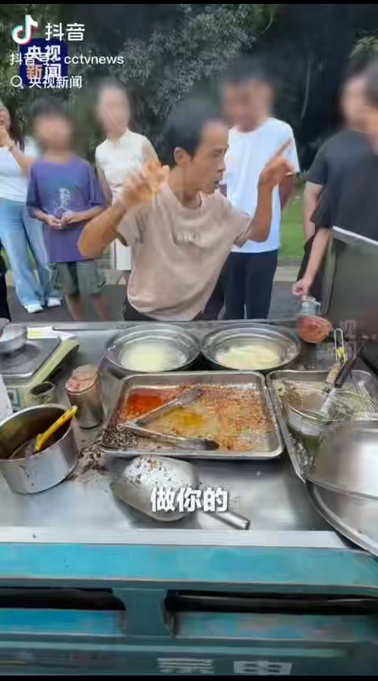
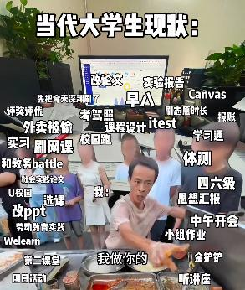
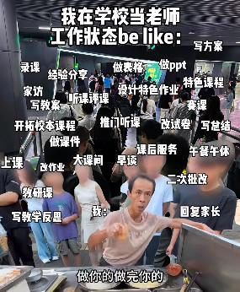
The application of photo retouching in China
Memes

Slide 13
The reasons of photo retouching in China
1.For beauty
①making the picture closer to the appearance/scenery in the eyes.
②diverse definitions of beauty
2.For emotional satisfaction
happy, nostalgic…
3.For consumption
…
The positive influence of photo retouching

Slide 14
The influence of photo retouching in Chhina
On the negative side: over-retouching/excessive photo editing can backfire.
1.Low credibility
“见光死”: the phenomenon that netizens retouch their selfies so ridiculously that once they show up in reality, they cannot fake it anymore.
“照骗”and “照片”: both pronounce “zhaopian”. The former means fraud using fake photos and the later means photos.
“One minute of phototaking, two hours of photoshopping”
“拍照一分钟，修图两小时”
2.The confusion of self-cognition and self-lost
Immersed in illusory beauty and praise

Slide 15
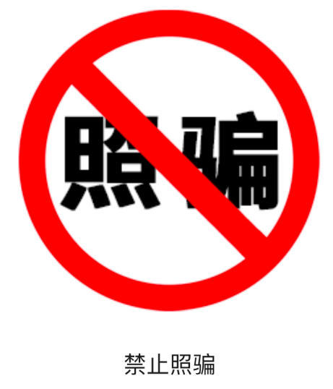
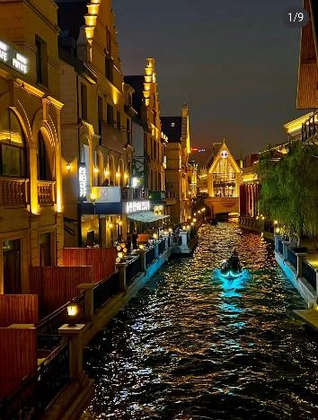
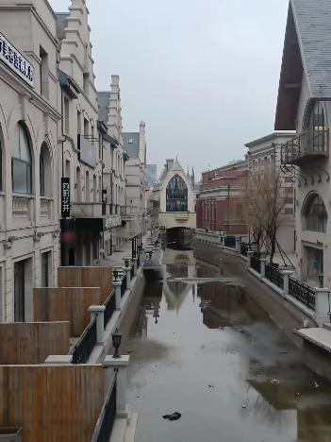
The influence of photo retouching in Chhina
“One minute of phototaking, two hours of photoshopping”
“拍照一分钟，修图两小时”

Slide 16
The influence of photo retouching in Chhina
On the negative side: over-retouching/excessive photo editing can backfire.
1.Low credibility
“见光死”: the phenomenon that netizens retouch their selfies so ridiculously that once they show up in reality, they cannot fake it anymore.
“照骗”and “照片”: both pronounce “zhaopian”. The former means fraud using fake photos and the later means photos.
“One minute of phototaking, two hours of photoshopping”
“拍照一分钟，修图两小时”
2.The confusion of self-cognition and self-lost
Immersed in illusory beauty and praise

Slide 17
Source
视频、图片、文字来源：
教材《中国语言文化》
小红书
抖音
百度
花瓣网

Slide 18
Thanks for your listening
Presented by Li Pan

