Slide 1
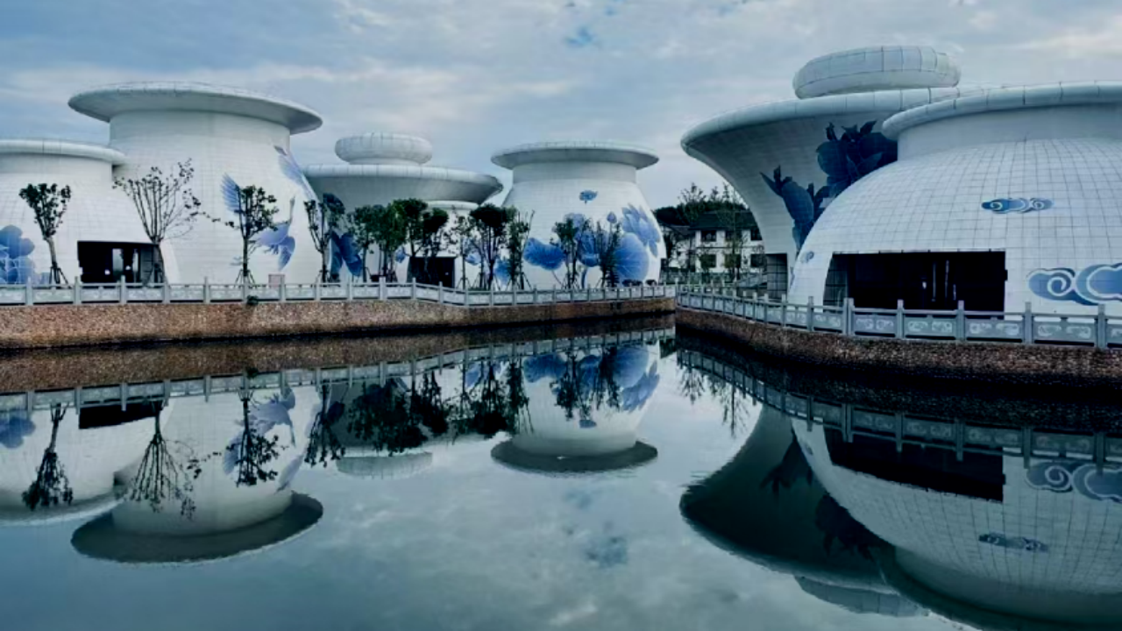
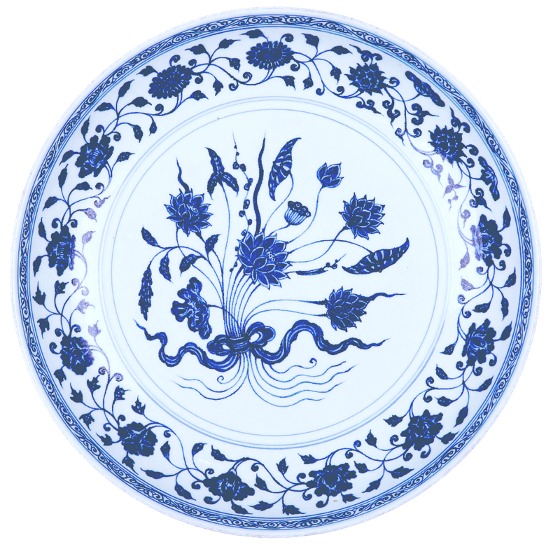

景
德
Jingdezhen Porcelain
Li Dinghao
镇

Slide 2
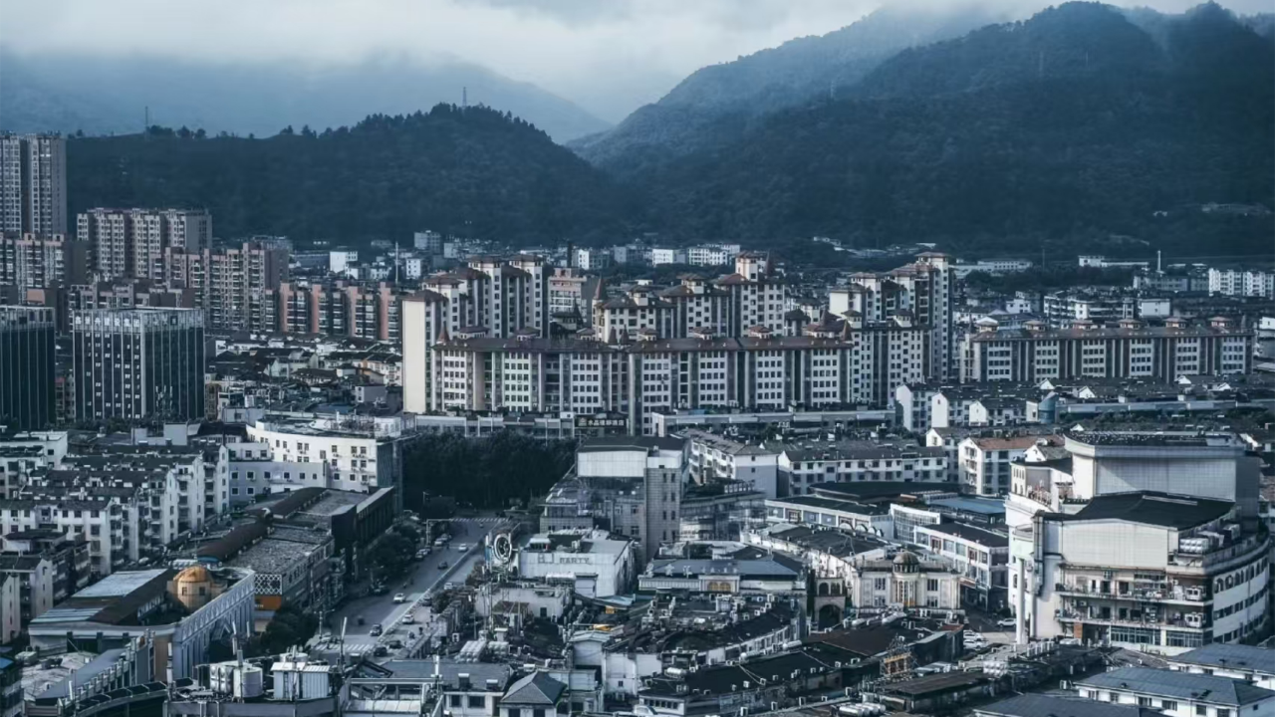
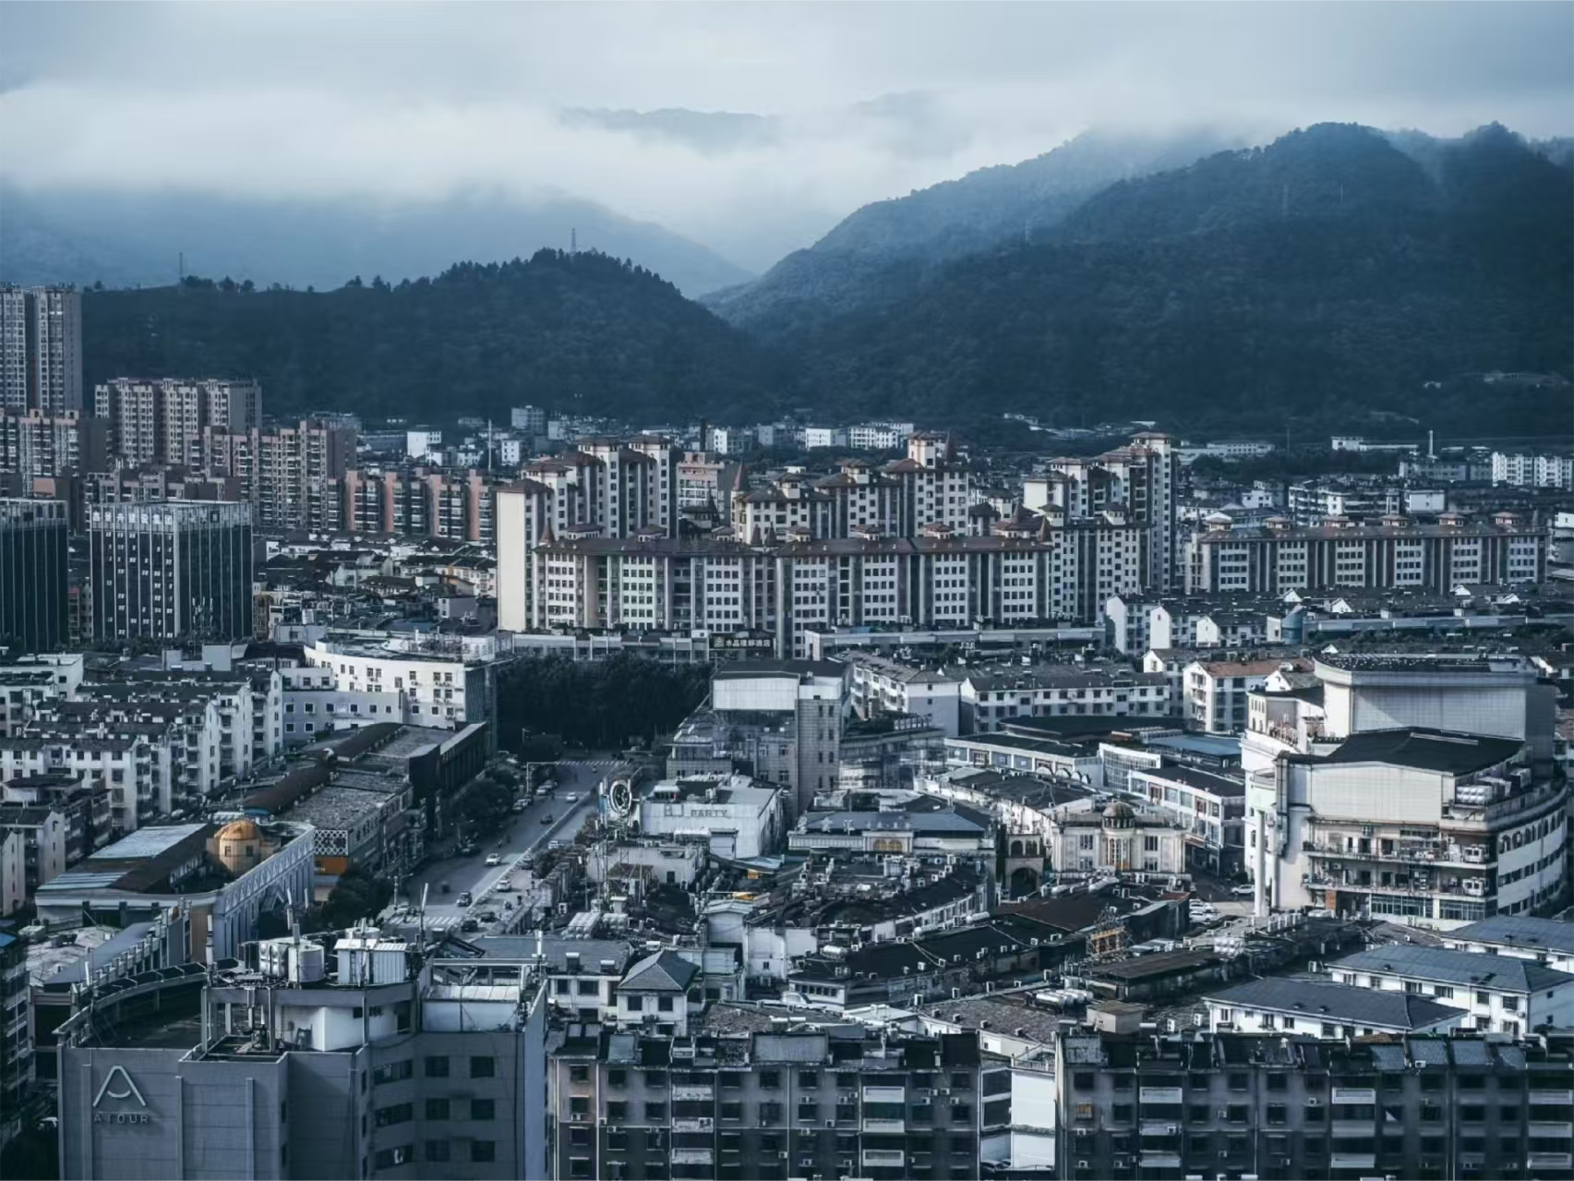
1. Introduction
2. Development History
3. Four Characteristics of Jingdezhen Procelain
4. Four Famous Porcelains
5. Famous Tourist Attarctions
Content

Slide 3
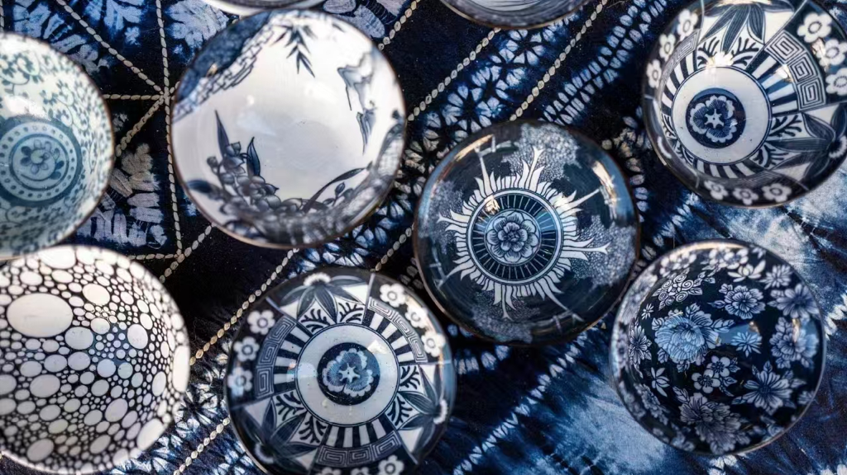
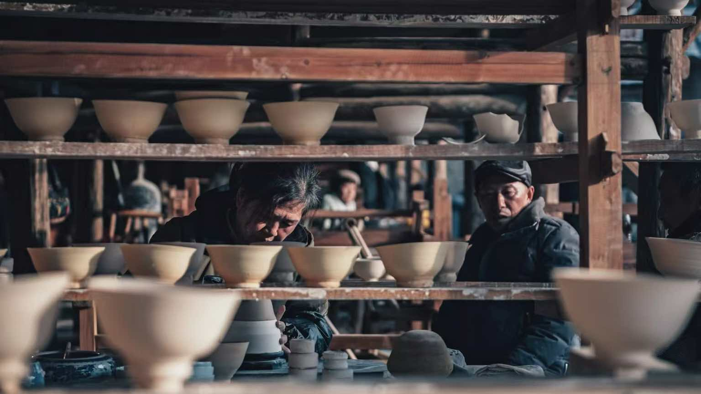
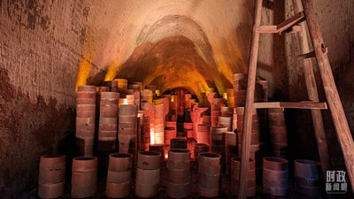
1
Introduction
Jingdezhen Porcelain refers to the porcelain produced in the city of Jingdezhen, Jiangxi Province, China. Because of its excellent quality, Jingdezhen has won the reputation of “Porcelain Capital”. Jingdezhen has been supported by its porcelain industry for thousands of years. With unique cultural symbolism and influence, it is still the most influential porcelain city in the world.

Slide 4
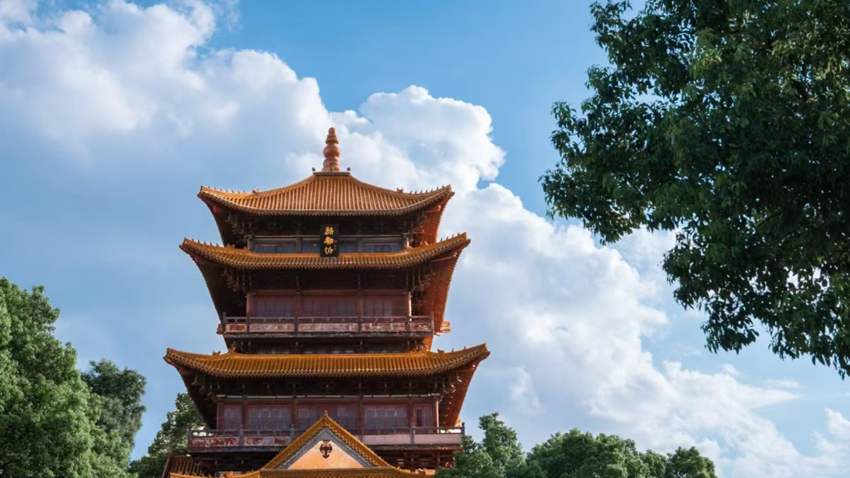

2
Development History

Slide 5
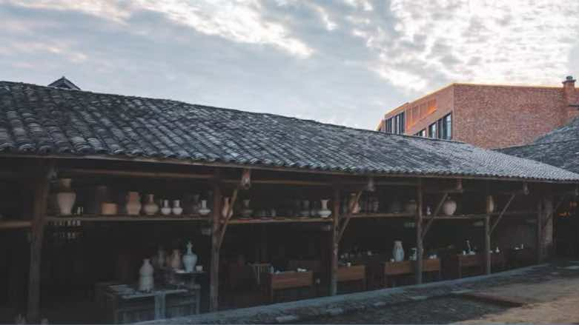
2
Development History
2
Song and Yuan Dynasties
With the southward migration of the Song court, a large number of scholars, artisans, and skilled craftsmen moved to the Jiangnan region. As a result, Jingdezhen absorbed the techniques from across the country. It became famous worldwide for its light, elegant, and exquisite Shadow Blue porcelain (影青瓷).
The Yuan Dynasty marked a period of innovation for Jingdezhen ceramics. A new variety, blue-and-white porcelain (青花瓷), reached technical maturity during this time, ushering in a new era of transition from plain porcelain（素瓷） to colored porcelain（彩瓷）.
1
From Han to the Five Dynasties
Historical records state that “Xinping smelted pottery, beginning in the Han Dynasty.” At this time, porcelain was described as “coarse, thick-bodied, with light and rough glaze,” and was “used only for common, rudimentary purposes,” without being widely exported.
During the Tang Dynasty, Jingdezhen porcelain had already gained significant influence within China.
By the Five Dynasties period, Jingdezhen had reached a considerable scale in porcelain production. The main products were celadon (青瓷) and white porcelain（白瓷）, which are among the earliest examples of relatively mature porcelain that we can see today.

Slide 6
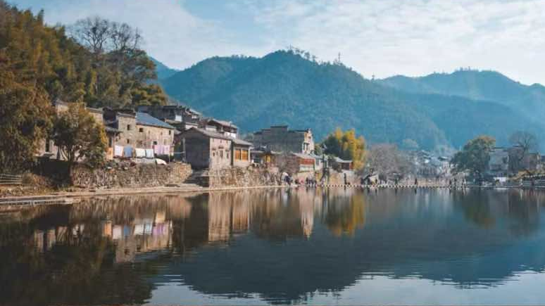
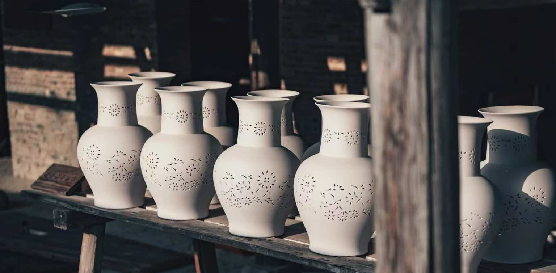
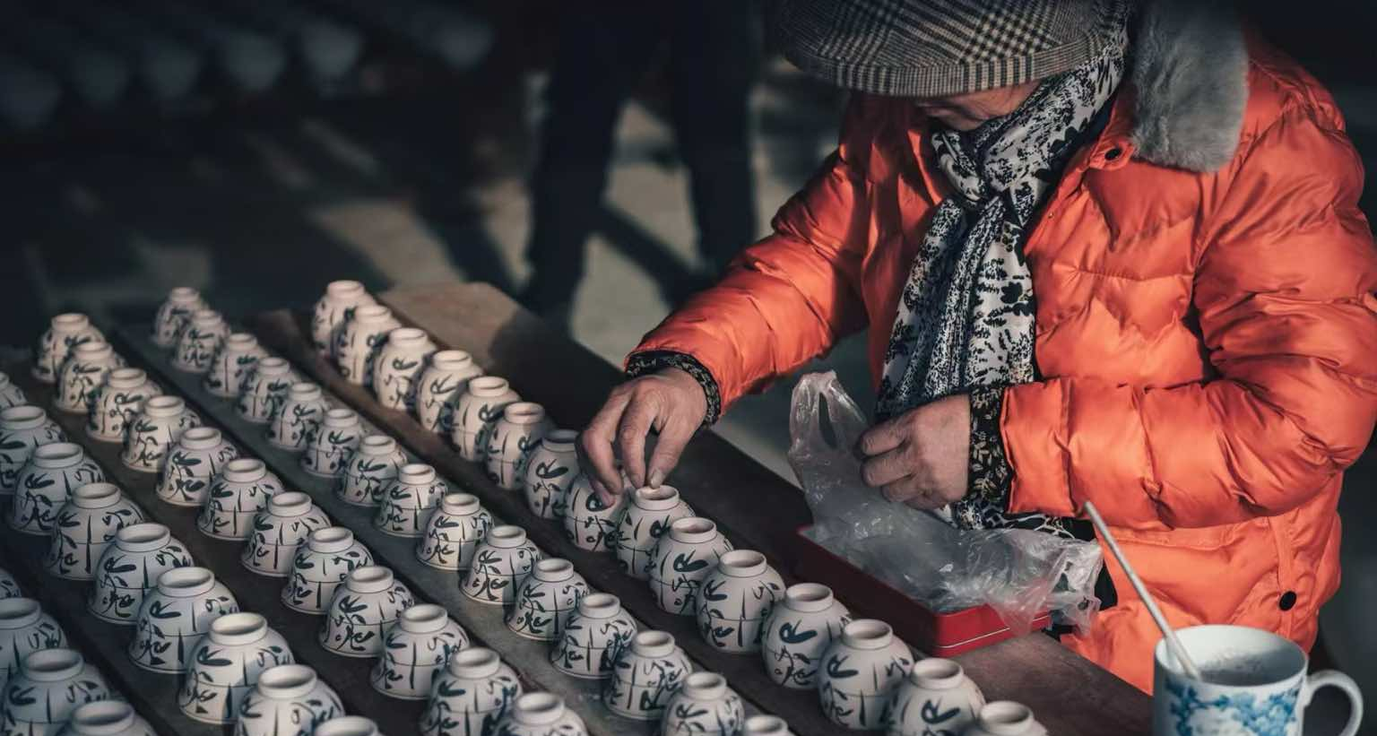
2
Development History
3
Ming and Qing Dynasties
In the early Qing Dynasty, Jingdezhen procelain, whether from official kilns（官窑） or folk kilns（民窑）, reached a state of unprecedented prosperity in terms of product design, decorative techniques, themes, and styles.

Slide 7
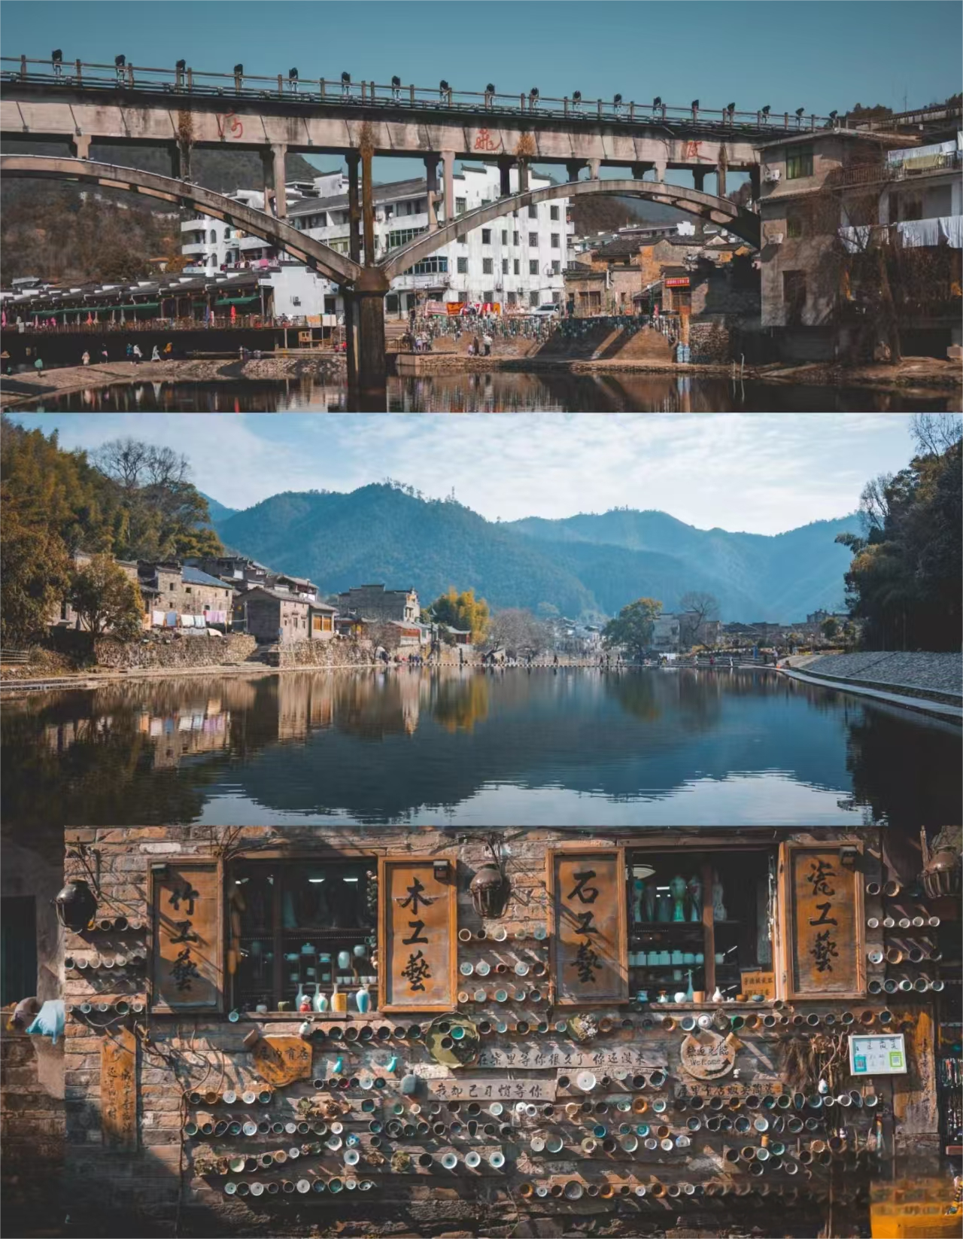
2
Development History
4
Modern and Contemporary Periods
After the reform and opening-up, ceramic production in Jingdezhen entered a new era. Numerous innovations were made, including new types of colored glazes (色釉彩), modern ceramic art, modern blue-and-white porcelain (现代青花), in-glaze decoration (釉中彩), and various new forms, techniques, and materials.
Many outstanding contemporary ceramic artists have come to Jingdezhen, dedicating their lives to advancing ceramic art and craftsmanship.

Slide 8
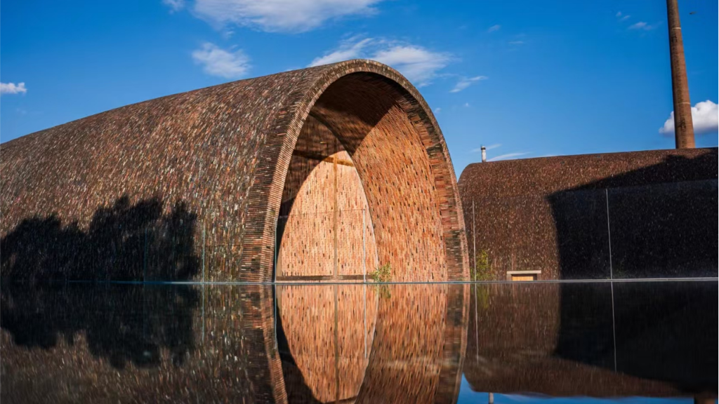
3
Four Characteristics of Jingdezhen Procelain

Slide 9
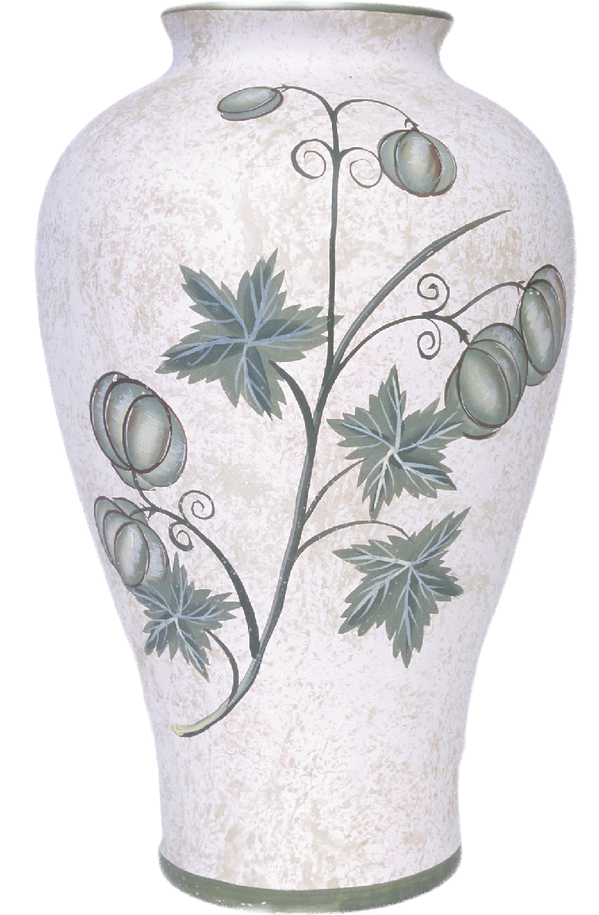
▪ 白如玉
White as jade: Jingdezhen porcelain has a milky white color, with a soft luster and a texture as smooth as jade.
▪ 明如镜
Bright as a mirror: The glaze of Jingdezhen porcelain is smooth, crystal-clear, and radiant, resembling a bright mirror.
▪ 薄如纸
Thin as paper: Jingdezhen porcelain has a thin and lightweight body that is translucent to light.
▪ 声如磬
Sound like a chime: Jingdezhen porcelain has a crisp and delicate texture. When gently tapped with a finger, it produces a clear sound, akin to the melodious tone of a chime stone.

