Slide 1
Animals：
Panda Culture
speaker : Pei Xinxian

Slide 2
Contents
03
05
Current situation
01
Actions and Contributions
Introduction
04
The importance of protecting giant pandas
02
Status and symbolism

Slide 3
01.Introduction

Slide 4
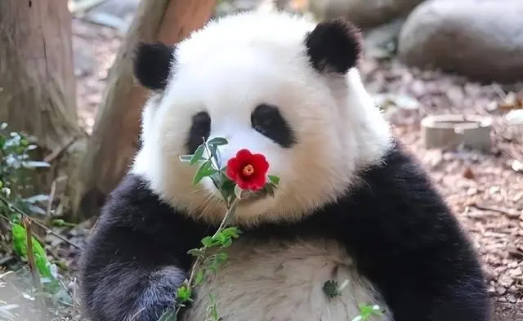
official Introduction
Pandas, also known as giant pandas, belong to the mammal family Ursidae and genus Pandas, and are endemic to China. There are only two subspecies of giant pandas, Sichuan subspecies and Qinling subspecies, mainly inhabiting mountainous areas in Sichuan, Shaanxi, and Gansu provinces of China. Male individuals are slightly larger than females. The body is plump and bear like, with a round head and short tail. The head and body are 1.2-1.8 meters long, and the tail is 10-12 centimeters long. Weighing 80-120 kilograms, with a maximum weight of up to 180 kilograms. The body color is black and white, with round cheeks and large "black circles" under the eyes. It also features a signature eight figure walking style and sharp claws like a dissecting knife. Giant pandas have thick skin, with the thickest part reaching up to 10 millimeters. The black and white appearance is beneficial for hiding on trees in dense forests and snow covered ground, making it difficult for natural enemies to detect.

Slide 5
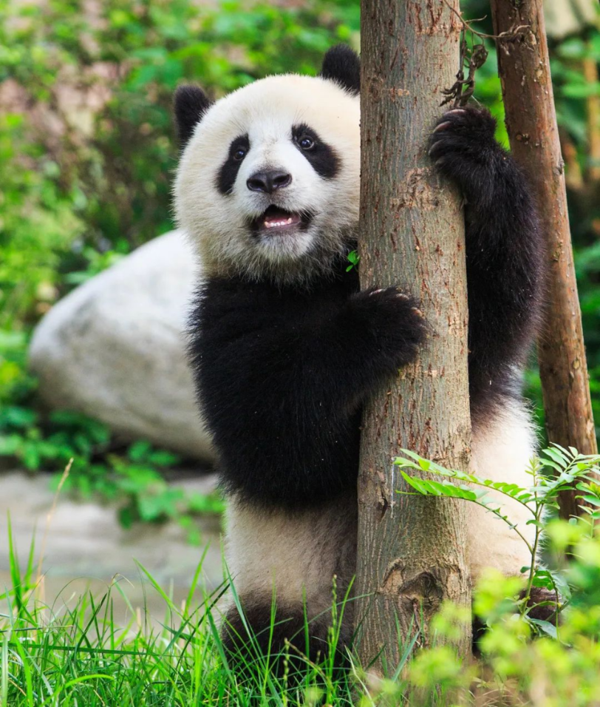
their living habits
Giant pandas live in dense bamboo forests at an altitude of 2600-3500 meters, where the annual temperature is below 20 ℃ and there is sufficient bamboo. The distribution of terrain and water sources is conducive to the species building nests, hiding, and nurturing their young. Giant pandas are good at climbing trees and also enjoy playing. The act of climbing trees is generally a way for the weak to avoid the strong when approaching the proposal period, or to avoid danger, or when meeting each other. Giant pandas spend most of their remaining half of their day in sleep, except for half of their feeding time. In the wild, giant pandas sleep for 2-4 hours between every two meals. 99% of the food for giant pandas is bamboo, and there are over 60 species of bamboo plants belonging to 12 genera available for consumption. The lifespan of wild giant pandas is 18-20 years old, and they can exceed 30 years old in captivity.
高海拔的山区
适合竹子生长
大熊猫适宜生存的环境特点。
提供大熊猫的主要食物来源
为大熊猫提供了独特的生存条件

Slide 6
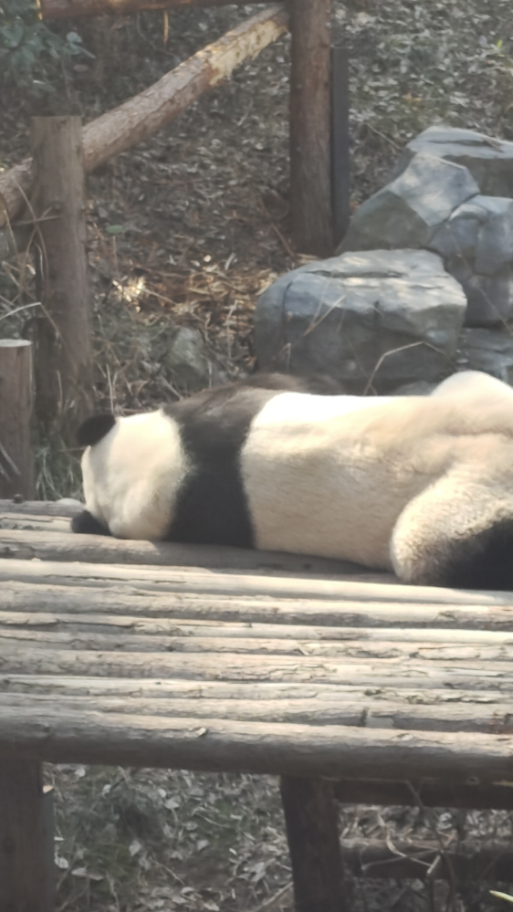
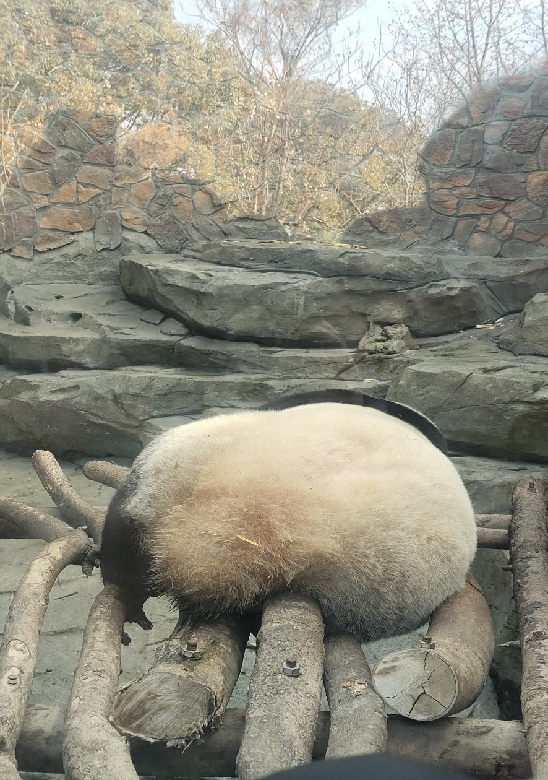
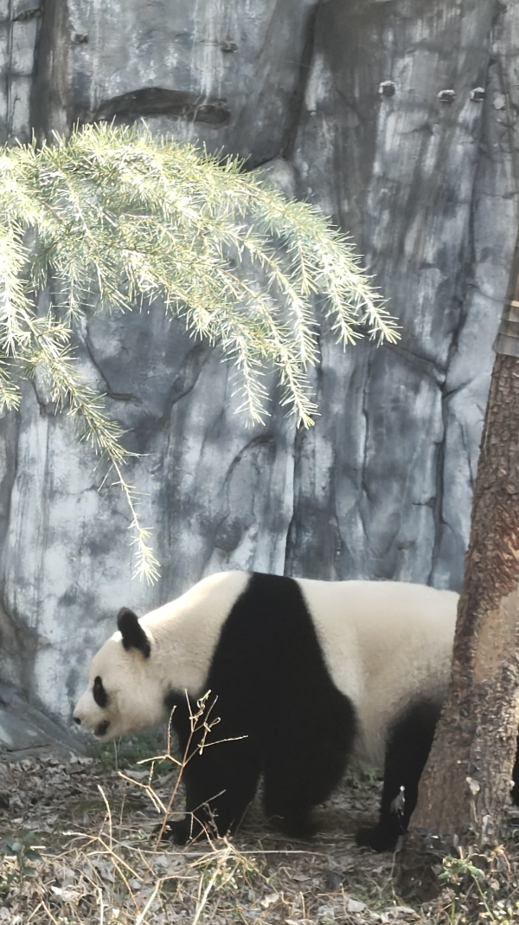
in my eyes

Slide 7
02.Status and symbolism

Slide 8
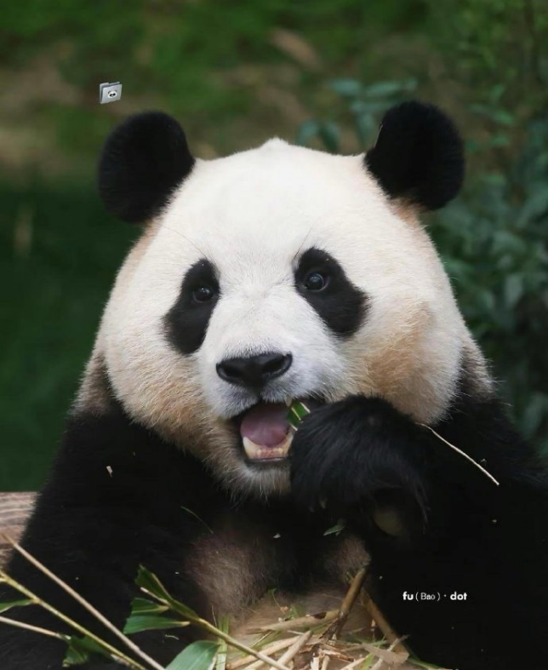
Giant pandas have been living on Earth for at least 8 million years and are known as "living fossils" and "national treasures of China". They are the ambassador of the World Wildlife Fund and the flagship species of biodiversity conservation in the world. As of January 2024, the wild population of giant pandas in China has increased to nearly 1900. As of October 2023, the total number of giant pandas living abroad in China has reached 63.

Slide 9
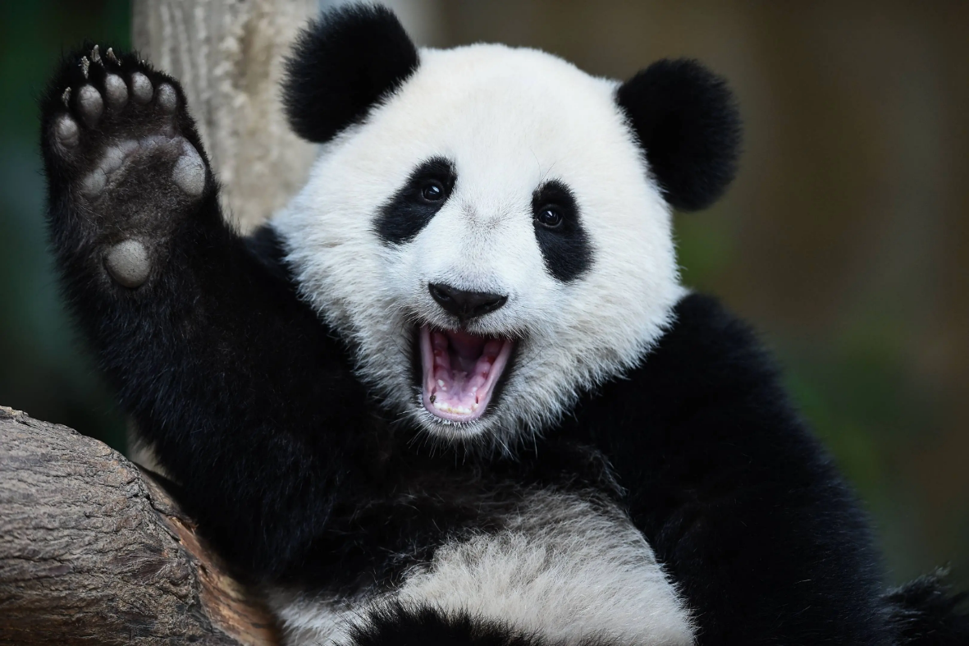
Why pandas are national treasures
Unique evolutionary history.
Pandas have lived on Earth for about 8 million years and are known as "living fossils", which have important scientific value for studying and protecting biodiversity as well as environmental changes on Earth.
Rarity.
Pandas are a rare and endangered species unique to China. This rarity, combined with its unique appearance and behavior, has made pandas a global focus of attention.
Cultural symbols.
Diplomatic symbols.
From 1957 to 1982, China presented 23 pandas as national gifts to 9 countries, expressing a signal of peace and friendship. Pandas have played an important role in the friendship between China and foreign peoples.

Slide 10

The symbolism of pandas as mascots
Pandas are often seen as symbols of peace. The black and white appearance of pandas represents the philosophical concept of yin-yang balance and also symbolizes harmonious coexistence between different cultures, races, and beliefs. The peaceful image of pandas has also become a symbol of international peace activities. For example, in 1972, the Chinese government gifted two pandas, Kangkang and Lanlan, to Japan to promote friendly relations between the two countries.

Slide 11
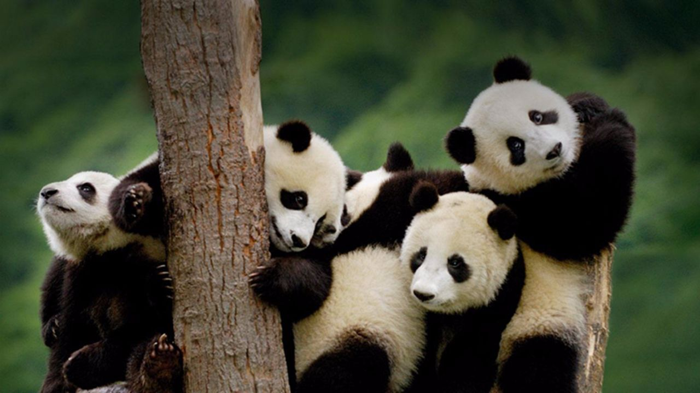
Pandas also symbolize friendship. Pandas are very cute and friendly animals, and they usually establish close relationships with humans. Therefore, pandas have also become symbols of friendship between China and foreign countries. The Chinese government often gives pandas as gifts to international friends as a symbol of friendly exchanges. For example, in April 2019, the Chinese government presented two pandas, "Ruyi" and "Dingding", to Russia to celebrate the 70th anniversary of the establishment of diplomatic relations between the two countries.

Slide 12

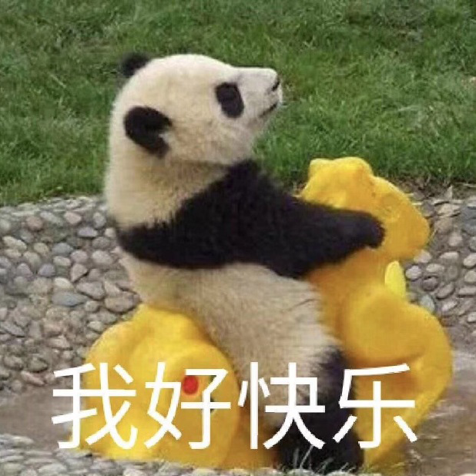
Pandas are also seen as symbols of happiness. Pandas are very cute and happy animals. They usually play, eat, and roll in bamboo forests, bringing joy and happiness to people. Therefore, pandas have also become symbols of happiness. In Chinese culture, pandas are often used to represent happiness and auspiciousness.
Pandas also symbolize joy. Pandas are very lively and active animals. They enjoy playing and jumping, bringing joy and joy to people. Therefore, pandas have also become symbols of happiness. In Chinese culture, pandas are often used to represent happiness and joy. For example, pandas are very popular in Chinese children's literature, and many children's stories feature pandas as the protagonist, bringing joy and joy to children.

Slide 13
Panda Culture Going Global
As a national treasure of China, the giant panda often represents the image of the country. In international sports events hosted by China, the giant panda is the mascot with the highest appearance rate. In 2022, the Beijing Winter Olympics will launch the mascot "Bing Dwen Dwen" created in the image of giant panda, which will become popular in the world, even in the Olympic Village. The giant panda is also a city symbol of Chengdu. The image of the giant panda was used in the 2022 Chengdu World Table Tennis Championships and the 2023 Chengdu World University Games, and it is deeply loved by contestants and audiences. China is the only country in the world to have giant pandas, but the presence of giant pandas is ubiquitous worldwide. It can be said that wherever there are giant pandas, there will be a "panda effect". The American animated film "Kung Fu Panda" was released in 2008 and grossed $630 million worldwide. The high popularity of the film made it the highest grossing original animated film at DreamWorks at the time. Afterwards, Kung Fu Panda 2 and Kung Fu Panda 3 were released successively, and Kung Fu Panda 4 is expected to be released in 2024. The Kung Fu Panda series has become a highly successful original IP. Although China is the only country with giant pandas, the image of pandas is no longer exclusive to China. It has moved towards internationalization and is becoming a cultural link and a medium for emotional connection between people in international communication.

Slide 14



Construction of Youth Cultural Identity
The Internet social expression pack, led by Panda Head, is the product of technological development and the increase of social communication frequency. After the subcultures generated by the development of these two have had a strong influence, emoticons have had the opportunity to develop, but their usage scenarios are to some extent limited. Young people are restrained in the process of social networking on the Internet, and there are strict restrictions on the scope of social networking. A clear sense of boundaries and a high degree of cultural identity within the circle together constitute the characteristics of youth Internet social networking.

Slide 15
03.Current situation

Slide 16
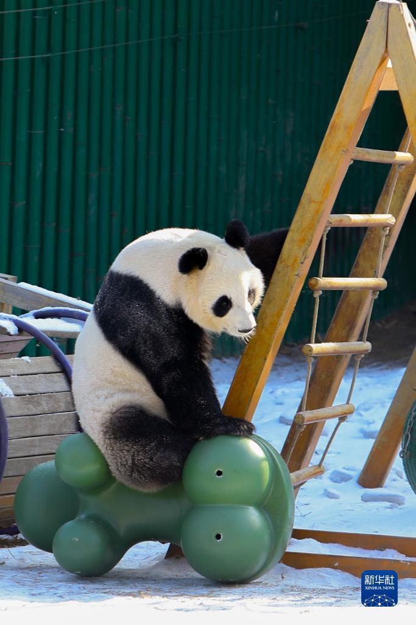
endangered reasons
Due to human blind activities, their habitats have been destroyed, resulting in a reduction in their habitat area.
Unauthorized mineral development, pollution, and logging and hunting by miners are also threats in the habitat of giant pandas.
Capturing too much.
The reproductive ability of pandas is reduced, and their reproductive system is infected by certain bacteria. The egg laying rate of females is reduced, and the mating desire of males is reduced, which is also a major reason for the imminent extinction of pandas.

Slide 17
04.The importance of protecting giant pandas

Slide 18
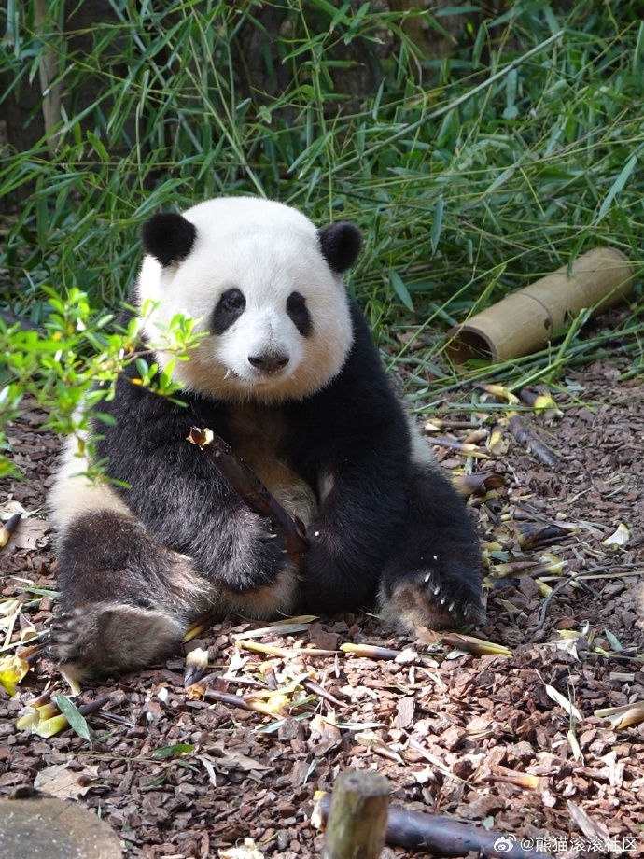
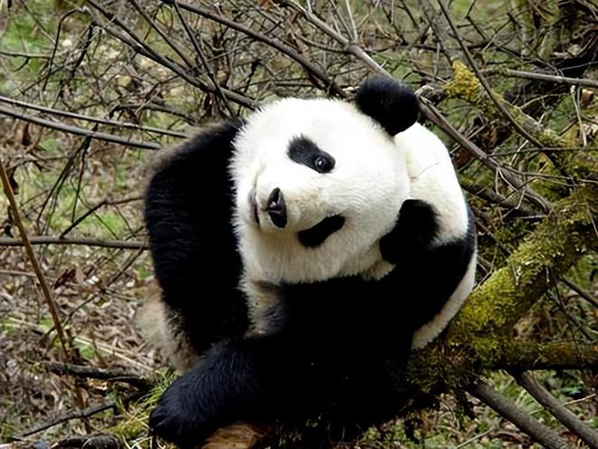
ecological value
Maintaining the ecology of bamboo forests
Spread seeds
Attracting ecotourism

Slide 19
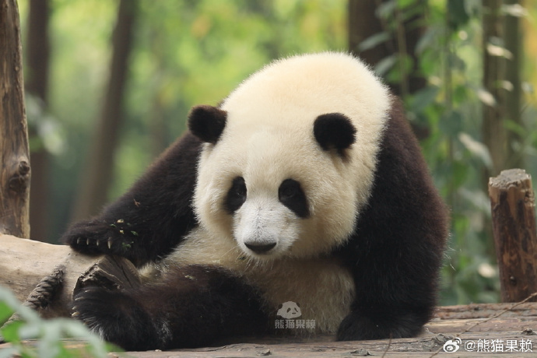
Cultural and economic values
The giant panda is one of the symbols of Chinese culture, representing international image and cultural soft power.
Giant pandas are an important attraction of China's tourism industry.
Giant pandas have a positive impact on the local economy

Slide 20
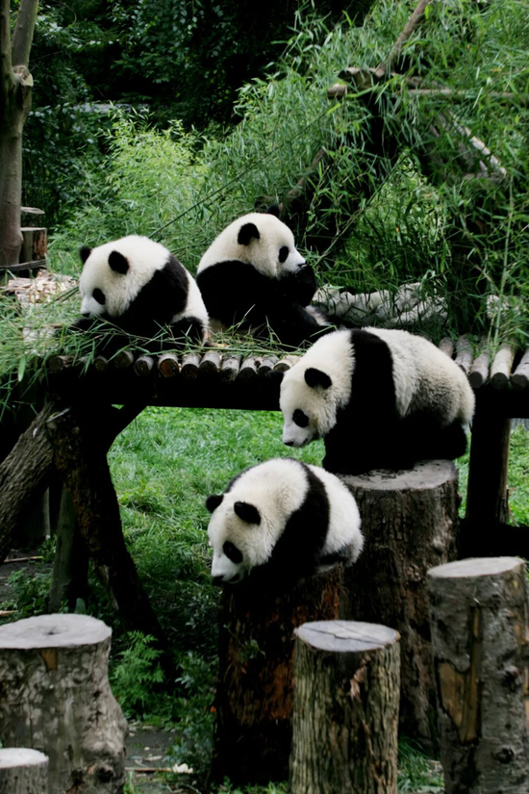
Ecological balance value
Giant pandas are an important component of the ecosystem: they are an indispensable part of the ecosystem.
Giant pandas are one of the representatives of species diversity, and protecting them helps to protect the diversity and gene pool of other species.
The protection of giant pandas requires the protection of their habitats, which is crucial for protecting water sources, reducing soil erosion, and maintaining ecosystem stability.

Slide 21
05.Actions and Contributions

Slide 22
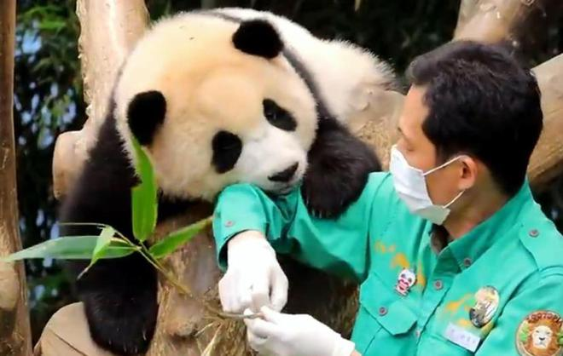
Donate funds to support giant panda conservation work and research projects, and contribute to environmental protection.
Participate in volunteer activities organized by giant panda conservation organizations, personally participate in conservation work, and enhance awareness of giant panda conservation.
Spread the knowledge and importance of giant panda conservation to more people through social media, speeches, or promotional activities.

Slide 23

References
[1]金泽华. 熊猫符号与中国国家形象的建构研究[D].安徽财经大学,2024.DOI:10.26916/d.cnki.gahcc.2023.000361.
[2]陈晓兵, 顾一阳, 陈枻豪. 国际传播中大熊猫符号的当代阐释与系统建构[J]. 青年记者, 2023, (22): 63-66.
[3]于婉莹.新时代熊猫魅力助力中国公共外交[J].公共外交季刊,2023(02):75-81+136.DOI:10.16869/j.cnki.pdq.2023.02.012.
[4]吴冰妍,张艺.青年亚文化视角下的青年文化认同建构——以熊猫头表情包为例[J].文化创新比较研究,2023,7(20):54-58.
部分资料和全部图源均来自百度

Slide 24
Thank You

