Slide 1
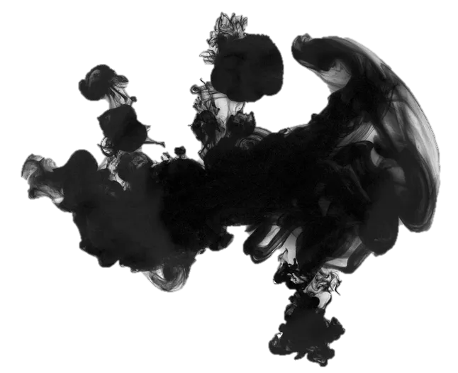
Stage Entertainment:
Crosstalk
Reported by Gao Zhihui

Slide 2
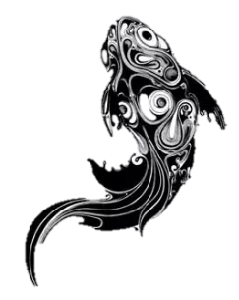
The Development of Crosstalk
Four Basic Skills in Crosstalk
目 录
Characteristics of Crosstalk
Famous Artists of CrossTalk

Slide 3
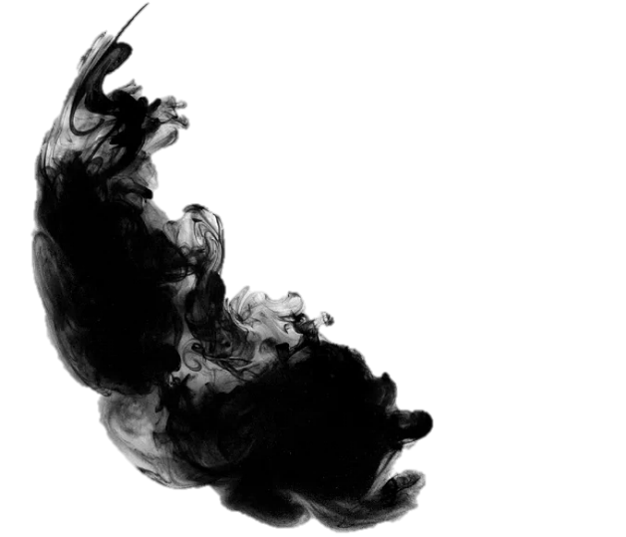
The Development of Crosstalk
Part One

Slide 4

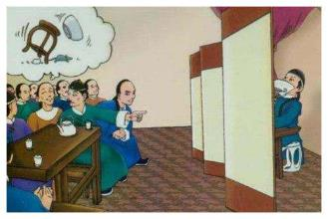
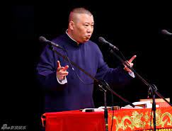
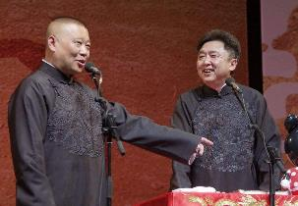

1.The Development of Crosstalk
Onomatopoeia
One person stand-up talk
Stand-up crosstalk,
Dual crosstalk,
Group crosstalk
Originally refers to imitate others’ voices. It was evolved and further developed from the folk opera in North China, and integrated with imitating oral skills and other folk art forms.
It’s a folk vocal art that uses jokes or funny questioning and answering to make the audience laugh.
Finally, it becomes a
veritable form of art.

Slide 5
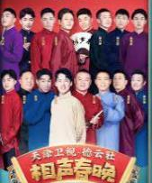
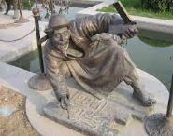
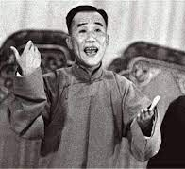
1.The Development of Crosstalk
1949
1978
2022
2005
Qing Dynasty
It is generally believed to be formed during the Emperor Xianfeng and Emperor Tongzhi period in Qing dynasty.
After 1949, a lot of crosstalk performers who began their career transformed the content of the crosstalk, got rid of many pornographic contents and those segments which play jokes on people’s physical defects.
During the Cultural Revolution, only some type of praise-type crosstalk were able to perform.
With the spread of online video sites and other new media, and the advent of DeYun Community, crosstalk achieved the second renaissance.

Slide 6
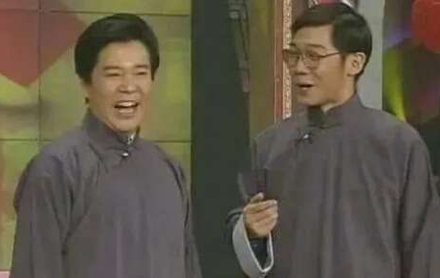
1.The Development of Crosstalk
Crosstalk mainly use the Beijing dialect. However, there are also some dialect crosstalk in different regions. Crosstalk is an original folk art with a long history in China, which is deeply loved by the majority of the people. It is no longer only palys in several cities in the north, nor spread only within the citizens, but also spread from the north to the whole country, and from the city to the countryside.

Slide 7
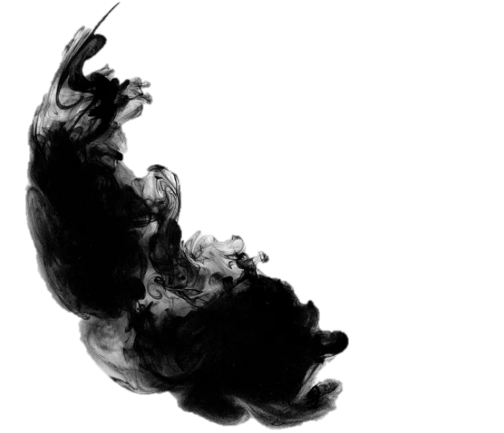
Four Basic Skills in Crosstalk
Part Two

Slide 8
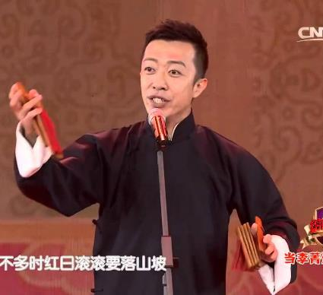
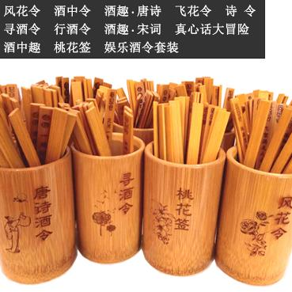
2.Four Basic Skills of Crosstalk
Speaking: to tell jokes, stories, lantern riddles, drinking games
Imitating: to imitate all kinds of birds and animals, hawking, singing and the sound of different languages
Teasing: to gag and tease
Singing: to sing Taiping Lyrics((most of which contain the meaning of peace and prosperity, so they are called Taiping), opera lyrics and songs.
Crosstalk artists regard “speaking, imitating, teasing and singing” as
their "four compulsory lessons". For example, the artists grasp the
rhythm in language and correct their pronunciations by “saying tongue twisters" or "reciting classical repertoires".

Slide 9
Characteristics of Crosstalk
Part Three

Slide 10
3.Characteristics of Crosstalk
a language performance art with comedy style
Crosstalk is the art of "laughter", Crosstalk performers use laughter as a weapon to expose contradictions, shape characters and evaluate life.In other words, crosstalk has the characteristics
of humor and satire. It reflects that life is not flat, but exaggerated and even deformed.
Crosstalk is the art of “speaking”, which belongs to the art of “performing with words”, In this sense, crosstalk is a collective performance of actors and audiences.
Crosstalk is different from comedy. In comedy, the laughter of audience mainly comes from plot and comic characters, while in crosstalk it mainly comes from “baofu” (jokes)

Slide 11
Famous Artists of CrossTalk
Part Four

Slide 12
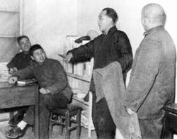
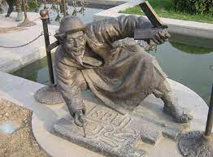
4.Famous Artists of CrossTalk
Zhu Shaowen 朱绍文
Nickname: Qiong Bupa
（Fear No Poverty）
The “ancestor”of crosstalk art.
Hou Baolin 侯宝林
Under his leadership and promotion, crosstalk art has really entered thousands of households and reached a remarkable artistic peak. His crosstalk works including Drama Talks, Drunkenness and etc.

Slide 13
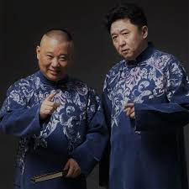
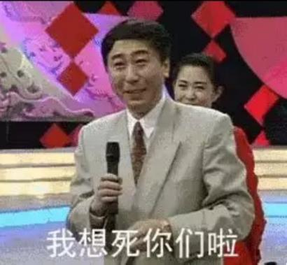
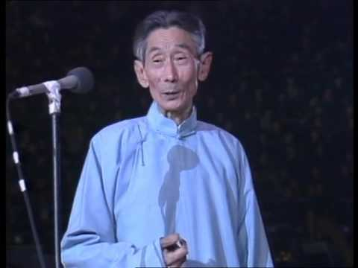
4.Famous Artists of CrossTalk
Ma Sanli 马三立
Ma Sanli devoted himself to the exploration of long-term artistic practice, and created the unique “Ma’s Style of Crosstalk”.His representative works including “Eating Yuanxiao(dumpling)”, “Selling Tickets” and “the Yellow Crane Tower”.
Feng Gong 冯巩
Guo Degang 郭德纲
Yu Qian 于谦......

Slide 14
Bonus！
Video link: https://b23.tv/DsqkT8Z

Slide 15
Thank you!

