Slide 1
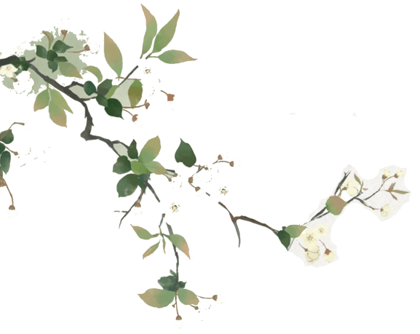
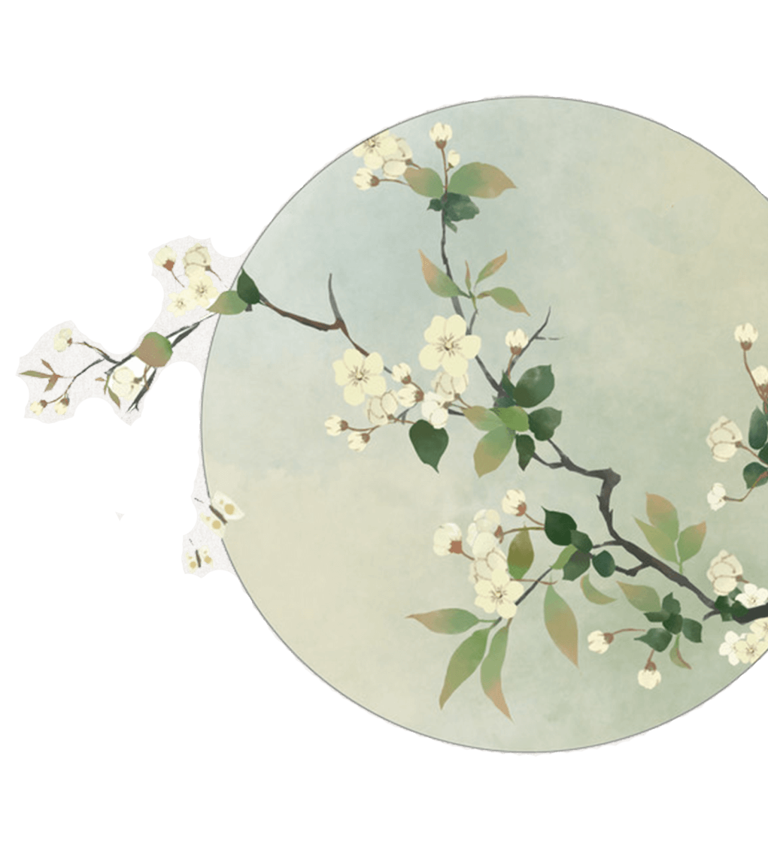

Silk and Porcelain: Celadon and the Celadon Song
Cao Wen

Slide 2


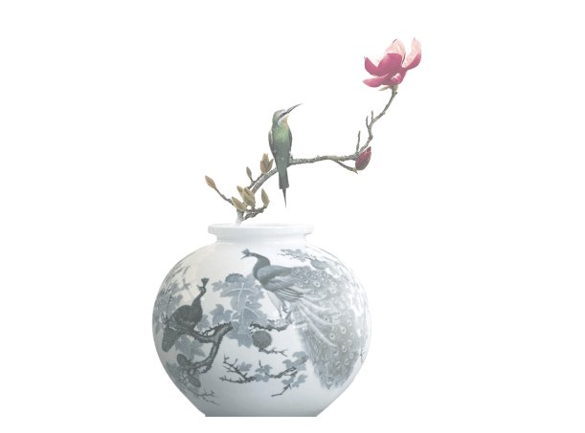
https://www.ypppt.com/
Contents
1
Introduction
2
History
3
Origination
4
The Celadon Song

Slide 3
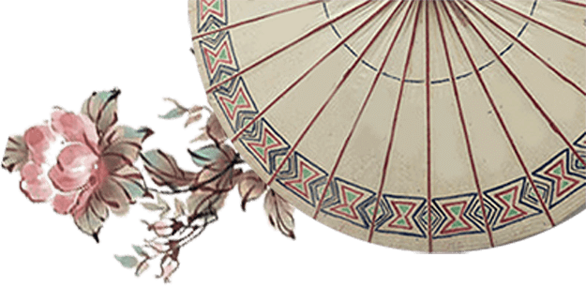

PART.01
Introduction
China is well-known as the birthplace of ceramics（陶器）, which could even be reckoned from its English name – a synonym for porcelain（瓷器）.

Slide 4
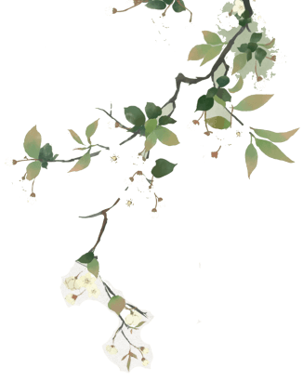
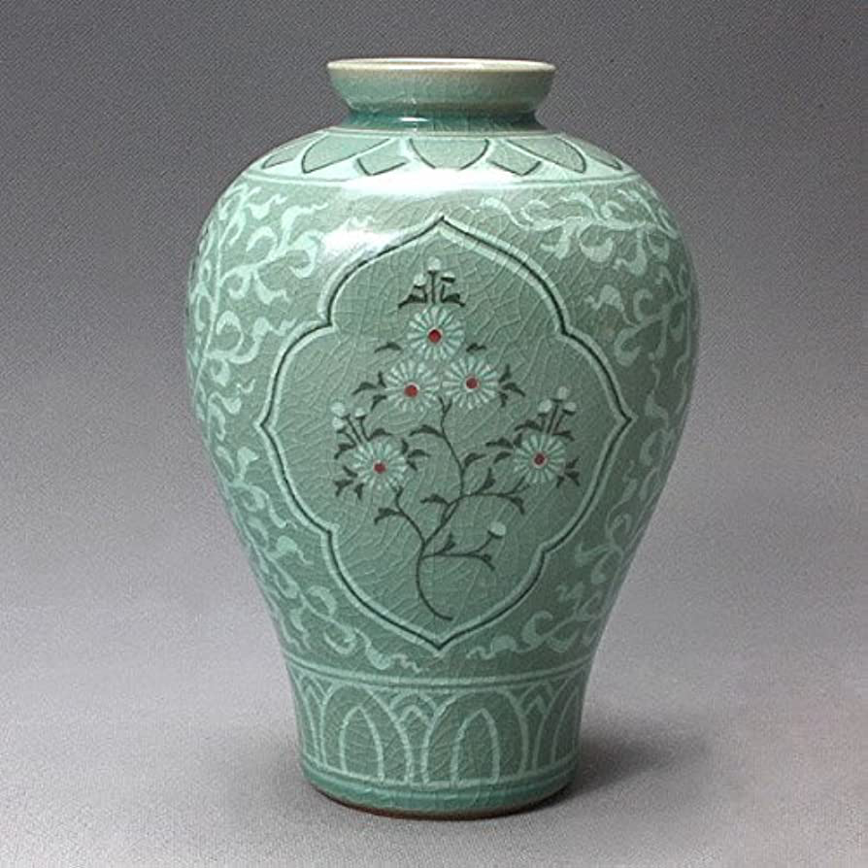
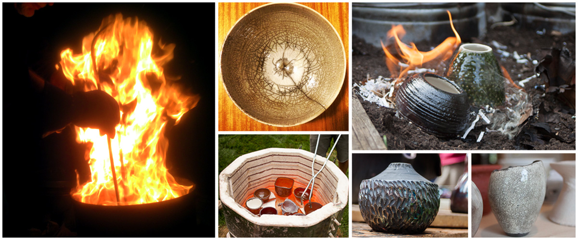
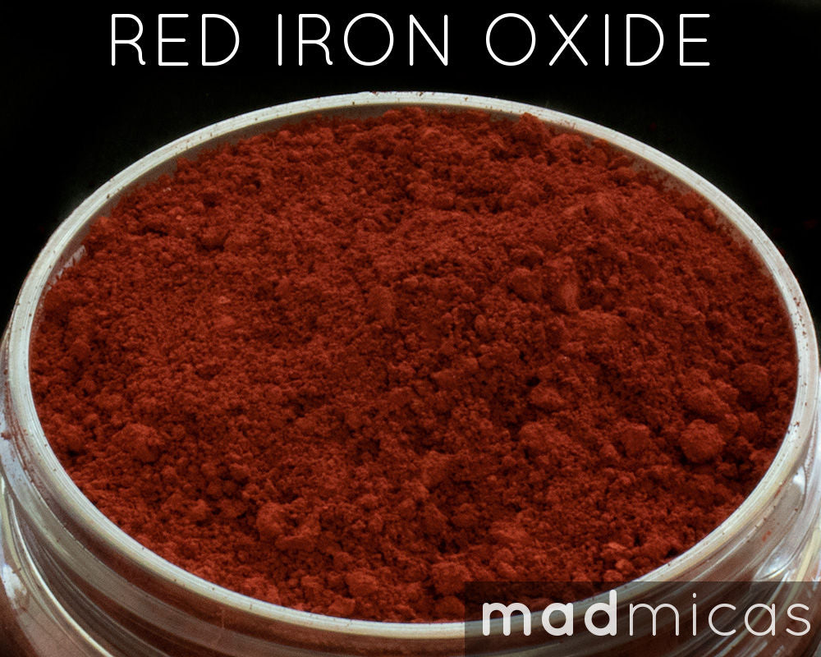
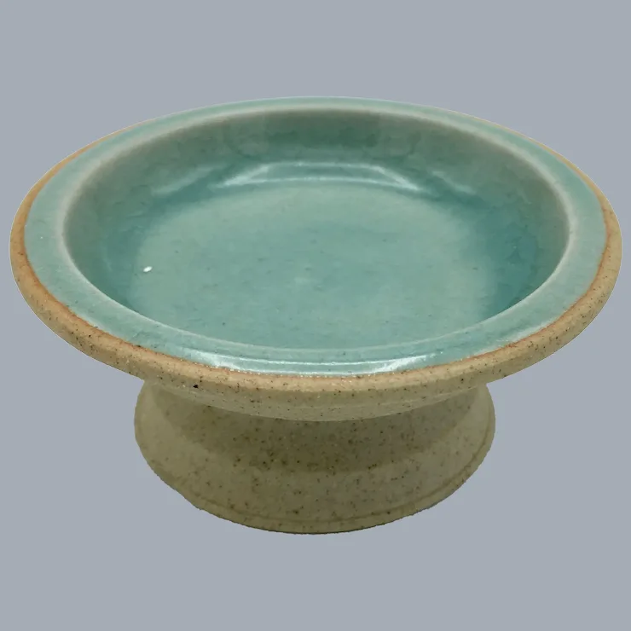
Introduction
Celadon is the most widespread type of ancient Chinese porcelain.
It is a mixture of iron oxide with a glaze that results during the firing process.
The glaze is the characteristic green tone of the porcelain, which occurs due to the presence of iron in the clay.

Slide 5
PART.02
History

Slide 6
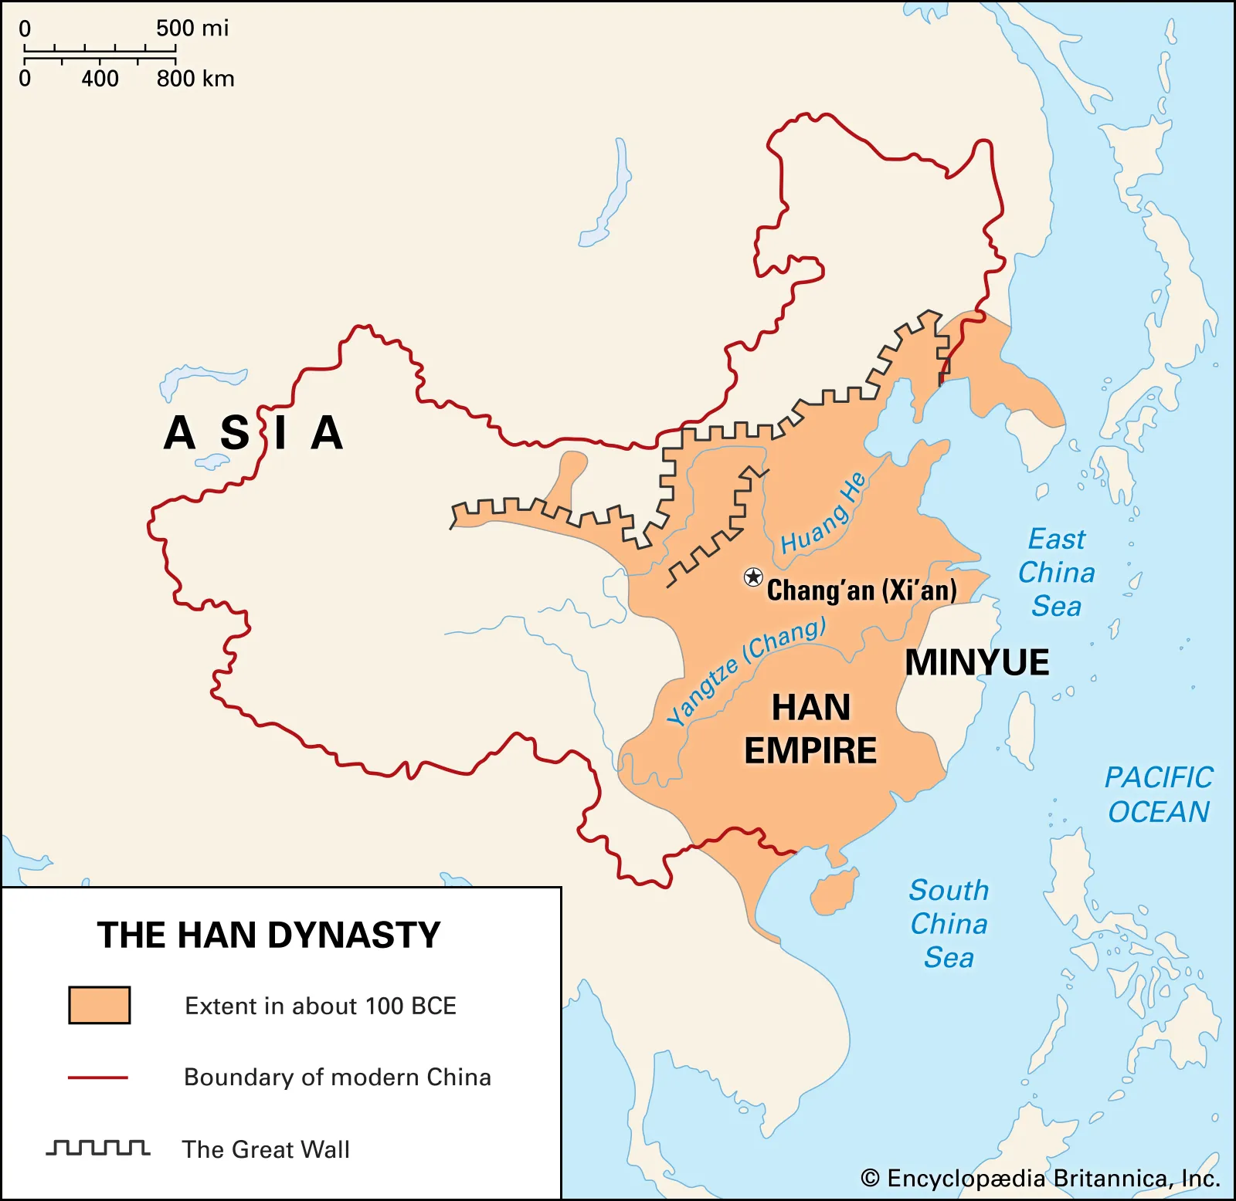
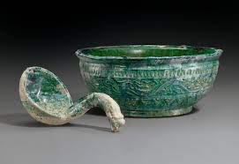
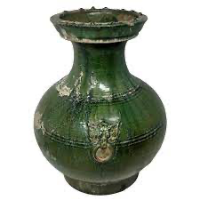
History
When celadon first appeared in East China during the Han Dynasty (206 BC-25 AD), it was simply known as green porcelain.
the Han Dynasty

Slide 7
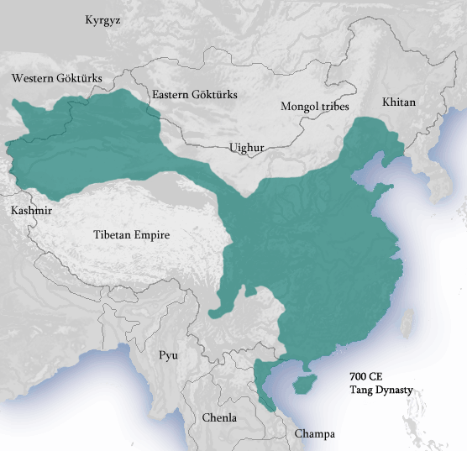
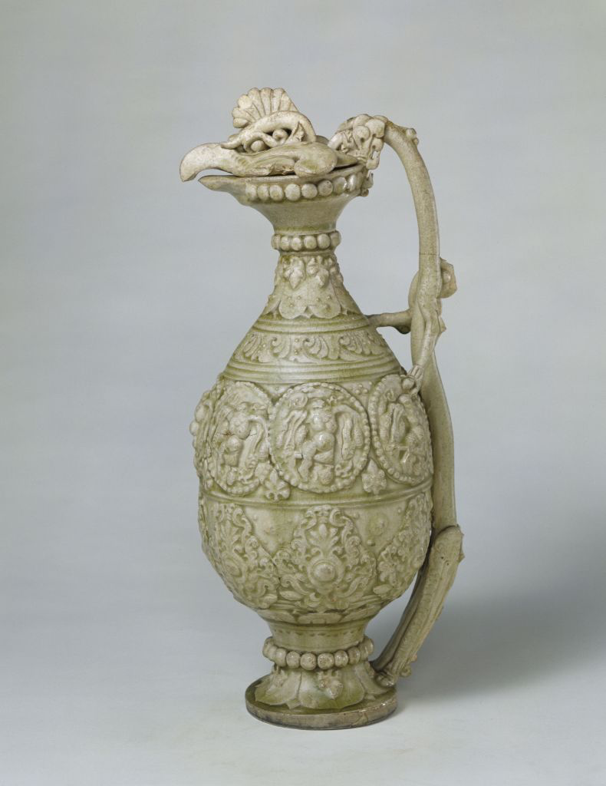
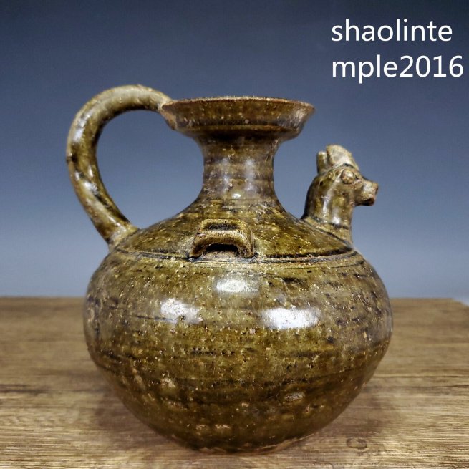
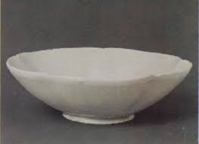
History
It was not until the Tang Dynasty (619-960) that the art of making celadon matured.
the Tang Dynasty

Slide 8
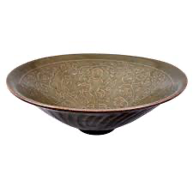
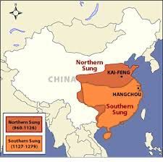
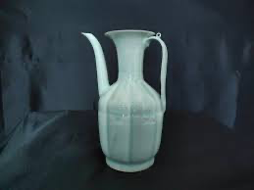
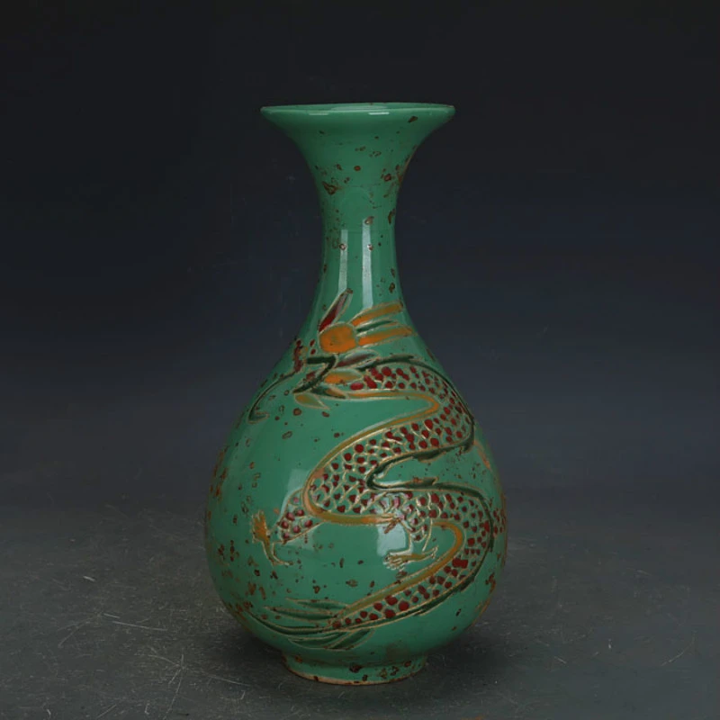
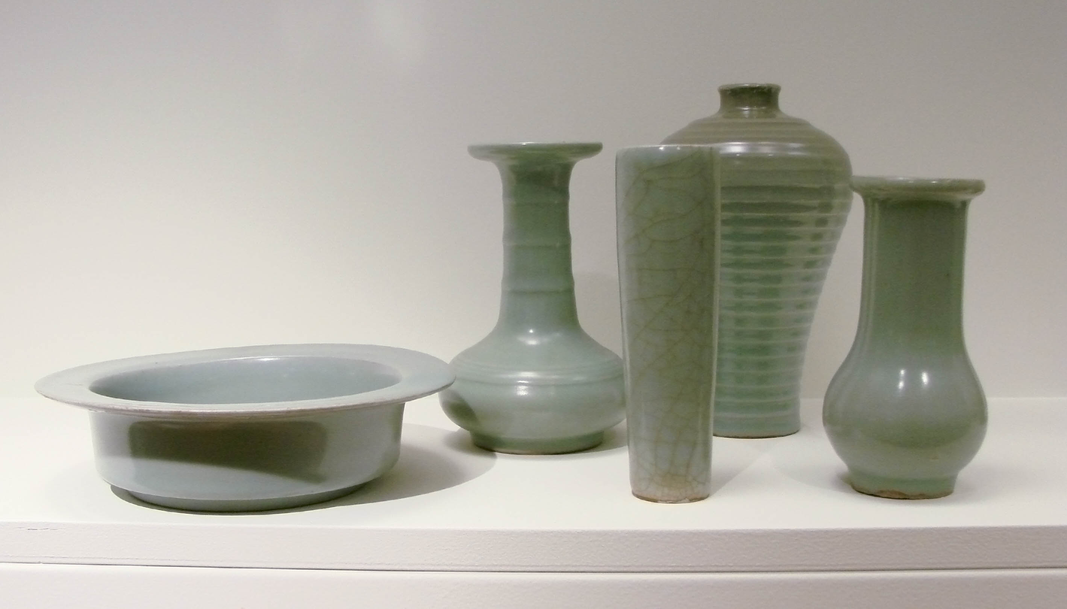
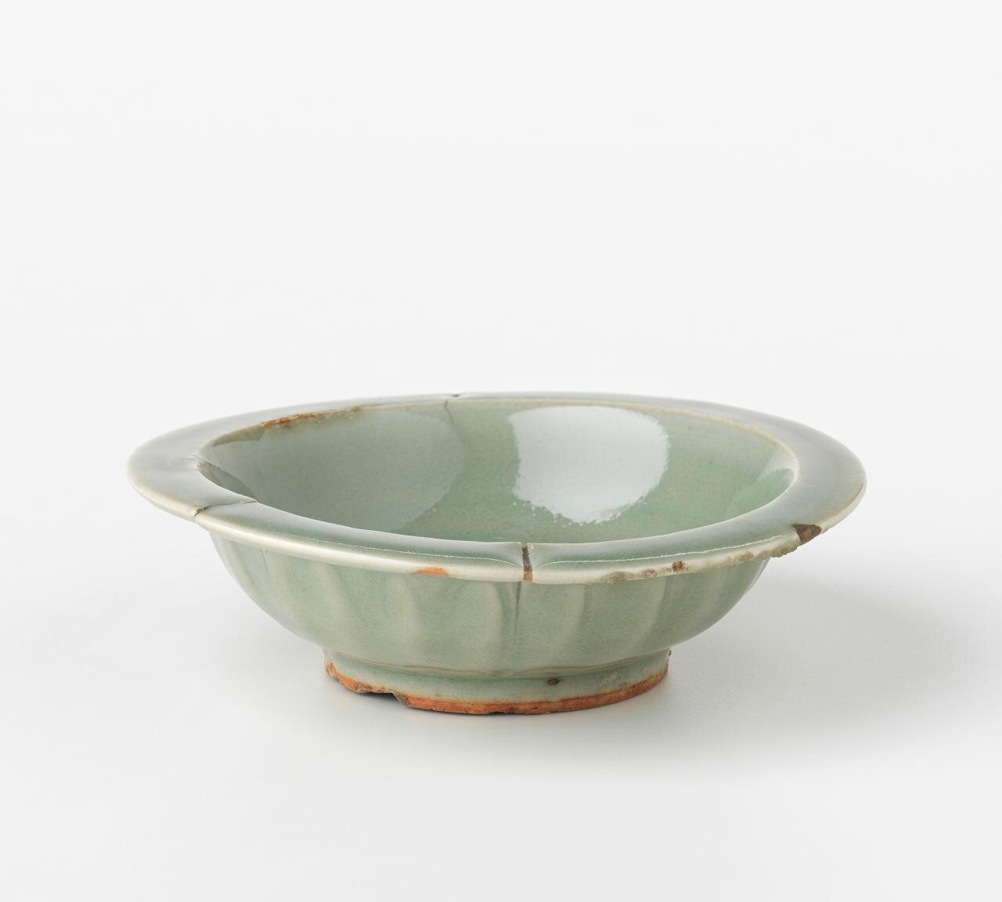
History
After the establishment of the southern capital in Hangzhou in 1127 during the Song Dynasty (960-1279), the manufacturing of the green porcelain reached new heights.
the Song Dynasty

Slide 9
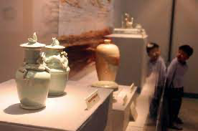
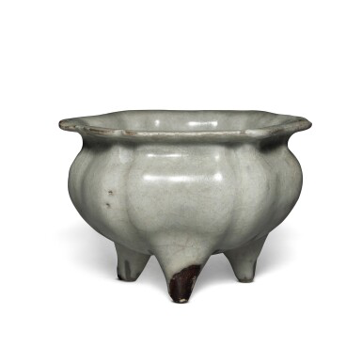
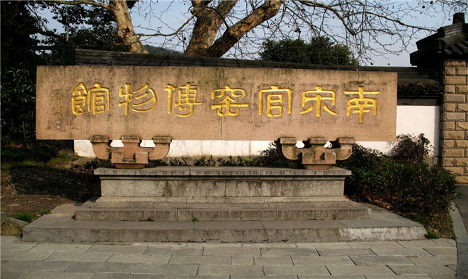
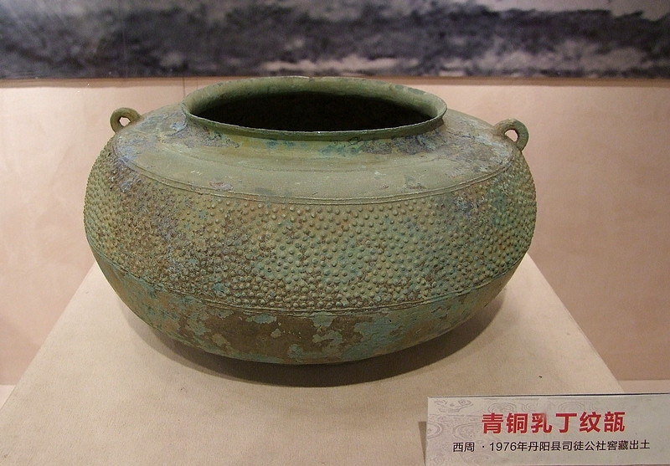
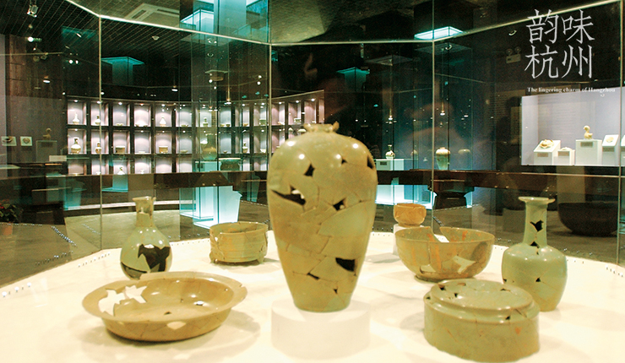
History
New imperial kilns (or official kilns)官窑 near Hangzhou and kilns in Longquan, southwest Zhejiang, produced a type of porcelain that was of extraordinary delicacy and purity.

Slide 10
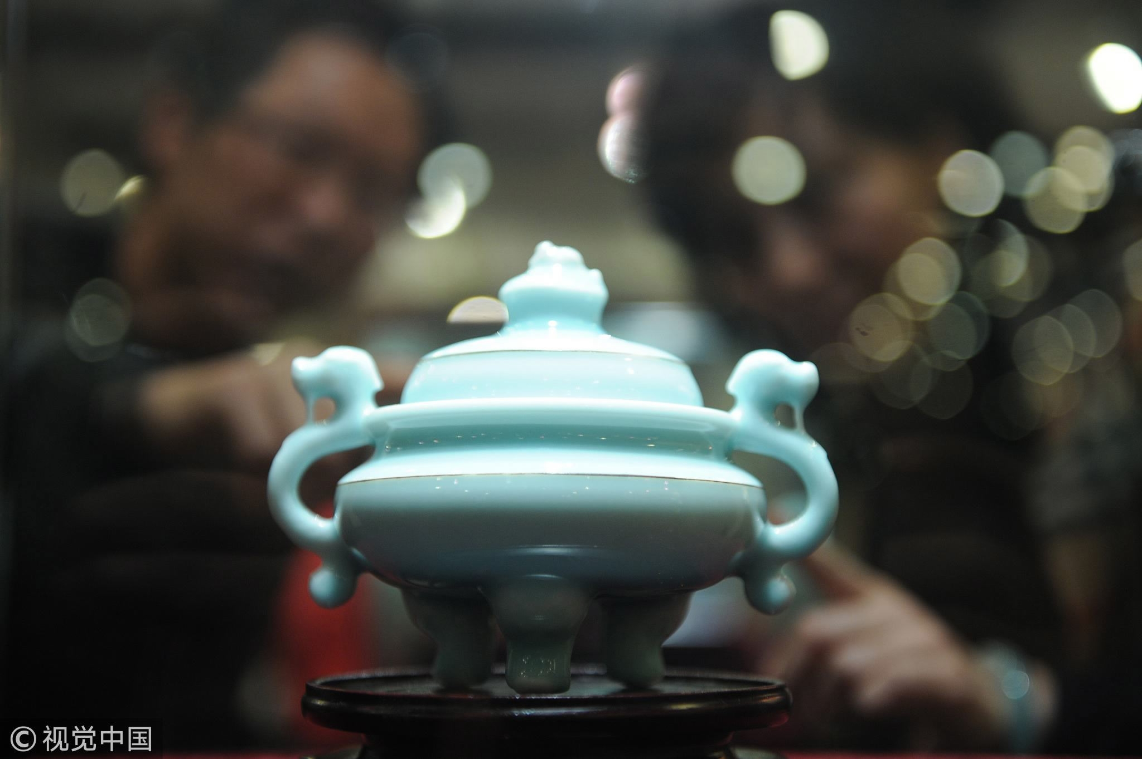
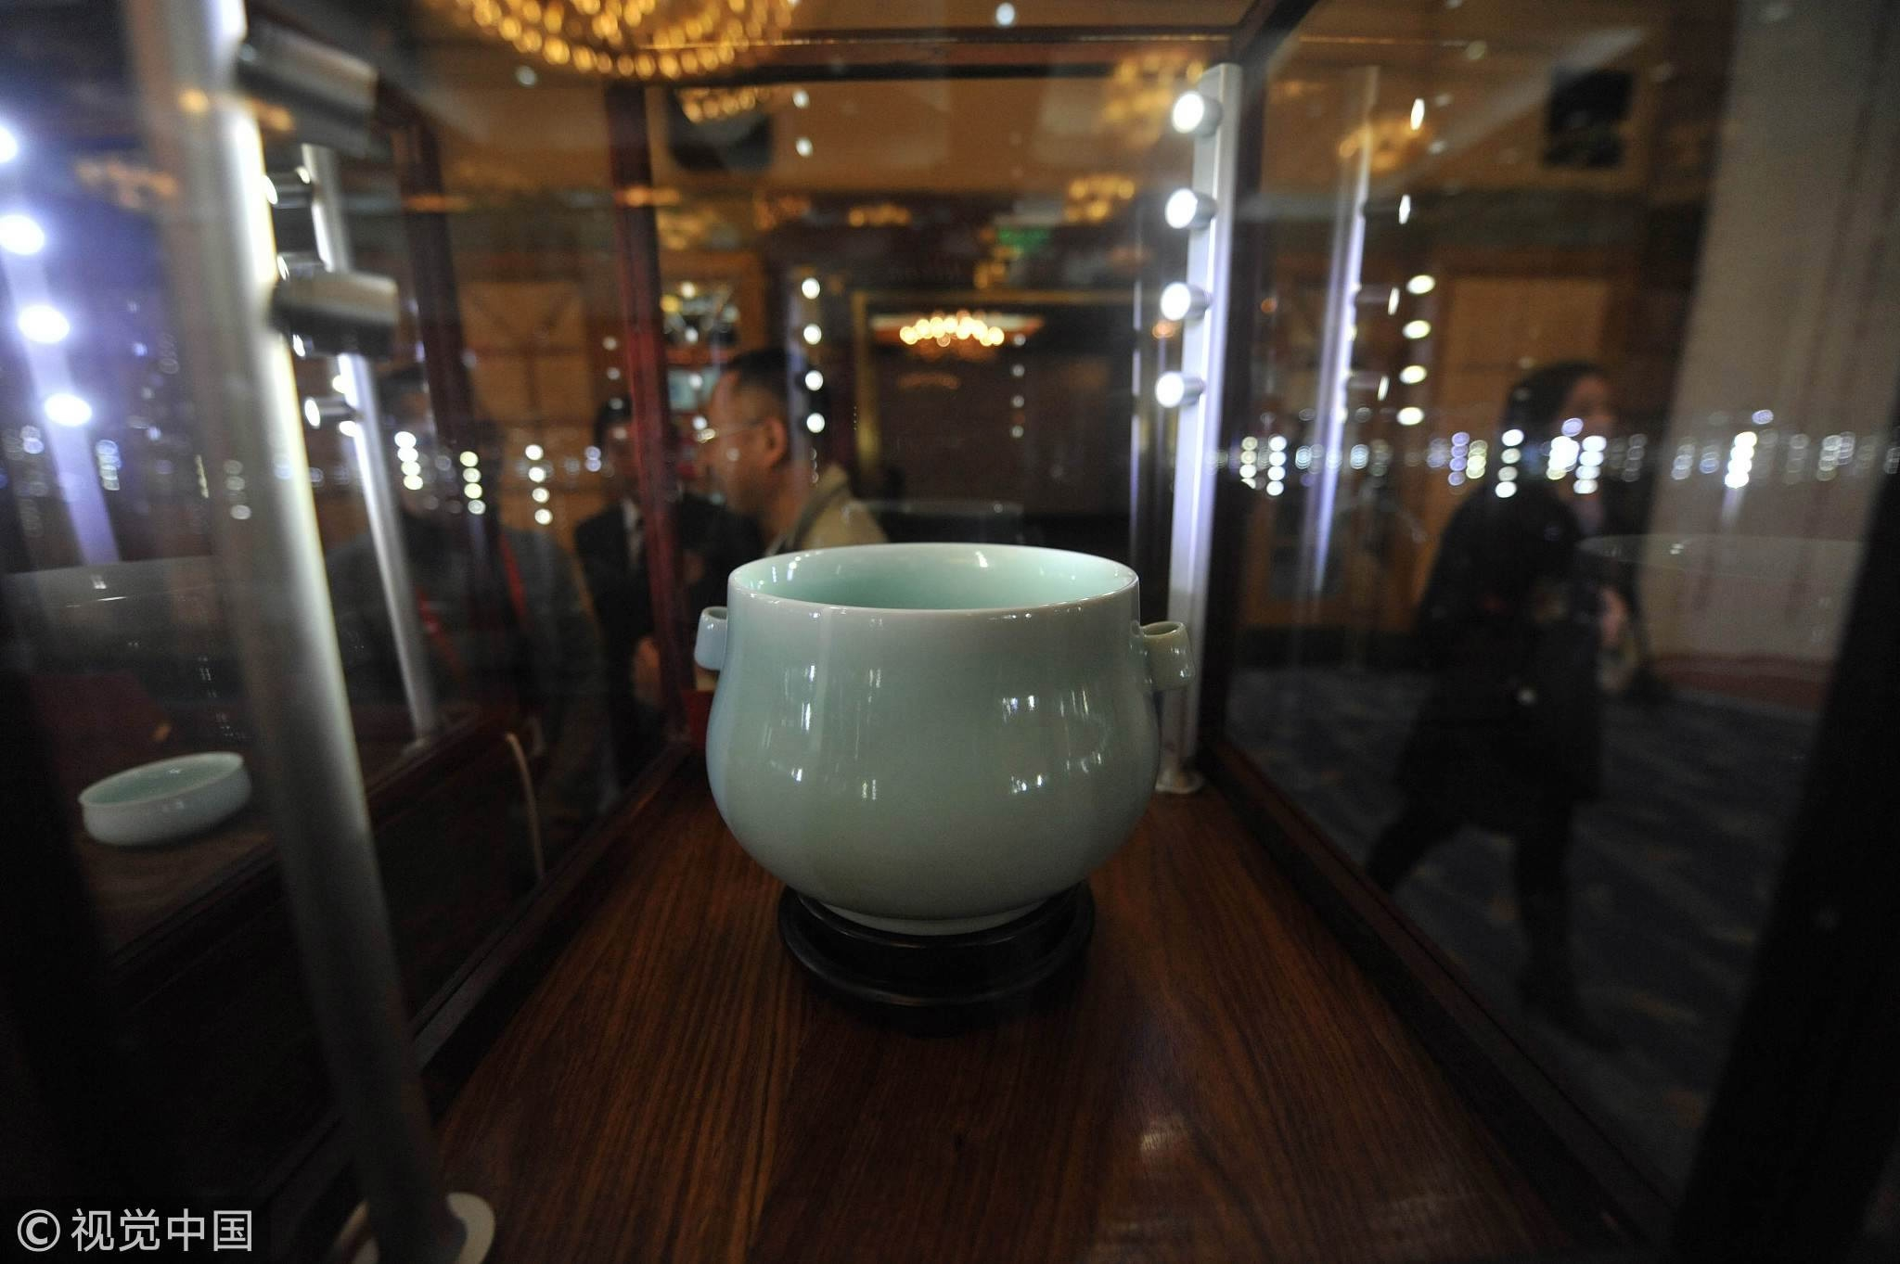
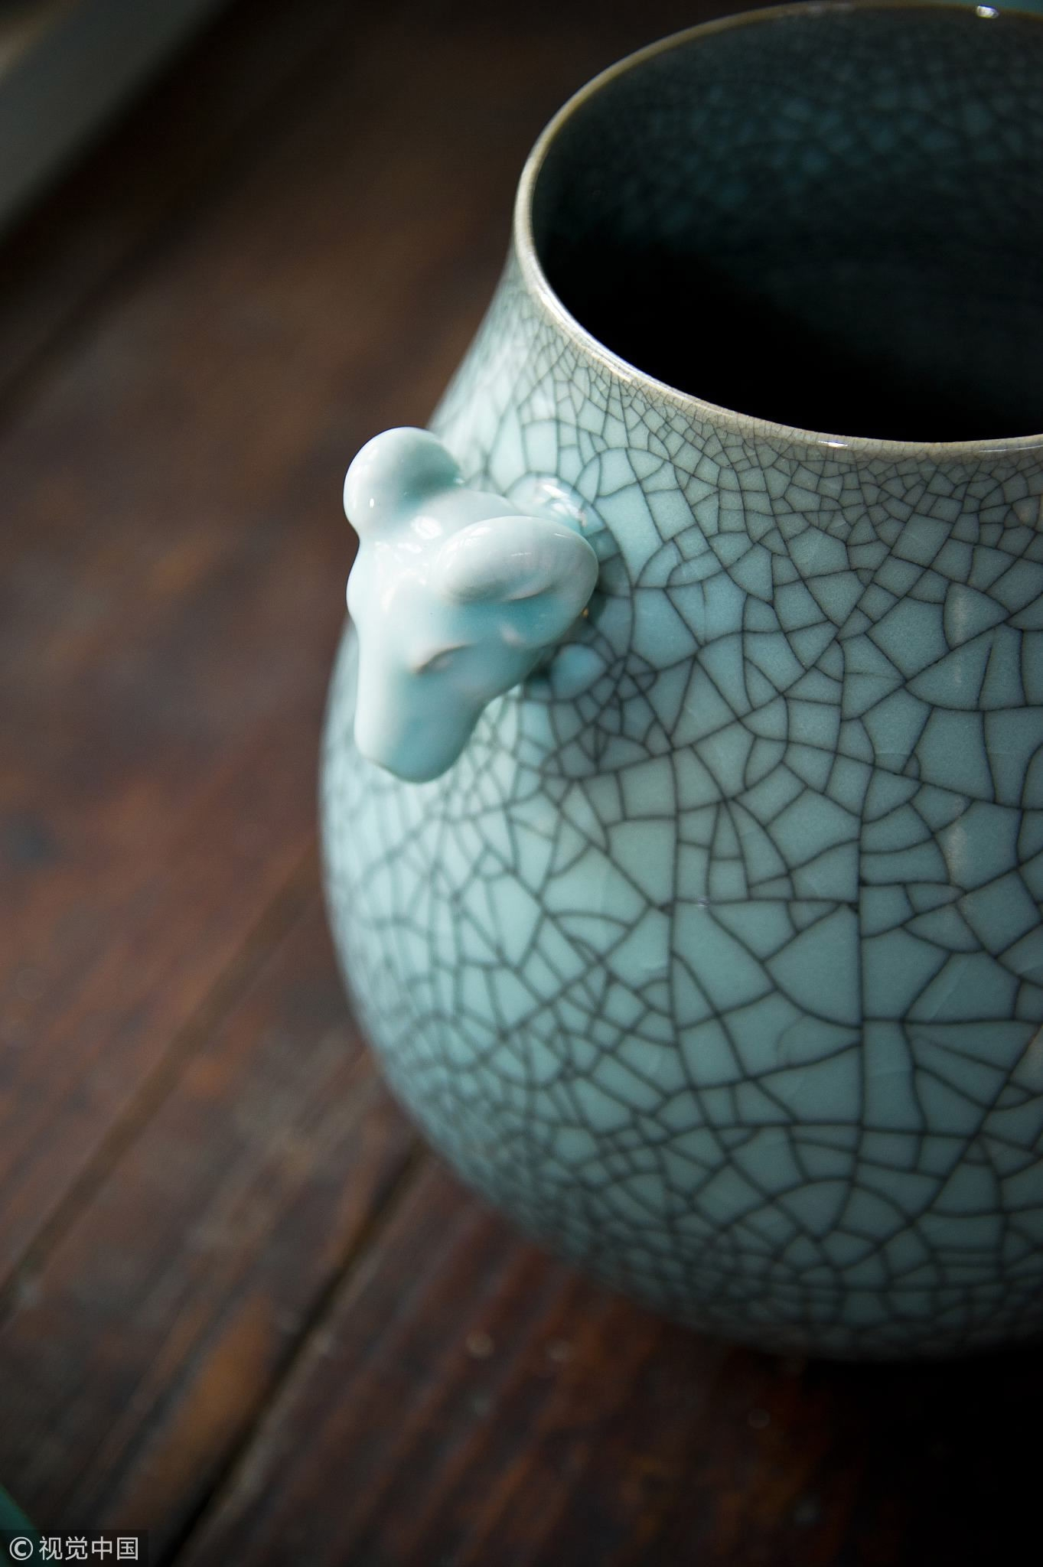

About Longquan
History
According to the local newspaper, at least 16,000 people live on their income from producing celadon in Longquan city, allowing for further possibility in developing and discussing the progresses and innovations in the craftsmanship.
Nowadays, vases, teapots, cups, sculptures and much more, all from Longquan Celadon, have not only re-appeared on the table of many Chinese, but also appear on display at the exhibitions and in the museums.And one thing is for sure: The “jade of the Chinese porcelain” will continue to shine, not only in China, but also around the world.

Slide 11

History
Through the efforts of Chinese and Arab travelers and businessmen, large quantities of this high-quality celadon found its way into West Asia, Egypt and Europe.

Slide 12
PART.03
Origination

Slide 13

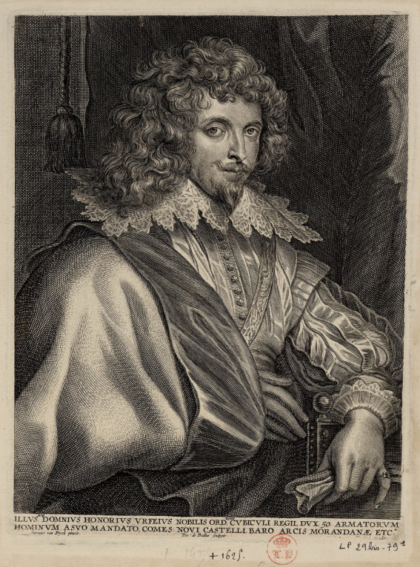
Origination
The name “celadon” originated from a 17th century drama by Honore d’Urfe that was played on the stages of Paris.
The hero, a shepherd named Celadon, was clad in delicate green. As it happened, the Parisians liked the green porcelain from China so much that they renamed it after the hero of Honore d’Urfe’s play. And so, while the original meaning of Celadon is “tender lover”, it came to mean green porcelain from China. The name has stuck ever since.
Notes:
https://www.ypppt.com/

