Slide 1

Unit 4
Tea, Silk and Ceramics

Slide 2
Questions Concerning Section A
1. Why is Chinese tea healthful?
2. What variety ranks first in output? Can you name some of its types?
3. What makes black tea different from green tea?
4. Why is white tea so named?
5. What is the most precious variety of Chinese tea?
6. What variety is unique to China?
7. What variety is popular with minority people?
8. How shall we prepare tea?
9. Is the tea-house different from the coffee bar?

Slide 3
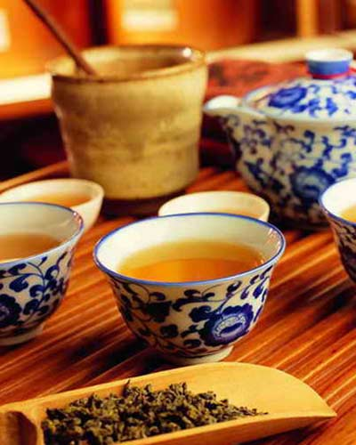
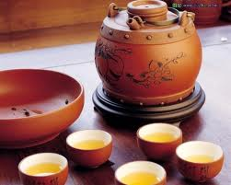
Tea pot & cups

Slide 4
Translation exercise
乌龙茶是一种半发酵茶，特征是叶片中心为绿色，边缘为红色，俗称绿叶红镶边。它有红茶的醇厚，而又比一般红茶涩味浓烈；有绿茶的清爽，而无一般绿茶的涩味。其香气浓烈持久，并具有提神、消食等功效。清初就远销欧美诸国，目前最受日本游客欢迎。

Slide 5
Questions Concerning Section B
1. How long is the history of silk production in China?
2. What did the Greeks and the Romans call China and the Chinese people?
3. How did Nanjing come to be a silk textile center?
4. Which provinces are China’s silk production centers?
5. How important is Hangzhou as a silk textile center?
6. What are the 3 best known brocades of China?

Slide 6
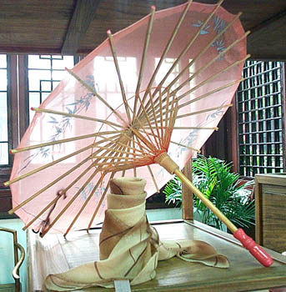
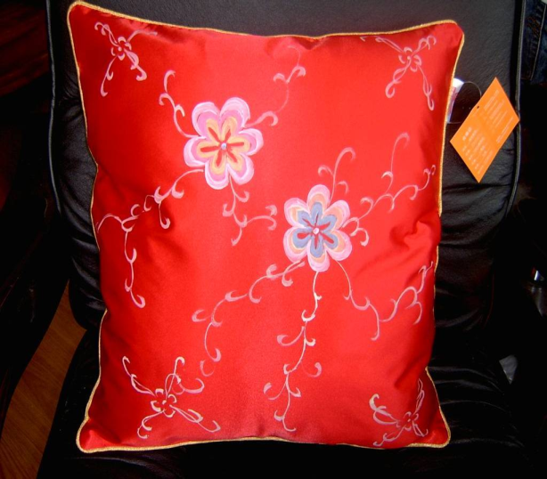
Silk pillow and umbrella

Slide 7
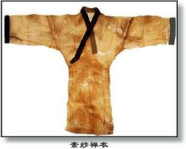
The 49-g. silk coat unearthed from Mawangdui, the lightest coat then in the world

Slide 8
Questions Concerning Section C
1. When was china brought to Europe? & when did Chinese ceramics reach its zenith?
2. What capitals are Jingdezhen and Yixing?
3. Why was Changnan Town renamed Jingde Town?
4. What do you know about monochrome porcelain of Jingde Town?
5. What do you know about blue-and-white porcelain of the Yuan Dynasty?
6. What achievements were made in ceramics in the Ming and Qing dynasties?
7. How prosperous is Jingde Town?

Slide 9
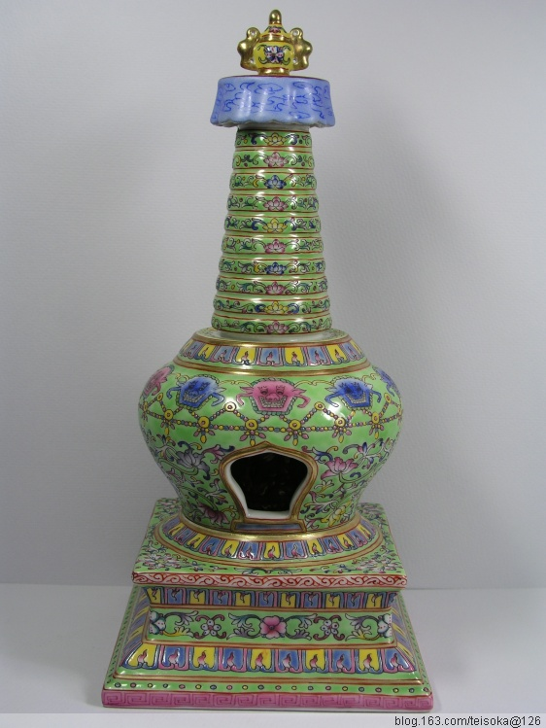
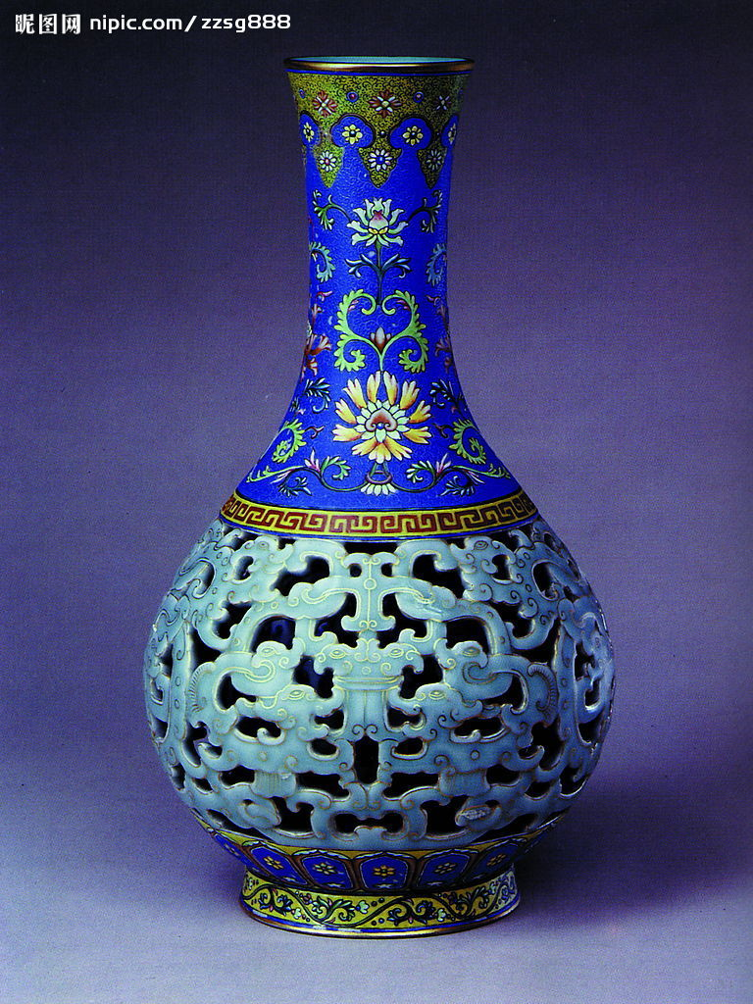
porcelain tower
pierced porcelain vase

Slide 10
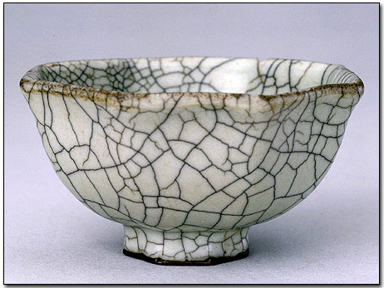
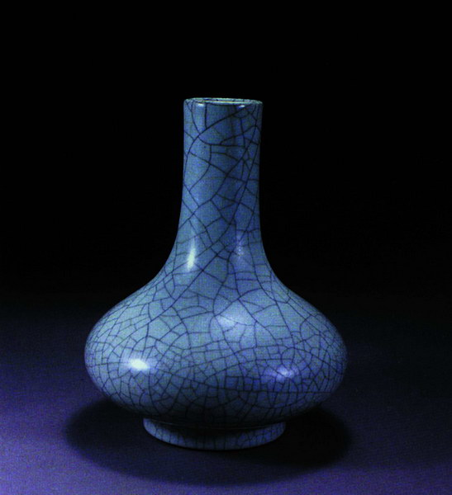
Crackled porcelain

Slide 11
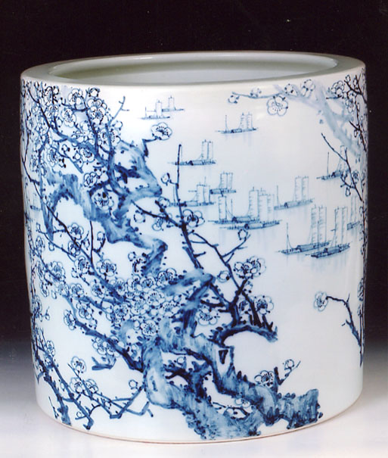
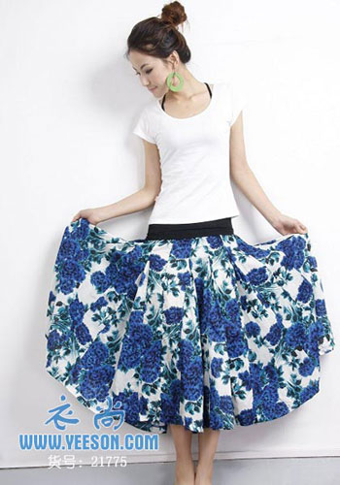
Blue-&-white porcelain

Slide 12
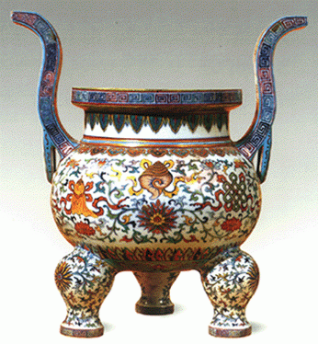
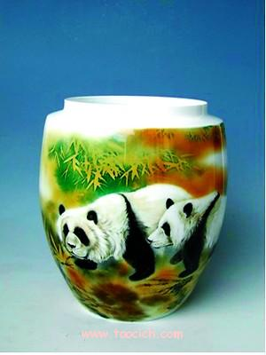
Five-colored porcelain

Slide 13
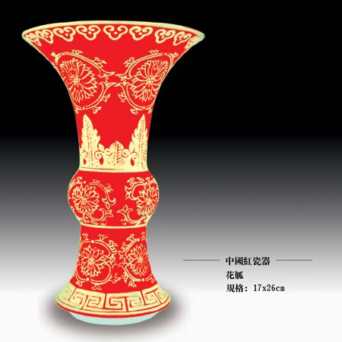
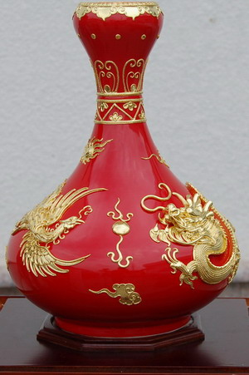
China Red porcelain vases

Slide 14
Questions Concerning Section D
1. Why does celadon appear green?
2. Why was the celadon industry prosperous in Hangzhou?
3. Why was Chinese green porcelain named Celadon?
4. What do you know about crackleware?

Slide 15
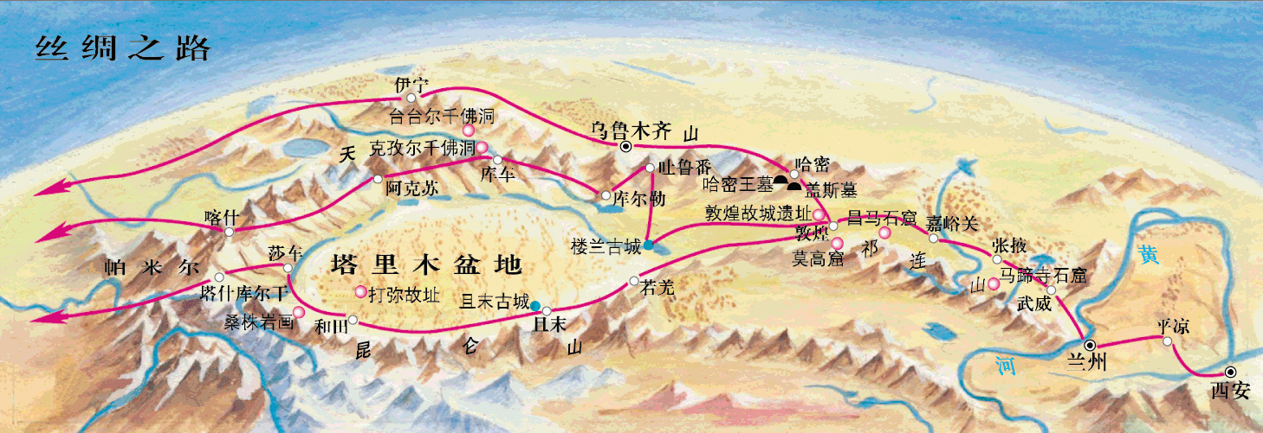
What do you know about the Silk Road?

Slide 16
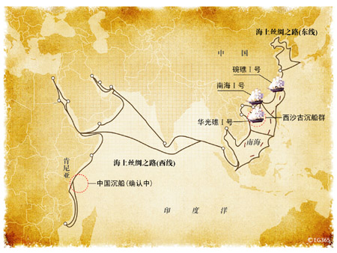
What do you know about the Silk Road?

Slide 17
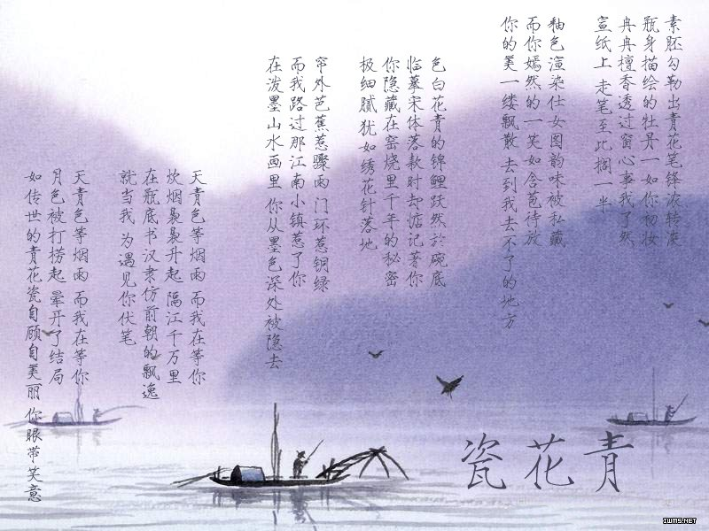

Slide 18
Topics for discussion
1. What role did tea, silk and china play in China’s export or ancient economic globalization?
2. What do you know about the Silk Road?
3. How do you appreciate Zhou Jielun and Fang Wenshan’s pop song “Blue-and-White Porcelain”?

Slide 19
See you next time!

Slide 20
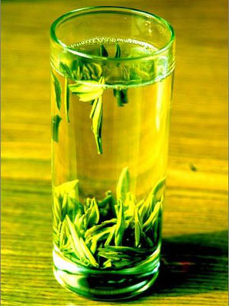
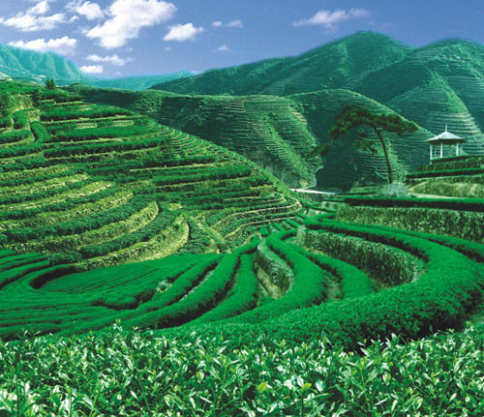
What variety ranks first in output? Can you name some of its types?

Slide 21
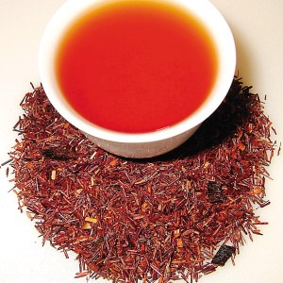
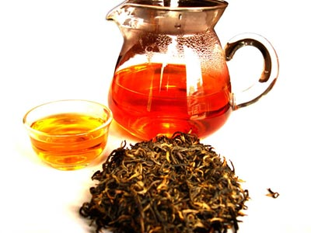
What makes black tea different from green tea?

Slide 22
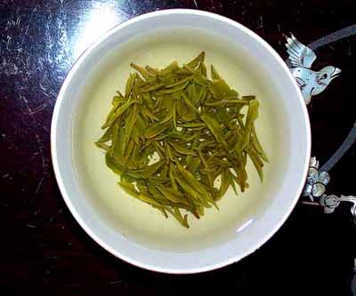
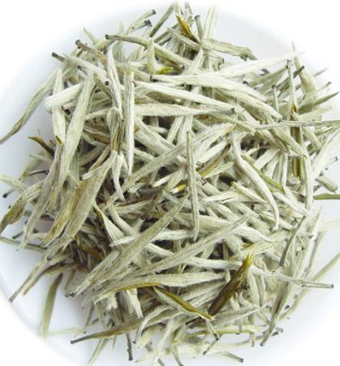
Why is white tea so named?

Slide 23
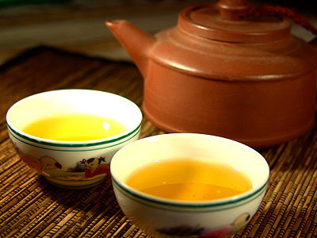
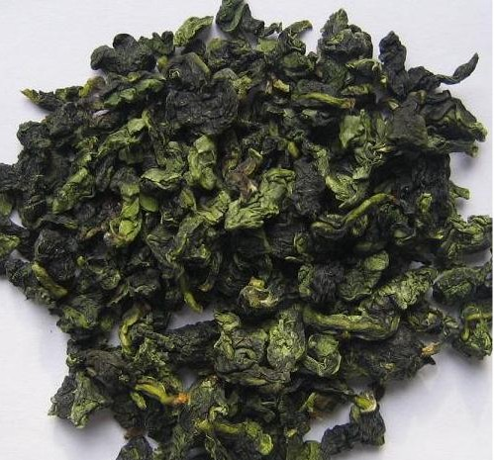
What is the most precious variety of Chinese tea?
Wulong tea

Slide 24
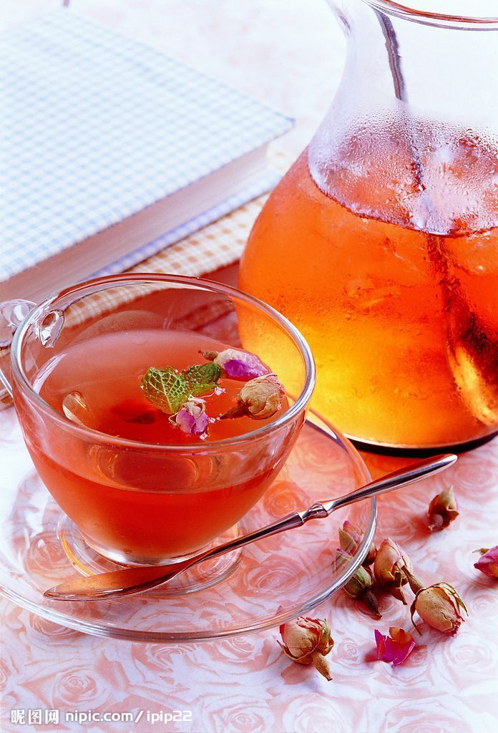
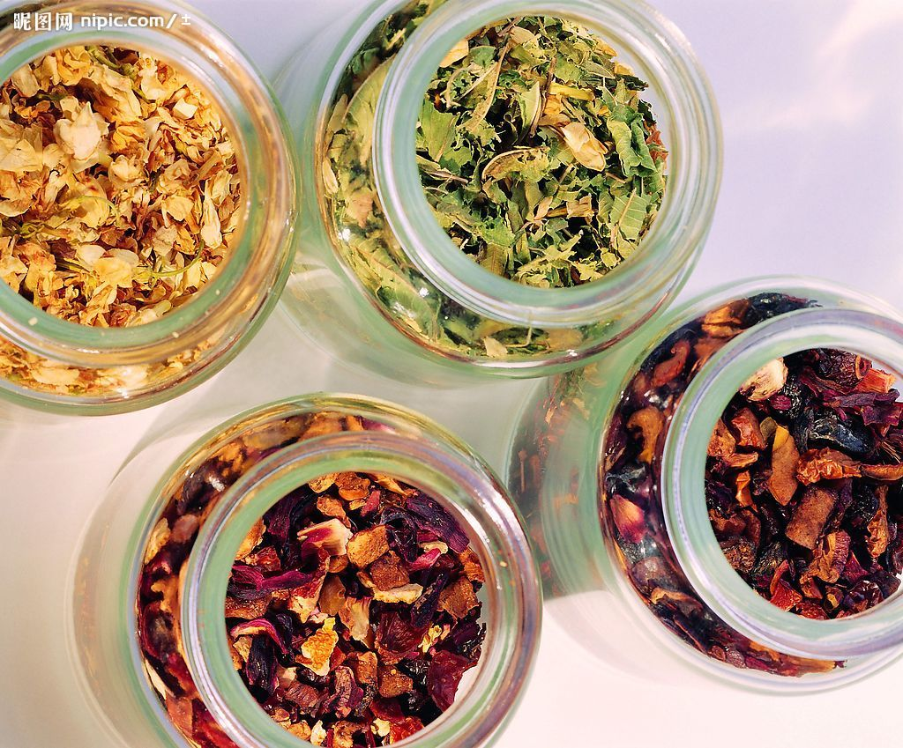
What variety is unique to China?
scented tea

Slide 25
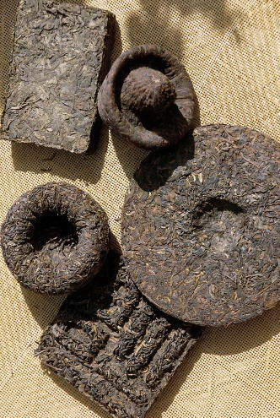
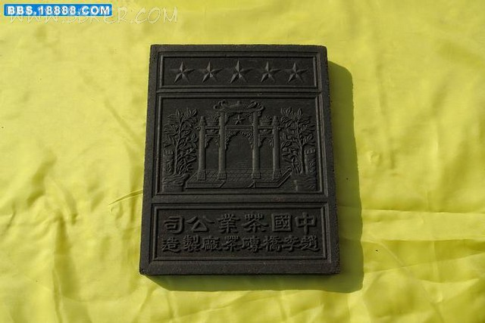
What variety is popular with minority people?
Tightly-pressed tea lumps

Slide 26
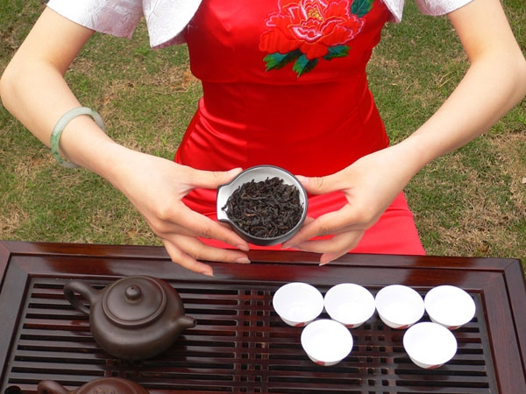
How shall we prepare tea?

Slide 27
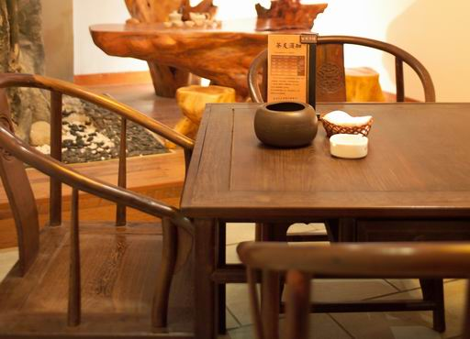
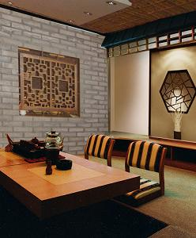
Is the tea-house different from the coffee bar?

Slide 28
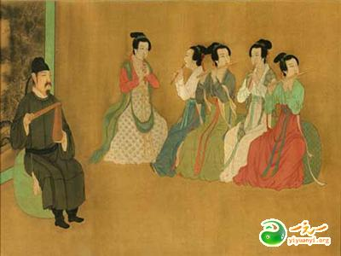
How long is the history of silk production in China?
Ancient silk painting (or painting on silk)

Slide 29
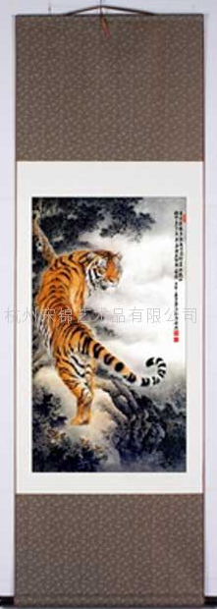
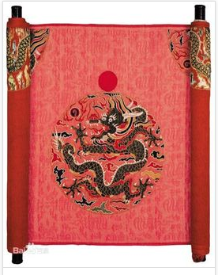
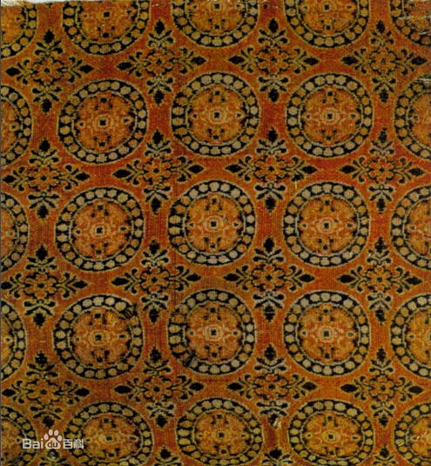
What are the 3 best known brocades of China?
Nanjing brocade
Sichuan brocade
Song Brocade

Slide 30
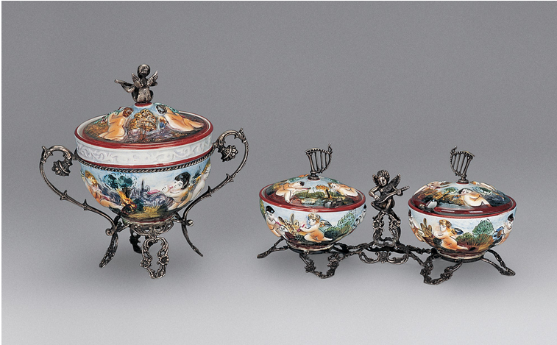
When was china brought to Europe? & when did Chinese ceramics reach its zenith?

Slide 31
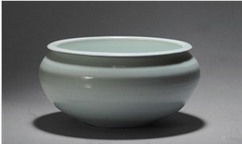
What do you know about monochrome porcelain of Jingde Town?

Slide 32
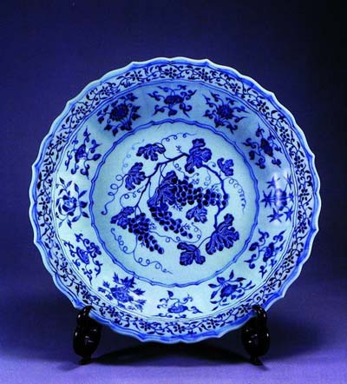
What do you know about blue-and-white porcelain of the Yuan Dynasty?

Slide 33
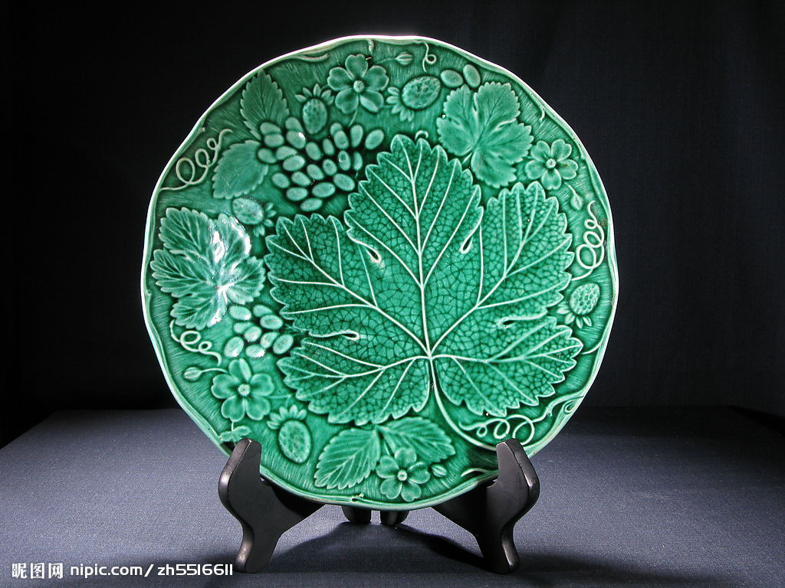
Why does celadon appear green?
Celadon plate

Slide 34
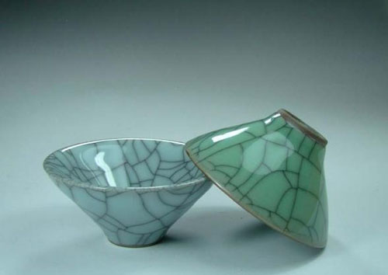
What do you know about crackleware?
Celadon crackleware

