Slide 1

The “Four Gentlemen”:
Plum, Orchid, Bamboo, Chrysanthemum
汇报人：胡筝

Slide 2
1
Plum blossom
目 录
2
Orchid
3
Bamboo
4
Chrysanthemum

Slide 3
1
Plum blossom

Slide 4
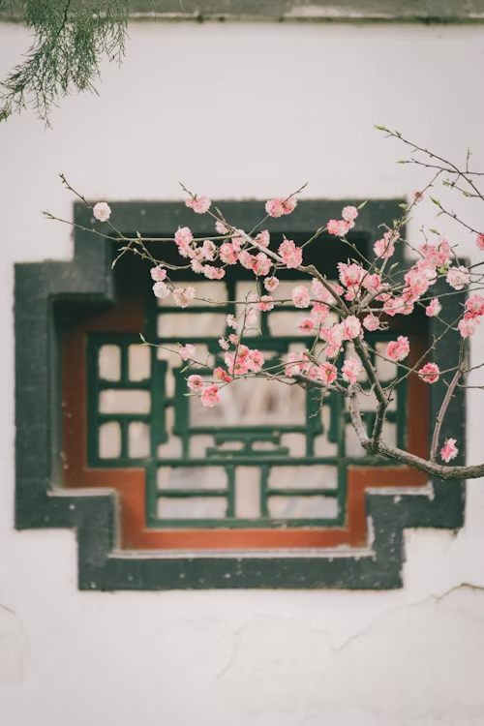
Introduction
A cultivation history of more than 3000 years in China
Blooms in winter and spring
Noble, strong, and humble character
A symbol of performance and resilience

Slide 5
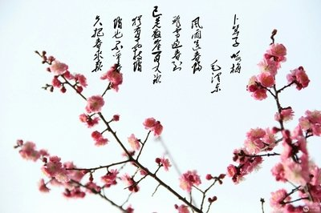
Plum Blossom in Poetry
To the Tune of Bu Suan Zi：Ode to Plum Blossoms
Wind and rain bid farewell to spring
Flurries of snow extend a welcome
Icicles dangle on the sheer cliffs
Yet plum blossoms appear on the icy boughs
Still, they do not out-bloom spring
They are no more than its harbingers

Slide 6
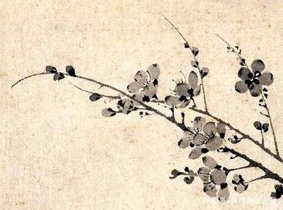
Plum Blossom in Painting
Wang Mian’s Ink Painting of Plum Blossom

Slide 7
2
Orchid

Slide 8
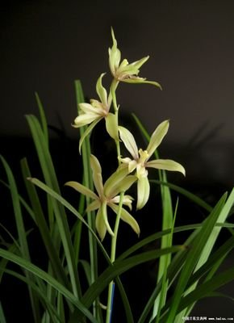
Introduction
Chinese orchid: Spring Orchid, Hui Orchid, Jian Orchid, Mo Orchid, and Han Orchid
A simple and elegant temperament
A cultivation history of over a thousand years in China

Slide 9
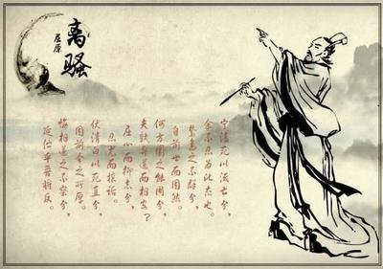
Orchid in Poetry
Li Sao
…
Adorned with the flowers of Jiangli and Pizhi
I sewed autumn orchids to wear as ornaments
…
I lead my horse to the orchid-fringed bank
and gallop to the spicy hill where I take my rest
…

Slide 10
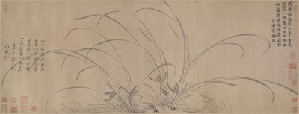
Orchid in Painting
Zhao Mengjian’s Ink Painting of Orchid

Slide 11
3
Bamboo

Slide 12
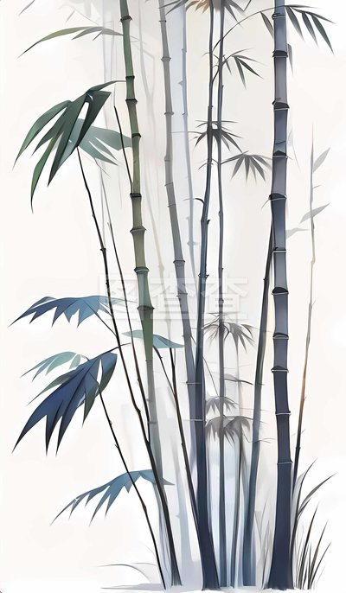
Introduction
Rapid growth ability as a symbol of a vigorous and enterprising attitude towards life
Evergreen all year round, with tall and slender branches
Hollow and straight, symbolizing a humble, courteous, and open-minded gentleman’s personality

Slide 13
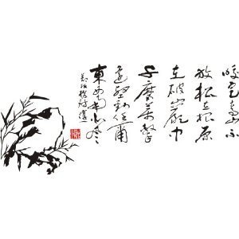
Bamboo in Poetry
Bamboo and Stone
The plant roots grip the green hill tightly
They grow in the broken rocks
After thousands of abrasions and impacts, they are still sturdy
No matter how the wind blows from all directions

Slide 14
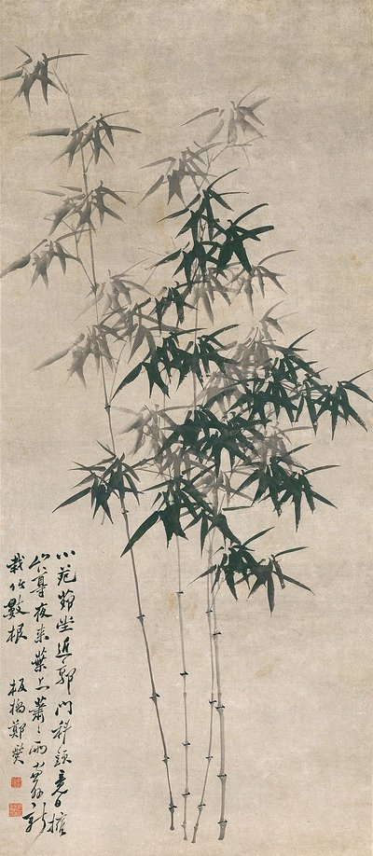
Bamboo in Painting
Zheng Banqiao’s Ink Bamboo

Slide 15
4
Chrysanthemum

Slide 16
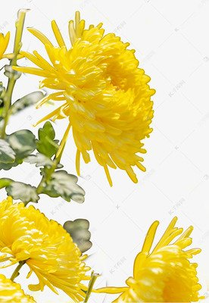
Introduction
Originated in China, transmitted to Japan through Korea during the Tang and Song dynasties, to Europe in the 17th century, and then to America
300-400 varieties
Often bloom in September, therefore expressing a hope for long-term longevity

Slide 17
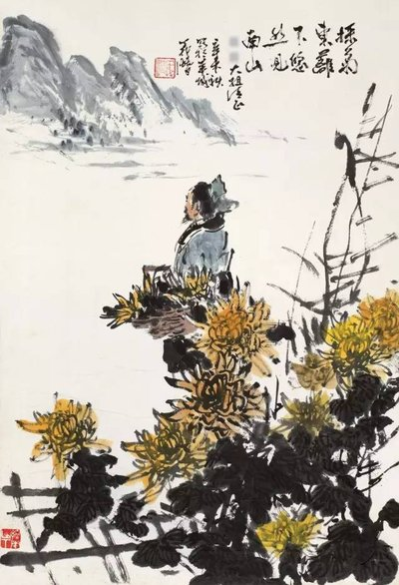
Chrysanthemum in Poetry
Picking chrysanthemums
…
Picking chrysanthemums under the eastern fence
I leisurely gaze upon the southern mountains
…

Slide 18
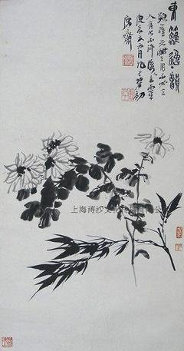
Chrysanthemum in Painting
Lu Yanshao’s Bamboo and Chrysanthemum Painting

Slide 19
Question：
What is the sentence about orchid written by Qu Yuan in Li SAO?

Slide 20
Thanks for watching！

