Slide 1

China’s ways of culture export
by Xu Zhiyuan

Slide 2
目录
Ⅰ.
Chinese Web novels
CONTENTS
Chinese TV series
Ⅱ.
Li Ziqi(李子柒)
Ⅲ.

Slide 3
Ⅰ.Chinese Web novels

Slide 4
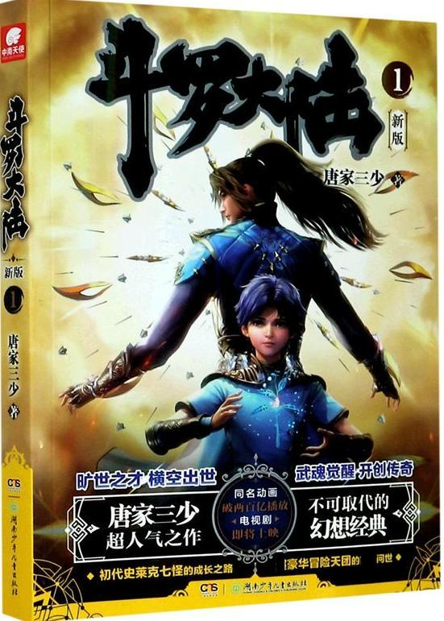


Some famous Chinese Web novels
Battle Through the Heavens
Soul Land
The Great Ruler

Slide 5
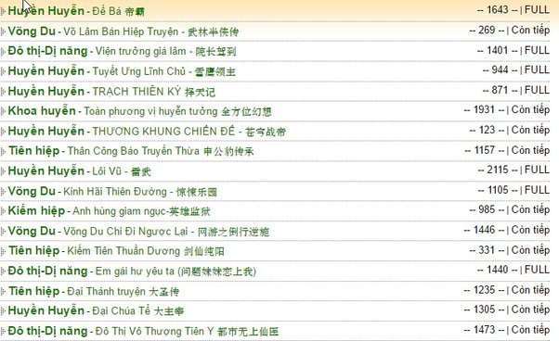
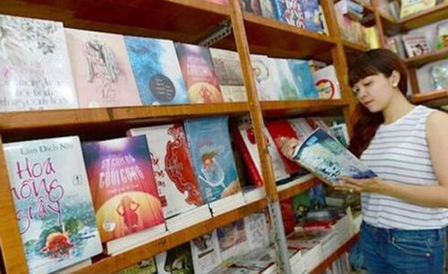
Chinese Web novels are popular in many places
Chinese online literature is popular in Vietnam. China’s publishing of romance novels to Vietnam accounts for most of their publisher’s sales.
Chinese online literature performed also well in the EU and US markets. For example, this ranking was overwhelmed by Chinese online novels.

Slide 6
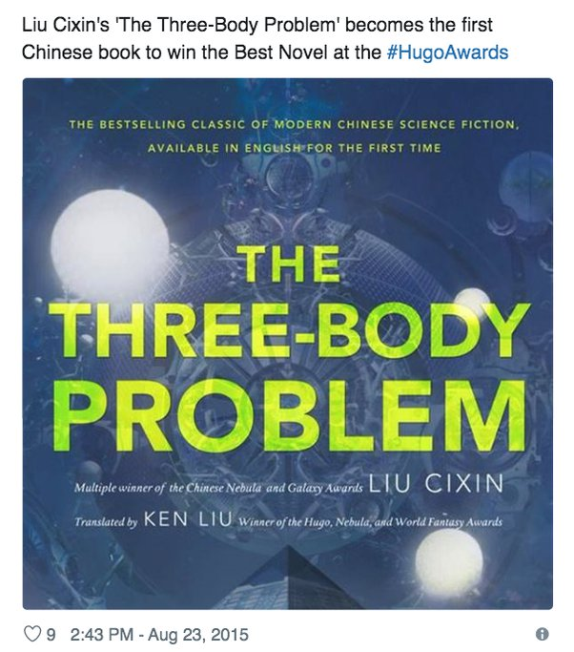
The great achievements of Chinese novels in the world.
The Chinese writer Liu Cixin has won the 2015 Hugo Award for best science-fiction novel. It is the first time the prestigious prize has gone to a Chinese writer and the first time that multiple finalists were originally written in languages other than English, the World Science Fiction Society announced.

Slide 7
Conclusion
Chinese web novels have achieved good results. Its audience is dominated by ACG-loving otaku. One day it will grow into a cultural pillar like Japanese anime and Korean TV drama.

Slide 8
Ⅱ.Chinese TV series

Slide 9
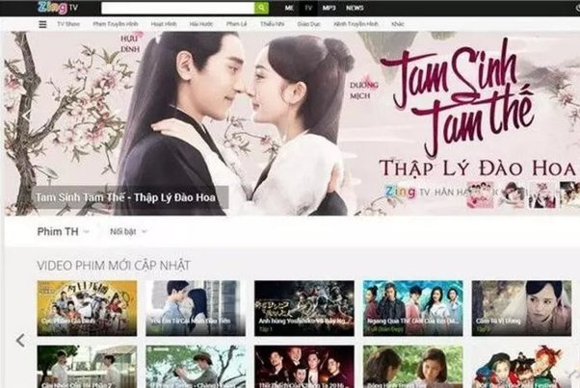

Some popular TV series
Similarly, after being adapted into TV series and comics, many contents still popular in Southeast Asia, such as the Chinese TV series, The Journey of Flower.（花千骨）
The “Story of Yanxi Palace” copyright has sold more than 100 countries. Its copyright revenue has reached more than 100 million dollars, and ranked first in Google's global TV program.

Slide 10
Conclusion
Chinese culture is reflected in many details in Chinese TV series, so we can say that it is part of Chinese culture export.

Slide 11
Ⅲ.Li Ziqi（李子柒）

Slide 12
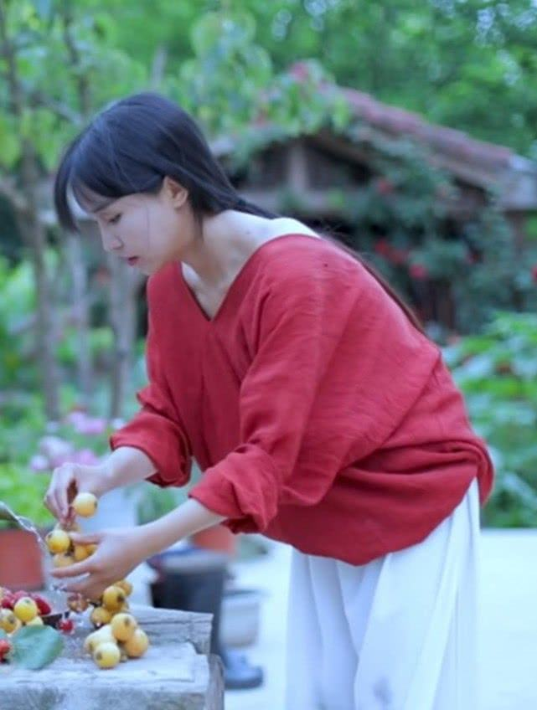
Li Ziqi（李子柒）
Li Ziqi's works are based on the Chinese people's true and quaint traditional life. Her videos are based on the food culture that the Chinese nation is proud of, focus on clothing, food, housing and travel, and attract many people with this unique style.
Because of her videos, many people began to understand China, understand Chinese culture, and even began to learn Chinese. Some people even cured their depression because they watched her video. Her video is indeed healing, and in this impetuous world, it satisfies people's yearning for pastoral life.

Slide 14
Thank you！

