Slide 1

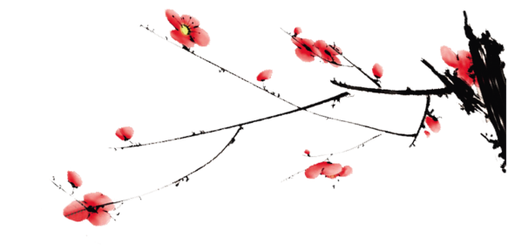

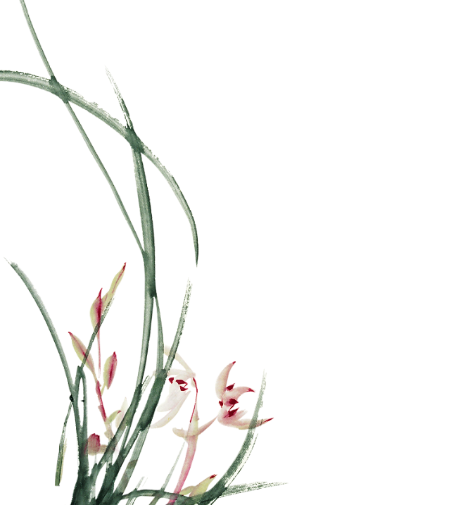

Ancient Chinese Values
Passed down Until Today
Presenter: 刘丛领Liu Congling
夏紫纯Xia Zichun

Slide 2
Contents
01
Definition&Classification
02
Ancient Chinese Values
03
Ancient Chinese Values Handed down Until Today
04
Conclusion

Slide 3

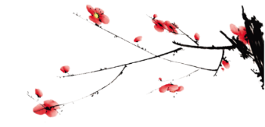
Definition
1.In ethics and social sciences, value denotes the degree of importance of something or action, with the aim of determining which actions are best to do or what way is best to live, or to describe the significance of different actions. (Wiki)
2. Values are the understanding, theory and doctrine of value, and the fundamental views of people on what is value and how to create value. (Marxism)
3.Values are the cognition, understanding, judgment or choice made by people based on certain thinking senses, that is, a kind of thinking or orientation that people identify things and distinguish right from wrong, so as to reflect the certain value or function of people, things and things. Values are characterized by stability and persistence, historicity and selectivity, and subjectivity.

Slide 4
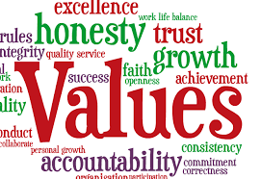
Classification
Values are generated by the interaction between people and surrounding things.
personal values
cultural values

Slide 5
Ancient Chinese Values
1.Xia, Shang and Zhou Dynasties
4.Qin and Han Dynasties
women are required to maintain chastity
the three cardinal principles
worship nature and revere nature.
the coexistence of traditional gods and newly created gods.
respecting morality and cultivating morality.
five constants（ benevolence, righteousness,
propriety, wisdom and faith）
2.Spring and Autumn Period and Warring States Period
3.Song, Yuan, Ming and Qing Dynasties
benevolence.
filial piety and universal love.
the unity of heaven and man.
the use of nature.
valuing morality; Let go of human desires and preserve
natural principles.
ideal personality

Slide 6
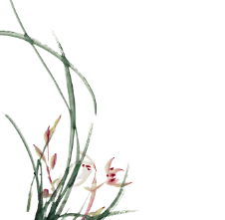
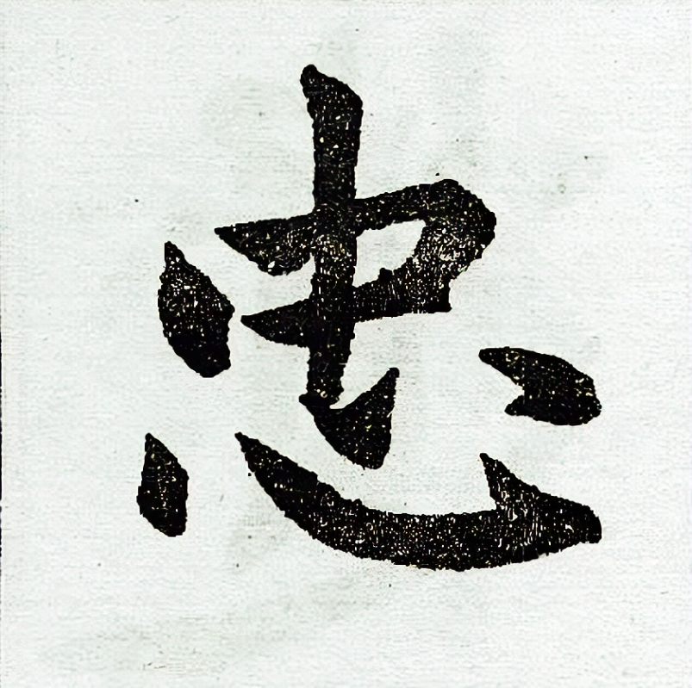
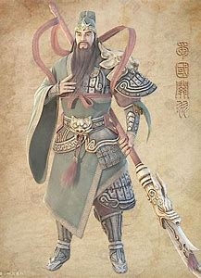
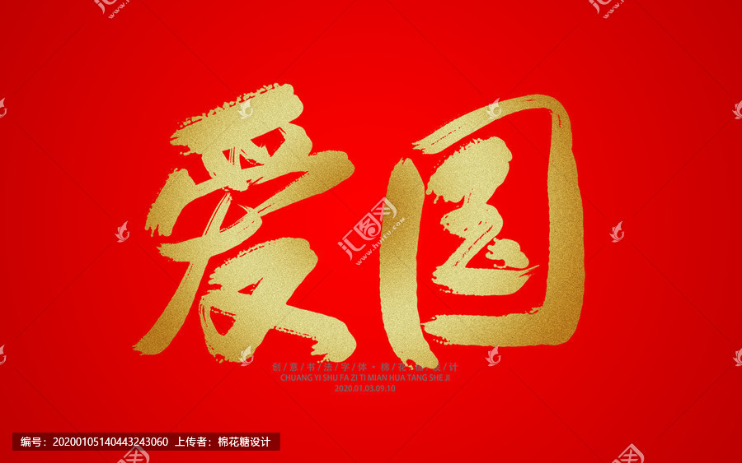
Ancient Chinese Values Handed down Until Today
1.loyalty and patriotism
loyal to the emperor and love your nation
loyal to the Communist Party of China
and love the People’s Republic of China

Slide 7
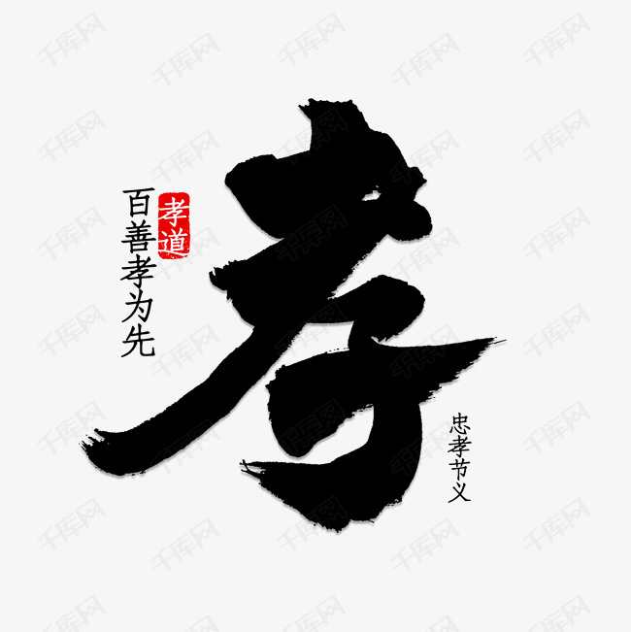
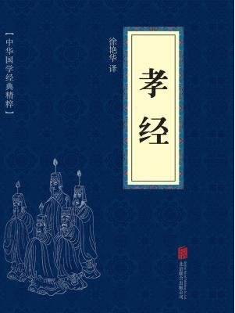
Ancient Chinese Values Handed down Until Today
2.filial piety
Of all virtues, filial piety is most important. 百善孝为先
The Book of Filial Piety
ancestor veneration and family-oriented

Slide 8
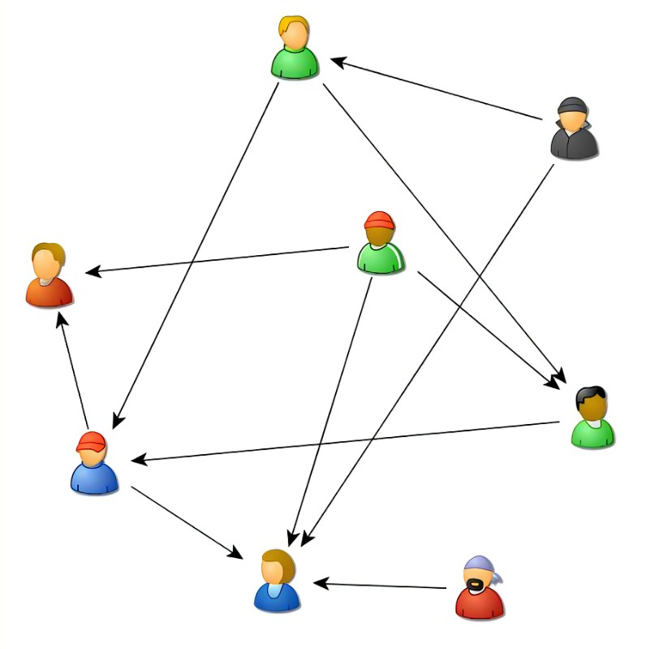
Ancient Chinese Values Handed down Until Today
3.social connection
relationship
to pull strings/
to get a green light
centralism and rule of man

Slide 9
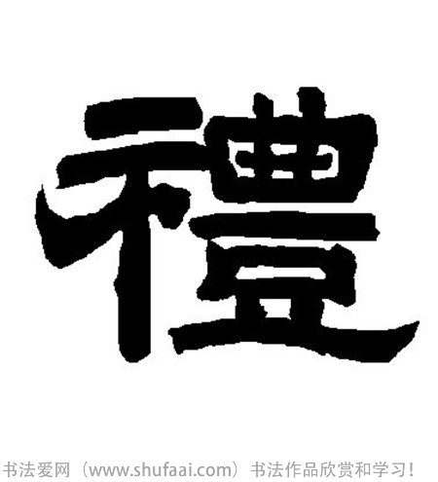
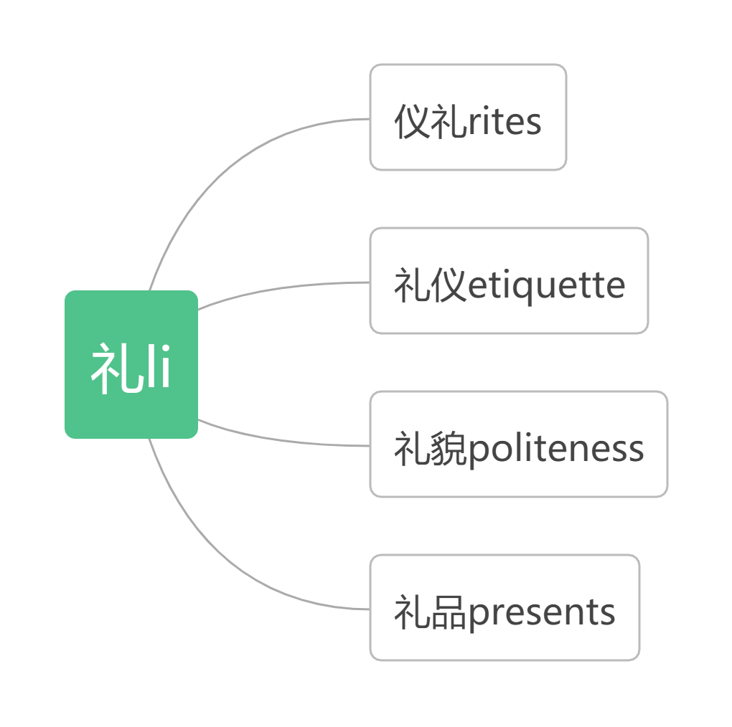
Ancient Chinese Values Handed down Until Today
4.li
tea rites, funeral rites, etc.
behaviors you should observe during different occasions
be polite when you deal with people
social connections and face-related
It is impolite not to return what one receives. 来而不往非礼也。

Slide 10
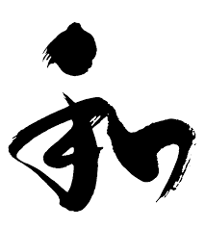
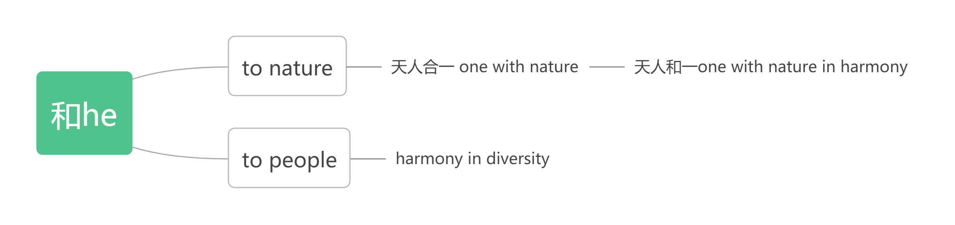
Ancient Chinese Values Handed down Until Today
5.harmony/peace
A peaceful family will prosper. 家和万事兴。
Harmony brings wealth.和气生财。
the Five Principles of Peaceful Coexistence 和平共处五项原则
Harmony is the most valuable.以和为贵。
To make concessions to avoid trouble息事宁人

Slide 11
Conclusion
1.Confucianism-oriented
2.holistic thinking
the golden mean中庸之道
3.outcome-driven
pragmatism经世致用/实学（a school in Song Dynasty)

Slide 12
References
1.Yan Hui 晏辉.(2009). 现代语境下的价值与价值观[Values in the
modern context]. Beijing Normal University Press 北京师范大学出版社.
2.Liu Caihong 刘彩虹.(2014). 当代中国社会价值观念变迁与人的全
面发展[The changes of contemporary Chinese social values and the all round development of human beings]. Inner Mongolia University 内蒙古大学.
3.Lin Hongtao 蔺宏涛.(2016). 社会主义核心价值观的源流研究
[Research on the origin of socialist core values]. Hunan University 湖南大学.
4.Zhao Fujie 赵馥洁.(2004). 论中国主体价值观念的起源[On the origin of the concept of value subject in China]. Journal of Humanities 人文杂志, 000(005), 46-52.
5.Wang Chuanman 王传满.(2008). 夏商周:贞节观念滥觞[Xia, Shang and Zhou Dynasties: the beginning of the concept of chastity]. Journal of Hubei University of Economics 湖北经济学院学报,6(4):4.
6.Li Qiuxiang 李秋香.(2015). 文化认同与文化控制:秦汉民间信仰研究[Cultural identity and cultural control: a study of folk beliefs in the
7. Maiese, Michelle. "Causes of Disputes and Conflicts." Beyond Intractability. Ed. Guy Burgess and Heidi Burgess. Conflict Research Consortium, University of Colorado, Boulder, Colorado. October 2003. Downloaded 13 February 2016.
8.Roth, Steffen (2013). "Common values? Fifty-Two Cases of Value Semantics Copying on Corporate Websites". Human Systems Management. 32 (4): 249–65. doi:10.3233/HSM-130801.
9.https://en.wikipedia.org/wiki/Value_(ethics_and_social_sciences)

Slide 13
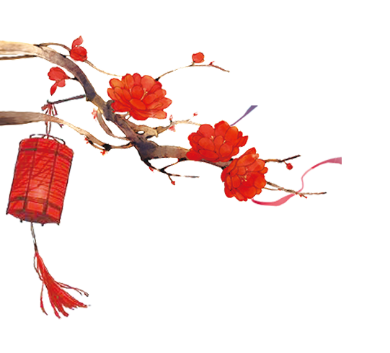

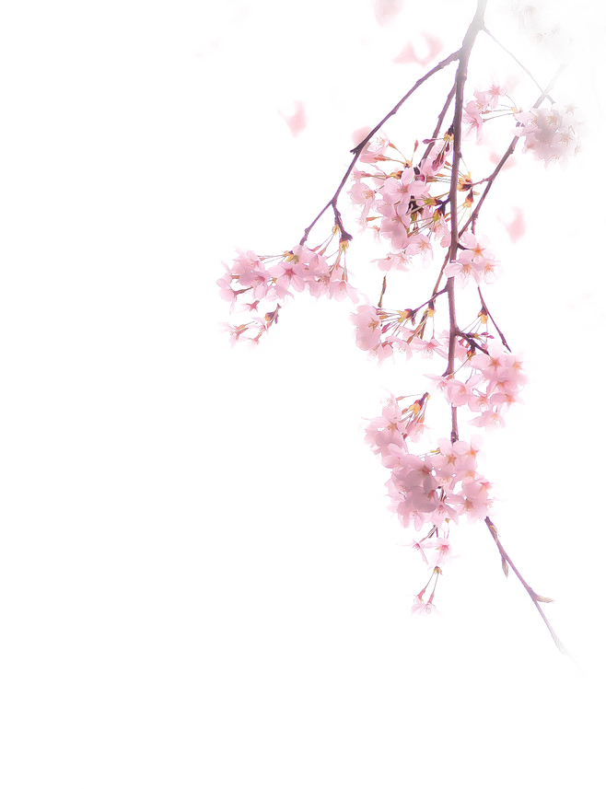

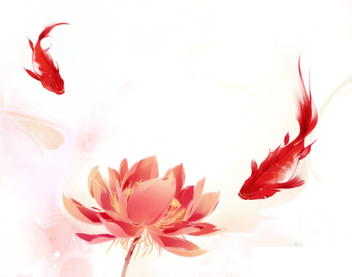


Ancient Chinese Values Handed Down Until Today
汇报人：Xia Zichun
时间：2022.12.16

Slide 14
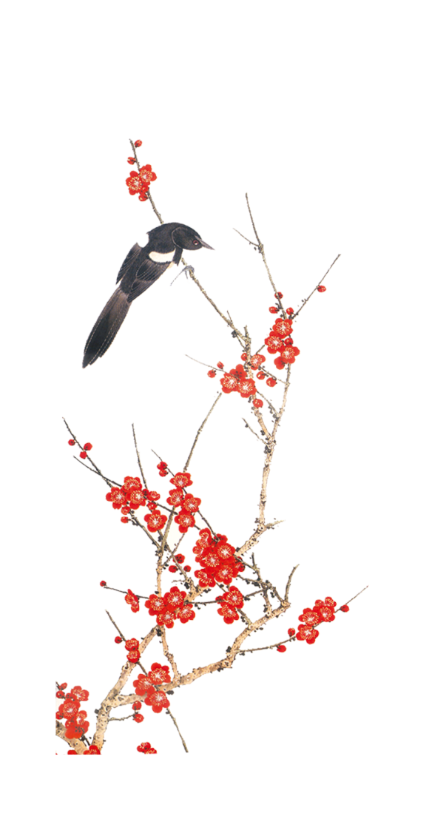
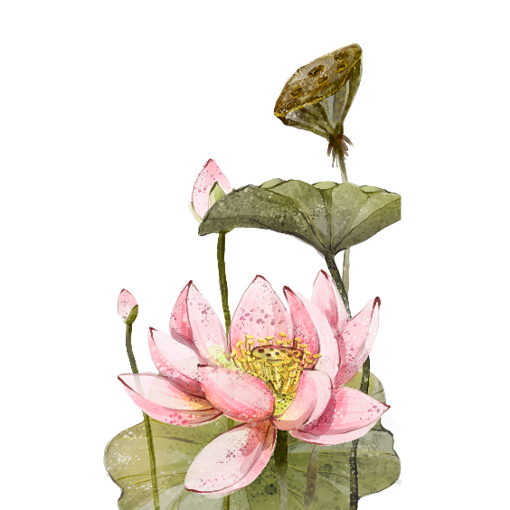
01
The Interactive Part

Slide 15
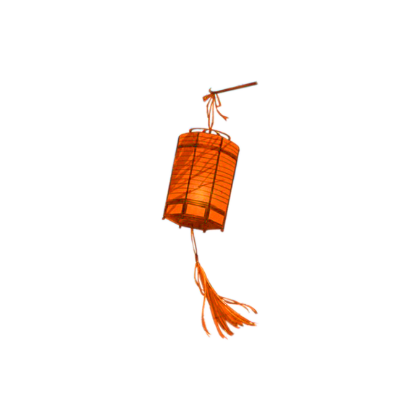
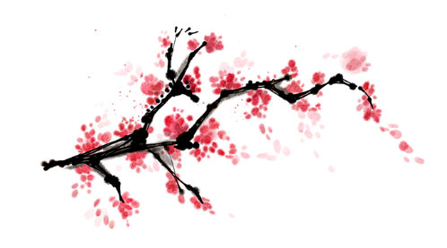
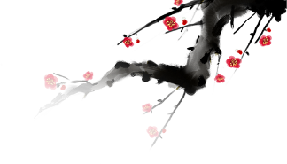
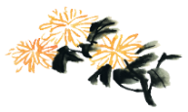
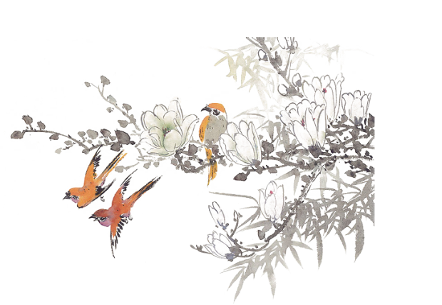
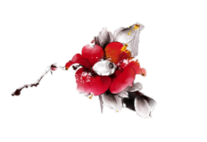

Q1 :
What do you think of Chinese Wine culture?
男人不喝酒，枉在世上走。
感情深，一口闷；感情浅，舔一舔；
感情厚，喝不够；感情薄，喝不着；感情铁，喝出血。
一杯情，二杯意，三杯才是亲兄弟。
半斤不当酒，一斤扶墙走，斤半墙走我不走。

Slide 16
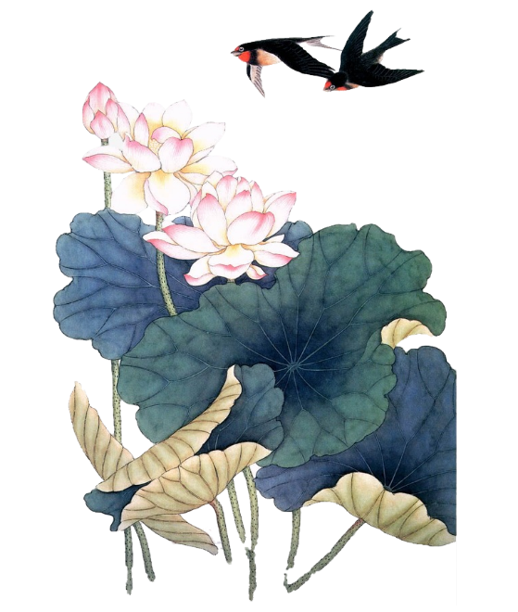
小学时，年龄太小，不准谈恋爱。
初中时，学业为重，不准太恋爱，
高中时，学业为重，不准谈恋爱。
大学时，年龄太小、学业为重、异地，不准太恋爱。
毕业后，你说说你都多大了，连个对象都没有，看看xx家连孙子都抱上了，怎么就一点不上心呢？
话说这一切都是谁造成的？
Q2 :
At what stage of your life do you think it is more appropriate to start a relationship?

Slide 17
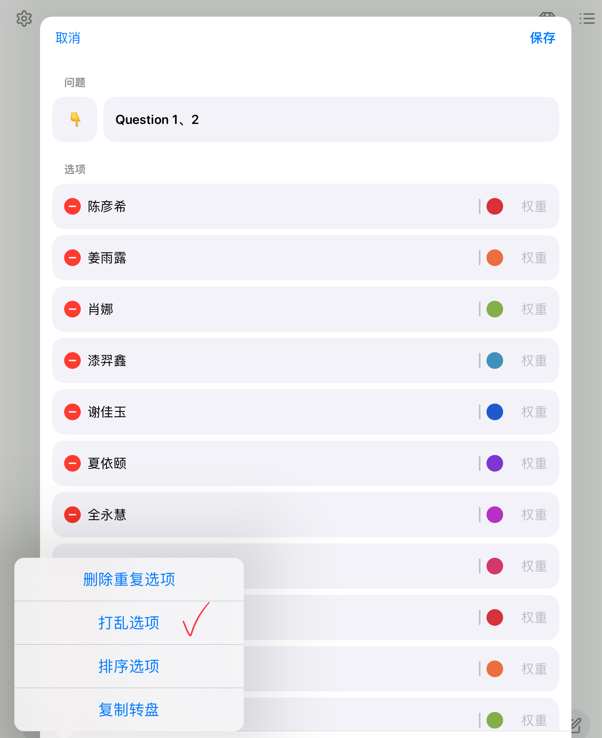
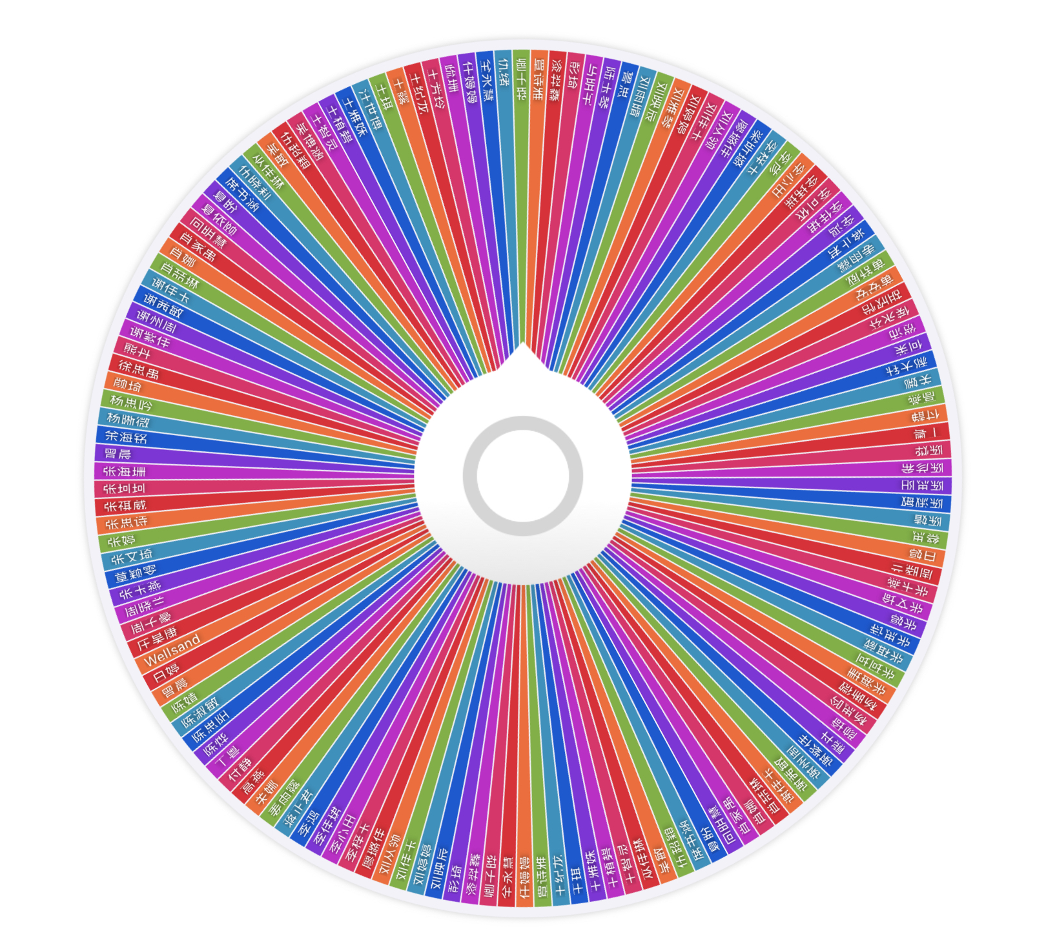

Slide 18
02
Conclusion

Slide 19
Attitude:
Take the essence and discard the dregs.
取其精华，去其糟粕。

Slide 20
Thank you
汇报人：Xia Zichun
时间：2022.12.16

