Slide 1


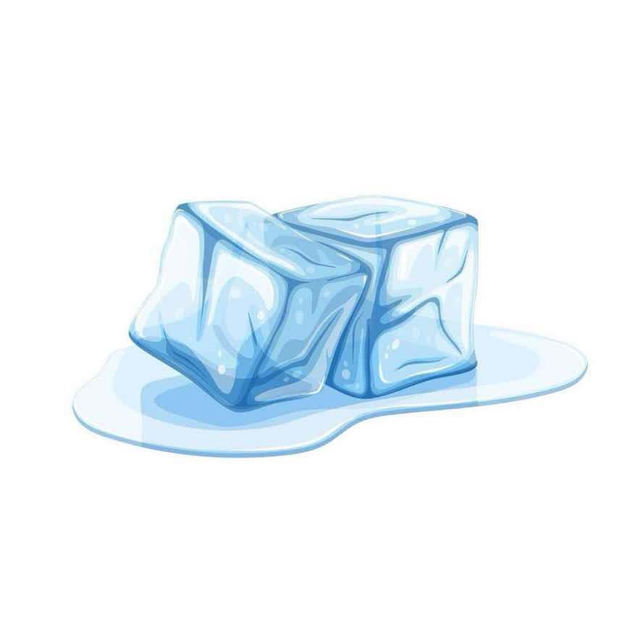

？
= 1000+

Slide 2
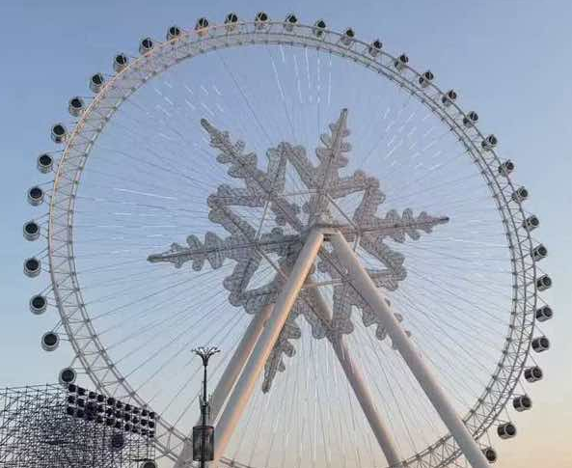
Ice and Snow World
汇报人：Cai Lanying

Slide 3
Content
History
01
Ice carving
02
Folk custom
03
Summary
04

Slide 4
01
History

Slide 5




History
Initiated in 1999
In 2011
A large-scale ice and snow art project created by the Harbin Municipal Government of Heilongjiang Province to celebrate the millennium(2000).
The park relocated and expanded, its area increased, and for the first time, a large-scale live ice and snow performance was introduced, shifting from mere viewing to an experience-oriented approach.
In 2024
In 2026
The 25th edition was officially recognized by the Guinness World Records as the "World's Largest Ice and Snow Theme Park". It received 2.71 million visitors in a single session
The park closed on February 21st. This year, the single-day visitor count exceeded 120,000, setting a new record high.

Slide 6
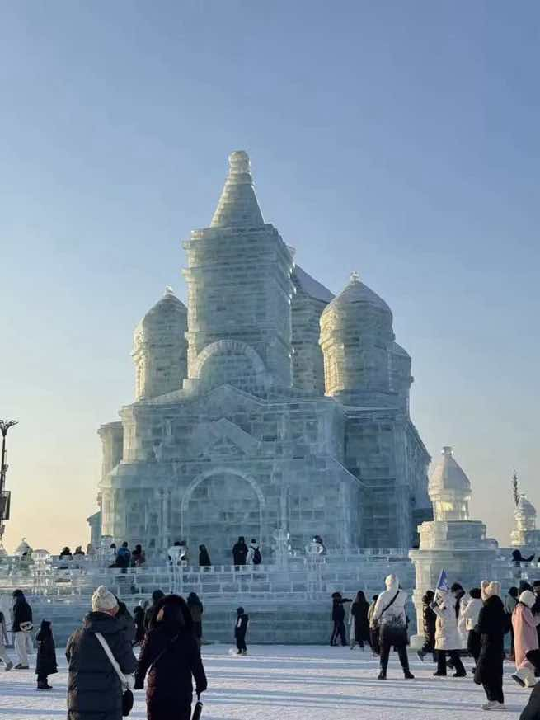
02
Ice carving and
snow carving

Slide 7
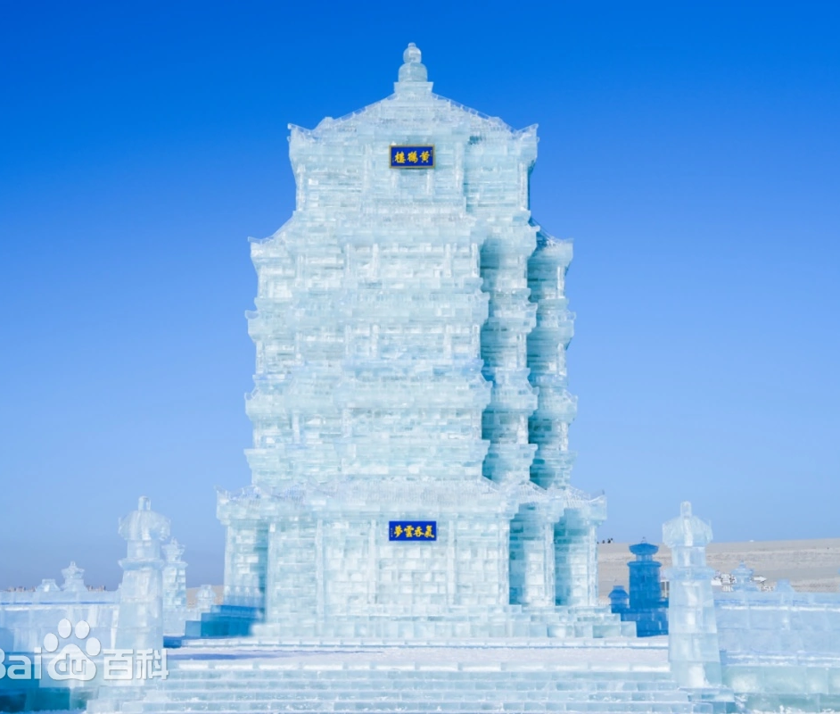
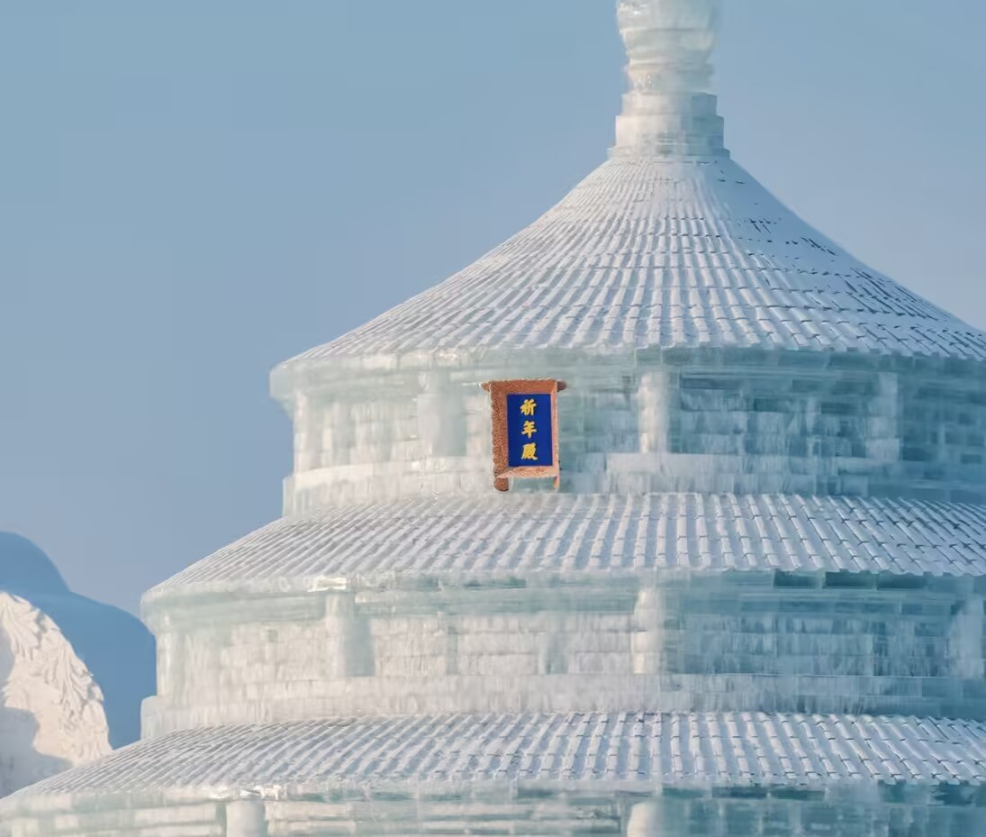

Ice carving
Yellow Crane Tower
Hall of Prayer for Good Harvests
The Great Wall
The landscape is 27.4 meters high and the total amount of ice used is 8,600 cubic meters. It was constructed by over 10,000 workers over a period of more than ten days.
In 2017, it served as the main stage of the CCTV Spring Festival Gala's Harbin branch event. Standing at approximately 30 meters tall, it used over 10,000 cubic meters of ice.
Based on the design of the Great Wall, it was constructed using 15,000 cubic meters of ice from the Songhua River. The details of the walls and watchtowers are extremely realistic. There are 24 slides, with the longest one being 521 meters long and the total drop being approximately 21 meters.

Slide 8
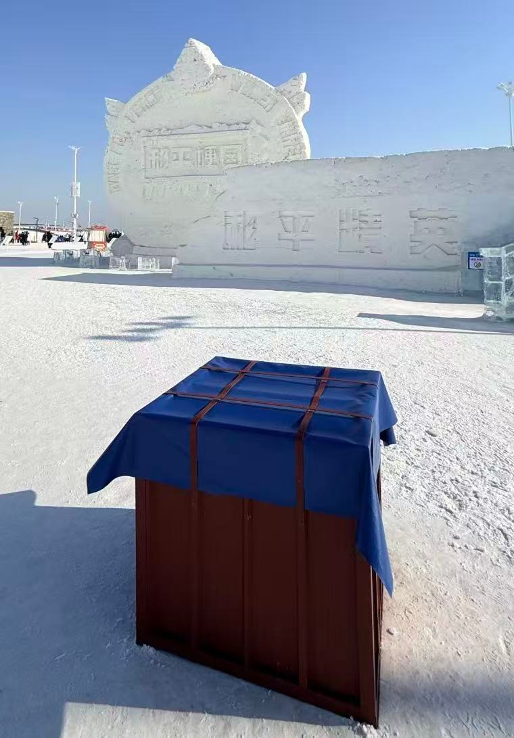
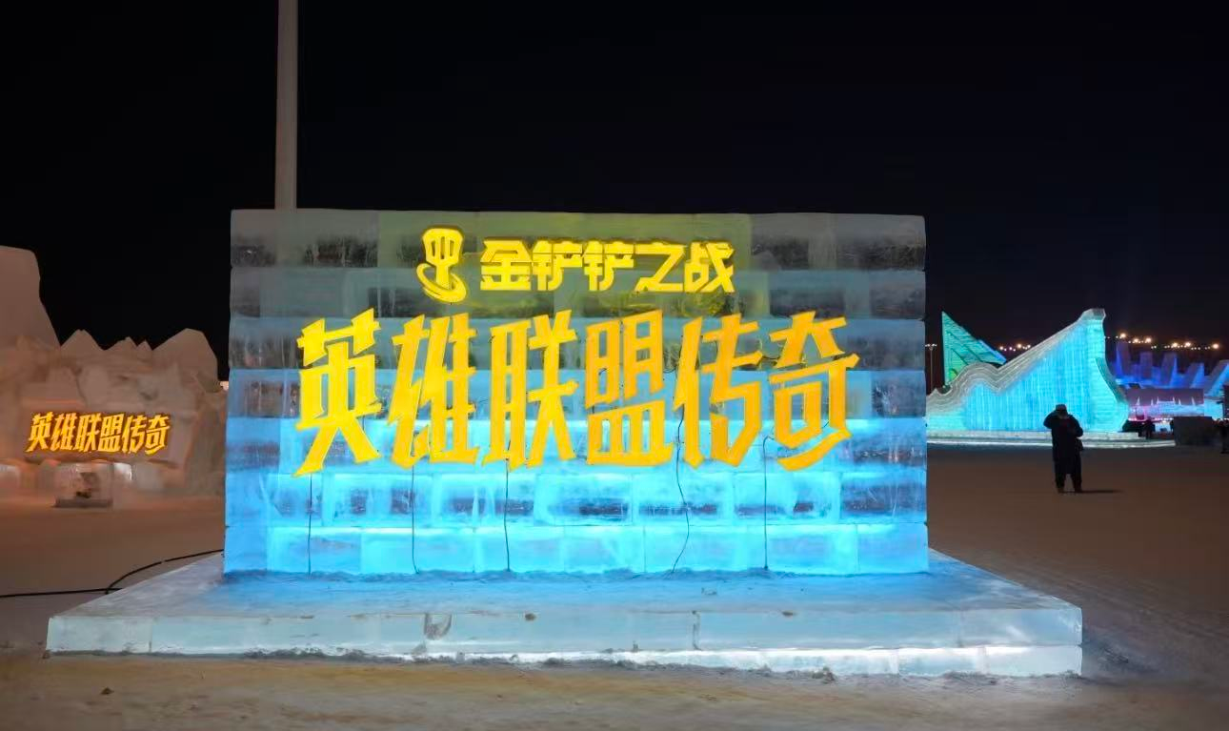

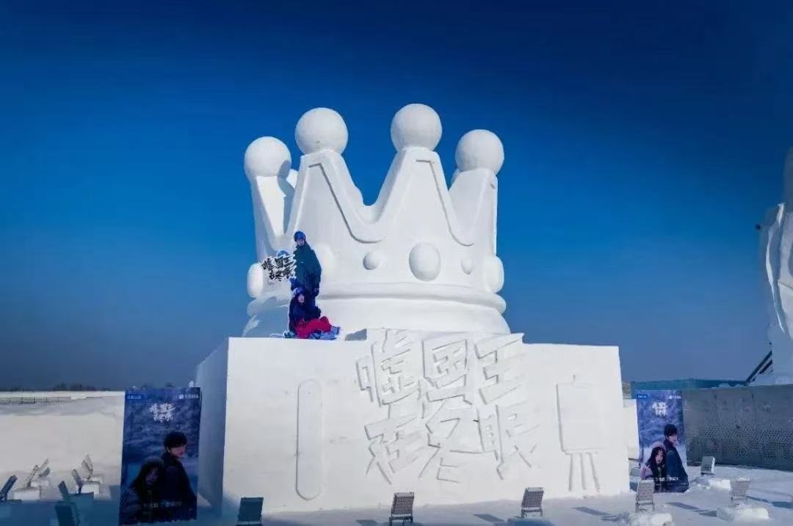
Ice carving and
snow carving
Carry out interconnection with different IPs
Teamfight Tactics
Collaborate with travel companies
Game for Peace
film and television works

Slide 9


Question
Where does the ice for Harbin Ice and Snow World come from?
a.Yangtze River
b.Amur River（黑龙江）
c.Xiang River
d.Songhua River

Slide 10
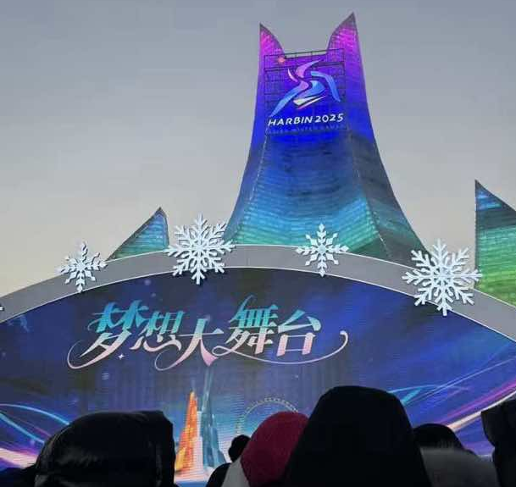
03
Folk custom

Slide 11
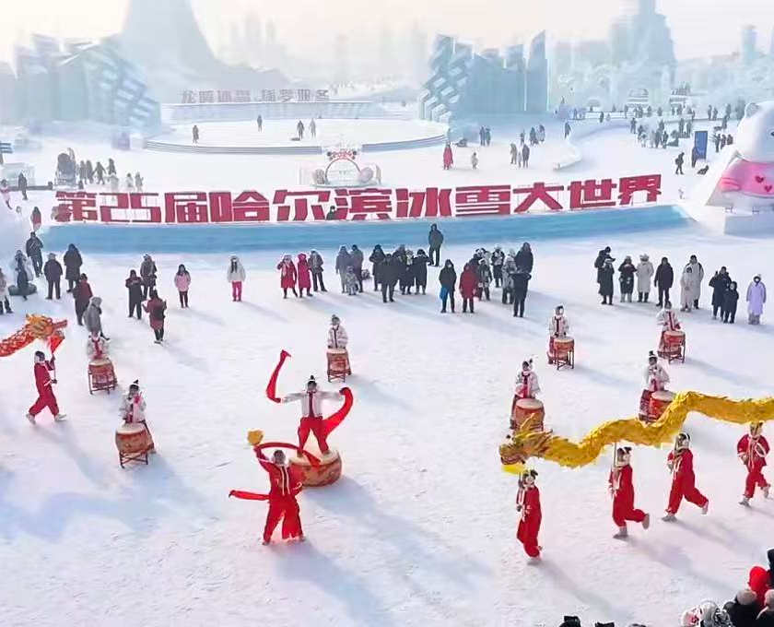
Folk custom
The Dance of Ice and Snow
Northeastern folk dance, dragon dance, lion dance
Snowy campfire, thousands of people dancing
Showcased the characteristics of the people from the north

Slide 12
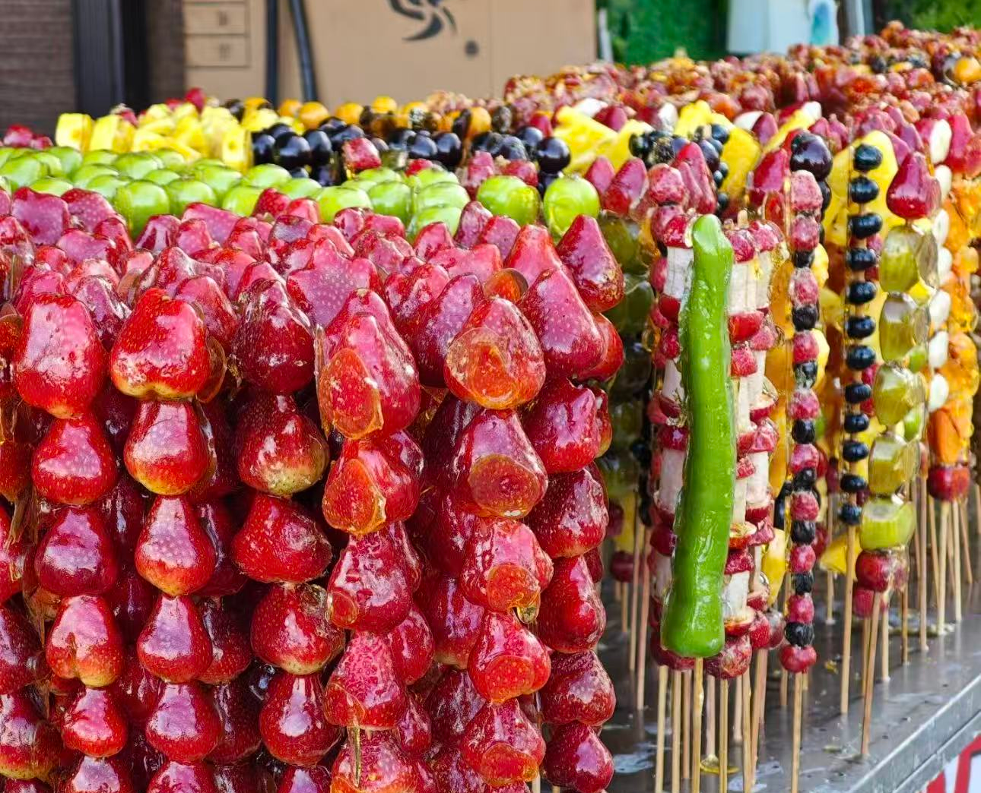
Folk custom
Local food
sugar-coated haws on a stick
Baked sweet potato
Iron pot stewing

Slide 13
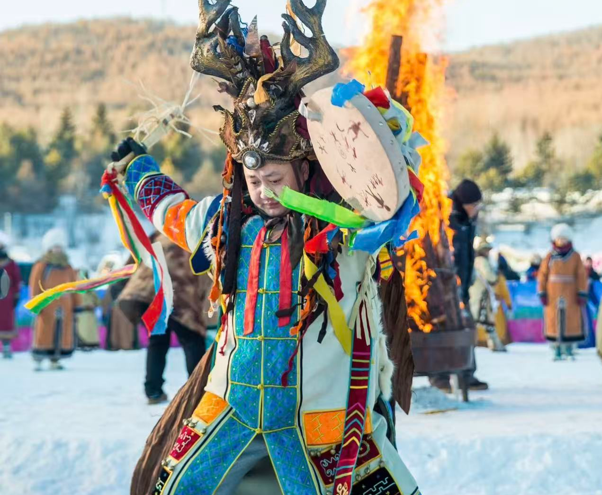
Folk custom
the Oroqen nationality（鄂伦春族
The smaller ethnic minorities in China (approximately 9,168 people) have no written language but do have spoken language.
Wearing animal skins, wearing reindeer antler hats, leading reindeer, interacting with tourists on Central Avenue and the Ice and Snow World

Slide 14
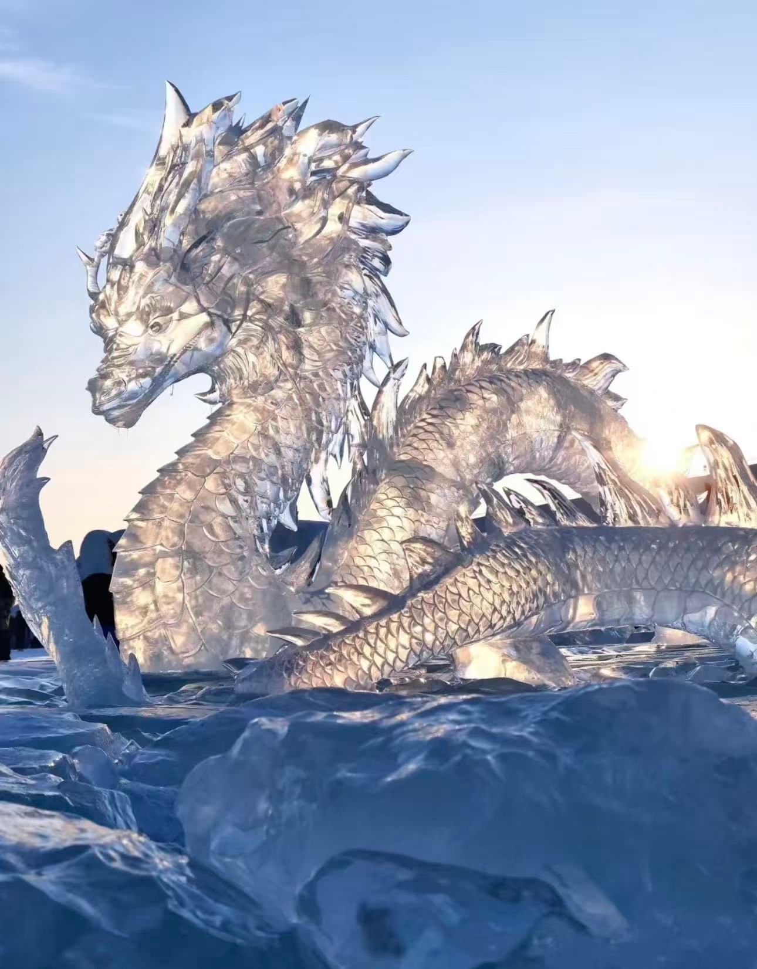
04
Summary

Slide 15
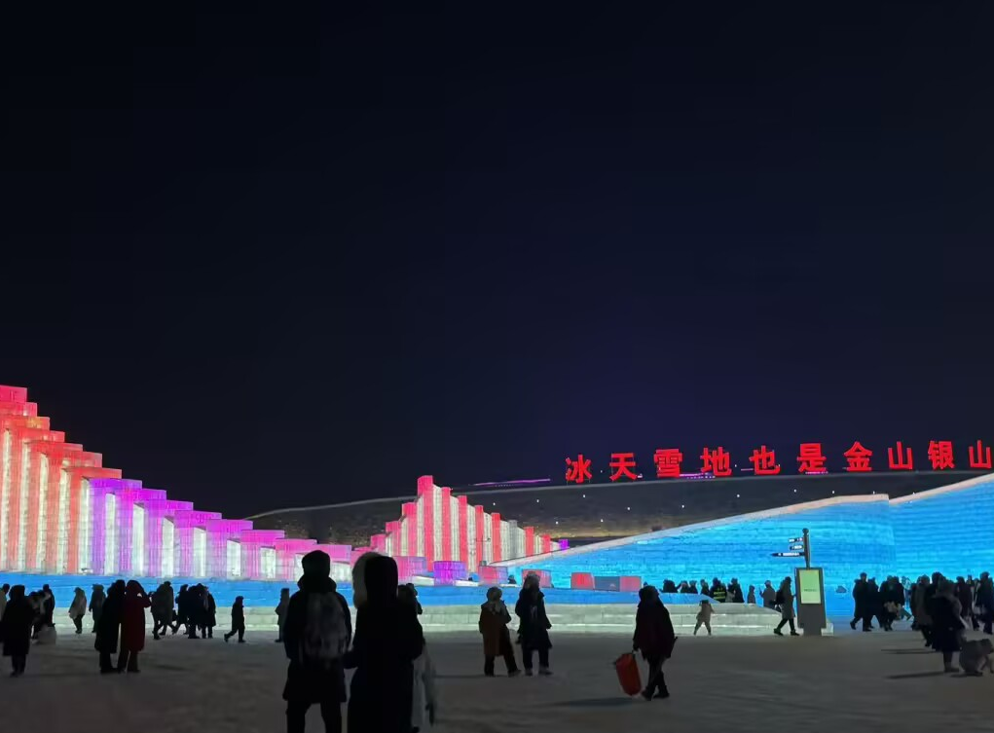
Summary
The icy and snowy landscape is also a treasure trove of wealth. The Ice and Snow World is not only a cultural wonder but also a vivid illustration of China's cultural tourism innovation, rural revitalization and green development.

Slide 16
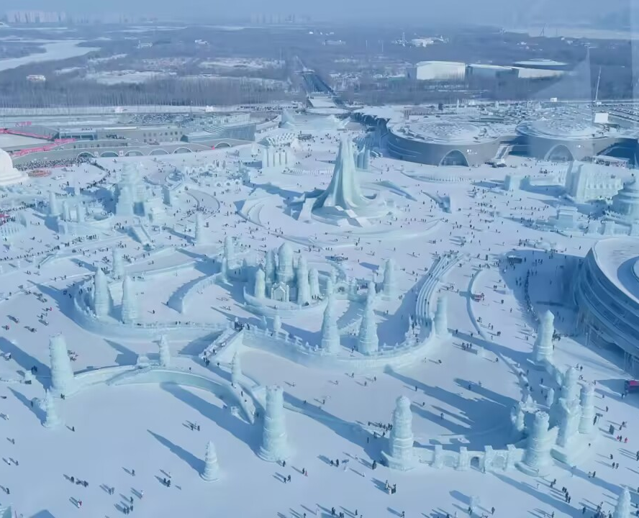
Summary
The ice and snow will melt, but the charm of culture will never fade. The Ice and Snow World is a winter gift from China to the world, and it is also the most beautiful testimony of the Chinese people's cultural confidence and love for life.

Slide 17
Thank you!

