Slide 1

Comparison among
Different Translation Styles
Guan Qinqing(管钦清）

Slide 2

The Definition of Translation Style
目录
The Forming of Translation Style
Content
Different Types of Style

Slide 3

1
The Definition of
Translation style

Slide 4
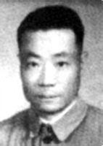
The Definition of Translation Style
“风格离不开语言，不同的语言无法表达同样的风格.”
Style cannot be separated from language.Namely,
different languages are unable to show the same style.
Style is related to linguistic factors.
周熙良(Zhou Xiliang)

Slide 5
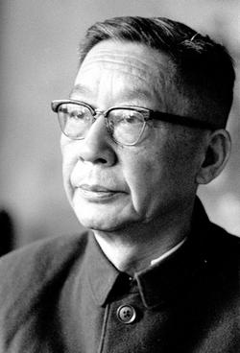

保持原作的风格大非易事，但是，倘若我们能够真的对一位外国作家有深刻的了解，知道他在艺术上的地位与特点，我们还是能够从我们的文字表达中表现出他的风格的。
Maintaining the style of the original work is difficult, but if we can really have a deep understanding of a foreign writer and know his status and characteristics in art, we can still express his style in our words.
老舍（Lao She)

Slide 6
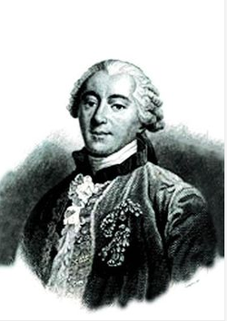
The Definition of Translation Style
“ Style is the man. ”
文如其人。
Style is closely related to the author's
temperament and personality.
Buffon (布封)

Slide 7
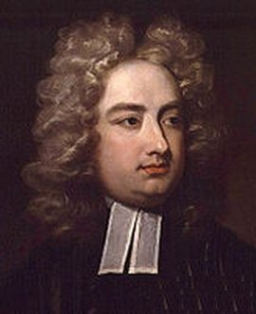
Proper words in proper places make the true definition of a style.
适当的词用于适当的场合，就是风格的确切定义。
乔纳森·斯威夫特
（Jonathan Swift)

Slide 8

The Definition of Translation Style
Summary
Considering different communicative environment, methods, objectives and purposes,communicators would opt different language varieties ( 语言变体) that has different functions ,so as to perform their communication effectively.The language varieties are what people called“style" (文体或语体).

Slide 9
2
The Forming of
Translation Style

Slide 10
The Forming of Translation Style
Man for the field and women for the hearth;
Man for the sword and for the needle she.
Man with the head and women with the heart;
Man to command and women to obey.
----Alfred Tennyson

Slide 11
The Forming of Translation Style
Version One
Version Two
男人耕作女持家,
男上战场女纺纱。
男人冷静女优柔,
男施命令女听话。
男人主外女主内,
男人舞剑女缝衣。
男人理智女多情，
男人吆喝女相随。

Slide 12
The Forming of Translation Style
Version Three
丈夫劳作在田间，女子持家灶炉边；
丈夫挥舞刀枪剑，女子织补拿针线。
丈夫威武智勇全，女子贤德真心善；
丈夫统帅声令下，女子遵命垂首间。
Version Four
男耕女织，男武女文。
男刚女柔，男尊女卑。

Slide 13
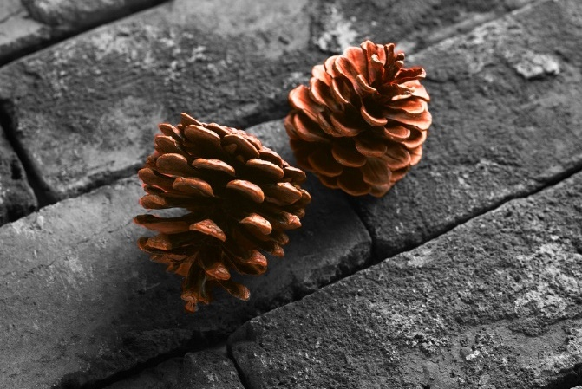
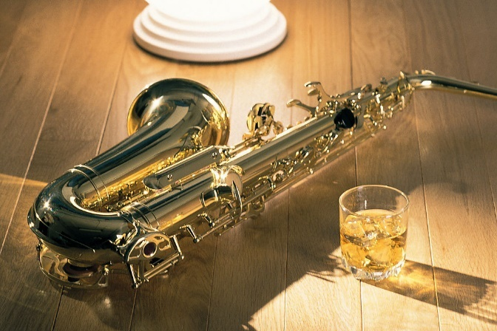
The Forming of Translation Style
Studies serve for delight, for ornament,and for ability.
东旭（Dong Xu)
读书是为了娱乐、装饰和增长才能。
王佐良（Wang Zuoliang)
读书足以怡情，足以博彩，足以长才。

Slide 14
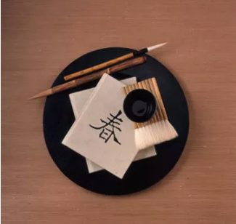
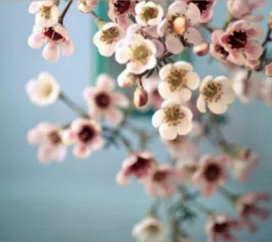
The Forming of Translation Style
Reading makes a full man,conference a ready man,and writing an exact man.
东旭（Dong Xu)
读书能诗人充实，谈话能使人机敏，写作能使人精确。
王佐良（Wang Zuoliang)
读书使人充实，讨论使人机智，笔记使人准确。

Slide 15


The Forming of Translation Style
So every defect of the mind may have a special receipt.
东旭（Dong Xu)
所以，各种心智上的缺陷都有一种专门的补救方法。
王佐良（Wang Zuoliang)
如此头脑中凡有缺陷，皆有特药可医。

Slide 16
3
Different Types of Style：
Level of Formality

Slide 17
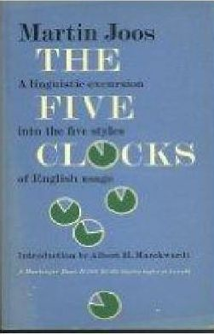
Different Types of Style:Level of Formality
Martin Joos(1962) in his book The Five Clocks suggests five degrees of formality:frozen,
formal,consultative,casual and intimate.

Slide 18
Different Types of Style:Level of Formality
The Five Clocks by Martin Joos
(1) the frozen style (庄严体):most used on ceremonies,in very formal occasion,
in written legal documents or highly solemn speech
(2)the formal style (正式体):public address
(3)the consultative style (商谈体/一般体):less formal gatherings,used in daily lives
(4)the casual style (随意体):among friends
(5)the intimate style (亲密的):between family members or bosom friends

Slide 19

Different Types of Style:Level of Formality
A)Visitors would make their way at once to the upper floor by way of the staircase.(frozen)
B)Visitors should go up the stairs at once.(formal)
C)Would you mind going upstairs please?(consultative)
D)Time you all went upstairs now.(casual)
E)Up you go,Chaps!(intimate)

Slide 20
Translation and Style
Linguistic style is the embodiment of the unity of linguistic form and content.It has the duality of form and spirit .The style of the target text is to express the style of the author and the original text.That is to say,to get as close to the original text as possible,the translation must be vivid and expressive .

Slide 21
Thank
You

