Slide 1
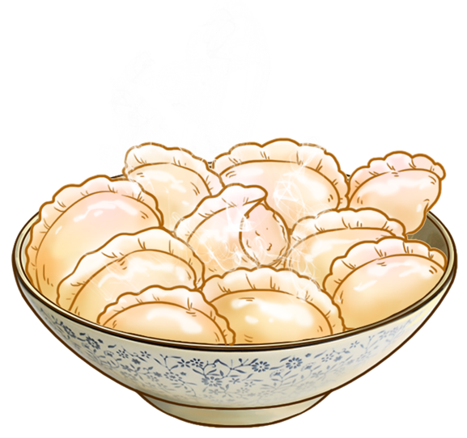
Jiaozi
饺子
英语口译 刘译
ZER from English Interpreting

Slide 2
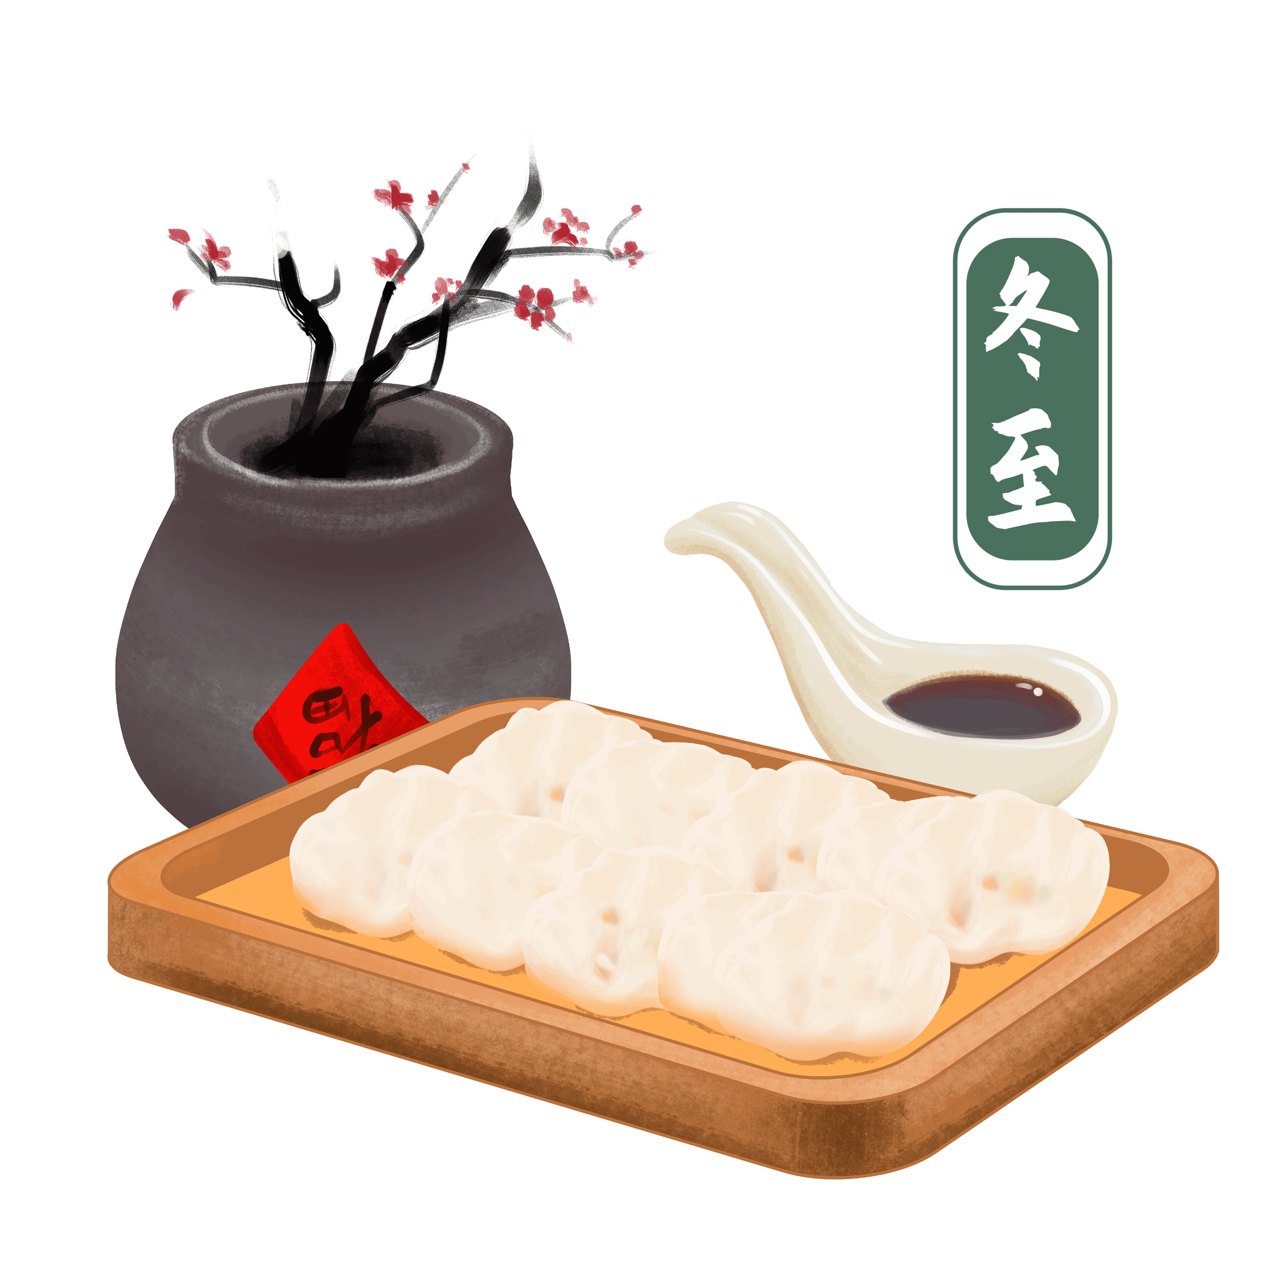
饺子—Jiaozi
Jiaozi
Family reunion;
Good luck.

Slide 3
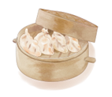
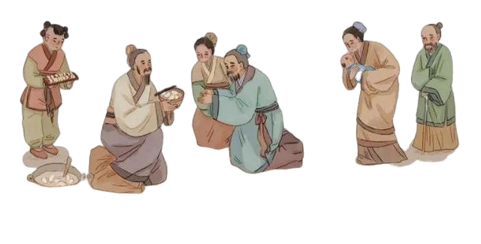
Legend and History of Jiaozi
饺子的传说与历史
The history of Jiaozi goes way back to the Han Dynasty (202 BCE – 220 CE);
Jiaozi was first called “Jiao’er” (娇耳) , and was invented by Zhang Zhongjing, a famous doctor from the Eastern Han Dynasty (25 – 220 CE).
  Many people were suffering from frostbitten ears, so he came up with a special dish to help;
  Zhang wrapped medicinal herbs in dough to warm people up as they ate;
  Jiaozi looked like little ears and was meant to protect people’s ears from frostbite, so Zhang named it “Jiao’er”;
  Since then, people have eaten Jiaozi during the Winter Solstice and the Spring Festival in honor of this story.

Slide 4
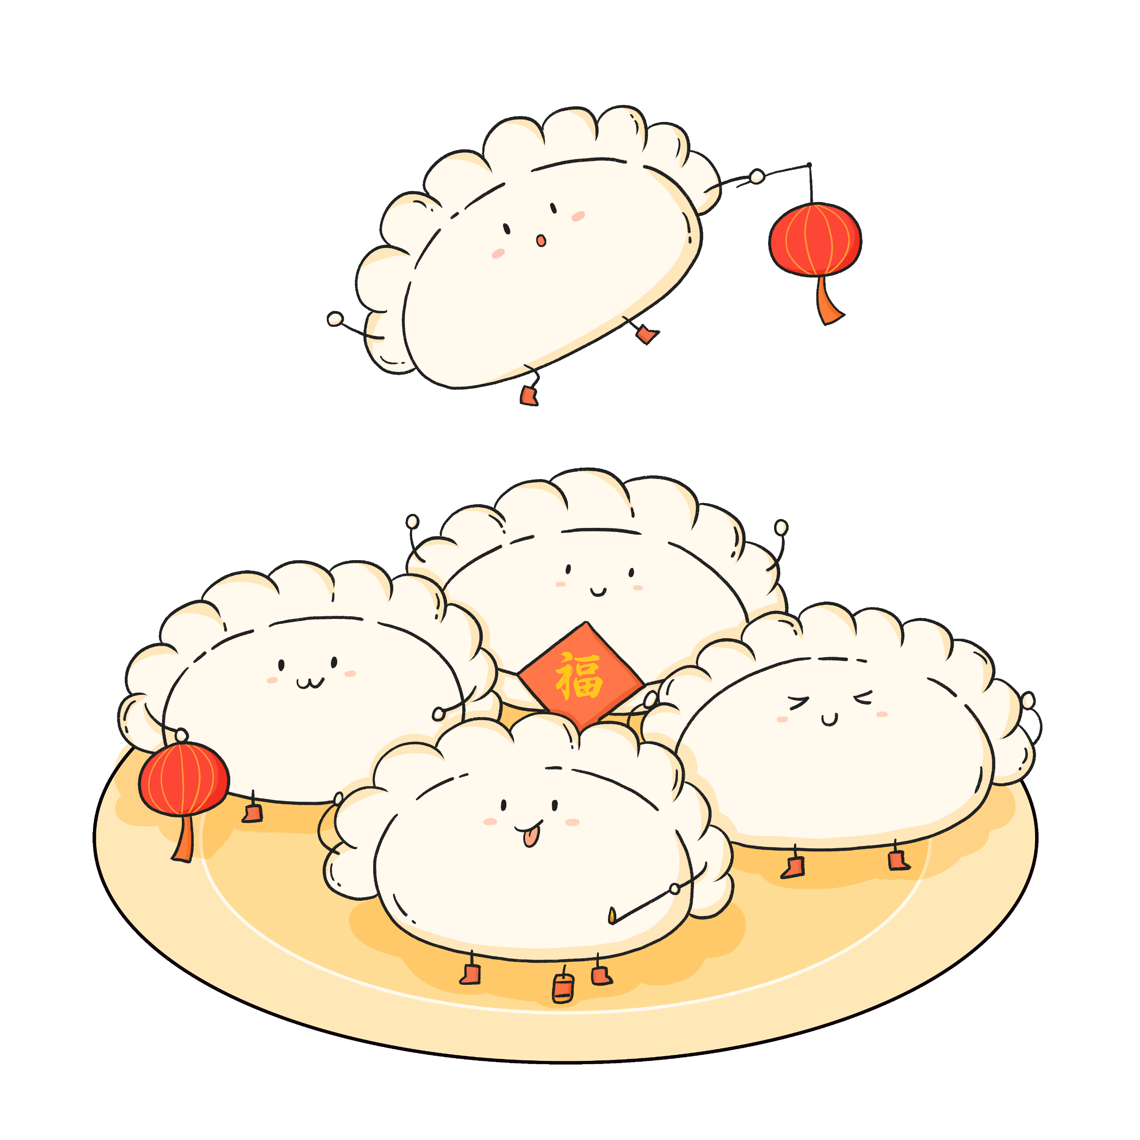
Legend and History of Jiaozi
饺子的传说与历史
“jiao’er” “Jiaozi”.
  The word “Jiaozi” sounds similar to “交子” (jiāozi), meaning the transition between the old year and the new;
  Many families eat Jiaozi on Chinese New Year’s Eve as a way to say goodbye to the old year and welcome new beginnings.

Slide 5
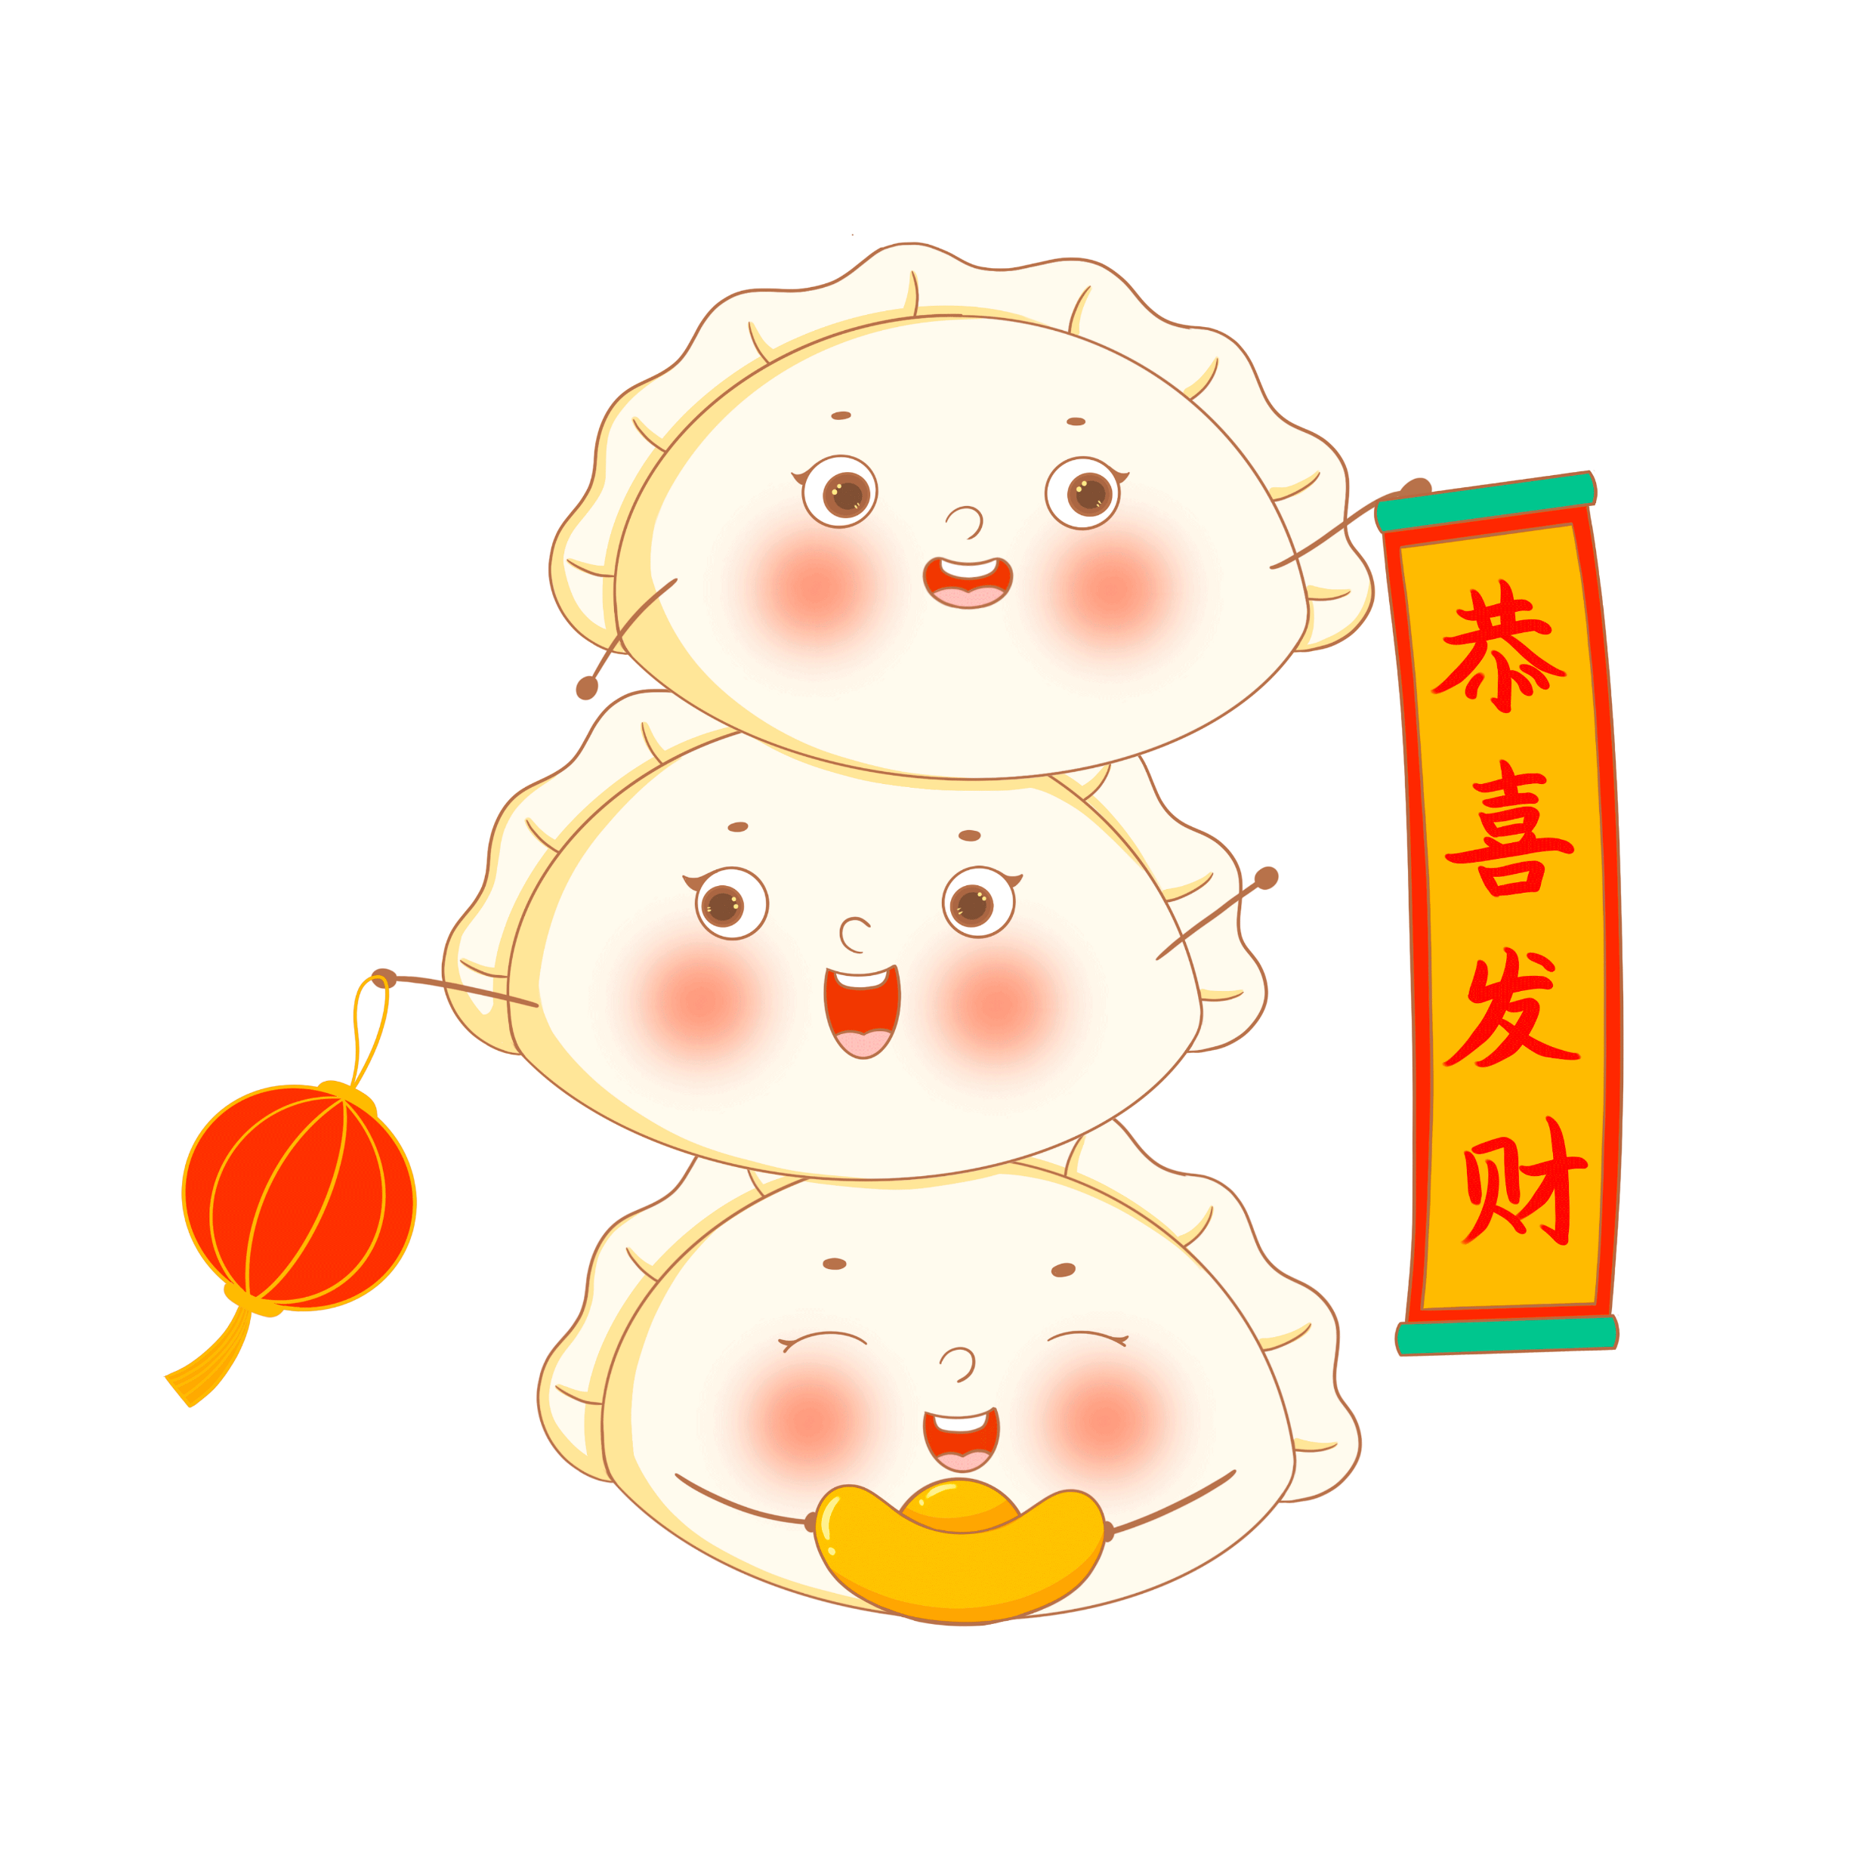
Symbolism and Meaning of Jiaozi
饺子的寓意与意义
Reunion & happiness;
Jiaozi is also shaped like 金元宝 (an ancient Chinese currency made from gold), symbolizing wealth and prosperity.

Slide 6
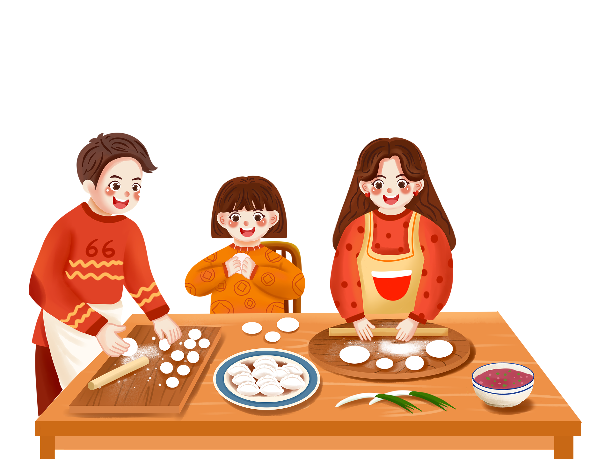
Symbolism and Meaning of Jiaozi
饺子的寓意与意义
A symbol of saying goodbye to the old year and welcoming the new;
By making Jiaozi, people hope to wrap away the troubles of the past year and embrace the blessings of the new year.

Slide 7


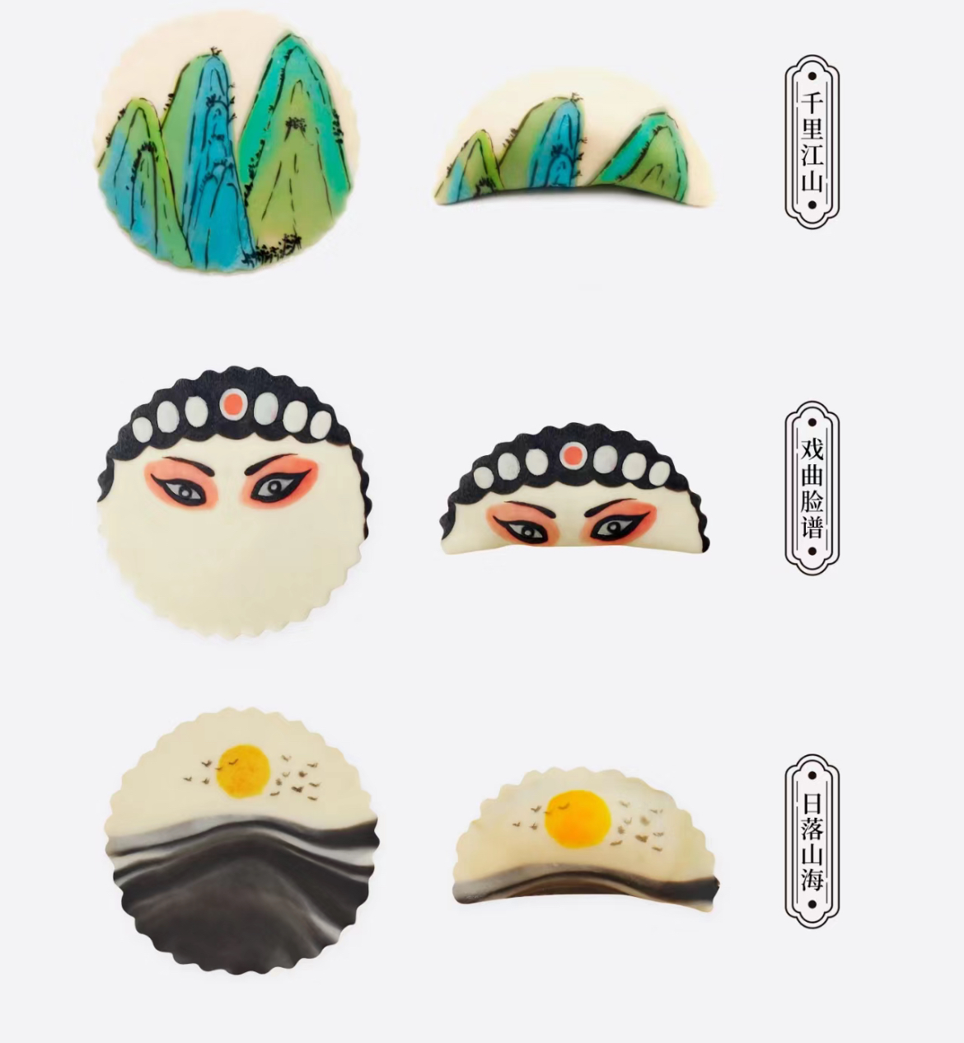
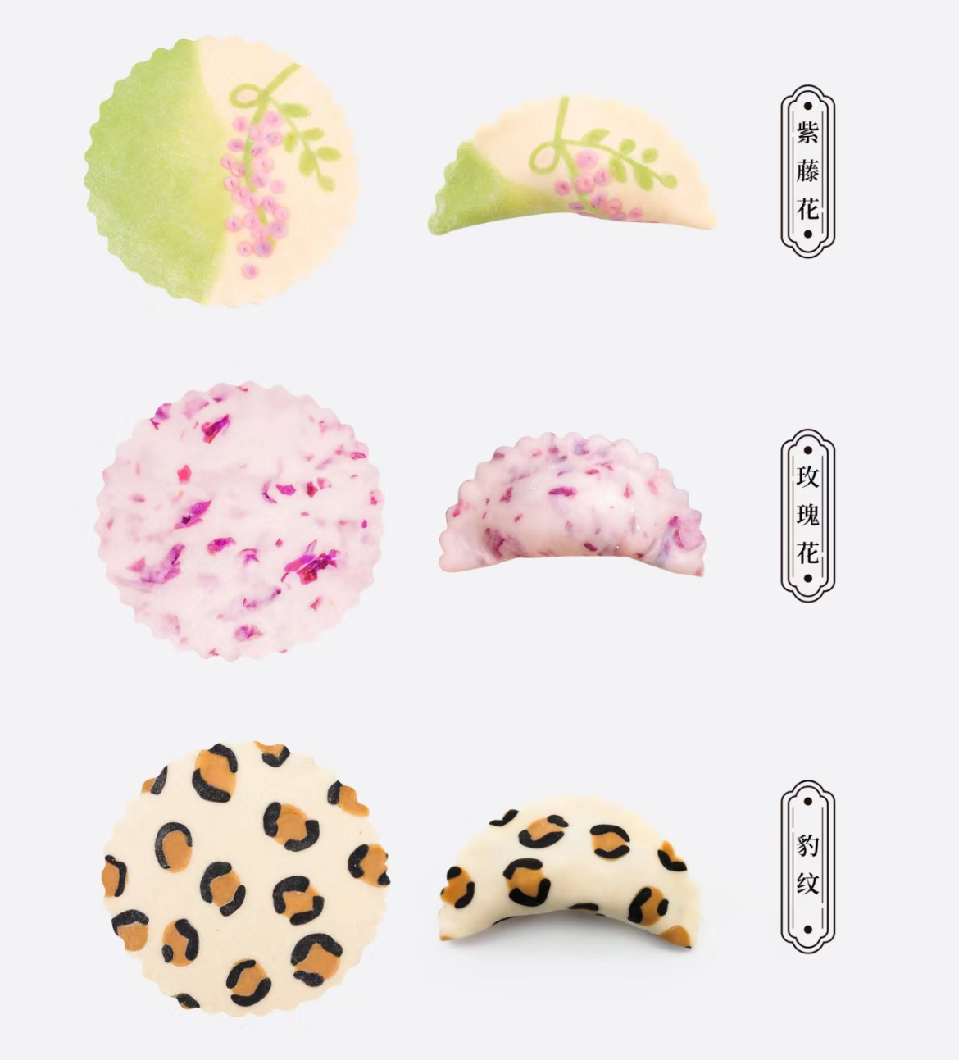
Innovation of Jiaozi
饺子的创新
“Chinese style” Jiaozi wrappers.
  Traditional elements are combined with artistic designs;
  A way to promote Chinese culture.

Slide 8

Interaction

Slide 9
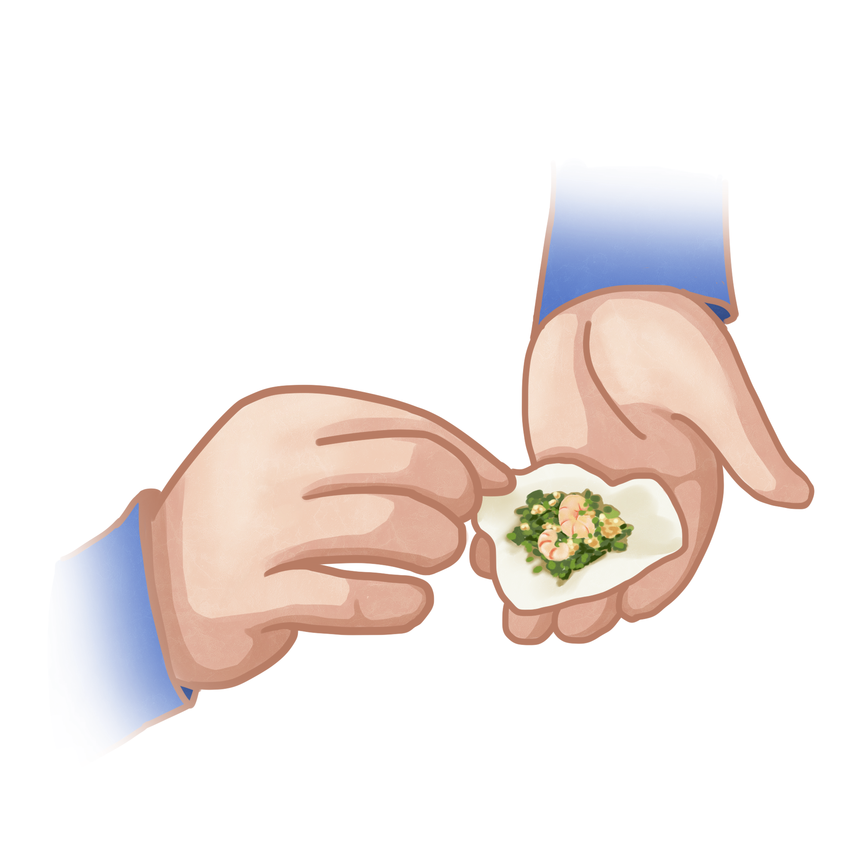
Interaction
互动环节
Making Clay Jiaozi
10 students will be invited;
Use light clay to create your OWN Jiaozi.

Slide 10
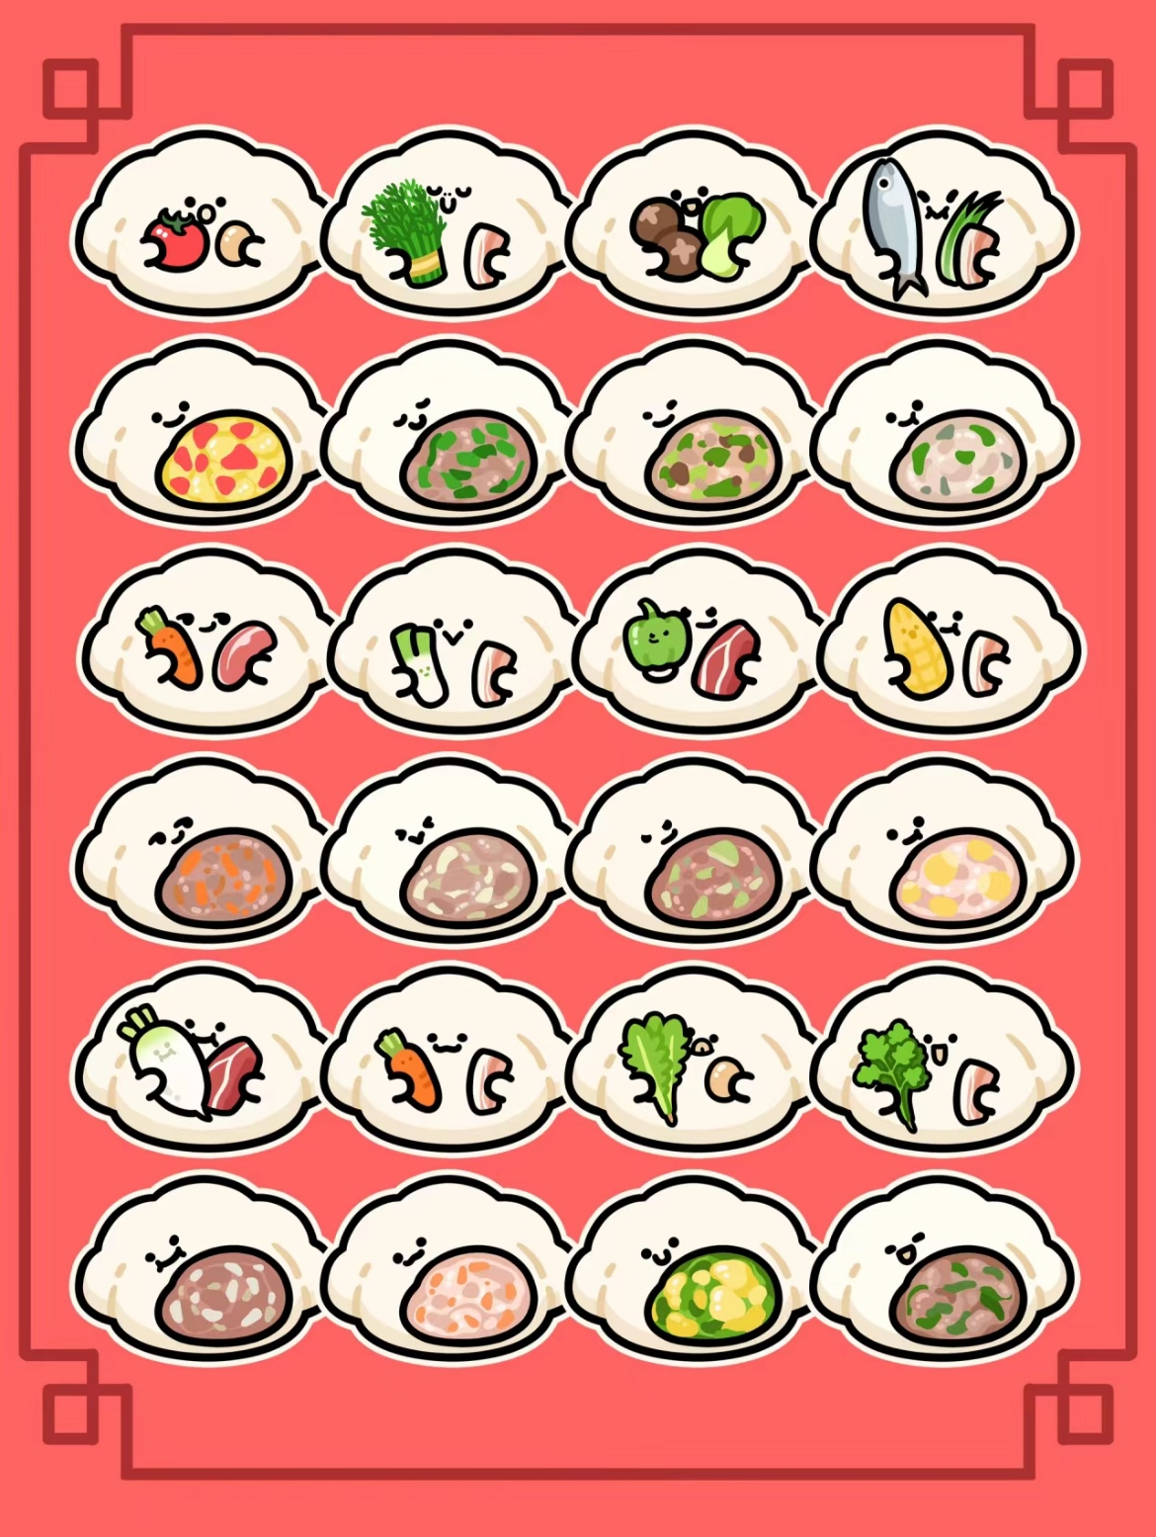
Interaction
互动环节
Jiaozi Filling Guessing
Five types of Jiaozi with different fillings were prepared;
Participants need to guess the filling by just observing the Jiaozi.
  ✓: TAKE IT!
  ✗: Just pick one of the Jiaozi you’ve guessed, and the rest will be left for the next participant to try.

Slide 11
Reflection
个人感悟
Jiaozi is more than just food; it is Chinese cultural heritage. As a representative of traditional Chinese cuisine, Jiaozi carries rich historical and cultural value, making it a treasure of Chinese culinary culture.
In the future, we should cherish and preserve this valuable cultural heritage. Through education, media, and cultural exchanges, more people can learn about the culture and history of Jiaozi. Furthermore, we should encourage innovation, combining the traditional culture of Jiaozi with modern tastes and lifestyles, keeping it alive in today’s world.

Slide 12
Reflection
个人感悟
说到“饺子”的英文，许多人首先想到的是“dumplings”。其实，“dumplings”是一个泛指词，用来描述各种包馅的面食，不仅包括中国的饺子，还包括意大利的“ravioli”、俄罗斯的“pelmeni”等。《牛津英语词典》（Oxford English Dictionary）中已收录了“饺子”的音译词“Jiaozi”。通过推广“Jiaozi”这个独特的音译名称，我们能够更好地向世界展示中国美食的丰富性和多样性，让更多人了解并欣赏中国的饮食文化。
在传承和发扬中国传统美食饺子时，我们可以自豪地说“饺子就是Jiaozi，而不是dumplings，它口感鲜美、营养丰富，是中国传统美食的瑰宝”。

Slide 13
Thank you!

