Slide 1
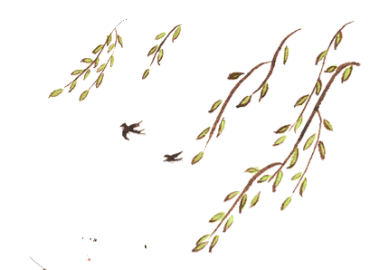
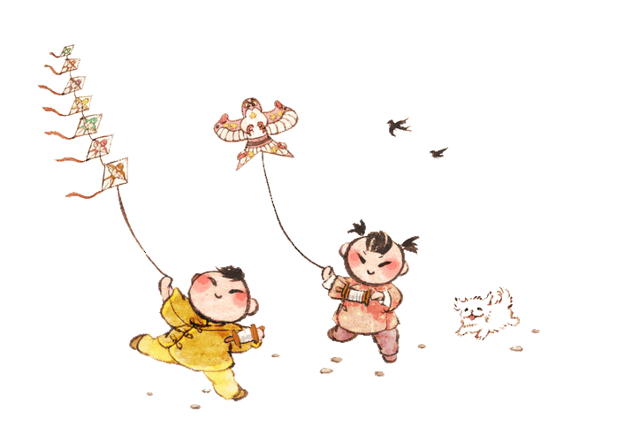

Games: Kite Flying
杨子璇

Slide 2


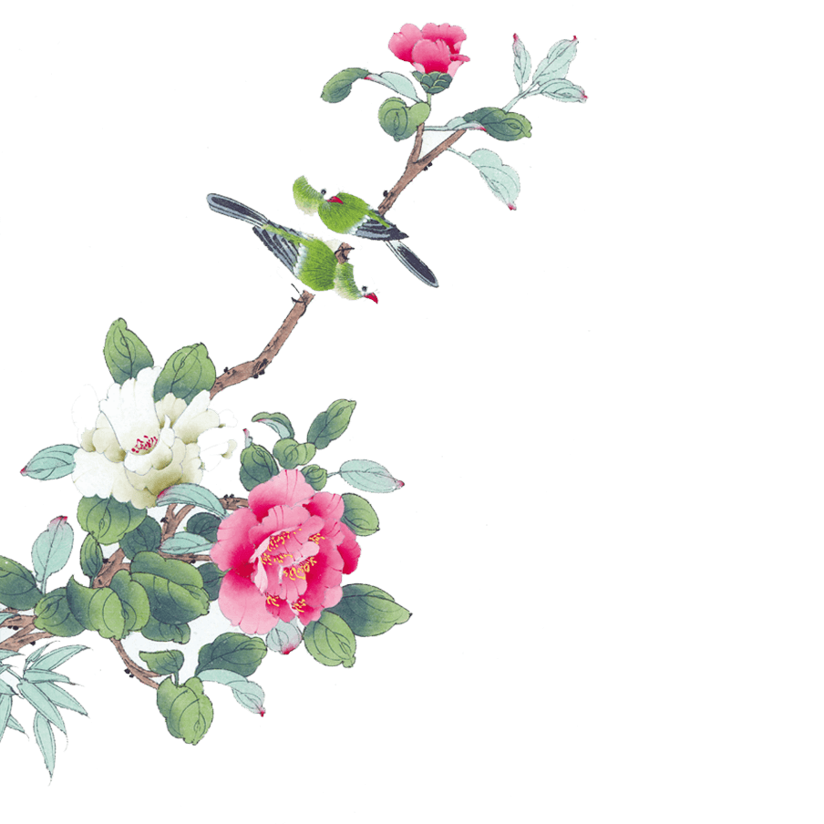
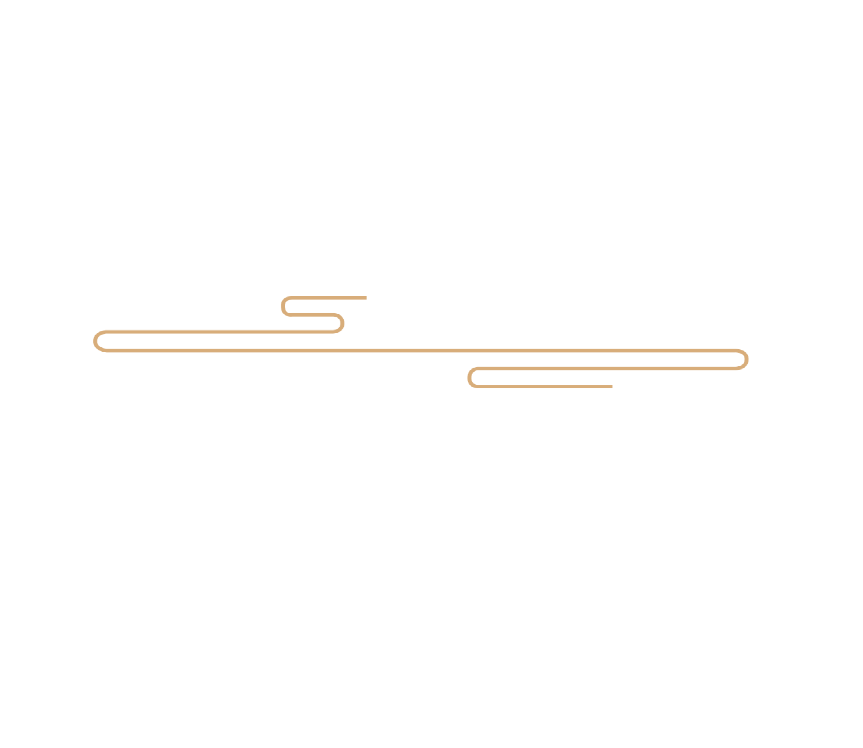
儿童散学归来早，
Children returned home early after school.
忙趁东风放纸鸢。
They got busy flying kites in east wind.

Slide 3
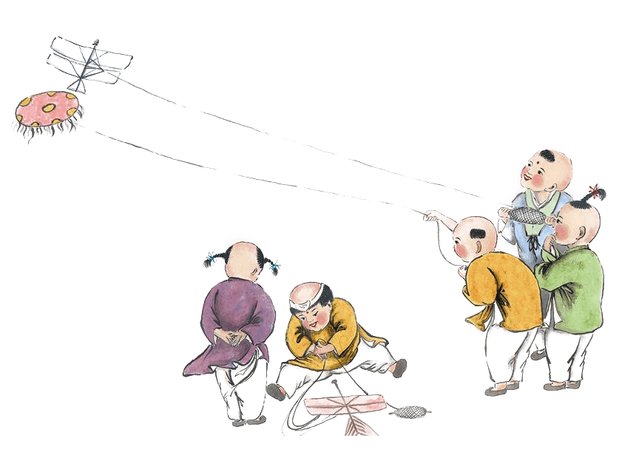
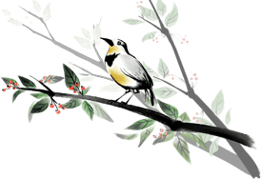

PART 1
Introduction

Slide 4
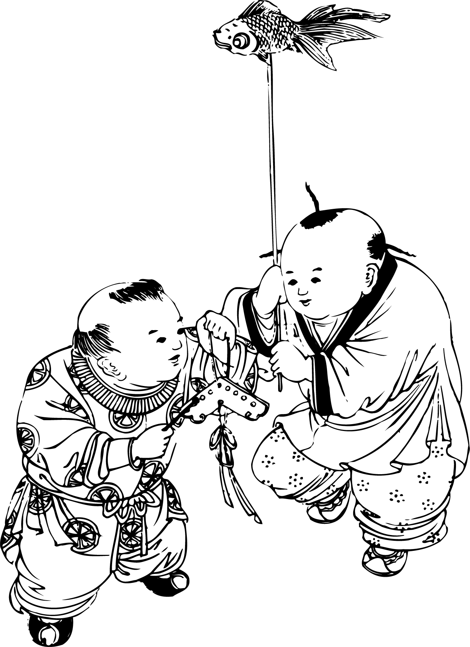
Kite flying has a long history in China, and it has been a long-standing sport to this day. Kites can be seen flying in parks, squares and open grasslands, and the various shapes of kites are spectacular, adding much fun to people's leisure time. At the same time, as a traditional national sport, kite flying is deeply imprinted with Chinese culture, fully expressing people's beautiful aspirations and fitness interests, and rich in national characteristics and local flavor. As a kind of folklore, kite flying is a kind of game and recreational activity for the purpose of leisure and physical and mental conditioning, so that people can rest after their work and benefit their physical fitness, mental and emotional, creativity and moral sense.

Slide 5
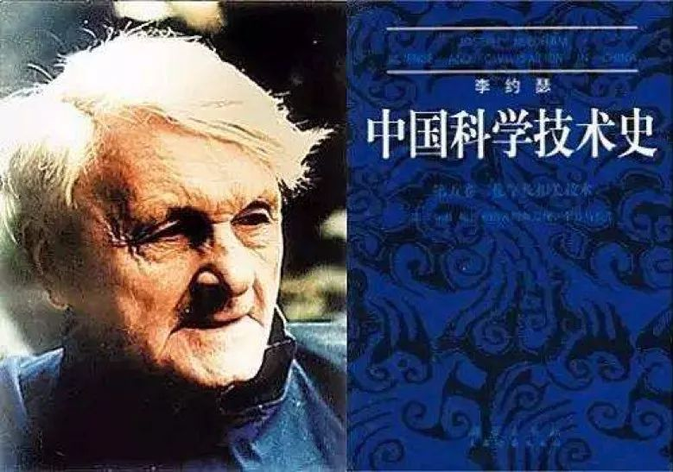
Kites were listed as one of the important scientific inventions of the Chinese people to mankind.

Slide 6
PART 2
Inventor & Origin

Slide 7
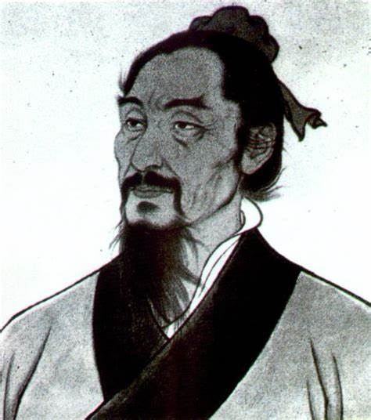
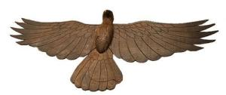
Invented by Mozi
费时三年，以木制木鸢，飞升天空
It took three years to make a wooden kite and fly up to the sky.

Slide 8
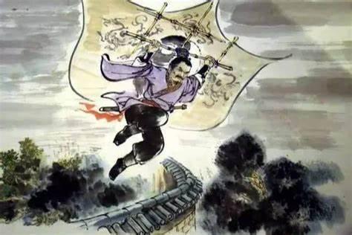
Originated from war
Hanxin used kite to measure the length of a field in a war.
Han Xin made various kites out of cowhide and had musicians sit on them to fly over the Chu army and play Chu songs to try to make them miss their hometown and not be interested in fighting.

Slide 9
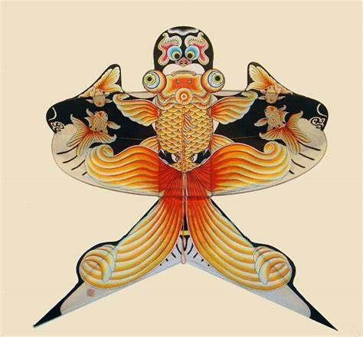
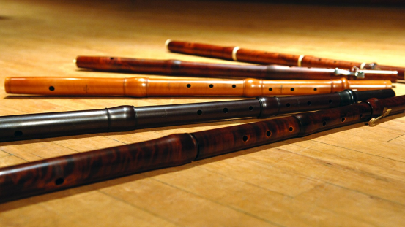
Originated from entertainment
Li Ye made a paper kite game in the palace and made a flute out of bamboo and tied it to the head of the paper kite. When it flew in the air, with the wind springing up, it sounded like that someone is playing Chinese zither, thus the name "kite" was given.

Slide 10
PART 3
Use & Production

Slide 11
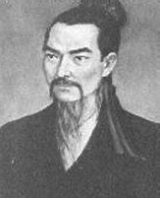
the Spring and Autumn Period
Kites were often used as military tools to spread messages and measure the wind direction in the sky.
"作木鸢以觇宋城"
"Made wooden kite to spy on Song city."

Slide 12
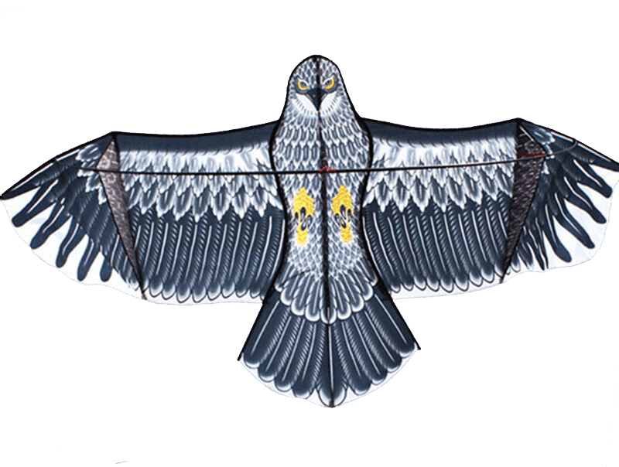
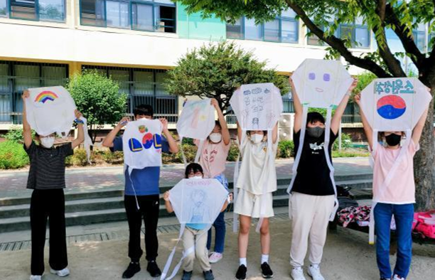
the Tang Dynasty
Kites played a prominent role in entertainment and became popular at the court and among the people.
Kites were also introduced to neighboring countries such as Korea and Japan.

Slide 13
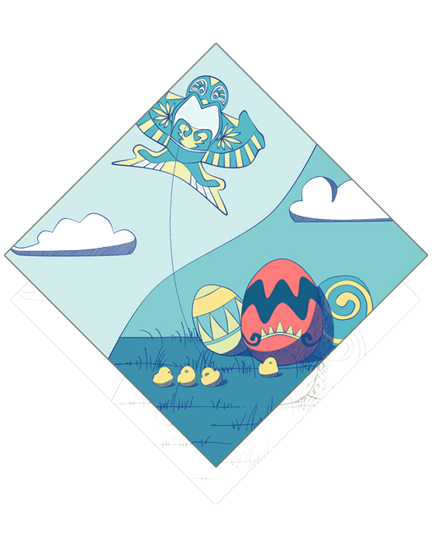
The production of the kite
tying the frame
gluing the paper
tying
gluing
painting
flying
painting the flowers
flying the kite

Slide 14
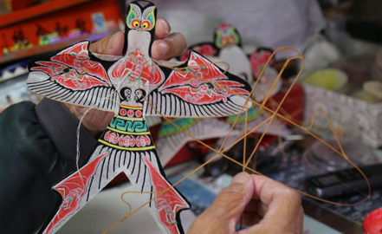
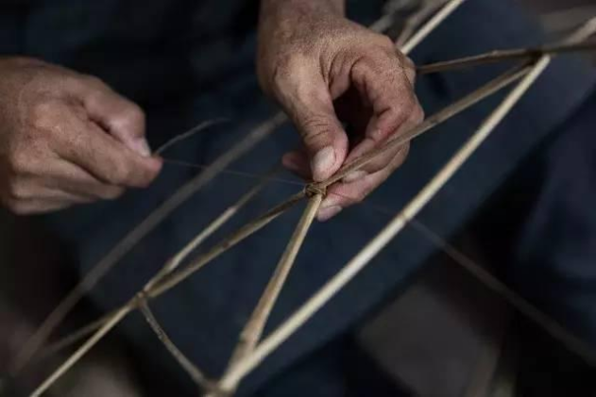
Tying includes declaring, splitting, bending, cutting and joining.
Gluing includes selecting, cutting, gluing, edging and schooling.

Slide 15
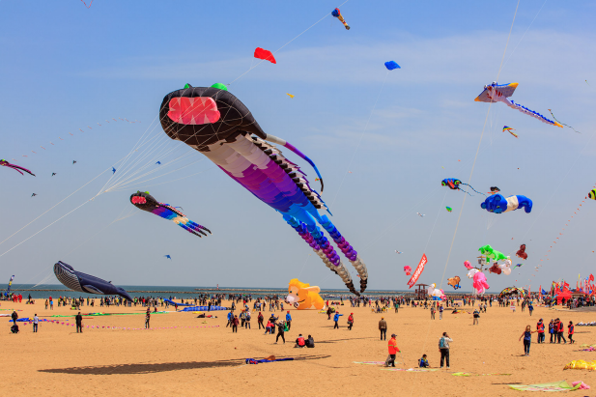
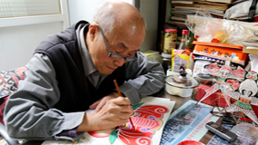
Painting includes coloring, base, tracing, dyeing and repairing.
Flying includes wind, line, release, adjustment and collection.

Slide 16
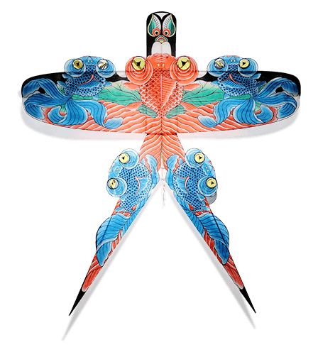

In May 2006, kite making skills were listed in the first batch of national intangible cultural heritage.

Slide 17
PART 4
Types

Slide 18
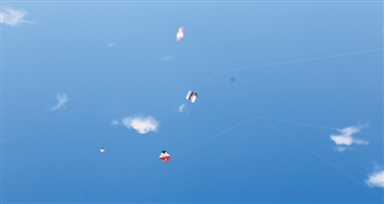
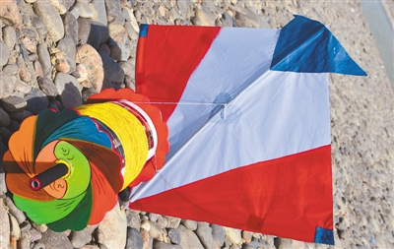
The fighter kite
Fighter kites are kites used for the sport of kite fighting. Traditionally most are small, unstable single line flat kites where line tension alone is used for control, and an abrasive line is used to cut down the string of other kites.

Slide 19
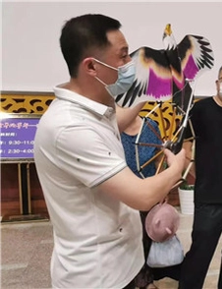
The indoor kite
Indoor kites are kites designed to fly in a windless environment. They are flown by using the relative wind provided by the motion of the kite flier. This motion is typically generated by the user walking slowly backwards (and often within a circle), but it can also be achieved with suitable pulls and jerks along the kite lines.

Slide 20
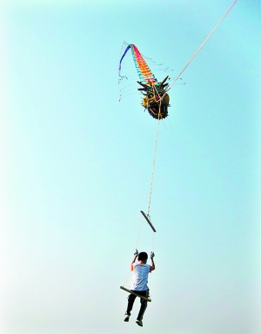
The man-lifting kite
A man-lifting kite is a kite designed to lift a person from the ground. Historically, man-lifting kites have been used chiefly for reconnaissance and entertainment.

Slide 21
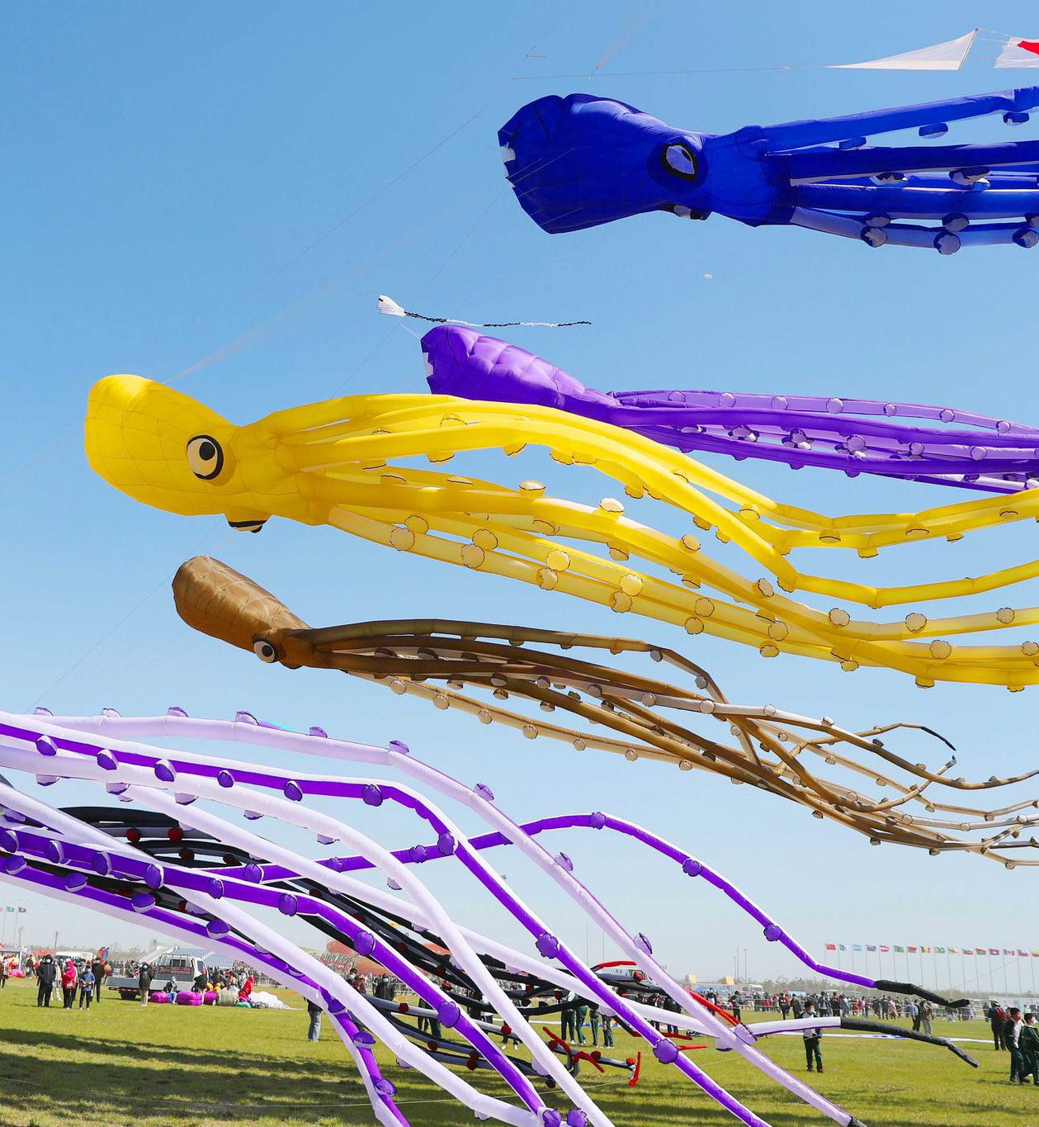
The inflatable single-line kite
An inflatable single-line kite is a ram-air kite. Balloon kites are inflatable kites. Kites sometimes combine ram-air inflation as well as closed-bladder inflation. As with hot air balloons, artistic creativity is often applied, so that fish, cats, and many other animals and characters are depicted.

Slide 22
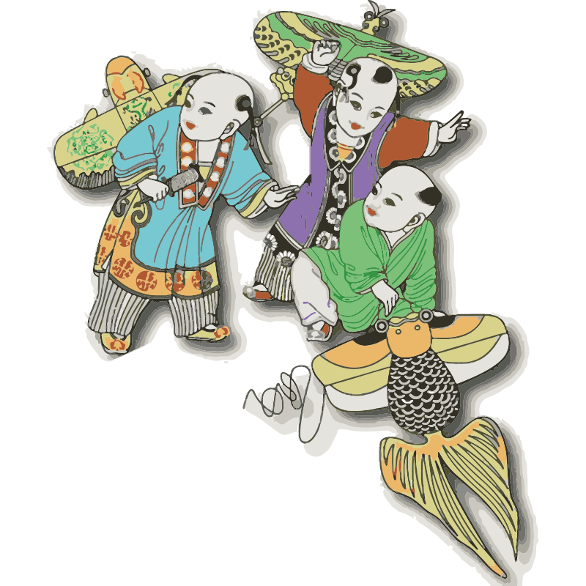
Questions
1. How did the kite got its name?
2. What are the four words of the kite flying skills of the traditionalChinese kite?
3. What are the types of kite?

Slide 23
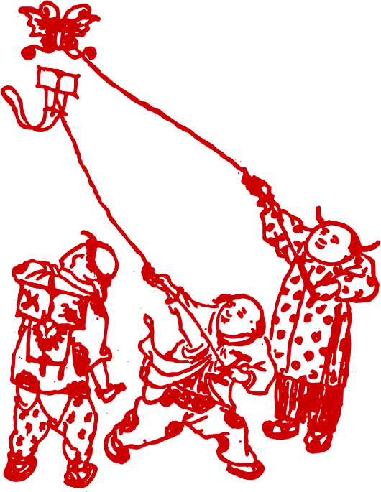
Thanks for listening!

