Slide 1
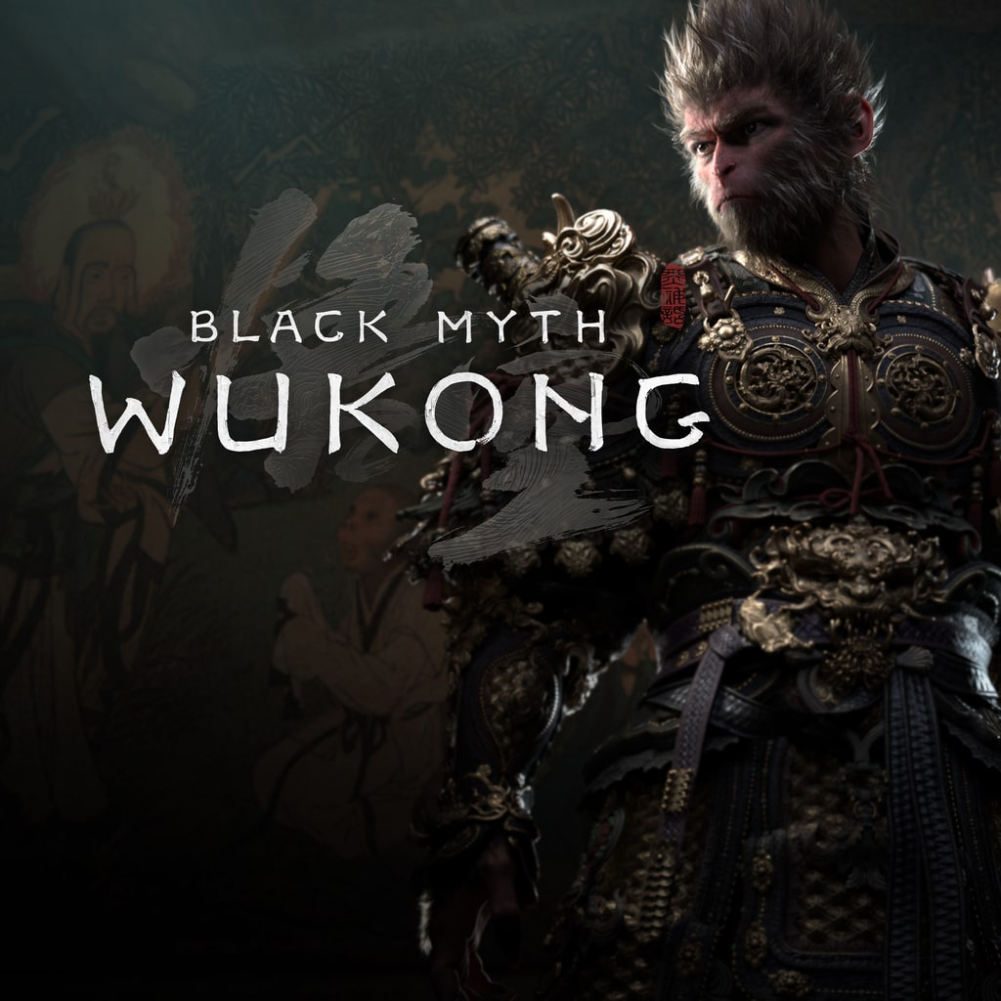
Black Myth: Wukong
Introduction to Chinese Culture
Presenter:WU SHENGQIU
Notes:
Hello everyone. Today, we're going to embark on a fascinating journey, not just through a groundbreaking video game, but deep into the rich tapestry of Chinese mythology and culture. We'll explore how "Black Myth: Wukong" serves as a modern vessel for ancient wisdom, bringing the legendary Monkey King to life in a way that resonates with audiences worldwide.

Slide 2

Game Introduction
Developer & Global Launch
Genre: AAA ARPG
Sensational Sales Surge
Developed by the visionary team at Game Science in China, the game made its worldwide debut on August 20, 2024. This marked a significant milestone for the Chinese gaming industry, bringing a uniquely crafted experience to players across the globe.
Recognized as China’s first bona fide AAA Action Role-Playing Game, it transcends conventional boundaries. Rooted in rich Chinese mythology, it delivers an epic journey with soul-stirring combat and a meticulously built open world that redefines the genre.
The game became an instant global phenomenon, selling 4.5 million copies on its first day alone. Its momentum continued unabated, surpassing the 10 million sales mark within a mere three days, a testament to its universal acclaim.
Steam’s New Benchmark
6.5 Years of Meticulous Craftsmanship
It shattered the Steam concurrent player record for single-player titles, peaking at an astonishing 2.2 million players online simultaneously. This unprecedented achievement underscored the game’s massive global resonance and the hunger for high-quality narrative-driven experiences.
Over six and a half years of dedicated development were poured into every aspect of the game. From the intricate art design echoing classical Chinese aesthetics to the polished gameplay mechanics, it represents a labor of love and an extraordinary leap forward for Chinese game artistry.
Notes:
"Black Myth: Wukong" is more than just a game; it's a cultural event. Developed by the Chinese studio Game Science and released in August 2024, it's hailed as China's first true AAA game. Its success was unprecedented, breaking sales records and captivating millions of players around the globe. This wasn't just a commercial triumph; it was a statement of China's growing prowess in the global gaming industry.

Slide 3
Cultural Origin: Journey to the West
Literary Heritage
Historical Basis
Narrative Structure
One of China's Four Great Classical Novels, penned by Wu Cheng'en in the 16th-century Ming Dynasty. A pinnacle of vernacular fiction, it has shaped Chinese popular culture and storytelling for centuries with its imaginative prose.
Loosely rooted in the epic real-life pilgrimage of the monk Xuanzang (629-645 AD). He traveled to India against imperial decrees to retrieve sacred Buddhist scriptures, an act of devotion that inspired the legendary tale of perseverance.
Structured around a "cycle of adversity and spiritual growth," mirroring the Buddhist path to enlightenment. The journey is a metaphor for the human experience, where overcoming tribulations leads to self-realization and transcendence.
Philosophical Fusion
Universal Themes
A profound masterpiece that masterfully interweaves Buddhism, Taoism, and Confucianism—the three pillars of traditional Chinese thought. It embodies the concept of "Three Teachings as One," exploring how these distinct philosophies coexist and complement each other through the characters' quests and interactions, offering a holistic view of human virtue and cosmic harmony.
Beyond its cultural context, the story resonates universally with themes of redemption, unwavering perseverance against overwhelming odds, and the transcendence of the self. The pilgrimage becomes a journey of the soul, where flawed characters find their purpose and attain enlightenment through collective effort and inner reflection, speaking to the timeless human spirit.
Notes:
To understand the game, we must first look to its source: "Journey to the West." This 16th-century novel is a cornerstone of Chinese literature. It blends the historical journey of the monk Xuanzang with a rich tapestry of mythology. The story's structure of overcoming countless hardships mirrors the Buddhist path to enlightenment. What makes it truly unique is its synthesis of China's three major philosophical traditions: Buddhism, Taoism, and Confucianism, creating a narrative that is deeply rooted in Chinese culture.

Slide 4
Sun Wukong: The Cultural Icon
Epic Character Arc
Spirit of Rebellion
Wisdom & Adaptability
From a wild, rebellious "Stone Monkey" to the arrogant "Great Sage Equal to Heaven," and ultimately to the enlightened "Victorious Fighting Buddha." His journey reflects the path from chaos to spiritual maturity and transcendence.
His legendary "Havoc in Heaven" is a timeless metaphor for defying unjust authority. This act embodies the human desire for freedom, dignity, and the courage to challenge the established order of the world.
The 72 transformations and the cloud-somersault represent ingenuity and resourcefulness. These powers symbolize the ability to navigate adversity, adapt to changing circumstances, and overcome any obstacle through wit and skill.
Fusion of Three Traditions
Embodiment of National Spirit
Sun Wukong is a masterpiece of cultural synthesis. He wields Taoist magic, embraces Buddhist compassion through his quest for enlightenment, and upholds Confucian loyalty to his master. This blend creates a character that resonates deeply with the philosophical underpinnings of Chinese civilization.
Beyond a mythical hero, he is a powerful symbol of the Chinese national character: resilient in the face of overwhelming odds, courageous in the pursuit of justice, and endlessly curious about the world. His enduring legacy continues to inspire resilience and a fighting spirit across generations.
Notes:
At the heart of this story is Sun Wukong, the Monkey King. His journey is one of the most compelling character arcs in literature. He starts as a symbol of unbridled rebellion, challenging the gods themselves. Through his journey, he learns discipline and compassion, ultimately achieving enlightenment. He is more than a hero; he is a cultural icon, representing the indomitable spirit of the Chinese people—always striving, always overcoming.

Slide 5

Chinese Mythological Universe
Multi-dimensional Cosmology
Hierarchical Divine System
Core Philosophical Concepts
The world is structured around distinct and interconnected realms: the Celestial Heaven, the Mortal Earth, the Underworld, the Dragon Palace beneath the seas, and the Buddha Realm, each with its own rules and inhabitants.
A complex pantheon of deities exists in strict order—gods, immortals, Buddhas, demons, and spirits each hold unique ranks, territories, and divine powers, creating a vast and stratified supernatural society.
The universe adheres to profound laws: the inescapable cycle of Karma (cause and effect), the eternal process of reincarnation, and the delicate dynamic balance of opposing yet complementary cosmic forces.
Harmony with Nature
Distinctly Eastern Worldview
Rooted in Taoist thought, a central theme explores the symbiotic and harmonious relationship between humans, the natural world, and supernatural beings. It emphasizes respect for the Dao (the Way) and the idea that all existence is an interconnected part of a greater, living cosmos.
Beyond mere fantasy, this is a universe built upon traditional Chinese cosmology and metaphysics. It offers a unique perspective that contrasts sharply with Western mythologies, focusing on moral cultivation, the fluidity of power, and the journey toward enlightenment within a cyclical, non-dualistic reality.
Notes:
"Black Myth: Wukong" doesn't just tell a story; it builds a universe. This world is deeply influenced by traditional Chinese mythology, featuring a multi-layered cosmology with heavens, hells, and everything in between. It's a world governed by concepts like karma and cosmic balance. This isn't just fantasy; it's a reflection of a distinct Eastern worldview, one that emphasizes harmony and interconnectedness.

Slide 6
Traditional Chinese Architecture
Authenticity Through Technology
Revered Architectural Prototypes
Tang Dynasty Aesthetic Essence
Developers employed photorealistic 3D scanning to recreate 36 ancient monuments with stunning precision. This digital archaeology method ensures every structural detail is preserved as it exists in the physical world.
The game draws from China’s most significant historical sites, including the Foguang Temple, Yungang Grottoes, Dazu Rock Carvings, and Dule Temple—each representing a zenith of classical Chinese engineering and artistic expression.
It masterfully captures the grandeur of Tang design, featuring iconic interlocking Dougong brackets, gracefully upturned eaves, and the mythical Chiwen ornaments. These elements reflect the era’s confidence and harmonious philosophy.
Shanxi: The Living Museum of Architecture
A Catalyst for Cultural Reconnection
Over 80% of the in-game structures are rooted in Shanxi Province, a region unparalleled for its well-preserved wooden architecture spanning the Tang, Song, Liao, and Jin dynasties. This digital tribute brings to life a province often called the "cradle of ancient Chinese building art," making its treasures accessible to a global audience.
Beyond its immersive gameplay, the title sparked a tangible cultural revival. Search interest for these historical landmarks skyrocketed by over 300%, bridging the gap between virtual exploration and real-world heritage tourism. It serves as a powerful modern medium to reignite appreciation for China’s profound architectural legacy.
Notes:
One of the most striking aspects of the game is its architectural fidelity. The team went to extraordinary lengths, using 3D scanning to replicate real ancient Chinese buildings, many of which are located in Shanxi province. The result is a breathtakingly authentic recreation of Tang Dynasty architecture. This isn't just eye candy; it's a digital preservation effort that has introduced millions to the beauty of China's historical heritage.

Slide 7
Cultural Elements: Costume, Music & Martial Arts
COSTUME
MUSIC
MARTIAL ARTS
Drawing inspiration from the opulent elegance of Han and Tang Dynasty attire, the design marries historical reverence with fantasy. Meticulous details, such as the symbolic "Mamianqun" skirt patterns integrated beneath armor, reflect a deep respect for traditional aesthetics.
A rich auditory tapestry woven from the soul of ancient China, featuring masterful performances on the Guzheng, Pipa, Dizi, and Suona. These timeless instruments form the backbone of a soundscape that evokes the grandeur of imperial courts and the serenity of misty mountains.
The combat system is deeply entrenched in the principles of traditional Chinese Kung Fu, placing emphasis on fluid staff techniques and the profound philosophical concept of "soft overcoming hard." Every strike and stance is a tribute to centuries of martial heritage.
The iconic Golden Cudgel is recreated with historical accuracy, featuring intricate dragon engravings and gold inlays that shimmer, embodying the legendary weapon's mythical status within a grounded historical context.
This is reimagined through a groundbreaking fusion with modern electronic beats, birthing a unique "Cyber Guofeng" style. It resonates with contemporary audiences while preserving the emotional depth and melodic essence of traditional folk music.
The transformation mechanics echo the Monkey King's mythical 72 Bian (72 Transformations), granting each form a distinct and dynamic fighting style. This creates a visually spectacular and strategically rich experience that honors both legend and lore.
Notes:
The cultural immersion extends to every detail. The costumes blend historical styles with fantasy. The music is a stunning fusion of ancient instruments and modern beats. The combat system is a love letter to Chinese martial arts, capturing its philosophy and dynamism. Every element is a deliberate choice to create a truly authentic and immersive experience.

Slide 8
Philosophy: Syncretism of Three Teachings
BUDDHISM
TAOISM
CONFUCIANISM
Karma, Compassion & Enlightenment
Harmony & Self-Cultivation
Benevolence & Social Duty
The narrative of a long, arduous journey directly reflects Buddhist ideals of overcoming suffering to achieve awakening. It teaches that actions bear consequences, and empathy is the path to transcendence.
Rooted in the principle of "Dao follows nature," the focus is on internal power and transformation. The path of cultivation mirrors the Taoist pursuit of aligning oneself with the natural flow of the universe to attain profound wisdom.
Embodying values of benevolence (Ren), righteousness (Yi), and loyalty (Zhong). The intricate relationships between characters and their unwavering sense of duty to family and society reflect the core tenets of Confucian ethics.
THREE TEACHINGS AS ONE
The game masterfully weaves these ancient philosophies into its narrative and mechanics, transcending mere storytelling to become a modern cultural tapestry. This syncretism—where the wisdom of the Buddha, the way of nature, and the virtue of humanity coexist—mirrors the profound and defining feature of Chinese thought, offering players a journey that is as much an exploration of the soul as it is an adventure in a fantastical world.
Notes:
Beneath the action and adventure lies a deep philosophical core. The game is a showcase of the "Three Teachings as One" – the syncretism of Buddhism, Taoism, and Confucianism. Buddhist ideas of karma and enlightenment, Taoist principles of harmony with nature, and Confucian values of loyalty and righteousness are all present. It's a sophisticated exploration of Chinese philosophical thought, presented in a medium accessible to a global audience.

Slide 9
Significance of Cultural Export
Breaking the Monopoly
Global Blockbuster Status
Digital Cultural Bridge
It marks the first time a Chinese game has broken the Western stranglehold on the AAA gaming market. This achievement proves China's capability to produce high-quality, world-class content that can stand shoulder-to-shoulder with international giants.
As the first Chinese game to achieve genuine global blockbuster success, it has transcended borders and language barriers, resonating with millions of players across diverse cultures and solidifying its place in global pop culture history.
The game acts as a powerful digital medium, transforming ancient Chinese mythology and aesthetics into an immersive experience. It makes profound traditional culture exciting, accessible, and relevant to the younger generation worldwide.
Creative Transformation of Heritage
National to World Culture
It stands as a shining example of the "Creative Transformation and Innovative Development" of traditional culture. By reimagining classic stories with cutting-edge technology and artistic vision, it demonstrates how historical heritage can be revitalized for the modern world, creating a new language for cultural expression that speaks to global audiences.
Its unprecedented global success serves as a powerful testament to the universal appeal of authentic cultural expression. It vividly illustrates that "National culture is world culture"—that deeply rooted local stories, when told with passion and excellence, can transcend geographical and cultural divides to touch the hearts of people everywhere.
Notes:
The significance of "Black Myth: Wukong" extends far beyond the gaming world. It represents a milestone in Chinese cultural export. By creating a game of such high quality and cultural depth, it has successfully introduced global audiences to Chinese mythology and aesthetics. It demonstrates that cultural heritage can be a source of global appeal when presented with creativity and technical excellence. This is a powerful new chapter in how China tells its stories to the world.

Slide 10
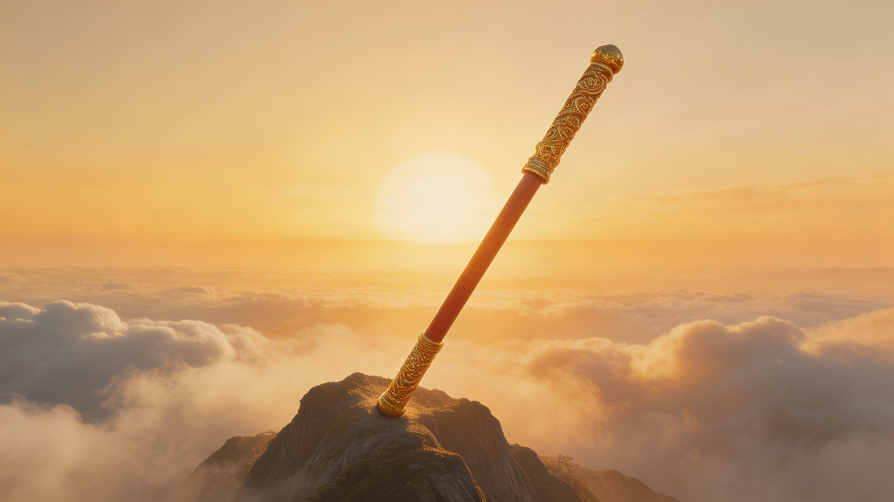
Conclusion & Reflection
More Than a Game
Reviving Tradition
Bridging Cultures
Beyond its gameplay, "Black Myth: Wukong" is a profound cultural carrier. It transcends entertainment to become a medium through which a new generation experiences the depth and soul of Chinese mythology.
Harnessing cutting-edge game technology, it breathes new life into ancient folklore. The game vividly re-presents traditional Chinese philosophy, art, and aesthetics in a form that resonates with a global, digitally native audience.
Gaming has proven to be a universal language without borders. This work acts as a powerful bridge, fostering cross-cultural understanding and appreciation by inviting the world to explore a unique perspective on Chinese spiritual heritage.
Timeless Symbol
A New Chapter
The Monkey King remains an enduring icon, transcending epochs and geographies. He stands as a timeless symbol of rebellion, wisdom, and perseverance, seamlessly connecting the profound traditions of the East with the contemporary aspirations of the West.
This game marks a pivotal new chapter in digital cultural storytelling. It demonstrates how technology can serve as a vessel for tradition, reimagining China's rich narrative heritage in an immersive format that captivates and inspires a worldwide audience.
Thank You
Notes:
In conclusion, "Black Myth: Wukong" is a landmark achievement. It's a shining example of how technology can serve as a bridge between tradition and modernity, between East and West. The Monkey King's journey continues, not just in the pages of a book, but in the hearts and minds of a new global generation. Thank you.

