Slide 1



Chinese Classics on Overseas Bookfairs
组员：钟青、周哲、朱丽娟、段小蝶
PPT展示：周哲&朱丽娟

Slide 2
1
2
A Brief Introduction about Bookfairs
Different Bookfairs Worldwide
目录
3
4
What Overseas Bookfairs Mean to Chinese Literature
Chinese Literature on Overseas Bookfairs from 1949 to 2022

Slide 3

Part 01
A Brief Introduction about Bookfairs

Slide 4
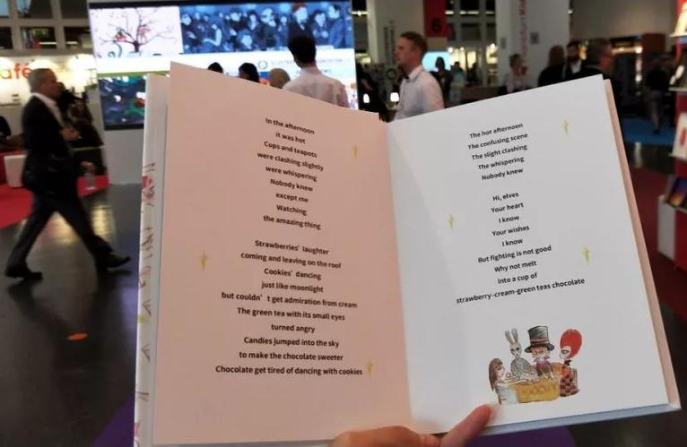

There are about 40 or 50 countries in the world holding international book fairs every year and nearly 100 book fairs of various types around the world.

Slide 5

The book fair can build a communication platform between publishers and book managers, shorten the distance between writers and readers, and enlarge marketing channels for book dealers.
As it integrates display, publicity, sales, trade, exchange and cooperation, the book fair is a good opportunity to understand the international publishing industry and the book market and strengthen exchanges in the international publishing industry.
It is an important channel for books from all countries to go to the world.

Slide 6
Part 02
Different Bookfairs Worldwide

Slide 7
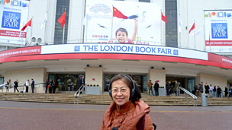
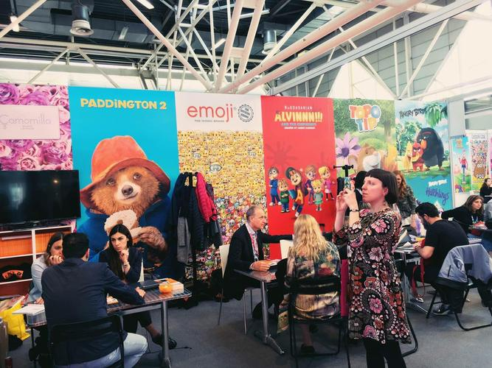
The functions and types of book fairs are different:
1 The London Book Fair features copyright trade. It has the world's largest copyright trade center to facilitate copyright trade for publishing institutions in various countries;
2 The Bologna Book Fair is the world's largest children's book fair;

Slide 8
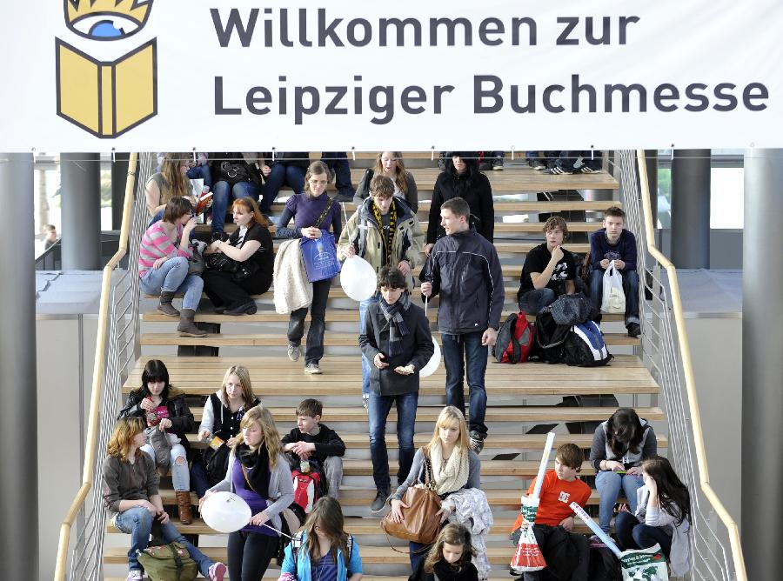

4 The Frankfurt Book Fair is the largest comprehensive book fair in the world.
3 The Leipzig Book Fair focuses on literary books;

Slide 9
Part 03
What Overseas Bookfairs Mean to Chinese Literature

Slide 10
The channels of Chinese literature “go global” mainly include local publishing houses, newspapers and magazines and other media, and overseas book fairs.
At the beginning of 21th century, the Chinese literary community has clearly realized the importance of literary exchanges in cultural exchanges between China and foreign countries and in the “go global” of Chinese culture. The Chinese government has also created more opportunities to develop face-to-face communication between Chinese writers and foreign writers, publishers and readers.

Slide 11
Guest of honor at the book fair is an effective form of introducing the cultural situation of the country in a fast way, and it is a good opportunity to display the national culture.
At present, China has been the guest country of honor in Paris Book Salon, Moscow International Book Fair, Seoul International Book Fair, Frankfurt Book Fair, Greece Thessaloniki Book Fair, Egypt Cairo Book Fair, Turkey Book Fair, London Book Fair, etc.
For example, in October 2009, more than 100 Chinese writers attended the opening ceremony of the 61st Frankfurt Book Fair and held more than 60 literary events. In April 2012, China was the guest country of honor at the London Book Fair, the world’s largest international book copyright trade fair second only to the Frankfurt Book Fair. The foreign book fair has become an important platform for Chinese literature works to “go global”.

Slide 12
Part 04
Chinese Literature on Overseas Bookfairs from 1949 to 2022

Slide 13

Since the founding of the PRC, the Party and the government have attached great importance to international publicity and cultural exchanges with foreign countries.
Upon the establishment of China International Bookstore, China has endowed it with the task of representing China to participate in international book fairs, thus attending book fairs became an important part of foreign cultural exchanges.
Between the founding of the PRC to 1990s, the International Bookstore participated in various overseas book fairs, which effectively promoted the book trade and foreign promotion and publication of Chinese Classics, and enhanced mutual friendship and understanding with the people of other countries.

Slide 14
Characteristics of exhibition books at different stages
Before 1978: in addition to the ancient Chinese classics, many Mao Zedong's works was exhibited
Between 1978 and 2000: themes of Chinese books on overseas bookfairs became more and more diversified
After 2000: More and more works of modern and contemporary China writers have received attention

Slide 15
Part II

Slide 16
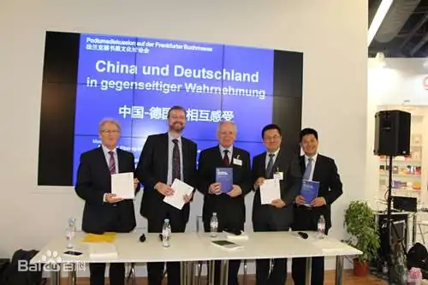
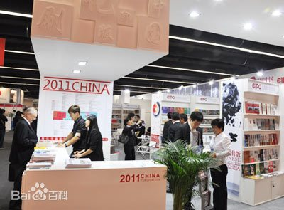
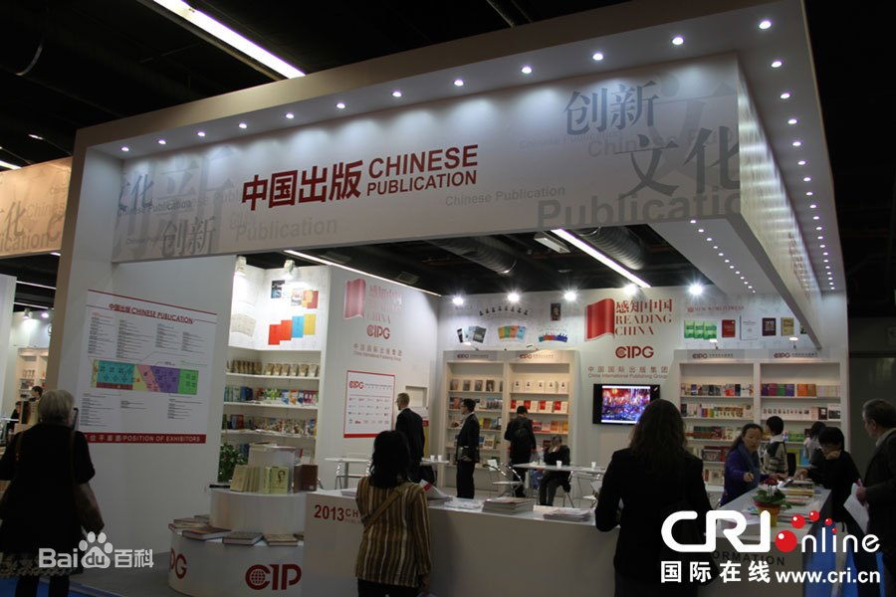
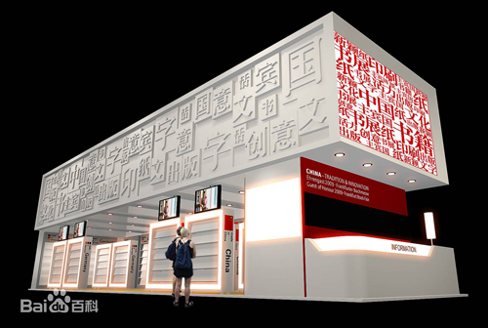
Frankfurt Book Fair

Slide 17
1956
2009
2021

Slide 18
1956

Slide 19
○It was the first time since 1949 that China participated in book fairs in Western countries.
○Import demand for science and technology book increased.
○Marching forward to science.
China took this opportunity to display a positive international image.

Slide 20


Export
√ Various types of art publications.
√ Products with Chinese characteristics.
√ Scientific and technical books and periodicals.

Slide 21
2009

Slide 22
○For the first time, our country attended as the guest of honor.
○China took advantage of this opportunity to promote the going global of Chinese culture.
○High specifications.
○Large in scale.
○Various forms of activities.

Slide 23




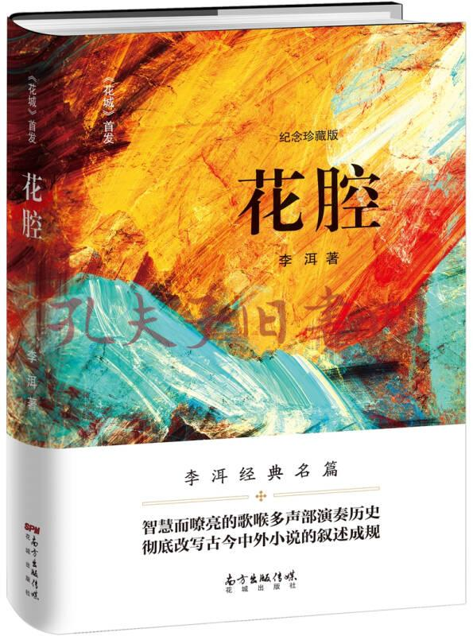
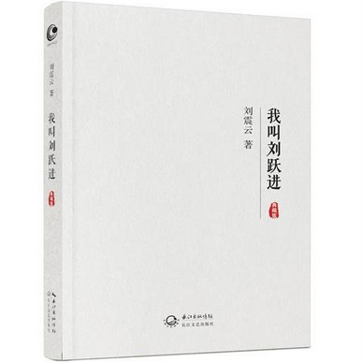
Most popular with local readers and media

Slide 24
2021

Slide 25
○The host country adopts the mode of combining offline exhibitions with online platforms.
○All countries pay more attention to the challenges and transformation measures faced by the global publishing industry.
○Chinese publishing units display works to introduce traditional Chinese culture.

Slide 26
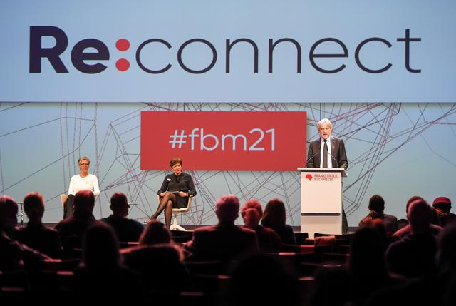

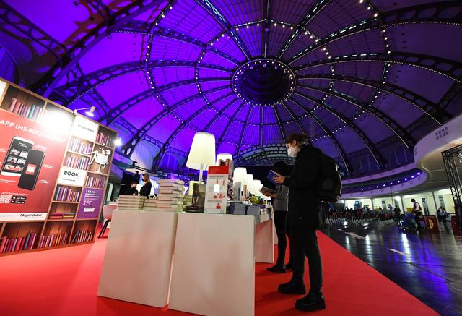
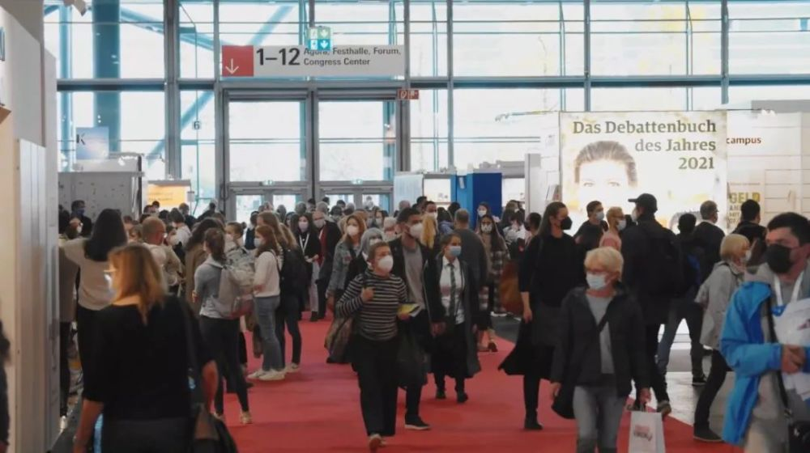

Slide 27

01
Chinese publishing units held five online copyright promotion activities from five popular publishing categories. In each activity, the publishing units recommended key books on a topic.

Slide 28



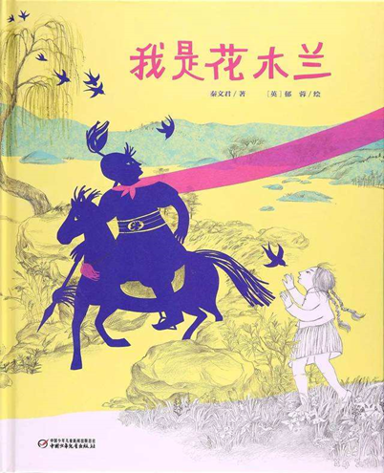

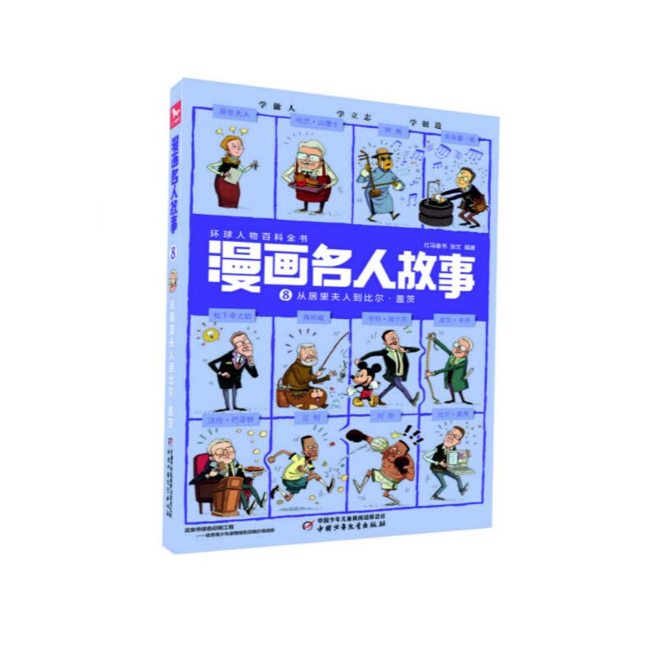
Related Books

Slide 29

Chinese publishing units invite foreign copyright principals to exchange and communicate with each other through online platforms to carry out accurate copyright recommendation and negotiation
02

Slide 30

A number of publishing houses jointly held promotion meetings to show the achievements of China's copyright export to the world.
03

Slide 31



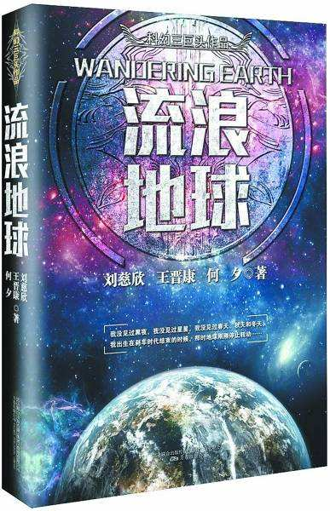

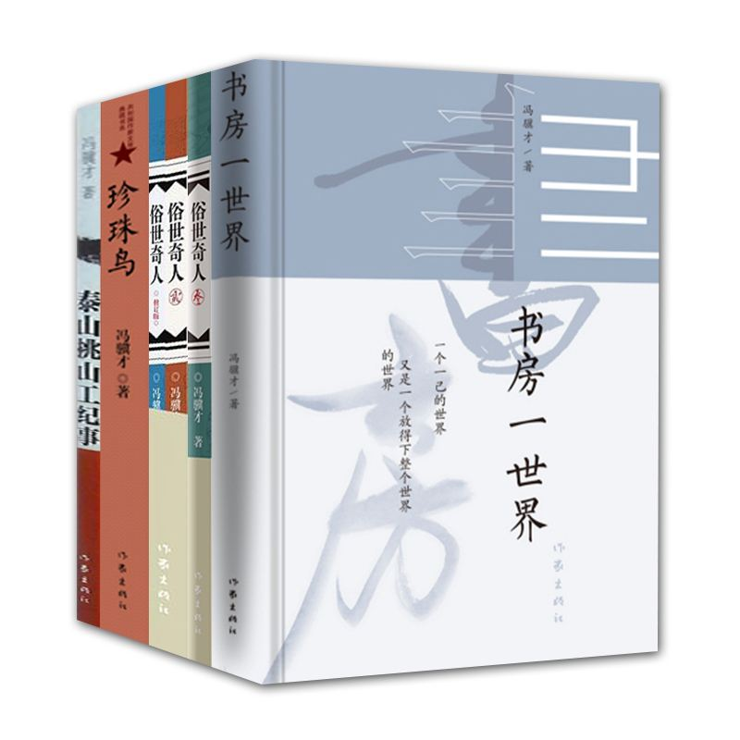
Related Books

Slide 32
Conclusion

Slide 33

√ The cultural products exported by China are changing from those concerning traditional culture to modern scientific and cultural products.
√ Now, Chinese books are closer to readers. Chinese publishing industry as a whole is also more professional and open.

Slide 34
√ Since the Eighteenth National Congress of the Communist Party of China, Chinese publishing industry launched a number of theme publications that deeply reflect the voice of the party, the voice of the people.

Slide 35
Appendix

Slide 36
序号 | 书籍
① | 《寒夜》Cold Night
② | 《习近平治国理政》Xi Jinping on Governing the Country
③ | 《读懂中国》Reading China
④ | 《三体》Three-body
⑤ | 《平凡的世界》Ordinary World
⑥ | 《解密》Decryption
⑦ | 《羽毛》Feathers

Slide 37
序号 | 书籍
① | 《汉字的智慧》Wisdom of Chinese Characters
② | 《之江新语》Zhijiang New Language
③ | 《茶经图说》Tea Sutra Illustrations
④ | 《木兰双城》Mulan Twin Cities
⑤ | 《中国进行时》China in Progress
⑥ | 《海岛天堂》Island Paradise
⑦ | 《熊猫的故事》The Story of the Panda

Slide 38
Thanks

