Slide 1

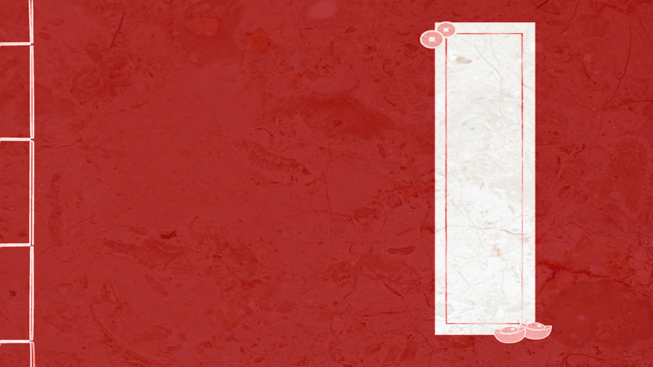
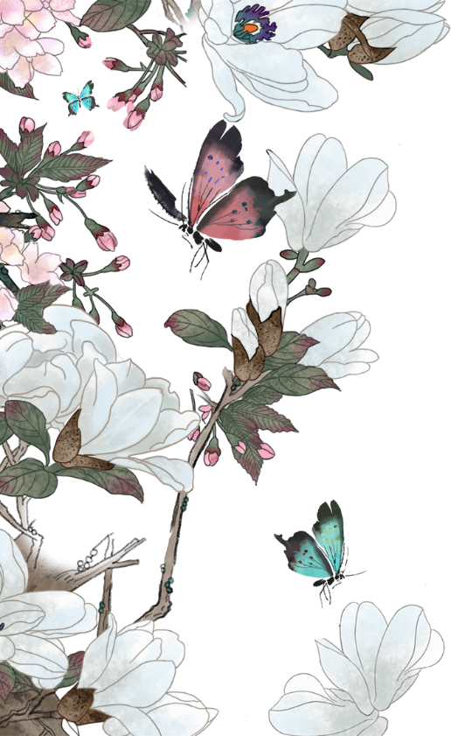
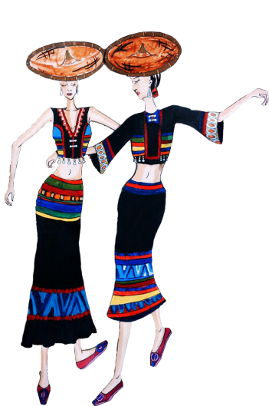
Ethnic Minorities' Costumes
少数民族服饰
Emily（曾蔓）
2024年9月26日

Slide 2
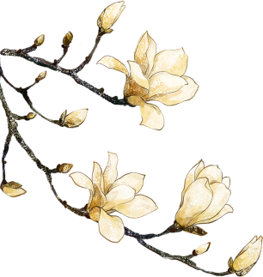
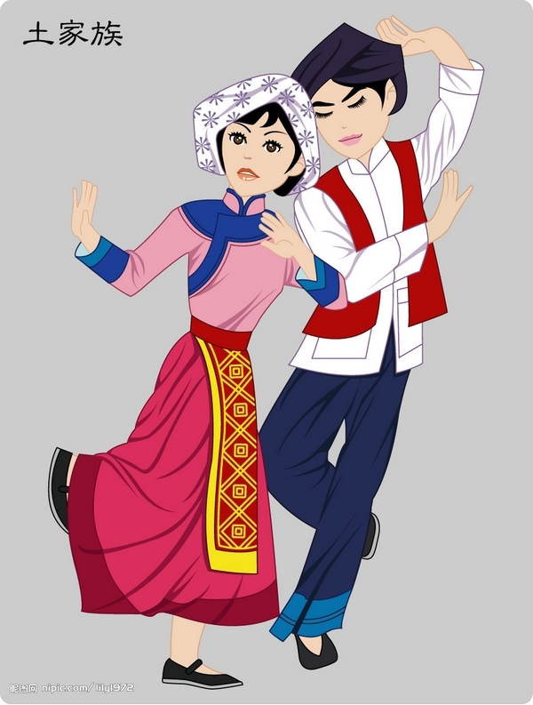
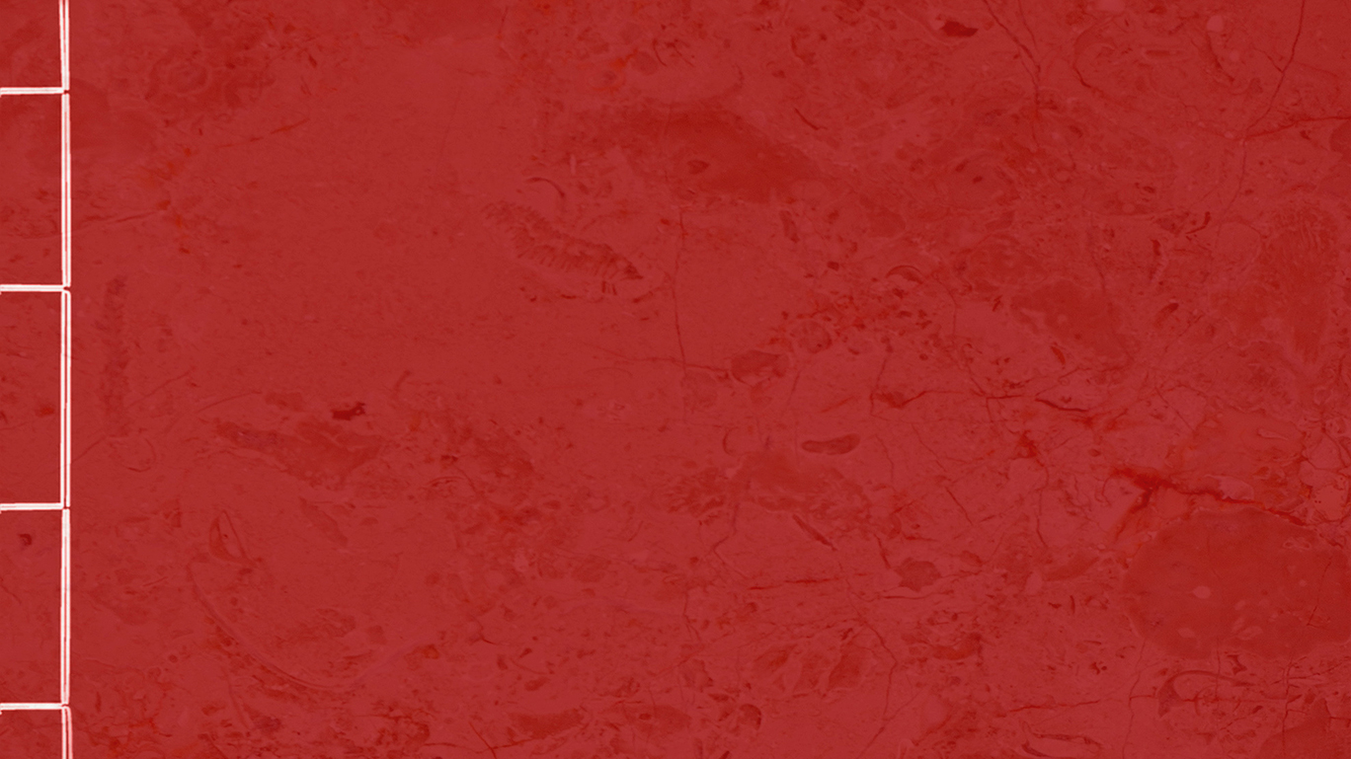
Part One
Part Two
Origin
Distribution and Habitation
Part Three
Part Four
Xilan Kapu
Costumes

Slide 3
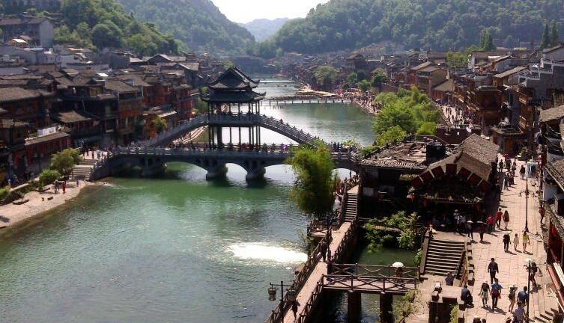
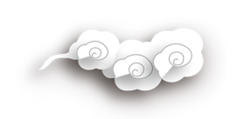
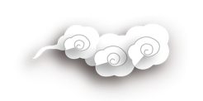
0rigin
The Tujia Ethnic Group call ourselves "Bifzivkar"（毕兹卡）, meaning "indigenous people".
Its main source is Linjun tribe（廪君蛮） and Bandun tribe（板楯蛮）, two branches of the ancient Ba people（巴人）. It integrated the local aborigines and the ethnic groups such as Han, Pu, Chu and Wu people and formed after the late Tang Dynasty and the Five Dynasties.
The Tujia have lived in China as early as 5,000 years ago.The names of Tujia was different in different historical periods, such as "Ba people" in Shang and Zhou Dynasties.

Slide 4
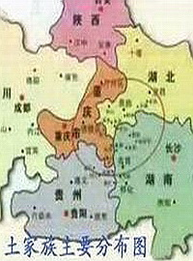
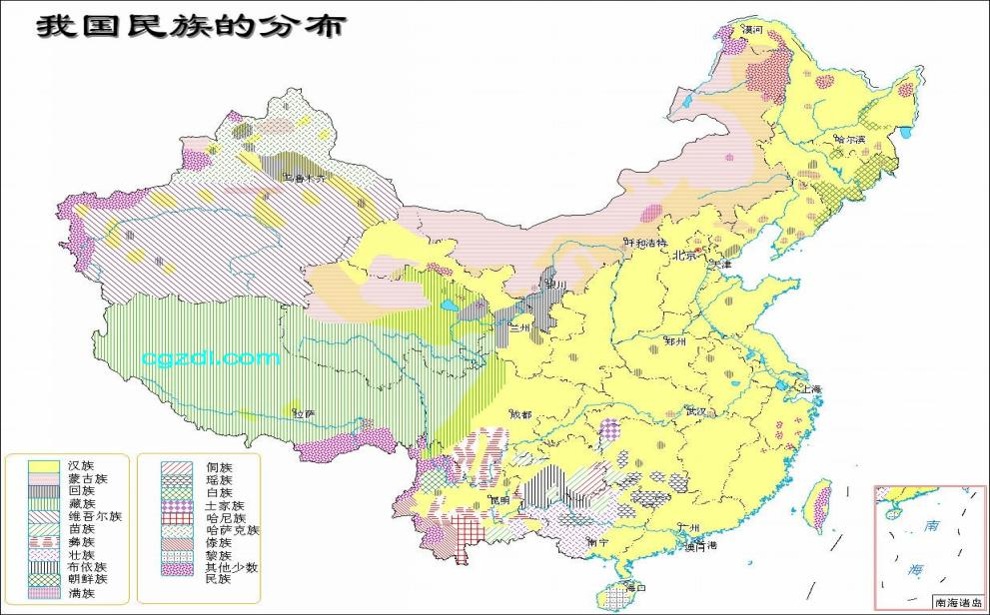
Distribution
The Tujia ethnic group is mainly distributed in the Wuling mountain area at the junction of Hunan, Hubei, Chongqing and Guizhou, mainly in the Xiangxi Tujia and Miao Autonomous Prefecture of Hunan and Enshi Tujia and Miao Autonomous Prefecture of Hubei Province.
（湘西土家族苗族自治州、
恩施土家族苗族自治州）

Slide 5
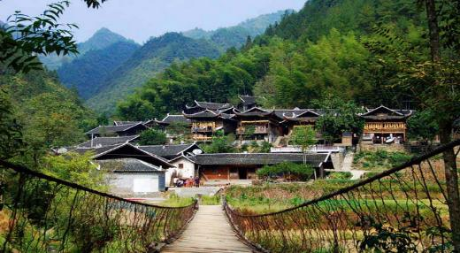
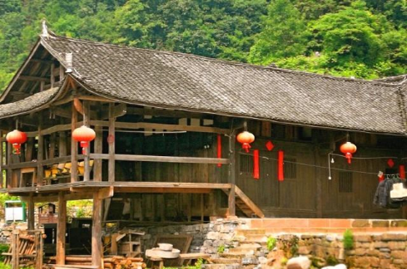
Habitation
Tujia people live together, and the folk houses form their own communities. The traditional houses of the Tujia people mainly include four types: thatched house, brick and tile house, wooden frame slab house and stilt house（吊脚楼）.

Slide 6
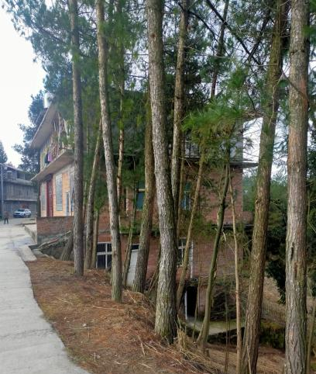
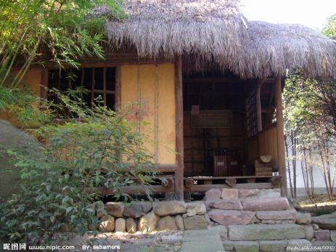
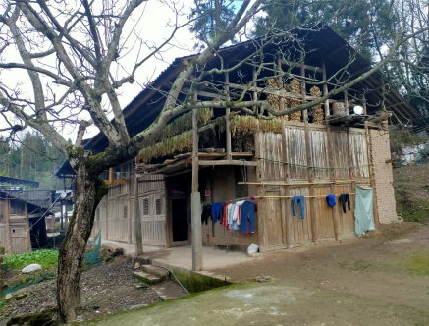
Housing
thatched house
wooden frame slab house
茅草屋
木架板壁屋
brick and tile house
砖瓦房

Slide 7

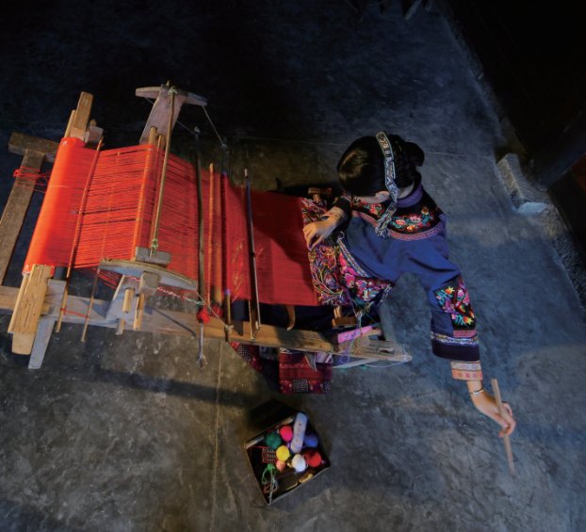
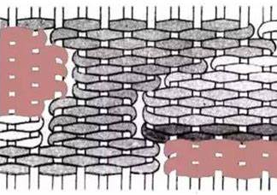
Xilan Kapu（西兰卡普）
Tujia brocade, also known as "Xilankapu"（花铺盖）, means " bedding with beautiful patterns". Its weaving method is cotton yarn as the warp, a variety of colorful thick silk, cotton wool as the weft, through the method of breaking the weft（通经断纬）, weaving a variety of gorgeous patterns. It mainly used as beddings and interior decoration. Xilan Kapu features warm colors and a rigorous structure dominated by geometric symmetry and diamonds and diagonal lines. In 2006, it was included as part of the first batch on the national intangible cultural heritage list under the name “Tujia Brocade（土家织锦）.”

Slide 8
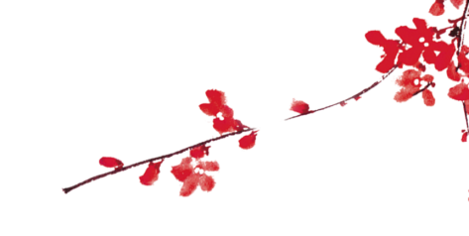
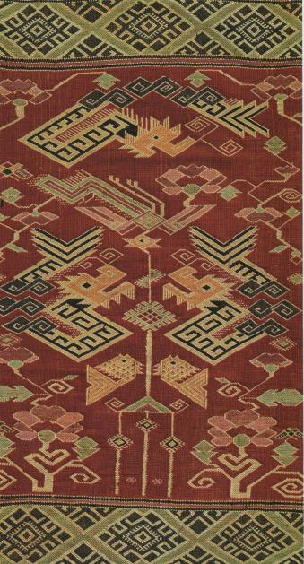
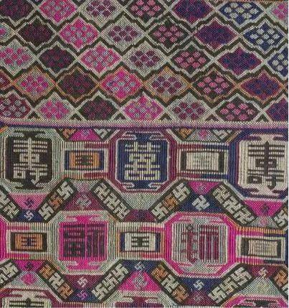
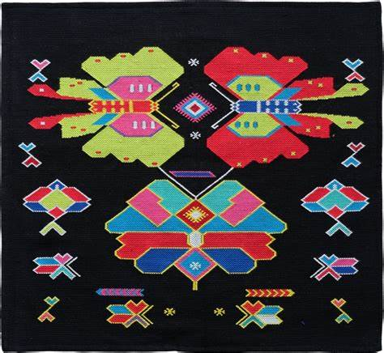
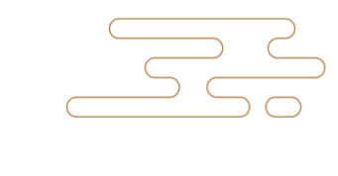
In the Tujia brocade, the choice and use of patterns is specially particular. The patterns are mostly based on （1）the images of animals and plants in nature, such as flowers, grass, insects, fish, birds, and so on. （2）Geometric patterns, figurative "characters" （3）as well as some myths and legends and historical stories.
These patterns contain profound cultural connotations and meanings, such as "prosperity brought by the dragon and the phoenix", "surplus year after year ", "five blessings come to the family", and so on, expressing the Tujia people's yearning for and pursuit of a better life.

Slide 9
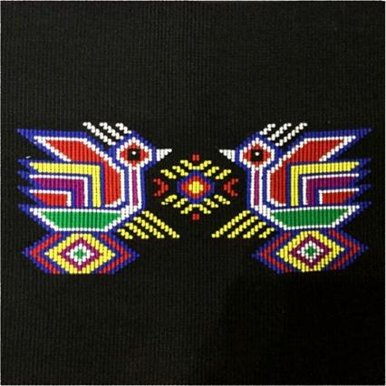
Cuckoo and Flower (阳雀花)
The symbolic pattern of Tujia brocade.
This pattern shows the moving legend of a girl Xilan, the legendary Tujia "Weaving Goddess". She turned into a cuckoo when she died. This pattern is inherited by the Tujia in order to commemorate her.
Uses the decorative technique of "exaggerated deformation" and becomes the representative pattern of Tujia brocade.

Slide 10
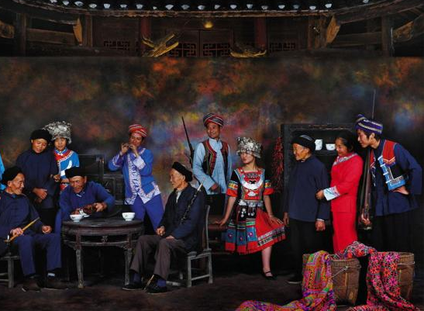
Clothing
In terms of clothing, the Tujia costumes are simple, like loose style.
Traditional clothing materials are mostly self-woven blue and black native cloth or linen, which is called "Xi cloth" and "Dong cloth" （溪布、峒布）in historical books.
"Eight -fu Skirt", "Crow magpie clothes" and "Pipa lapel" are the traditional national costumes.

Slide 11
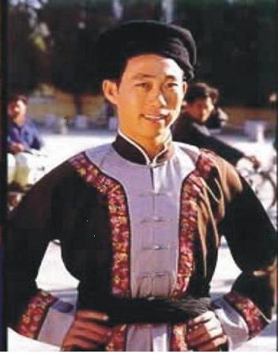
Male Clothing
Men’s clothing is relatively simple, mostly blue or black short suits, convenient for work.
Men’s coat is "Pipa lapel"（琵琶襟）, and then wears a short shirt and a collarless jacket（马褂）;
Loincloth belt（缠腰布带）;
Fat pants, pant leg is large and short, wear gaiters（绑腿）;
Head is covered with black silk or headcloth five or six feet long in the shape of "人".

Slide 12
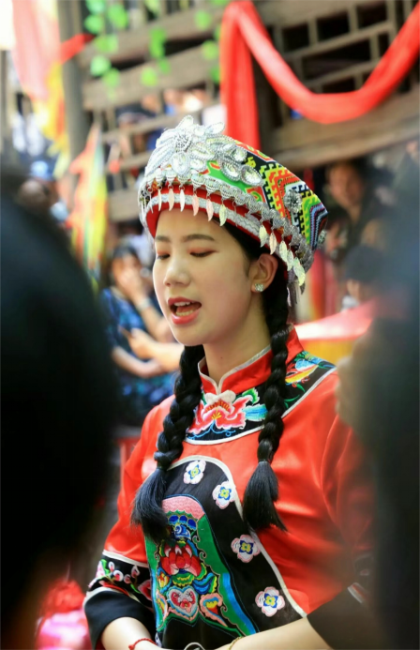
Female clothing
Women’s clothing is more complex, diverse and colorful.
Women's blouse: low collar, right lapel(右衽) , collar inlaid with three lace ( known as "three strands(三股筋) "). The front edge and cuffs embroidered three small border railings.
Wear eight-fu skirts（八幅罗裙）, skirt has many straight pleats. Later, skirts changed into loose trousers with three colored lace.
The girl’s plain clothes is a black cloth jacket. In Spring and Autumn, wear white, black coat. It looks like a crow or magpie, so called "crow magpie clothes（鸦雀衣）”
Hair in a bun, wear a hat or wrap a cloth(包头帕） around head.

Slide 13
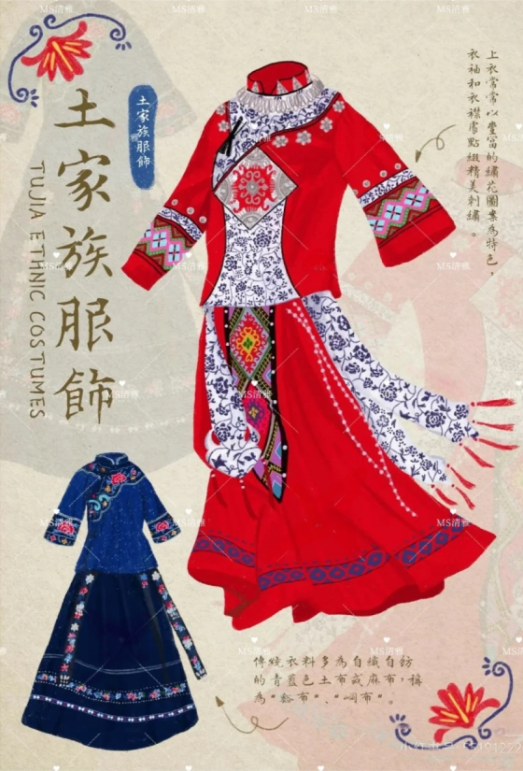
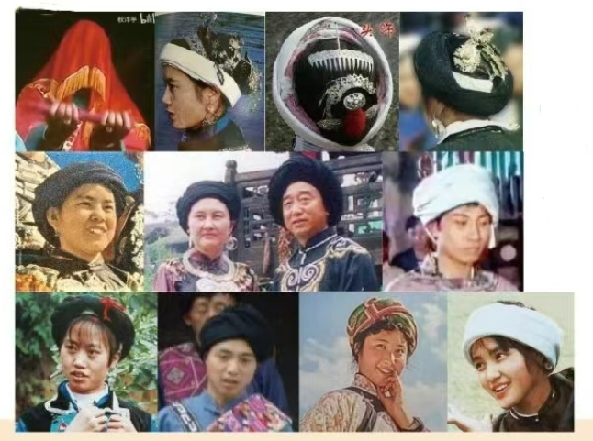
Headcloth(包头巾/帕子)

Slide 14
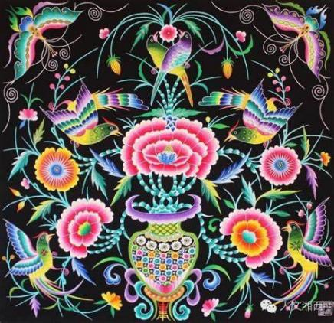
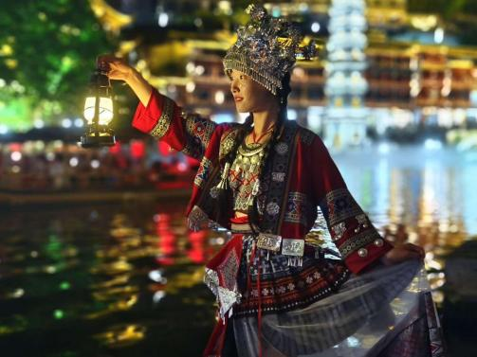
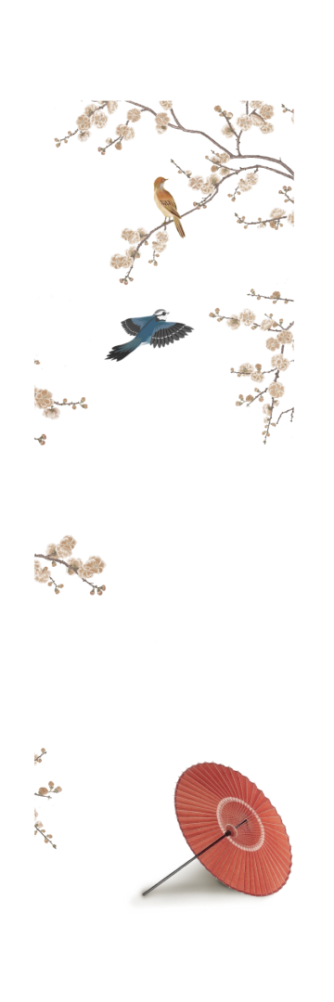
Difference between Tujia and Miao clothing
1. Silver jewelry: Miao people like silver jewelry; Tujia use less
2. Embroidery: Miao patterns are exquisite and lifelike; Tujia pattern abstract, geometric figures
3. Color: Miao dress colorful; The Tujia dress color is relatively simple, mainly blue, black and white.
With the development of modern society, many traditional dress may be combined with modern elements to form a new dress style. The difference between them is not obvious.

Slide 15
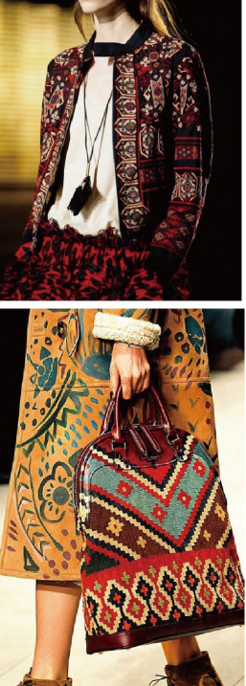
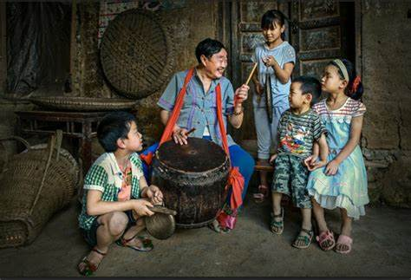
Today’s Tujia Clothing
The Sinicization（汉化） of Tujia was early in history, which can
be traced back to the Five Dynasties and Ten Kingdoms（五代十国）. Traditional Tujia costumes have largely disappeared.
Due to the needs of performance，tourism and cultural protection, modern Tujia costumes have risen again.
Although the Tujia were influenced by the Han, we also retained our unique national customs and ethnic elements.

Slide 16
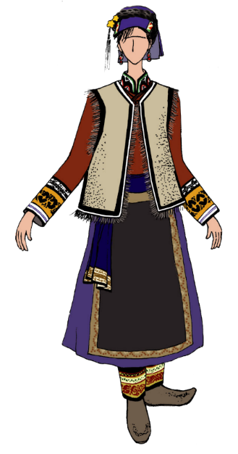
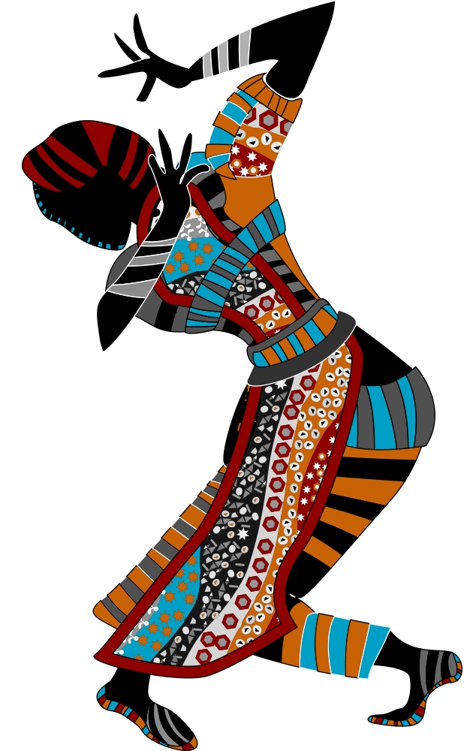
Thank you

