Slide 1


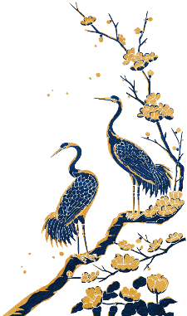


Four Folk Stories
of
Ancient China
Reported By Ma Yanhuan majoring in English Translation

Slide 2



目 录
CONTENTS
1. Cowherd and Weaving Girl
2. Meng Jiangnu Crying on the Great Wall
3. The Stories of the White Snake
4. Butterfly Lovers

Slide 3


壹
1. Cowherd and Weaving Girl

Slide 4
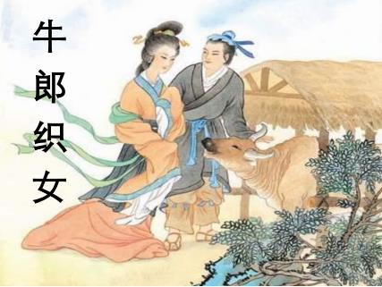
Cowherd and Weaving Girl
Background Information：
Who： Cowherd
Weaving Girl
When：Western Zhou Dynasty
Where: Xiniu village of Nanyang city

Slide 5
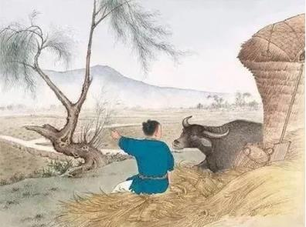
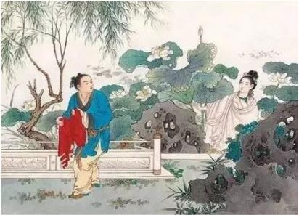
Cowherd and Weaving Girl
The old ox told the Cowherd to steal her clothes so that she was unable to return to the heaven and would stay here to be his wife.

Slide 6
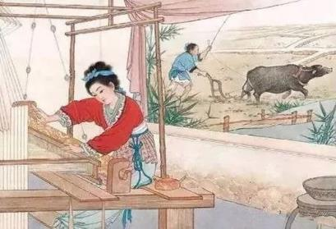
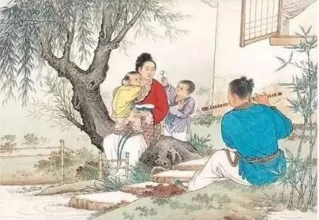
Cowherd and Weaving Girl
Weaving Girl married Cowherd and soon they had a son and a daughter. They led a happy life with husband laboring in the field and wife weaving at home.

Slide 7
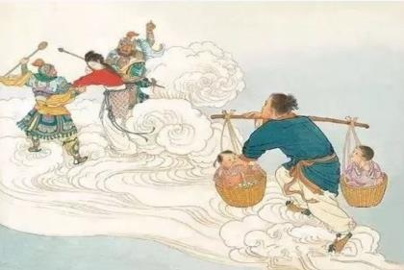
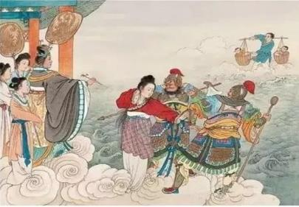
Cowherd and Weaving Girl
Ignoring tearful Cowherd and two crying children, the Queen Mother broke up the couple and brought Weaving Girl back. the Queen Mother took off her golden hairpin and separate them by a large river, which is now called the Milky Way.

Slide 8
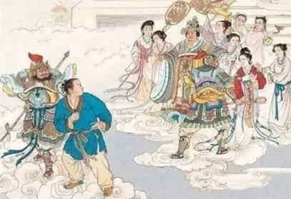
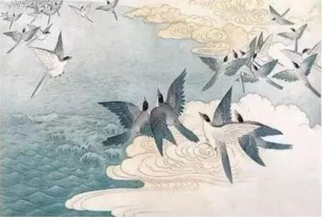
Cowherd and Weaving Girl
Hopelessly, the two lovers can only look at each other across the river. Fortunately, touched by their love, hundreds of thousands of magpies flied and formed a bridge over the river.

Slide 9
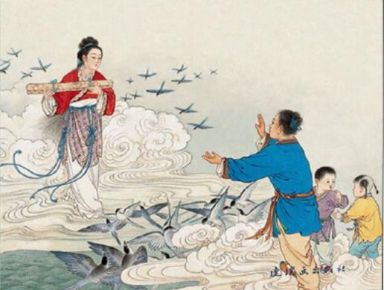
Cowherd and Weaving Girl
Finally the Queen Mother showed a little mercy, allowing them to meet once a year on the magpie bridge. The day was the seventh day of the seventh lunar month, which later has become the Chinese Valentine’s Day

Slide 10
贰
2. Meng Jiangnu Crying on the Great Wall

Slide 11
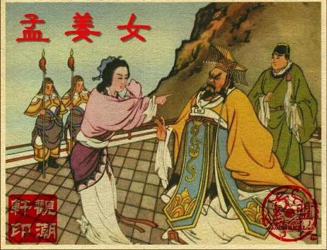
Meng Jiangnu Crying on the Great Wall
Background Information:
Who: Fan Xiliang
Meng Jiangnu
When: the reign of the first emperor
of Qin Dynasty
Where: Mengjiang mountain in
Lizhou County, Hunan Province

Slide 12
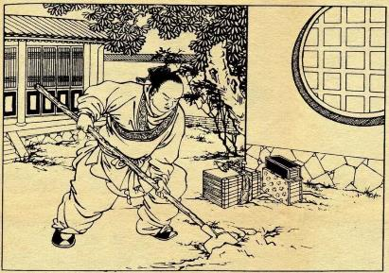
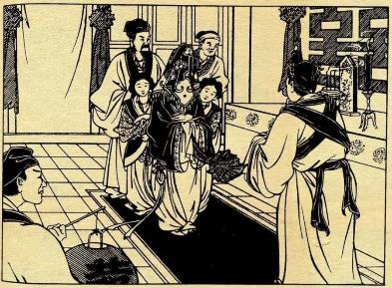
Meng Jiangnu Crying on the Great Wall
Fan Xiliang had just finished the hard labor and returned to his hometown to get married.

Slide 13
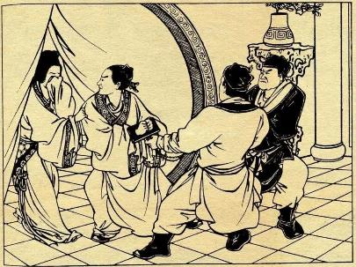
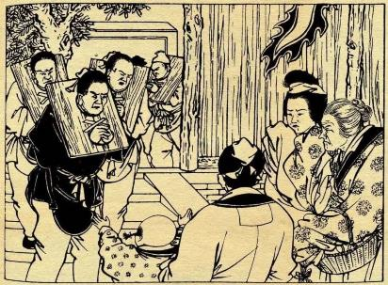
Meng Jiangnu Crying on the Great Wall
But unfortunately, on the night of their wedding, Fan Xilang was sent to the north to build the Great Wall.

Slide 14
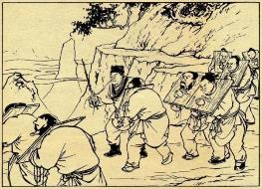
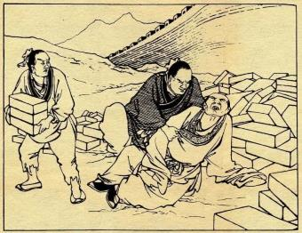
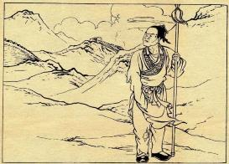
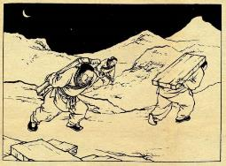
Meng Jiangnu Crying on the Great Wall
He toiled away with hunger, cold and fatigue, and soon met a miserable death at the end of his efforts. His body was buried under the Great Wall.

Slide 15
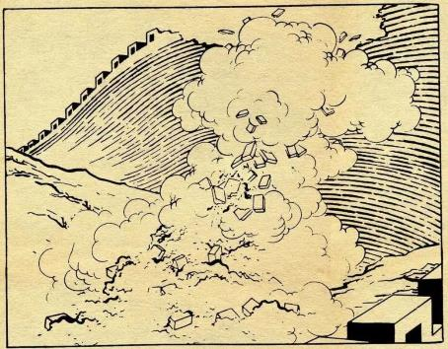
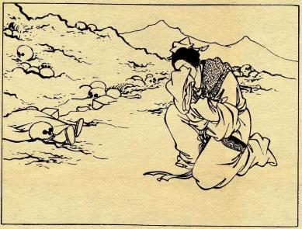
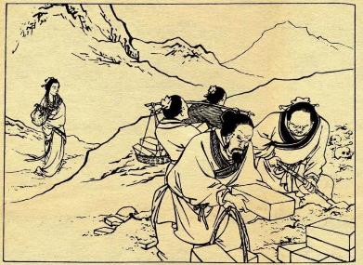
Meng Jiangnu Crying on the Great Wall
Meng Jiangnu, Fan’s new wife, got the bad news and went through all kinds of hardships to reach the Great Wall. She cried bitterly there for three days and three nights, and finally cried down the Great Wall and found her husband's remains.

Slide 16
叁
3. The Stories of the White Snake

Slide 17

The Stories of the White Snake
Background Information:
Who: Xu Xian
Bai Suzhen
What: the love story between human and snake
When: Created in the Southern Song Dynasty
prevailed in the Qing Dynasty
Where: Hangzhou

Slide 18
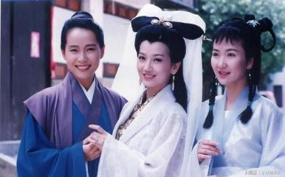
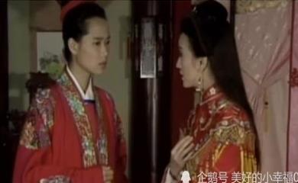
The Stories of the White Snake
Bai Suzhen and Xiaoqing translated into two beautiful girls and came to visit Hangzhou. After encountering with a young man named Xu Xian in the rain, Bai Suzhen fell in love with him and soon later they get married.

Slide 19
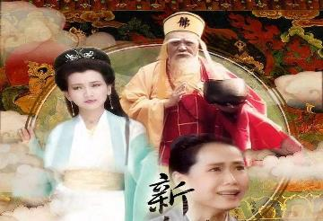
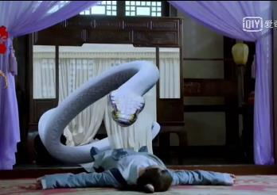
The Stories of the White Snake
Fahai persuaded Xu Xian to intoxicate his wife with realgar wine on the Dragon Boat Festival. After being drunk, Bai Suzhen couldn’t control herself and showed the shape of a snake, which scared Xu Xian to death.

Slide 20
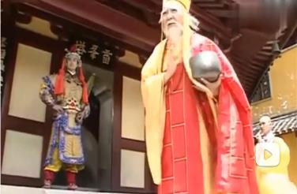
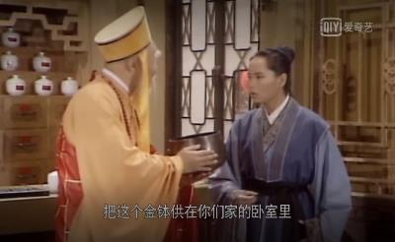
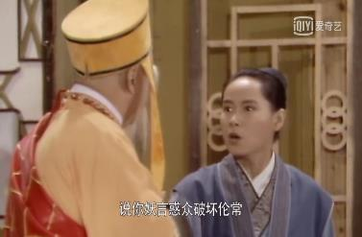
The Stories of the White Snake
But Fahai did not give up. He then lured Xu Xian to the JinshanTemple to separate the couple. Bai Suzhen and Xiao Qing had no choice but to inundate the temple with flood. During the fierce battle, Bai was finally defeated and put into a small bowl under the Leifeng Pagoda.

Slide 21
肆
4. Butterfly Lovers

Slide 22
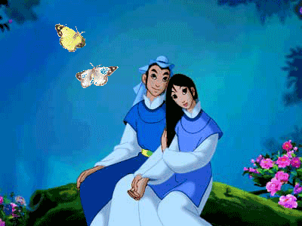
Butterfly Lovers
Background Information:
Who: Liang Shanbo
Zhu Yingtai
When: Eastern Jin Dynasty
Where: Hangzhou, Zhejiang Province

Slide 23
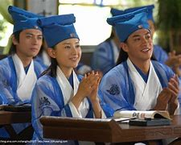
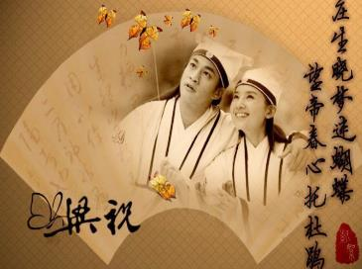
Butterfly Lovers
Women are not accepted into school but Zhu Yingtai wanted a good teacher, so she dressed as a man and went to Hangzhou to study. She met Liang Shanbo, a young and knowledgeable man, they slept and studied together, and gradually Zhu fell in love with Liang.

Slide 24

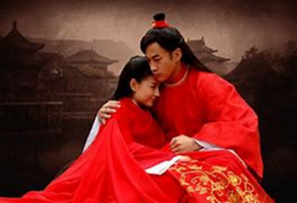
Butterfly Lovers
Until graduation，Liang failed to realize that she was a girl so Zhu had no choice but to lied to Liang that she had a little sister who was similar to her in appearance and learning. He was surprised to see “her sister” dressed up as a girl. Only then did he know the truth. They then confessed their love to each other and pledged to marry without the permission of parents.

Slide 25
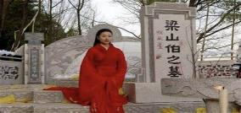
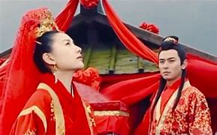
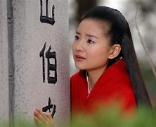
Butterfly Lovers
Zhu’s parents wanted to marry their daughter to Ma Wencai, the son of the local governor. Zhu Yingtai’s protest was in vain. The two young lovers was forced to part in tears. Since then, Liang was too depressed to die a few months later. On the wedding day, Zhu asked for a detour to pass by Liang 's tomb so that she could say goodbye to him. Wearing a bright red wedding dress, she knelt in front of his grave and cried bitterly.

Slide 26
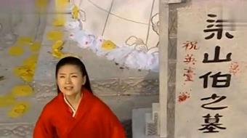
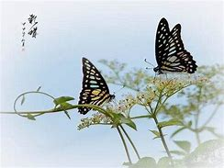
Butterfly Lovers
Lighting flashed, thunder rolled and the sky went dark. Liang's tomb suddenly cracked open and Ying-tai immediately jumped into it before it closed. Then a pair of beautiful butterflies flied out of the graves and dancing in the sunlight. It is believed that these two butterflies are Liang and Zhu. They finally get rid of all the shackles and bounds and can stay together forever.

Slide 27

Thank You!

