Slide 1
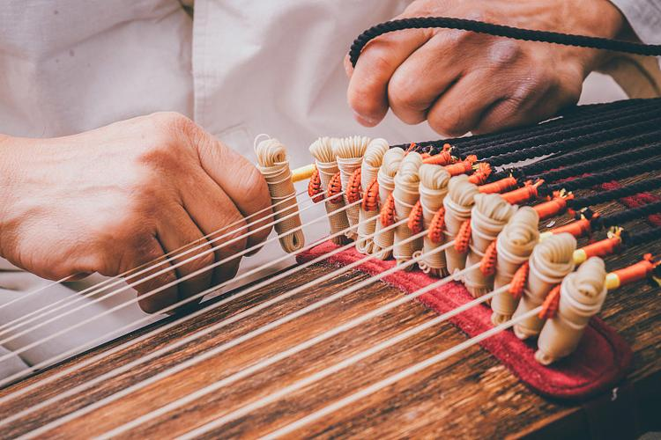
Gayageum
伽倻琴
Speaker: Zhang Meiling 张美玲

Slide 2
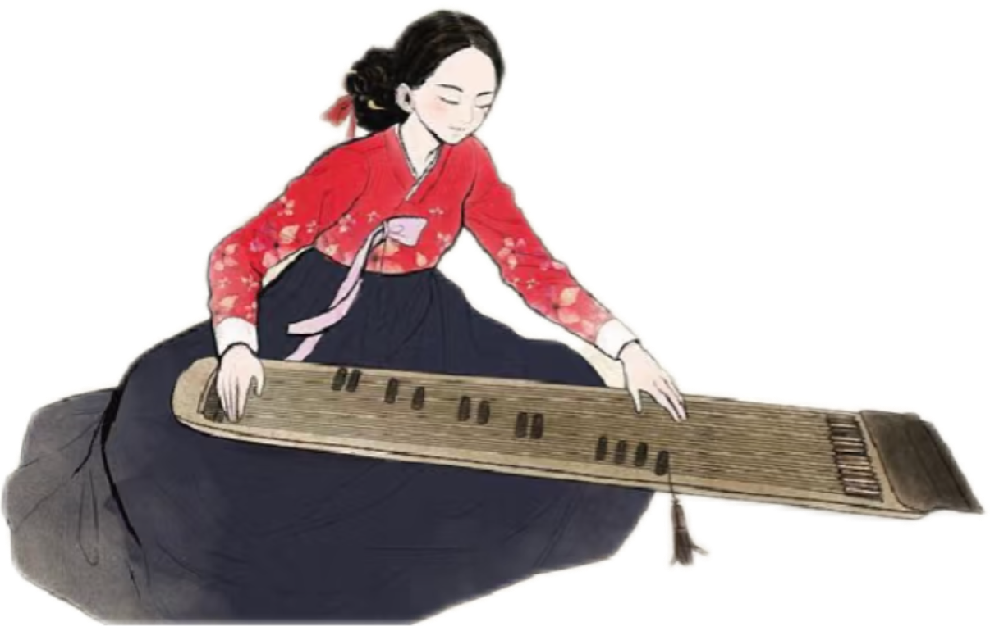
CONTENTS
PART 1 Introduction to the Gayageum
PART 2 The Historical Evolution of the Gayageum
PART 3 Transmission of the Gayageum Tradition

Slide 3
Does anyone know which ethnic group
the gayageum belongs to?

Slide 4
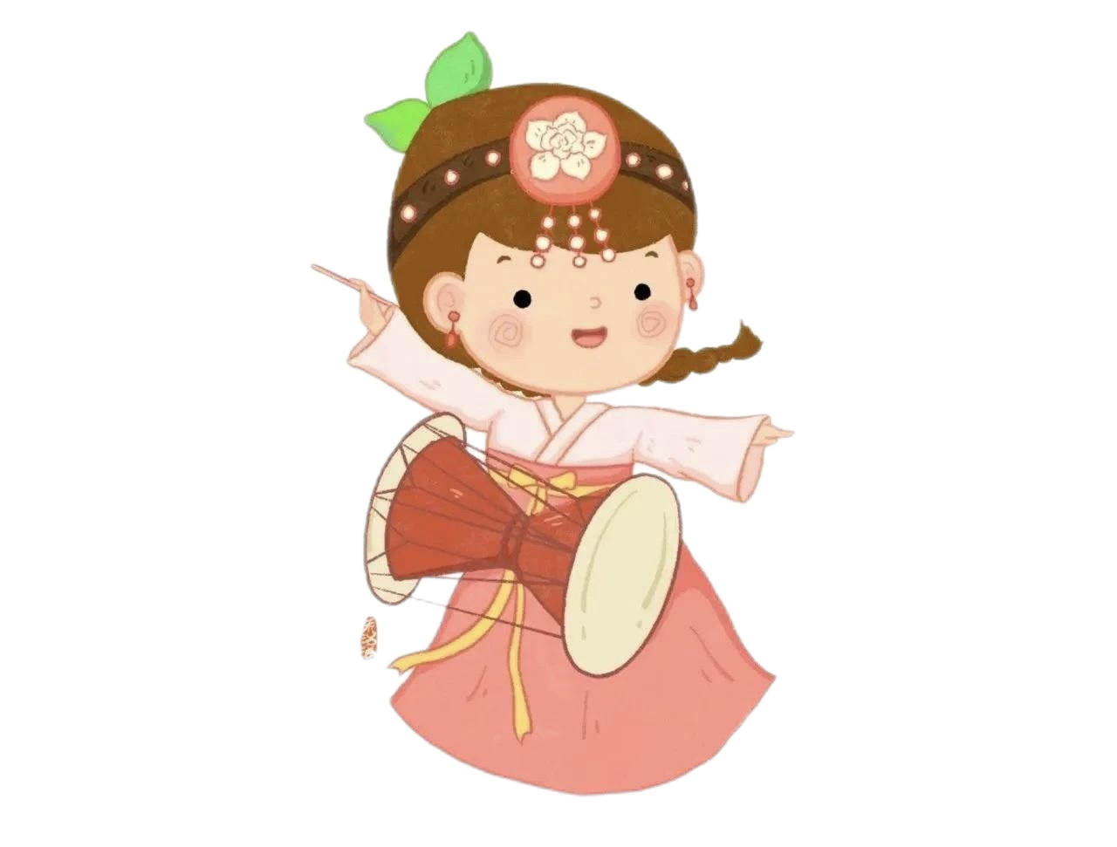
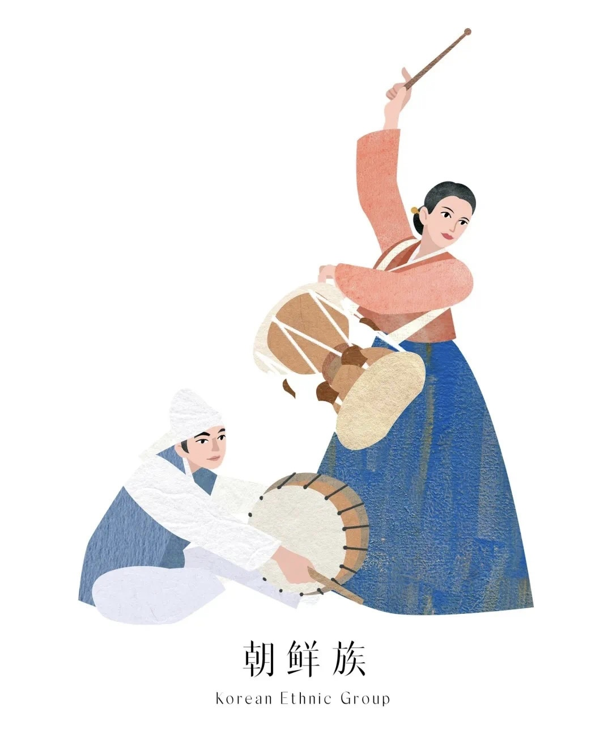
Korean Ethnic Group
朝鲜族

Slide 5
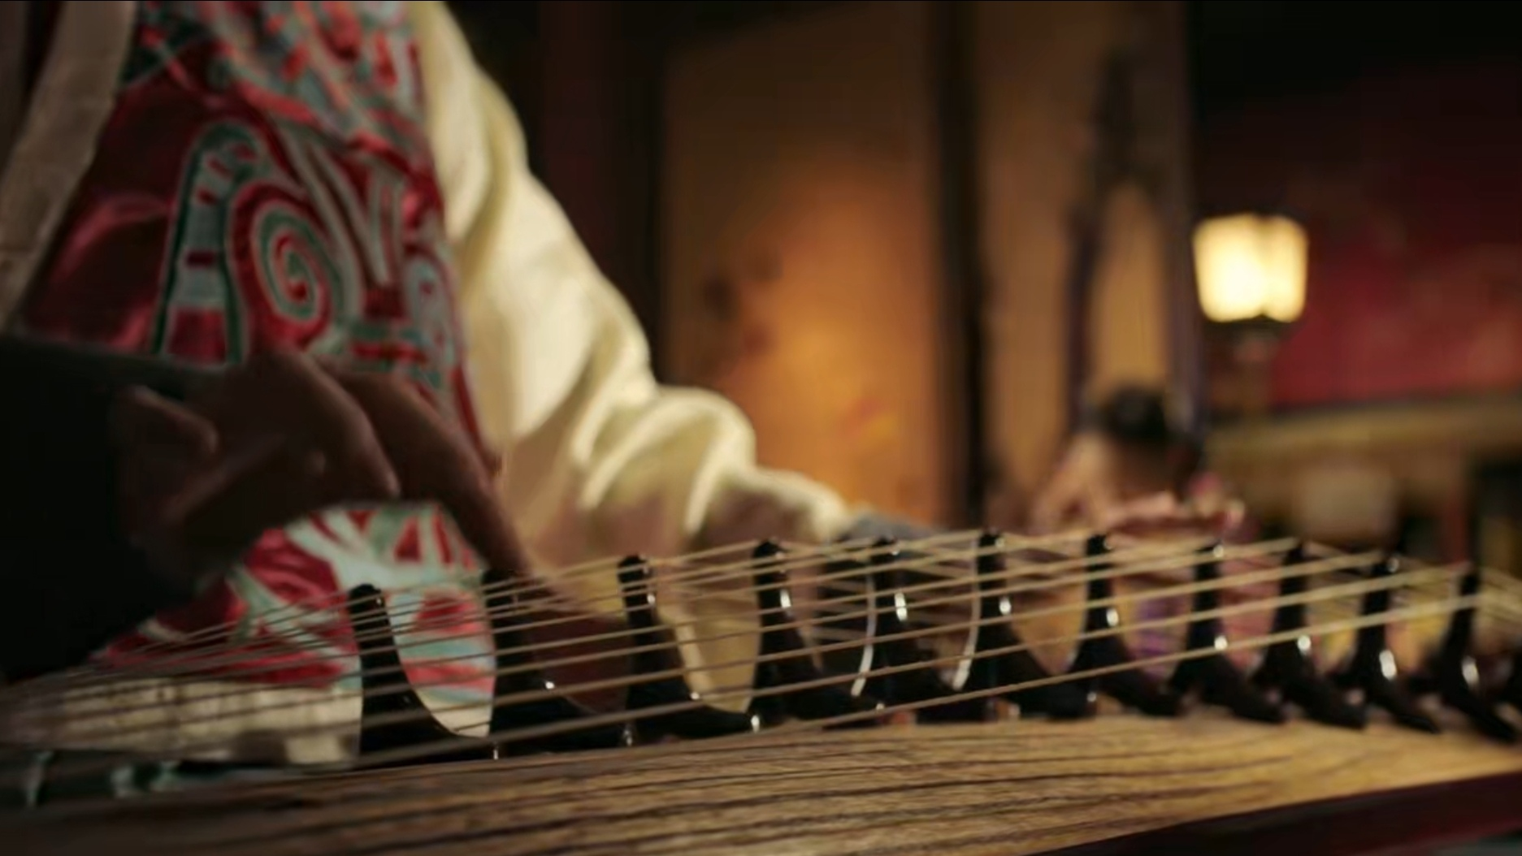
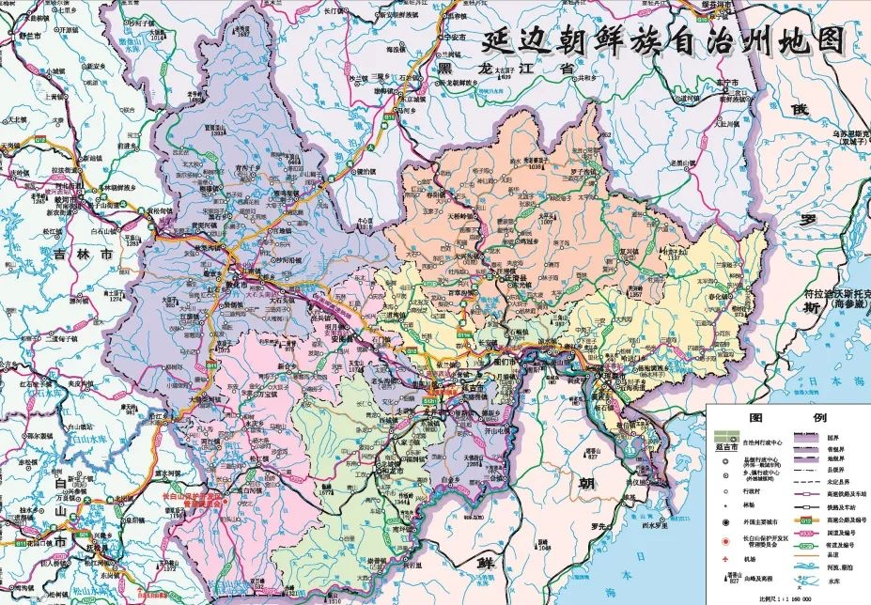
PART 1 Introduction to the Gayageum
Gayageum, as a plucked string instrument of the Korean ethnic group, has a history of more than 1,500 years. It is widely popular in provinces including Jilin, Liaoning, Heilongjiang and Hebei, with particularly strong prevalence in the Yanbian Korean Autonomous Prefecture.
伽倻琴作为朝鲜族的弹拨乐器，已有1500多年的悠久历史。该乐器在吉林、辽宁、黑龙江、河北等省份广为流传，尤以延边朝鲜族自治州最为盛行。

Slide 6
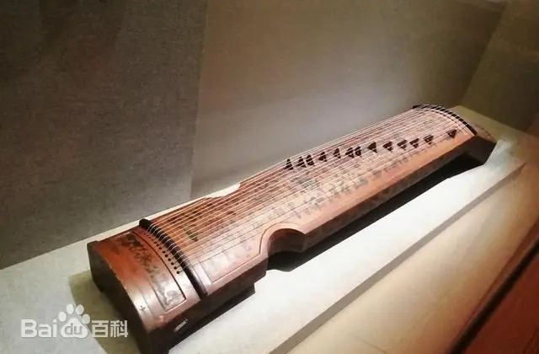
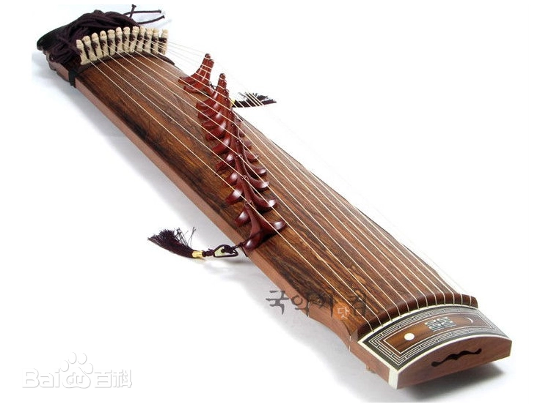
PART 1 Introduction to the Gayageum
Structure & Technique:
Resembling the Chinese Zither, the gayageum features one string per bridge.
Chinese Zither
Gayageum

Slide 7
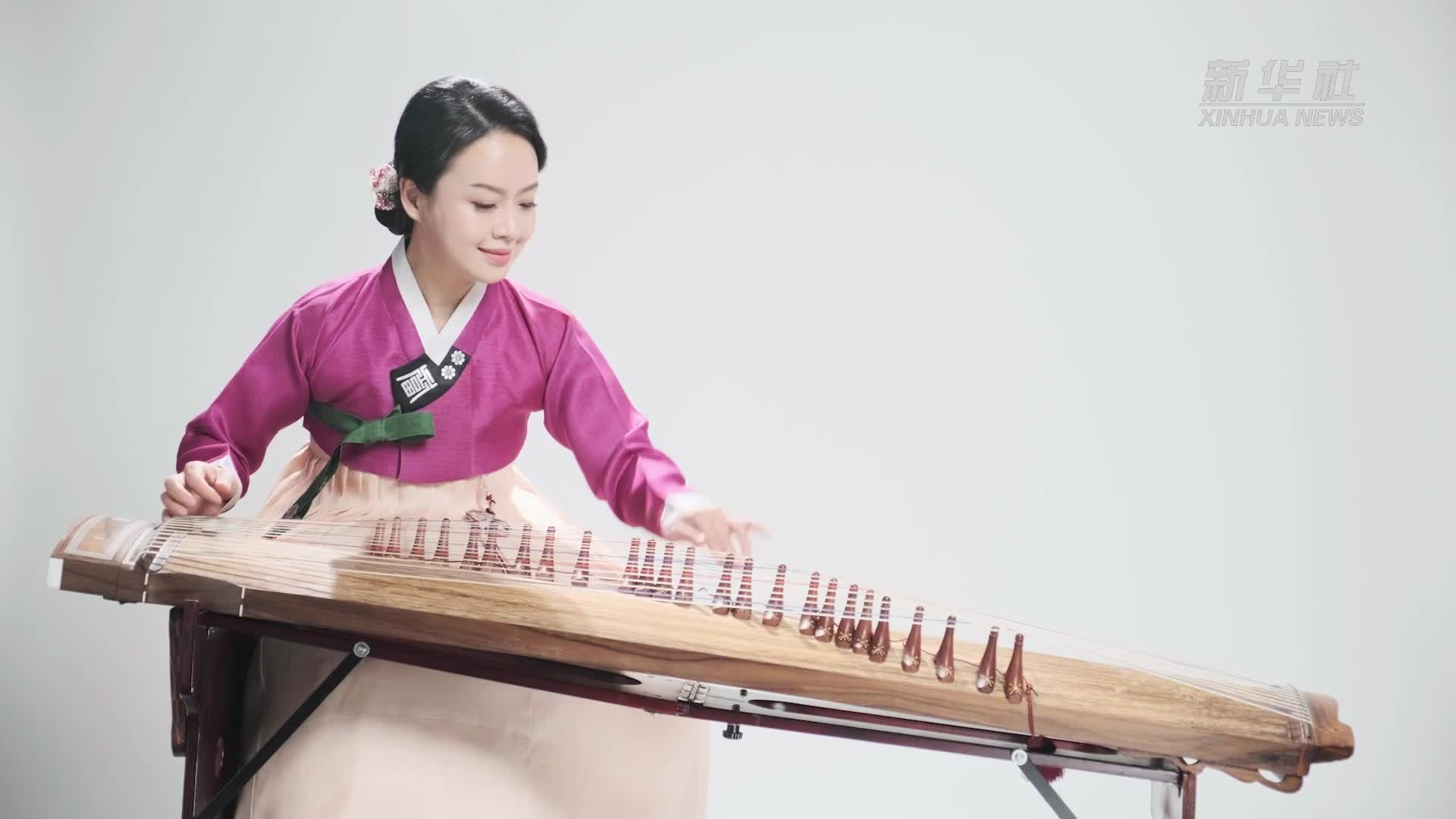
PART 1 Introduction to the Gayageum
Structure & Technique:
Modern versions typically have 21 strings, tuned to either seven-note or pentatonic scales. Played by plucking with the right hand while pressing strings with the left, its technique closely mirrors that of the Chinese Zither.

Slide 8
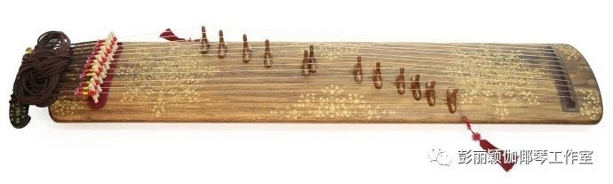
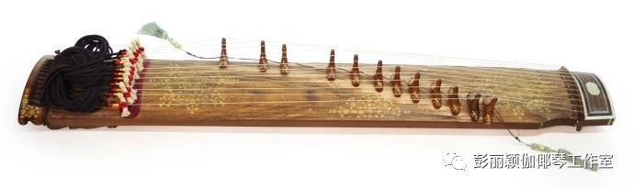
PART 1 Introduction to the Gayageum
Types
The gayageum comes in several types including the:
Jeongak gayageum 正乐伽倻琴
Sanjo gayageum 散调伽倻琴
21-string modern gayageum 21弦伽倻琴
Jeongak gayageum
Sanjo gayageum

Slide 9
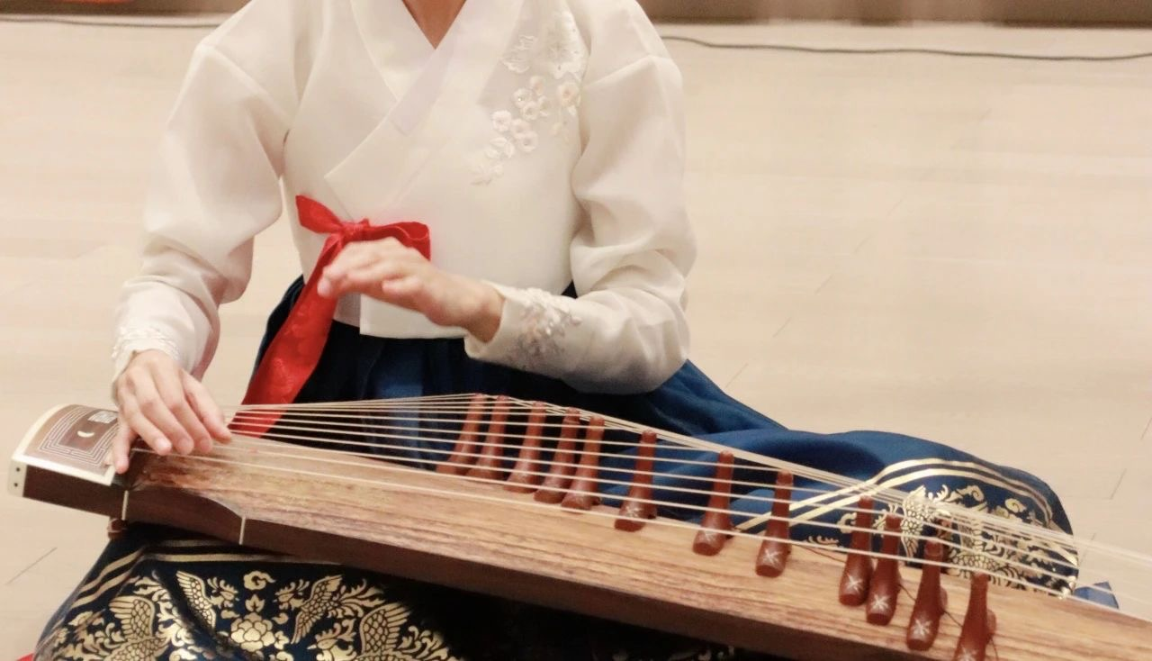

PART 1 Introduction to the Gayageum
Uses
Known for its crystalline tone, it is used in solos, ensembles, and dance accompaniments.
The gayageum is capable of expressing a wide range of emotions with remarkable subtlety, from strength and tenderness to joy, anger, sorrow, and delight.

Slide 10
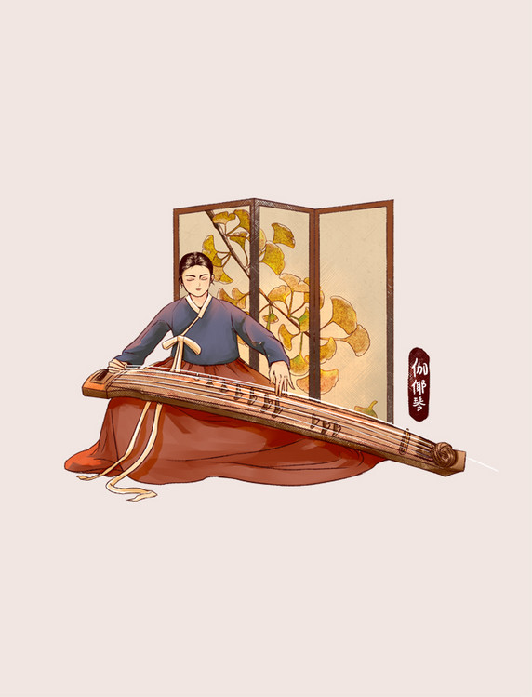
PART 2 The Historical Evolution of the Gayageum
Historical records indicate that around 500 AD, the king of the ancient Korean Gaya Kingdom created a plucked string instrument modeled after the Chinese Zither, which the Korean Ethnic Group named the "gayageum" .
据史书记载，在公元500年前后，朝鲜古代国家伽耶国的国王模仿古筝制造了一种弹拨弦鸣乐器，朝鲜族人民把它称为伽耶琴。

Slide 11

PART 2 The Historical Evolution of the Gayageum
Late 19th Century Development:
slow, meditative jeongak tradition vibrant improvisational style of sanjo
从缓慢的宫廷乐转变为轻快活泼的散调
Since the 1950s, the gayageum tradition in Yanbian has entered a new phase of development, transitioning from informal folk transmission to systematic professional training.
Notes:
By the late 1800s, gayageum music reached new artistic heights, transitioning from the slow, meditative jeongak tradition to the vibrant improvisational style of sanjo. This evolution necessitated structural modifications to the instrument itself, leading to the creation of the specialized sanjo gayageum with enhanced resonance and quicker string response.
Since the 1950s, the gayageum tradition in Yanbian has entered a new phase of development, transitioning from informal folk transmission to systematic professional training.

Slide 12
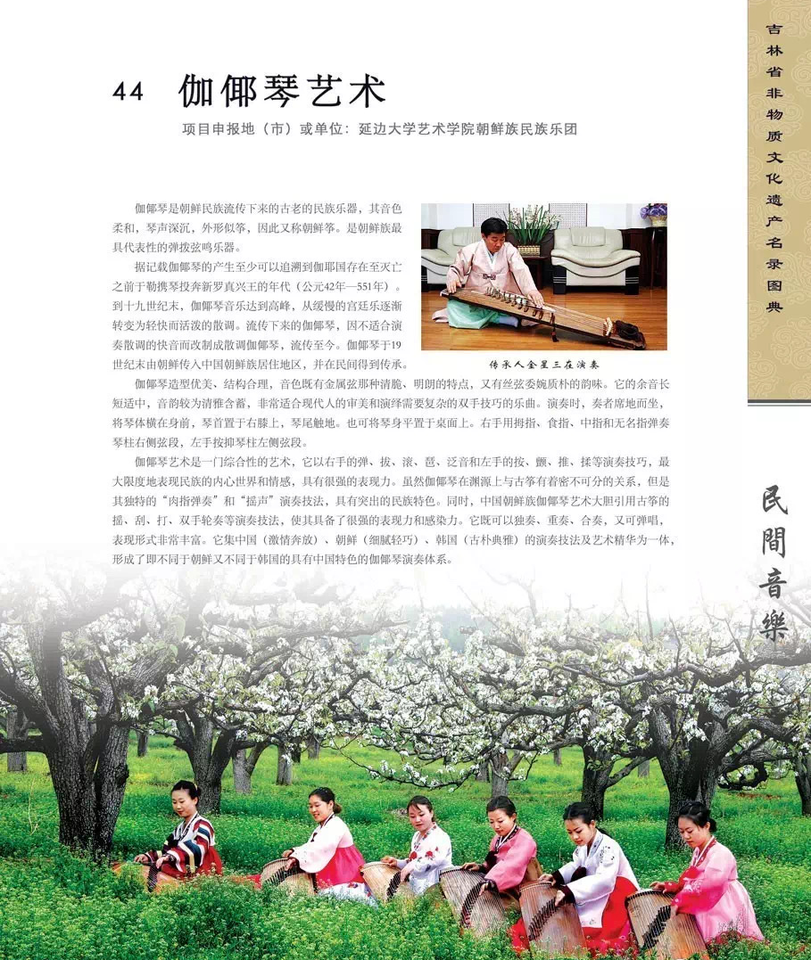
PART 3 Transmission of the Gayageum Tradition
In 2011, the art of the gayageum was inscribed on China's National List of Intangible Cultural Heritage, solidifying its status as a vital symbol of Korean Ethnic Group culture.
伽倻琴艺术在2011年被列入国家级非物质文化遗产名录，成为朝鲜族文化的重要象征。

Slide 13
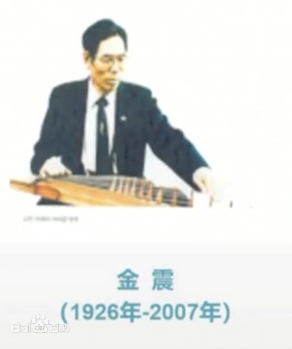
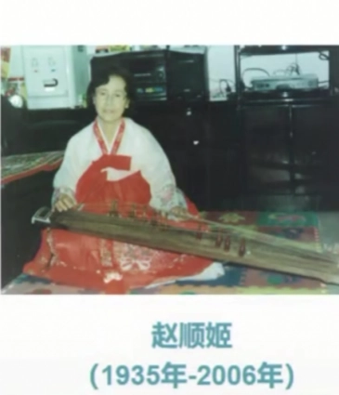
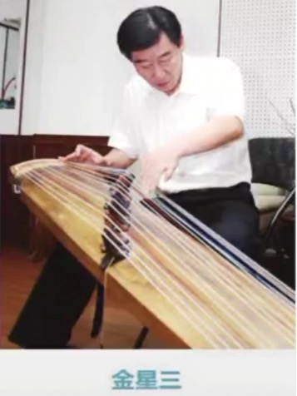
PART 3 Transmission of the Gayageum Tradition
Gayageum inheritors

Slide 14
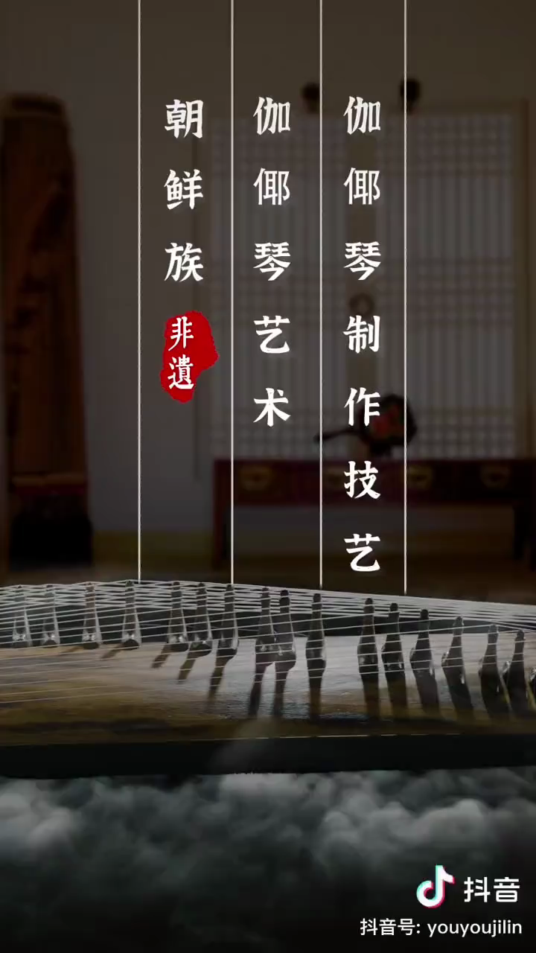

Slide 15
Thanks for your listening !

