Slide 1
presentation
汇报人：李晓苏

Slide 2
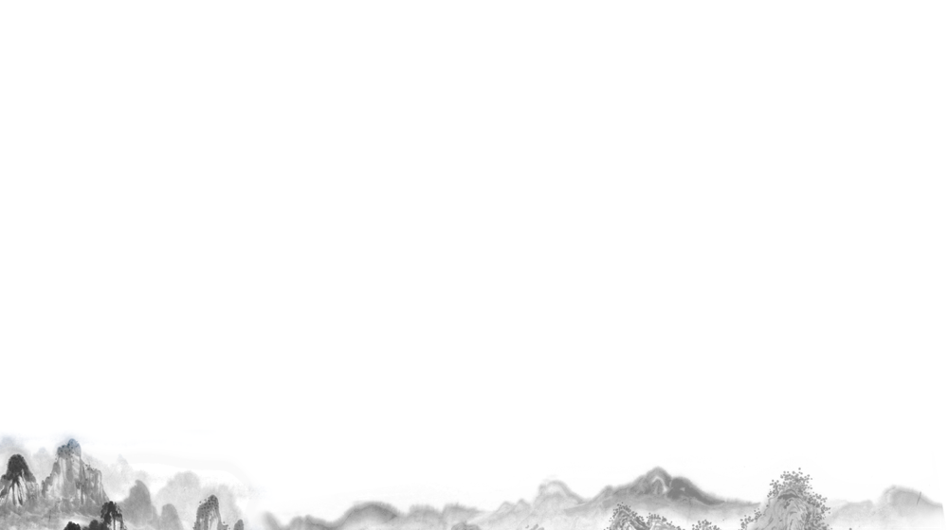
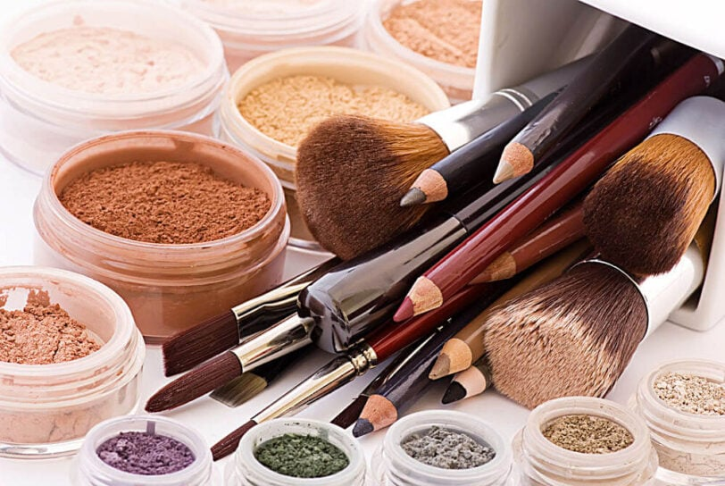
The History and Social Significance of Facial Makeup in China

Slide 3
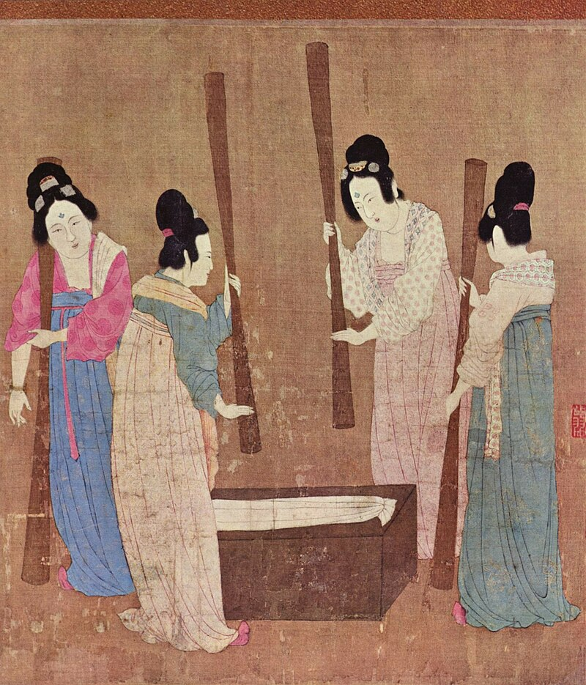
Historical Origins
Facial makeup in China dates back to the Neolithic era, evolving significantly in royal courts. By the Zhou Dynasty, it had become a crucial element of aristocratic life, symbolizing status and spiritual values.
Zhou Dynasty and Beyond: Throughout history, the diversity and sophistication of makeup increased, particularly during the Han Dynasty when new materials and techniques were introduced via the Silk Road.

Slide 4
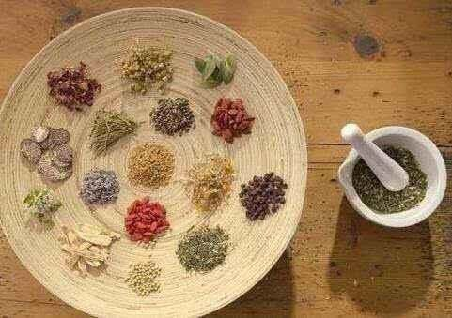
Social Significance
Makeup in ancient China was not merely aesthetic but also served profound social and cultural roles, influencing aspects of religion, society, and politics.
Symbol of Social Status: Different social classes used specific makeup styles and materials to denote their status. Royals and nobles, for example, used expensive ingredients like pearl powder and gold dust.
Cultural and Religious Ceremonies: Makeup was integral in rituals and festivals, used to express reverence for ancestors or seek divine favor.
Reflection of Aesthetic Values: The evolving makeup styles mirrored the prevailing aesthetic ideals of various dynasties, such as the preference for thick eyebrows and large eyes during the Tang Dynasty.

Slide 5
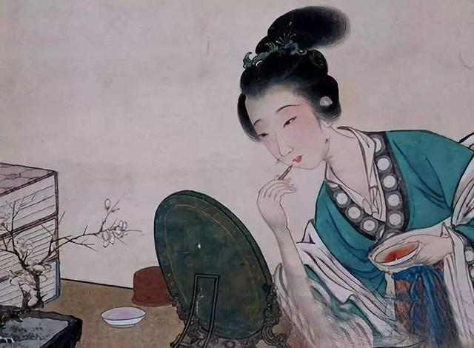
Historical Impact
The evolution of makeup techniques and materials reflects both technological progress and shifts in societal values. From natural ingredients to modern synthetic products, the development of makeup has paralleled changes in safety standards, effectiveness, and skincare compatibility.
In summary, facial makeup in China is more than just a beauty practice; it’s a rich part of China’s cultural heritage that offers insights into the social dynamics and values of ancient times.

Slide 6
Traditional Makeup Ingredients and Applications

Slide 7
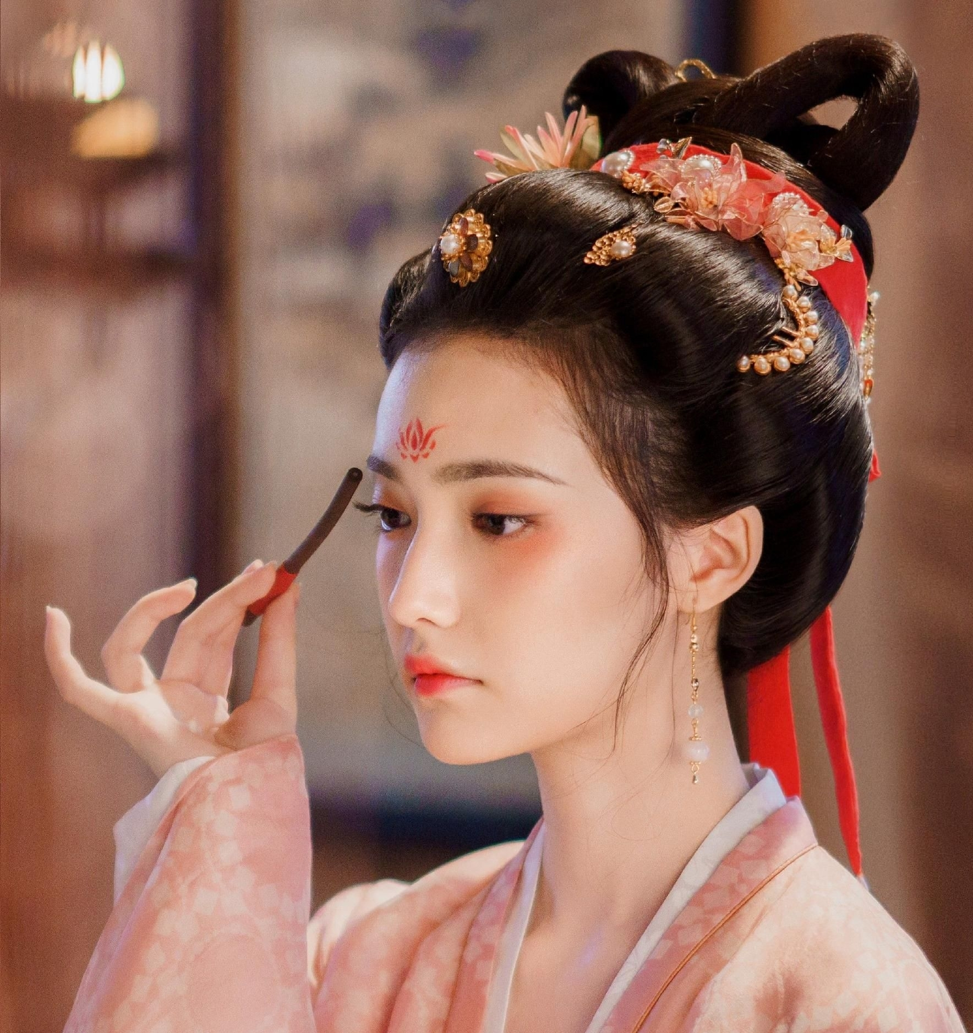
Ingredients
Traditional Chinese makeup used natural ingredients:
Rice and Pearl Powders: For whitening the complexion, symbolizing purity.
Plant Extracts: Used in rouges for cheeks and lips to denote health.
Charcoal and Ink: Applied to eyebrows and eyes to enhance expressiveness.
Animal Fats and Plant Oils: Bases for lipsticks and rouges, providing moisture.

Slide 8
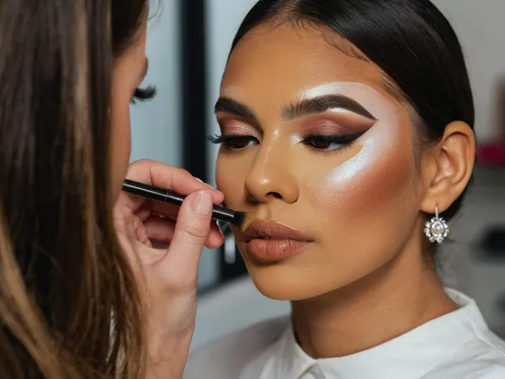
Applications
Makeup was applied according to the occasion:
Daily Wear: Focused on a natural appearance.
Ceremonial Makeup: Elaborate styles for festivals and weddings.
Theatrical Makeup: Exaggerated features for performances.

Slide 9
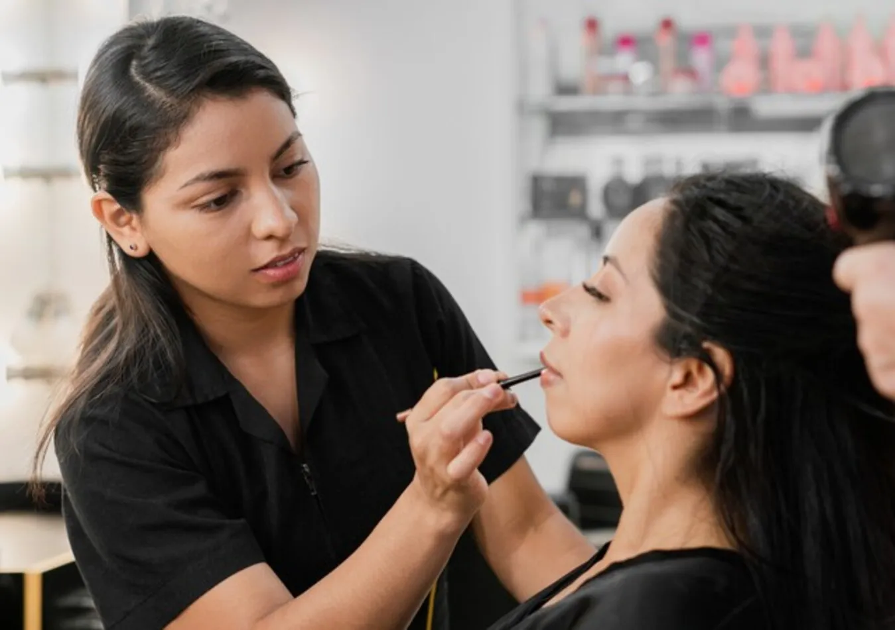
Techniques
Precision and skill were crucial:
Layering: Foundation was layered for durability and aesthetics.
Contouring: Used to define facial structures.
Symmetry and Balance: Emphasized harmonious features.

Slide 10
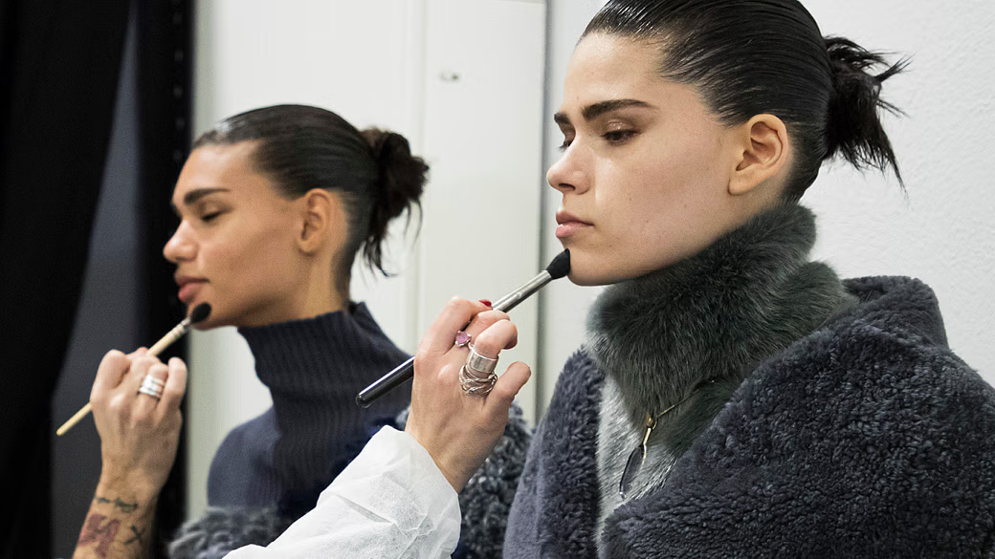
Methods
Makeup application was almost ritualistic:
Preparation: Skin was prepped with oils for a smooth base.
Application Tools: Brushes made from natural materials for precise application.
Removal: Special oils and herbs were used for makeup removal, ensuring skin care.
These sections detail the careful blend of natural materials and meticulous methods in traditional Chinese makeup, highlighting its role in personal beautification and cultural practices.

Slide 11
Makeup and Etiquette

Slide 12
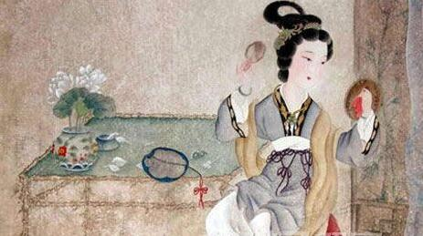
Makeup in Social Etiquette
In ancient China, makeup extended beyond personal beautification to serve as a crucial element of social etiquette, especially in the court, where it indicated status and identity.
Court Makeup: Used by empresses and noblewomen, court makeup was luxurious, emphasizing their high status with precious materials and complex techniques.
Festivals and Ceremonies: Specific colors and styles were chosen to match the themes of events, with red symbolizing happiness and prosperity during celebrations.

Slide 13
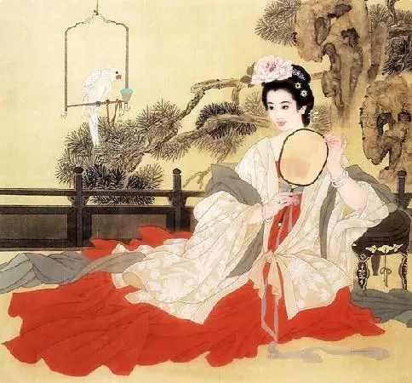
Makeup and Social Expectations
Makeup reflected societal expectations related to age and social class, influencing how individuals presented themselves during different life stages and activities.
Age and Makeup: Young women’s makeup emphasized freshness and vitality, while older women’s styles were more subdued and dignified, showcasing respect and experience.
Social Activities: Makeup styles varied with the nature of events—artistic or official—adapting to the social and cultural expectations of each setting.

Slide 14
thank you！

