Slide 1

Aesthetic ideals and social customs: The Panda
刘亦欣

Slide 2

CONTENTS
PART 01
PART 03
The origin of giant pandas
The diet features of giant pandas
PART 02
Appearance features of giant pandas

Slide 3

01.
The origin of giant pandas
起源

Slide 4
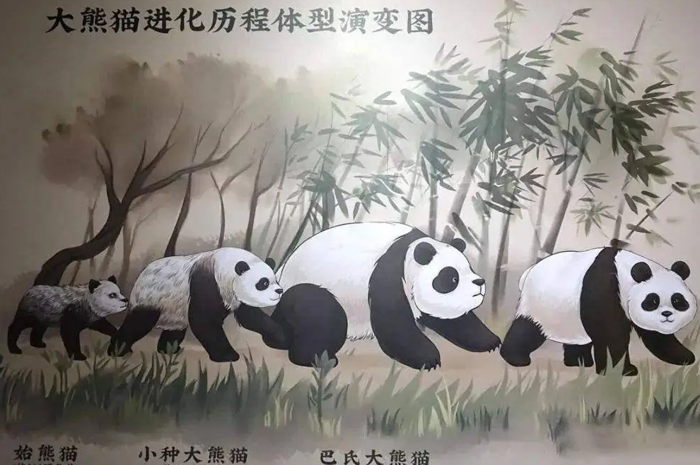
The origin of giant pandas
How to distinguish between traditional family structure and modern family structure
Q: What is the ancestor of the giant panda?
A: The ancestor of the giant panda is Ailuaractos（始熊猫）. The scientific name of the giant panda is actually "cat bear", which means "a bear like a cat". Biological fossils show that the ancestors of giant pandas appeared in the early 2 to 3 million years ago.
Q: Where was the giant panda's habitat?
A: The habitat of giant pandas once covered most of eastern and southern China. In the process, giant pandas have adapted to life in subtropical（亚热带） bamboo forests, gradually increasing in size and relying on bamboo for their livelihoods. Giant panda fossils are usually found in temperate（温带） or subtropical forests at an altitude of 500 to 700 meters.

Slide 5
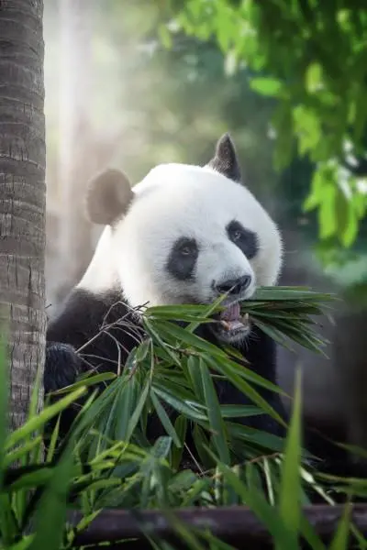
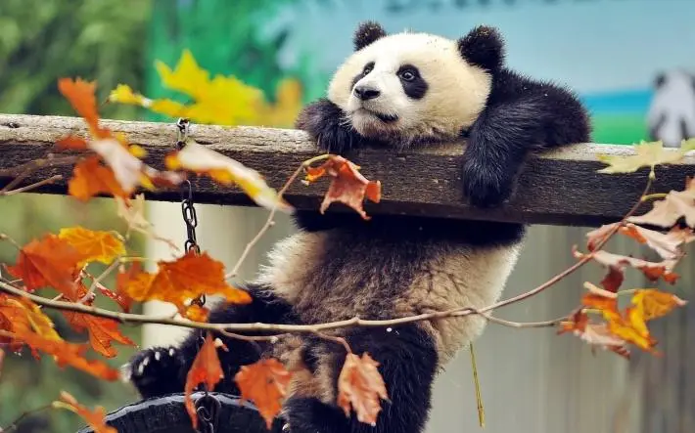
The origin of giant pandas
How to distinguish between traditional family structure and modern family structure
Q: What is the research value of giant pandas??
A: Giant pandas have survived to now and maintain their original ancient characteristics. Therefore, they have a lot of scientific value and are known as "living fossils". China calls them "national treasures".

Slide 6
02.
Appearance features of giant pandas
外貌特点

Slide 7
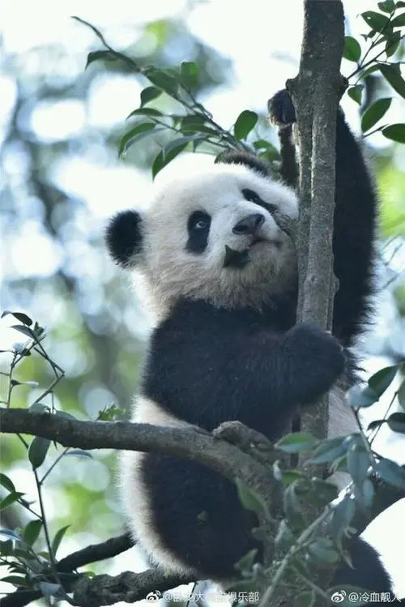
At types in China are mainly divided into the following categories
Appearance features
Posture
Color
Giant pandas are fat like bears, round heads and short tails.
Relatively sharp claws, powerful front and rear limbs help the giant panda to climb up tall trees quickly.
The hair color of its head and body is distinct from black and white. It is black with brown through and white with yellow. Its appearance is conducive to hiding in dense forest trees and snow-covered ground without being easily spotted by natural enemies.

Slide 8
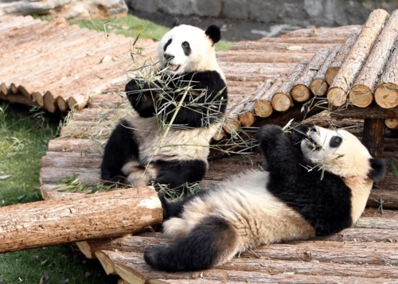
At types in China are mainly divided into the following categories
Appearance features
Skin
Weight
The weight is 80-120kg, and its maximum weight can reach 180kg. The raised pandas are a little heavier, and the males are generally slightly larger than the females.
The giant panda's skin is thick, which can be up to 10 mm at its thickest point. The average thickness of the skin is about 5 mm.
The skin thickness of different parts of the body is different. The back of the body is thicker than the ventral side, and the outside of the body is thicker than the inside of the body.

Slide 9
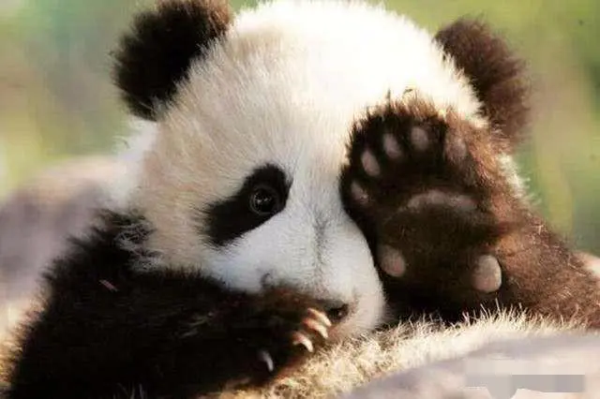
At types in China are mainly divided into the following categories
Appearance features
Vision
The vision of giant pandas is extremely underdeveloped. This is because giant pandas live in dense bamboo forests for a long time. The light is very dark and there are many obstacles, making their eyes very short and shallow.
In addition, because its pupils（瞳孔）are split like cats, they can still do activities when night comes.

Slide 10
03.
The diet features of giant pandas
饮食特点

Slide 11

The recipes of giant pandas are very special, almost including all kinds of bamboo that can be found in high mountain areas. Giant pandas also occasionally eat meat (usually the carcasses of animals).

Slide 12
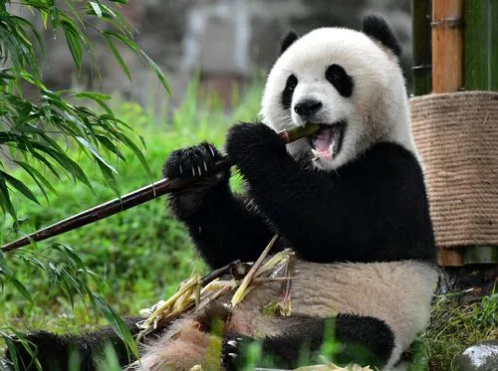
As bamboo has a few nutrition that can only provide the basic nutrients needed for pandas’ survival, giant pandas eat up to 14 hours a day except for sleeping or some short-distance activities in the wild environment.
A giant panda eats 12 to 38 kilograms of bamboo per day, which is close to 40% of its body weight.

Slide 13
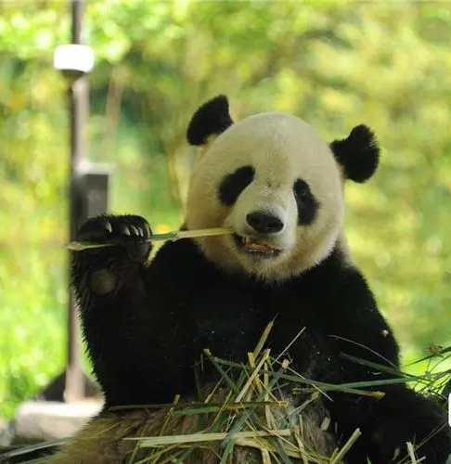
They like to eat the most nutritious-containing parts of bamboo, namely the tender stems（嫩茎）, burgeons（芽）, and bamboo shoots（竹笋）.
There are usually at least two types of bamboo in the giant panda habitat. When one kind of bamboo blooms and dies, pandas can choose other bamboos. However, the continued fragmentation of the habitat increases the possibility that there is only one kind of bamboo. When this kind of bamboo becomes distinct, the giant pandas in this area will face the threat of starvation.

Slide 14
Thanks for your listening!
刘亦欣

