Slide 1
Architecture
By Huang Zilong

Slide 2
1
A brief introduction
2
The three categories
CONTENT
3
The roofs of Chinese buildings

Slide 3

PART 1

Slide 4
A Brief Introduction
China has a long history and a rich cultural heritage. Here history has left behind many old and outstanding architectural relics, which are the result of several thousand years of development and form a system unique among the architectural styles of the world. Wooden frames appeared in Chinese architecture as long as 2,000 years ago. From relics in Han Dynasty tombs（坟墓） and watch-towers（瞭望台） built above the ground, early forms of wood structures can be seen.

Slide 5
PART 2

Slide 6
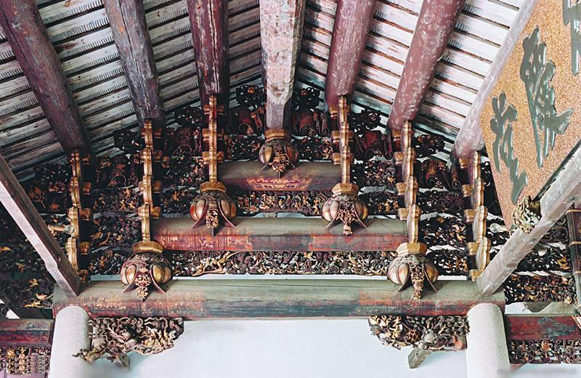
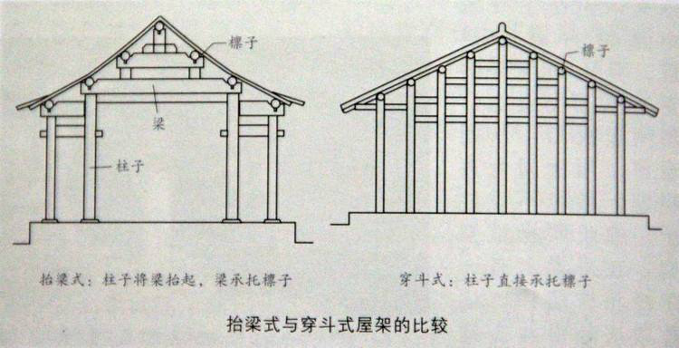
The three categories
the beams-in-tiers（抬梁式） structural system
1
the log cabin-type（井干式） system
2
3
the column and tier-beam（穿斗式） structural system

Slide 7
beams-in-tiers vs. the column and tier-beam
1、The first one shows the relation ship between beams and tiers;that is, beams are placed tier by tier vertically.
2、The other, however, shows the realtion between columns and beams, which means the column with beam,instead of beam itself, is the main body of the strcture.

Slide 8
PART 3

Slide 9
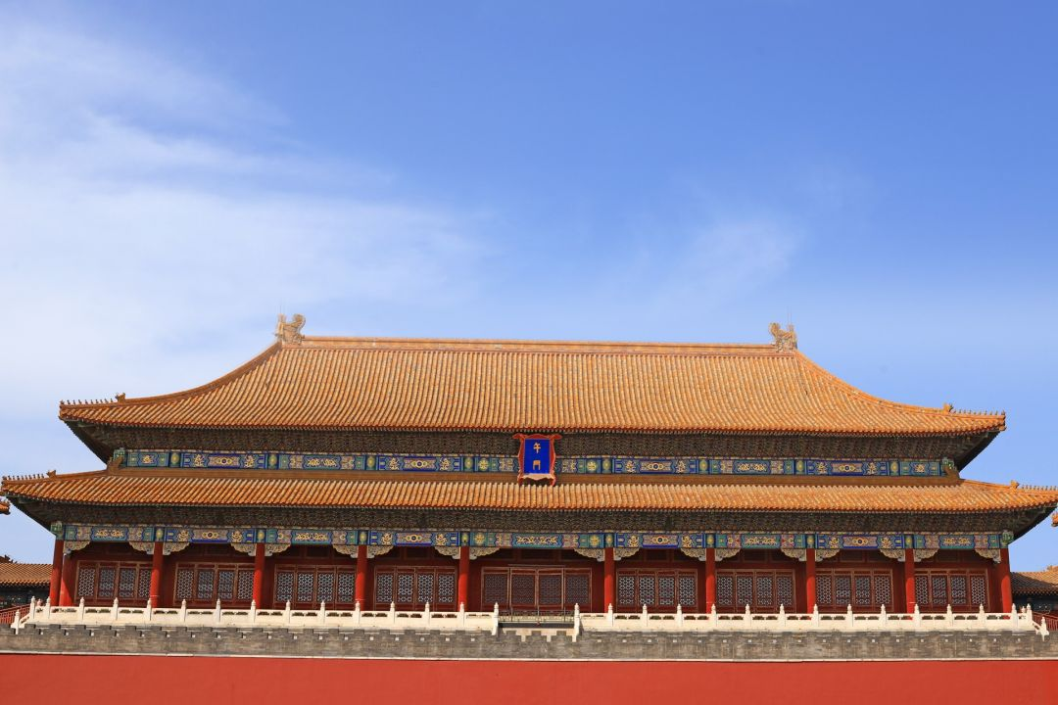
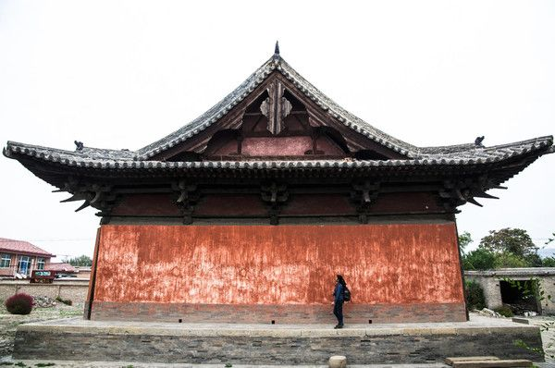
The roofs of Chinese buildings
1、 the hipped roof（庑殿顶,五脊顶）
庑：堂下周屋（rooms around the principal room)
2、the hipped and gabled roof（歇山顶，九脊顶）
gable(山墙)：the end wall between the two sloping sides of the roof, that is shaped like a triangle

Slide 10
THANK YOU

