Slide 1
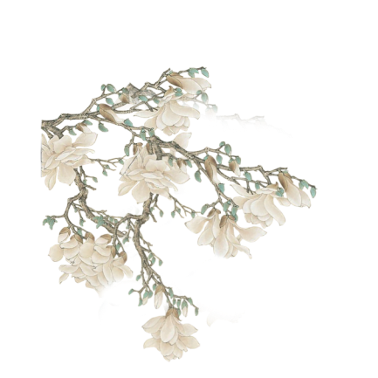
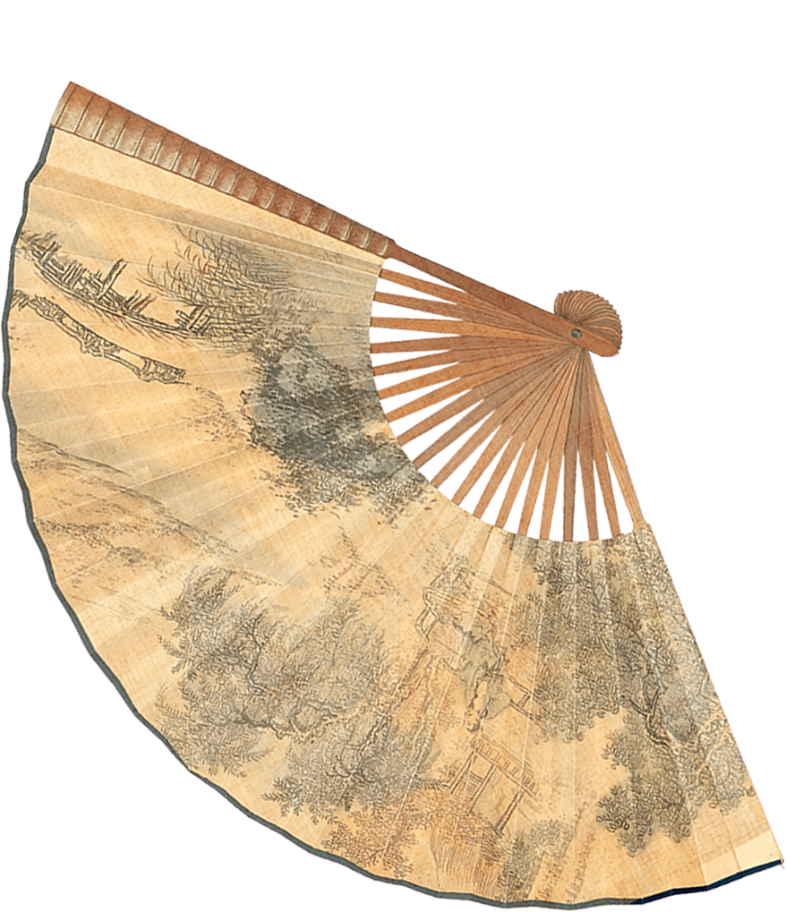
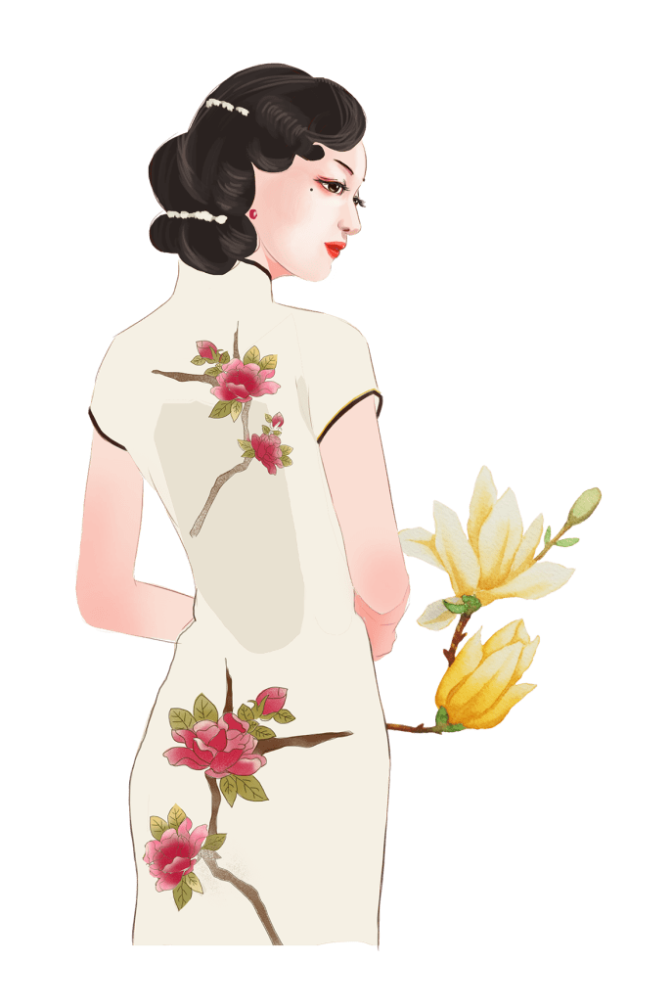
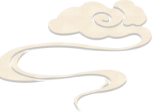
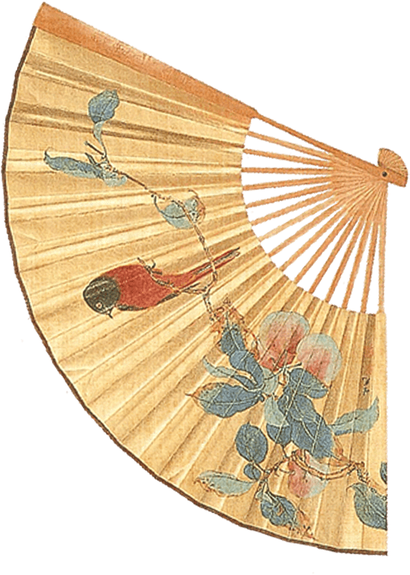
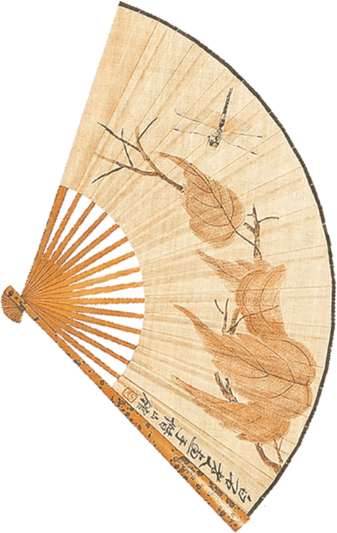

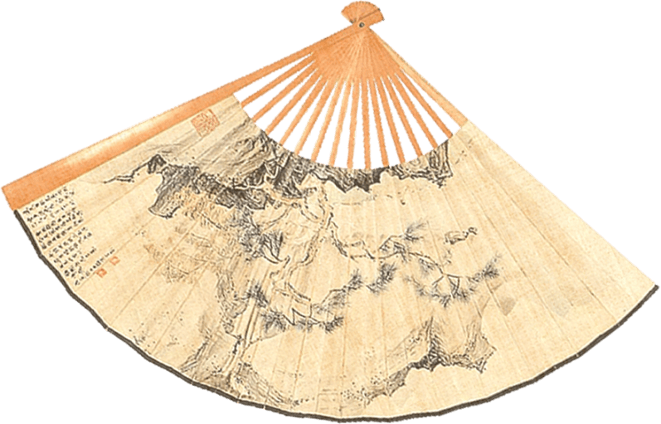
Clothing Cheongsam
Reporter: Tang Yingzi

Slide 2
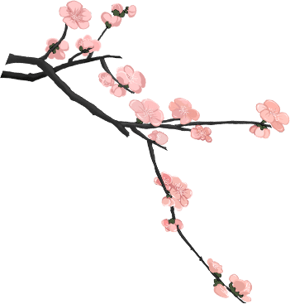
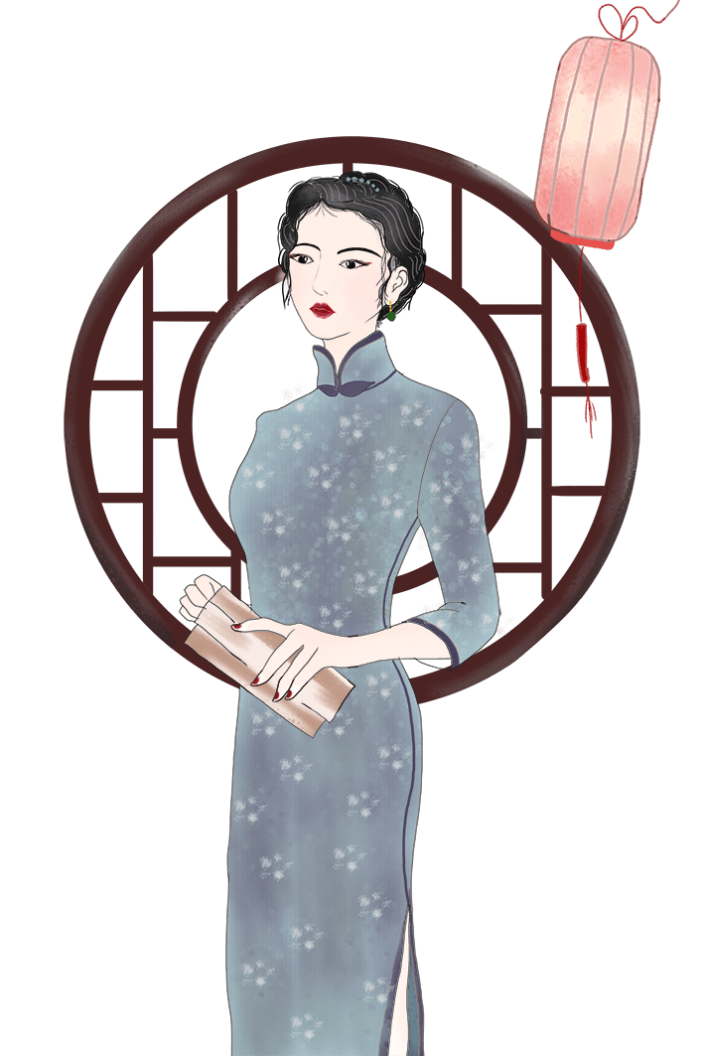
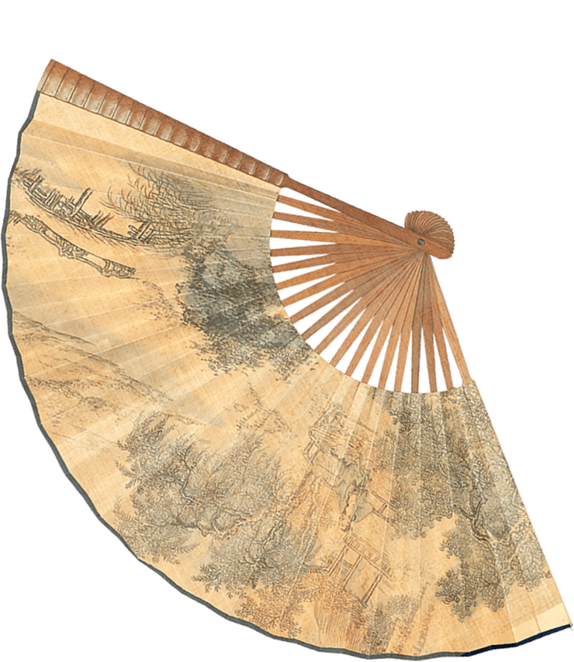
Contents
1. The History of the Cheongsam
2. Features of Cheongsams in Different Periods
3. Styles of Cheongsam
4. Modern Cheongsam Dress

Slide 3
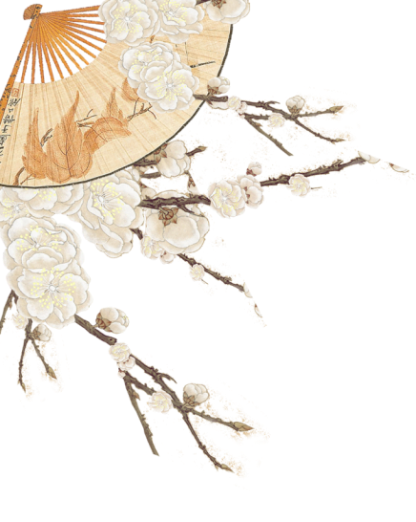

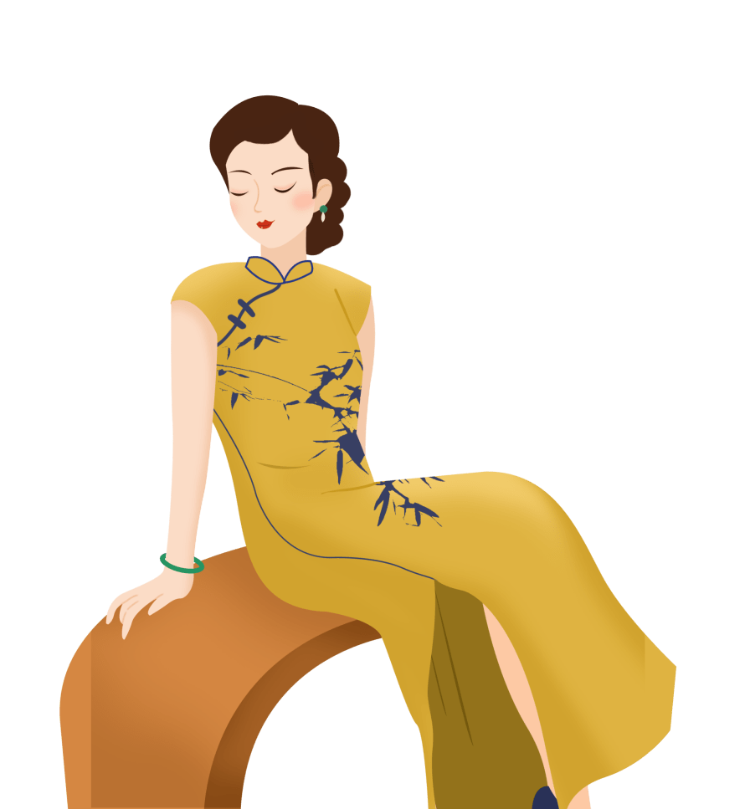
The History of the Cheongsam

Slide 4

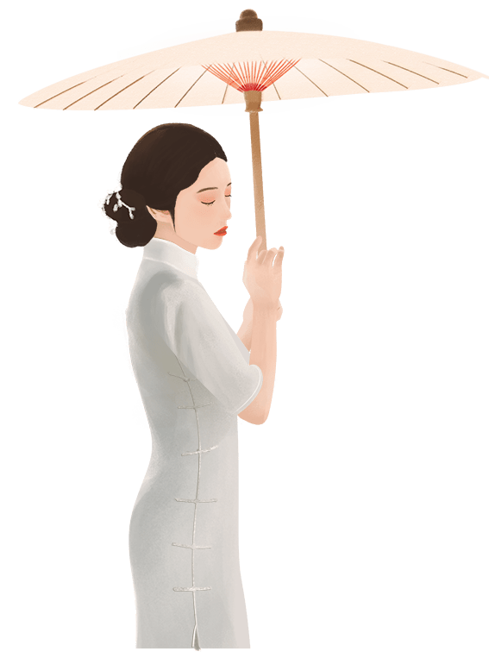
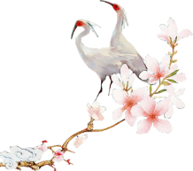
Origins of the Qipao
The history of cheongsams can be dated back to the Qing Dynasty era (1644–1912). During the Qing Dynasty’s reign, the Manchu ethnic group people was called Qi people by Han Chinese. So, the long gown (pao) they wore was called a qipao by the Han Chinese. At that time, officials and scholars of the Qing court were required to wear qipaos as their daily uniform.

Slide 5
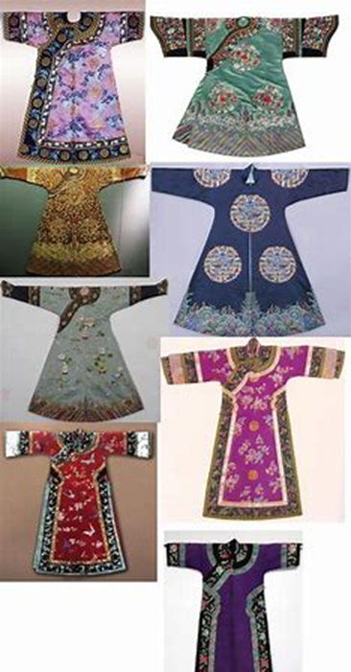
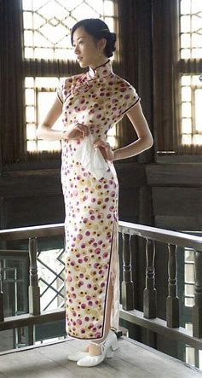
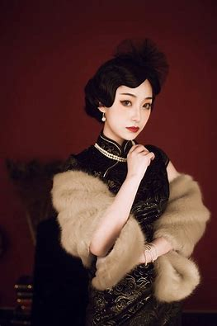
Further Transformation of the Qipao
the Republic of China era (1912–1949)
golden age

Slide 6
Features of Cheongsams in Different Periods

Slide 7
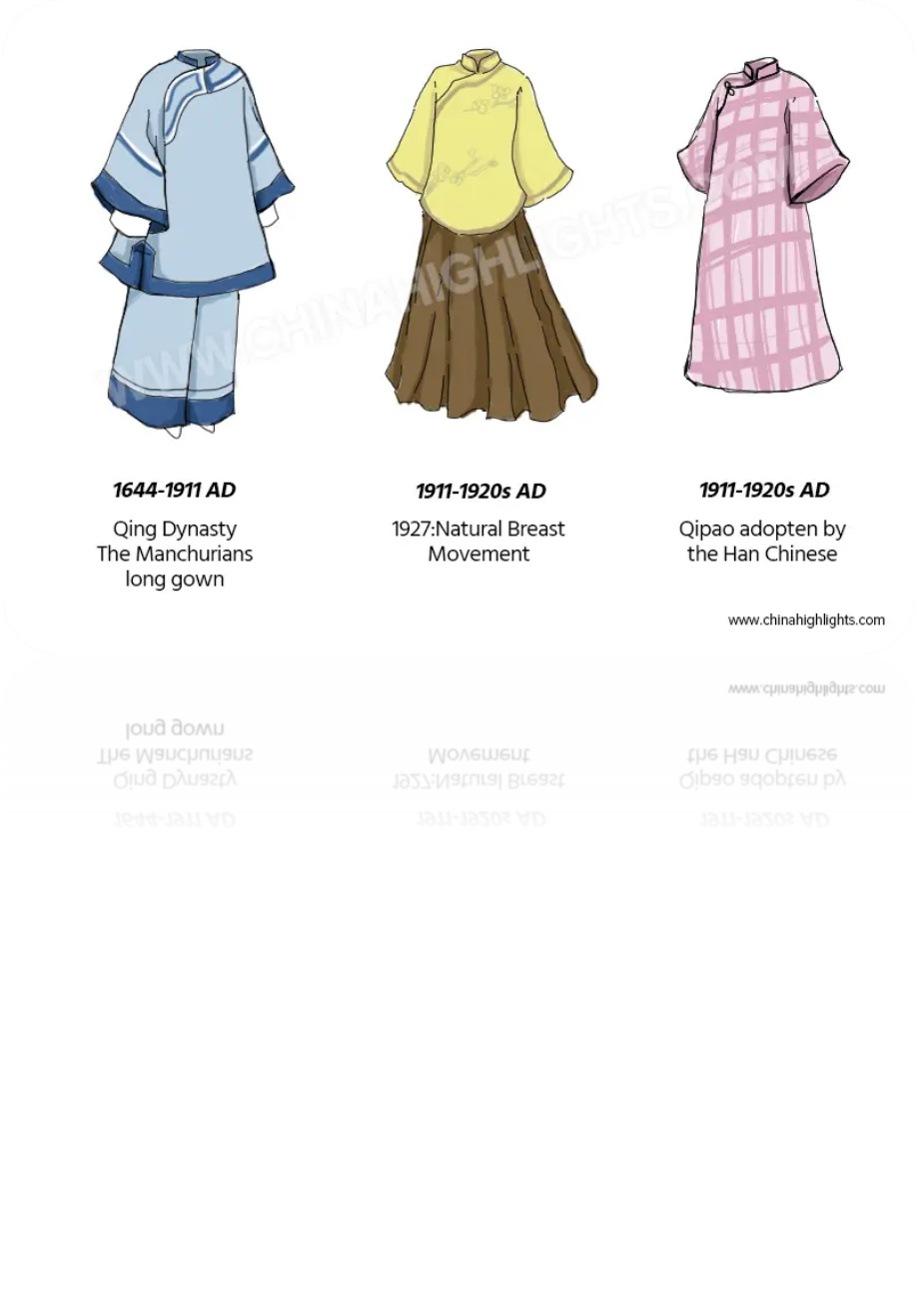
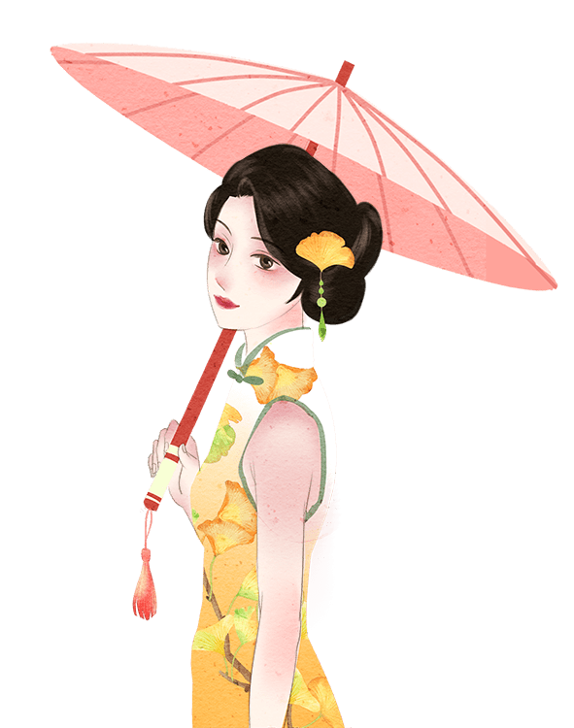
Qing Dynasty
A long rope without sleeves and collars.
Republic of China
Shanghai-style cheongsams had loose, long, and wide sleeves. They became more and more tightly-fitted and body-hugging to show a woman’s curves. Cheongsams were chosen as the national dress for official occasions during the Republic of China period.

Slide 8
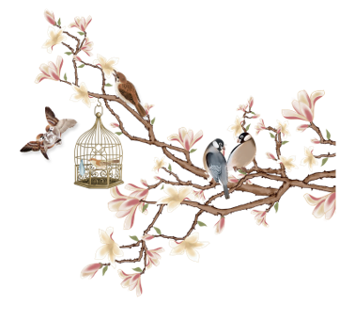
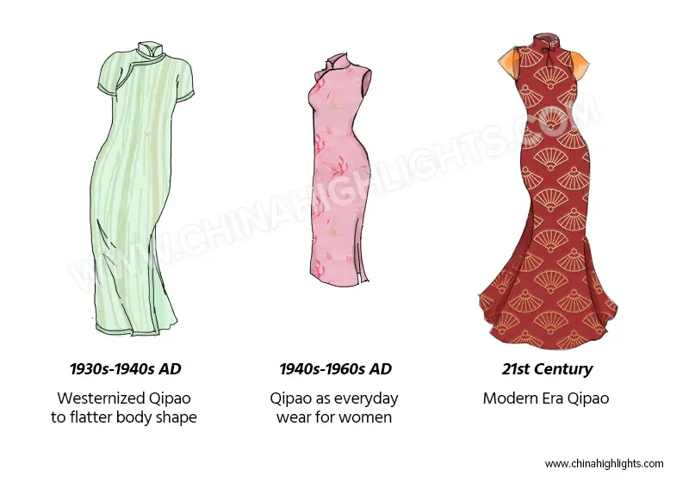
1940s: Women wore qipaos with stockings from this time and no longer wore long trousers with qipaos. High heels also became more and more popular for wearing with qipaos.
The Modern China Era (from 1949): The cheongsam became fashionable in films, fashion shows, TV Shows, and more types of formal occasions. Many female diplomatic agents and members of government wore qipaos to formal meetings.

Slide 9
Styles of Cheongsam

Slide 10
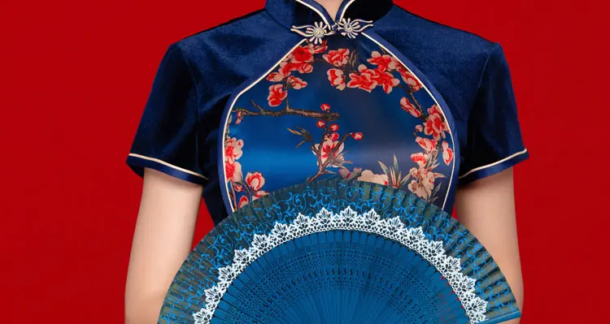
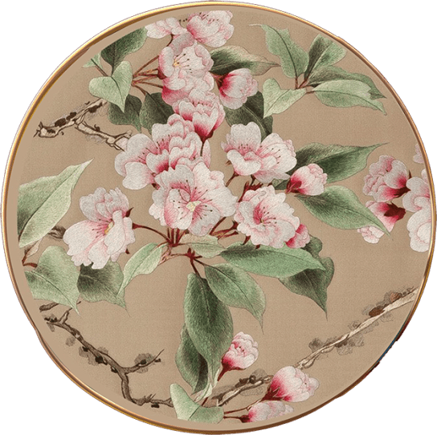
Beijing-Style Cheongsams
The Beijing style is also called the Jing Pai style. As capital of the Qing Dynasty and modern China, Beijing’s cheongsam style is more traditional and conservative than Shanghai’s and Hong Kong’s. The colors of Beijing-style qipaos are much brighter and their decoration is more complicated than other styles’. High-quality Beijing-style cheongsams are hand-made, which means they take a longer time to make, and the price of a hand-made cheongsam is much higher.

Slide 11
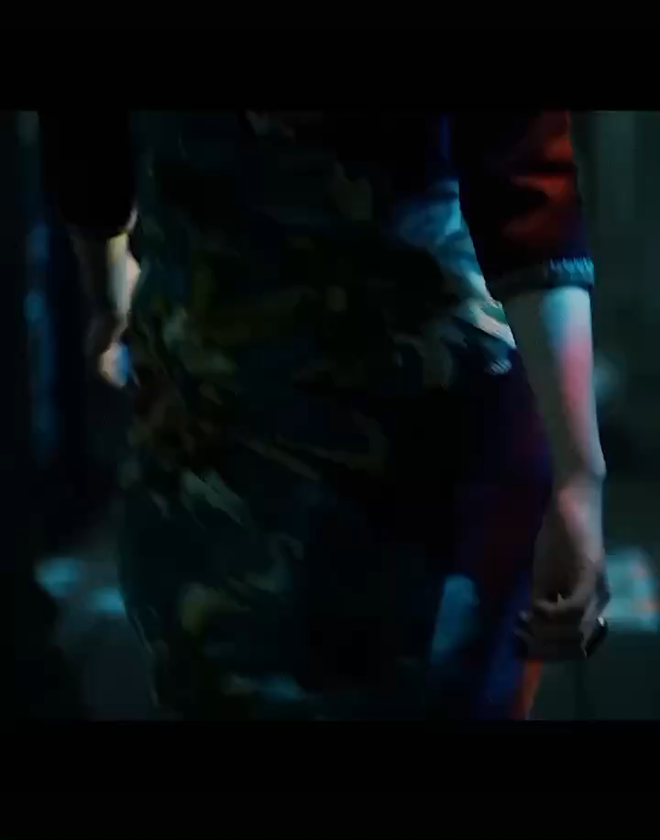
Shanghai-Style Cheongsams
The Shanghai-style is called Hai Pai style in Mandarin. Compared to Beijing-style, Shanghai-style cheongsams are more commercial and forward-looking. More Western elements are used in the designs and colors of Shanghai-style cheongsams. They are a blend of Western and Eastern styles. Shanghai-style cheongsams became the most popular qipao style during the Republic of China period due to their fashionable designs and slim shape. Nowadays, Shanghai-style qipaos are still the majority choice and particularly popular with younger women in China.

Slide 12
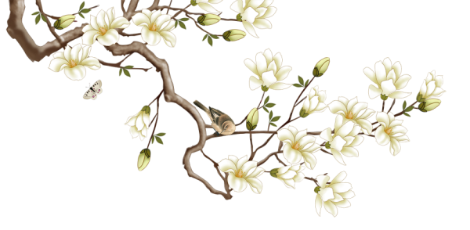
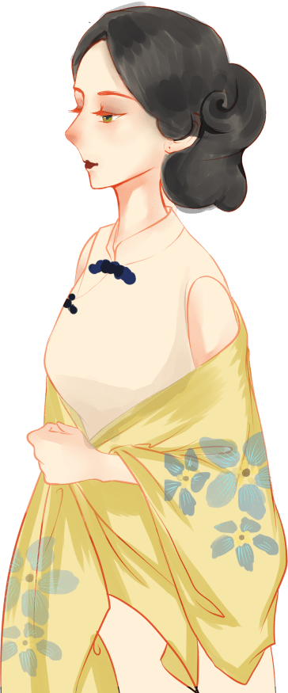
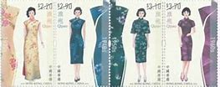
Hong-Kong-style Cheongsams
Hong-Kong-style cheongsams were influenced greatly by European fashions. The sleeves of Hong-Kong-style cheongsams are shorter than the Beijing and Shanghai styles’. The decorations are simpler too. It was common to see women in Hong Kong wearing a traditional cheongsam with their high-heel shoes, a leather handbag, and white gloves in the 1950s.

Slide 13
Modern Cheongsam Dress

Slide 14
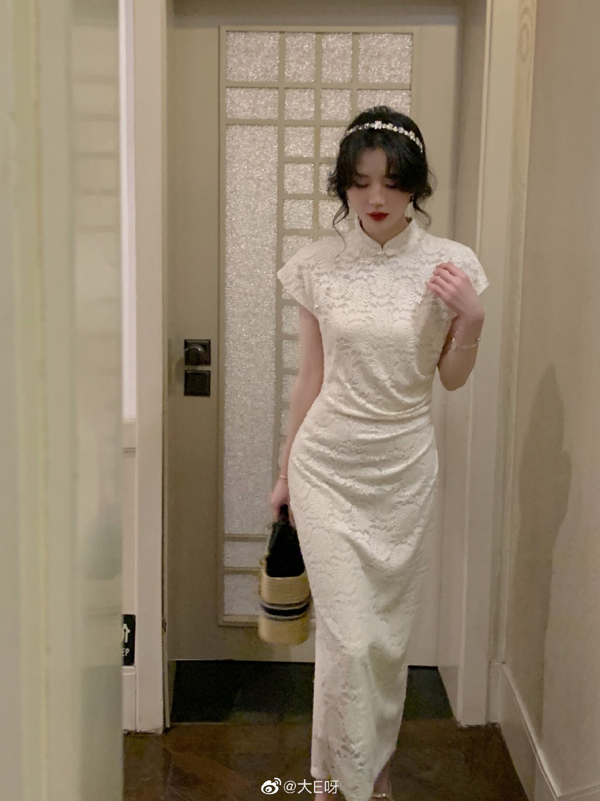
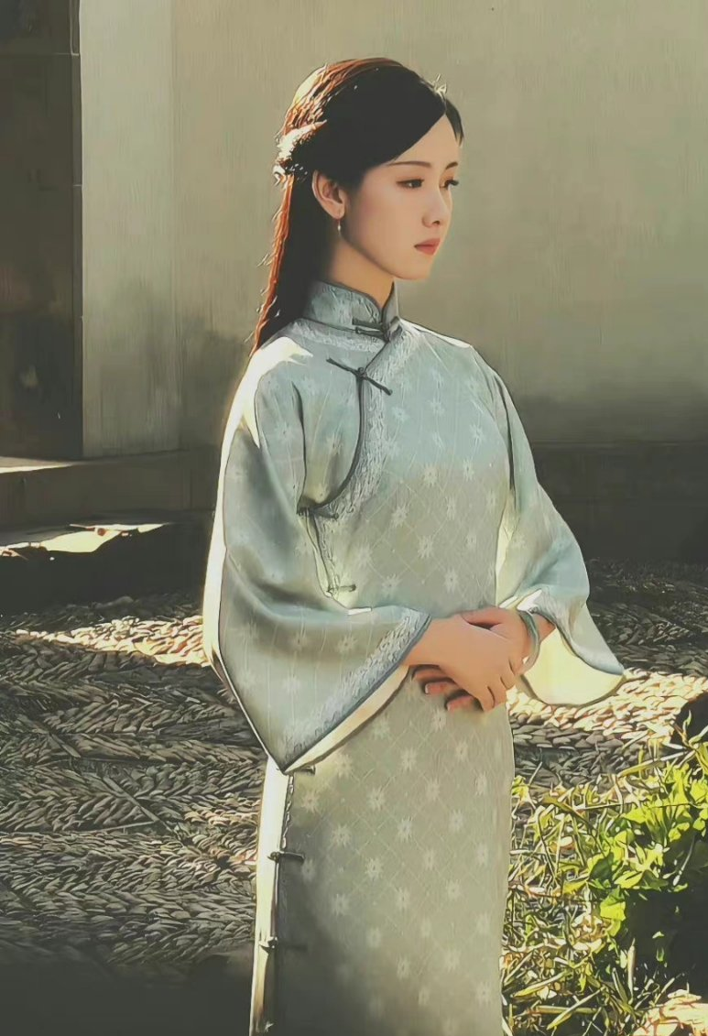
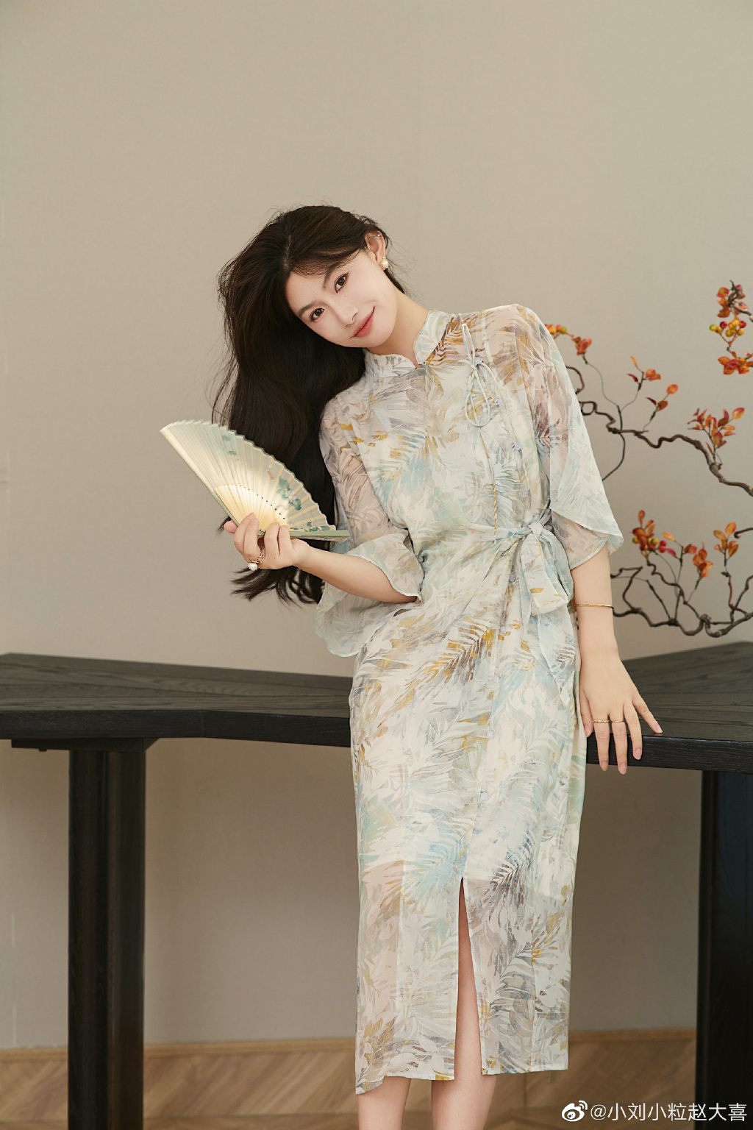
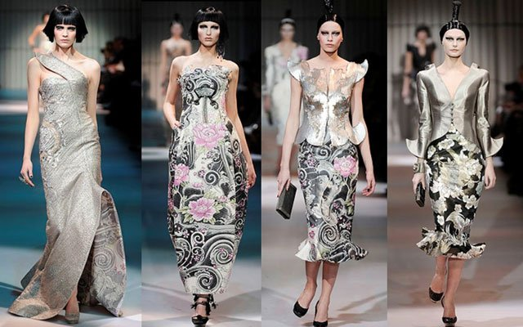
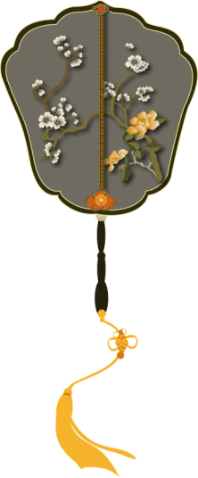

Slide 15
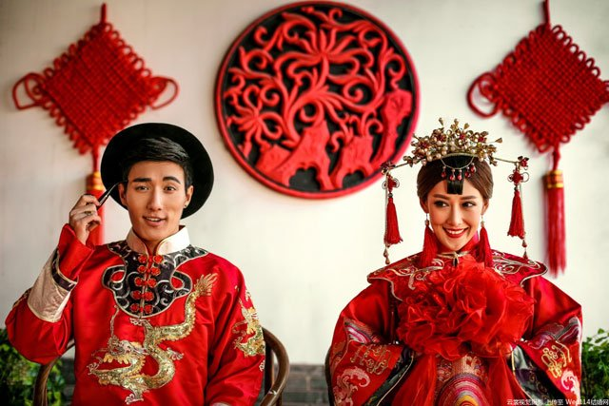
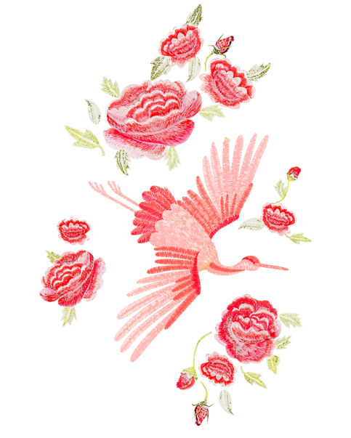
"I think any woman can wear a qipao. Plump or slim, as long as she has a certain body proportion, she would look great in it," says Fen Zhang. The 30-year-old designer who runs a qipao studio in Hangzhou.
"What is interesting is foreign designers seeing or re-imagining the Qipao, or Chinese retro textile, with fresh eyes," Chen said. "Qipao is not a new thing, it could even often appear in 21st Paris Fashion Week, but recently, its influence more than before."
"Our customers mostly are young people in China. Maybe they will have a very traditional qipao for their wedding, but they like qipao, they want to wear them in their everyday life." Wang said, "I want to break the rules of qipao were designed. We want to create an option for today's Chinese girls when they want to buy Chinese-looking clothes. There's also an option that is like qipao; young people have the right to wear qipao."

Slide 16
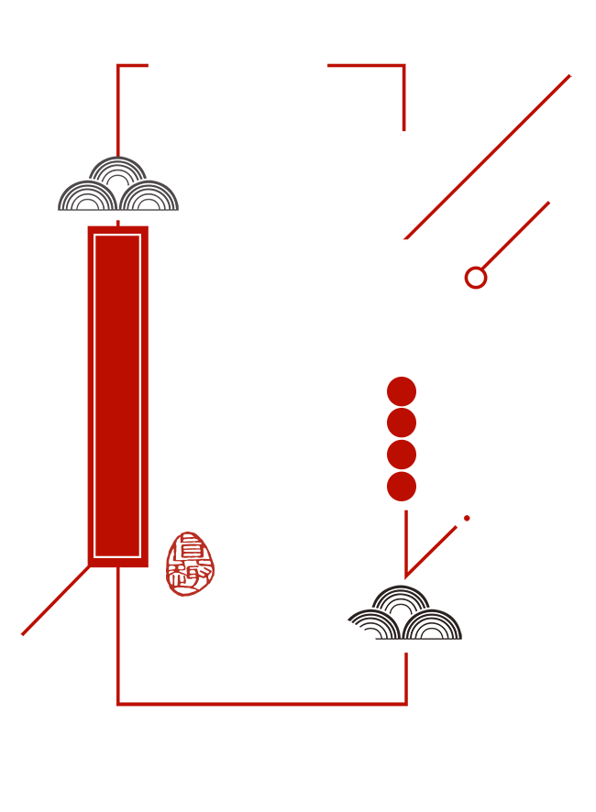
THANK YOU
Tang Yingzi

