Slide 1
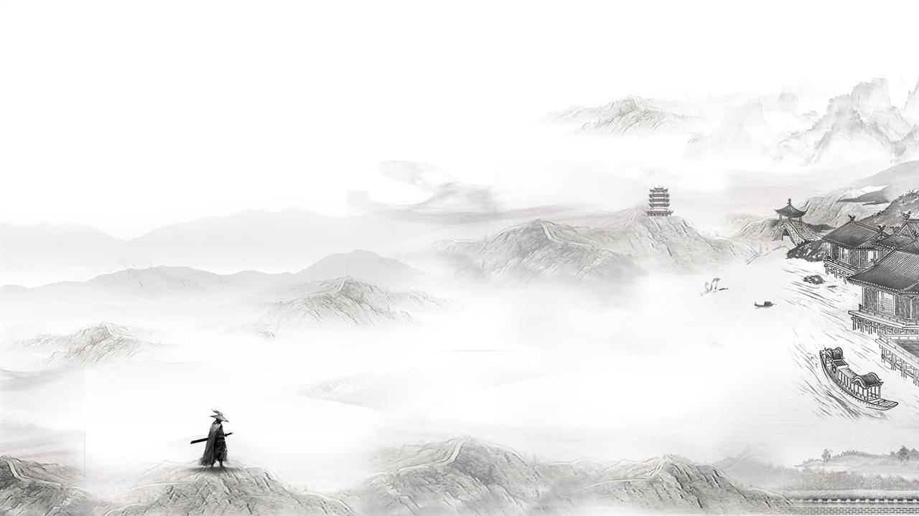
Chinese Folk Argot
By
English Translation
Fu Jing (PPT)
Zhang Wenqi (interaction)

Slide 2



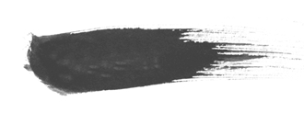

Content
1
Lead-in
2
Definition
3
Three Origins
4
Interaction

Slide 3

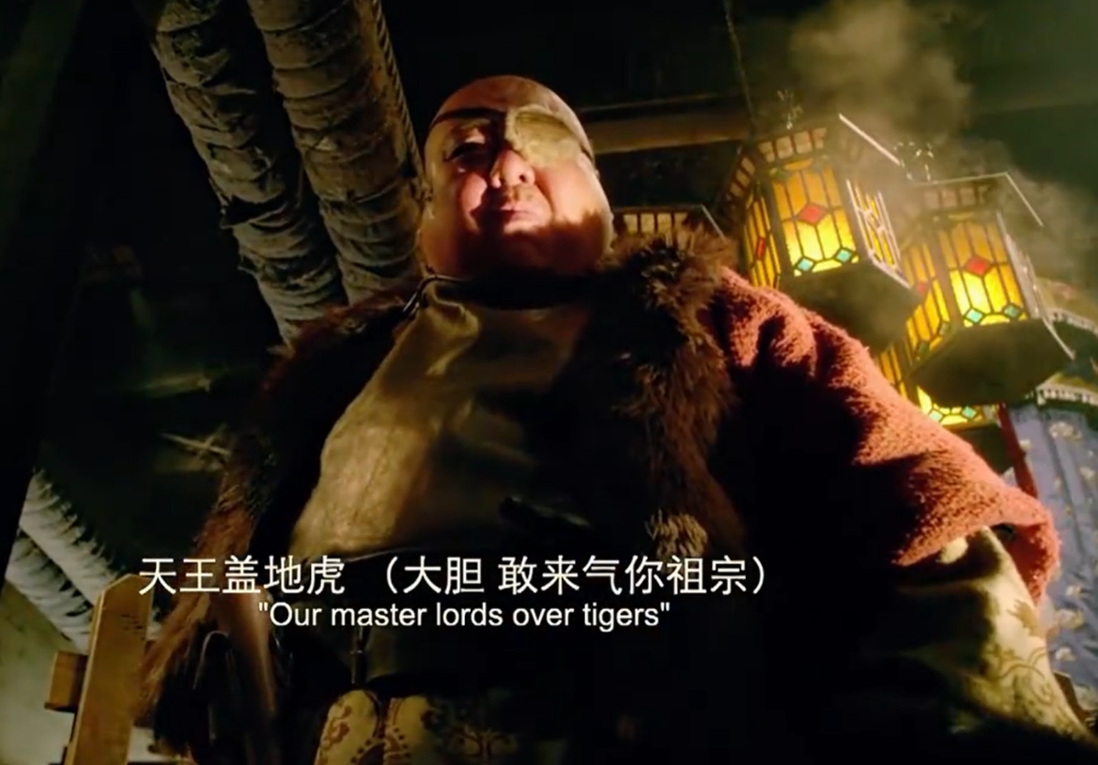
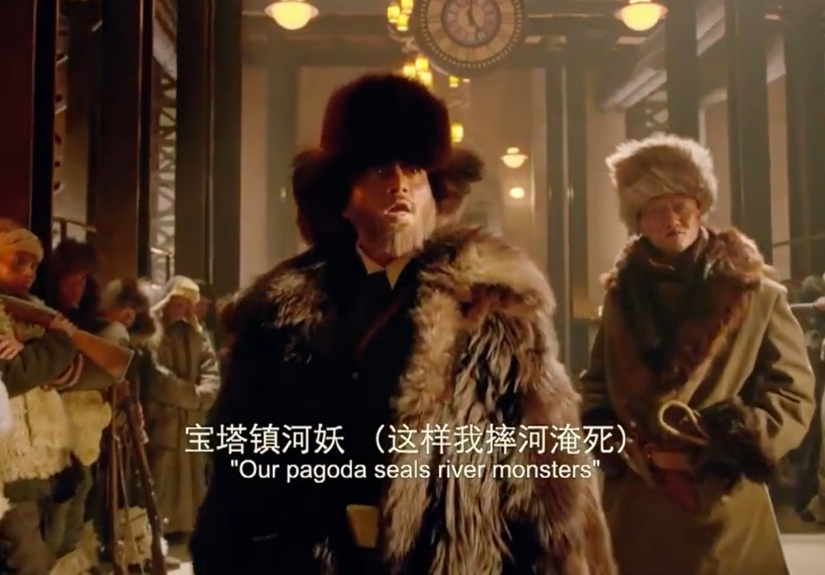


Lead-in
写入文本
Pictures from:《The Taking of Tiger Mountain》

Slide 4

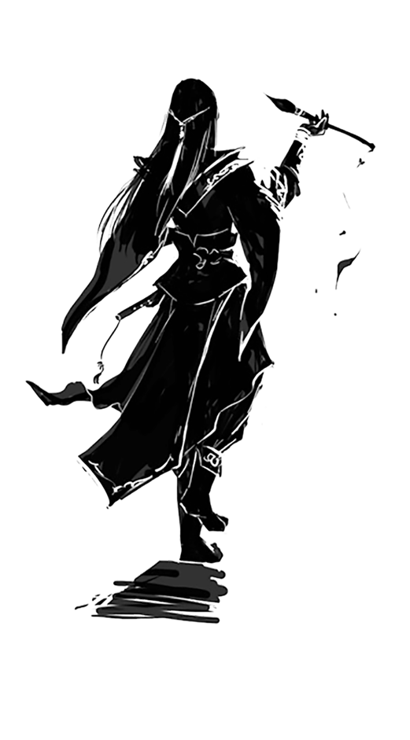
Definition
Argot
a language used by a particular type of people: an often more or less secret vocabulary and idiom peculiar to a particular group. (Webster’s Dictionary)
a secret language used by various groups to prevent outsiders from understanding their conversations. (Wikipedia)
the informal specialized vocabulary from a particular field in which sense it overlaps with jargon. (Wikipedia)
lexically divergent forms of a particular language, with a part of its vocabulary replaced by words unknown to the larger public, in which sense is synonymous with cants. (Wikipedia)
（明末清初“天地会”洪门）

Slide 5
Chinese Folk Argot
隐语是人类社会全民语言或地域方言在社会层次上的变体，是附着在全民语言或地域方言系统上的一个子系统，是语言的一种特殊变异现象。隐语指人们为隐蔽自己（保守群体秘密，维护集团利益等），为避讳禁忌而创造使用的一切秘密语。秘密性是隐语的最根本特质。” （郝志伦，2001 ）
a variant of the universal language or regional dialect of human society at the social level; it refers to all the secret words that people create and use to conceal themselves (keep group secrets or defend group interests) and to avoid taboos. Secrecy is the fundamental quality of argot. (Hao Zhilun, 2001)

Slide 6
Chinese Folk Argot
民间秘密语(或称民间隐语行话)，是某些社会团体或群体出于维护内部利益、协调内部人际关系的需要，而创制、使用的一种内部语言交际的，以遁辞隐义或谲譬指事为特征的封闭性或半封闭性符号体系，是一种特定的民俗语言现象。 （曲彦斌，1991；1996）
a closed or semi-closed system of symbols created and used by certain social groups or communities to maintain internal interests and coordinate internal interpersonal relations. It is characterized by evasion and metaphor. It is a specific folk language phenomenon. (Qu Yanbin, 1991，1996)

Slide 7

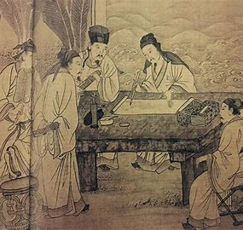
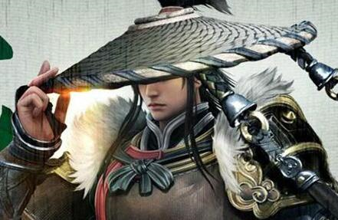
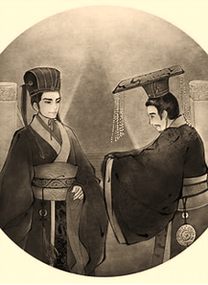
Origins
单击此处添加文本内容
Tang & Song Dynasty
Nowadays
1
2
3
4
Pre-Qin Dynasty
Qing Dynasty
Taboo
(禁忌语)
Linguistic games
（语言游戏）
Jargon
(行话)

Slide 8
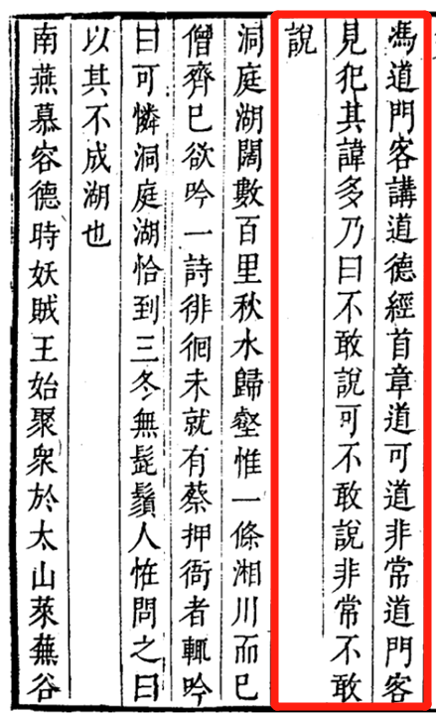
Folk argot to avoid taboos
（原）： “道，可道，非常道。”
（隐）： “不敢说，可不敢说，非常不敢说。” （“道”，避讳“冯道”）
(Trans.)：“I am afraid to say it. I should be afraid to say it. I should be very afraid to say it.”
隐语 argot | 汉义 meaning | 英译 translation
shuǐ suō huā (佛) 水梭花 | yú 鱼 | fish
huí shǒu 回首 | sǐ 死 | die

Slide 9
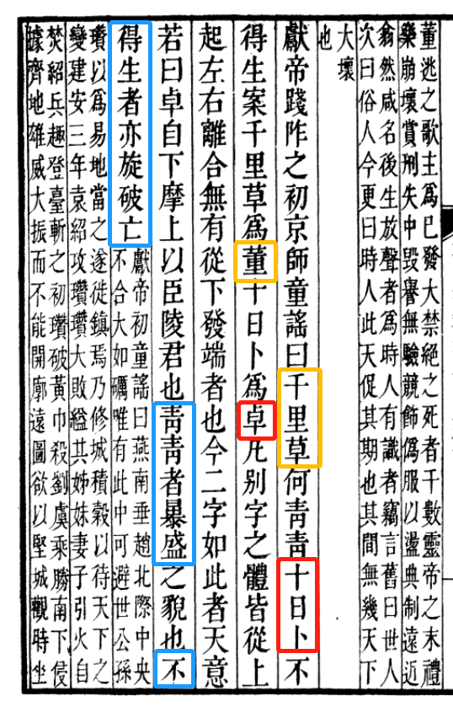

Folk argot in language games
dōng xī
无 东西 (things)
南 北
后汉书
清乾隆四年刻本
二三四五
六七八九
缺 一（yī）
衣
clothes
少 十（shí）
食
food

Slide 10


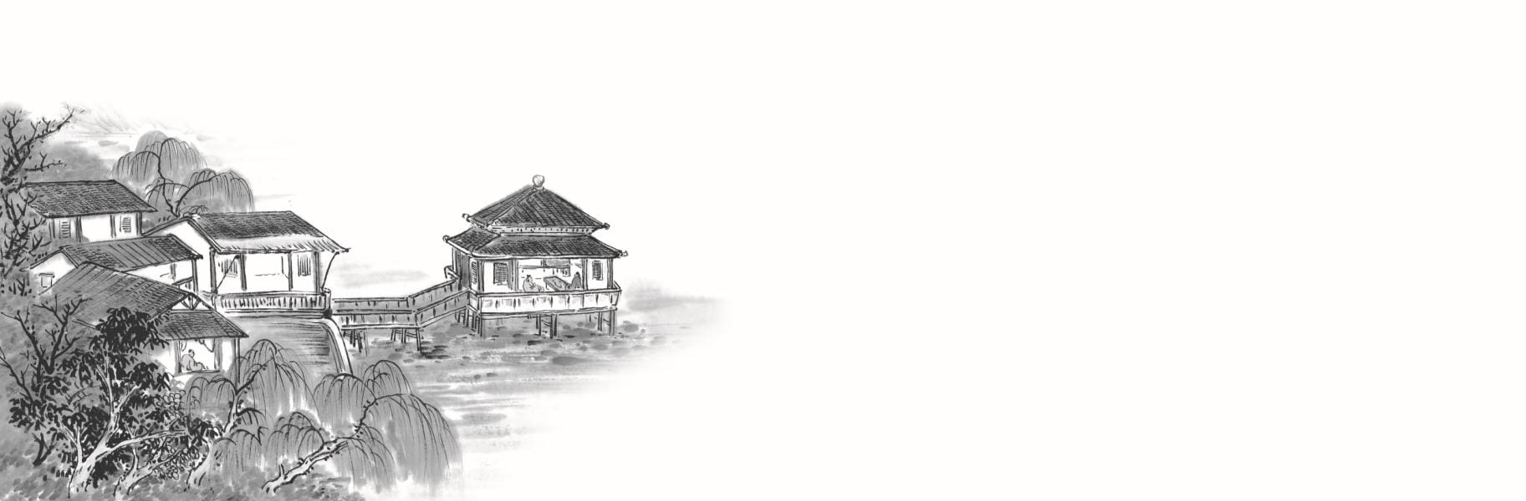
隐语 argot | 中义 meaning | 英译 translation
丁不勾 | 一 | one
示不小 | 二 | two
王不直 | 三 | three
白水真人 | 钱 | money
木易儿 | 杨 (姓氏) | Yang (surname)
卧尺 | 床 | bed
曹国 | 舅舅 | maternal uncle
船家烧纸 | 为何 | for what?
火烧竹林 | 一群光棍 | a bunch of bachelors

Slide 11
Folk argot in jargon
酒馆对话（原文） |  | A conversation in an ancient Chinese pub (Translation)
老板 Owner | (隐) “金木火土事如何？” | How is the “ metal, wood, fire, and earth ” thing going?
 | 掺水的事办得如何？ | Did you add water to liquor?
伙计 Worker | “扬子江中已掺和。” | It is with the Yangtze River now.
 | 放心！水已掺进酒里了。 | Yes, liquor is with water now.
酒客 Drinker | “有钱不买拖泥带。” | My money should not be spent on a muddy belt.
 | 我有钱也不用来买水喝。 | I will not buy for liquor with water.
伙计 Worker | “别处青山绿更多。” | There are more green hills and the blue in other stores.
 | 其他酒铺掺的水还更多！ | More water could be added to liquor in other shops!

Slide 12
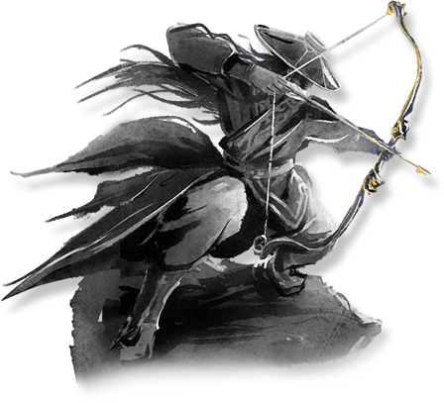
行当 sector | 隐语 argot | 中义 meaning | 英译 translation
算命 | 金点 | 算命先生 | the fortune teller
 | 火点 | 有钱人 | the rich
 | 空子 | 外行 | the outsider
 | 海挖 | 狠狠地敲 | to charge much higher
制酱 | 杜枪 | 麦子 | wheat
 | 飞尘 | 麦粉 | flour
 | 白沙子 | 盐 | salt
武术 | 支柱子 | 护院 | property guard
 | 暗挂子 | 窃贼 | the thief
 | 浑天 | 黑夜 | the night
 | 青天 | 白天 | the day

Slide 13
Literatures
[1] 《汉语隐语论纲》郝志伦著；巴蜀书社 , 2001.10
[2]《中国民间隐语行话》曲彦斌著；新华出版社 , 1991.12
[3]《江湖隐话行话的神秘世界》冷学人；河北人民出版社 , 1991.02
[4]《中国民俗语言学》曲彦斌主编；上海文艺出版社 , 1996.04
[5] 张思重.六种隐语趣谈[J].语文学习,1990(12):37-38.
[6]《成都通览·下》傅崇矩编；巴蜀书社 , 1987.07
[7]《后汉书·120卷》（南朝宋）范晔 等著；清乾隆四年刻本
[8] 《五杂组》（明）谢肇淛；明万历四十四年刻本

Slide 14
Interaction
1
Guessing & Matching
2
Q & A
by Zhang Wenqi

Slide 15
matching
match the argot (on the left) with its meaning (on the right）
e.g. 1--b
S1
1. 土货
2. 横川；眠川
3. 报春
4. 小人家去
a. 小黄鱼
b. 吃肉
c. (非法所得)出土文物
d. 三
S2
5. 二块
6. 双五百
7. 不算数
8. 三酉子
e. 千金小姐
f. 酒
g. 喝酒
h. (豫剧)彩旦演员

Slide 16
Argot | Meaning & Explanation | Categorization
土货 | (非法所得)出土文物，cultural relics obtained illegally | jargon
横川；眠川 | 汉字“三”，Chinese character “三” the character “三” can be obtained by rotating the character “川" | Linguistic games
报春 | 小黄鱼，the small yellow croaker In the past, fishermen believed this kind of fish appearing in early spring was a sign of coming spring | jargon
小人家去 | 和尚称“吃肉”，to eat meat (used by monks) | to avoid taboo
二块 | 豫剧彩旦演员，actors playing female clown in Henan Opera the actor’s both cheeks are painted red, which is different from other actors | jargon
双五百 | 千金小姐，a rich and nobble young lady two five hundred add up to one thousand; in Chinese, “千斤” and “千金" which refers to a rich young lady are homophones | Linguistic games
不算数 | 和尚称“喝酒”，to drink alcohol (used by monks) | to avoid taboo
三酉子 | 汉字“酒”，Chinese character “酒” This character can be divided into “氵”和“酉”, and the latter one looks like the character “三” | Linguistic games

Slide 17
Q & A
What role do you think the argot plays?
Or what’s the significance of the argot?
Hint: maybe you can think about the areas the argot may be involved in, such as linguistics, culture…

Slide 18
My opinion
As a variant of language, it promotes the diversity of language system.
It makes contributions to the studies of linguistics, history, folklore, culture and literature.
It plays a direct role in safeguarding the law and stopping crimes.

Slide 19
References
[1]宁宇杰. 隐喻视角下的汉语隐语研究[D].曲阜师范大学,2013.
[2]潘庆云. 中华隐语大全[M].学林出版社,1995.
[3]曲彦斌.中国民间秘密语(隐语行话)研究概说[J].社会科学辑刊,1997(01):41-47.

Slide 20

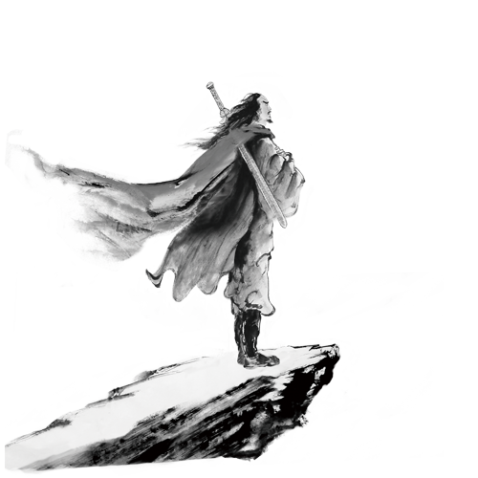

Thank
You !

