Slide 1

Milk Tea
Exploring the Origins, Evolution, and Impact of Milk Tea
彭璐 Peng Lu
Julia
2024.09

Slide 2
Contents
01. The Origin of Milk Tea
02. The Development of Milk Tea
03. Comparison of Oriental and Foreign Milk Tea
04. Milk Tea and Health

Slide 3
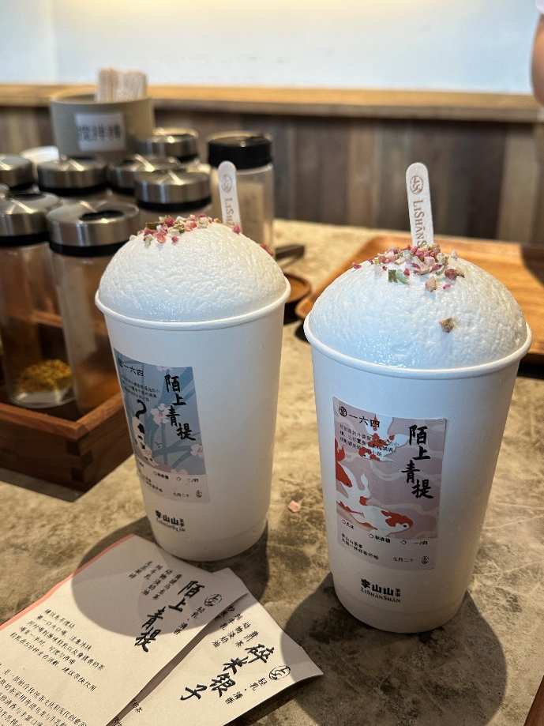
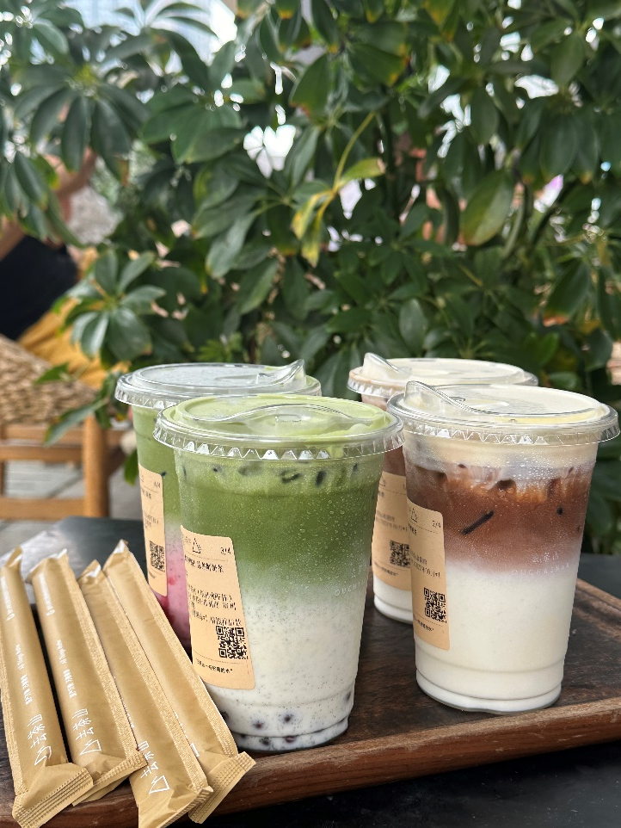
Youngsters continue their lives by drinking milk tea

Slide 4
The Origin of Milk Tea
Mongolia Milk Tea
nomadic tribes in Mongolia Plateau
an unshakable traditional custom

Slide 5
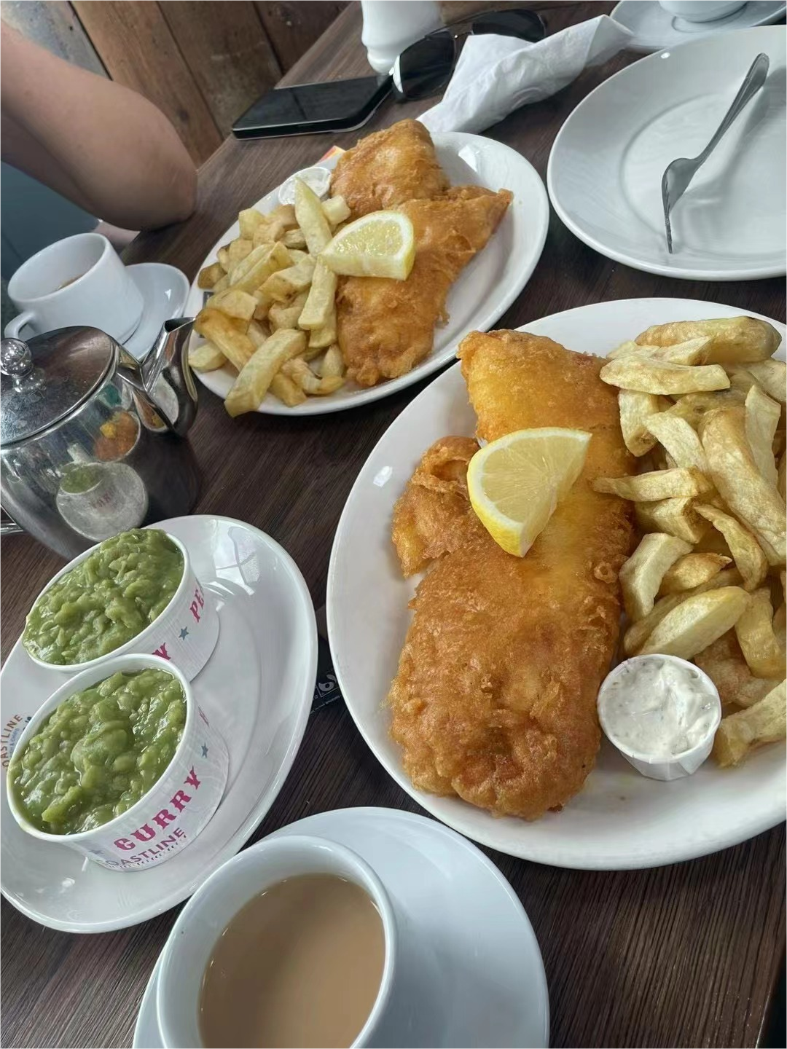
The Development of Milk Tea
British Milk Tea
influenced by climate and dietary habits
spice ×
mix sundry kinds of tea √
maple sugar as condiment √
the rudiment(雏形) of modern milk tea
Taiwan Milk Tea
1987
Ms. Lin Xiuhui of “Chunshuitang”(春水堂的林秀慧女士)
local snack flour √
black pearl
“Pearl Milk Tea”(Bubble tea, currently)
modern milk tea has preliminarily come into shape.

Slide 6
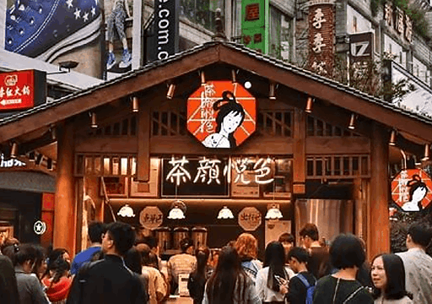
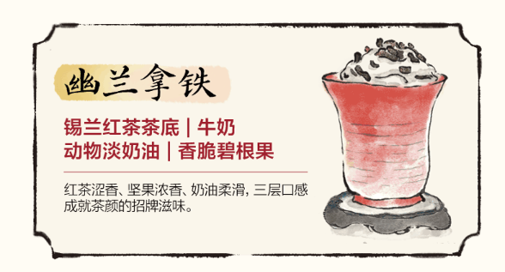
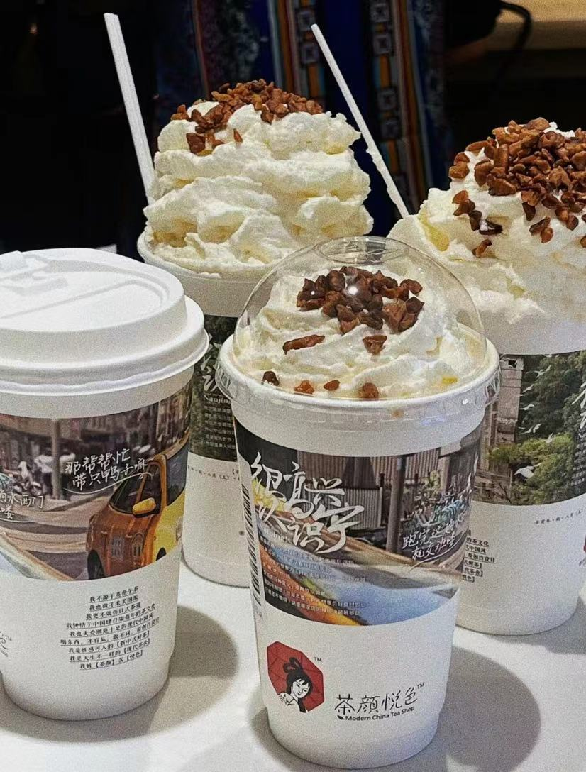
Comparison of Oriental and Foreign Milk Tea
Local Changsha Milk Tea
“Sexytea”---Modern China Tea Shop
“new Chinese-style fresh tea” produced with Nestle fresh milk and excellent quality tea leaves as ingredients
The logo is mainly composed of a Jiangnan woman, leaving a great impression on people.(茶颜悦色密码 2020, 68）
“Black Tea Latte” comprised of Ceylon black tea

Slide 7
Comparison of Oriental and Foreign Milk Tea
Hong Kong-style milk tea
Lin Muhe, the founder of the time-honored brand Lanfangyuan in Central(林牧合,香港中环老字号兰芳园茶餐厅创始人)
“Father of Hong Kong-style milk tea”(“港式奶茶之父”)
silk stockings milk tea(currently Hong Kong-style milk tea) without using silk stockings----pigmentation
(《百度百科——丝袜奶茶》)

Slide 8
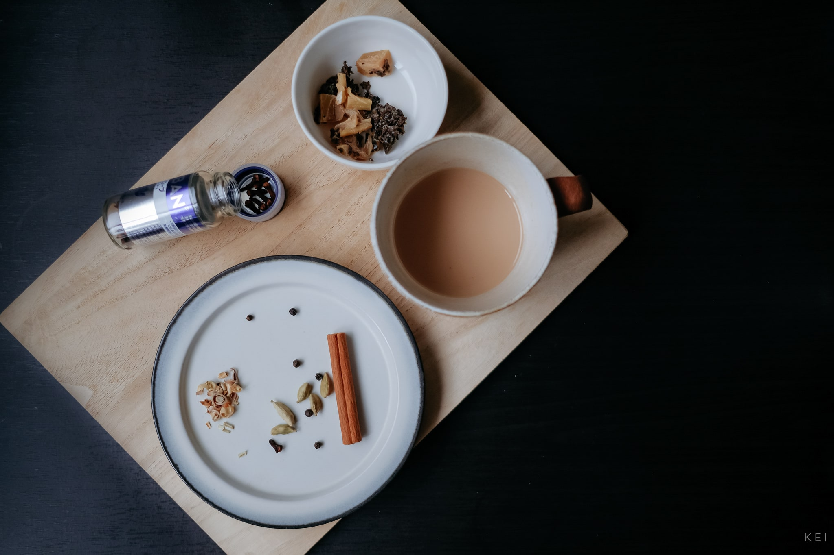
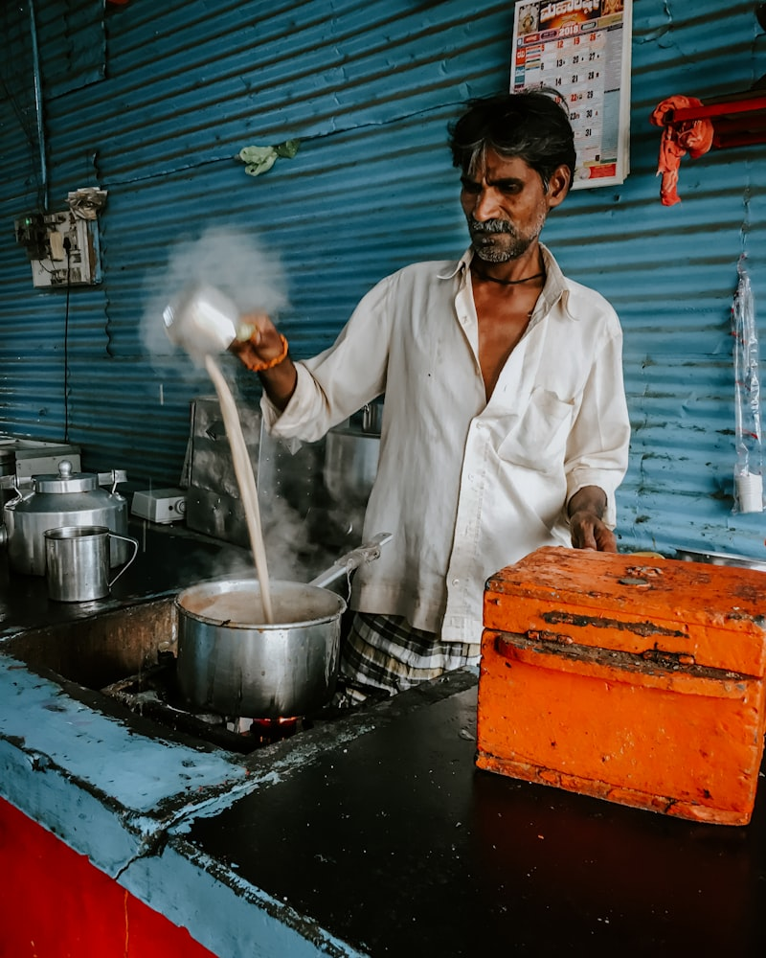
Comparison of Oriental and Foreign Milk Tea
Indian Masala Chai
cooked by delicate handicrafts
various spices
taste is strong, mellow, hot and spicy at the beginning---sweet or spicy---various flavors will react with each other
not only a baptism to taste, but also a return to primitive
nature. (《世界著名奶茶大全》 厨影美食）

Slide 9
Milk Tea and Health
Advantages
quickly supplement sugar
increase body energy
mitigate fatigue
improve working efficiency
Disadvantages
increase the possibility of getting fat
increase cholesterol(胆固醇)
lead to hyperlipidemia(高血脂) and hyperglycemia(高血糖)
do harm to liver and kidney
increase risks of angiocardiopathy(心血管疾病)
affect study and memory
damage normal gastrointestinal(肠胃的) function
cause cancer if drunk for a long time
Drink milk tea in moderation

Slide 10
Vocabularies
Milk tea 奶茶
Spice 香辛料
Rudiment 雏形
Sexytea 茶颜悦色
Black tea latte 幽兰拿铁
Hong Kong-style milk tea 丝袜奶茶
Cholesterol 胆固醇
Hyperglycemia 高血糖
Mongolian Plateau 蒙古高原
Maple sugar 枫糖
Bubble tea 珍珠奶茶
Internet celebrity city 网红城市
Pecans 碧根果
Masala Chai 马萨拉奶茶
Hyperlipidemia 高血脂
Angiocardiopathy 心血管疾病
Gastrointestinal 肠胃的

Slide 11
Questions
1. What is the origin of milk tea?
2. What is the birth place of modern milk tea?
3. Is Hong Kong-style milk tea produced with silk stockings?
4. Name three advantages of drinking milk tea
5. Name three disadvantages of drinking milk tea
1. Mongolia Milk Tea
2. Britain gives birth to the rudiment of modern milk tea while Taiwan witnesses modern milk tea preliminarily coming into shape.
3. No. The so-called silk stocking is acturally the tea bag.
4. quickly supplement sugar, increase body energy, mitigate fatigue
5. increase the possibility of getting fat, do harm to liver and kidney, cause cancer

Slide 12
The Connection Between Milk Tea and Regional Cultures
climate→lifestyle and modes of production→milk tea cultures
Milk Tea in Southern China
Climate: Warm and humid
Tea-growing region: Rich tea aroma
Emphasizes tea aroma, strong tea flavor
Suitable for humid climates and refreshing
Milk Tea in Northern China
Climate: Cold and dry
Developed livestock farming: Abundant milk resources
Rich in milk flavor, often based on brick tea
Provides warmth and energy in cold climates

Slide 13
The Connection Between Milk Tea and Regional Cultures
Cliamate→Lifestyle and modes of production→milk tea cultures
Milk Tea in India
Climate: Hot and humid
Rich in spices: Balances body constitution
Includes spices like ginger; warm and good for digestion; reducing dampness in the body
Adapted to hot and humid climates
Milk Tea in the UK
Climate: Mild and humid
Afternoon tea culture: Social etiquette
Uses black tea with milk, smooth taste, suitable for all-day drinking
Provides warmth, aligns with a comfortable and elegant lifestyle

Slide 14
Summary
From the tea-scented milk tea of Southern China to the rich and creamy milk tea of Northern China, from the spiced milk tea of India to the tea rituals of the UK, the flavors of milk tea in different regions are closely linked to local climate, agricultural production, and cultural habits. This close relationship not only influences the choice of ingredients and flavors of milk tea but also reflects how people in each region adapt to and respond to their climate and natural environment in every cup of milk tea.

Slide 15
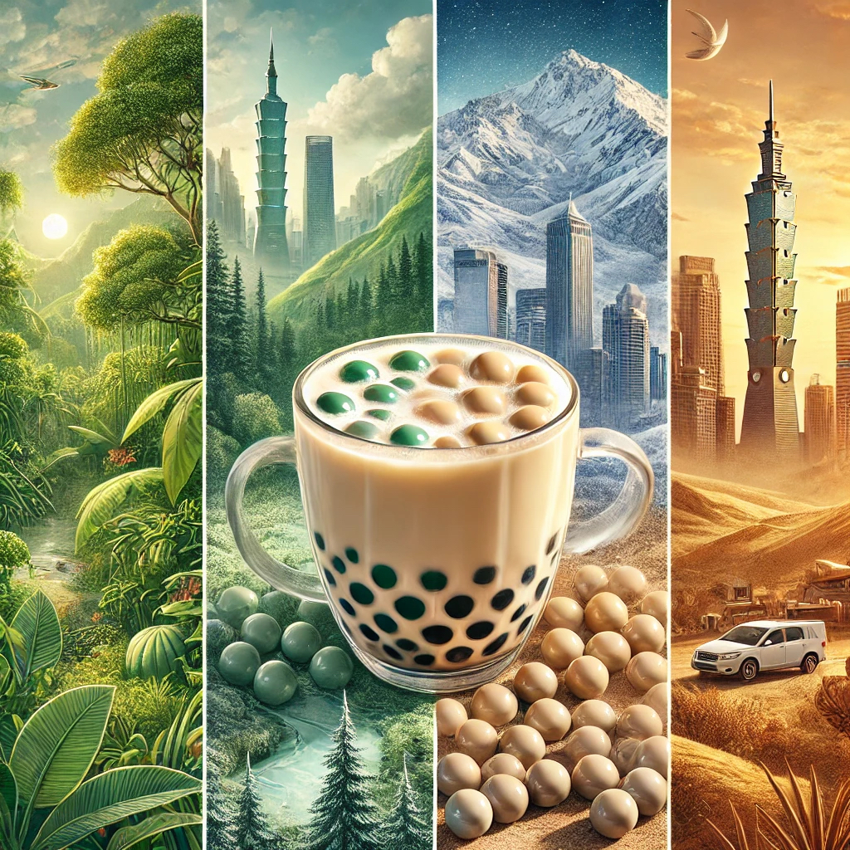
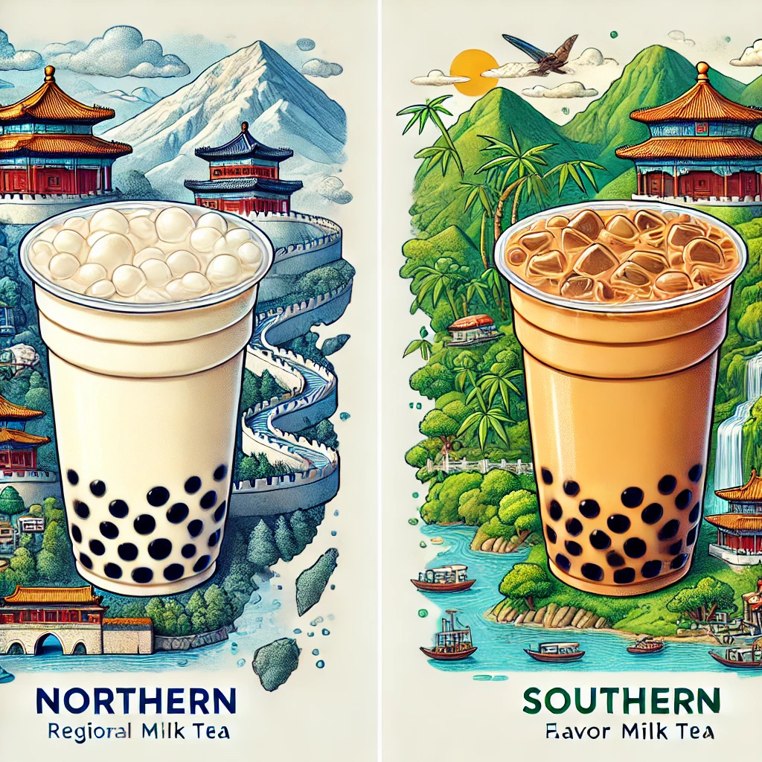

Slide 16
Thanks

