Slide 1

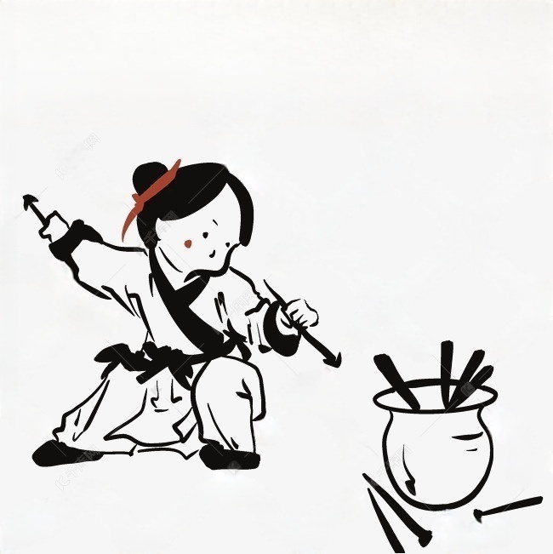



投
Pitch-pot game
壶
Presented by Kuang Jing

Slide 2
1
2
Introduction
Origin and Development
Contents
3
Types
4
Rules
5
Reflection

Slide 3
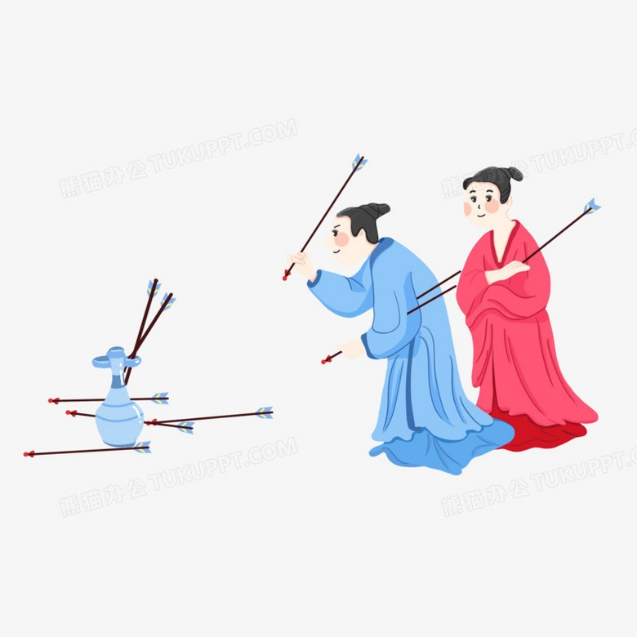
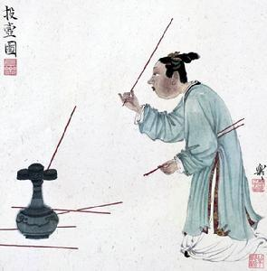
Introduction
Pitch-pot game (Tou Hu) is a throwing sport in ancient China. It evolves from archery, and is not only a sports activity, but also a game for fun.
The thrower stands at a certain distance, and then throws the arrows into the pot, and the number of shots determines the winner.

Slide 4
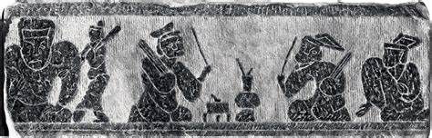
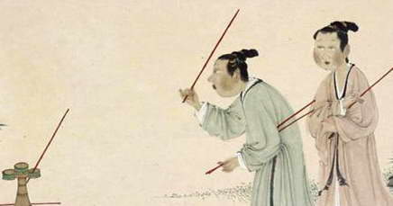
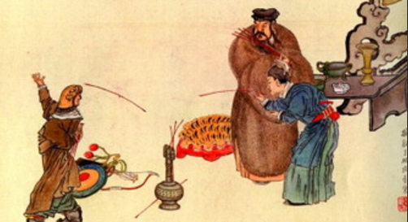
Origin and development
Spring and Autumn Period
Warring States Period
Qin and Han Dynasties
An alternative to archery.
Those who could not shoot would put sticks into the wine pot instead of arrows.
More elegant.
Scholars tended to cultivate their hearts, so this quiet and courteous activity met their needs.
More popular but difficult.
There were many new programs.

Slide 5
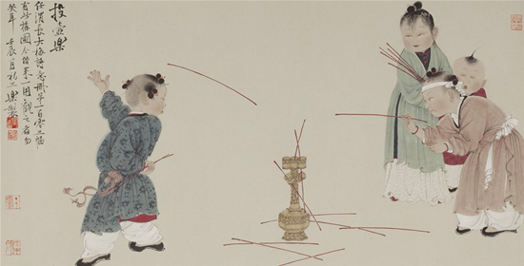
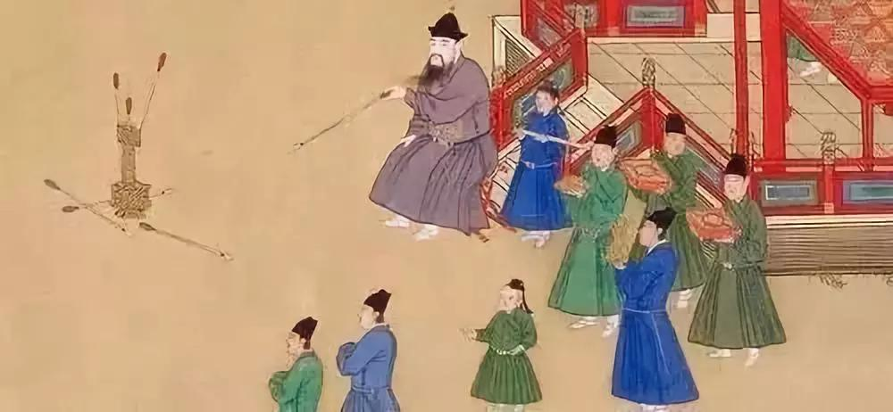
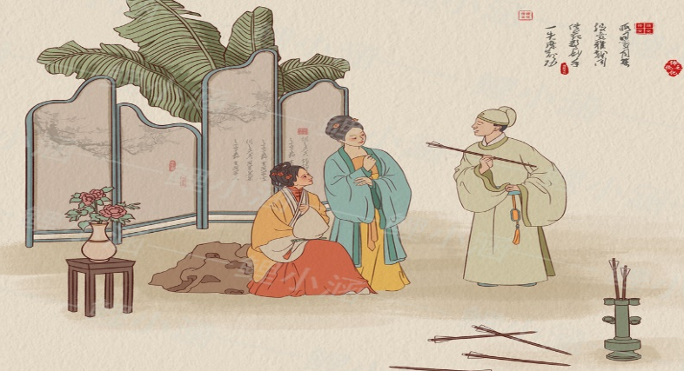
Origin and development
Southern and Northern Dynasties
Tang and Song Dynasties
Qing Dynasty
More Entertaining.
Pitch-pot game no longer demanded etiquette, but gradually developed into entertainment.
Be restricted.
Sima Guang modified and limited Pitch-pot game according to feudal etiquette.
Get declining.
With the introduction of modern western sports, Pitch-pot withdrew from the stage.

Slide 6
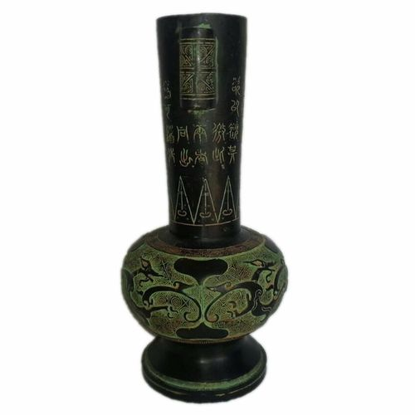
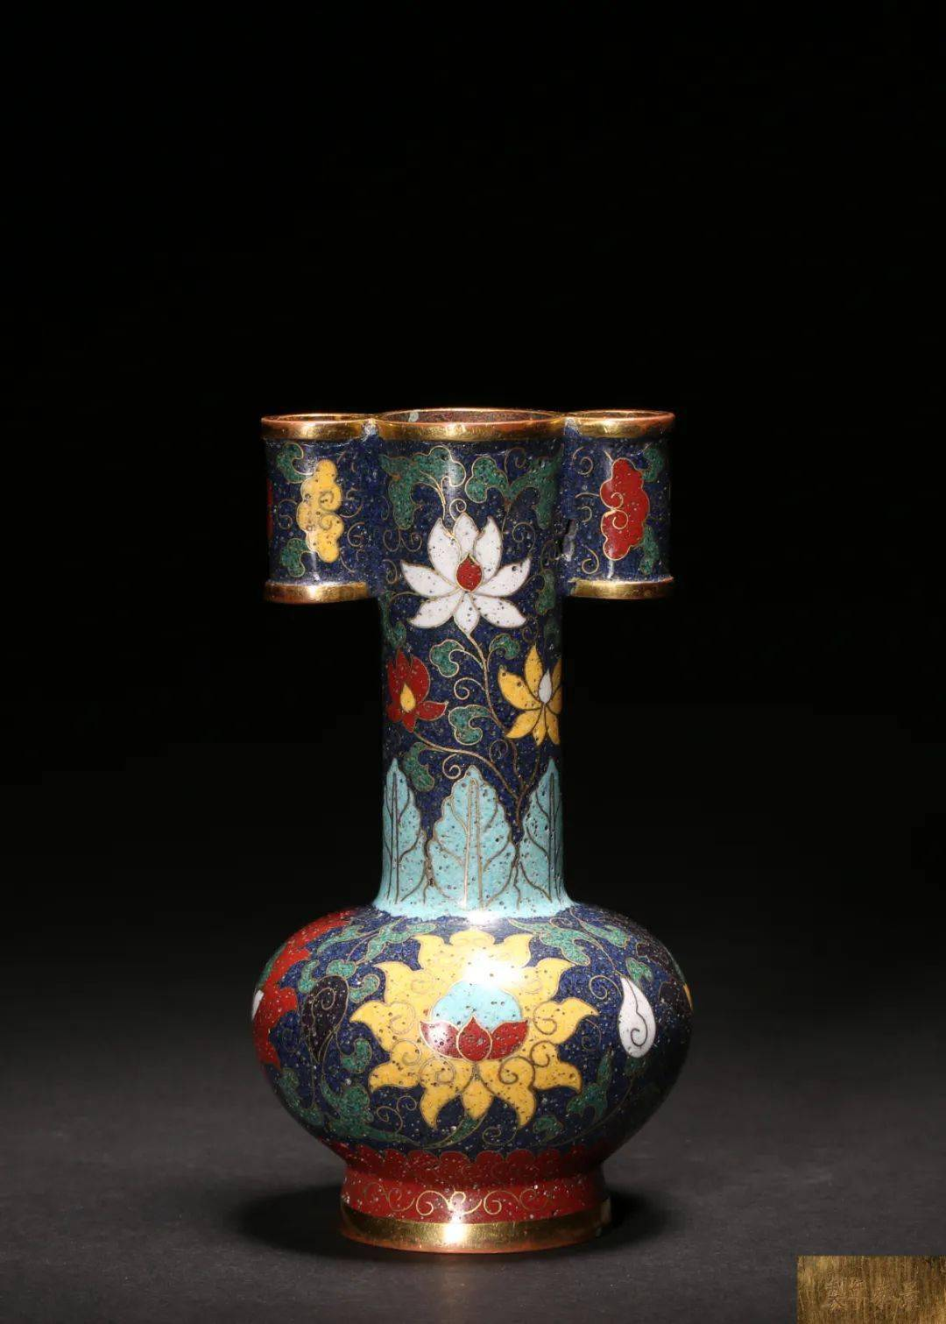
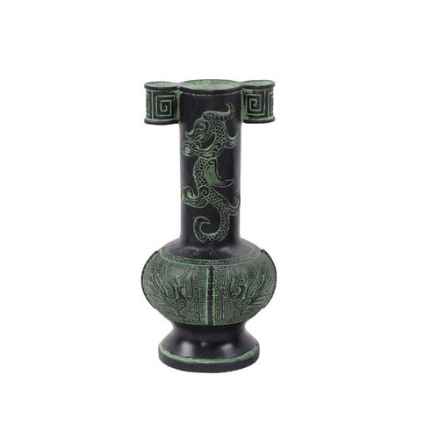
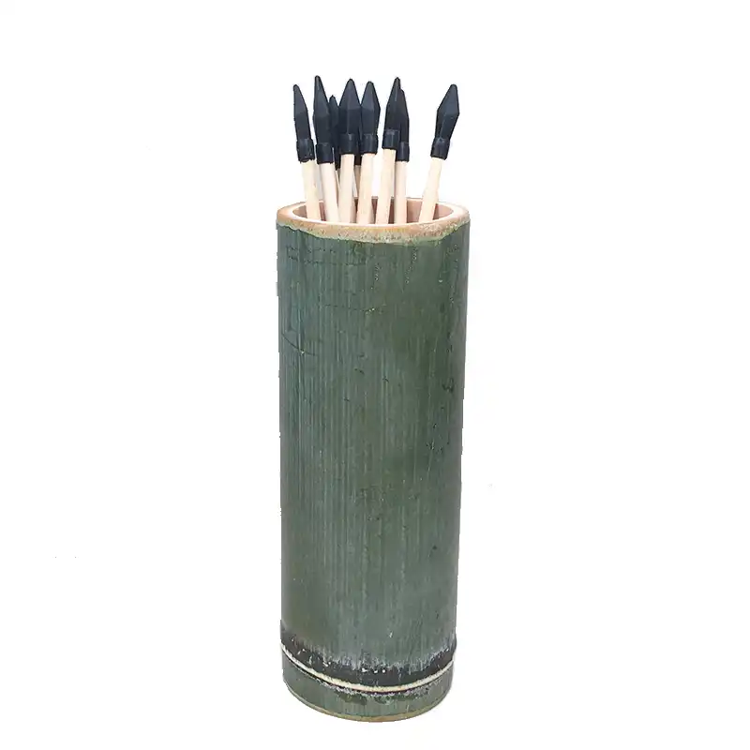
Types
Pitch-pot
Materials
bronze
porcelain
Shapes
bamboo
no handles
handles

Slide 7

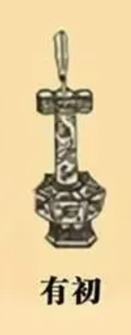
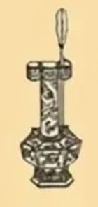
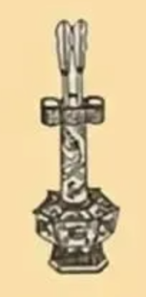
Rules
10
10
5
有初
贯耳
连中
Hit the target at the first time
Hit the handle next to the spout
Hit the target again after the first arrow

Slide 8

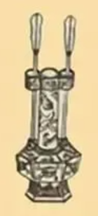
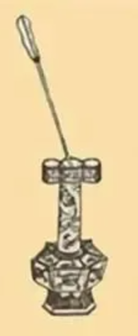
Rules
1
10
15
散箭
连中贯耳
倚箭
Miss the first arrow, but hit the target in following times.
Hit the handle twice in a row.
The arrow got stuck at the top of the pot, but it didn't fall into the bottom.

Slide 9

Reflection
Pitch-pot game is being ignored in modern times.
It’s our responsibility to pass on the Pitch-pot game and promote it to the world, so that more people can enjoy the fruit from the Chinese civilization.

Slide 10

行业PPT模板http://www.1ppt.com/hangye/
Thank you
Notes:
模板来自于： 第一PPT https://www.1ppt.com/

