Slide 1

An Overview of Chinese Utopian Literature
in the Early 20th Century
——Wang Yajuan

Slide 2
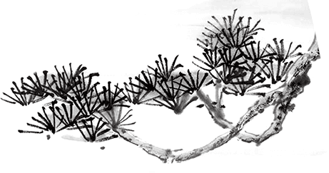

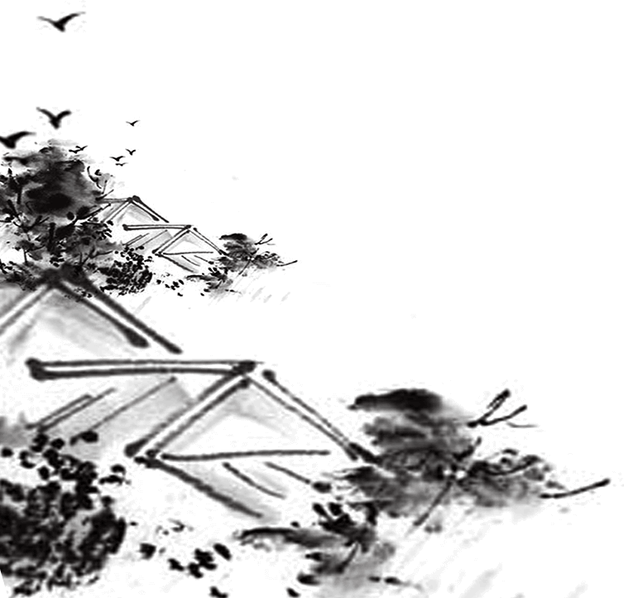
1
Introduction of Utopian Literature
2
Contents
Classification of Utopian Literature
3
Influence of Utopian Literature in China
Conclusion
4

Slide 3
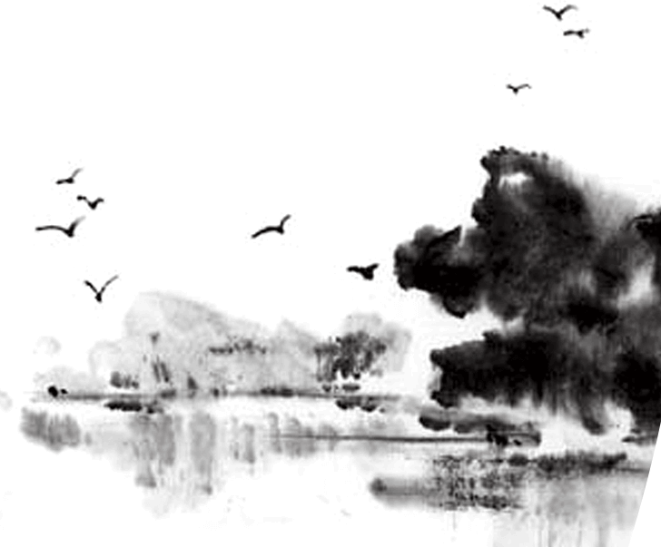
Introduction
The term “utopia” created by Thomas More, and its emergence was influenced by humanism. In China，the flourishing period of utopian literature began with the “Gengzi Change”(庚子之变) and ended with the May Fourth Movement. The connection between modern Chinese and Western utopian literature began with American writer Edward Bellamy’s utopian fiction Looking Backward, which influenced a number of important works in modern China, such as Kang Youwei’s The Book of the Great Unity（《大同书》）, Tan Sitong’s Treatise of Benevolence(《仁学》) and Liang Qichao's The Future of New China（《新中国未来记》）.

Slide 4
Classification
According to the content and its distance from reality, the utopian literature of early 20th century can be divided into distant-viewed, middle-viewed and close-viewed one.

Slide 5
Distant-viewed utopian literature explores philosophy. It focuses on the universal principles of society, which have an applicability across the world. The representatives include Kang Youwei’s The Book of the Great Unity, Cai Yuanpei's New Year's Dream and Wu Jianren's The New Story of Stone. Take The Book of the Great Unity for example, it involves the ideas that “people were born by Heaven and equal”(天民), the affirmation of human desire, and the view of “Three Worlds”（“三世”说）, establishing a value system similar to modernized one. It brings the spirit of freedom, which belongs exclusively to literature before, into the politics.

Slide 6
In middle-viewed Utopian literature, people think about how society works and provide blueprints for social order instead of focusing on religion and tradition as before. During this period, it emerged a large number of different understandings of the structure of society. According to their different political stance, it can be further divided into constitutional utopian novels of the conservative school, such as Liang Qichao’s The Future of New China（保守派的宪政乌托邦小说,如梁启超的《新中国未来记》）, exclusionary utopian novels of the revolutionary school ( such as Chen Tianhua‘s The Lion’s Roar, Huairen‘s Rousseau’s Soul)（革命派的排满乌托邦小说（陈天华的《狮子吼》，怀仁的《卢梭魂》等） and anarchist utopian novels (Lu Liao Ming‘s The Land of Happiness) (无政府主义的乌托邦小说（鲁哀鸣的《极乐地》）.

Slide 7
The close-viewed utopia is an emotional expression during those turbulent times. It aims to inspire people to save the nation in danger by prophesying the suffering of a dying nation. They often have no clear political opinions, only expressing patriotic passion and national dignity. Some representative works include The Prophecy of the Partition’s Tragic by Xuanyuan ZhengYi（轩辕正裔的《瓜分惨祸预言记》） and The Revenge of the Cold Country by Leng Bai（冷白的《冷国复仇记》等）

Slide 8
Influence
1.Utopia promotes the transformation of traditional Chinese society into modern society. It intensifies the contradiction between people and reality, and encouraged people to criticize and change the reality.
2.The appearance of utopian literature changed the nature of traditional literature and greatly enhanced the status of the fiction in modern literature in China. Fiction, which had been a vehicle for amusement before, turned into a vehicle to express people's spiritual and political pursuits.

Slide 9
Conclusion
In short, utopian literature greatly changed the language, form, and content of modern Chinese literature, greatly contributing to the comprehensive liberation of human knowledge and emotions. However, the proliferation of utopias can also have serious side effects. The “past”, “present” ,and “future” are all important to human existence, and it is important to find a balance among them, which is the value of studying utopian literature in the early 20th century.

Slide 10
References:
[1]耿传明. 清末民初“乌托邦”文学综论[J].中国社会科学2008(4)：176-190.
[2]乔·奥·赫茨勒. 乌托邦思想史，张兆麟等译[M].北京:商务印书馆。1990: 219.
[3]康有为.《大同书》[M]. 上海：上海古籍出版社, 2005: 123.
[4]卡尔·曼海姆.意识形态与乌托邦，艾彦译[M]. 北京：华夏出版社, 2001.
[5]托克维尔. 旧制度与大革命[M], 冯棠译. 北京：商务印书馆, 1992.
[6] 陶曾佑.论小说势力及其影响, 舒芜等编，《近代文论选》上册[M]. 北京：人民出版社，1999.

Slide 11
Thanks for your listening！

