Slide 1
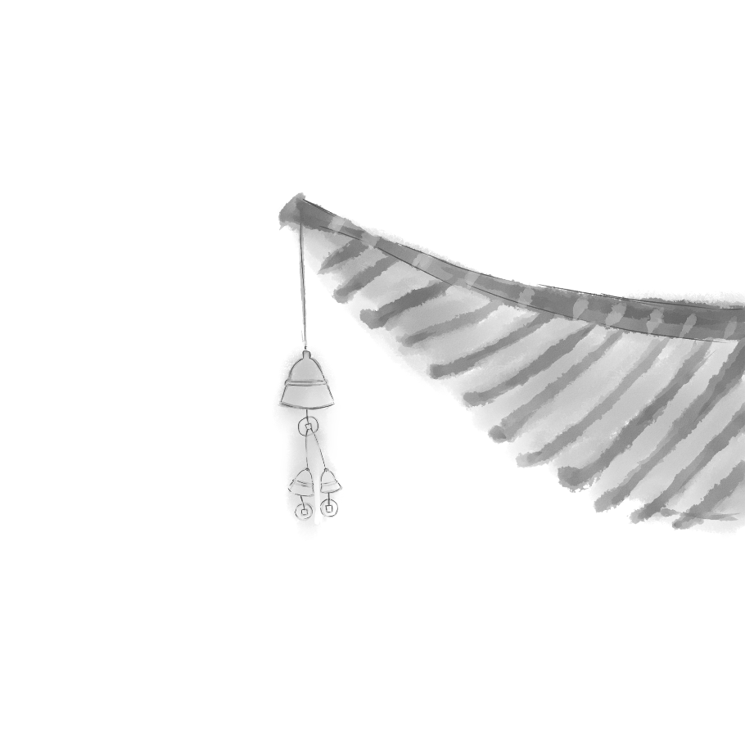

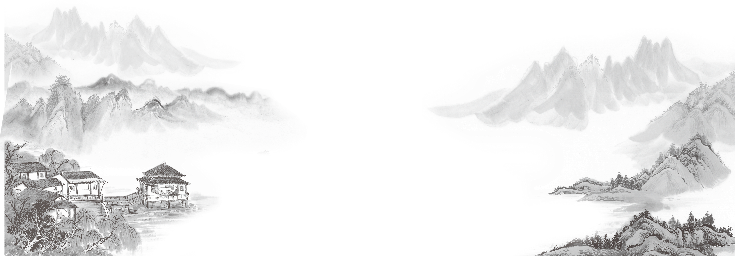
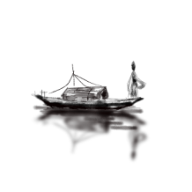
Feng Shui
in Chinese architecture
主讲人：郭玉熔

Slide 2

contents
壹
The Dedinition of Feng Shui
贰
The Fundamental principles of Feng Shui
叁
The Application of Feng Shui in Chinese Architecture

Slide 3

壹
The Dedinition of Feng Shui
philosophical system
balance and harmony
human and natural environment

Slide 4
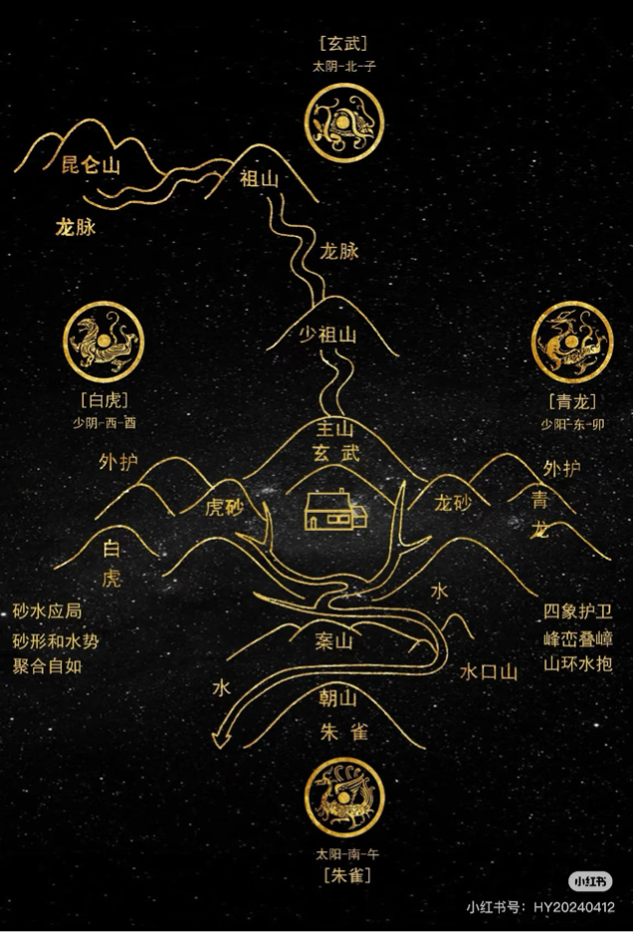
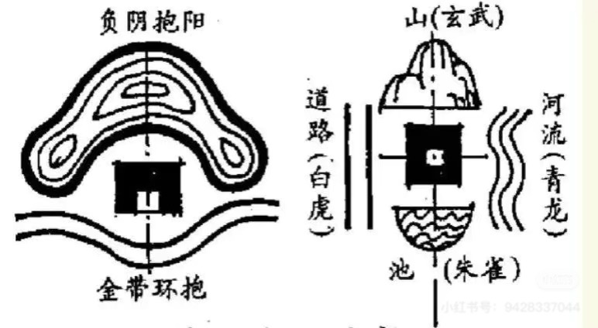

贰
The Fundamental principles of Feng Shui
The Five Elements
Qi
Yin and Yang
Orientation

Slide 5
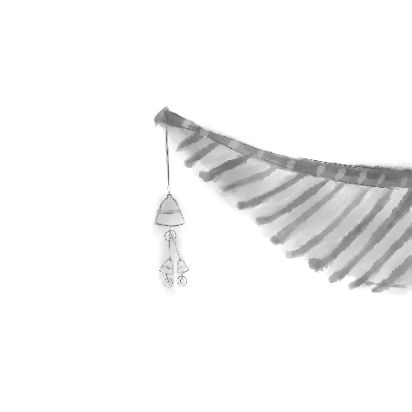
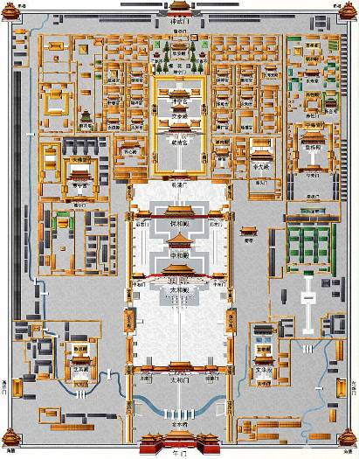
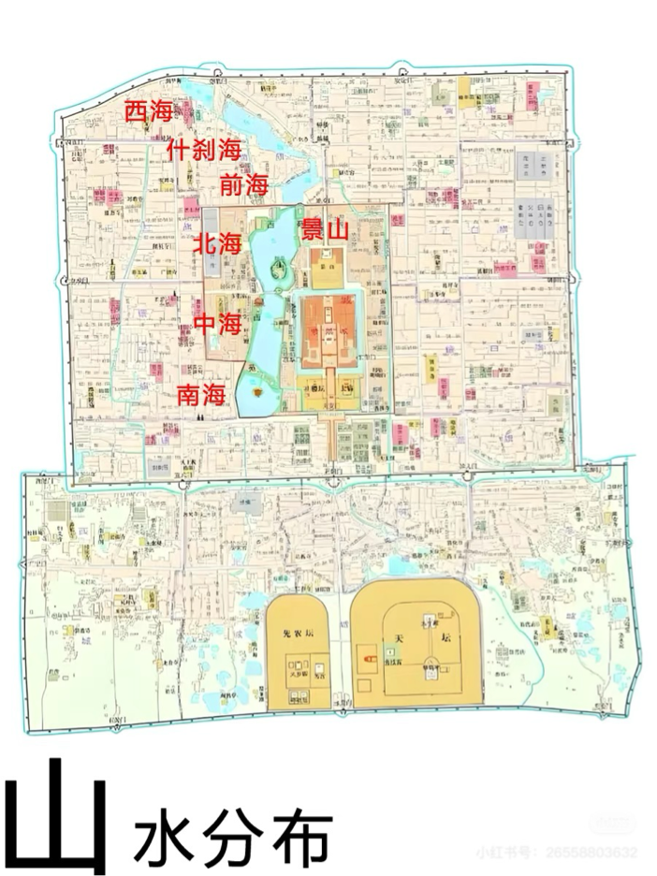



叁
The Application of Feng Shui in Chinese Architecture
Feng Shui in ancient Chinese architecture
Facing sourh with the back to the north
Axial symmetry
Fronting water and with hills on the back

Slide 6
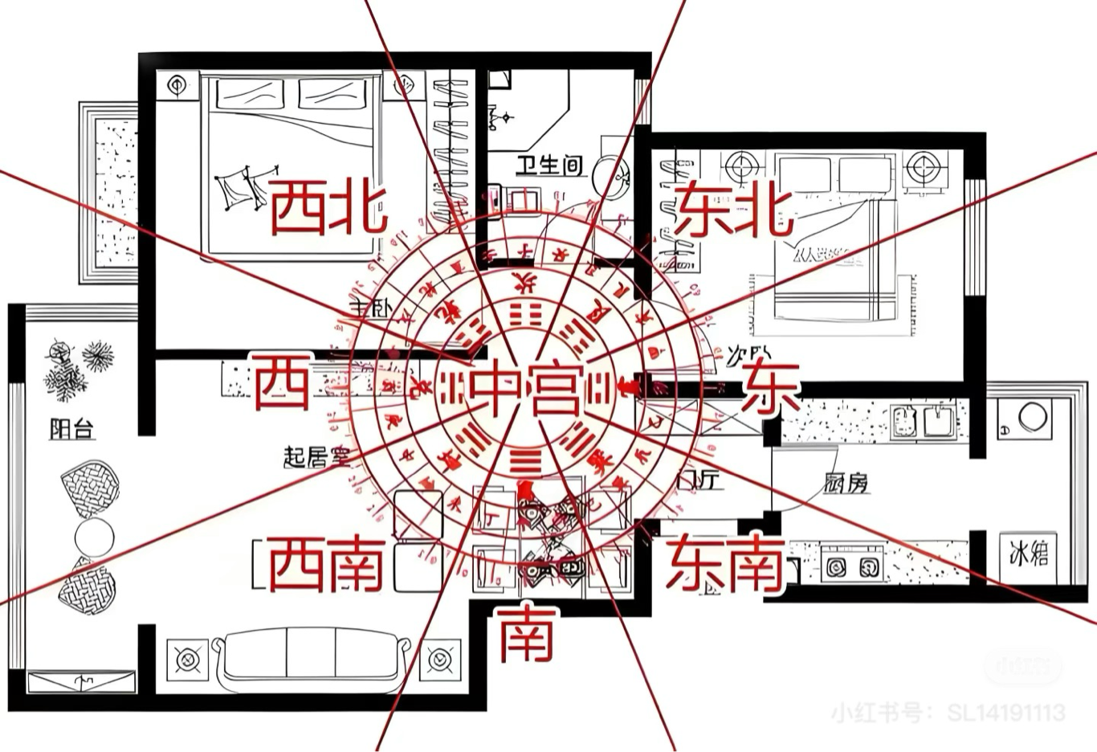
Layout of A House
The design of kitchen, dining room and bedroom

Slide 7
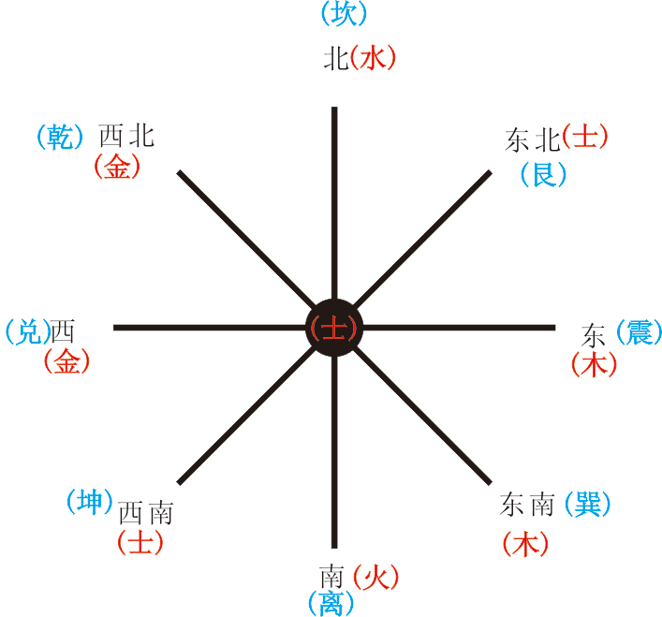
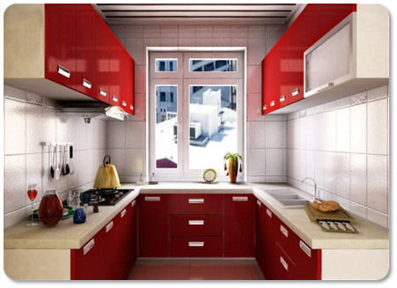
Layout of A House
The design of kitchen
In Feng Shui, the kitchen symbolizes wealth and salary of an official.
❌ The kitchen should not face south, as the south is associated with fire, and the kitchen is also associated with fire. Too much fire can be unfavorable.
✅ The most suitable locations are the east and southeast of the residence, as both the east and southeast belong to the element of wood, which can coexist peacefully with both water and fire.

Slide 8
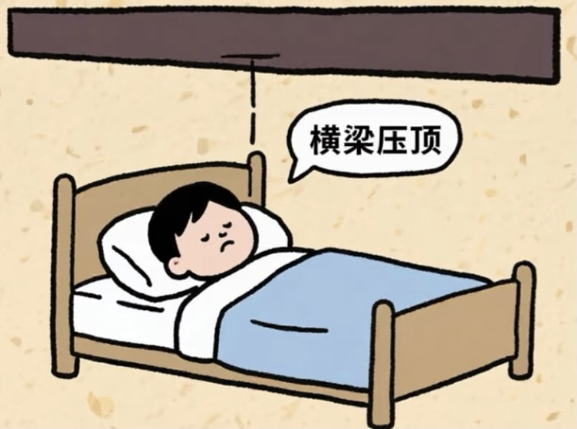
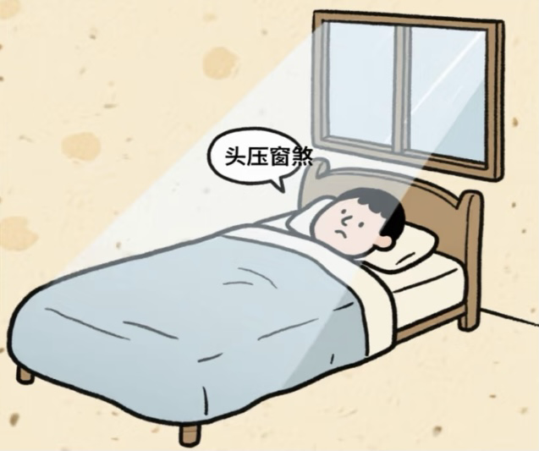
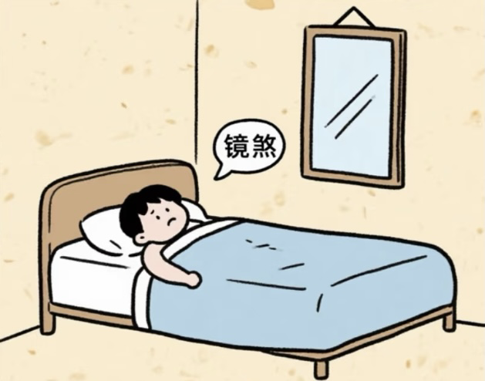
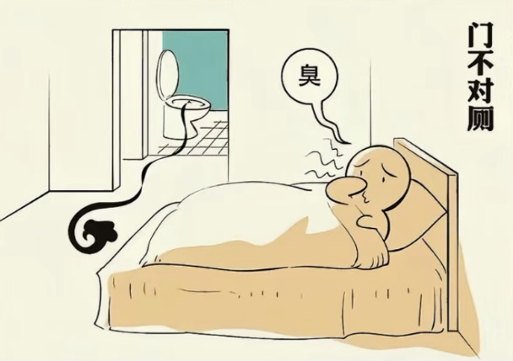
Layout of A House
The location of the bed
❌ Having a beam resting on top
❌ The bed is placed close to the window
❌ Facing the mirror
❌ Directly opposite the door

Slide 9
Thanks For Your Listening
The information is sourced from Baidu and Xiaohongshu.

