Slide 1
Crosstalk
By Zhou Sirui

Slide 2
The Development
Famous Artists of Crosstalk
Characteristics
Four Basic Skills in Crosstalk
CONTENTS

Slide 3
1
The Development of Crosstalk

Slide 4
1
Development
1850-1874
Late Qing Dynasty
1912-1949
After 1949
Forming
Having its modern features and styles
From one-person Ventrilo-quism to one person stand-up talk, and the name changed to cross talk.
stand-up crosstalk, dual crosstalk, and group crosstalk.
Break region restrictions

Slide 5
2
Four Basic Skills in Crosstalk

Slide 6
2
Four Basic Skills
tell jokes, stories, lantern riddles, drinking games
imitate all kinds of birds and animals, hawking, singing and the sound of different languages
speaking
imitating.
teasing
singing
gag and tease
sing Taiping Lyrics, opera lyrics and songs.

Slide 7
3
Characteristics of Crosstalk

Slide 8
3
Characteristics of Crosstalk
Art of speaking
-a collective performance of actors and audience
-different from drama
Art of laughter
-humor and satire
-different from other rap art forms
Art of language
-Baofu(jokes)
-different from comedy

Slide 9
4
Famous Artists of Crosstalk

Slide 10
4
Famous Artists of Crosstalk
Zhu Shaowen
stage name “Qiong Bupa, which means not afraid of poverty”
ancestor of crosstalk art.
Ma Sanli
long-term artistic practice
created the unique “Ma’s Style of Crosstalk”
Hou Baolin
a pioneering master of crosstalk.
crosstalk art has really entered thousands of households and reached a remarkable artistic peak.
Other famous crosstalk artists
Zhang Yongxi, Liu Baorui, Hou Yaowen, Jiang Kun, Feng Gong, Niu Qun and Guo Degang.

Slide 11
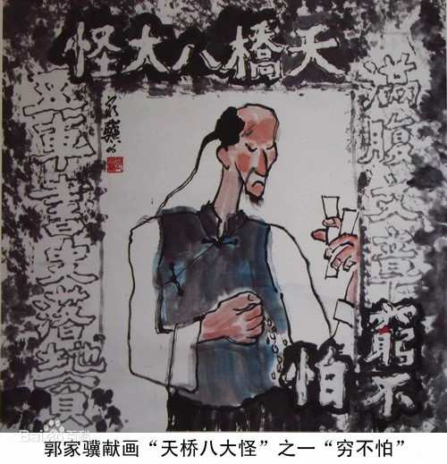
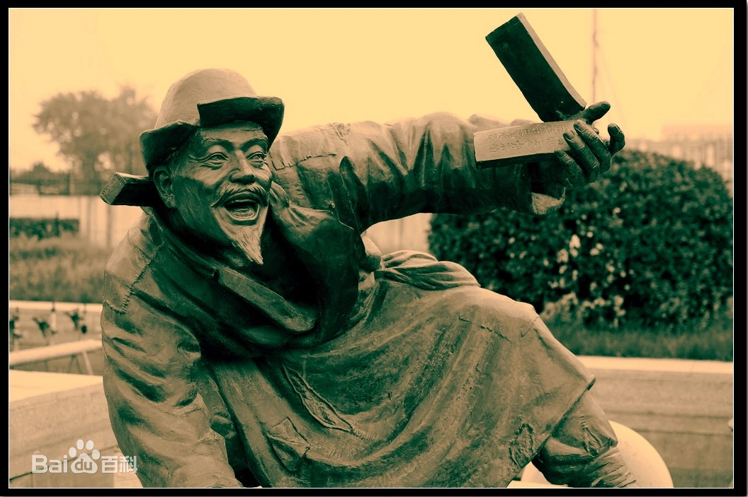
4
Famous Artists of Crosstalk

Slide 12
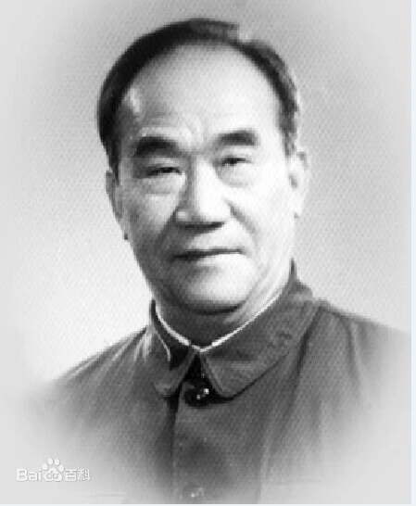
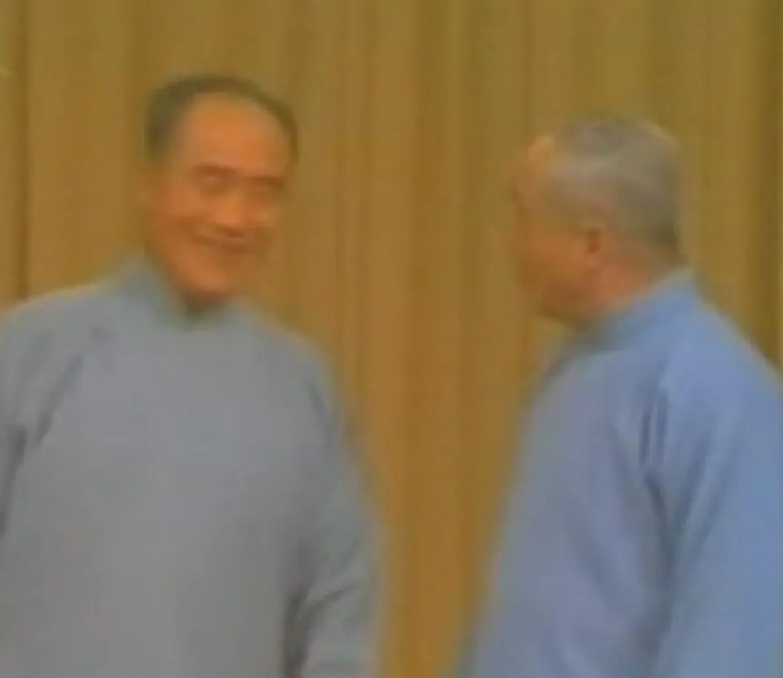
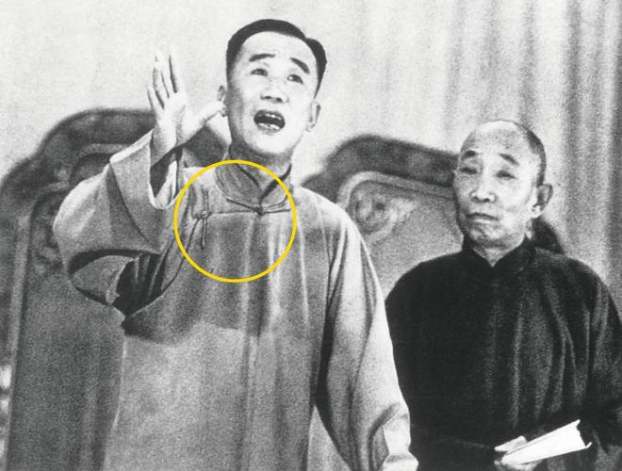
4
Famous Artists of Crosstalk
Drama Talks (戏剧杂谈）
Drunkenness
（醉鬼）

Slide 13
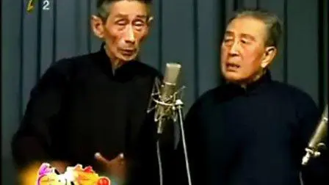
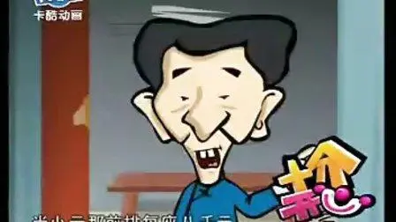
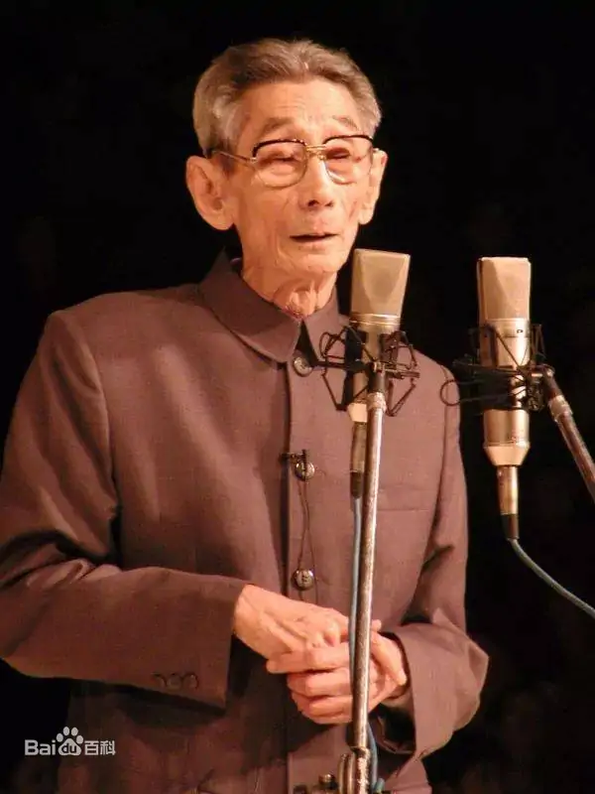
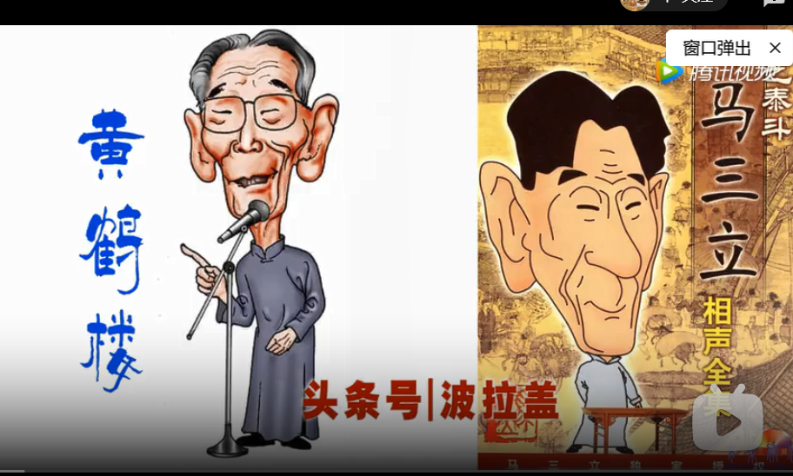
4
Famous Artists of Crosstalk
Eating Yuanxiao(dumpling)
Selling Tickets
the Yellow Crane Tower

Slide 14
THANK
YOU

