Slide 1

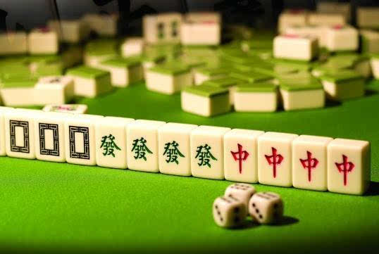
Games: Mahjong: An Ancient Chinese Card Play
WILLY

Slide 2

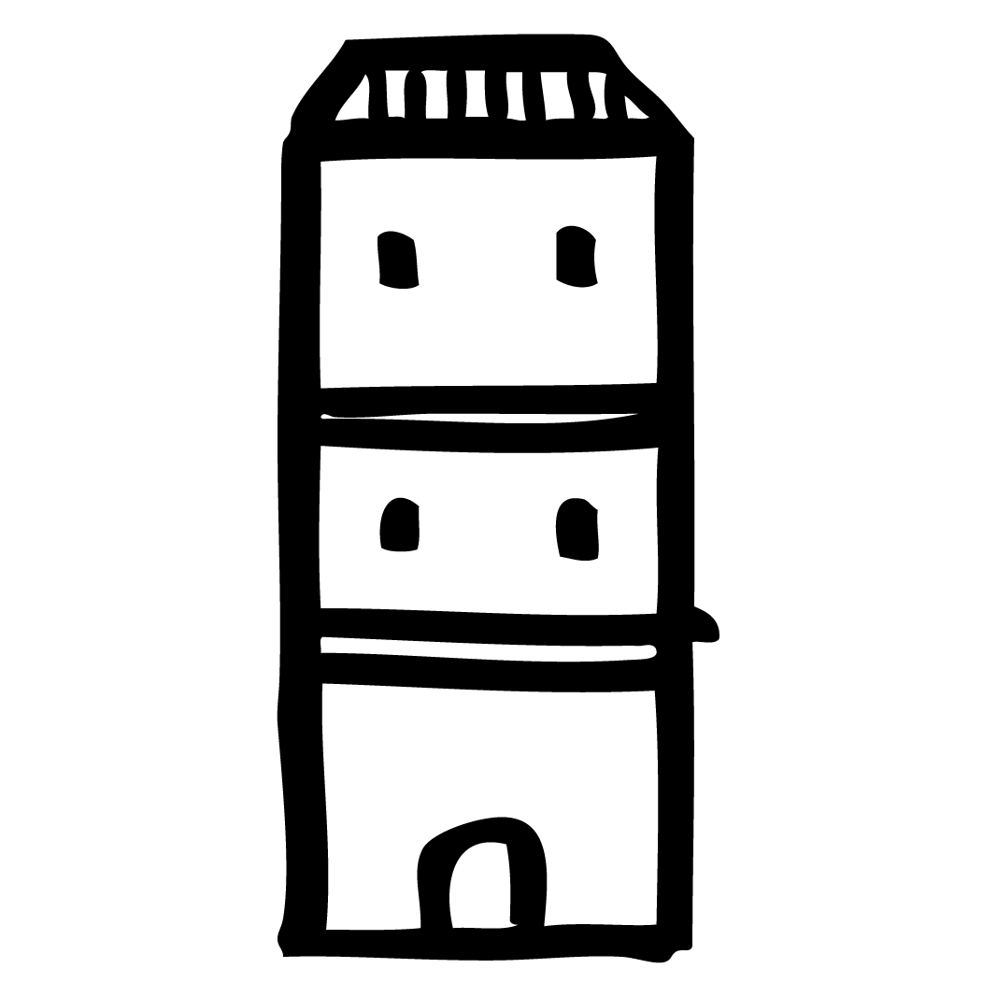



Contents
Introduction
Components
Origin
Changsha Mahjong

Slide 3
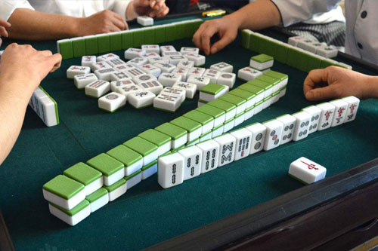
Mahjong or Mah-jongg
the earliest written record
Mahjong
麻雀(pinyin: máquè)
Ma Jiang tile（马将牌）
horse tags（马吊牌）
originally called
in Clear Barnyard Grass Banknotes

Slide 4
Mahjong tile count per set
 |  | Count
Suited | Dots | 36
 | Bamboo | 36
 | Characters | 36
Honors | Winds | 16
 | Dragons | 12
Bonus | Flowers | 4
 | Seasons | 4
TOTAL |  | 144

Slide 5


































 |  | Numbers
 |  | 1 | 2 | 3 | 4 | 5 | 6 | 7 | 8 | 9
Suited | Dots
 | Bamboo
 | Characters
Honors | Winds | East | South | West | North
 | Dragons | Red | Green | White

Slide 6








Flowers
No | Image | Name | Character | Direction
1 |  | Plum blossom | 梅 | East
2 |  | Orchid | 兰 | South
3 |  | Chrysanthemum | 菊 | West
4 |  | Bamboo | 竹 | North
Seasons
No | Image | Name | Character | Direction
1 |  | Spring | 春 | East
2 |  | Summer | 夏 | South
3 |  | Autumn | 秋 | West
4 |  | Winter | 冬 | North

Slide 7
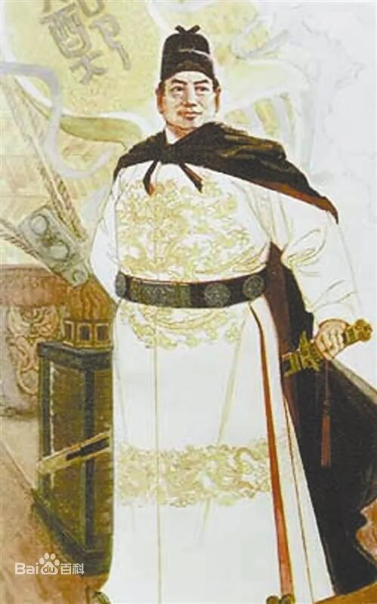
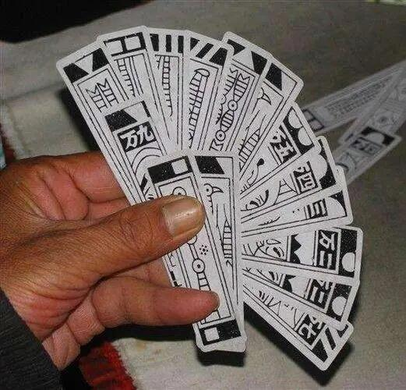
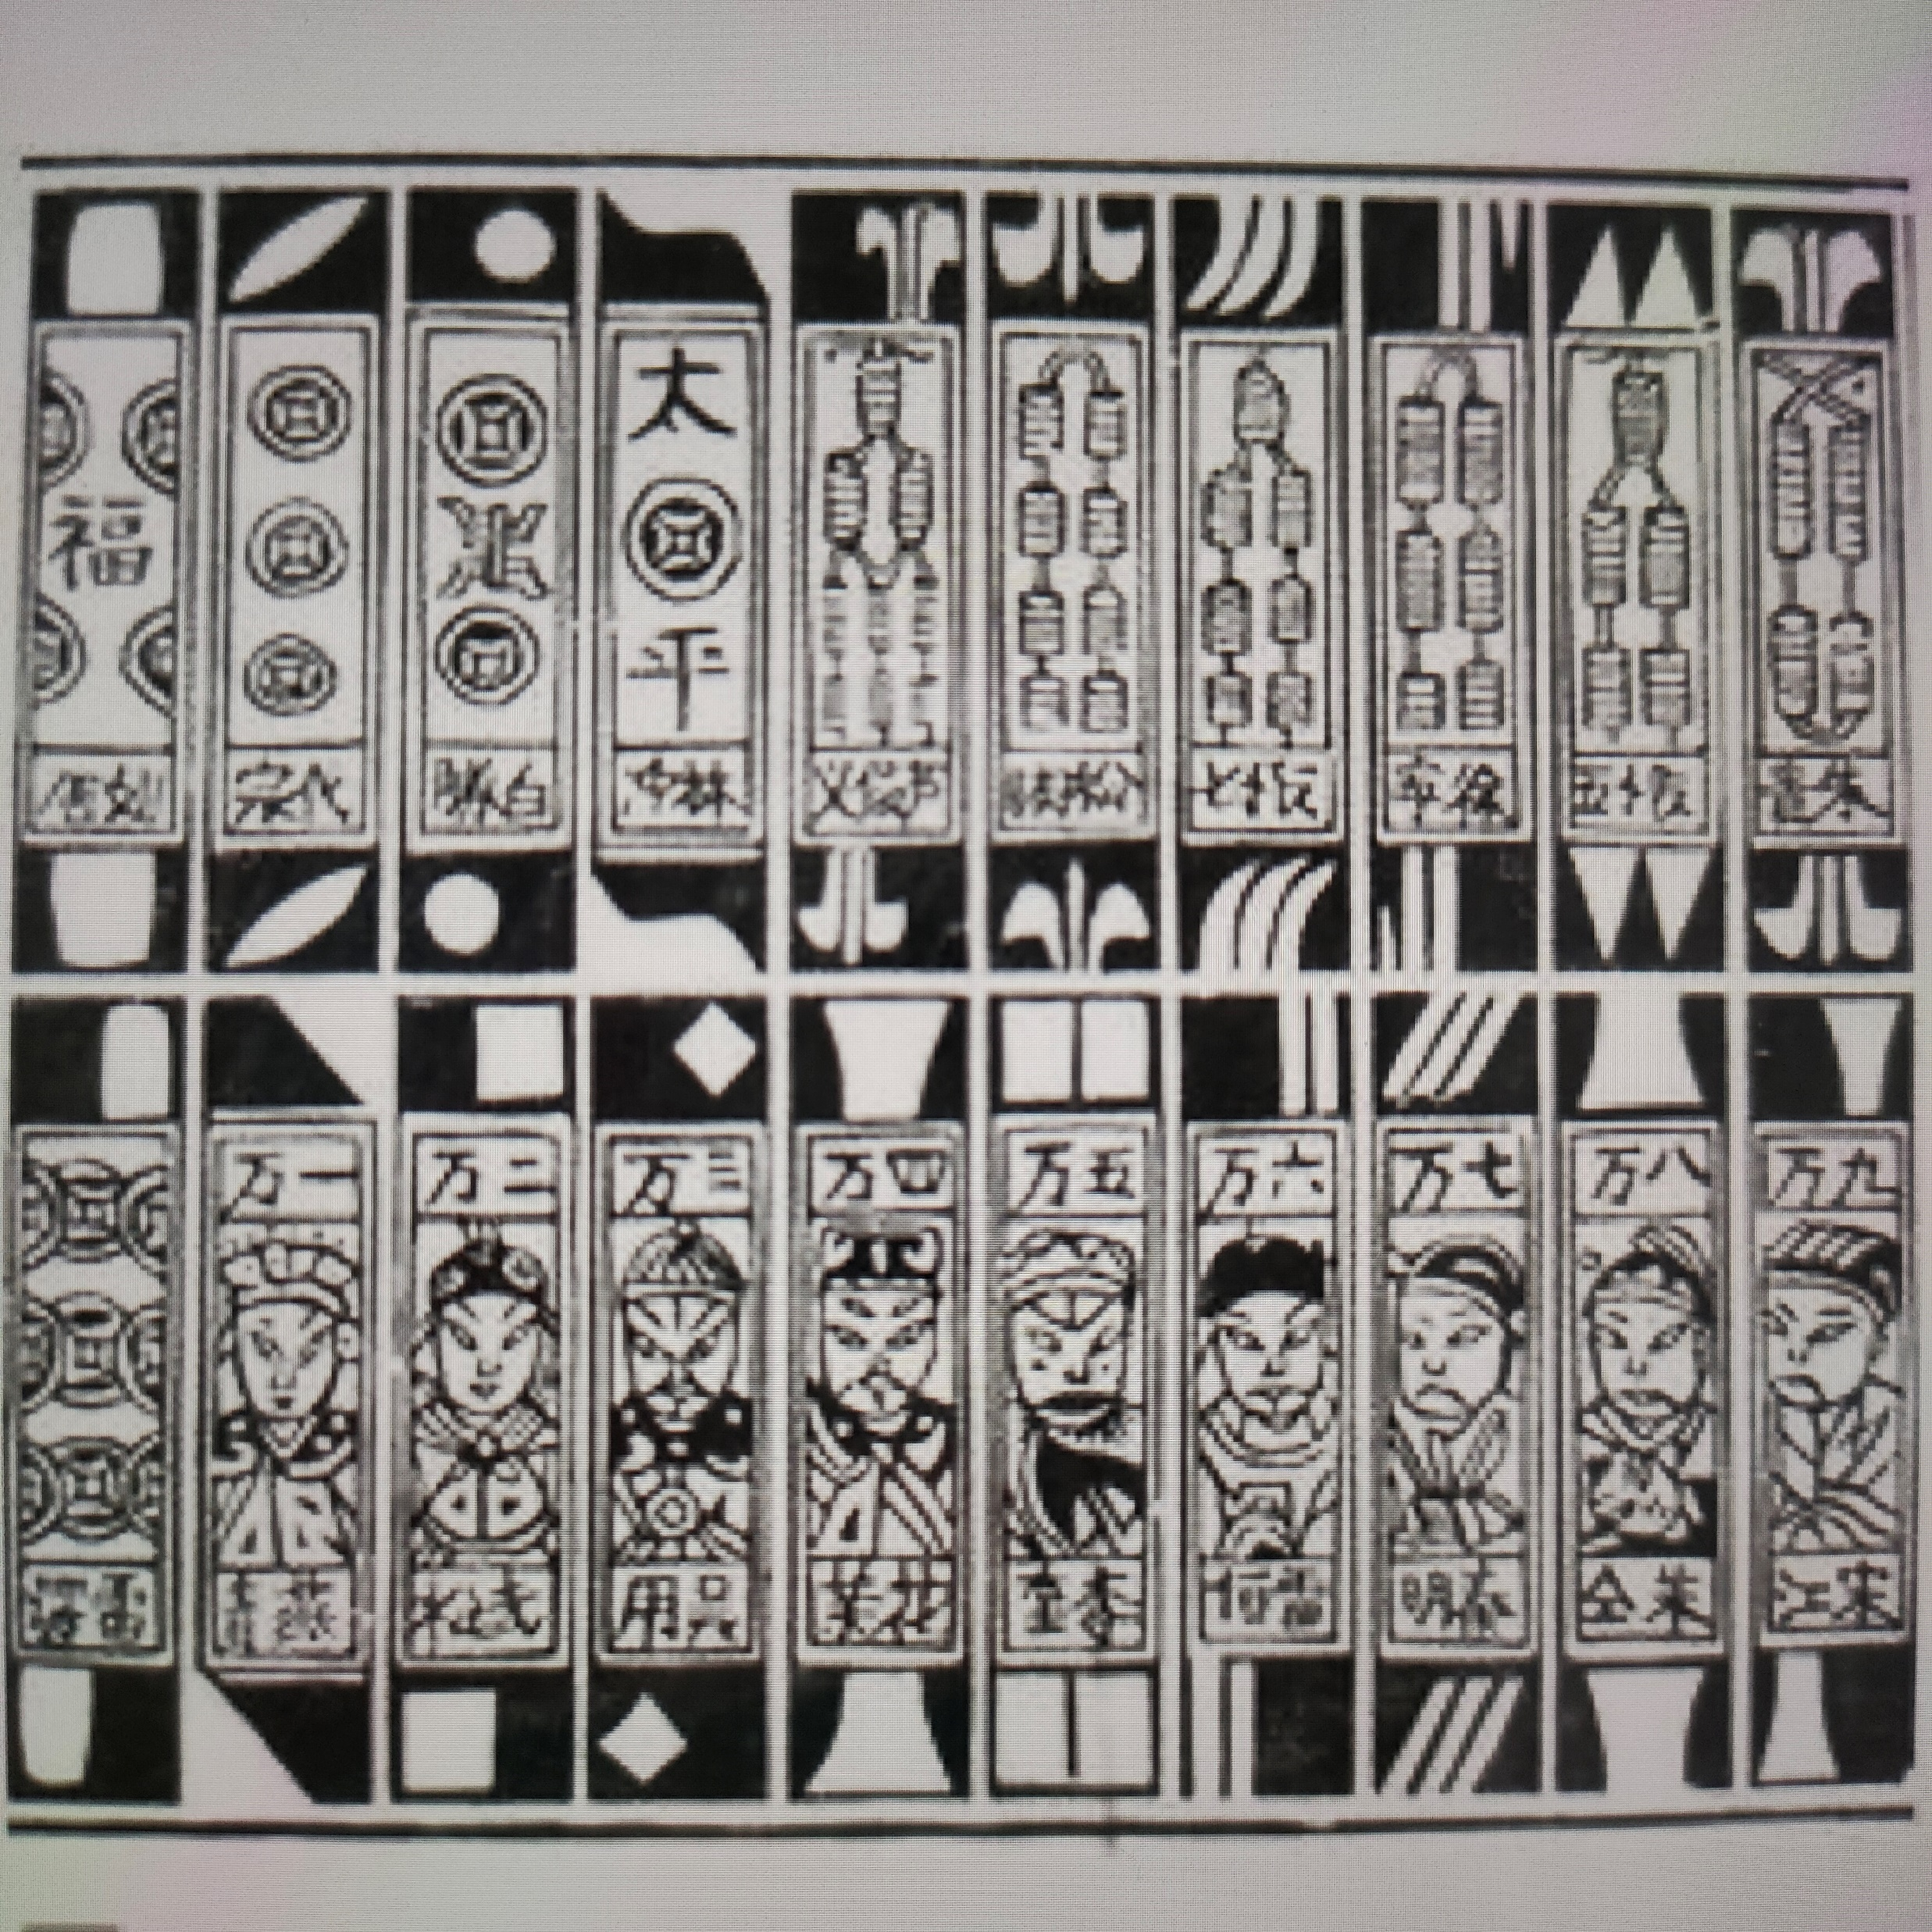
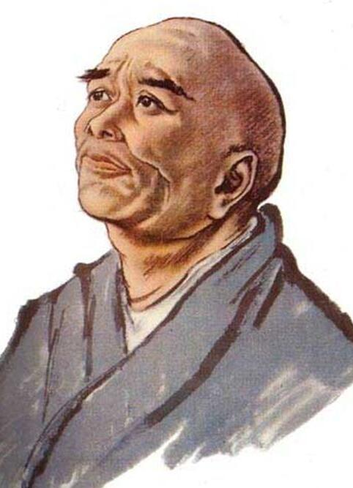

Slide 11
a set of cards
for entertainment
3.5 cm wide & 15 cm long
tubes: copper cash（铜钱）
robes: one hundred copper cashes
“wan” characters: ten thousand of robes
Zhang Sui
Tang Dynasty
A famous astronomer & monk

Slide 12

long-term travelling
boredom & nostalgia
bamboo cards
text patterns
rules of the game
square table: four people
“Fā”: earning money
circular designs: cakes
fishes, bars: food
“red middle”: hometown (vast central plains)
“West’, “East’, “North’, “South”: direction
four kinds of flowers: four seasons

Slide 13

Wan Bingtiao
Water Margin
“million”, “cake”, “strip”: 108
“east”, “south”, “west”, “north”, “central”: five directions of the country
“white”, “make”: poor & rich
Late Yuan and early Ming Dynasty

Slide 14

more well-known
north → south: grains
Taicang, Jiangsu Province: a large granary
✔rice & ✘birds: rewarding
recording: cards made of bamboo
“sparrow card”
“drum”, “Suo”, “wan”, “South”, “East”, “North”, “West”, “middle”, “white”, “prosperity”

Slide 15
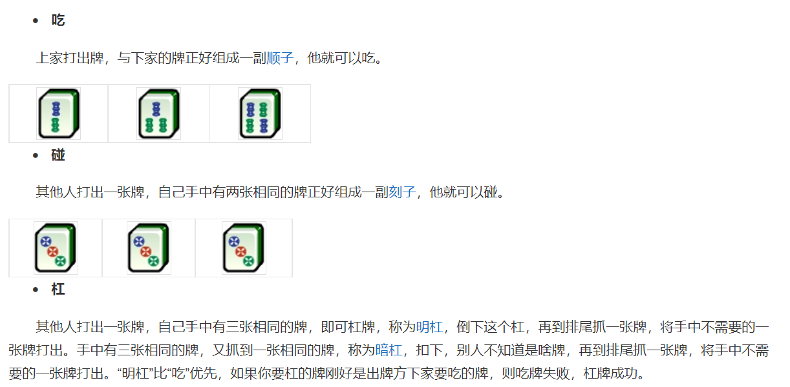
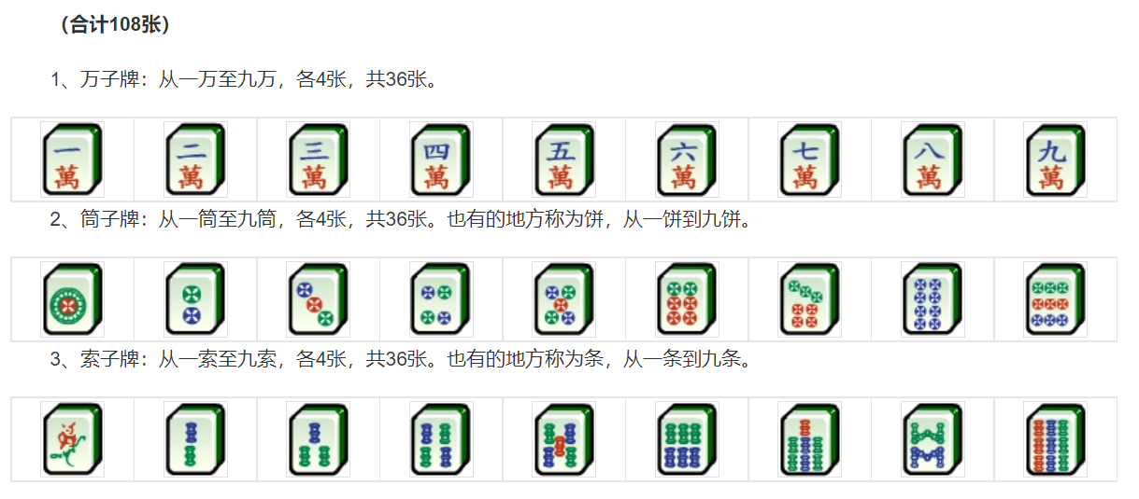
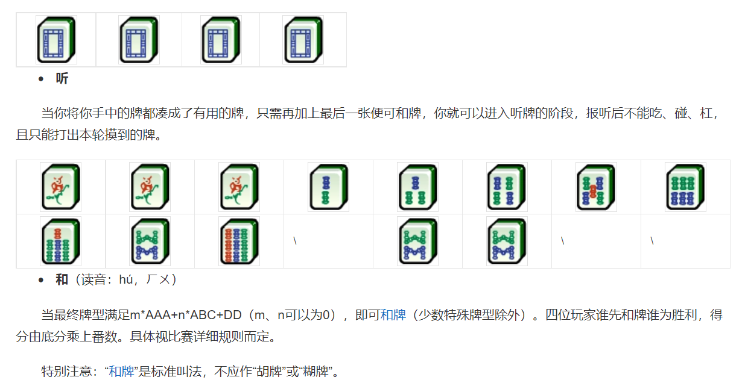

Slide 16

Thanks

