Slide 1

Language:
Chinese Dialects
By 肖冬晴 Xiao Dongqing

Slide 2
Contents
Classification of Chinese Dialects
Chinese Dialects in Contemporary World
Chinese Dialects vs English Variations

Slide 3

Classification of Chinese Dialects

Slide 4
Definition:
“Dialect” refers to different meanings in different groups. In Chinese, “dialect” is both a political concept and a linguistic one, and it is also known as “vernacular”. “Accent” refers to the difference in the language standard of a certain region, such as the relationship between relatives regardless of the language. Whereas in Europe, “dialect” is a linguistic concept subordinating under the concept of “language” at the beginning of the eighteenth century. Based on the relationship between the language (pronunciation, vocabulary and grammar), it is divided into family, group, branch and language. Considering the special national situation of China, The translation of “Chinese dialects” into English is “varieties of Chinese”.

Slide 5
The official dialects:
Northeast Mandarin; Peking Mandarin;
Ji Lu Mandarin; Jiao-Liao Mandarin;
Central Plains Mandarin; Lan-Yin Mandarin;
Southwest Mandarin; Jianghuai Mandarin.
Categories:
The nine local dialects:
Wu Dialect; Cantonese;
Fujian Dialect; Hunan Dialect;
Hakka; Gan dialect;
Hui Dialect; Jin Dialect;
Pinghua.

Slide 6
Chinese Dialects in Contemporary World

Slide 7
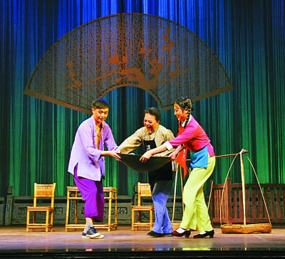
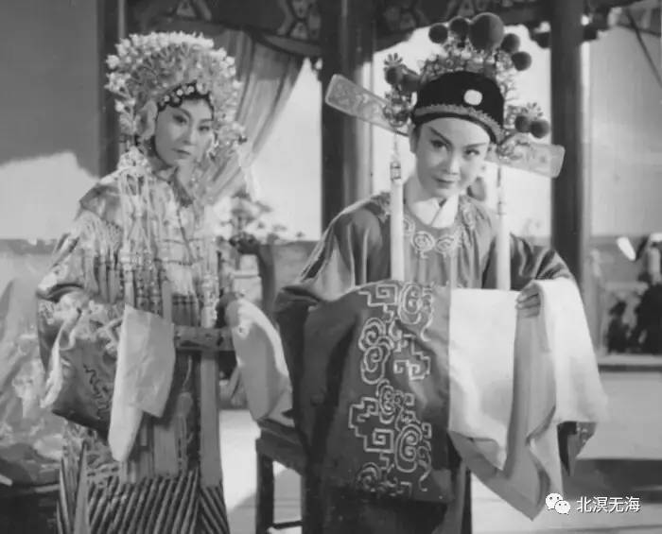
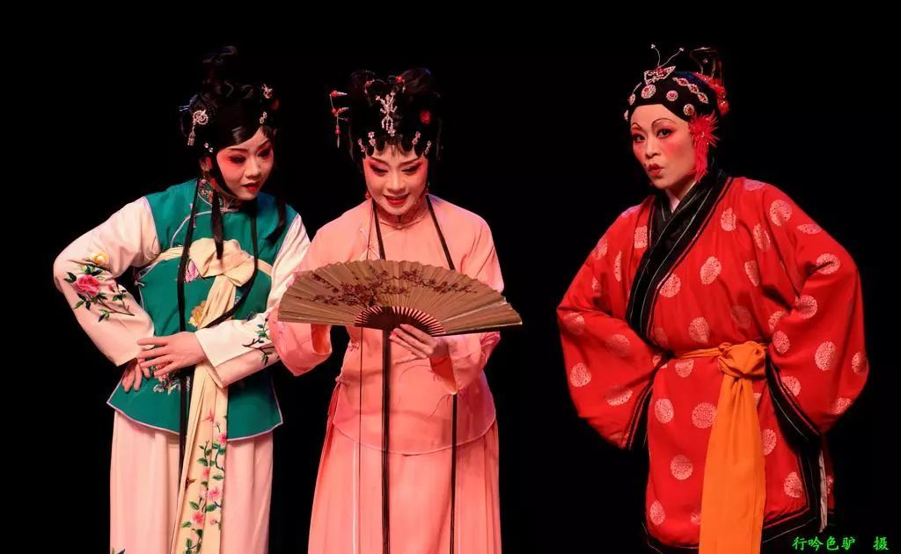
Artistic Interpretation of Dialects in China
Flower Drum Opera
Huangmei Opera
Liyuan Opera

Slide 8
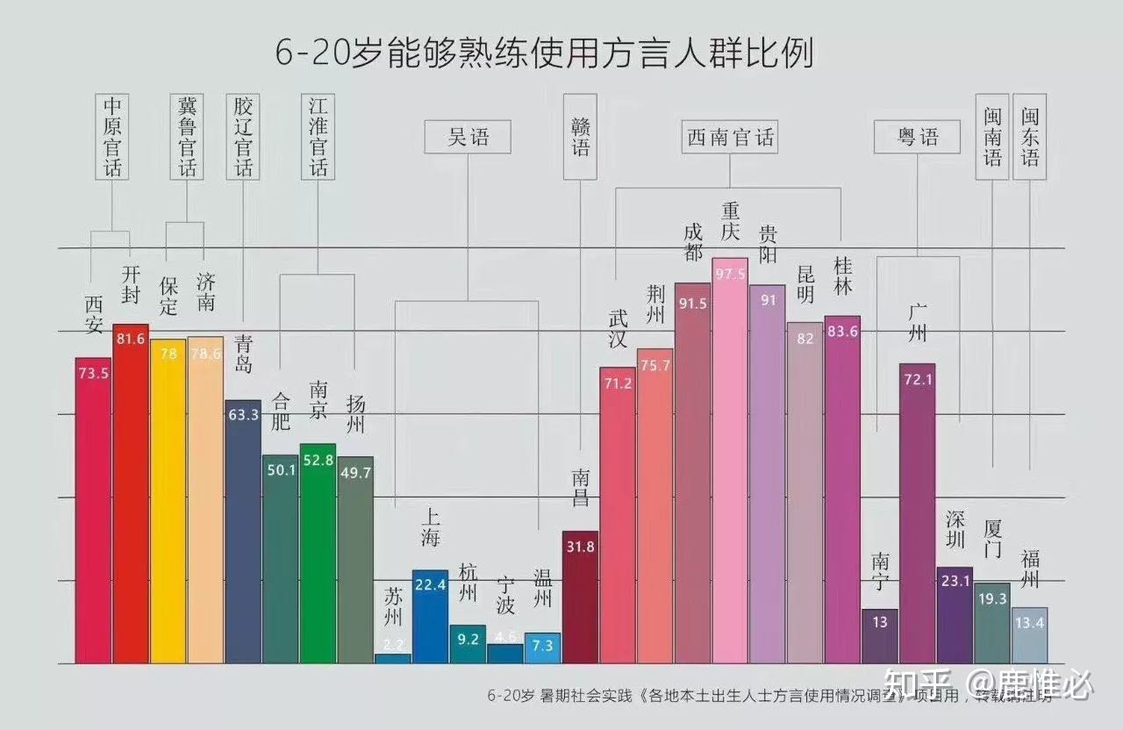
Varied;
Despite efforts to protect regional dialects in China, the number of people, especially those in large and developed cities who can speak dialects is still in decline.
the popularization of Putonghua;
the influence of social media;
the movement of people and intermarriage.

Slide 9
Chinese Dialects vs English variations

Slide 10
English variations:
Received Pronunciation; Cockney accent/Estuary English; Scouse; Welsh; Scottish Gaelic; Irish…
The “th” sound (think, three…);
The “glottal stop” (water, butter…);
The “l” sound (milk, Wales…);
The “h” sound (harry, have…);
Jargons…
The city of Liverpool
(the underlined three kinds) Developed from the Celtic;
Bilingual education;
A joint official language with English in Wales;
A Welsh-language television channel.

Slide 11
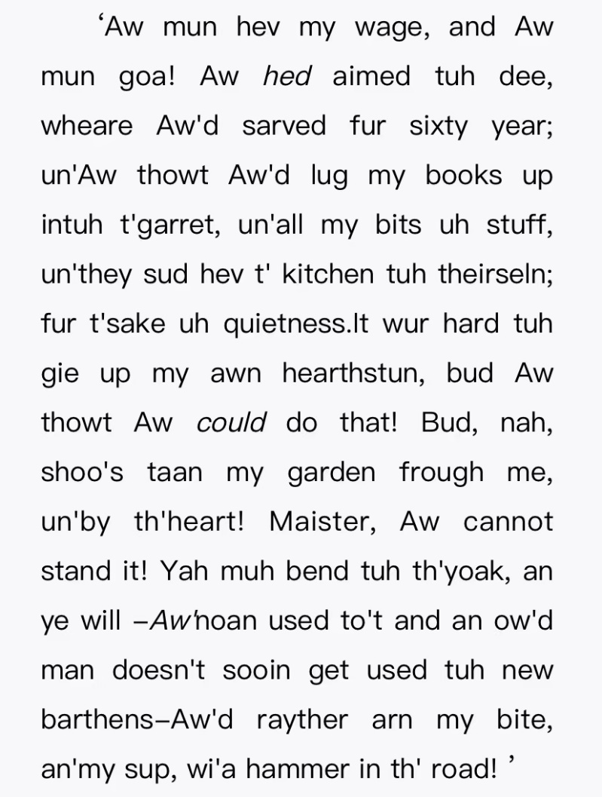
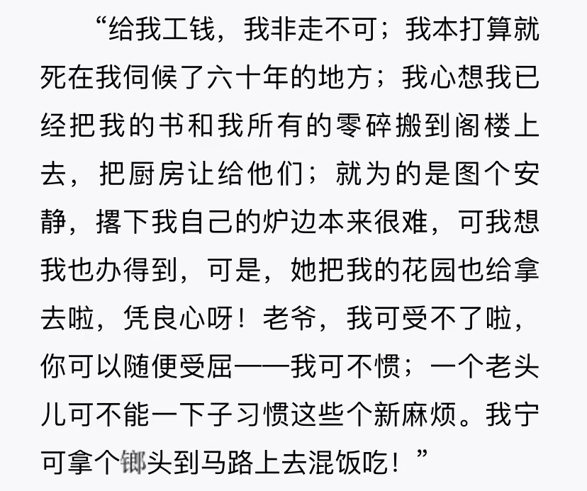
Reflections:
Perhaps, the translation of dialects could be achieved through the reproduction of their linguistic equivalents？

Slide 12
Websites for further reading:
https://www.zhihu.com/question/319714501/answer/714092325
https://m.cnki.net/express/#/literatureDetailZh?id=1021720433.nh&typeId=CMFD&VNK=ee2a163a
https://m.cnki.net/express/#/literatureDetailZh?id=ZJYX202201072&typeId=CJFD&VNK=63e5ab0d

Slide 13
Thank You!

